Slide 1
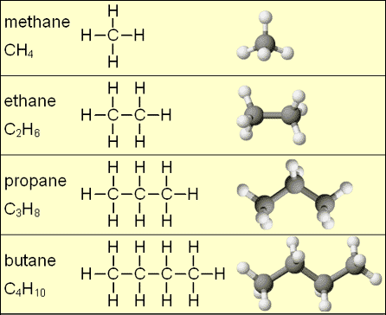
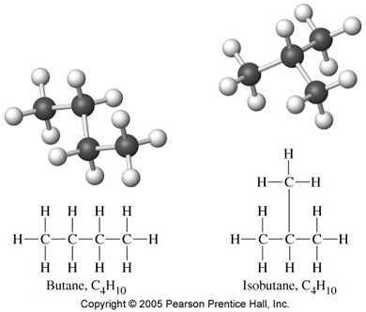

Slide 2
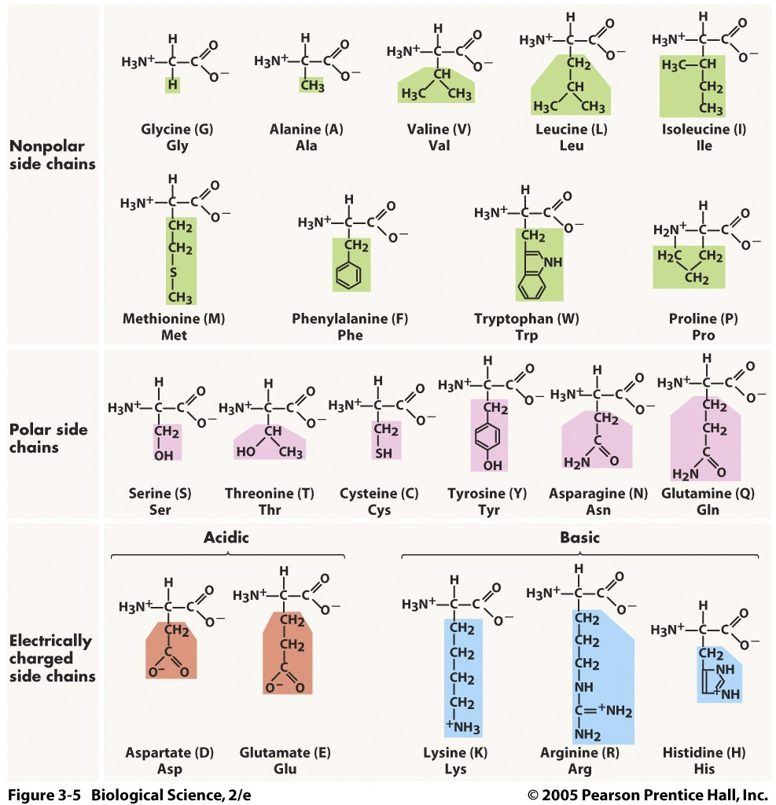

Slide 3
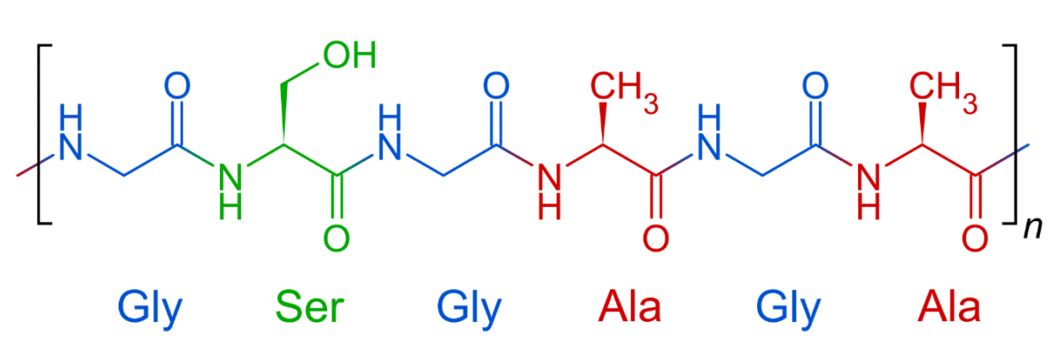

Slide 4
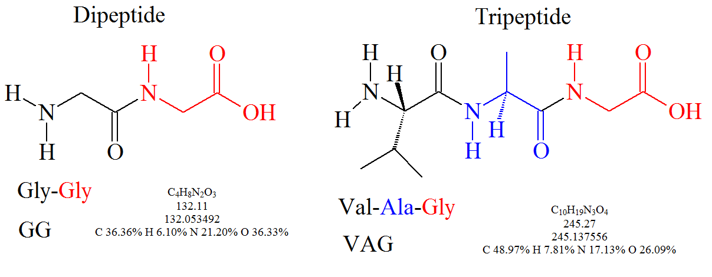

Slide 5
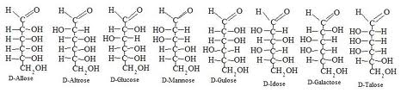
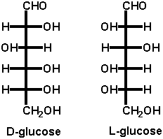
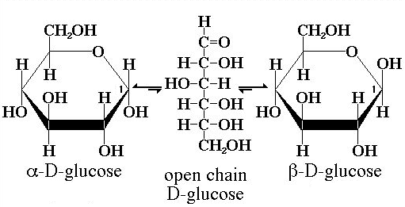
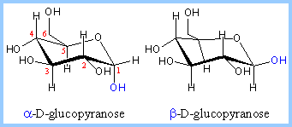

Slide 6
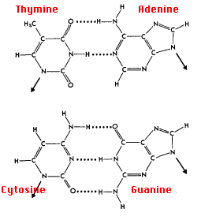

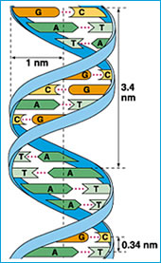


Slide 7


Slide 8
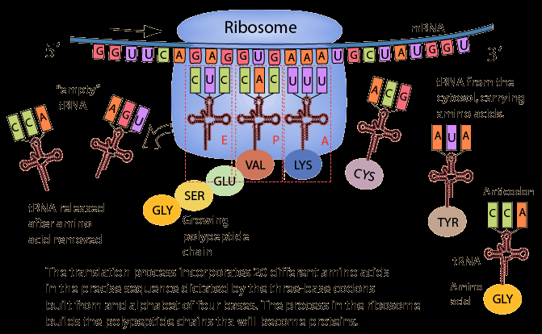

Slide 9
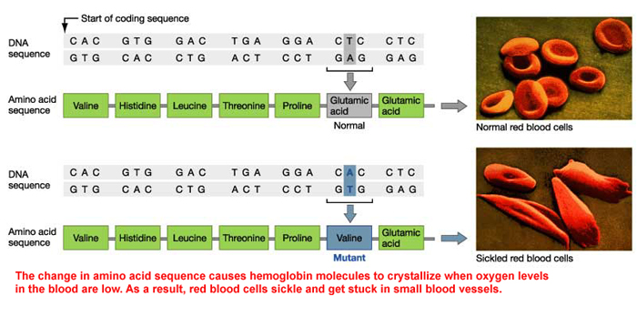


Slide 10

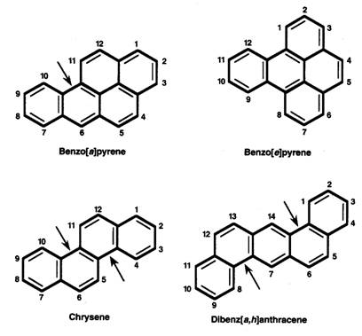

If a typical smoker puffs one and a half packs of cigarettes a day the amount of polonium 210 deposited in his lungs will give off the amount of radiation equivalent to 300 chest x-rays a year.

Slide 11
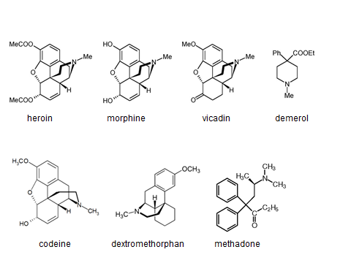

Slide 12
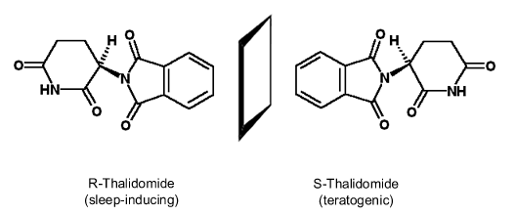

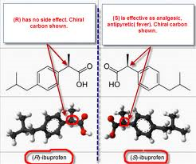
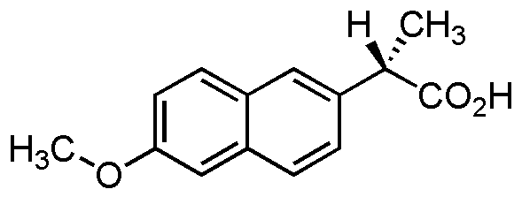

Slide 13
Thalidomide: Thalidomide is racemic. One enantiomer is effective against morning sickness, whereas the other is teratogenic. However, the enantiomers are converted into each other in vivo.[3] Dosing with a single-enantiomer form of the drug will still lead to both the D and L isomers eventually being present in the patient's serum and thus would not prevent adverse effects (though it might reduce them if the rate of in vivo conversion can be slowed).
Ethambutol: Whereas one enantiomer is used to treat tuberculosis, the other causes blindness.
Naproxen: One enantiomer is used to treat arthritis pain, but the other causes liver poisoning with no analgesic effect.
Steroid receptor sites also show stereoisomer specificity.
Penicillin's activity is stereodependent. The antibiotic must mimic the D-alanine chains that occur in the cell walls of bacteria in order to react with and subsequently inhibit bacterial transpeptidase enzyme.
Only L-propranolol is a powerful adrenoceptor antagonist, whereas D-propranolol is not. However, both have local anesthetic effect.
The L-isomer of Methorphan, levomethorphan is a potent opioid analgesic, while the D-isomer, dextromethorphan is a dissociative cough suppressant.

Slide 14
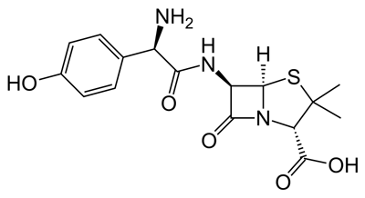
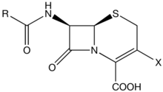
Penicillin G, Ampicillin
j-NH₂
Amoxicillin

Slide 15
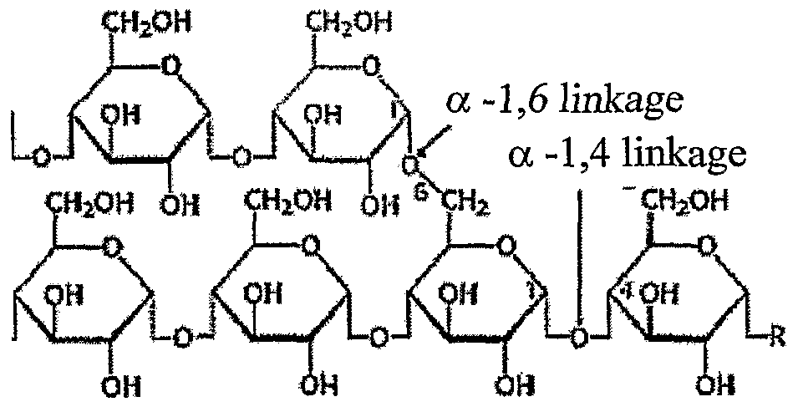
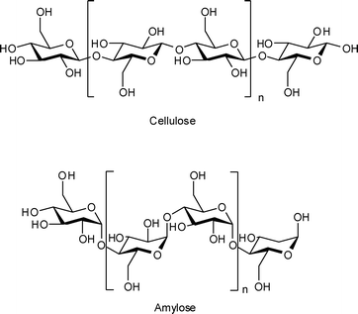
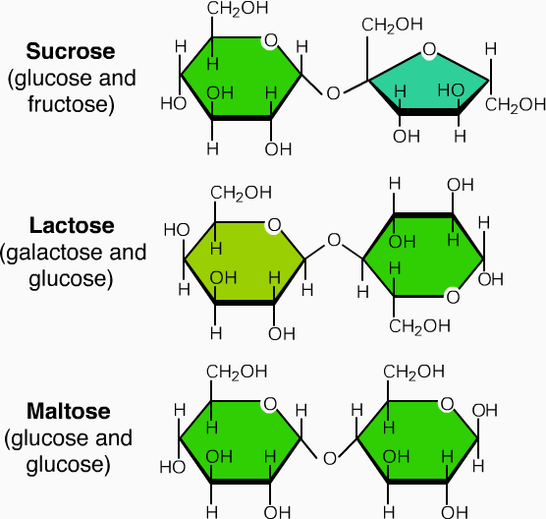

Slide 16
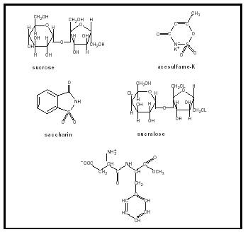

Slide 17
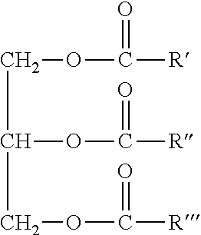
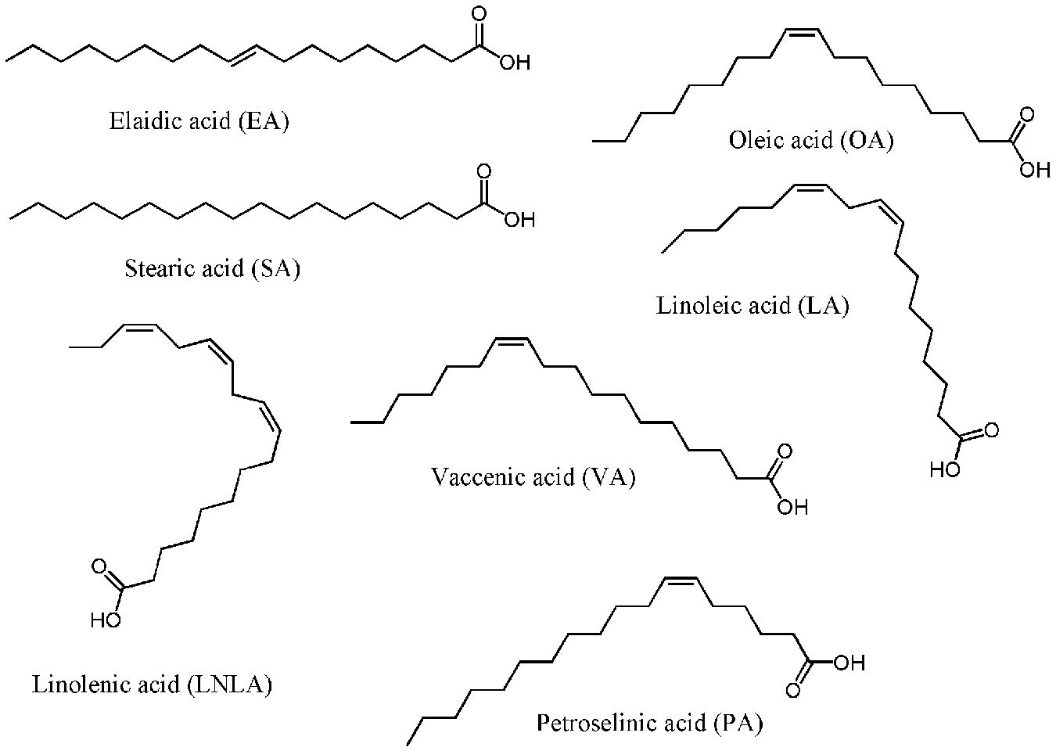

Slide 18


Slide 19
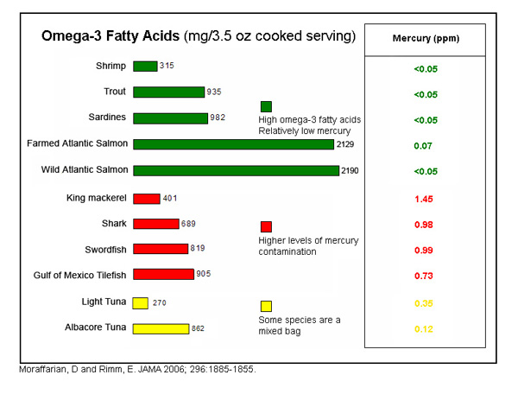


Slide 20
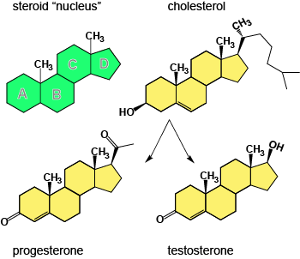
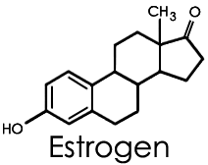
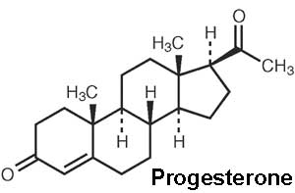

Slide 21
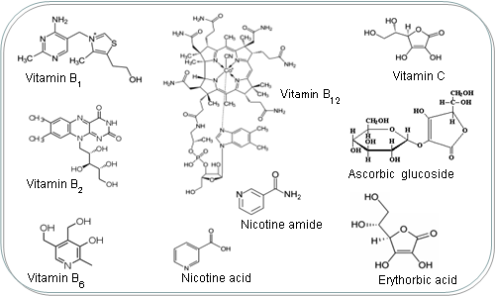

Slide 22
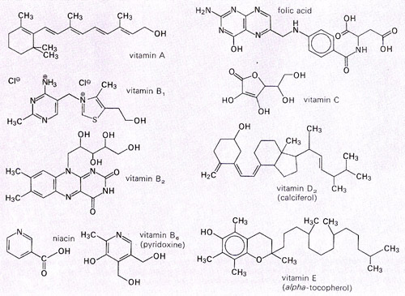

Slide 23




Slide 24
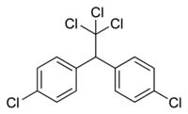

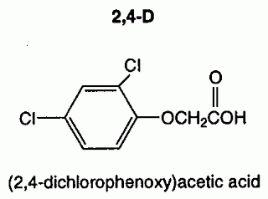
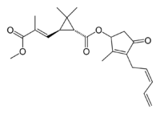

Slide 25


Slide 26
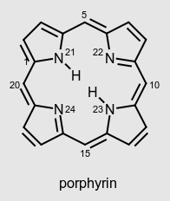
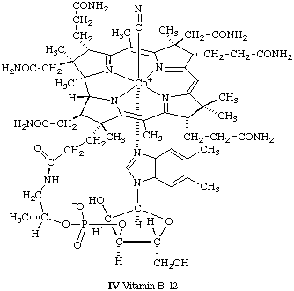
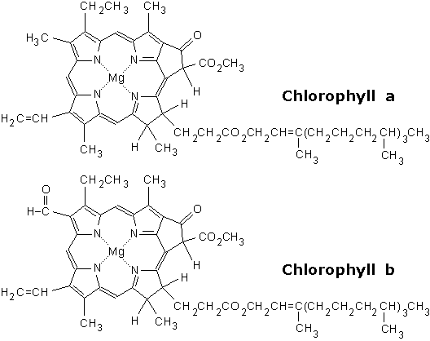
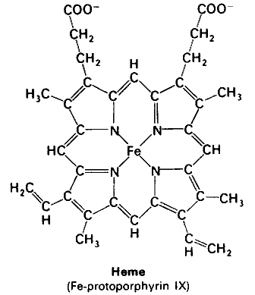

Slide 27
