Slide 1
Christmas Puns
are Treemendous
For many PowerPoint preshows and trivia challenges, visit:
http://murov.info

Slide 2
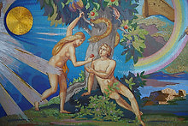
What did Adam say on the
day before Christmas?
It’s
Christmas,
Eve!

Slide 3
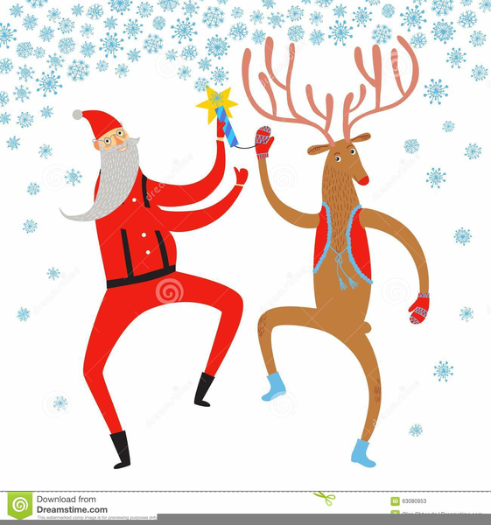
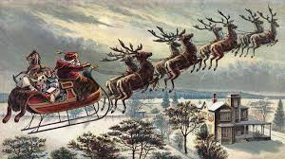
Which of Santa’s reindeer
has the best moves?
Dancer!

Slide 4
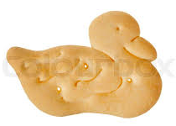
What do you get if you combine
Santa and a duck?
A Christmas Quacker!

Slide 5
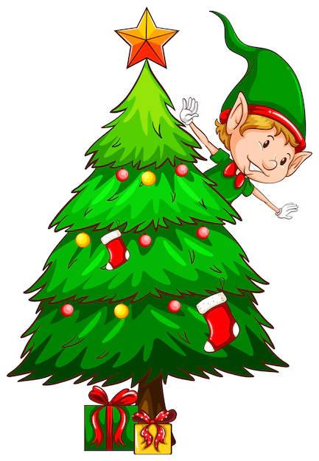
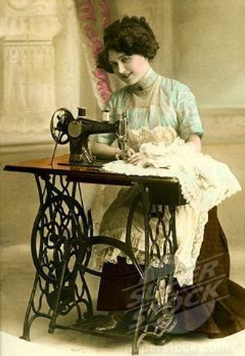
Why are Christmas trees
so bad at sewing?
They always drop
their needles!

Slide 6
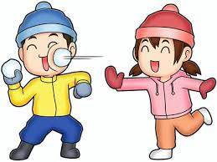
What do you call a party for Snowmen?
A SNOWBALL!
What do snowmen
eat for breakfast?
Snowflakes.

Slide 7
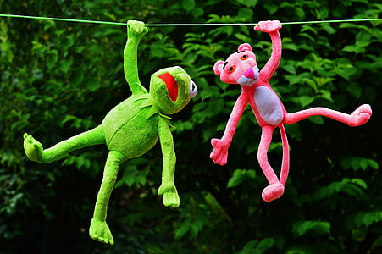
What did one ornament say to the other?
“Let’s hang out!”

Slide 8
How do sheep say, “Merry Christmas?”
Fleece Navidad!

Slide 9
What do you call a chicken
at the North Pole?
Come on, get real. There is no such thing as a Polar Chicken.
LOST!!!!

Slide 10
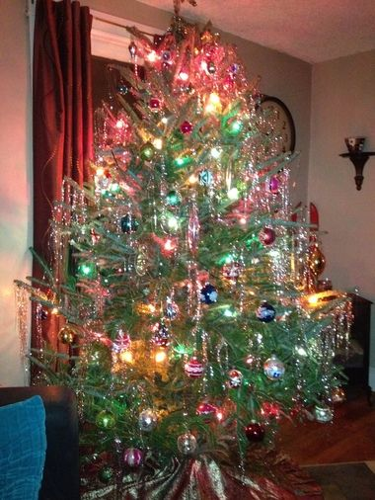
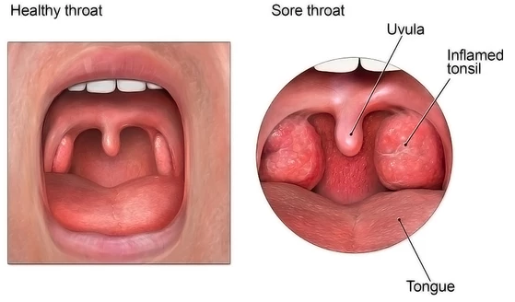
What would you get if you ate all the Christmas tree decorations?
Tinselitis

Slide 11
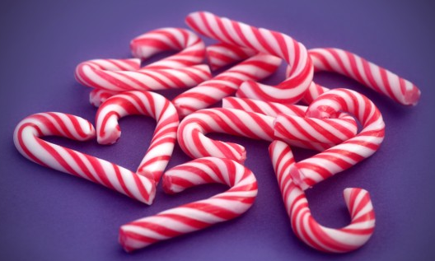
Why was the candy cane so expensive?
It was in mint condition.

Slide 12
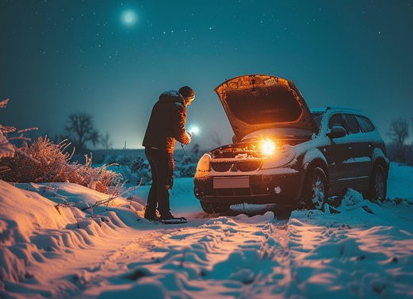
What should you do if your car stalls on Christmas Eve?
You get a mistletow.

Slide 13
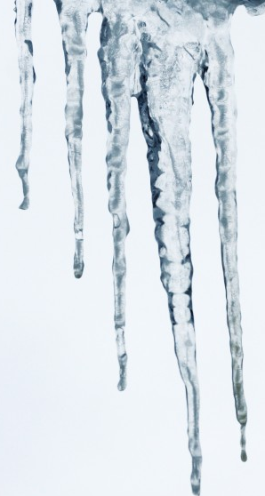
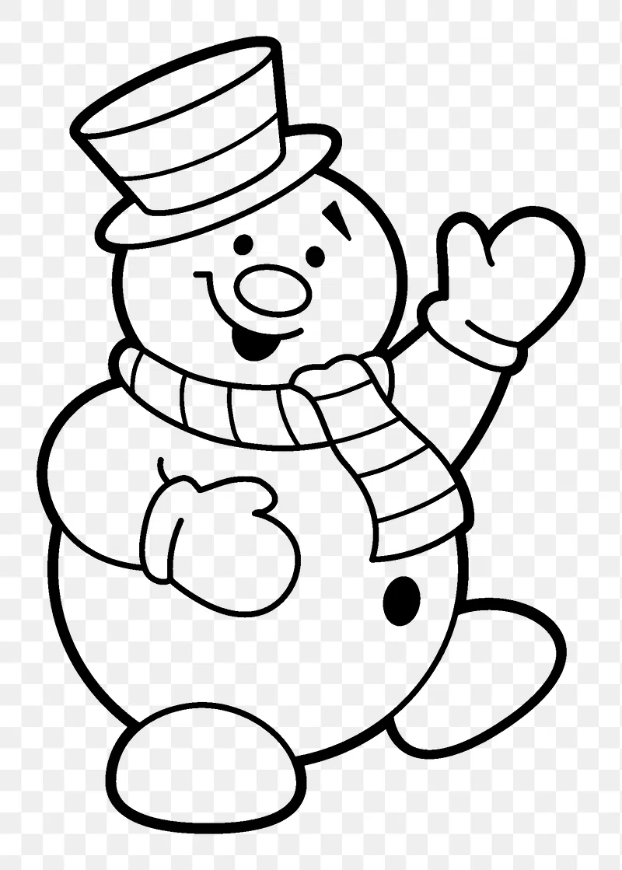
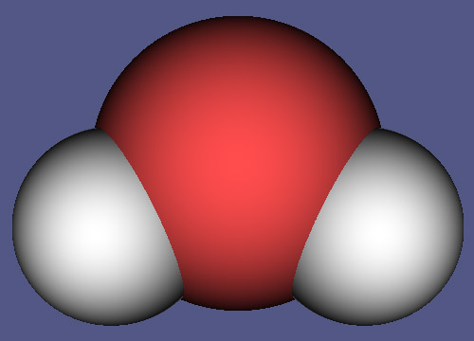
What do snowmen eat for dessert?
Ice crispies.
What do you call an old Snowman?
Water.

Slide 14
What do you call people who are afraid of Santa Claus?
Claustrophobic!

Slide 15
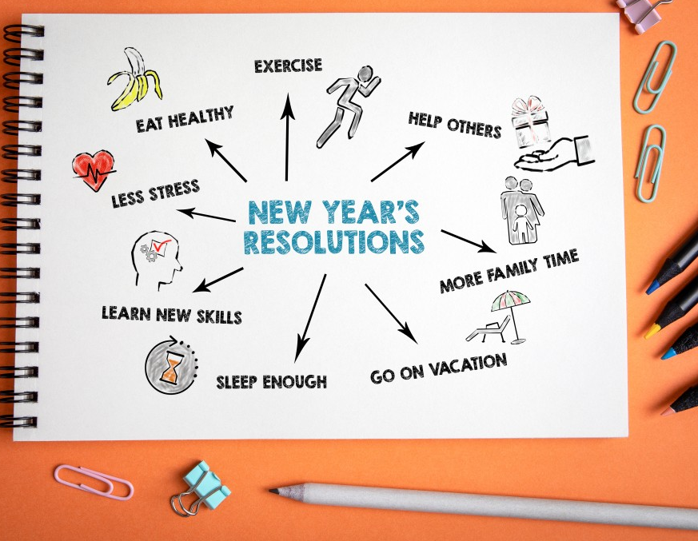
What is a New Year's resolution?
Something that goes in one year and out the other.

Slide 16
What happened to the man
who shoplifted a calendar
on New Year's Eve?
He got 12 months!

Slide 17
Why should you have your left foot in the air on New Year's Eve?
To make sure you start 2024 on the right one!

Slide 18
Why is partying in
Times Square overrated?
The organizers drop the ball every year!

Slide 19
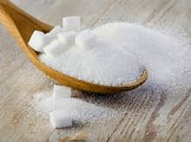
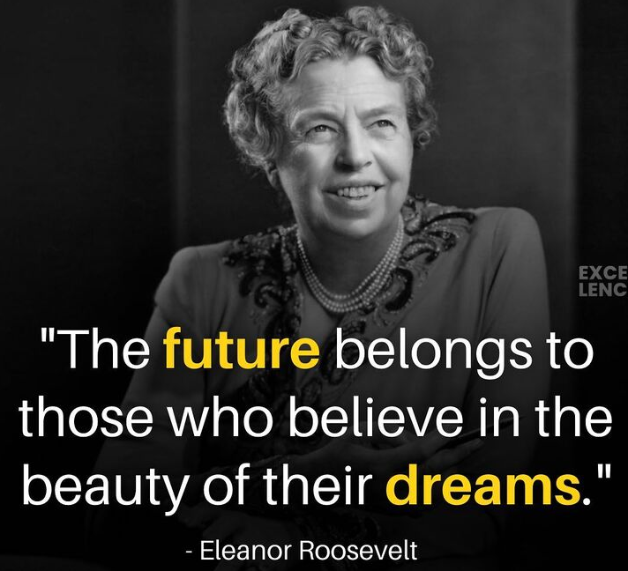
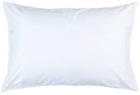
Why should you sprinkle sugar on your pillow on New Year's Eve?
To start the year
with sweet dreams.

Slide 20
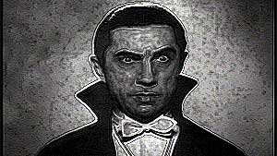
Why did Dracula pass out on New Year's Eve?
5
4
3
2
1
0
There was a Count down!.

Slide 21
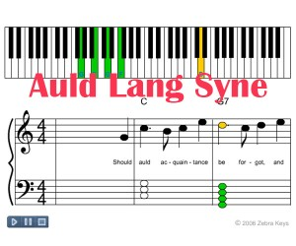
Q. What do you call a fear of New Year’s songs?
Ole Langxiety.

Slide 22
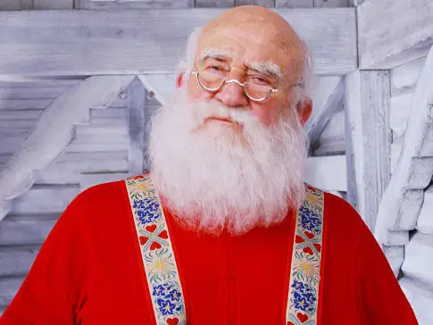
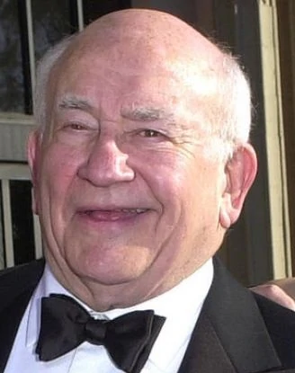
Ed Asner
NAME THE SANTA IMPERSONATOR

Slide 23
Chevy Chase

Slide 24
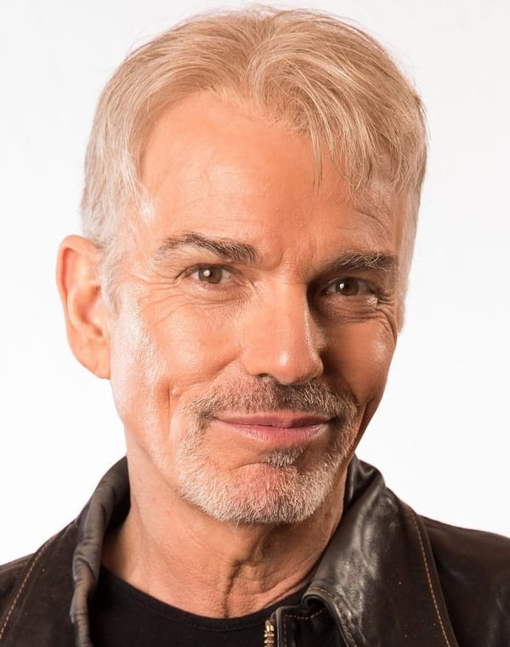
Billy Bob Thornton

Slide 25
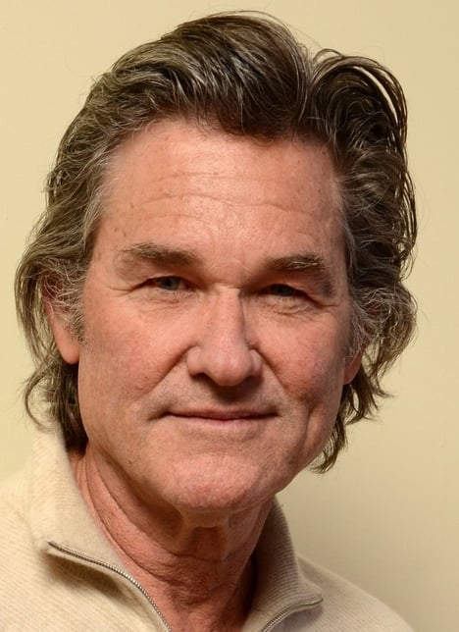
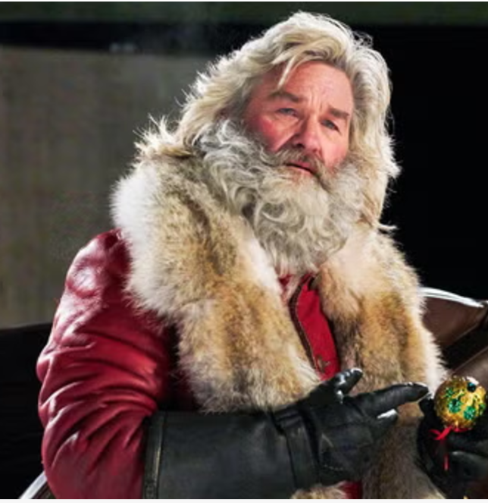
Kurt Russell

Slide 26
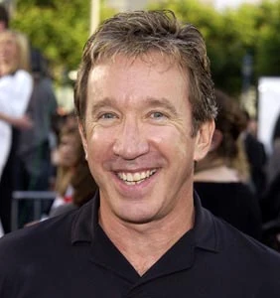
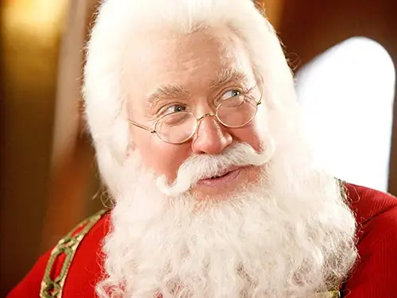
Tim Allen

Slide 27
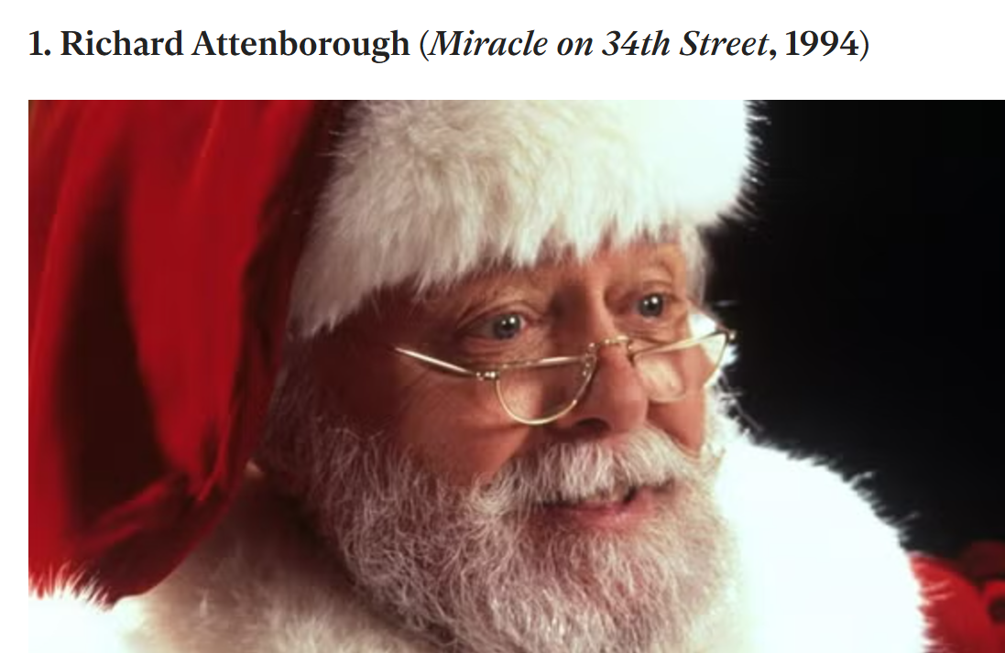

Slide 28
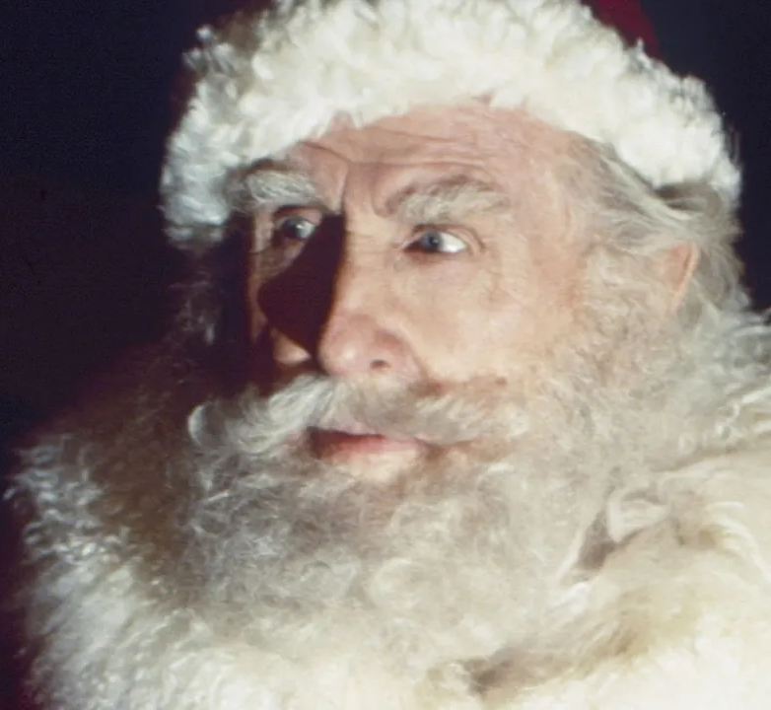
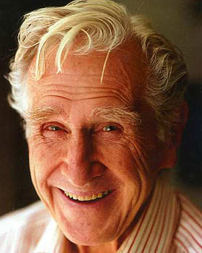
Lloyd Bridges

Slide 29
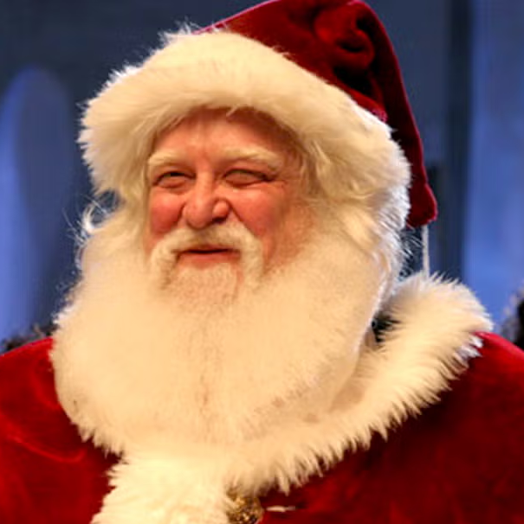
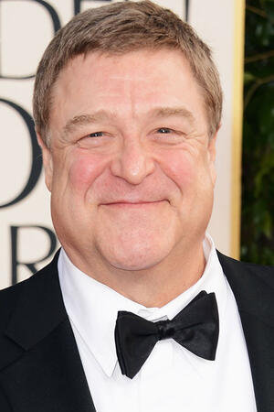
John Goodman

Slide 30
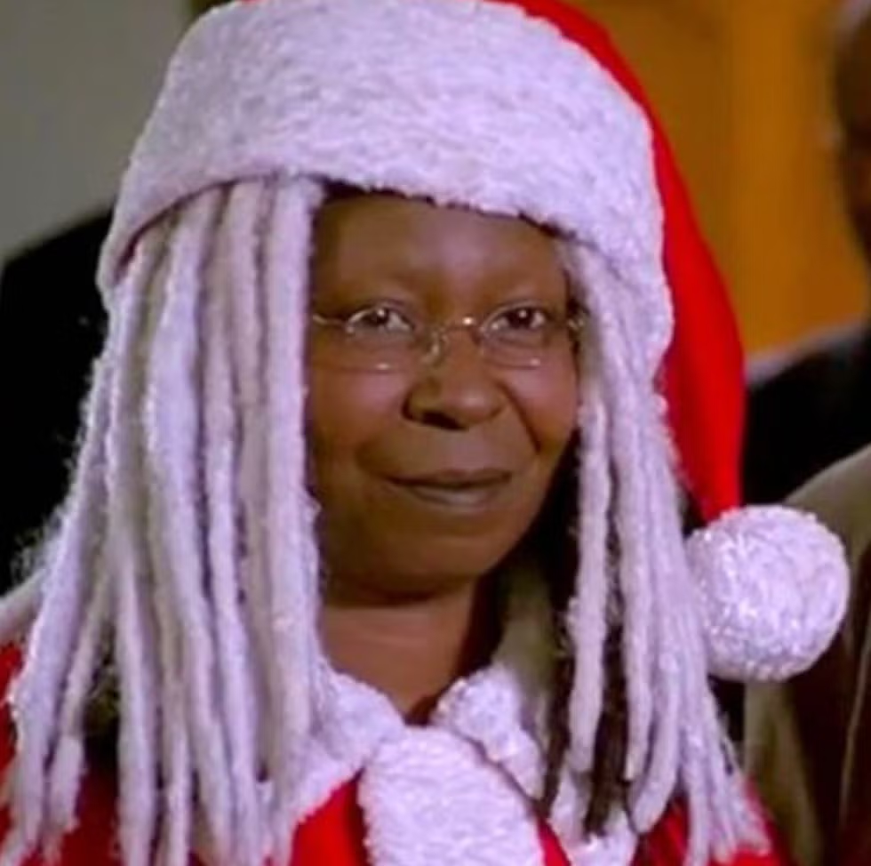
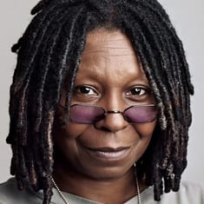
Whoopi Goldberg

Slide 31
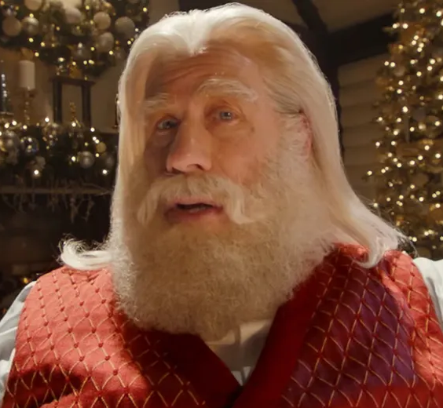
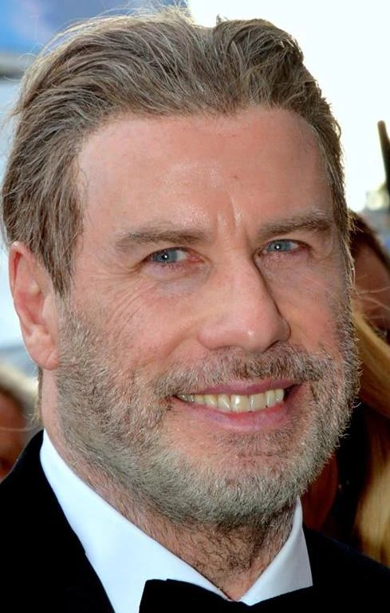
John
Travolta

Slide 32
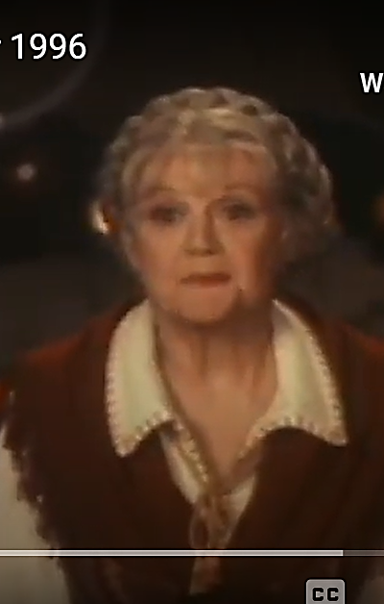
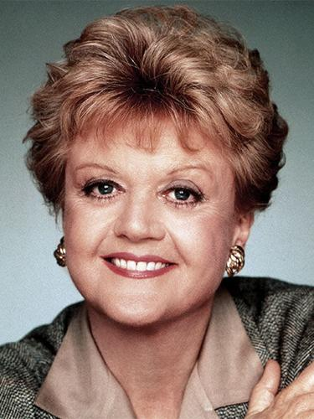
Mrs. Claus
Angela Lansbury

Slide 33
For many PowerPoint preshows and trivia challenges, visit:
http://murov.info

