Slide 1
Abbreviations,
Acronyms,
Initials
For each slide, what do the letters stand for?

Slide 2
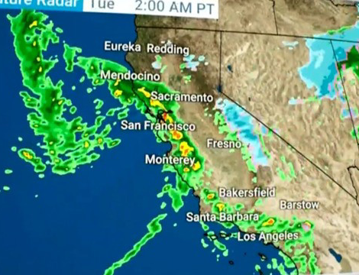
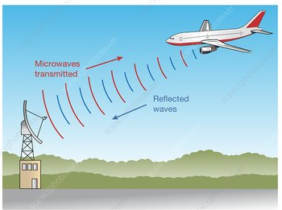
RADAR
Radio Detection And Ranging
A system for detecting the presence, direction, distance, and speed of aircraft, ships, vehicles, weather fronts and other objects, by sending out pulses of high-frequency electromagnetic waves that are reflected off the object back to the source.

Slide 3
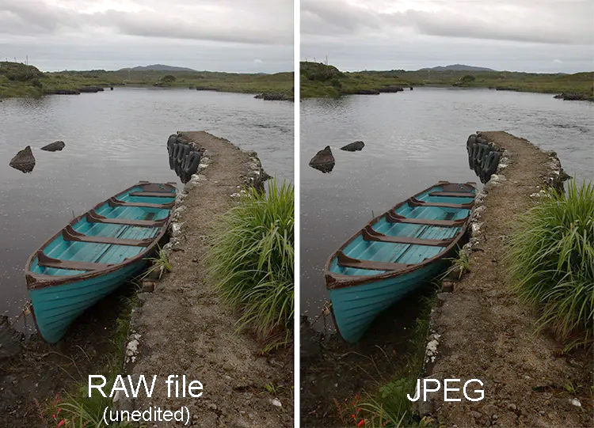
JPEG
Joint Photographic Experts Group
A JPEG is a standardized lossy compression mechanism for digital images. Digital cameras compress raw photographs as JPEG images to make the files smaller in size. It is the most common file format for photo storage.

Slide 4
PDF
Portable Document Format
It's a versatile file format created by Adobe that gives people an easy, reliable way to present and exchange documents - regardless of the software, hardware, or operating systems being used by anyone who views the document.

Slide 5
IPO
Initial public offering
When a private company first sells shares of stock to the public, this process is known as an initial public offering (IPO). In essence, an IPO means that a company's ownership is transitioning from private ownership to public ownership.

Slide 6
SCUBA
Self Contained Underwater Breathing Apparatus
A portable apparatus having a container with compressed air, a regulator that is equipped with a mouthpiece and adjusts the pressure of the released air to match the surrounding pressure, and often a buoyancy compensator, used for breathing under water.
Equipment worn by divers for breathing underwater, consisting typically of one or two compressed-air tanks strapped to the back and connected by a hose to a mouthpiece.

Slide 7
HTML
Hypertext Markup Language
Standard markup language for documents designed to be displayed in a web browser. This markup tells a web browser how to display text, images and other forms of multimedia on a webpage.

Slide 8
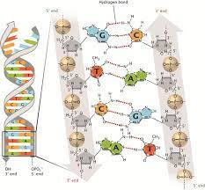
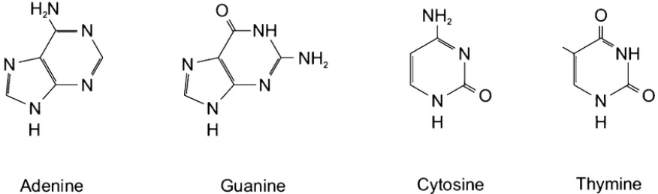
DNA
Deoxyribonucleic acid
A polymer composed of two polynucleotide chains that coil around each other to form a double helix. The polymer carries genetic instructions for the development, functioning, growth and reproduction of all known organisms and many viruses.

Slide 9
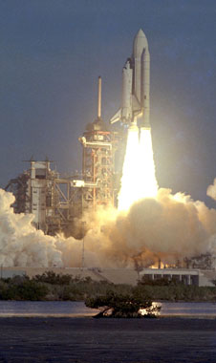
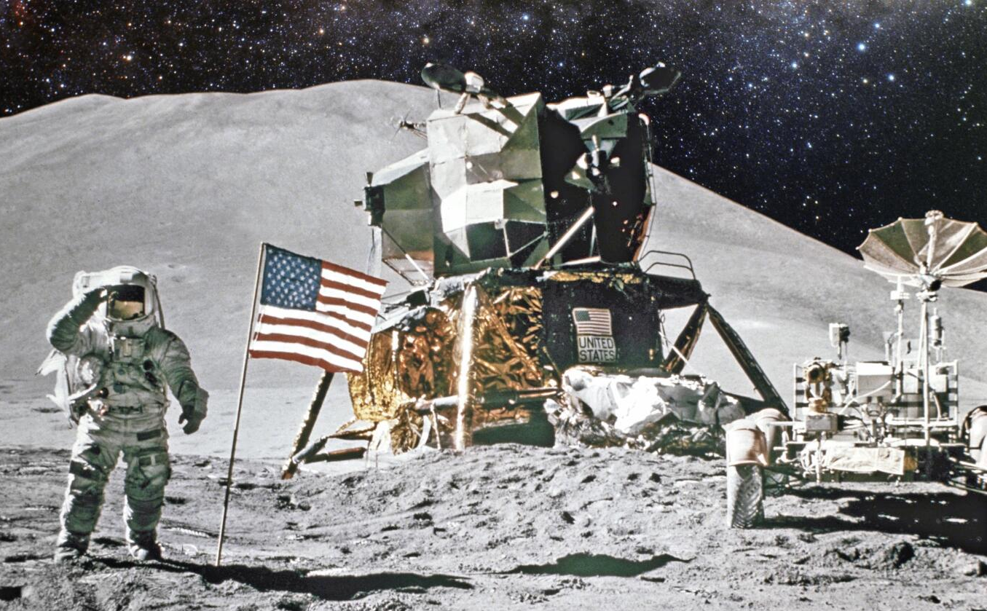
NASA
NASA stands for National Aeronautics and Space Administration. NASA is a U.S. government agency that is responsible for science and technology related to air and space. The Space Age started in 1957 with the launch of the Soviet satellite Sputnik. NASA opened for business on Oct. 1, 1958.
Americans on
the moon.

Slide 10
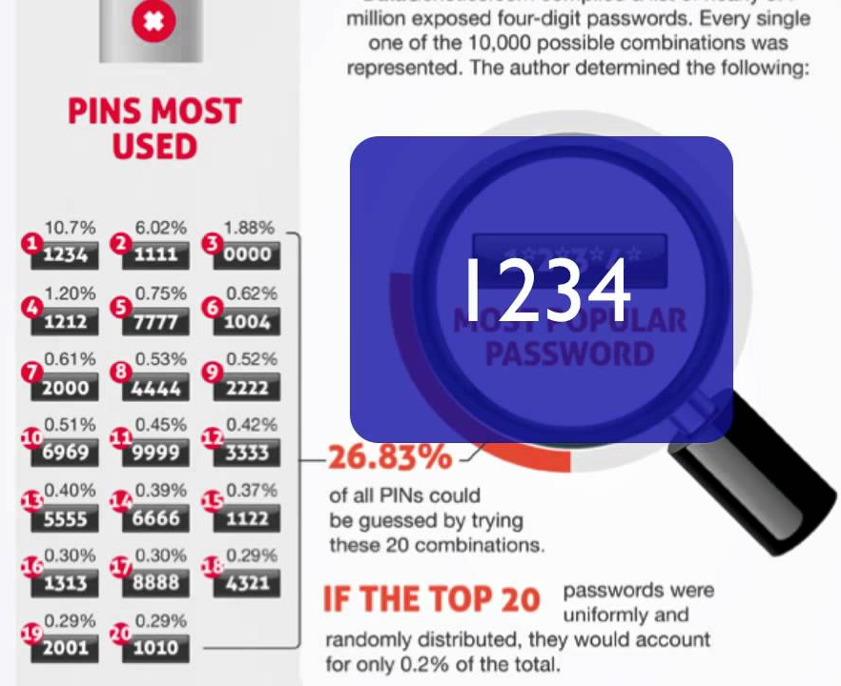
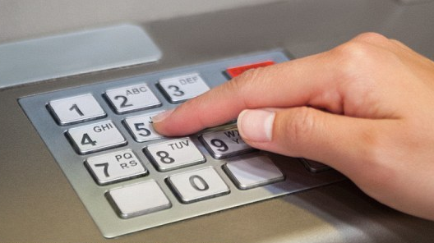
PIN
Personal Identification Number.
Abbreviation for personal identification number: a secret number used with a bank card or credit card to get money from a cash machine or pay for goods in a store.

Slide 11
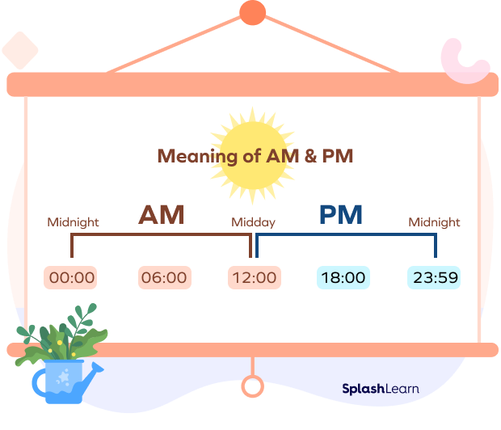
a.m., p.m.
ante meridiem and post meridiem
The abbreviations a.m. and p.m. stand for the Latin ante meridiem and post meridiem, meaning before and after midday.

Slide 12
NOAA
National Oceanic and Atmospheric Administration
The mission of the National Oceanic and Atmospheric Administration (NOAA) is to provide daily weather forecasts, severe storm warnings, climate monitoring to fisheries management, coastal restoration, and the supporting of marine commerce.
an agency in the Department of Commerce that maps the oceans and conserves their living resources; predicts changes to the earth's environment; provides weather reports and forecasts floods and hurricanes and other natural disasters related to weather

Slide 13
NSF
National Science Foundation
An independent agency of the federal government responsible for the promotion of progress in science and engineering by supporting programs in research and education.

Slide 14
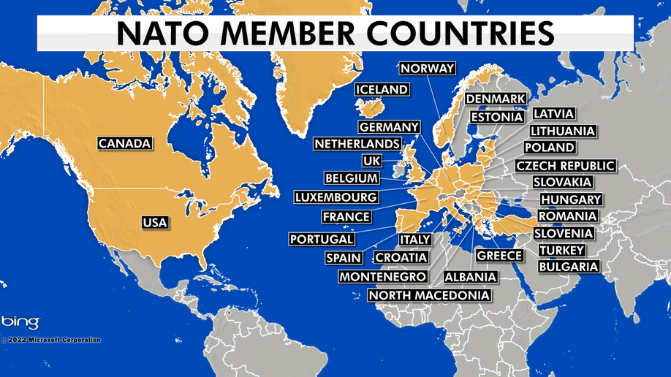
NATO
North Atlantic Treaty Organization
NATO was founded in 1949 and is a group of 31 countries from Europe and North America that exists to protect the people and territory of its members and provide collective security against the Soviet Union.

Slide 15
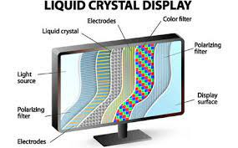
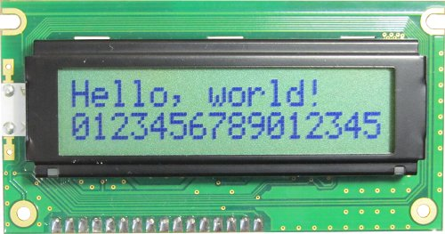
LCD
Liquid Crystal Display
A liquid crystal display is a flat-panel display or other electronically modulated optical device that uses the light-modulating properties of liquid crystals combined with polarizers. Liquid crystals do not emit light directly but instead use a backlight or reflector to produce images in color or monochrome.

Slide 16
YAHOO
Yet Another Hierarchical Officious Oracle
This odd name was coined in 1994 by two electrical engineering Ph.D. candidates at Stanford University, David Filo and Jerry Yang. The original name for what is now known as the Yahoo search engine was "David's and Jerry's Guide to the World Wide Web." Realizing they needed a better name, Filo and Yang turned to the dictionary and chose "yahoo" because it was a word that anyone can say and remember with ease.

Slide 17
AIDS
Acquired Immune Deficiency Syndrome (AIDS) was first recognized as a new disease in 1981 when increasing numbers of young homosexual men succumbed to unusual opportunistic infections and rare malignancies. HIV (human immunodeficiency virus) is a virus that attacks the body’s immune system. If HIV is not treated, it can lead to AIDS

Slide 18
SWAT
Special Weapons and Tactics
A military-like unit within the US police force, trained to deal with specially dangerous situations, such as hostage-taking and riots.

Slide 19
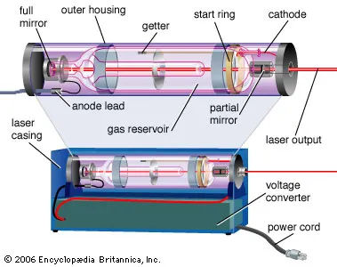
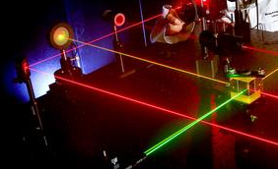
LASER
Light amplification by the stimulated emission of radiation
A device that produces a nearly parallel, nearly monochromatic, and coherent beam of light by exciting atoms to a higher energy level and causing them to radiate their energy in phase.

Slide 20
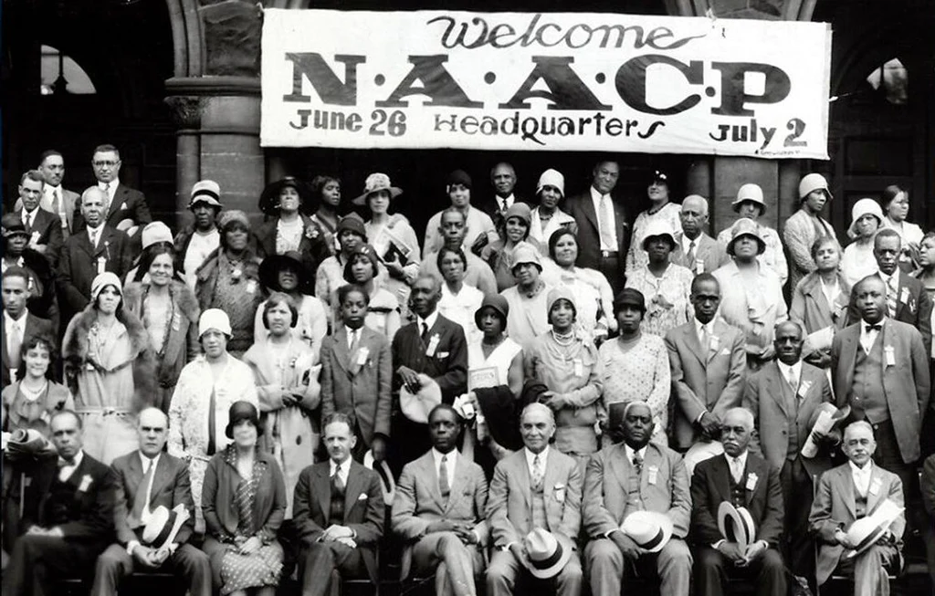
NAACP
National Association for the Advancement of Colored People
The National Association for the Advancement of Colored People is a civil rights organization in the United States, formed in 1909 as an interracial endeavor to advance justice for African Americans by a group including W. E. B. Du Bois, Mary White Ovington, Moorfield Storey and Ida B. Wells.

Slide 21
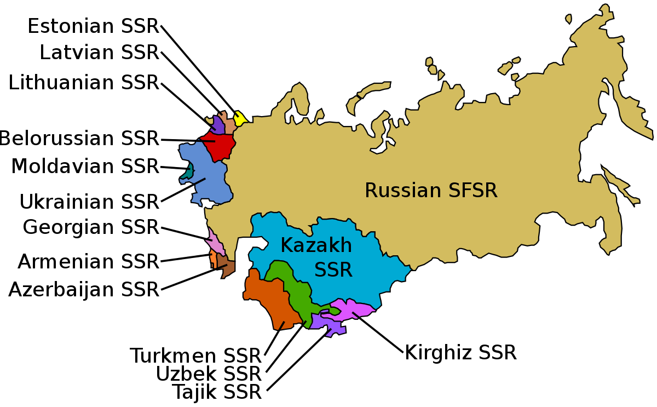
USSR
Union of Soviet Socialist Republics
After overthrowing the centuries-old Romanov monarchy, Russia emerged from a civil war in 1921 as the newly formed Soviet Union. The world’s first Marxist-Communist state became one of the biggest and most powerful nations in the world, occupying nearly one-sixth of Earth’s land surface, before its fall and ultimate dissolution in 1991. The United Socialist Soviet Republic, or U.S.S.R., was made up of 15 republics: Armenia, Azerbaijan, Belarus, Estonia, Georgia, Kazakhstan, Kyrgyzstan, Latvia, Lithuania, Moldova, Russia, Tajikistan, Turkmenistan, Ukraine and Uzbekistan.

Slide 22
RSVP
"répondez s'il vous plaît."
This directly translates to "Respond, if you please. Please reply used on invitations to ask the invited guests to indicate whether they will be able to attend.

Slide 23
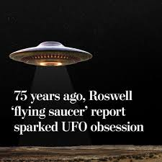
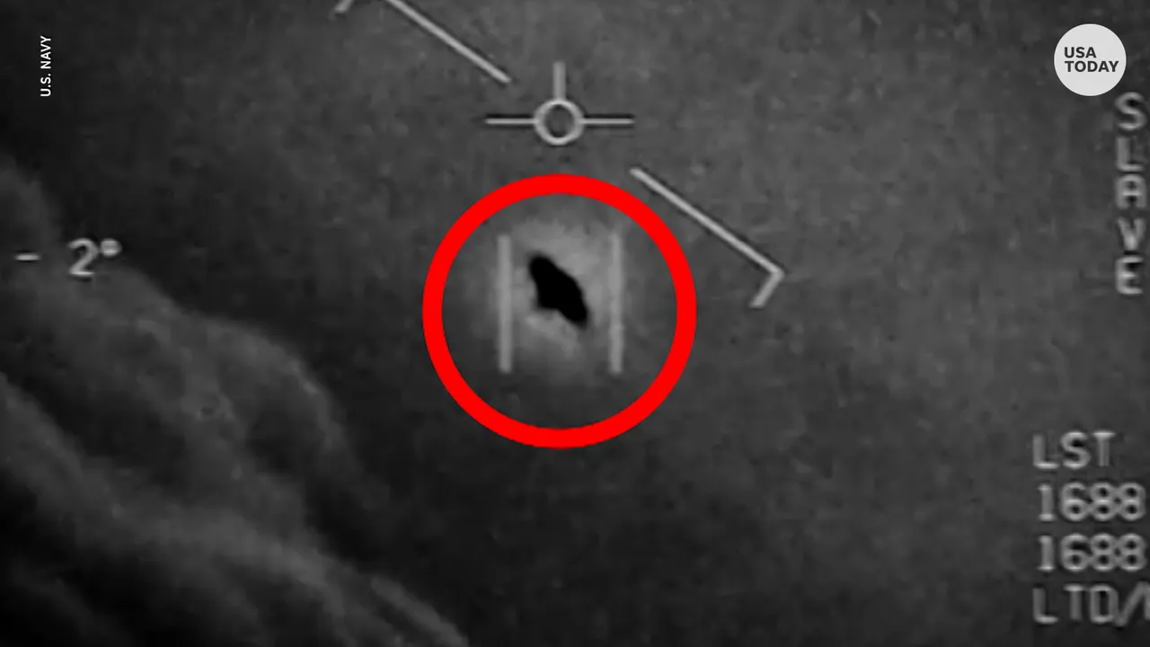
UFO
An unidentified flying object (UFO) is any perceived aerial phenomenon that cannot be immediately identified or explained. Upon investigation, most UFOs are identified as known objects or atmospheric phenomena, while a small number remain unexplained.
The Roswell incident centers on the 1947 recovery of metallic and rubber debris from a military balloon that was recovered by military personnel from Roswell Army Air Field. Decades later, conspiracy theories claimed that the debris was from a flying saucer which had been covered up by the United States government.
The first video, in color, posted on the Pentagon's website, was of an incident it said took place in the Middle East on July 12, 2022.

Slide 24
ASAP
As soon as possible
Without delay; promptly.

Slide 25
BOGO
Buy one, get one
An offer to a customer to buy an item and receive a second item at a discount.

Slide 26
NCAA
National Collegiate Athletic Association
A nonprofit organization that regulates student athletics among about 1,100 schools in the United States, Canada, and Puerto Rico. It also organizes the athletic programs of colleges and universities in the United States and Canada and helps over 500,000 college student athletes who compete annually in college sports. The organization is headquartered in Indianapolis, Indiana.

Slide 27
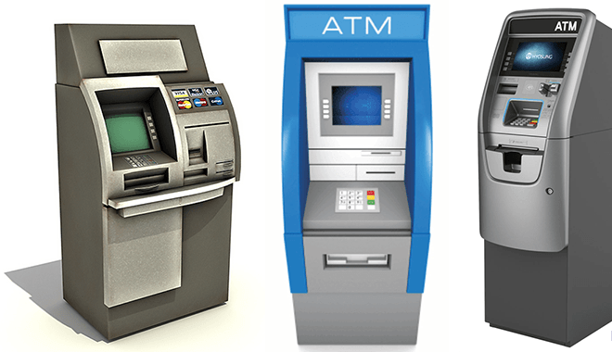
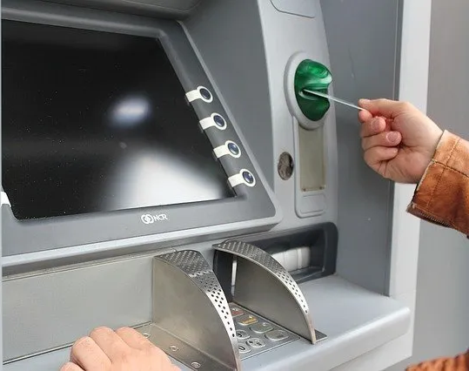
ATM
Automated teller machine
An electronic banking outlet that allows customers to complete basic transactions without the aid of a branch representative or teller. Anyone with a credit card or debit card can access cash at most ATMs, either in the U.S. or other countries.

Slide 28
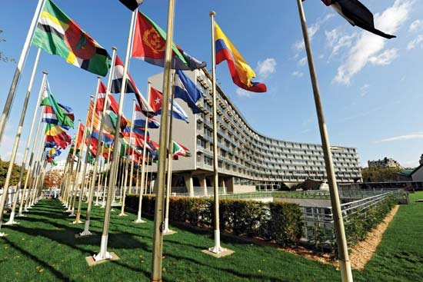
UNESCO
United Nations Educational, Scientific, and Cultural Organization.
A specialized agency of the United Nations (UN) aimed at promoting world peace and security through international cooperation in education, arts, sciences and culture. It has 193 member states and 12 associate members, as well as partners in the non-governmental, intergovernmental and private sector.

Slide 29
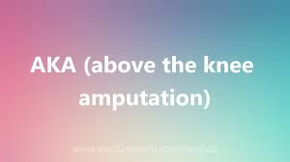
AKA
The following is a list of many of the meanings of the abbreviation “AKA” but the one intended for this slide is not on this list or the logos that will appear to the lower left.
Also known as:
Used to indicate another name that a person or thing has or uses.
AKA A King Agency
AKA Above Knee Amputation
AKA Advanced Knowledge Associates, Inc.
AKA Albert Kahn & Associates, Inc.
AKA Alcoholic Ketoacidosis
AKA All Kenyans Abroad
AKA Alpha Kappa Alpha
AKA American Kennel Association
AKA American Killifish Association
AKA American Kitefliers Association
AKA Anarchistic Key Authorization
AKA Applications of Kleene Algebra
AKA Asociace Komunikaèních Agentur
AKA Association of Korean Adoptees
AKA Attack Cargo Ship
Alpha Kappa Alpha

Slide 30
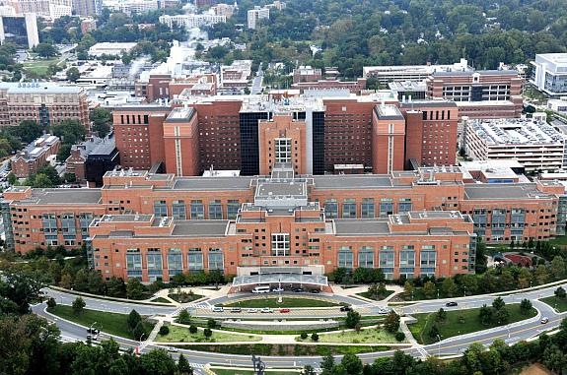
NIH
National Institutes of Health.
The steward of medical and behavioral research for the Nation. Its mission is to seek fundamental knowledge about the nature and behavior of living systems and the application of that knowledge to enhance health, lengthen life, and reduce illness and disability.

Slide 31
MAPS
Modesto Area Partners in Science
The Modesto Area Partners in Science (MAPS) lecture series has operated since 1990 to foster science education in our community for youths through adults. Once a month during the academic year, MAPS offers stimulating free science programming, bringing educators and local citizens into contact with scientists and mind-expanding ideas.
https://www.mjc.edu/instruction/sme/maps.php
http://murov.info/maps.htm
Videos of presentations:
https://www.youtube.com/playlist?list=PLL81u2WuJbe5jiggm9GH1hY4ICIjsaj3a
https://www.youtube.com/playlist?list=PLL81u2WuJbe6joR9r56BIf8UlXFdRXNxe

Slide 32
For more PowerPoint preshows and trivia challenges,
please visit any one of the following:
http://murov.info
http://murov.info/PPTPreshows.htm
http://murov.info/triviachallenges.htm

