Slide 1
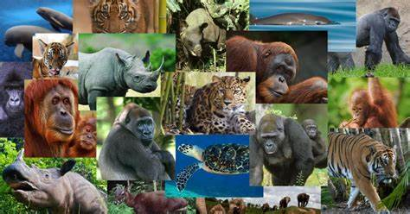
Critically Endangered Animals
Given the image, name the animal.
Source: https://www.newsweek.com/endangered-species-day-2019-list-animals-plants-us-world-1427238

Slide 2
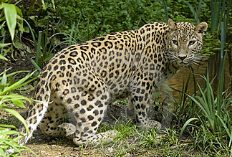
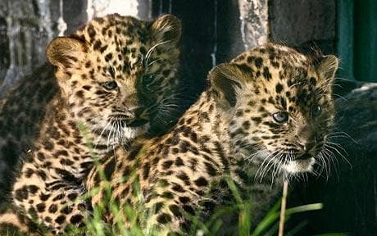
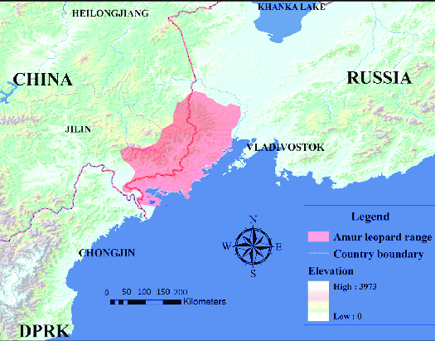
Estimated 80 remaining in a small area in the Russian Province of Primorsky Krai, between Vladivostok and the Chinese border.
Armur Leopard

Slide 3
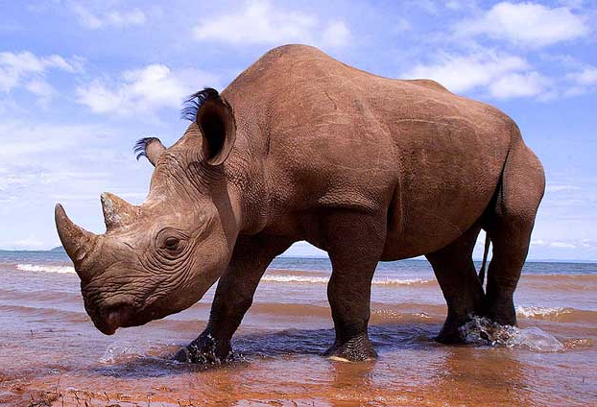
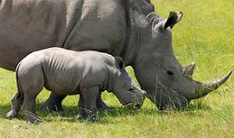
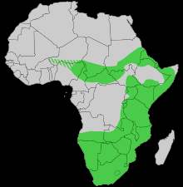
Black
Rhino
About 5000 remaining. Native to eastern and southern Africa including Botswana, Kenya, Malawi, Mozambique, Namibia, South Africa, Eswatini, Tanzania, Zambia, and Zimbabwe.
Although the rhinoceros is referred to as black, its colors vary from brown to grey.

Slide 4
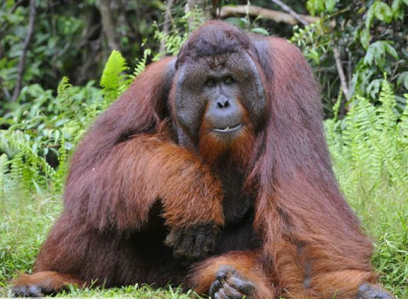
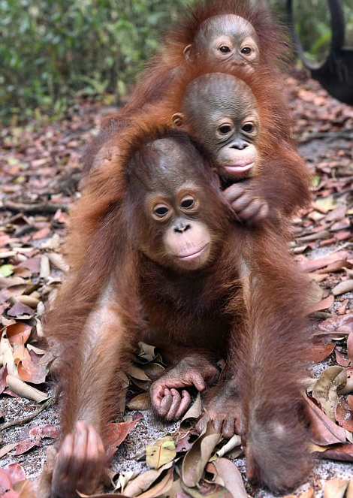
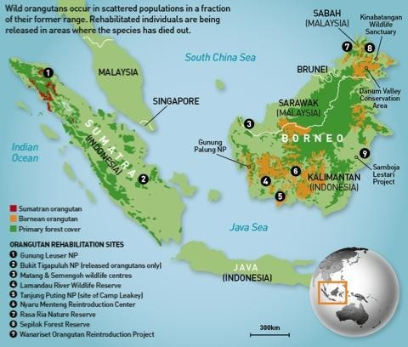
Bornean Orangutan
Together with the Sumatran orangutan and Tapanuli orangutan, it belongs to the only genus of great apes native to Asia.
Native to the island of Borneo. An estimated 100,000 remain.

Slide 5
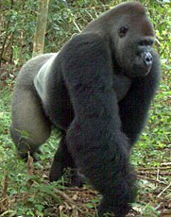
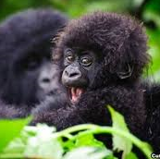
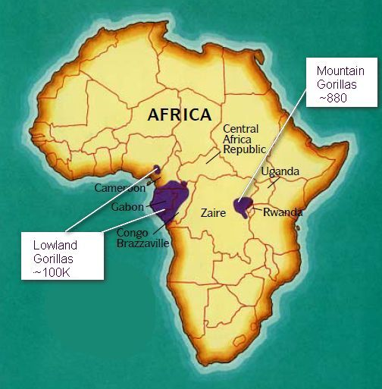
There are currently only 200-300 Cross River Gorillas left in the wild, making them the most endangered great ape in Africa. They live in mountainous border area between Cameroon and Nigeria at the top of the Cross River, after which they are named.
Cross River Gorilla

Slide 6
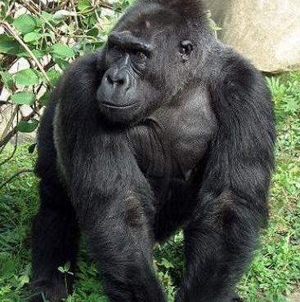
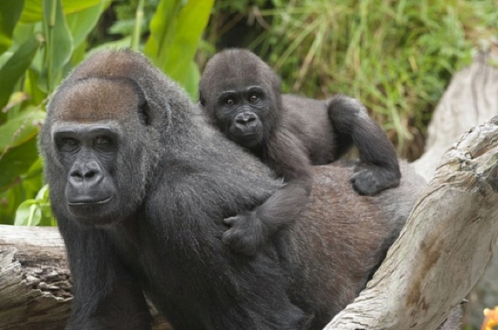
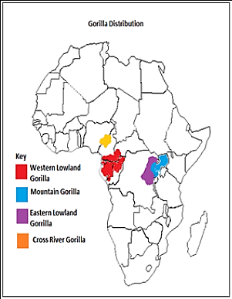
Endemic to the mountainous forests of eastern Democratic Republic of the Congo. About 5000 remain.
Eastern Lowland Gorilla

Slide 7
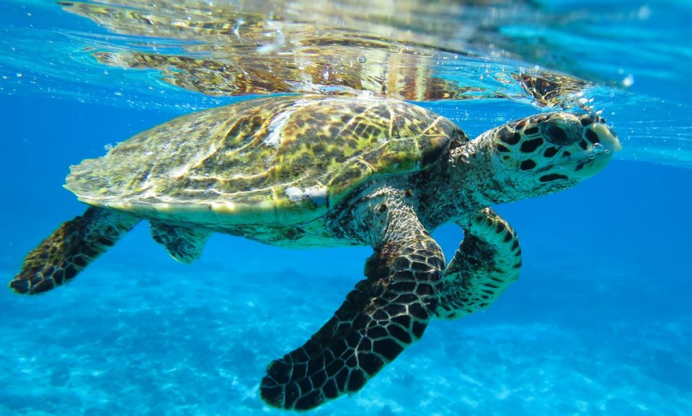
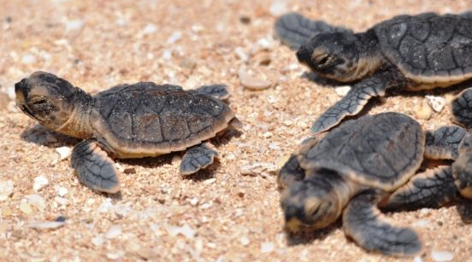
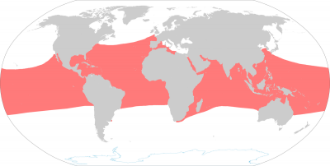
The species has a worldwide distribution primarily in tropical coral reefs with Atlantic and Indo-Pacific subspecies. There are an estimated 20,000 females remaining.
Hawksbill Sea Turtle

Slide 8
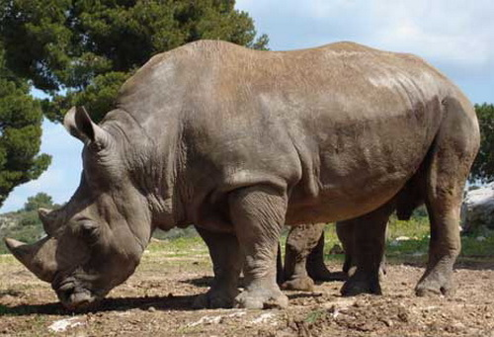
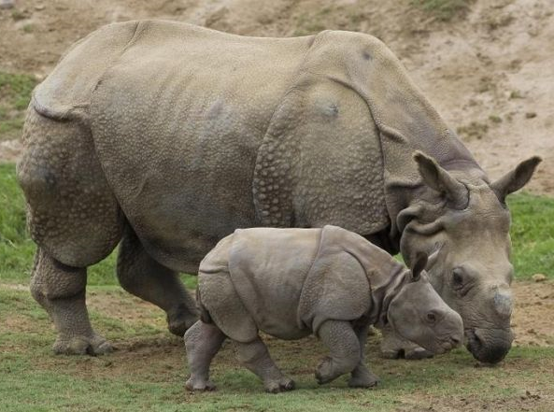
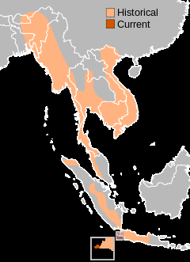
Javan Rhino
Found in Western Indonesia and Eastern Indochina. The Javan rhino habitats are tropical and subtropical moist broadleaf forests such as dense rainforests with mud wallows and plenty of water. Estimated that only 100 remain.

Slide 9
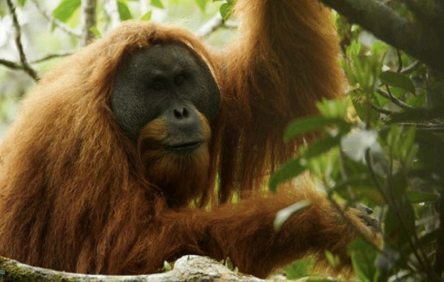
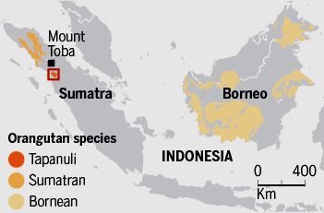
A species of orangutan restricted to South Tapanuli in the island of Sumatra in Indonesia. It is one of three known species of orangutan, alongside the Sumatran orangutan (Pongo abelii), found farther northwest on the island, and Bornean orangutan (Pongo pygmaeus).
Tapanuli
Orangutan
800 remain

Slide 10
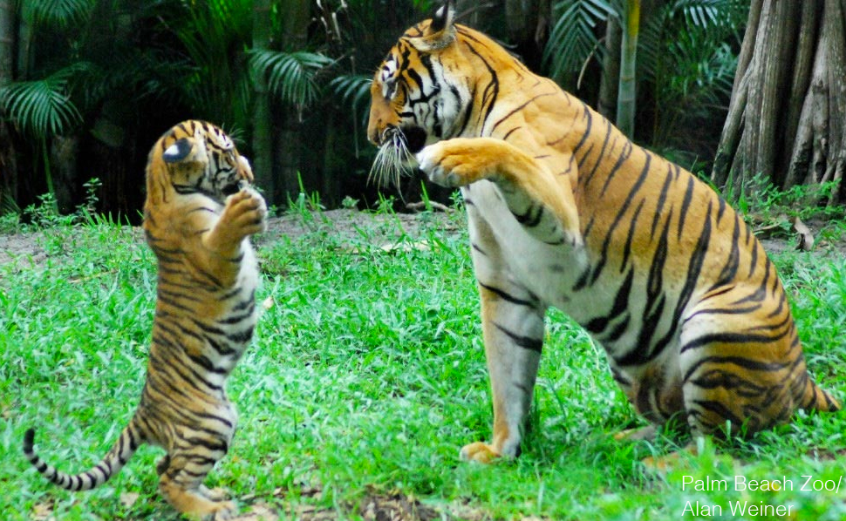
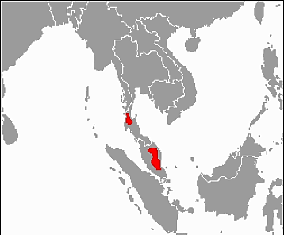
This population inhabits the southern and central parts of the Malay Peninsula. About 300 remain.
Malayan Tiger

Slide 11
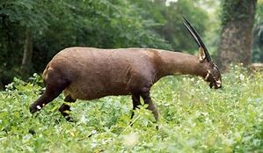
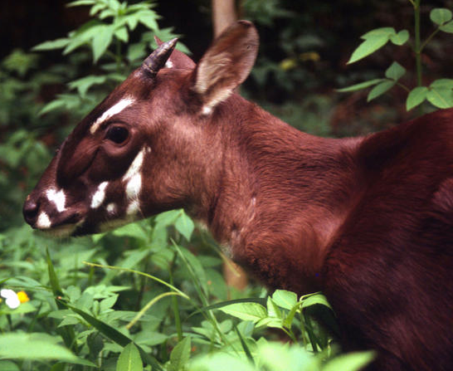
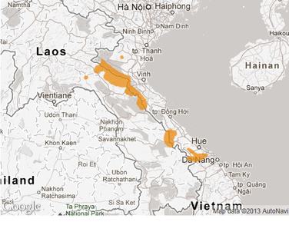
Saola
The saola, also called siola, Vu Quang ox, spindlehorn, Asian unicorn, or, infrequently, the Vu Quang bovid, is one of the world's rarest large mammals, a forest-dwelling bovine found only in the Annamite Range of Vietnam and Laos.
Between 100 and 700 survive.

Slide 12
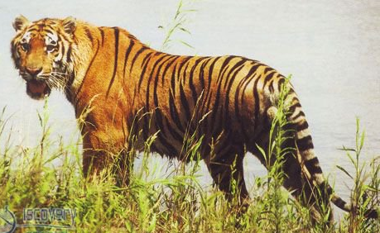
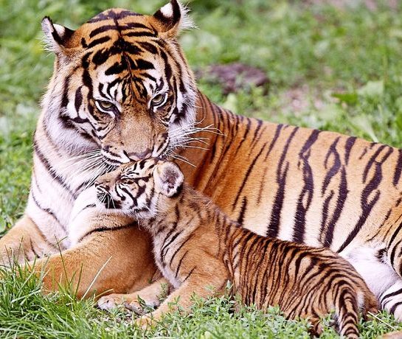
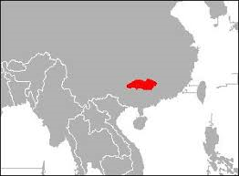
South China Tiger
The South China tiger is a Panthera tigris tigris population in southern China. The most critically endangered species of tiger and one of the 10 most endangered animals in the world, as there are thought to be less than 20 South China tigers left in the wild.

Slide 13
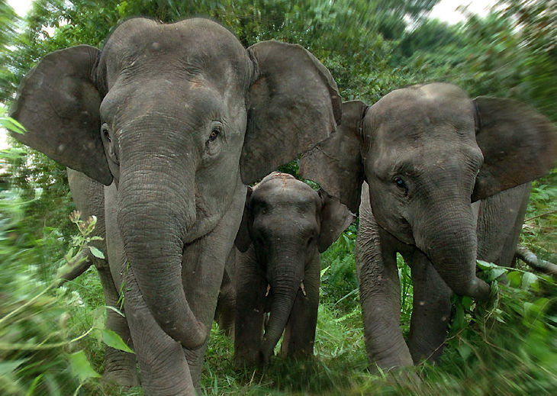
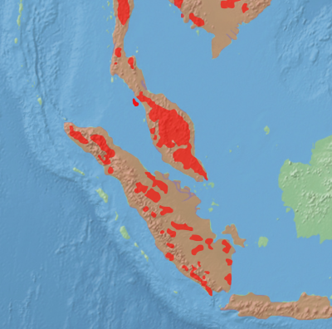
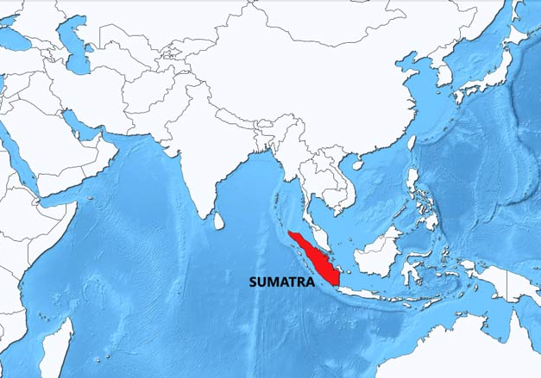
Sumatran Elephant
One of three recognized subspecies of the Asian elephant, native to the Indonesia island of Sumatra. About 2500 survive.
Sumatran Elephant

Slide 14
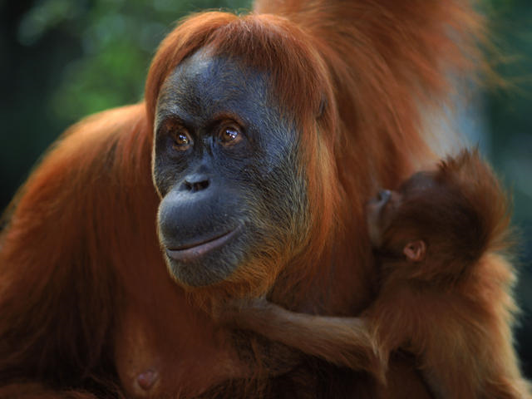
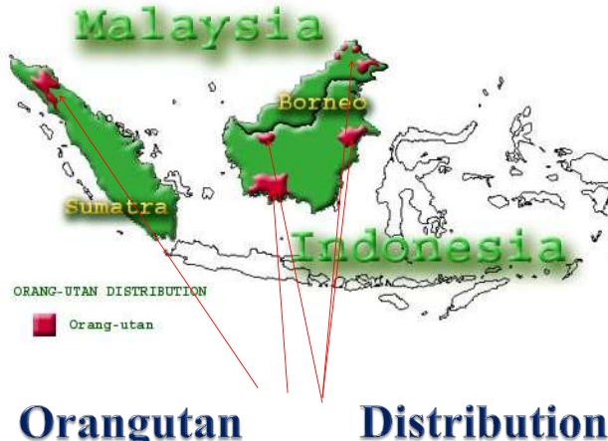
Sumatran Orangutan
The Sumatran orangutan is one of the three species of orangutans. Found only in the north of the Indonesian island of Sumatra, it is rarer than the Bornean orangutan but more common than the recently identified Tapanuli orangutan, also of Sumatra. About 7500 remain.

Slide 15
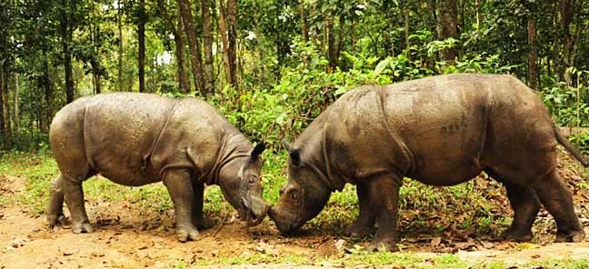
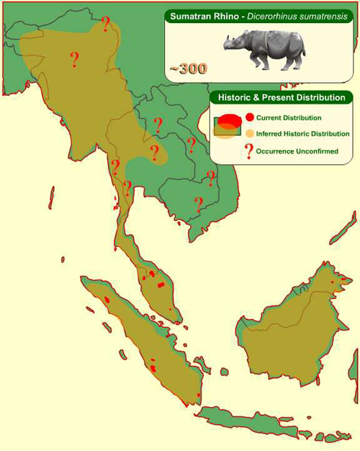
Sumatran Rhino
The Sumatran rhinoceros, also known as the hairy rhinoceros or Asian two-horned rhinoceros, is a rare member of the family Rhinocerotidae and one of five extant species of rhinoceros. It is the only extant species of the genus Dicerorhinus. About 80 remain in the wild.

Slide 16
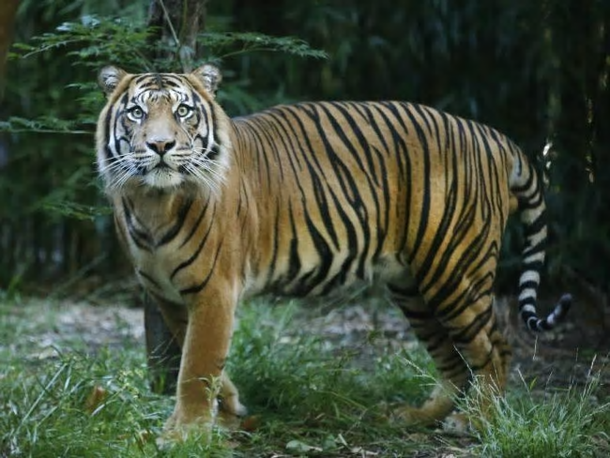
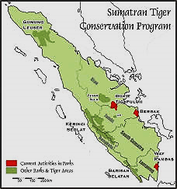
Sumatran tiger
The Sumatran tiger is a Panthera tigris sondaica population in the Indonesian island of Sumatra. About 500 remain in the wild.

Slide 17
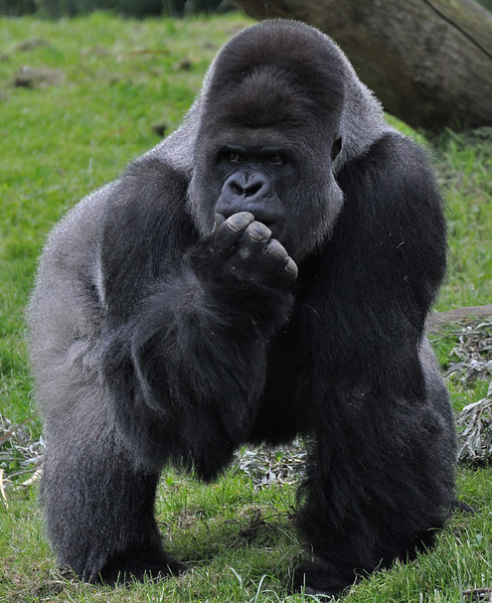
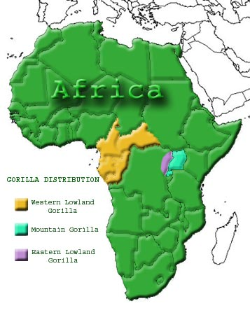
The western lowland gorilla is one of two subspecies of the western gorilla that lives in montane, primary and secondary forests and lowland swamps in central Africa. About 95,000 are left.
Western Lowland Gorilla

Slide 18
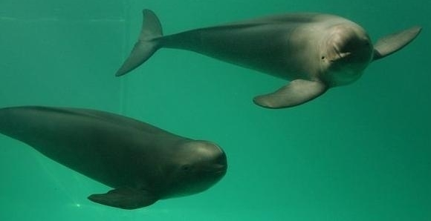
Yangtze Finless Porpoise
The Indo-Pacific finless porpoise, or finless porpoise, is one of seven porpoise species. Most of the population has been found around the Korean peninsula in the Yellow and East China Seas, although a freshwater population is found around Jiuduansha near Shanghai at the mouth of China's Yangtze River. About 1000 live in the wild.

Slide 19
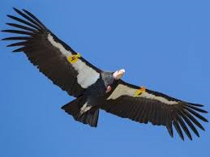
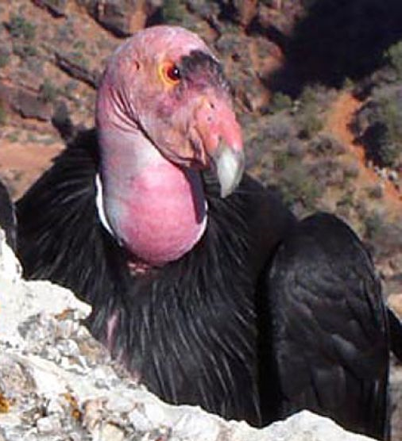
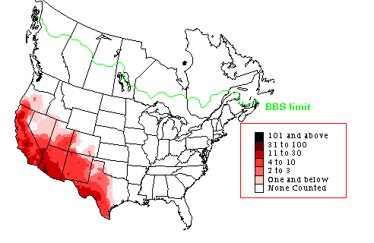
The California condor is a New World vulture, the largest North American land bird.
In 1987, the last wild California condor was removed from the wild, and all 27 condors left in the world were being kept in breeding facilities at the Los Angeles Zoo and the San Diego Wild Animal Park. After a successful breeding program, the California condor has been reintroduced into the wild and there are currently about 170 California Condors in captivity and 300 in the wild.

Slide 20
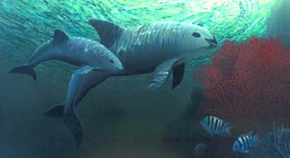
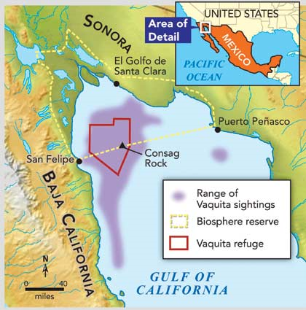
Vaquita
The population was estimated at 600 in 1997, below 100 in 2014, approximately 60 in 2015, around 30 in November 2016, and only 12-15 in March 2018, leading to the conclusion that the species will soon be extinct. A study in July 2019 concluded that the population size in autumn 2018 was about 9.
The vaquita is a species of porpoise endemic to the northern part of the Gulf of California that is on the brink of extinction.

Slide 21
In addition to the selected group of critically endangered animals included on the previous slides, there is a much longer list of endangered animals. Humans activities including human caused climate change are accelerating the rate at which animals are heading towards extinction. Worse yet, many animals have already gone extinct including the ones selected on the following slide which includes the year of the last sighting of the animal (source: https://onekindplanet.org/top-10/top-10-worlds-extinct-animals/.
We need to clean up or act or we will continue to lose diversity and even humans will be threatened.
For more Powerpoint Preshows, please visit: http://murov.info/PPTPreshows.htm

Slide 22
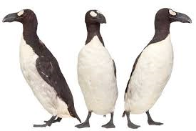
Tasmanian Tiger
(thylacine) 1936
African Black Rhinoceros 2011
Great Auk 1844
Passenger Pigeon
1914
Dodo 1681
Baiji White Dolphin 2006
Woolly
Mammoth
1650 BC
Selected extinct
animals. Years
given are
last sighting.
Pyrenean Ibex
2000
Sabre-toothed Cat 9700 BC
Steller’s Sea Cow 1768

Slide 23
Aug. 12, 2019. The Trump administration today released its finalized revisions for how the federal government assesses and implements species recovery under the Endangered Species Act. The final rules inappropriately insert economic considerations into the listing process and risk reduction in core protections for threatened species. At the same time, the rules expand collaboration on recovery efforts across federal agencies.
Lynn Scarlett, vice president for public policy and government relations at The Nature Conservancy said:
“The Endangered Species Act is one of America’s bedrock environmental laws. We are concerned that the changes released today will ultimately hinder our ability to protect threatened and endangered species across the country. We appreciate that the administration includes some improvements for how federal agencies collaborate on recovery efforts, but we are disappointed it has advanced changes that will threaten recovery efforts and will erode trust and confidence in ongoing work to improve implementation of the Act and collaborative efforts to protect imperiled species.”

Slide 24
For more Powerpoint Preshows, please visit: http://murov.info/PPTPreshows.htm

