Slide 1
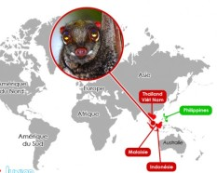
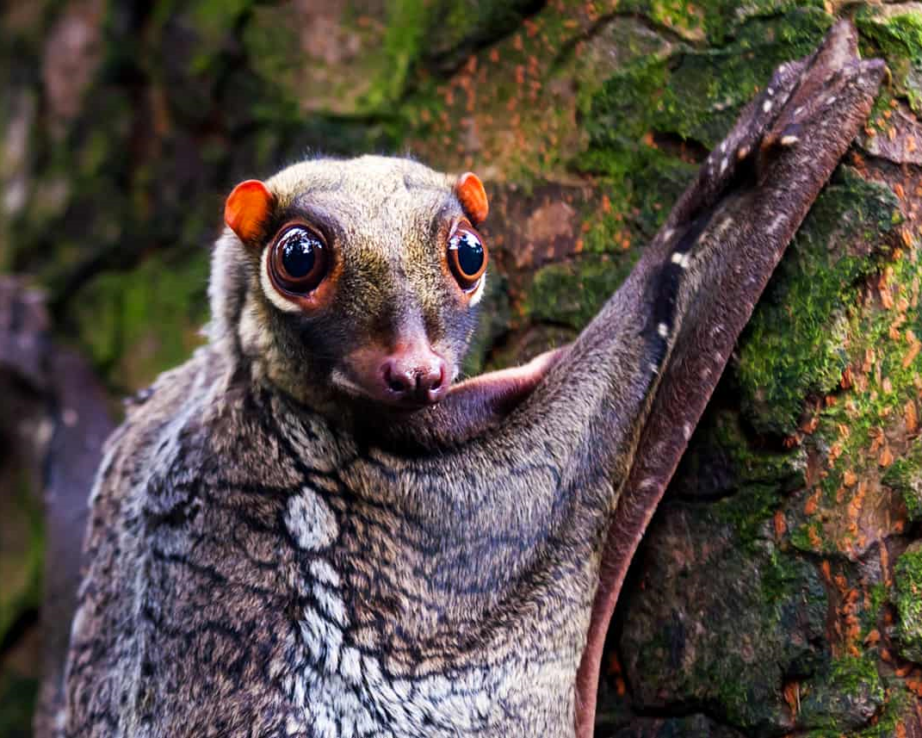
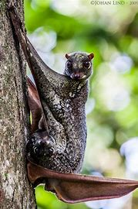
ANIMALS WITH UNUSUAL FEATURES
Colugo
Colugos are arboreal gliding mammals found in Southeast Asia, whose closest non-colugo relatives are primates.

Slide 2
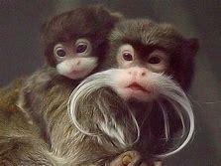
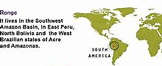
Allegedly named for its resemblance to the German emperor Wilhelm II. The fur of the emperor tamarin is predominantly grey colored, with yellowish speckles on its chest. The hands and feet are black and the tail is brown. Outstanding is its long, white beard, which extends to both sides beyond the shoulders. The animal reaches a length of 23–26 centimetres (9–10 in), plus a 35–41.5 cm (13.8–16.3 in) long tail. It weighs approximately 500 grams (18 oz).
Emperor Tamarin

Slide 3
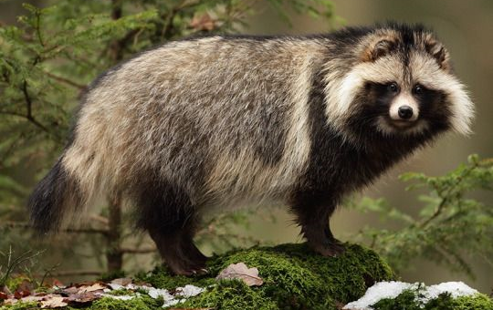
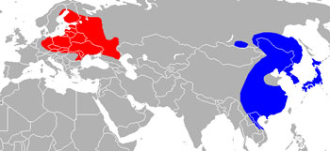
Raccoon Dog Range Map (Europe & Asia)
Blue - Native, Red - Introduced
Raccoon Dog
Raccoon Dogs are named for their resemblance to the common raccoon, but they are not closely related. They have a body length between 50 and 60 cms (20 - 23.5 inches), a tail length of around 18 cms (7 inches) and they weigh in the region of 7.5 kgs (17 lbs).
Raccoon Dogs are the only canids that hibernate in winter. In their introduced range they only hibernate during severe snowstorms.

Slide 4
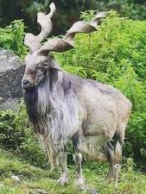
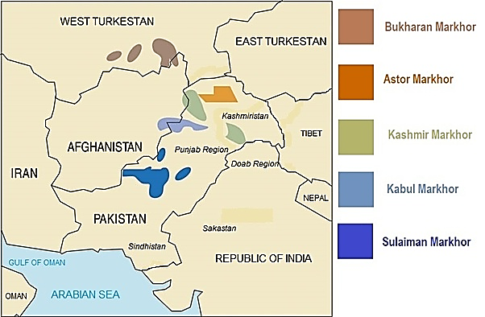
The Markhor (Capra falconeri) is the largest of the goat family and is found in the rugged mountains of central Asia, from Southern Russia to the sparse woodland of the West Himalayas. The markhor is largely found in the Northern Areas of Pakistan especially in Chitral, Ghizar and Hunza regions.
Markhor Goat

Slide 5
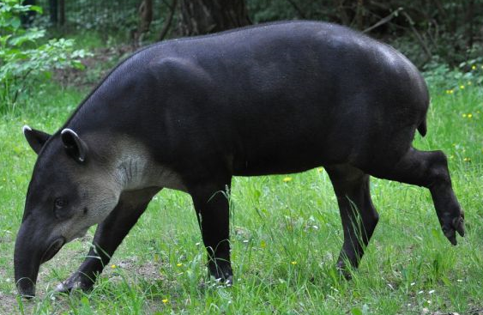
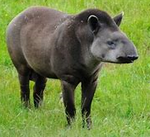
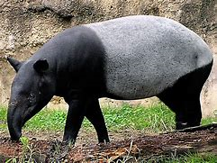
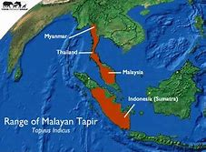
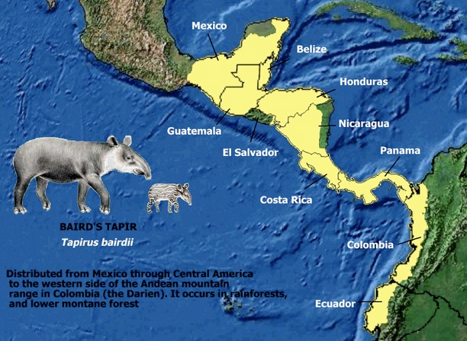
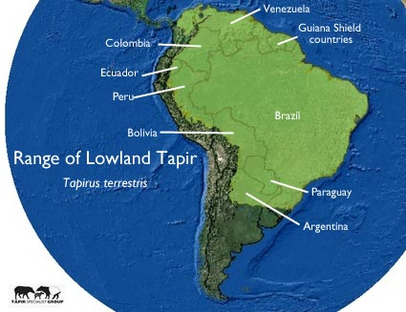
Baird’s Tapir Lowland Tapir Malayan Tapir
The tapir is a large, herbivorous mammal, similar in shape to a pig, with a short, prehensile nose trunk.

Slide 6
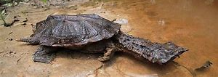
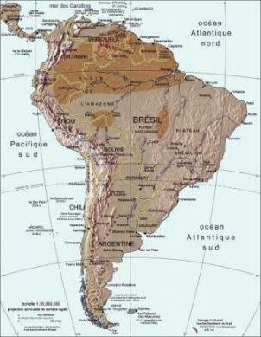
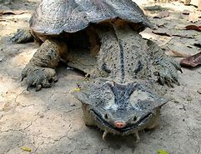
The mata mata can be found in slow moving, blackwater streams, stagnant pools, marshes. The mata mata is strictly an aquatic species but it prefers standing in shallow water where its snout can reach the surface to breathe.
Mata Mata Turtle

Slide 7
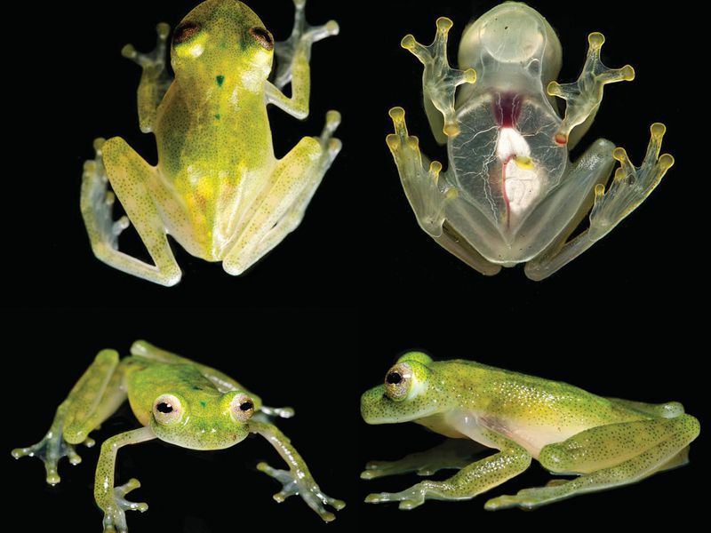
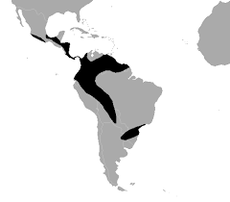
Glass Frogs
Glass frog, (family Centrolenidae), any of a group of tree frogs found in the New World tropics, some species of which have transparent bellies and chests. In glass frogs the viscera are visible, and an observer can see the heart pumping blood into the arteries and food moving through the gut.

Slide 8
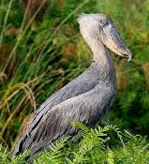
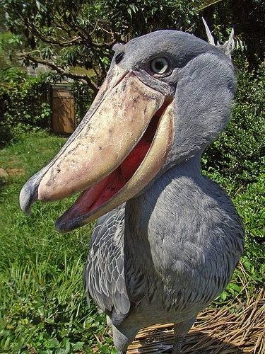
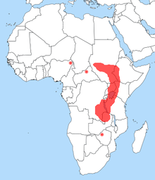
The shoebill also known as whalehead, whale-headed stork, or shoe-billed stork, is a very large stork-like bird. It derives its name from its enormous shoe-shaped bill.
Shoebill Stork

Slide 9
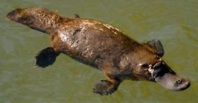
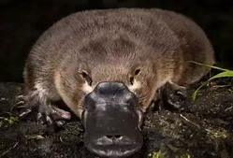
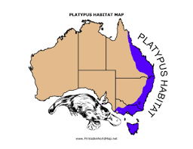
PLATYPUS
Platypus, (Ornithorhynchus anatinus), also called duckbill, a small amphibious Australian mammal noted for its odd combination of primitive features and special adaptations, especially the flat, almost comical bill that early observers thought was that of a duck sewn onto the body of a mammal.

Slide 10
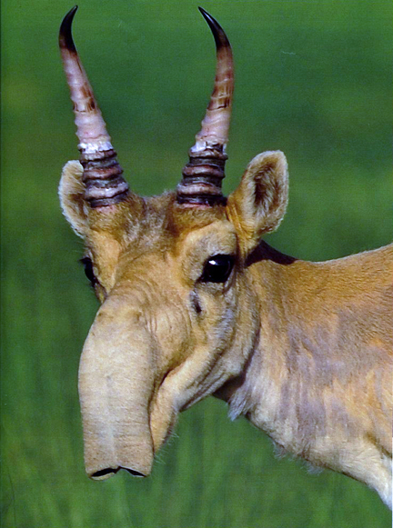
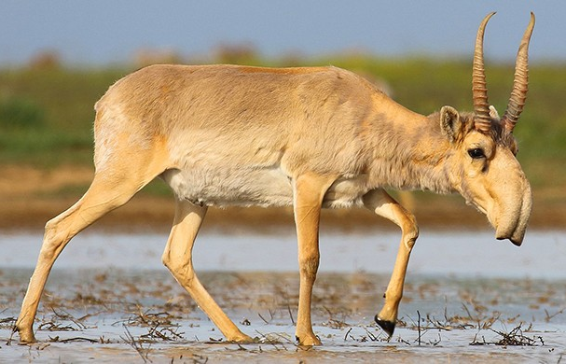
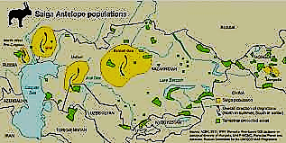
The Saiga antelope (Saiga tatarica and S. borealis mongolica) is (a critically endangered antelope) a large migratory herbivore of Central Asia found in Kazakhstan, Mongolia, the Russian Federation, Turkmenistan, and Uzbekistan. The saiga generally inhabits open dry steppe grasslands and semi-arid deserts. This antelope has an extremely unusual appearance with an over-sized and flexible nose.
SAIGA ANTELOPE

Slide 11
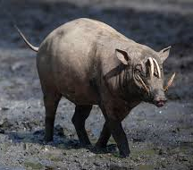
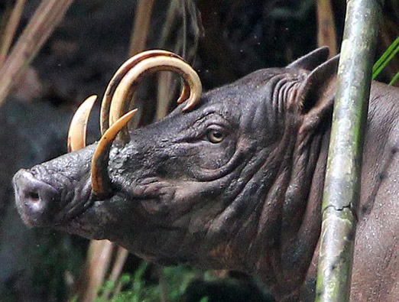
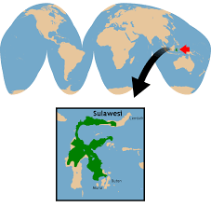
SULAWESI
BABIRUSA
The North Sulawesi babirusa (Babyrousa celebensis) is a pig-like animal native to Sulawesi and some nearby islands (Lembeh, Buton and Muna) in Indonesia. It has two pairs of large tusks composed of enlarged canine teeth. The upper canines penetrate the top of the snout, curving back toward the forehead.

Slide 12
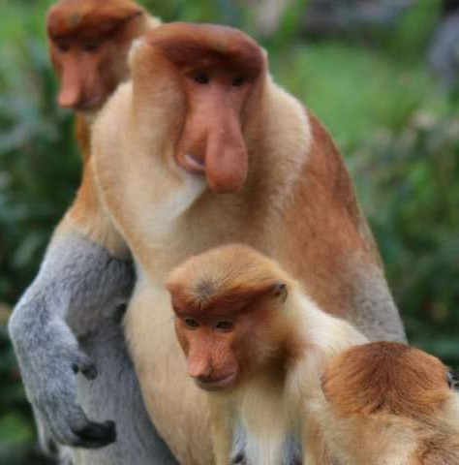
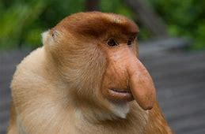
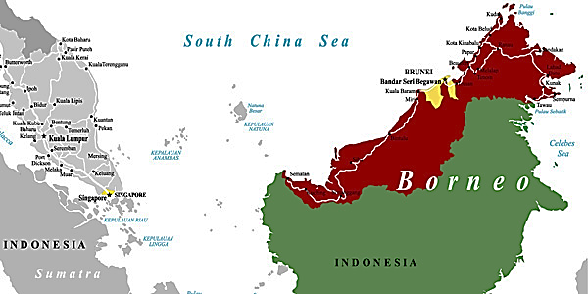
PROBOSCIS MONKEY
Proboscis monkey, (Nasalis larvatus), long-tailed arboreal primate found along rivers and in swampy mangrove forests of Borneo. Named for the male’s long and pendulous nose, the proboscis monkey is red-brown with pale underparts. The nose is smaller in the female and is upturned in the young.

Slide 13
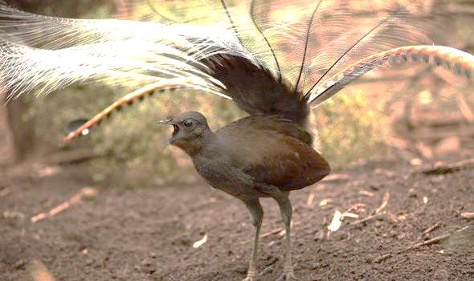
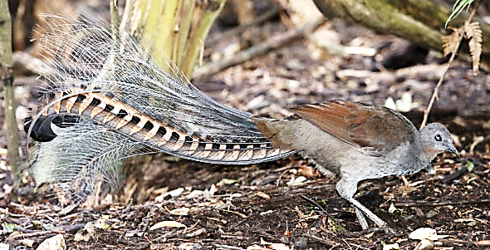
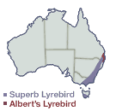
Lyrebird
Lyrebirds are ground-dwelling birds that are native to Australia. They are known for their noteworthy mimicking abilities, unique tails and plumes as well as interesting courtship display.

Slide 14
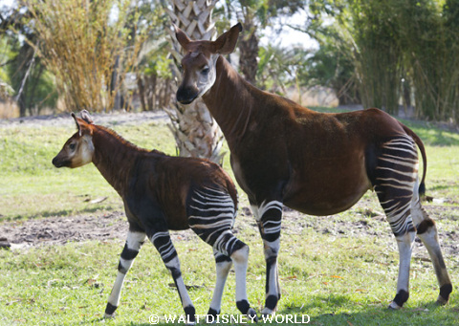
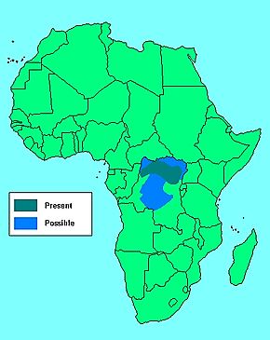
Okapi
The okapi, also known as the forest giraffe, Congolese giraffe, or zebra giraffe, is an artiodactyl mammal native to the northeast of the Democratic Republic of the Congo in Central Africa. Although the okapi has striped markings reminiscent of zebras, it is most closely related to the giraffe.

Slide 15
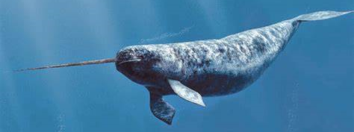
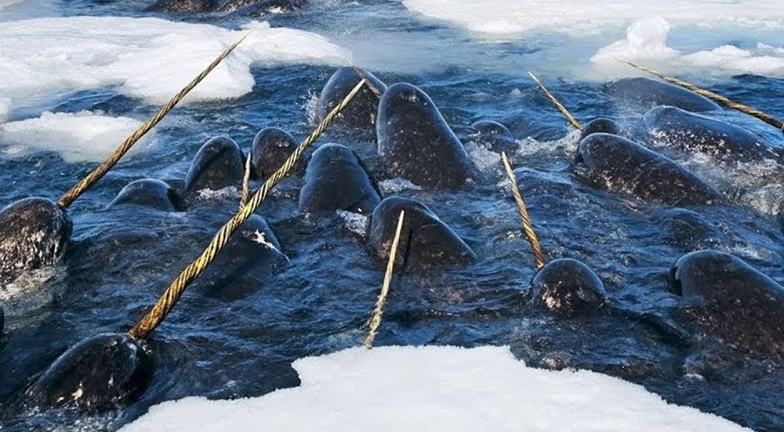
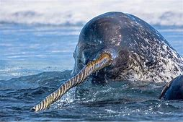
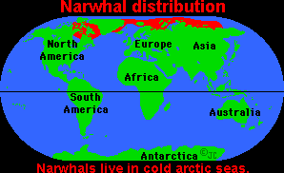
Narwhal whale
The narwhal is the unicorn of the sea, a pale-colored porpoise found in Arctic coastal waters and rivers. Narwhal Tusks. These legendary animals have two teeth. In males, the more prominent tooth grows into a swordlike, spiral tusk up to 8.8 feet long. The ivory tusk tooth grows right through the narwhal's upper lip.

Slide 16
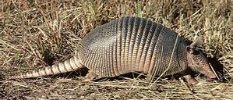
Pangolin
.
No, it is not an armadillo
Pangolins have large, protective keratin scales covering their skin; they are the only known mammals with this feature. They live in hollow trees or burrows, depending on the species. Pangolins are nocturnal, and their diet consists of mainly ants and termites, which they capture using their long tongues.

Slide 17
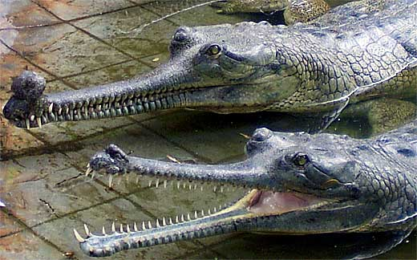
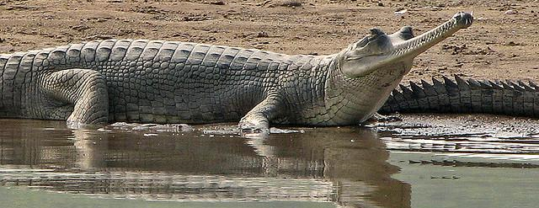
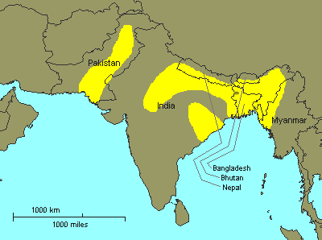
Gharial
Gharials have a typical crocodilian shape, other than their extremely elongated, narrow snouts. They are covered with smooth, non-overlapping scales. This crocodile is native to sandy freshwater river banks in the plains of the northern part of the Indian subcontinent.

Slide 18
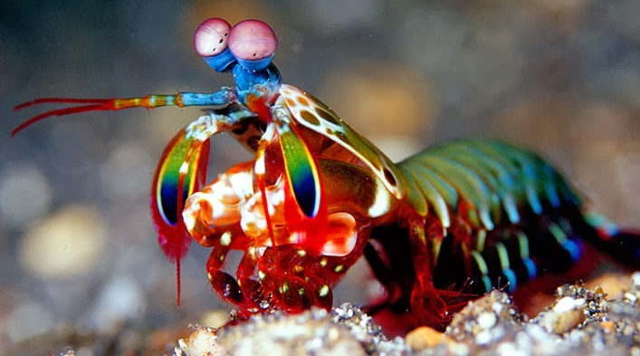
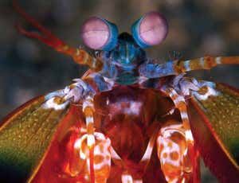
Mantis Shrimp
Mantis shrimps, or stomatopods, are marine crustaceans of the order Stomatopoda. Some species have specialized calcified "clubs" that can strike with great power, while others have sharp forelimbs used to capture prey.

Slide 19
Wombat
This large, pudgy mammal is a marsupial, or pouched animal, found in Australia and on scattered islands nearby. Like other marsupials, wombats give birth to tiny, undeveloped young that crawl into pouches on their mothers' bellies. A wombat baby remains in its mother's pouch for about five months before emerging.

Slide 20
Madagascar
Aye-Aye
The aye-aye is a small primitive nocturnal forest-dwelling primate (Daubentonia madagascariensis) of northern Madagascar that has a round head, large eyes and ears, and long thin fingers.

Slide 21
Pink Fairy Armadillo
The pink fairy armadillo or pichiciego is the smallest species of armadillo. This desert-adapted animal is endemic to central Argentina and can be found inhabiting sandy plains, dunes, and scrubby grasslands.

Slide 22
The red panda has given scientists taxonomic fits. It has been classified as a relative of the giant panda, and also of the raccoon, with which it shares a ringed tail. Currently, red pandas are considered members of their own unique family—the Ailuridae. Red pandas are an at-risk species, victims of deforestation.
Red Panda

Slide 23
Tarsier
It has been suggested that Yoda was based on a tarsier.
Tarsier, (family Tarsiidae), any of six or more species of small leaping primates found only on various islands of Southeast Asia, including the Philippines. Tarsiers are intermediate in form between lemurs and monkeys, measuring only about 9–16 cm (3.5–6 inches) long, excluding a tail of about twice that length.

Slide 24
Lowland Streaked Tenrec
The lowland streaked tenrec has four yellow streaks running the length of its body. It also has a long, pointed snout, no tail, big ears, and small eyes. It's a small creature, reaching only about 5.5 inches in length and about 4.5-10 ounces in weight. The lowland streaked tenrec is found only on the rainforest-covered eastern side of Madagascar.

Slide 25
Mexican Axolotl
The axolotl, Ambystoma mexicanum, also known as the Mexican walking fish, is a neotenic salamander related to the tiger salamander. Although the axolotl is colloquially known as a "walking fish", it is not a fish, but an amphibian.

Slide 26
PROTECT
OUR
DIVERSITY
For more Powerpoint Preshows,
please visit: http://murov.info/PPTPreshows.htm

