Slide 1
WONDERS OF ARCHITECTURE
Each of the slides that follows contains an image or images of an architectural treasure. Selection has been subjective. The treasures appear in the chronological order of construction dates. All treasures here were built prior to the industrial revolution. For an accompanying slide presentation on architectural wonders built since the beginning of the industrial revolution, please visit:
http://murov.info/archmod.pptx
For each slide, name the treasure, its location
and the approximate year of construction.
For some web sites used for selection of the treasures, please visit:
https://rationalwiki.org/wiki/Essay:Greatest_achievements_of_human_history
https://foyr.com/learn/wonders-of-the-world-architectural-marvels/
https://www.thediscoverer.com/blog/25-architectural-wonders-you-have-to-see-once/XvHyVpKgiwAG5apY
http://www.travelstart.co.za/blog/20-must-see-architectural-wonders-of-the-modern-world/

Slide 2
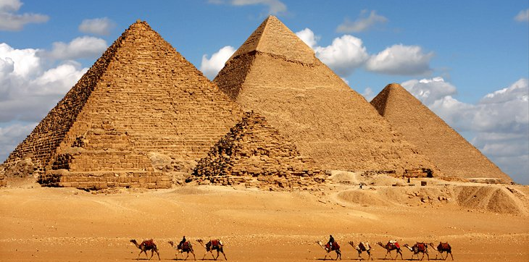
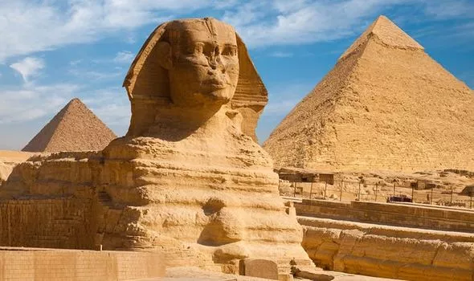
Great Sphinx of Giza/Age 4,540 years c. 2520 BC
Some literature suggests that the Sphinx was built much earlier than the pyramids.
The Giza Pyramids, built to endure an eternity, have done just that. The monumental tombs are relics of Egypt's Old Kingdom era and were constructed some 4,500 years ago. Egypt's pharaohs expected to become gods in the afterlife.
The Great Pyramid of Giza (also known as the Pyramid of Khufu or the Pyramid of Cheops) is the oldest and largest of the pyramids in the Giza pyramid complex bordering present-day Giza in Greater Cairo, Egypt. It is the oldest of the Seven Wonders of the Ancient World, and the only one to remain largely intact.
Egyptologists conclude that the pyramid was built as a tomb for the Fourth Dynasty Egyptian pharaoh Khufu and estimate that it was built in the 26th century BC during a period of around 27 years.

Slide 3
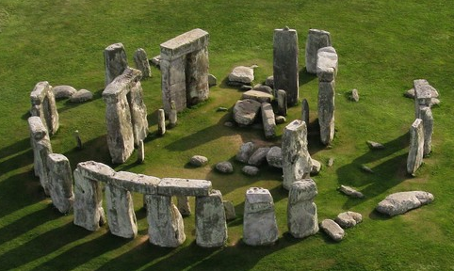
Stonehenge, Salisbury, England.
Stonehenge is perhaps the world's most famous prehistoric monument. It was built in several stages: the first monument was an early henge monument, built about 5,000 years ago, and the unique stone circle was erected in the late Neolithic period about 2500 BC.

Slide 4
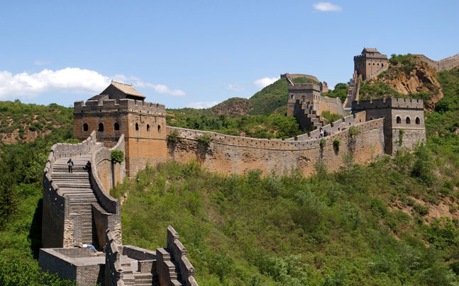
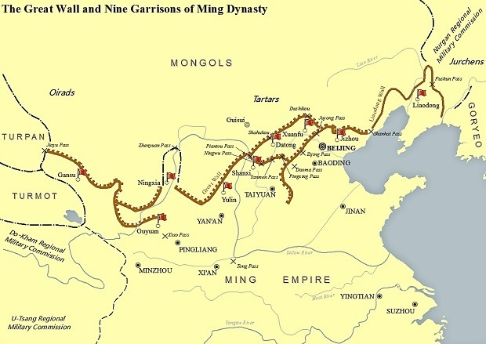
The Great Wall of China
The Great Wall consists of numerous walls—many of them parallel to each other—built over some two millennia across northern China and southern Mongolia. The most extensive and best-preserved version of the wall dates from the Ming dynasty (1368–1644) and runs for some 5,500 miles (8,850 km).
Historians usually consider the defensive walls built during the period (770–476 BCE) and the Warring States period (475–221 BCE) to be the first sections of what would eventually become the structure known as the Great Wall of China, putting parts of the wall at almost 3,000 years old

Slide 5
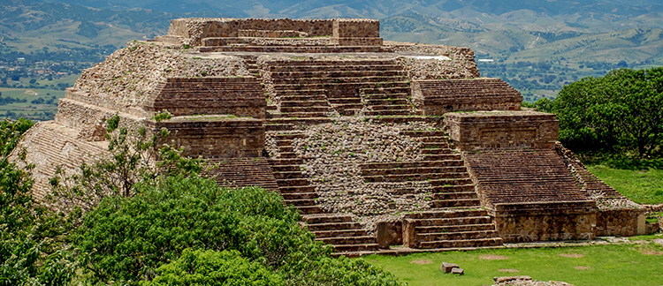
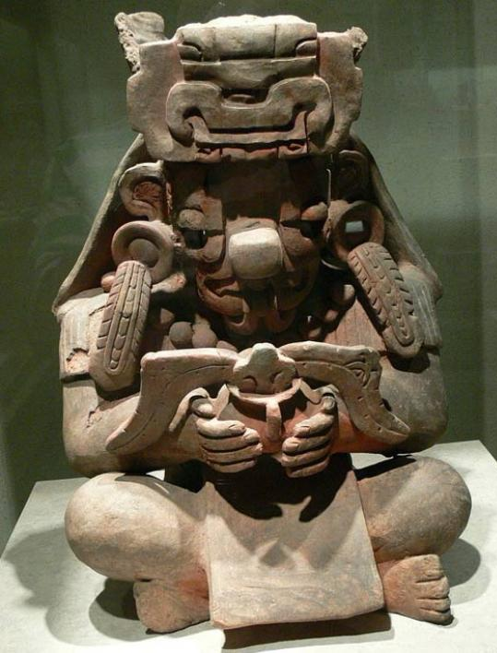
An ancient Zapotec metropolis, Monte Albán was founded in the sixth century B.C. on a low mountainous range overlooking the city of Oaxaca (Mexico) and functioned as their capital 13 centuries between 500 B.C. and 800 A.D. Built about 100 BC.

Slide 6
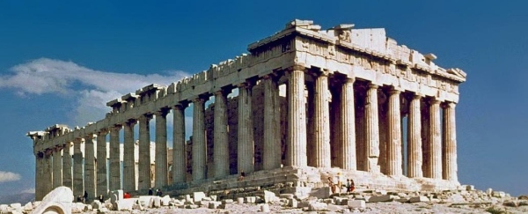
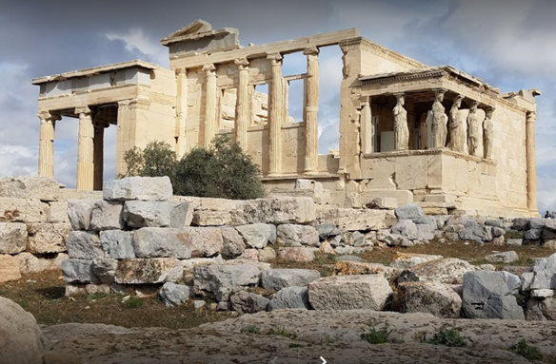
The Acropolis (525 BC) of Athens is an ancient citadel located on a rocky outcrop above the city of Athens and contains the remains of several ancient buildings of great architectural and historical significance, the most famous being the Parthenon.
The Parthenon – Greece (447 BC)

Slide 7
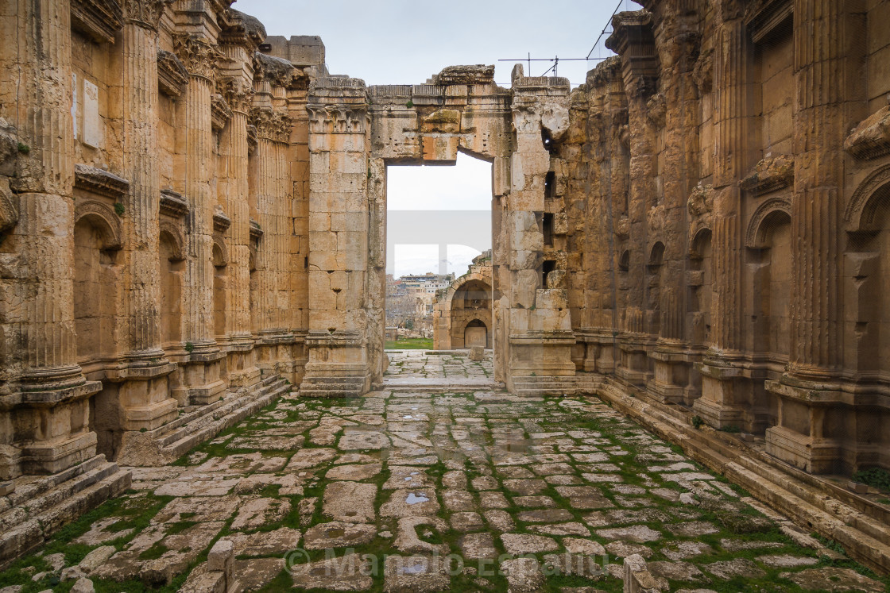
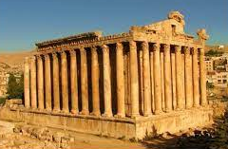
Baalbek, Lebanon, is the site of one of the most mysterious ruins of the Roman Empire, a monumental two-thousand-year-old (about 15 BC) temple to Jupiter that sits atop 3-thousand-ton stone blocks. (The pillars of Stonehenge weigh about a fortieth of that.)

Slide 8
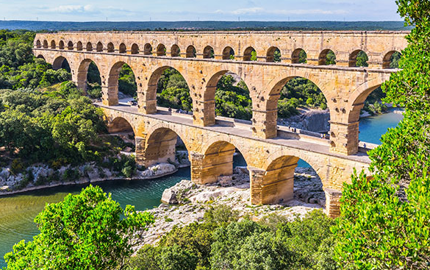
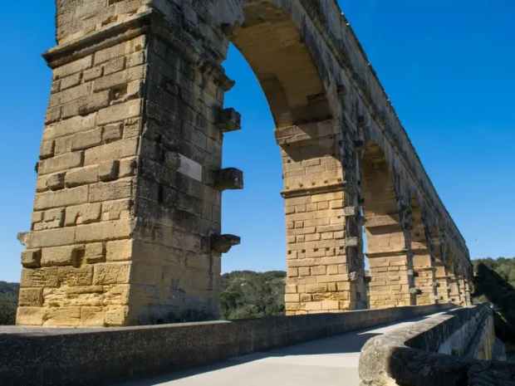
The Pont du Gard, Remoulins, France is an ancient Roman aqueduct bridge built in the first century AD to carry water over 50 km to the Roman colony of Nemausus. It crosses the river Gardon near the town of Vers-Pont-du-Gard in southern France. (about 60 AD)

Slide 9
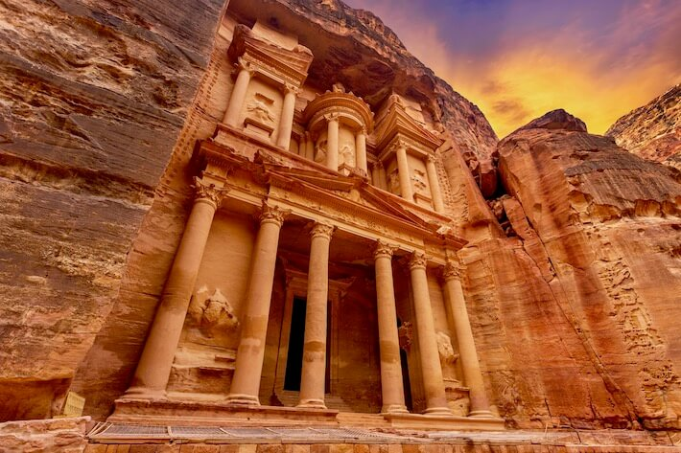
The structure is believed to have been the mausoleum of the Nabatean King Aretas IV in the 1st century AD. It is one of the most popular tourist attractions in both Jordan and the region. It became known as "Al-Khazneh", or The Treasury, in the early 19th century by the area's Bedouins as they had believed it contained treasures.
Al Khazneh
Petra, Jordan. Al-Khazneh (Arabic: الخزنة‎; "The Treasury") is one of the most elaborate temples in Petra, a city of the Nabatean Kingdom inhabited by the Arabs in ancient times. As with most of the other buildings in this ancient town, including the Monastery (Arabic: Ad Deir), this structure was carved out of a sandstone rock face.

Slide 10
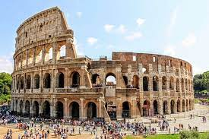
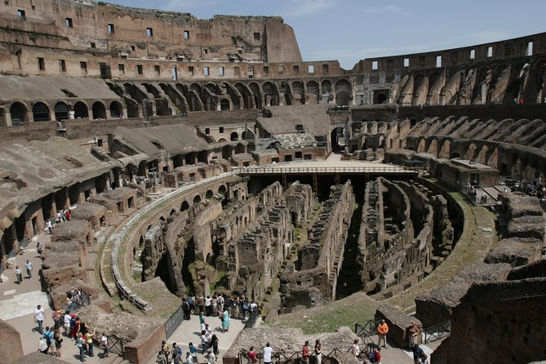
Colosseum, Rome, Italy
Built in: AD 70–80; over 1900 years ago

Slide 11
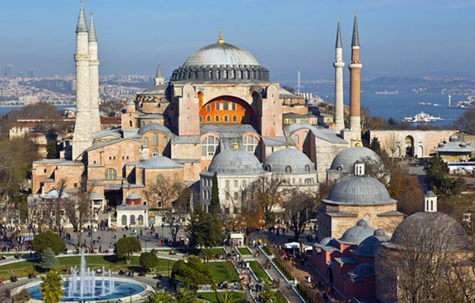
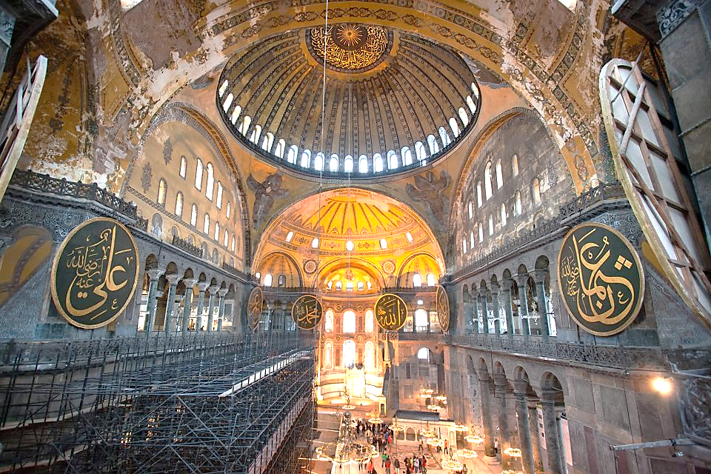
Built between 532 and 537, Hagia Sophia (Holy Wisdom, Ayasofya) represents a brilliant moment in Byzantine architecture and art. It was the principal church of the Byzantine Empire in its capital, Constantinople (later Istanbul), and a mosque after the Ottoman Empire conquered the city in 1453.

Slide 12
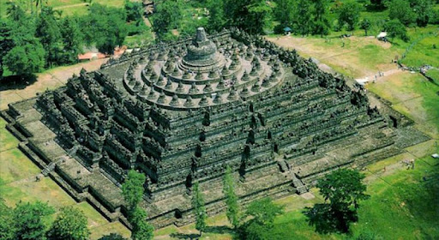
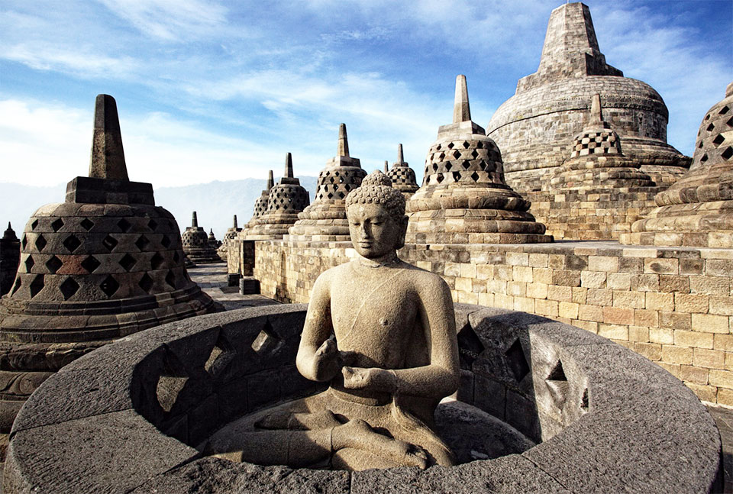
Borobudur , Java, Indonesia, is a 7th-century Mahayana Buddhist temple in Magelang Regency, not far from the town of Muntilan, in Central Java, Indonesia. It is the world's largest Buddhist temple. The temple consists of nine stacked platforms, six square and three circular, topped by a central dome.

Slide 13
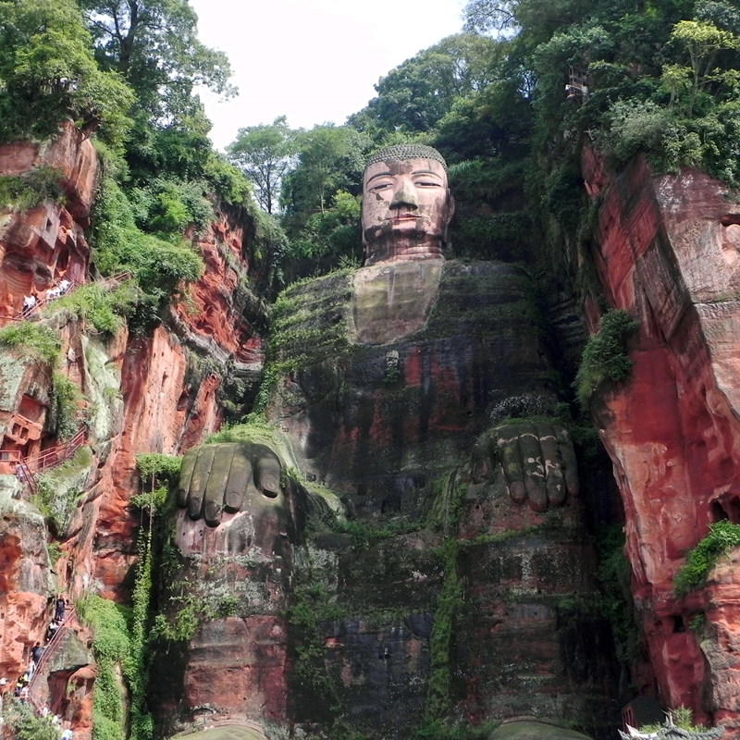
The Leshan Giant Buddha, Sichuan Province, China, is a 71-metre (233 feet) tall stone statue, built between 713 and 803 during the Tang dynasty. It is carved out of a cliff face of Cretaceous red bed sandstones that lies at the confluence of the Min River and Dadu River in the southern part of Sichuan province in China, near the city of Leshan.

Slide 14
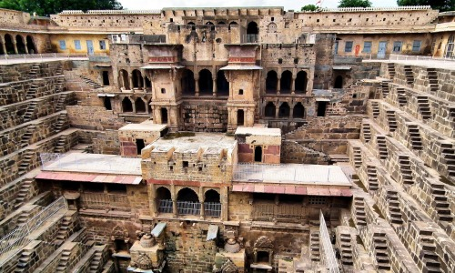
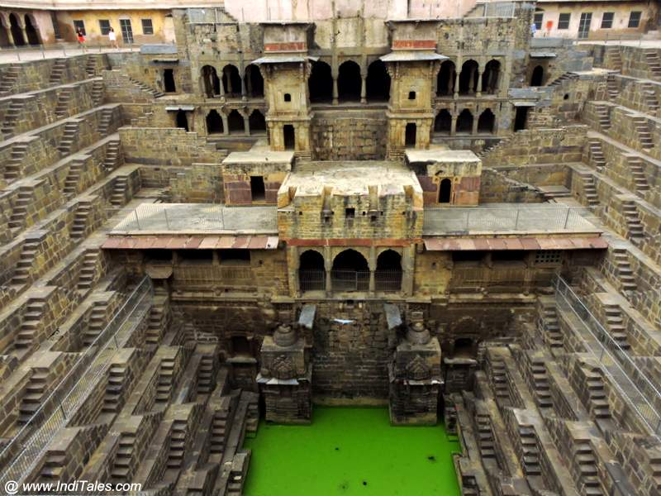
The Chand Baori (India) is a stepwell built over a thousand years ago in the Abhaneri village of Rajasthan. It is one of the largest stepwells in the world and also one of the most beautiful ones. Located in the eastern part of the province of Rajasthan, it was built by King Chanda somewhere in the 9th century.

Slide 15
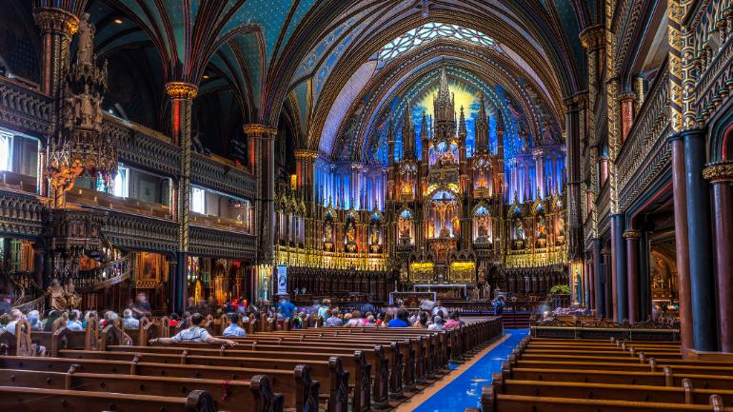
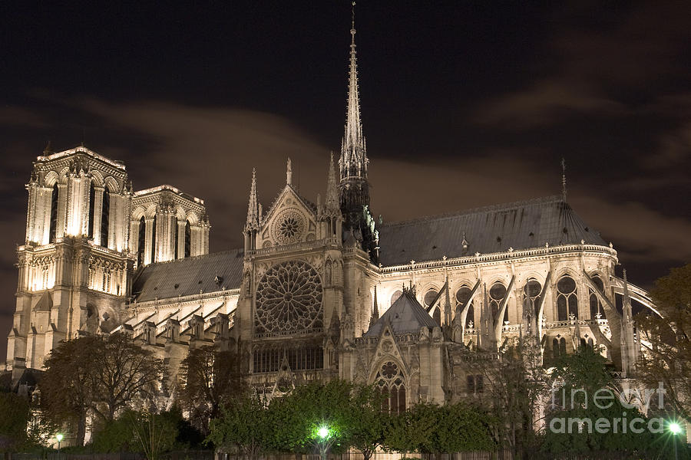
Notre-Dame (Paris, France) was built on the ruins of two earlier churches, which were themselves predated by a Gallo-Roman temple dedicated to Jupiter. The cathedral was initiated by Maurice de Sully, bishop of Paris, who about 1160 conceived the idea of converting into a single building, on a larger scale, the ruins of the two earlier basilicas. The foundation stone was laid by Pope Alexander III in 1163. During a restoration in 2019, a fire broke out in the cathedral’s attic, and the massive blaze destroyed most of the roof, Viollet-le-Duc’s 19th-century spire, and some of the rib vaulting. It is being rebuilt in its previous image.

Slide 16
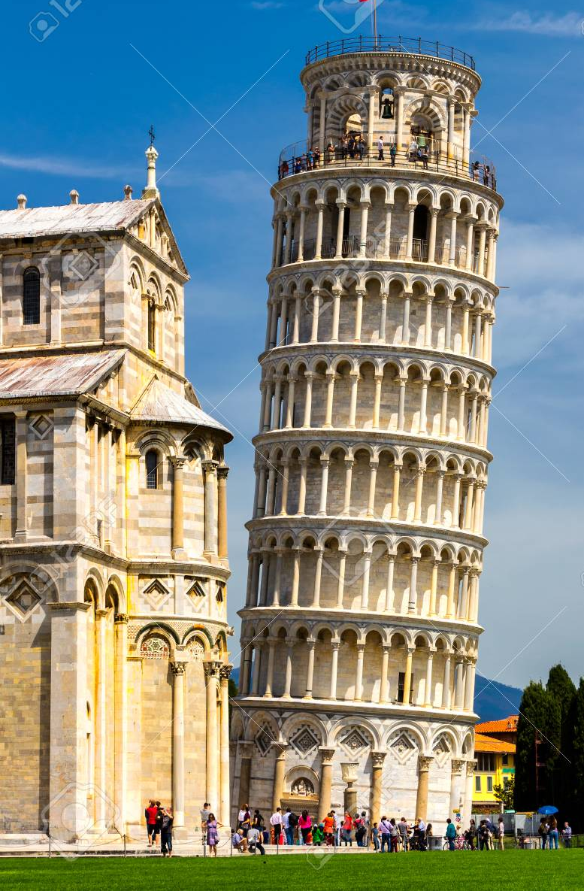
Leaning Tower of Pisa, Italian Torre Pendente di Pisa, medieval structure in Pisa, Italy, that is famous for the settling of its foundations, which caused it to lean 5.5 degrees (about 15 feet [4.5 metres]) from the perpendicular. Extensive work in 1990 - 2001 was subsequently done to straighten the tower, and its lean was ultimately reduced to less than 4.0 degrees.
The bell tower, begun in 1173 as the third and final structure of the city’s cathedral complex, was designed to stand 185 feet (56 metres) high and was constructed of white marble. Three of its eight stories had been completed when the uneven settling of the building’s foundations in the soft ground became noticeable.
Giovanni di Simone, the engineer in charge when construction resumed, sought to compensate for the lean by making the new stories slightly taller on the short side, but the extra masonry caused the structure to sink still further.

Slide 17
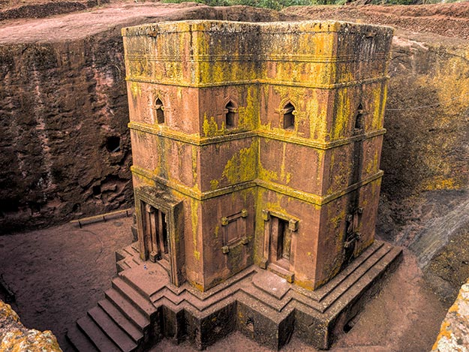
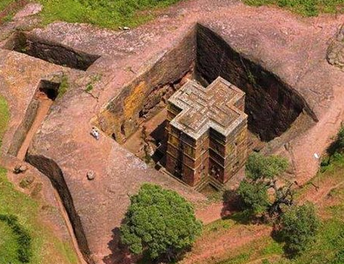
Rock-Hewn Churches of Lalibela, Ethiopia
In a mountainous region in the heart of Ethiopia, some 645 km from Addis Ababa, eleven medieval monolithic churches were carved out of rock. Their building is attributed to King Lalibela who set out to construct in the 12th century a ‘New Jerusalem’, after Muslim conquests halted Christian pilgrimages to the holy Land. Lalibela flourished after the decline of the Aksum Empire.

Slide 18
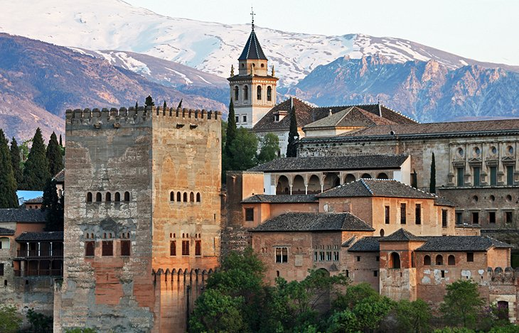
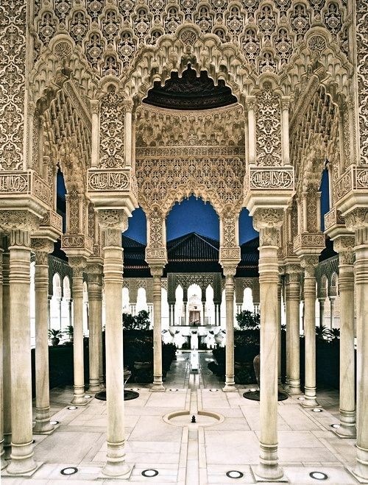
Palace of Alhambra
Alhambra, palace and fortress of the Moorish monarchs of Granada, Spain. The name Alhambra, signifying in Arabic “the red,” is probably derived from the reddish colour of the tapia (rammed earth) of which the outer walls were built. Constructed on a plateau that overlooks the city of Granada, the Alhambra was built chiefly between 1238 and 1358, in the reigns of Ibn al-Aḥmar, founder of the Naṣrid dynasty, and his successors.

Slide 19
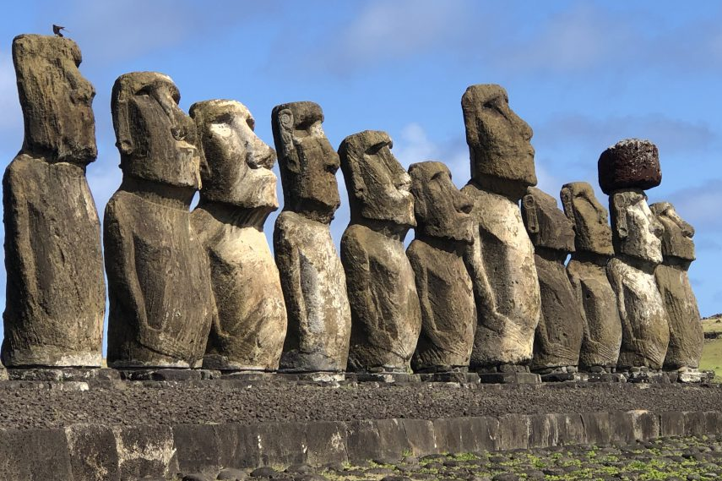
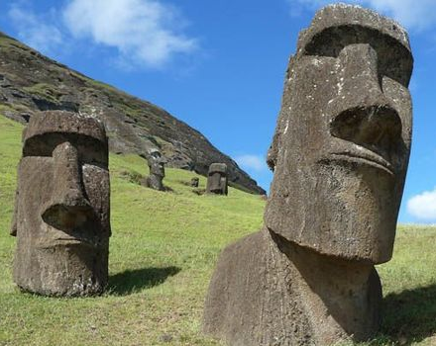
Easter Island, a Chilean territory, is a remote volcanic island in Polynesia. Its native name is Rapa Nui. It’s famed for archaeological sites, including nearly 900 monumental statues called moai, created by inhabitants during the 13th–16th centuries. The moai are carved human figures with oversize heads, often resting on massive stone pedestals called ahus.

Slide 20
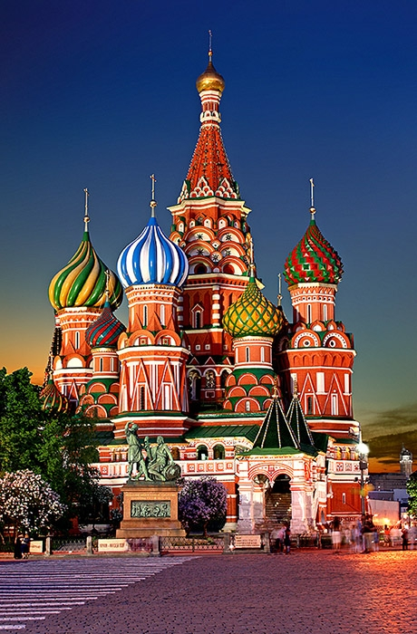
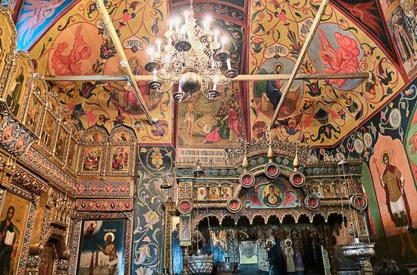
St Basil's Cathedral , Moscow, Russia was completed in 1561 to celebrate Russian victory over the Khanate of Kazan. ... The cathedral was recognised as significant and irreplaceable national monument by the Soviets. It underwent extensive restoration and became a museum of architecture, history, politics, and religion.

Slide 21
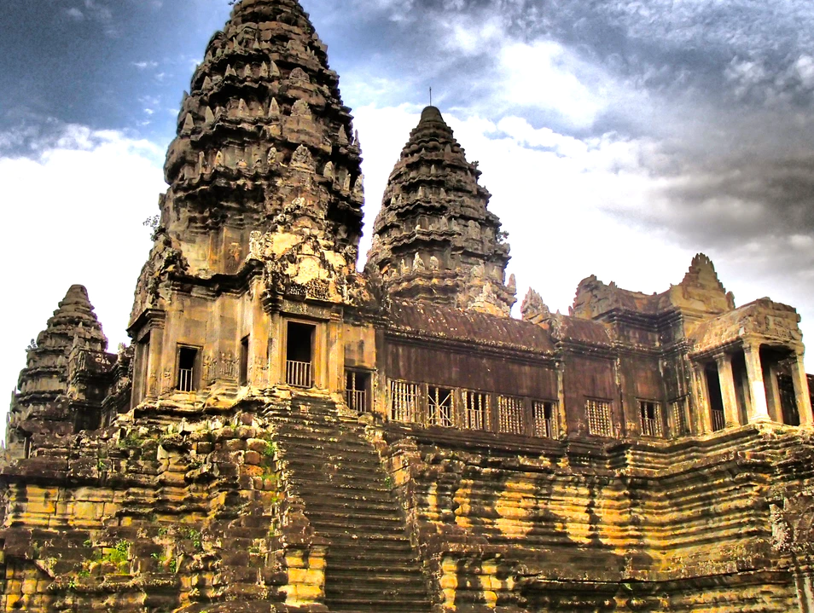
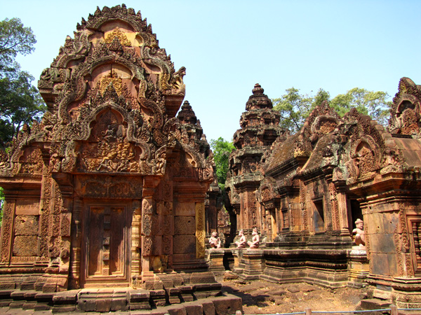
Angkor Wat, Cambodia
It was built by the Khmer King Suryavarman II in the first half of the 12th century, around the year 1110-1150, making Angkor Wat almost 900 years old. The temple complex, built in the capital of the Khmer Empire, took approximately 30 years to build.

Slide 22
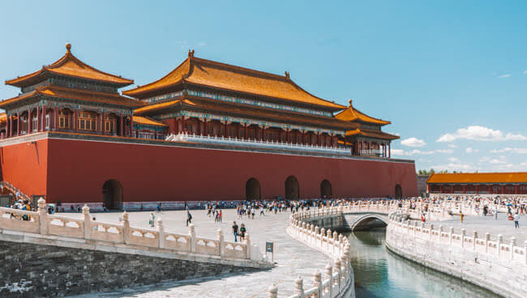
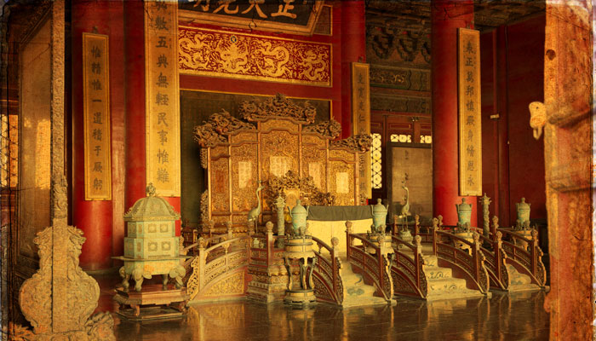
The Forbidden City, Beijing, China, was constructed from 1406 to 1420, and was the former Chinese imperial palace and winter residence of the Emperor of China from the Ming dynasty (since the Yongle Emperor) to the end of the Qing dynasty, between 1420 and 1924.

Slide 23
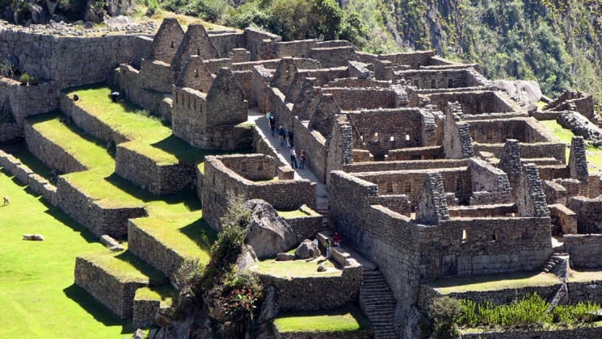
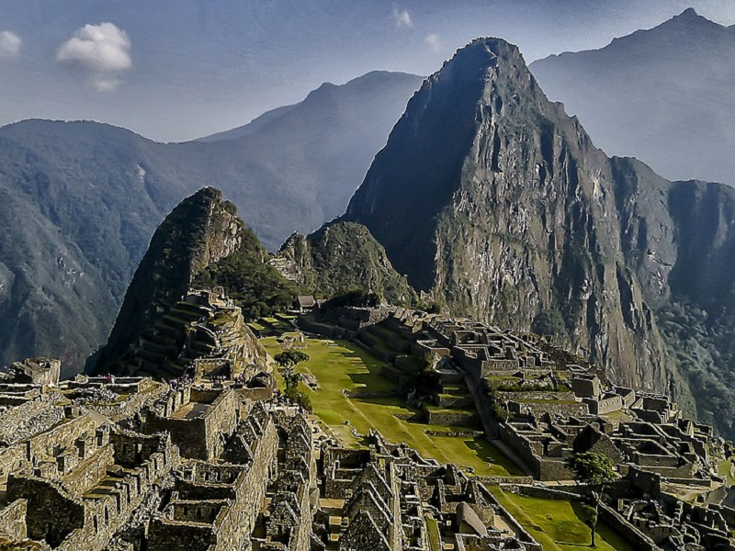
Machu Picchu is an Incan citadel set high in the Andes Mountains in Peru, above the Urubamba River valley. Built in the 15th century.

Slide 24
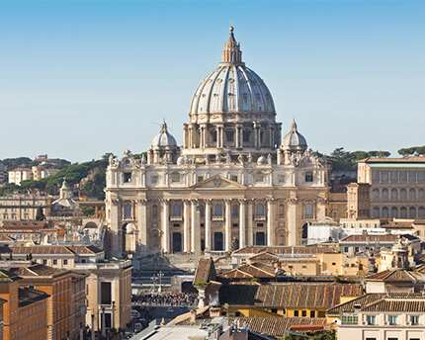
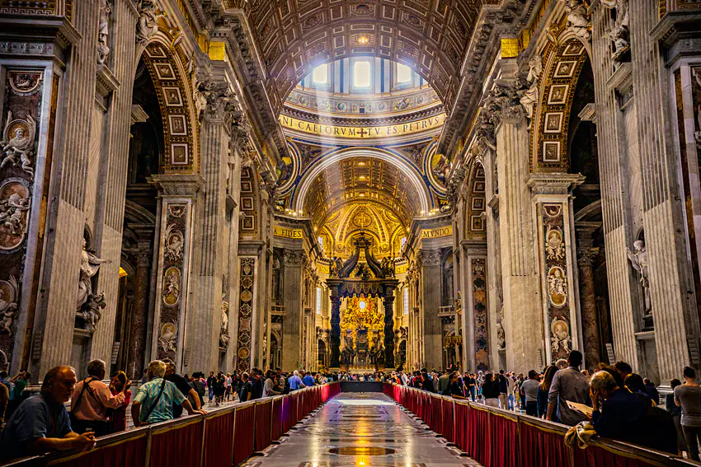
St. Peter’s Basilica, also called New St. Peter’s Basilica, present basilica of St. Peter in Vatican City (an enclave in Rome), begun by Pope Julius II in 1506 and completed in 1615 under Paul V. It is designed as a three-aisled Latin cross with a dome at the crossing, directly above the high altar, which covers the shrine of St. Peter the Apostle.

Slide 25
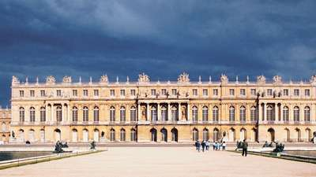
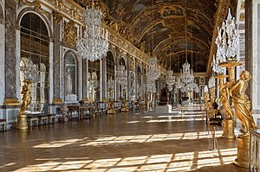
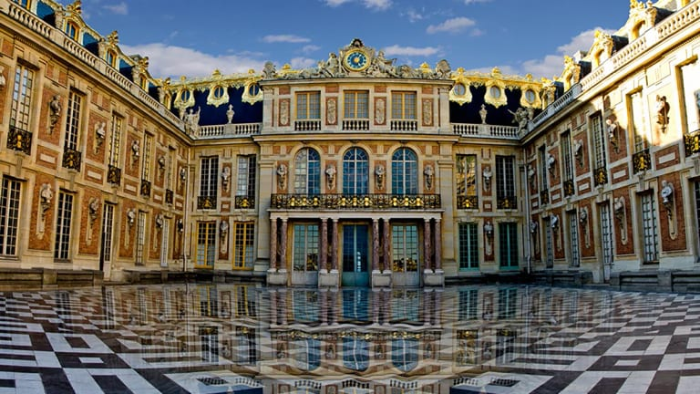
Palace of Versailles. It was a small country residence and, according to the Maréchal de Bassompierre, “a mere gentleman would not have been overly proud of the construction.” Louis XIII decided to rebuild it in 1631. Construction continued until 1634 and laid the basis of the Palace we know today.

Slide 26
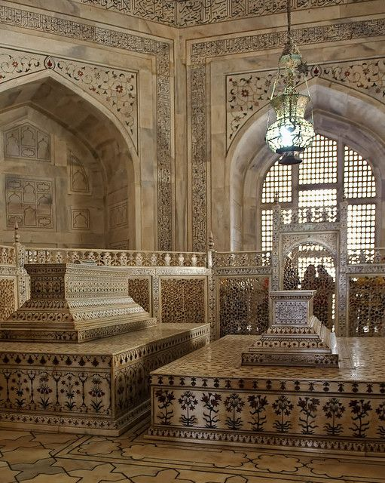
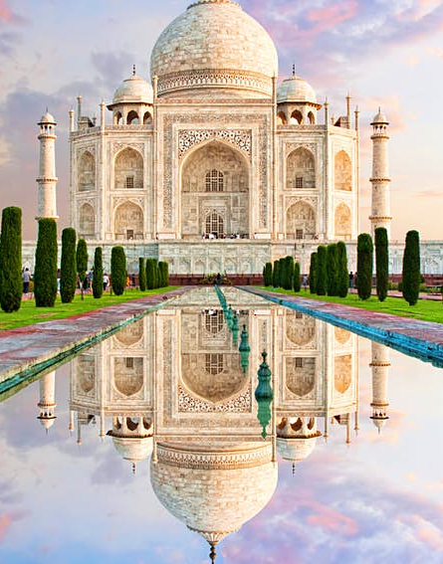
Taj Mahal, 1632–53
Location: Agra, ‎Uttar Pradesh‎, ‎India

Slide 27
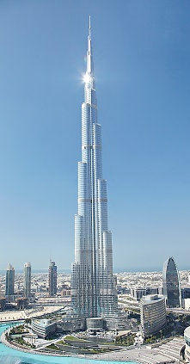
HOPE TO SEE YOU AGAIN SOON
For a plethora of online quizzes and challenges appropriate for individuals or groups, please visit:
http://murov.info
or
http://murov.info/triviachallenges.htm
or
http://murov.info/PPTPreshows.htm
For modern architectural wonders, please visit: http://murov.info/archmod.pptx

