Slide 1
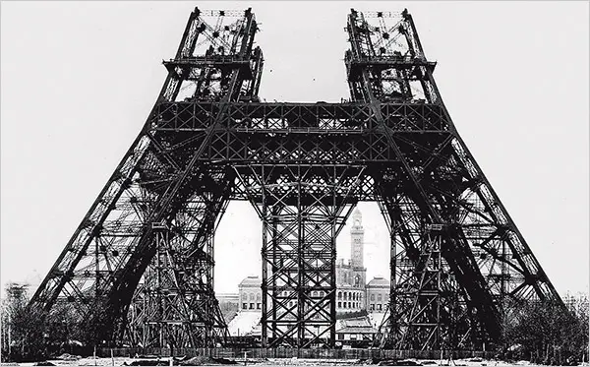
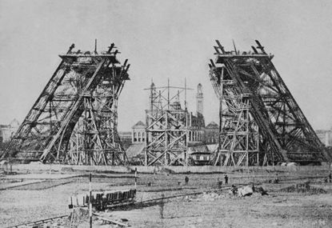
WONDERS OF MODERN ARCHITECTURE
Each of the slides that follows contains an image or images of an architectural marvel Selection has been subjective. The marvels appear in random order. All treasures here were built after the industrial revolution. For an accompanying slide presentation on architectural wonders built before the beginning of the industrial revolution, please visit: http://murov.info/arch.pptx .
For each slide, name the marvel
and its location.

Slide 2
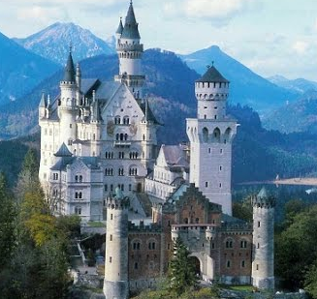
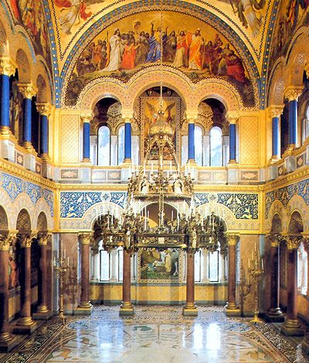
Neuschwanstein Castle is a 19th-century historicist palace on a rugged hill above the village of Hohenschwangau near Füssen in southwest Bavaria, Germany. The palace was commissioned by King Ludwig II of Bavaria as a retreat and in honor of Richard Wagner. Construction started in 1869.

Slide 3
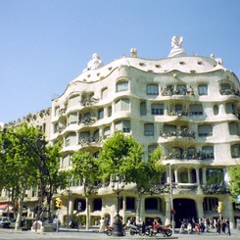
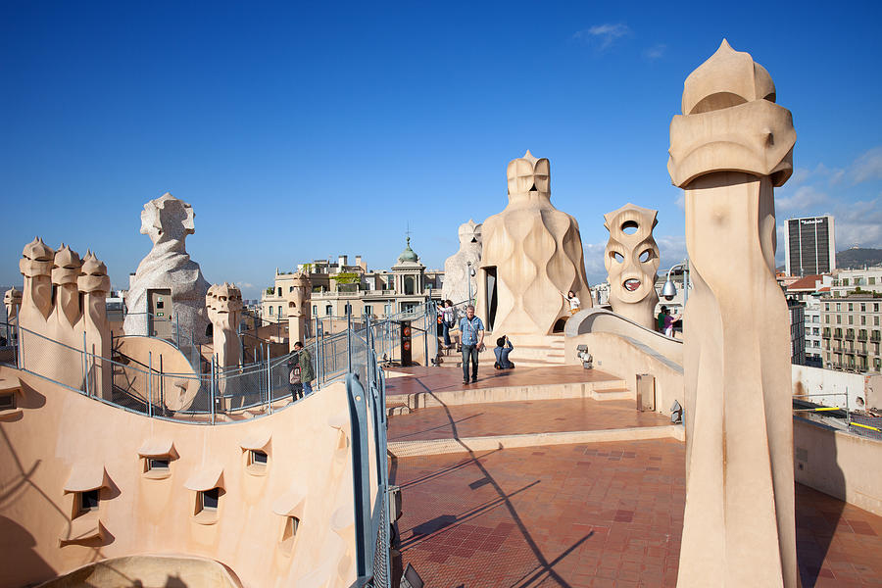
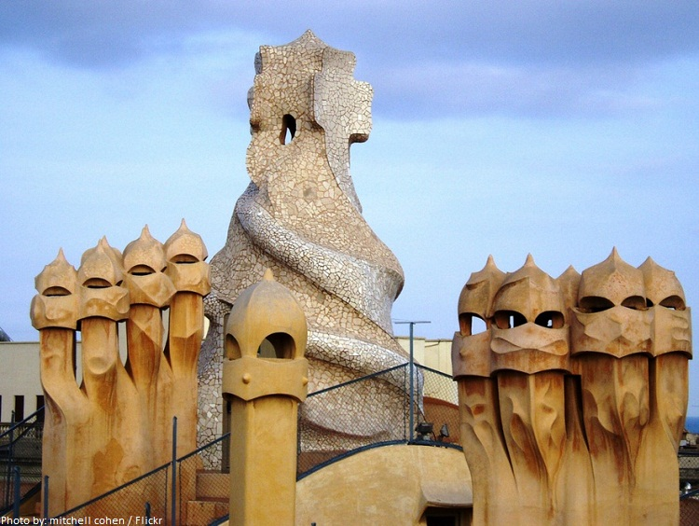
roof
Casa Milà, popularly known as La Pedrera, Barcelona, Spain, or "The stone quarry", a reference to its unconventional rough-hewn appearance, is a modernist building in Barcelona, Catalonia, Spain. It was the last private residence designed by architect Antoni Gaudí and was built between 1906 and 1912.

Slide 4
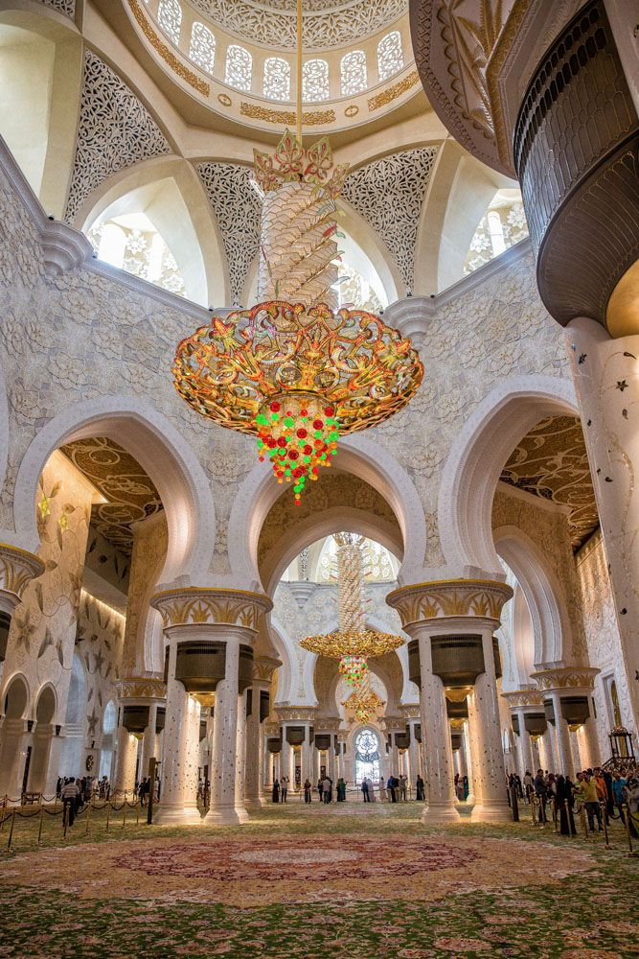
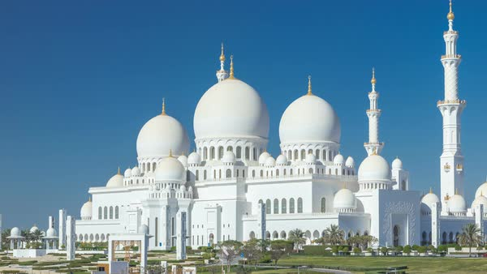
The Sheikh Zayed Grand Mosque, Abu Dhabi, is one of the world's most popular attractions according to TripAdvisor. It's easy to see why. Work on Abu Dhabi's beacon of splendor started in 1996 and took 12 years to complete at the reported cost of around $545 million.

Slide 5
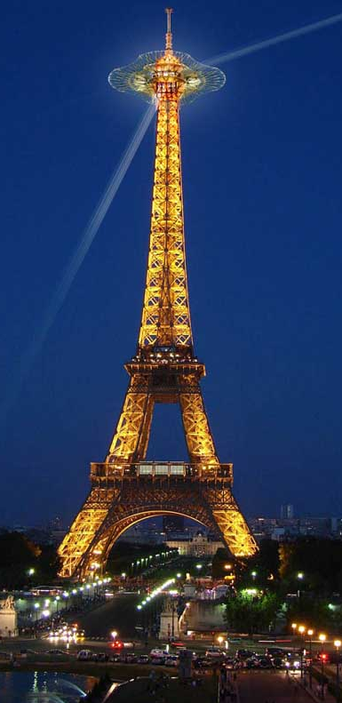
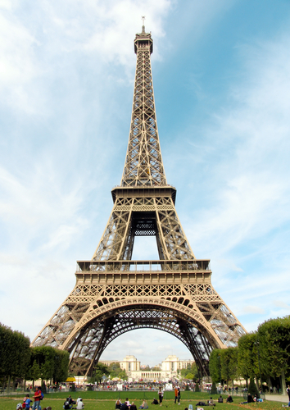
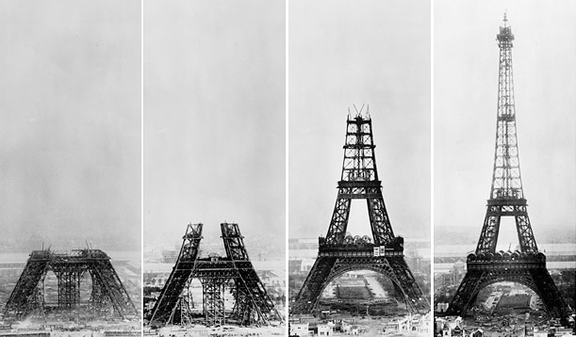
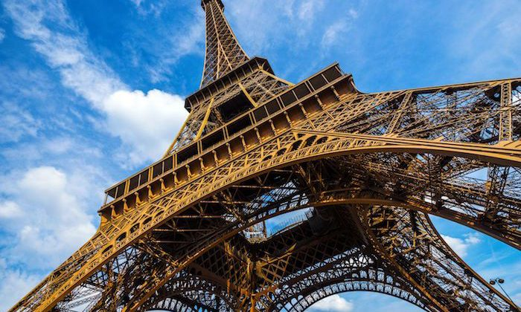
The Eiffel Tower was built to be one the main attractions at the Paris World's Fair in 1889. That year, the World's Fair covered the entire Champ de Mars in Paris and its focus was the vast constructions in iron and steel that were the great industrial advancement of that time.

Slide 6
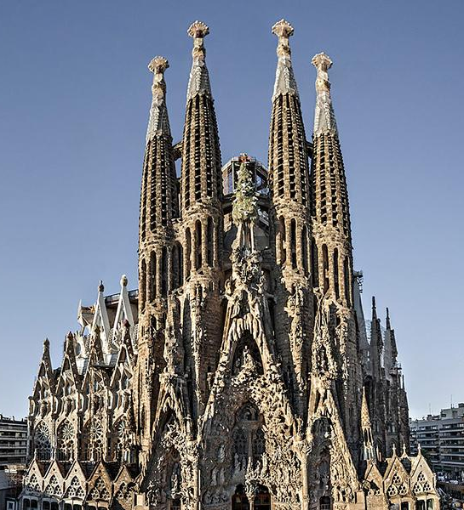
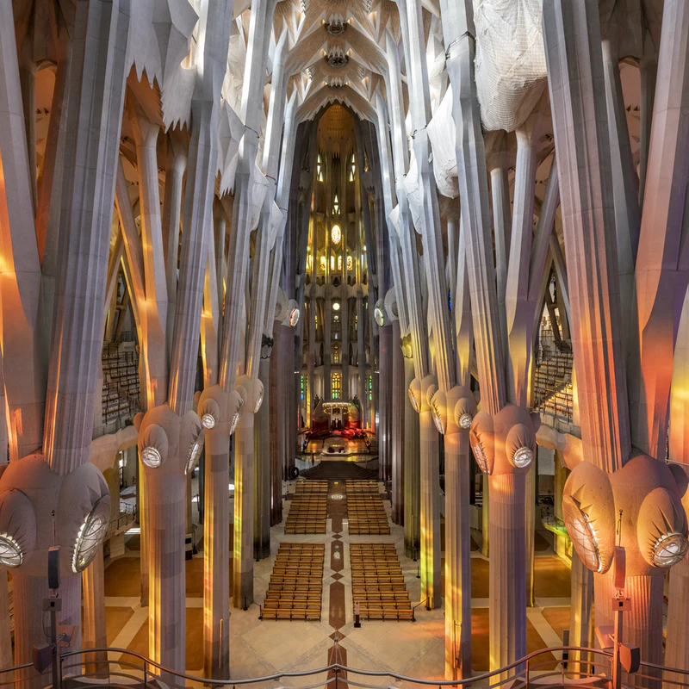
La Sagrada Familia, Barcelona, Spain. The project has been under construction since 1882. After 144 long years of construction, Spain's Sagrada Familia was finally slated for completion in 2026, the 100th anniversary of Antoni Gaudi's (the original architect) death.

Slide 7
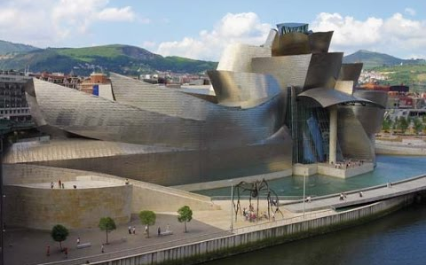
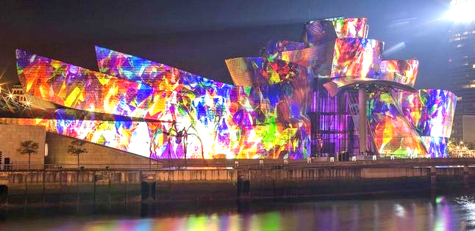
The Guggenheim Museum Bilbao is a museum of modern and contemporary art designed by Canadian-American architect Frank Gehry, and located in Bilbao, Basque Country, Spain. The museum was inaugurated on 18 October 1997 by King Juan Carlos I of Spain, with an exhibition of 250 contemporary works of art.

Slide 8
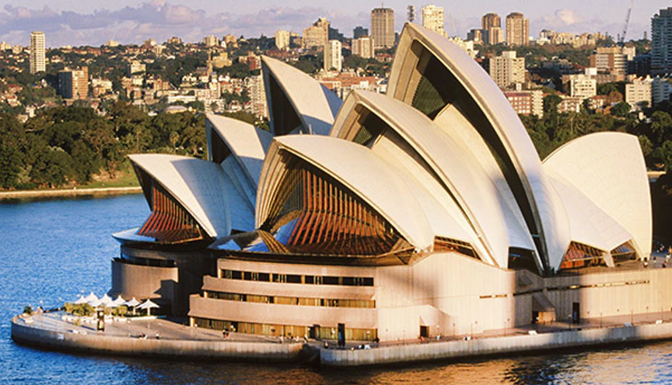
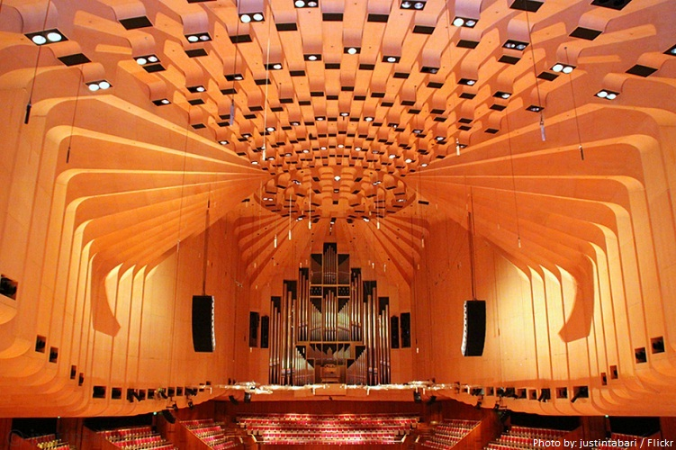
The Sydney Opera House, Sydney, Australia, is a multi-venue performing arts centre on Sydney Harbor located in Sydney, New South Wales, Australia. It is one of the 20th century's most famous and distinctive buildings. Designed by Danish architect Jørn Utzon but completed by an Australian architectural team headed by Peter Hall.
Construction started: 1 March 1959.

Slide 9
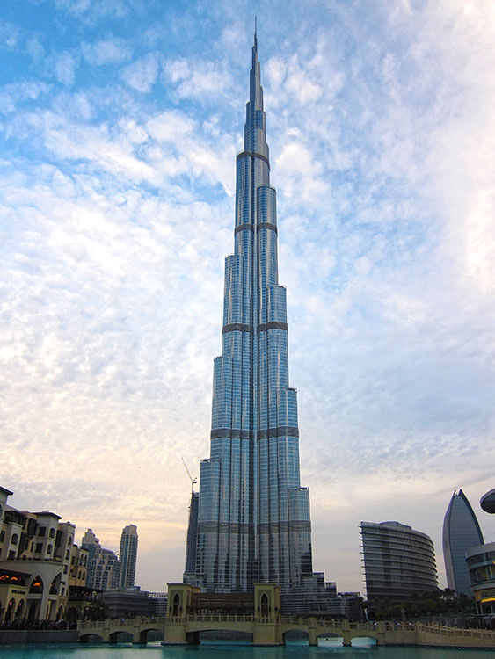
Construction started 6 January 2004
Topped-out 17 January 2009
Completed 1 October 2009
Opened 4 January 2010
Cost US$1.5 billion
Owner Emaar Properties
Height
Architectural 828 m (2,717 ft)
Tip 829.8 m (2,722 ft)
Top floor 584.5 m (1,918 ft)
Observatory 555.7 m (1,823 ft)
Burj Khalifa, Dubai, UAE, is the tallest tower in the world and it's one of the top attractions to visit in Dubai.

Slide 10
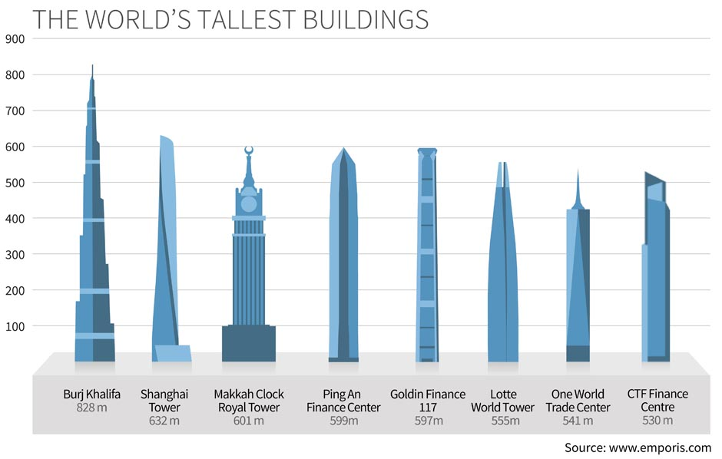
2 buildings including Sky City, 838 meters, in China and Jeddah Tower, 1000 meters in Saudi Arabia were started but construction on both has been at least temporarily halted.

Slide 11
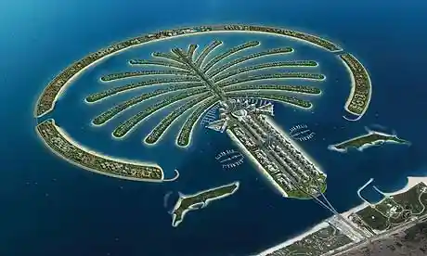
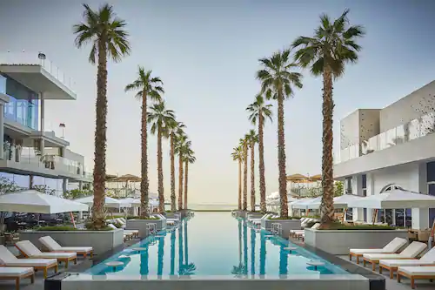
The tree-shaped Palm Jumeirah island is known for glitzy hotels, posh apartment towers and upmarket global restaurants. Food trucks offering snacks like shawarma dot the Palm Jumeirah Boardwalk, popular for its views of the Dubai coastline and the sail-shaped Burj Al Arab hotel. Beach clubs with spas and infinity pools turn into boisterous nightclubs with live DJs in the evening.

Slide 12
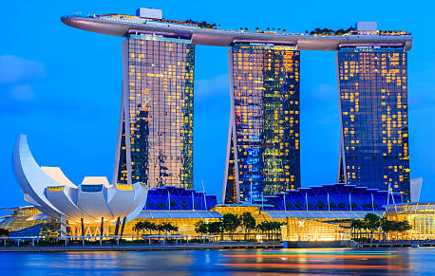
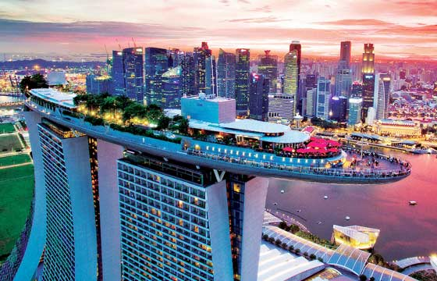
Marina Bay Sands, Singapore. Located along Marina Bay waterfront with 3 cascading hotel towers, 2,560 rooms, extraordinary Sands Sky Park, floating crystal pavilions, lotus-inspired Art Science Museum. Marina Bay Sands is an integrated resort. At its opening in 2010, it was billed as the world's most expensive standalone casino property at S$8 billion. Constructed about 2010.

Slide 13
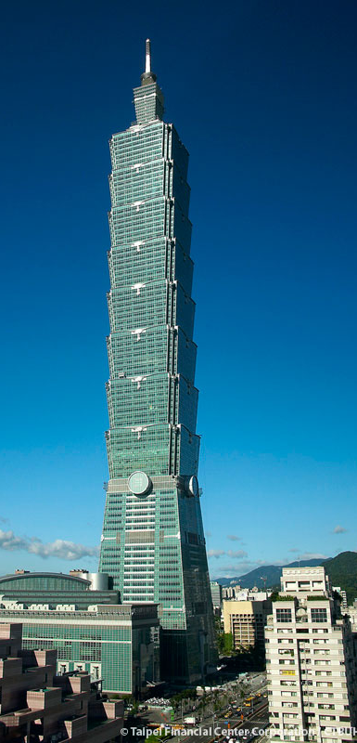
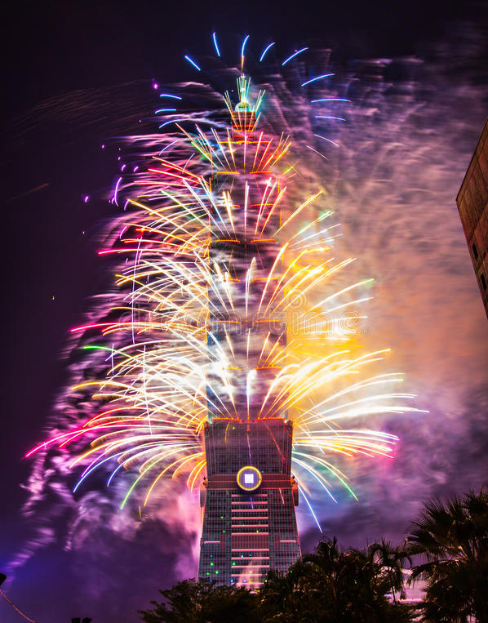
Taipei 101 displaced the Petronas Towers as the tallest building in the world by 57.3 m (188 ft). The record it claimed for greatest height from ground to pinnacle was surpassed by the Burj Khalifa in Dubai, which is 829.8 m (2,722 ft) in height. Construction of Taipei 101 began in 1999. The structure was topped out in 2003, and work was completed in 2004. Each evening a different color light is shone on the building representing the different days of the week. The outdoor observatory, is accessible by stairs from the 89TH floor, watch out for strong winds!
Fireworks!

Slide 14
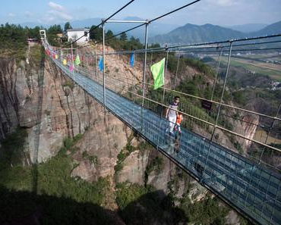
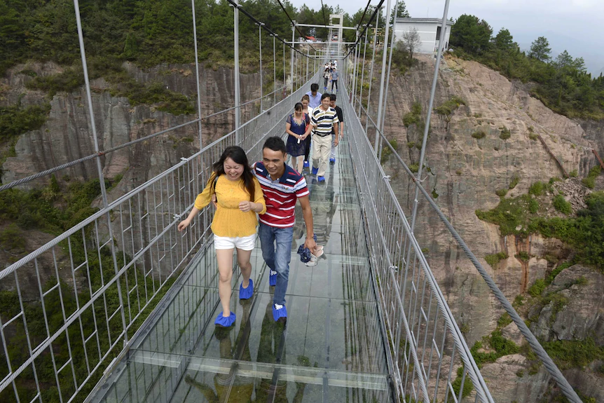
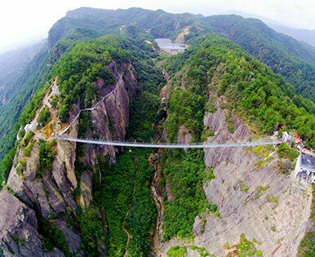
Haohan Qiao Bridge, China. This is the world’s longest glass bottomed bridge. Sufferers of vertigo are not going to have a good time, whatever you do- don’t look down. Or do as the thrill is in the clear, reinforced glass view of the surrounding national park. Known as Brave man’s bridge this is not for the faint hearted.

Slide 15
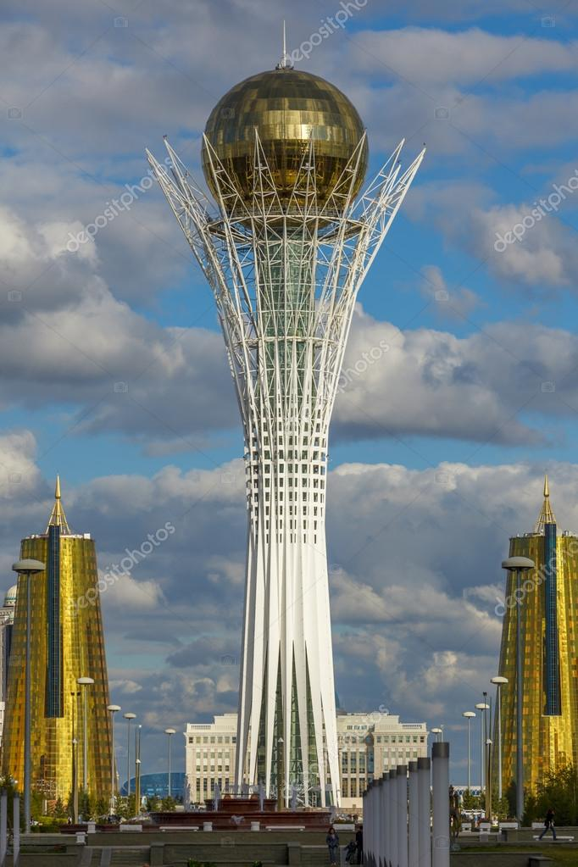
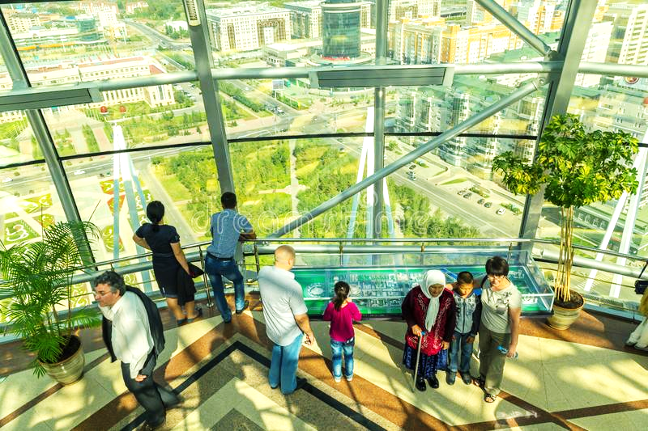
The striking Bayterek monument iin the capital Astana, Kazakhstan, was designed to represent a folk tale about the mythical tree of life and a magic bird of happiness named Samruk, who laid its egg in the crevice between two branches of a poplar tree. Construction started, 1996, opened 2002. Height - 97 m (318 ft).

Slide 16
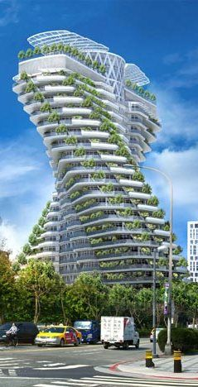
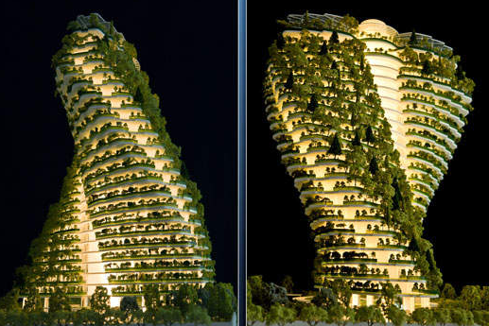
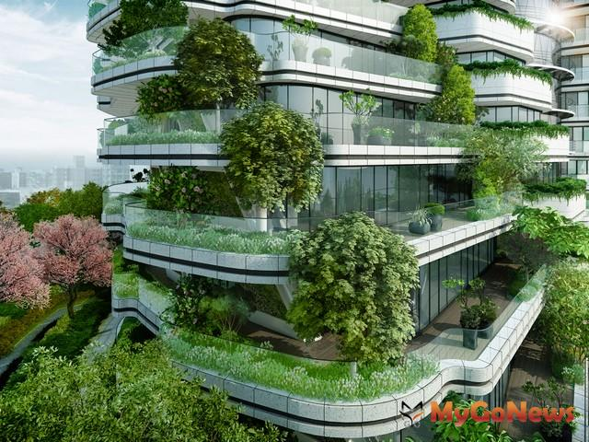
Agora Garden, Taipei. This incredible helix design is unlike anything you’ve seen before. The purpose of Vincent Callebau’s twist design is to create a series of hanging gardens. This energy efficient building hails a new generation of design. Built 2013- 2017. Height - 93.2 m (306 ft) with 21 floors above ground and four basement levels,

Slide 17
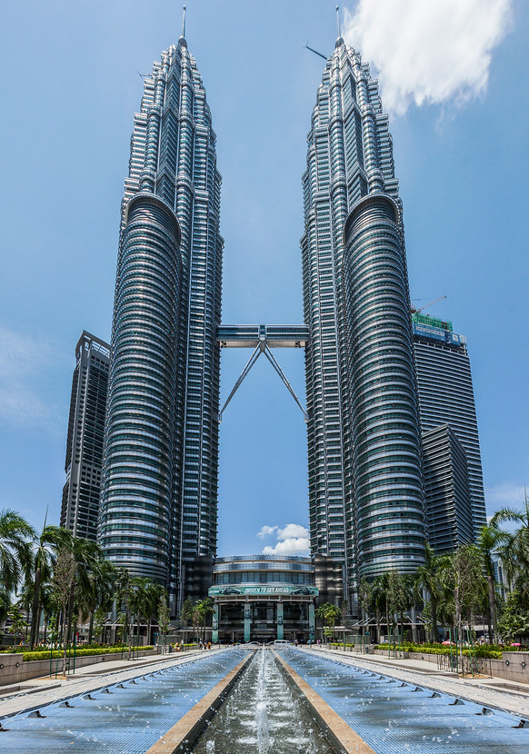
Petronas Towers, Kuala Lumpur, Malaysia. According to the Council on Tall Buildings and Urban Habitat's official definition and ranking, they were the tallest buildings in the world from 1998 to 2004 when they were surpassed by Taipei 101. Standing tall at a height of 452m, the Petronas Towers is the tallest twin tower in the world. The towers also feature a 58.4 m long bridge between the two towers. The glass panels of the twin towers come with special properties such as light filtering and noise reduction. The twin towers are a representation of cultural and economic growth in Malaysia.

Slide 18
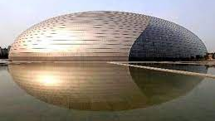
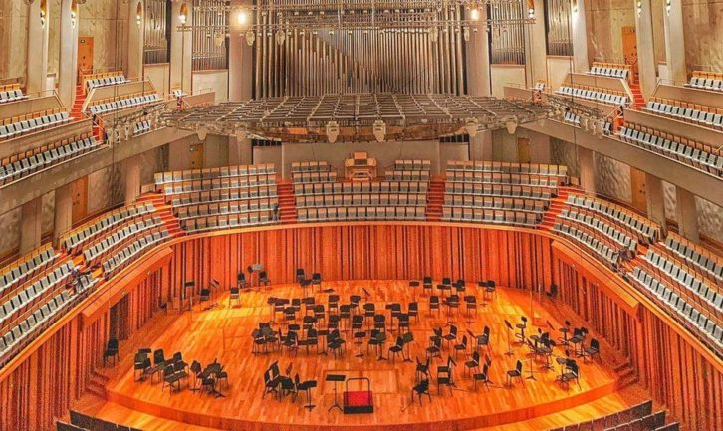
The National Centre for the Performing Arts, Beijing, China, and colloquially described as The Giant Egg, is an arts centre containing an opera house in Beijing, People's Republic of China. Designed by French architect Paul Andreu, the NCPA is the largest theatre complex in Asia. The NCPA was designed by French architect Paul Andreu, and houses an opera house capable of seating 2,398, a concert hall seating 2,019, a theatre seating 1,035, and a smaller multi-function theatre. Construction work began in 2001, and the inaugural concert was held in December 2007.

Slide 19
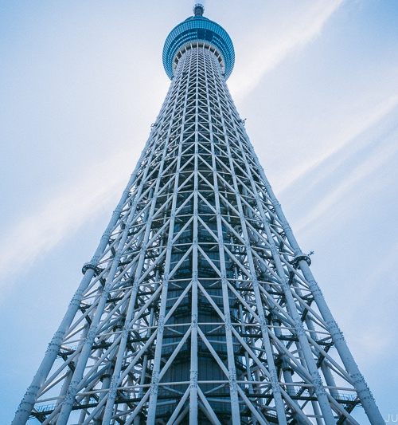
Tokyo Skytree is a broadcasting and observation tower in Sumida, Tokyo. It became the tallest structure in Japan in 2010 and reached its full height of 634 meters in March 2011, making it the tallest tower in the world, displacing the Canton Tower, and the second tallest structure in the world after the Burj Khalifa.

Slide 20
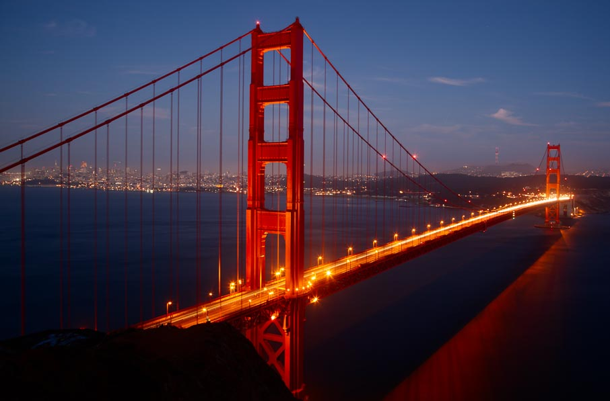
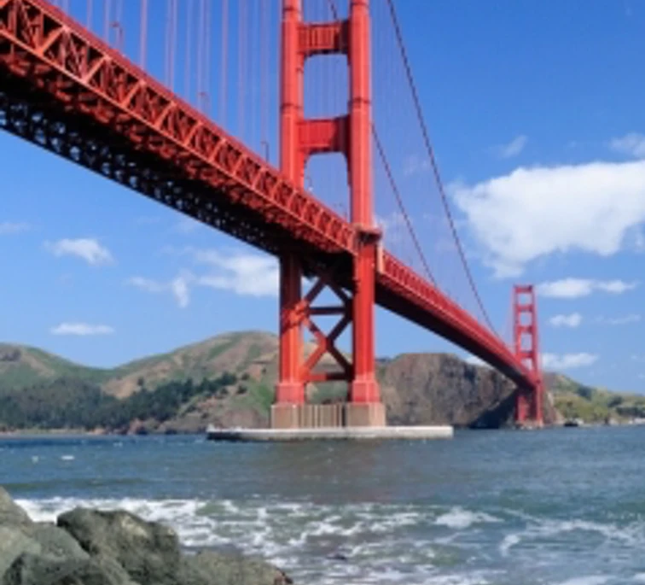
Golden Gate Bridge, San Francisco, California. Crossing the strait of the Golden Gate from San Francisco's Presidio to the Marin headlands for 1.7 miles is the Bridge, easily identified by its International Orange color. Opened in 1937, the bridge was built at a cost of $35 million in principal and $39 million in interest and 11 workers’ lives. The single-suspension span is anchored by twin towers that reach skyward 746 feet, and was once taller than any building in San Francisco.

Slide 21
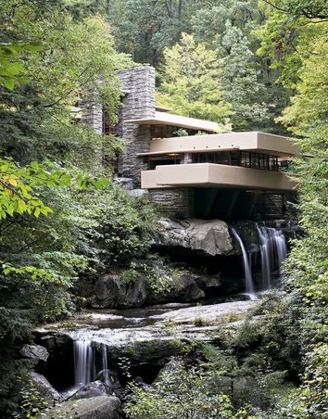
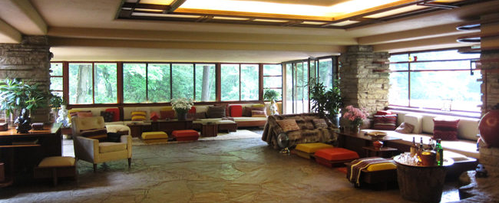
Fallingwater is a house designed by the architect Frank Lloyd Wright in 1939 in the Laurel Highlands of southwest Pennsylvania, about 70 miles southeast of Pittsburg. Perched above a mountain cataract on a rocky hillside deep in the rugged forest of Southwestern Pennsylvania, is America’s most famous house. The commission for Fallingwater was a personal milestone for the American architect Frank Lloyd Wright, since it clearly marked a turning point in his career. After this late-career triumph, the sixty-seven year old would go on to create a series of highly original designs that would validate his claim as “The world’s greatest architect.”

Slide 22
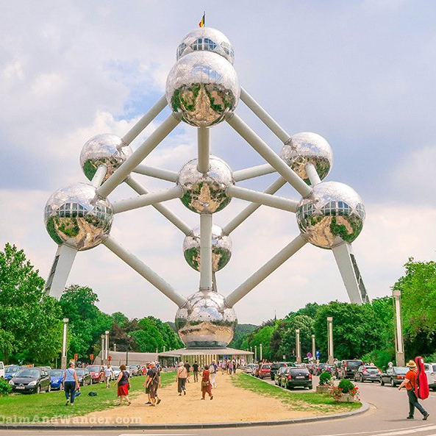
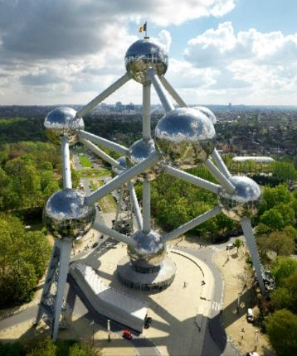
The Atomium, Brussels isa landmark building in Brussels, originally constructed for the 1958 Brussels World’s Fair. It is now a museum. Designed by the engineer André Waterkeyn and architects André and Jean Polak, it stands 102 meters tall.

Slide 23
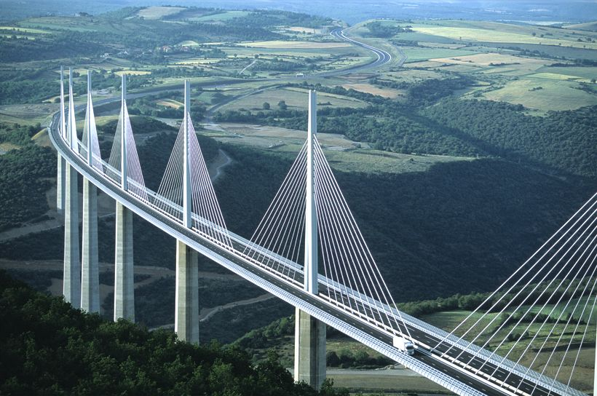
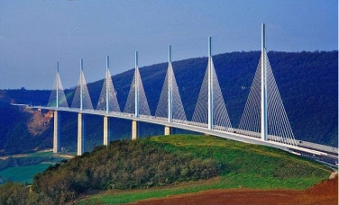
Millau Viaduct
The Millau Viaduct is a multispan cable-stayed bridge completed in 2004 across the gorge valley of the Tarn near Millau in the Aveyron department in the Occitanie Region, in Southern France. The design team was led by engineer Michel Virlogeux and English architect Norman Foster. As of September 2020, it is the tallest bridge in the world, having a structural height of 336.4 metres (1,104 ft).

Slide 24
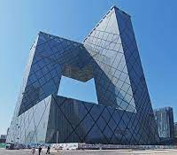
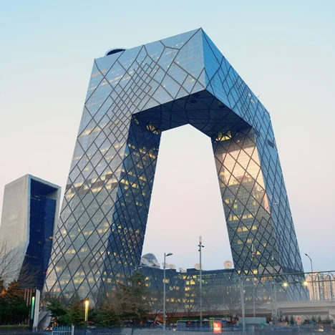
China Central Television Headquarters is a 234 meter tall building with a highly unusual shape, described as a 'three-dimensional cranked loop'. The building is formed by two leaning towers, bent 90° at the top and bottom to form a continuous tube. The design comes from architects Rem Koolhaas and Ole Scheeren with engineering handled by Cecil Balmond.

Slide 25
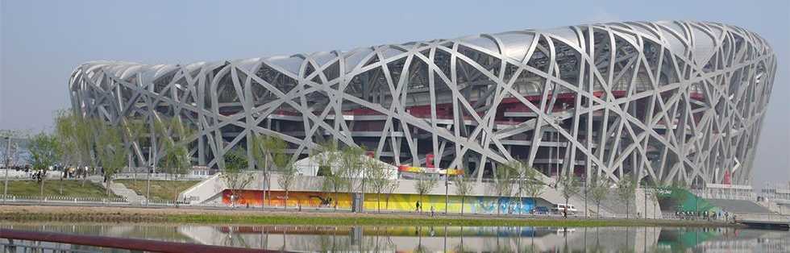
Built on the Olympic Green, Beijing National Stadium, China, or the Bird’s Nest Stadium, as it has become known, is the biggest stadium in Beijing and an important Olympic venue, which staged the 2008 Summer Olympics. The outer shell is the world's largest steel structure, forming part of the most complex Olympic stadium ever constructed.

Slide 26
One of the most decorated luxury hotels in the world, the Burj Al Arab in Dubai, was recently named the "best hotel in the world" by the Ultratravel Awards. The Burj has frequently been called "the world's first seven-star hotel" and "the most luxurious hotel in the world" by travel writers and critics. Height 321 meters, built 1994 – 1999.

Slide 27
Danfoss Universe (Cumulus Building) is a 5.5-hectare science museum park embedded in the agricultural landscape of Nordborg, Denmark, next to Danfoss headquarters and its founder’s home. It opened in May 2005 and is already enlarging due to its considerable success.

Slide 28
Sunrise Kempinski Hotel, Beijing, China. From a side angle view, the hotel building is shaped like a scallop which represents ‘Fortune’ in the Chinese culture. The front view is that of the ‘Rising Sun’ – Symbolic of the fast- developing economy of China. Opened 2014 with a spire height of 333m.

Slide 29
Capital Gate, also known as the Leaning Tower of Abu Dhabi, is a skyscraper in Abu Dhabi,UAE, that is over 160 meters tall, 35 stories high, with over 16,000 square meters of usable office space. Capital Gate was designed to incline 18° west.

Slide 30
Ferrari World Abu Dhabi is a mostly indoors theme park located on Yas Island in Abu Dhabi, United Arab Emirates. It was the world’s first Ferrari-themed park and features Formula Rossa, the world's fastest roller coaster.

Slide 31
QUEEN SOFIA PALACE OF ARTS. Palau de les Arts Reina Sofía is an opera house, performing arts centre, and urban landmark designed by Santiago Calatrava to anchor the northwest end of the City of Arts and Sciences in Valencia, Spain. It opened on 8 October 2005.

Slide 32
HOPE TO SEE YOU AGAIN SOON
For a plethora of online quizzes and challenges appropriate for individuals or groups, please visit:
http://murov.info
or
http://murov.info/triviachallenges.htm
or
http://murov.info/PPTPreshows.htm
Visit http://murov.info/arch.pptx for pre-modern architecture.

