Slide 1
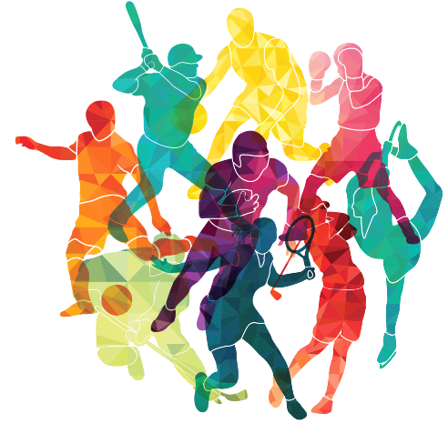
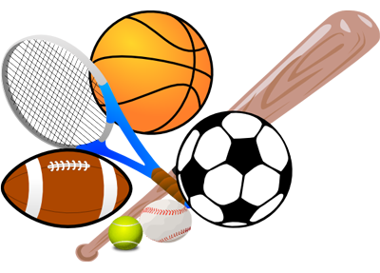
43 of the Most Prominent Athletes of Modern Time
A question and answer PowerPoint presentation about the most prominent athletes of modern time. Selection of the athletes was based on a consensus of Internet lists. The order of presentation was selected randomly and does not represent any kind of ranking.
For a similar exercise on 21st century athletes, please visit:
http://murov.info/athletes21cent.pptx

Slide 2
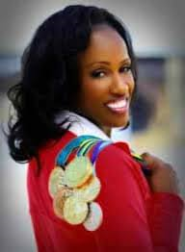
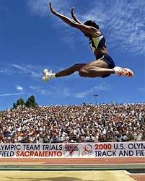
Ranked among the all-time greatest athletes in the heptathlon as well as long jump.
She won three gold, one silver, and two bronze Olympic medals, in the heptathlon and the long jump at four different Olympic Games (1984 – 1996).
Jackie Joyner Kersee

Slide 3
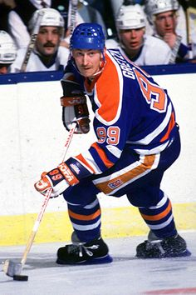
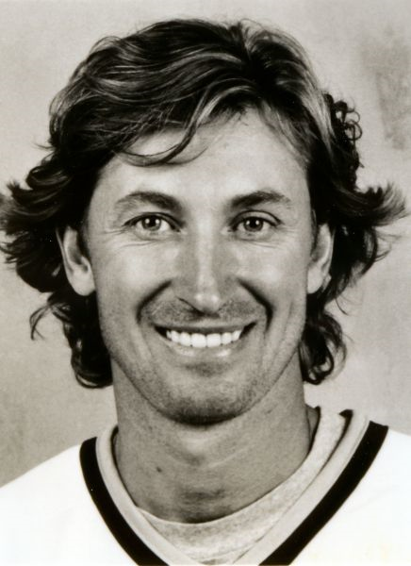
Began skating at age two and a half and was first taught hockey by his father. By age 6 he was playing as an all-star in novice hockey with boys 10 and 11 years old.
His finesse and speed revolutionized the sport, which had been known for its physical play. In his first season with the Oilers, he scored 51 goals and 86 assists (137 total points). In the 1980–81 season he became the first player in NHL history to average more than two points a game.
Wayne Gretzky
He is considered by many to be the greatest player in the history of the National Hockey League and was nicknamed The Great One.

Slide 4
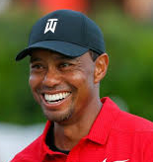
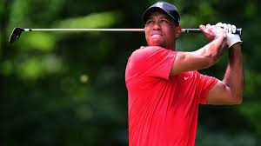
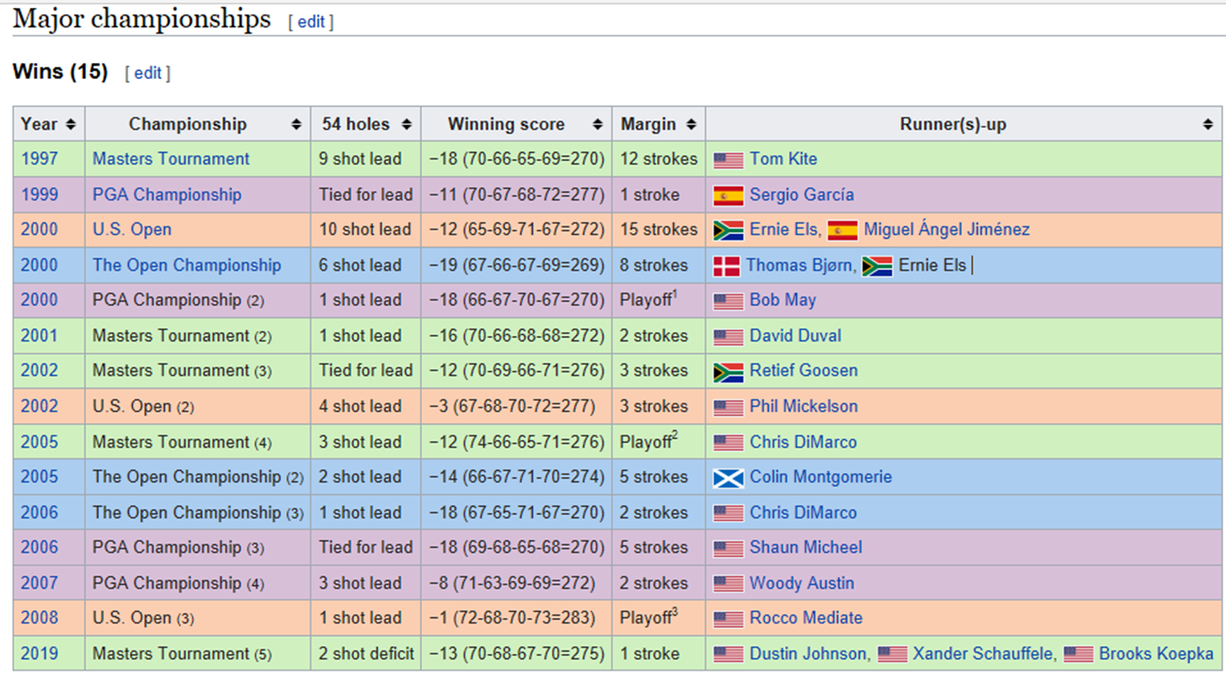
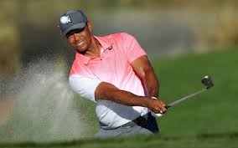
Ranks second in both major championships (15) and PGA Tour (81) wins and also holds numerous records in golf.
With his victory at the 2019 Masters, He claimed his first major title in nearly 11 years.
TIGER WOODS

Slide 5
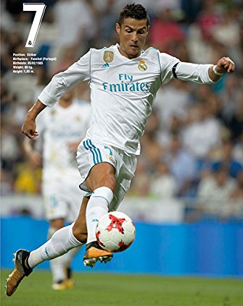
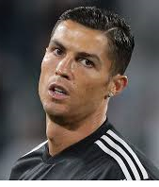
Often considered the best player in the world and widely regarded as one of the greatest players of all time of ….
soccer.
A Portuguese professional footballer who has played for Manchester United, Real Madrid and Portugal.
His sustained performance has enabled him to break numerous records for goal scoring and has been named FIFA player of the year (Ballon d’Or) five times.
Christiano
Ronaldo

Slide 6
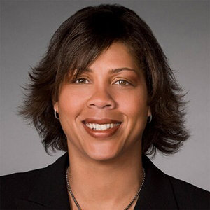
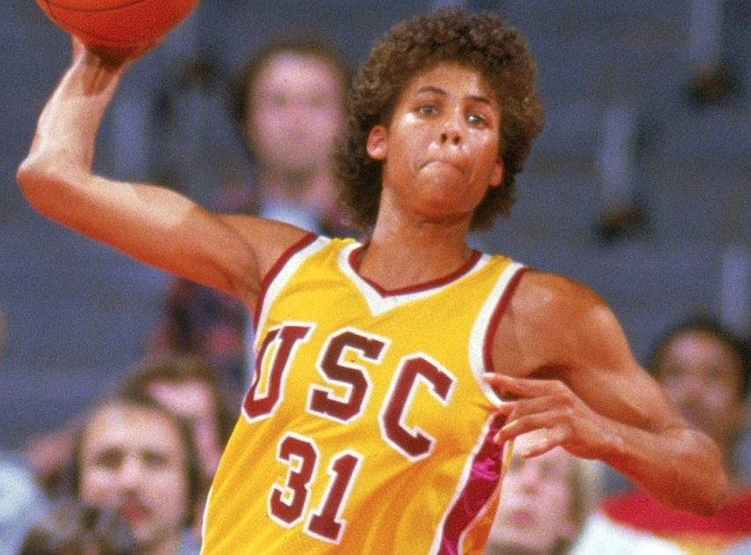
The women's basketball coach at Cal State LA and a former college basketball player and sportscaster for TNT.
She was a four-time college All-American and three-time national Player of the Year, along with being a member of the 1984 gold medal-winning Olympic team.
The first woman to dunk in organized play and one of the greatest players in the history of women's basketball.
Cheryl Miller

Slide 7
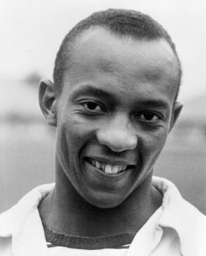
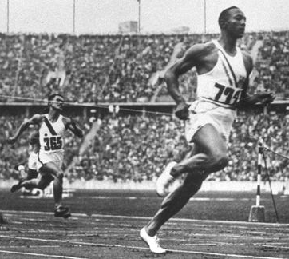
Specialized in the sprints and the long jump, and was recognized in his lifetime as "perhaps the greatest and most famous athlete in track and field history. Set a long jump world record of 26 ft., 8 inches that lasted 25 years.
Jesse Owens
Known as "The Buckeye Bullet," he was an American track and field athlete who won four gold medals and broke two world records at the 1936 Olympic Games in Berlin.

Slide 8
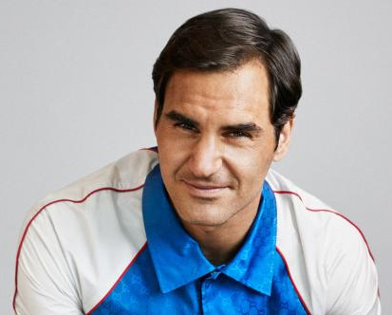
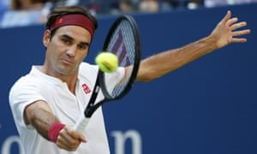
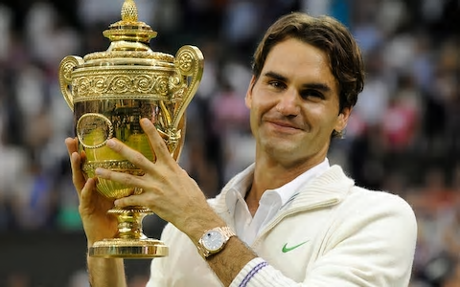
ROGER
FEDERER
Among his country's top junior tennis players by age 11. He turned pro in 1998, and with his victory at Wimbledon in 2003 he became the first Swiss man to win a Grand Slam singles title.
Has won a record-setting 20 Grand Slam singles championships.

Slide 9
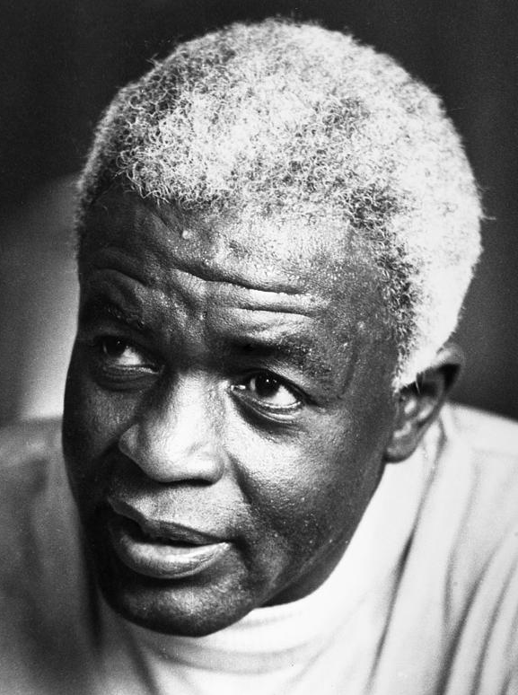
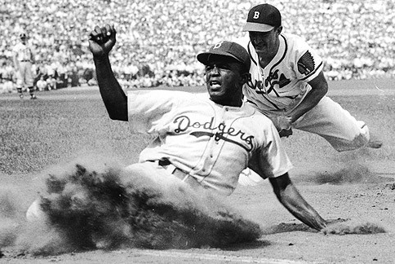
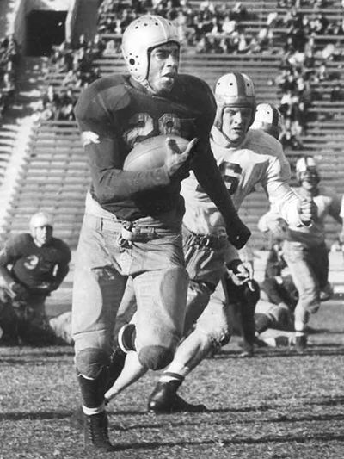
At UCLA, he became the first athlete to win varsity letters in four sports: baseball, basketball, football and track. In 1941, he was named to the All-American football team.
Jackie Robinson
An American professional baseball player who became the first African American to play in Major League Baseball in the modern era. He broke the baseball color line when the Brooklyn Dodgers started him at first base on April 15, 1947.
At the end of his rookie season with the Brooklyn Dodgers, he had become National League Rookie of the Year with 12 homers, a league-leading 29 steals, and a .297 average. In 1949, he was selected as the NL’s MVP and also won the batting title with a .342 average that same year. As a result of his great success, Jackie was eventually inducted into the Baseball Hall of Fame in 1962.

Slide 10
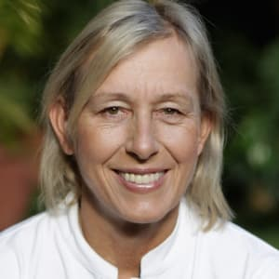
She won 18 Grand Slam singles titles, 31 major women's doubles titles (an all-time record), and 10 major mixed doubles titles, combined marking the open-era record for the most number of Grand Slam titles won by one player, male or female.
Tennis magazine selected her as the greatest female tennis player for the years 1975 through 2005 and she is considered one of the best female tennis players of all time.
Martina Navratilova

Slide 11
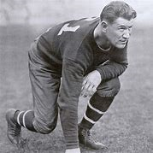
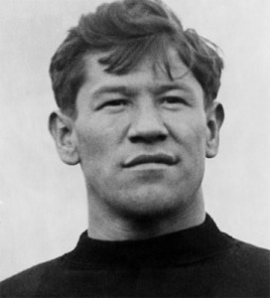
A member of the Sac and Fox Nation, he was voted "The Greatest Athlete of the First Half of the 20th Century" by the Associated Press and became a charter member of the Pro Football Hall of Fame.
Played major-league baseball for six seasons, the 6-foor-1, 185-pounder was an Olympic champion in the pentathlon and decathlon and at one point the greatest American football player in history (played for the Canton Bulldogs during the 1915, 1916, 1917, 1919, and 1920 seasons, leading a team that many recognized as the best in the country.
Sir, you are the greatest athlete in the world," declared Sweden's King Gustav in 1912. After the Games, however, he was forced to return his medals and trophies when the Amateur Athletic Union discovered that he had played minor-league baseball.
Jim Thorpe

Slide 12
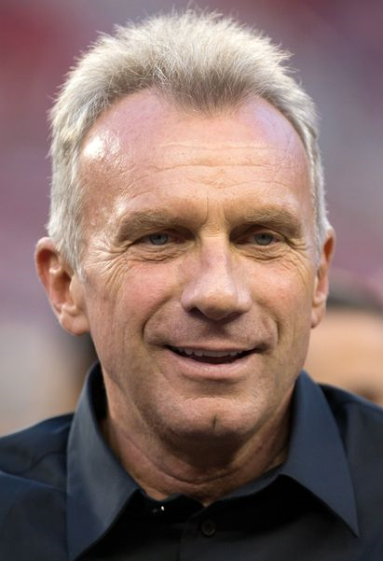
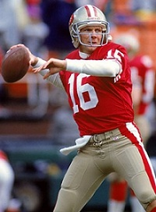
Nicknamed Joe Cool and The Comeback Kid. Considered by many experts to be the greatest quarterback in the history of NFL football.
Led the 49ers to victories in four Super Bowls, including consecutive wins in 1989 and 1990. earned a reputation as one of the top quarterbacks ever to play professional football, first rising to fame in the 1980s.
) Joe Montana

Slide 13
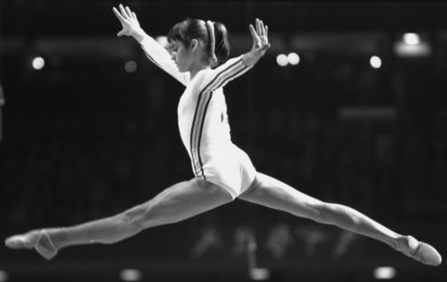
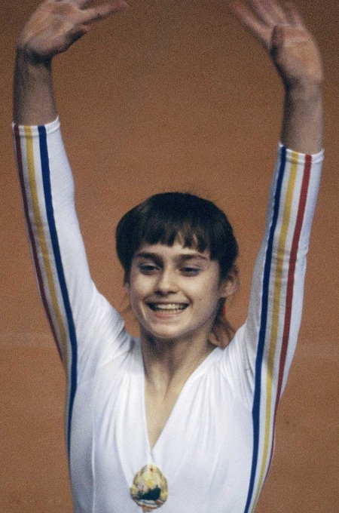
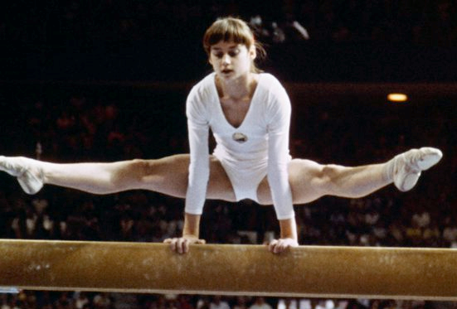
A five-time Olympic gold medalist, all in individual events.
Nadia Comaneci
First gymnast to be awarded a perfect score of 10.0 at the Olympic Games(1976), and then, at the same Games, she received six more perfect 10s en route to winning three gold medals.

Slide 14
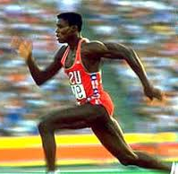
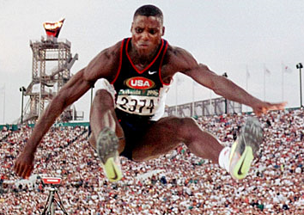
Carl Lewis
American former track and field athlete who won nine Olympic gold medals in four Olympics (2 in the 100 m, 1 in the 200m, 2 in the 4x100m, and 4 in the long jump), one silver medal, and 10 World Championships medals, including eight gold.

Slide 15
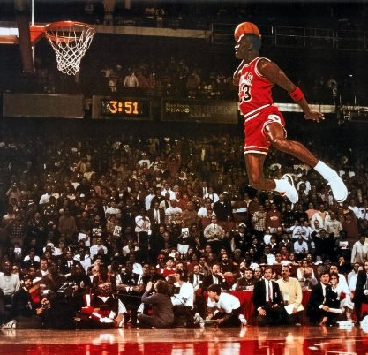
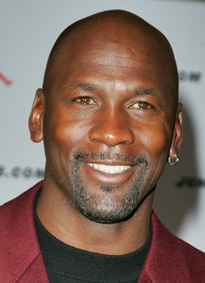
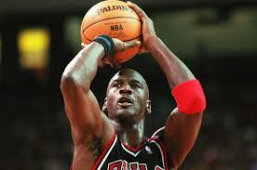
Hit the game-winning shot in the 1982 NCAA national title game. In addition to basketball, he played minor league baseball and was a much better than average golfer.
Michael Jordan
Won six titles with the Chicago Bulls.
Regarded by many as the NBA's greatest all-time player.

Slide 16
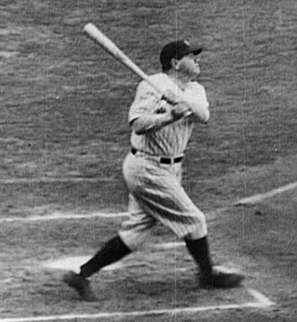
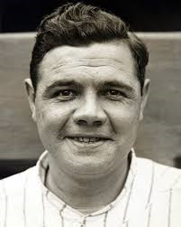
American professional baseball player whose career in Major League Baseball (MLB) spanned 22 seasons, from 1914 through 1935.
Babe Ruth
Holds the record for the most seasons (11) with 40+ home runs in MLB. In 1927 when, as a member of “Murderer’s Row”, he set a new home run record of 60, a record that would stand for 34 years.

Slide 17
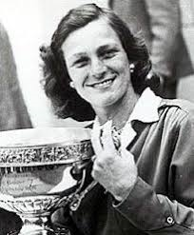
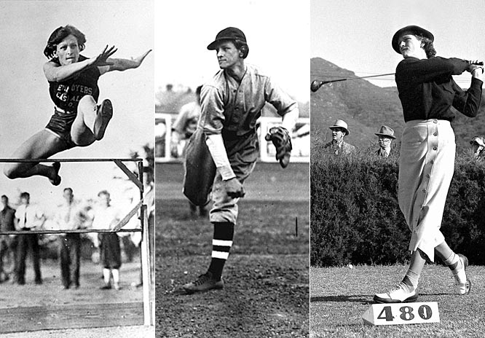
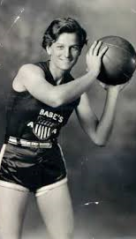
An American athlete who excelled in golf, basketball, baseball and track and field.
Won two gold medals in track and field at the 1932 Summer Olympics, before turning to professional golf and winning 10 LPGA major championships and a total of 82 wins.
Earned her nickname "Babe" by hitting five home runs in one childhood baseball game.
Babe Didrikson Zaharias

Slide 18
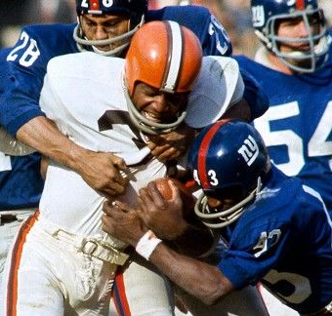
A running back for the Cleveland Browns of the National Football League from 1957 through 1965.
Jim Brown
Carried the ball 2,359 times for 12,312 rushing yards and 106 touchdowns, which were all records when he retired.

Slide 19
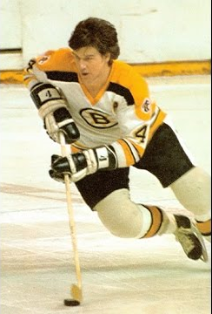
Used his ice skating speed, scoring, and play-making abilities to revolutionize the position of a defense man. For two seasons he was the leading scorer in the entire National Hockey League (NHL)
BOBBY ORR
From the time he joined the Boston Bruins at the age of eighteen, he revolutionized the way hockey was played. He kept possession of the puck rather than simply clearing it, and he frequently crossed the blue line to participate in offensive plays.

Slide 20
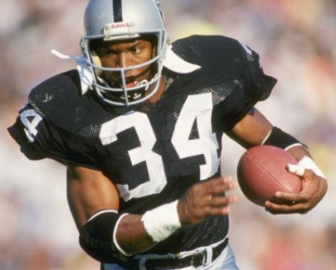
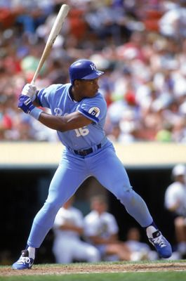
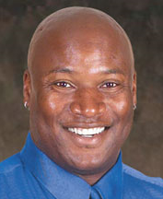
Starred for the Kansas City Royals of Major League Baseball and the Los Angeles Raiders of the National Football League (NFL) during his short but storied professional career and is widely considered one of the greatest all-around athletes in history.
Bo Jackson
Only athlete in history to be named an All-Star in both baseball and football.

Slide 21
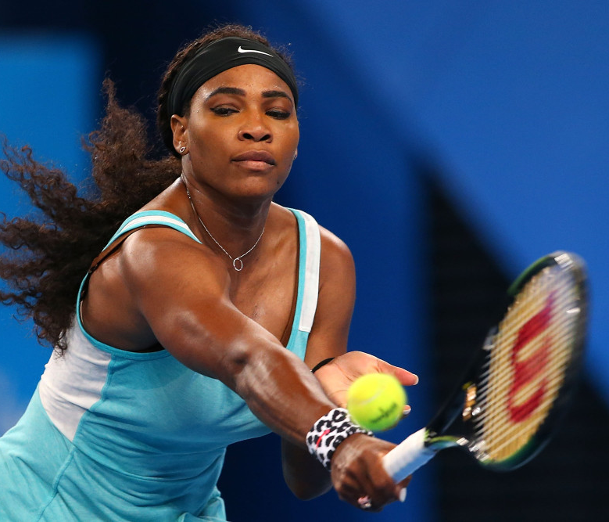
Serena
Williams
The Women's Tennis Association ranked her world No. 1 in singles on eight separate occasions between 2002 and 2017.
Revolutionized women's tennis with her powerful style of play and won more Grand Slam singles titles (23) than any other woman or man during the open era.

Slide 22
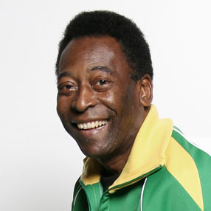
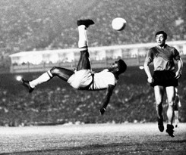
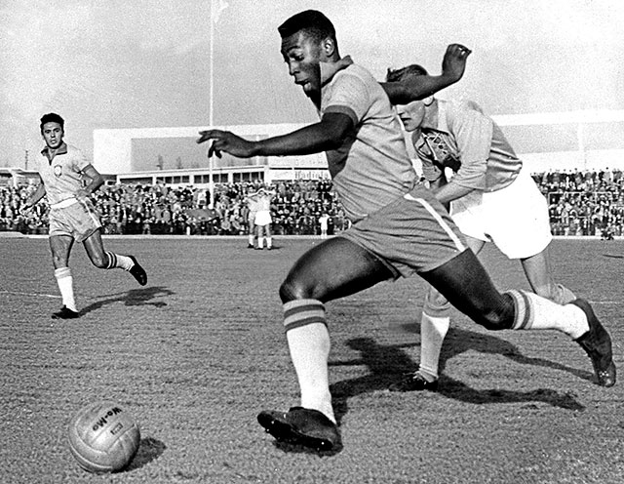
Pele
Edson Arantes do Nascimento
The most iconic footballer of the Twentieth Century.
Brazilian soccer legend who became a superstar with his performance in the 1958 World Cup. He played professionally in Brazil for two decades, winning three World Cups along the way,

Slide 23
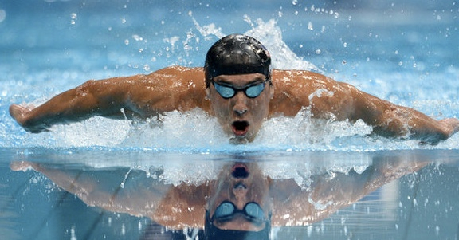
Michael
Phelps
Most successful and most decorated Olympian of all time, with a total of 28 medals including a record 23 gold and was the first athlete to win eight gold medals at a single Olympics.
At the end of the 2008 Olympics, he held 7 world records and 1 Olympic record in swimming. He still holds six world records (three individual and three relays).

Slide 24
Usain
Bolt
He became the first junior sprinter to break 20 seconds for the 200 metres.
Arguably the fastest man ever timed, winning three gold medals at the 2008 Olympic Games in Beijing, China, and becoming the first man in Olympic history to win the 100-meter and 200-meter and 4x100m races in world record times.
Created history at the 2016 Olympic Games in Rio when he achieved the ‘Triple Triple’, three gold medals at three consecutive Olympic Games.

Slide 25
The first African American athlete to cross the color line of international tennis.
For a short time, she turned to golf, making history again as the first African American woman ever to compete on the pro tour.
First African American to win a Grand Slam title (the French Championships).
Althea Gibson

Slide 26
Widely regarded as one of the most significant and celebrated sports figures of the 20th century and as one of the greatest boxers of all time.
Muhammad Ali
An American professional boxer, activist, and philanthropist. He was nicknamed "The Greatest.“
An Olympic gold medalist and the first fighter to capture the heavyweight title three times, He won 56 times in his 21-year professional career.

Slide 27
WILLIE
MAYS
Famous for “the Catch.”
Celebrated for his superb all-around play, he was twice named MVP and finished among the all-time leaders in home runs and hits.
Ncknamed "The Say Hey Kid", is an American former Major League Baseball center fielder who spent almost all of his 22-season career playing for the New York/San Francisco Giants.

Slide 28
DAN GABLE
At Iowa State, he won 117 wrestling matches in a row, along with two NCAA championships and three All-America titles. In his career, he compiled an unbelievable record of 181-1.
A world gold medalist, and an Olympic gold medalist.

Slide 29
Steffi Graf
She won 22 Grand Slam singles titles, and more than one hundred tournament victories in all. Her titles include 7 Wimbledon victories, 6 victories at Roland Garros, 5 in the US Open, 4 at the Australian Open and 5 WTA Tour Championships.
Her best year was 1988 when she became the first woman in 18 years to win all Grand Slam tournaments in a single season.

Slide 30
Deion
Sanders.
His other nickname is Neon Deion.
One of his nicknames is
Prime Time.
Athlete who played professional football and baseball and is the only person to play in both a Super Bowl and the World Series.

Slide 31
He was the founder of the hybrid martial arts Jeet Kune Do.
Lee Jun-fan known professionally as
Bruce Lee (Chinese: 李小龙)
Considered by commentators, critics, media, and other martial artists to be the most influential martial artist and pop culture icon of the 20th century, who bridged the gap between East and West.

Slide 32
Led UCLA to three
national basketball titles.
The NBA's all-time leading scorer. He won six NBA titles, five with the Los Angeles Lakers, over 20 years and was MVP a record 6 times.
KAREEM ABDUL-JABBAR

Slide 33
SUGAR RAY
ROBINSON
Six times a world champion: once as a welterweight (147 pounds), from 1946 to 1951, and five times as a middleweight (160 pounds), between 1951 and 1960. He is considered by many authorities to have been the best fighter in history.
Amassed 175 wins in boxing including 110 knockouts and just 19 losses.

Slide 34
Mia Hamm
Former American soccer player who competed on the U.S. women's national soccer team for 17 years.
She was on the winning Women's World Cup team in 1991 and 1999, and took home Olympic gold medals in 1996 and 2004.

Slide 35
Lebron James
With his unique combination of size, athleticism and court vision, he became a four-time NBA MVP.
He is often considered the best basketball player in the world and regarded by some as the greatest player of all time.

Slide 36
Donald
Bradman
Australian, widely acknowledged as the greatest batsman of all time.
Test batting average of 99.94 has been cited as the greatest achievement by any sportsman in any major sport.

Slide 37
Hank
Aaron
The baseball slugger who broke Babe Ruth's legendary record of 714 homers.
Retired as the all-time leader in career home runs after playing from 1954 to 1976 with the Milwaukee/Atlanta Braves and the Milwaukee Brewers.

Slide 38
Joe Namath
Broadway Joe
Ranked as one of the greatest players of the NFL, he is a legendary quarterback. He completed 1,886 passes for 27,663 yards, threw 173 touchdowns, and had 220 interceptions, for a career passer rating of 65.5.
His guarantee that came true of victory over the Baltimore Colts in the third Super Bowl helped make the game the media event that it continues to be today. He played for three division champions (the 1968 and 1969 AFL East Champion Jets and the 1977 NFC West Champion Rams), earned one league championship (1968 AFL Championship), and one Super Bowl victory (Super Bowl III).

Slide 39
Yelena Isinbayeva
She is a two-time Olympic gold medalist, a three-time World Champion, the current world record holder in the event, and is widely considered the greatest female pole-vaulter of all time.
Russian pole-vaulter who achieved numerous world records and became the first woman to clear the 5-metre (16-foot 4.75-inch) mark in the sport's history.

Slide 40
Jack
Nicklaus
Won two U.S. Amateur titles while attending Ohio State University. After turning pro in 1961, the "Golden Bear" won six Masters Tournaments, five PGA Championships, four U.S. Open titles and three British Opens for a record 18 major championships.
Many observers regard him as the greatest golfer of all time, a dominating figure in world golf from the 1960s to the '80s.

Slide 41
Julius Erving, Dr. J
An American retired basketball player who helped popularize a modern style of play that emphasizes leaping and playing above the rim. He became known for his style and grace on and off the court during his 16-year professional basketball career.
Won three championships, four Most Valuable Player Awards, and three scoring titles with the ABA's Virginia Squires and New York Nets (now the NBA's Brooklyn Nets) and the NBA's Philadelphia 76ers. He is the eighth-highest scorer in ABA/NBA history with 30,026 points (NBA and ABA combined).

Slide 42
Rafer
Johnson
USA team's flag bearer at the 1960 Olympics and lit the Olympic flame at the Los Angeles Games in 1984.
He was the 1960 Olympic gold medalist in the decathlon, having won silver in 1956 with an injured knee. He had previously won a gold in the 1955 Pan American Games.

Slide 43
Jean-Claude
Killy
He was a triple Olympic champion, winning the three alpine events at the 1968 Winter Olympics, becoming the most successful athlete there.
In the 1960-1961 season, he won the slalom, giant slalom, downhill, and combined gold medals in the French junior championships.

Slide 44
He delivered the fastball with the speed of a locomotive, hence the name "Big Train." His control was phenomenal, most thought because he lived in daily fear of injuring another player with his awesome speed.
Walter Johnson
He recorded statistics which seem beyond belief — 417 wins and 279 losses, 3,509 strikeouts, 110 shutouts, 12 20-win seasons, 11 seasons with an earned run average below 2.00, and what seems almost incomprehensible a century later, 531 complete games in 666 starts.

Slide 45
If you have suggestions or comments, please send an e-mail to murovs@yosemite.edu . For a similar PowerPoint presentation on the most prominent athletes of the 21st century, please visit:
http://murov.info/athletes21stcent.pptx
For many other PowerPoint exercises, please visit: http://murov.info/PPTPreshows.htm
Selection of athletes was based primarily on a consensus of web sites including those listed below.
https://list25.com/25-most-iconic-athletes-in-the-history-of-sports/
https://bleacherreport.com/articles/130288-the-25-greatest-athletes-of-all-time
https://thegruelingtruth.net/top10/20-greatest-athletes-time/
https://www.ranker.com/list/most-influential-athletes-of-all-time/ranker-sports

