Slide 1
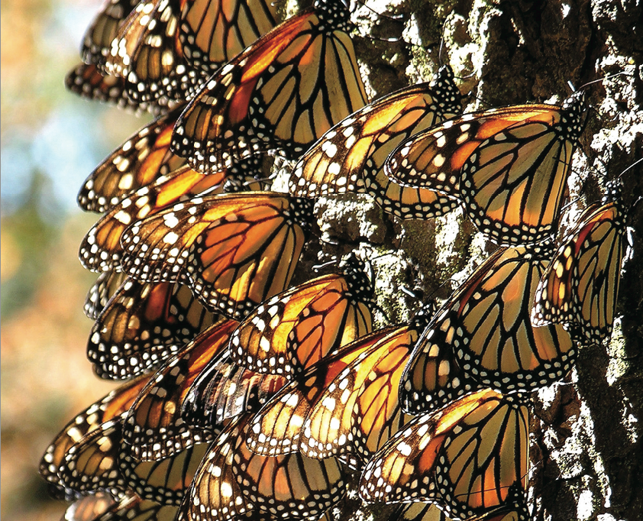
BUTTERFLIES OF NORTH AMERICA
Name the butterfly.

Slide 2
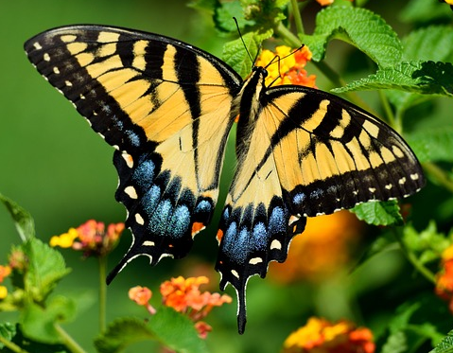
Tiger Swallowtail

Slide 3
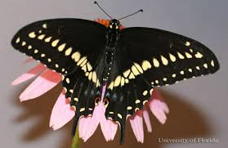
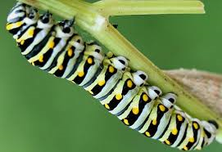
Black Swallowtail

Slide 4
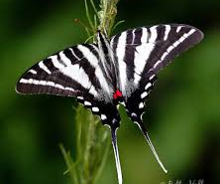
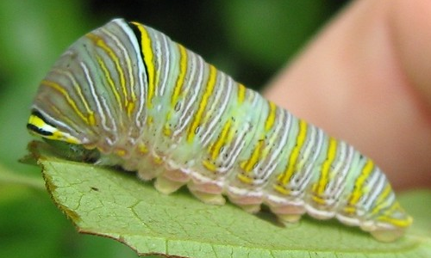
Zebra Swallowtail

Slide 5
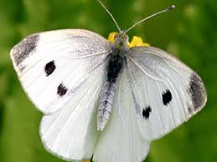
Cabbage White

Slide 6
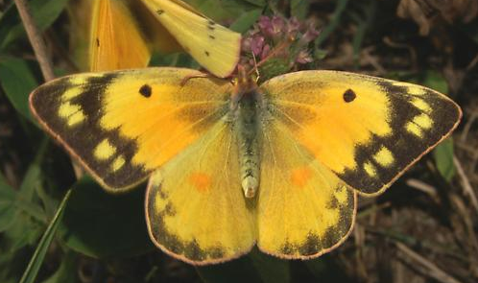
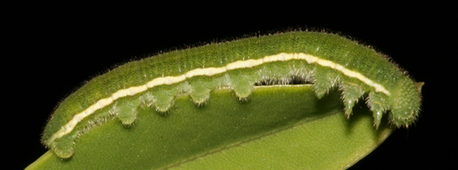
Orange Sulphur

Slide 7
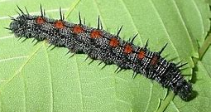
Mourning Cloak

Slide 8
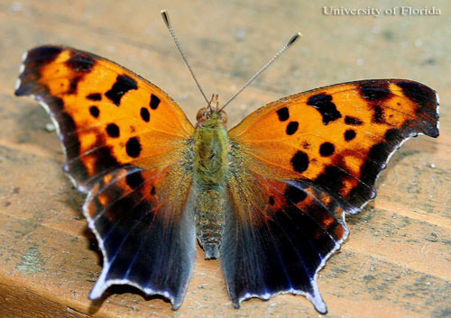
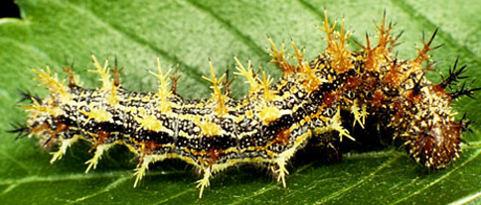
Question Mark and Comma

Slide 9
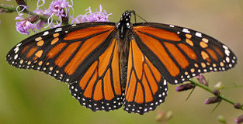
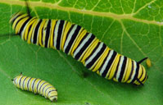
Monarch
The monarch butterfly or simply monarch is a milkweed butterfly in the family Nymphalidae. The body of a monarch butterfly contains chemicals that make it taste bad—so bad that a bird may even vomit if it eats one. That's a great protection for monarch butterflies because birds quickly learn not to eat them.

Slide 10
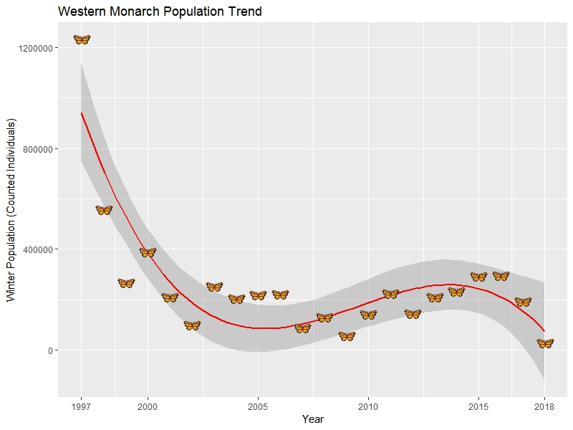
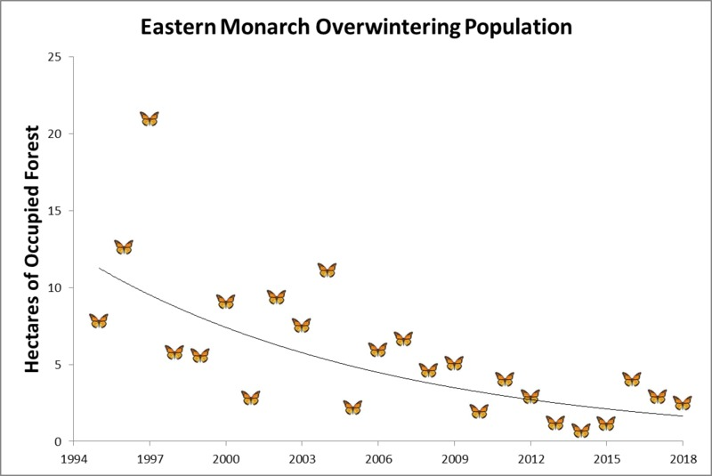
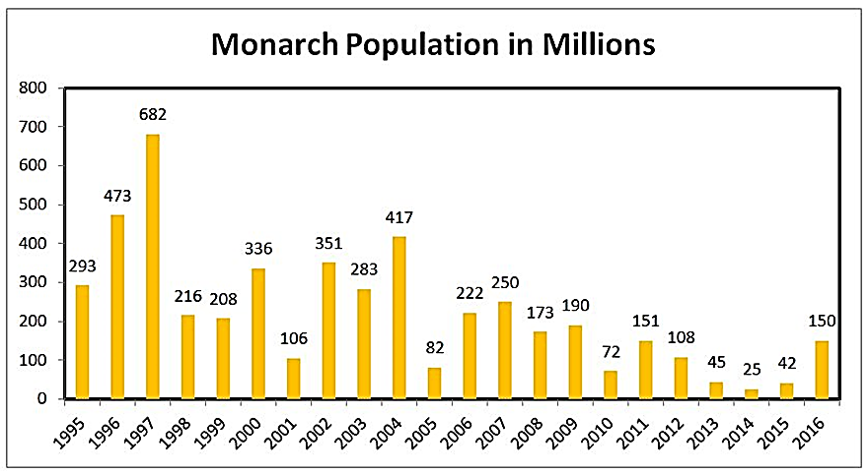
Declining monarch butterfly populations.

Slide 11
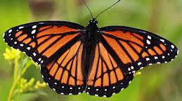
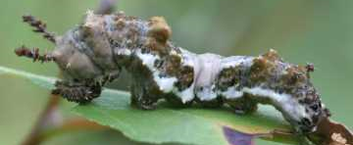
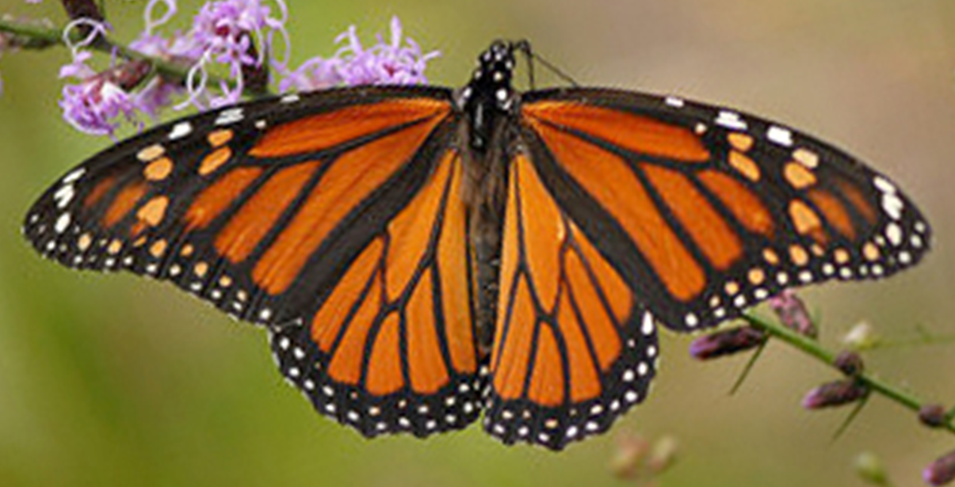
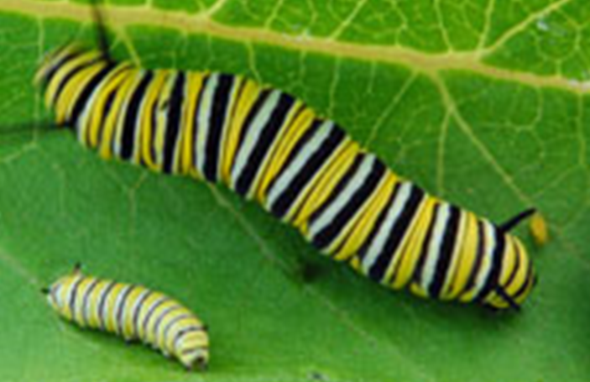
The main visual difference between the viceroy and monarch butterfly is the black line drawn across the viceroy's hind wings, which monarch butterflies do not have. The viceroy is also a bit smaller than the monarch. The caterpillars of monarchs and viceroys are significantly different in appearance as well. It was long believed that the Viceroy used Batesian mimicry- “mimicry in which an edible animal is protected by its resemblance to a noxious one that is avoided by predators.” However, it was found that the viceroy feeds on Willow species (cottonwood, willow, poplar trees) which contain salicylic acid, the active ingredient in aspirin and make them taste bitter to avian predators.
Viceroy
Monarch

Slide 12
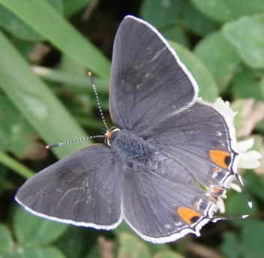
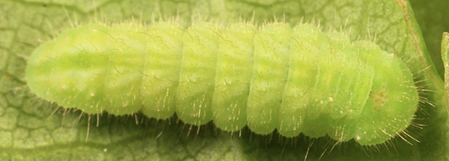
Gray Hairstreak

Slide 13
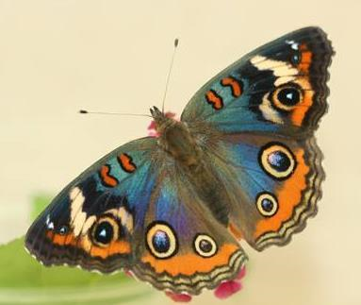
Buckeye

Slide 14
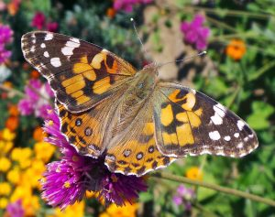
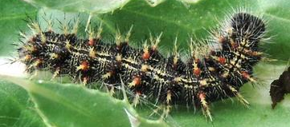
Painted Lady

Slide 15
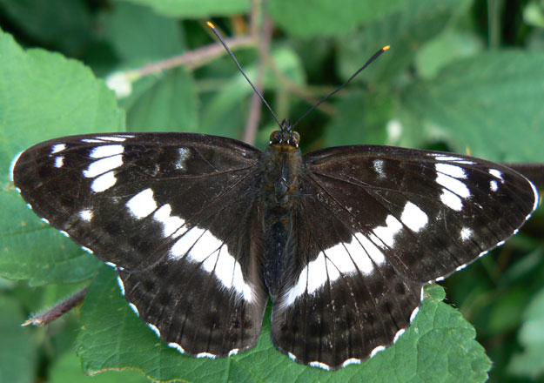
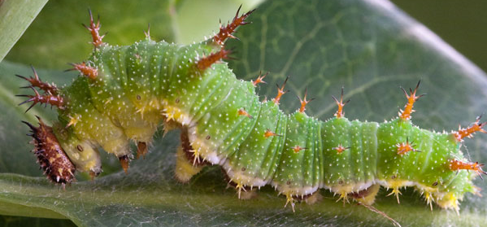
White Admiral

Slide 16
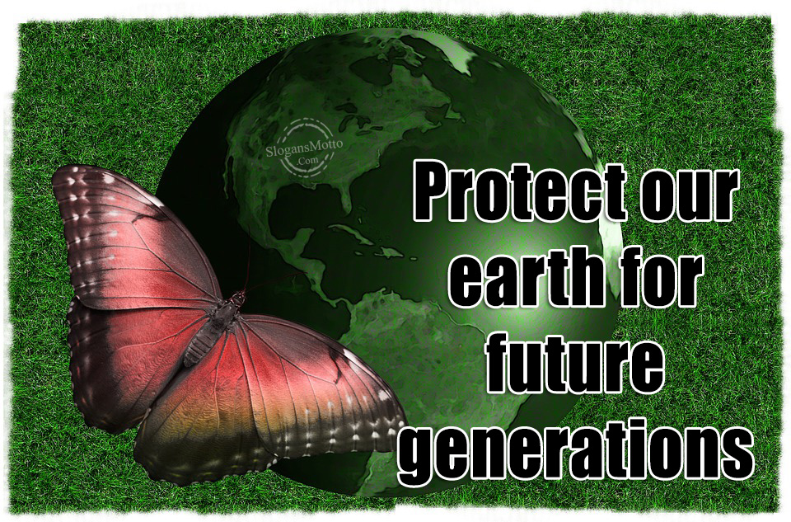
For more Powerpoint Preshows, exercises and challenges, please visit:
http://murov.info/PPTPreshows.htm

