Slide 1
CHEMISTRY CONCEPTS:
EXCERPTS FROM OLDTEXTBOOKS DESIGNED TO PROVIDE INSIGHT
Steven Murov,
http://murov.info

Slide 2
By reviewing old chemistry textbooks, it is possible to follow the development or evolution of many of our present-day chemistry concepts. This learning exercise can sometimes lead to a better understanding of concepts than can be gained by traditional chemistry exercises. An accompanying site http://murov.info/chemhistexe.htm provides links to many texts that are available free on the Internet. Students can be assigned a text, a chapter or even specific pages and asked to critically evaluate the content. One possible approach is to assign a topic or thread that has undergone significant improvement in understanding such as atomic composition, bonding and molecular structure. Differences between present day understanding and the discussion in the texts should not be considered to have been errors as there was limited and insufficient information available at the time to develop accurate concepts and explanations.
This PowerPoint exercise contains examples from texts that have been published since 1810. Many more examples could have been used and more might be added. The first edition of this exercise has been posted on March 24, 2023. Other chemistry web sites by this author that might be of interest to chemistry instructors are below. The second through the fifth have historical content. Slides and answers do not appear automatically but must be manually advanced.
http://murov.info http://murov.info/periodictables.htm http://murov.info/periodictable.pptx http://murov.info/periodictabcol.htm http://murov.info/timelines.htm http://murov.info/organicmilestones.htm http://murov.info/chemexe.htm http://exercises.murov.info/chemexercises.htm http://murov.info/Reaction-Map.htm

Slide 3
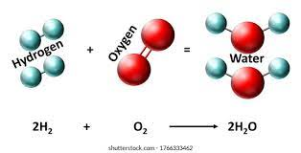
Murray, John, Elements of Chemistry, Edinburgh, 1810, pages 296-7. https://archive.org/details/elementschemist01murrgoog/page/n7/mode/2up
Critically evaluate the paragraphs on water to the right.
This date for this textbook was stated to be 1810. This was a few years after John Dalton published his set of atomic rules. This text might have been written before Dalton or without the acceptance of the concept of atoms. For the most part, the observations are consistent with our present-day knowledge of water. Interestingly, Murray did recognize that water is a compound composed of hydrogen and oxygen. While he does not use the words molecule or atom, he also recognized the 1 to 1 relationship between hydrogen and water. It is difficult to rationalize this with the earlier Aristotelian concept of continuous matter.

Slide 4
Wilson, George, Chemistry, William and Robert Chambers, London, 1960. Pages 36, 41, 42.
https://archive.org/details/chemistry01wilsgoog/page/n4/mode/2up
Are there problems with the analysis below?
It appears that the diatomicity of oxygen had not been recognized resulting in an atomic mass of oxygen half of its value. This in turn results in incorrect formulas. Nitrous oxide is not NO but N₂O and nitric oxide is NO and not NO₂ and so on.

Slide 5
White, George H., Elementary Chemistry, Ginn., Boston, 1895. Pages v, vi.
https://archive.org/details/elementarychemi00whitgoog/page/n13/mode/2up
The preface to White’s Elementary Chemistry makes a case for laboratory instruction.. Today, there seems to be a tendency to replace hands-on experiences with online material. Give your opinion on the values of live lecture, online lecture and hands-on laboratories.

Slide 6
Holmes, Harry N.,
General Chemistry, Macmillan Co., N.Y. 1921.
Symbolism and hydrolysis. Pages 144, 159.
Has the symbolism for ions changed much during the last 100 years?
Is Fe(OH)₃ accepted as the formula of ferric hydroxide today?
The use of charges such as +++ and - - has been changed to 3+ and 2- and inserted as superscripts. Most software includes the ability to insert superscripts and subscripts. With typewriters, superscripts and subscripts were a time-consuming challenge.
Fe(OH)₃ is commonly used but a better representation of the precipitate formed upon the interaction of ferric and hydroxide ions in aqueous solution is Iron(III) oxyhydroxide or FeOOH.

Slide 7
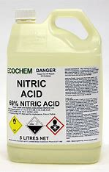
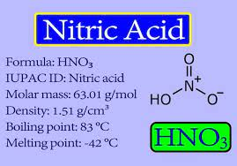
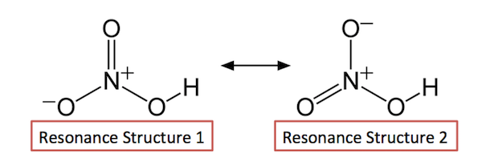
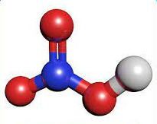
Page 248. The structure given for nitric acid to the right has five bonds to the nitrogen but does avoid formal charges. Is the structure consistent with Lewis structure guidelines?
Lewis structure guidelines and electronic energy levels do not permit nitrogen to exceed the octet rule. The resonance structures at the bottom are the accepted representations of the structure of nitric acid. Given an option, lower formal charges are preferred but the structure to the right violates a more important understanding of electron configurations.

Slide 8
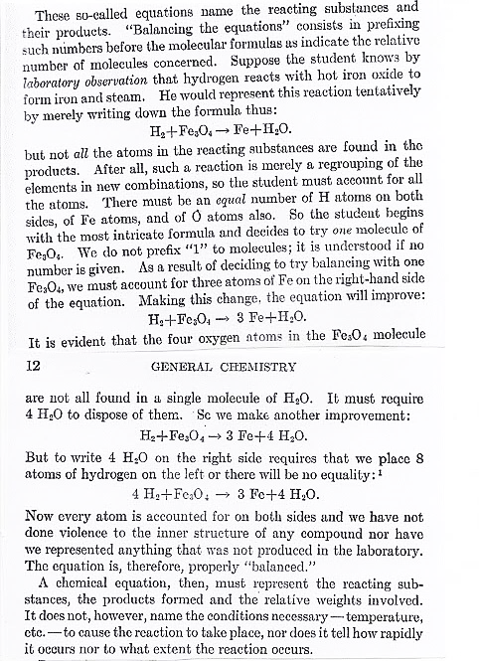
On pages 11 and 12, the text presents a method¹ for balancing chemical reactions.
Does the procedure presented make sense and does it have wide applicability?
Is Fe₃O₄ the formula you would have written for iron oxide?
¹In summary, the method indicates that when balancing reactions of this type, start with the most complex chemical and leave the simplest chemical till last. If the simplest chemical is an element, a change of the coefficient will affect the element only and not unbalance previously inserted coefficients.
1. When one of the reactants or products is in elemental form (common as many reactions have oxygen or hydrogen as a reactant or product), the method is a systematic and logical approach for balancing the reaction. Does your current textbook suggest use of this method?
2. Iron oxide is an incomplete name as there are three iron oxides (FeO, Fe₂O₃ and Fe₃O₄). Fe₃O₄ is called by several names: iron(II,III) oxide, iron oxide black, ferrous ferric oxide, ferroso ferric oxide, magnetite (see next slide for more information on magnetite).

Slide 9
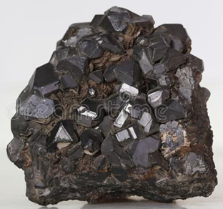
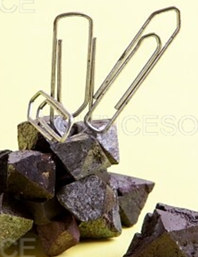
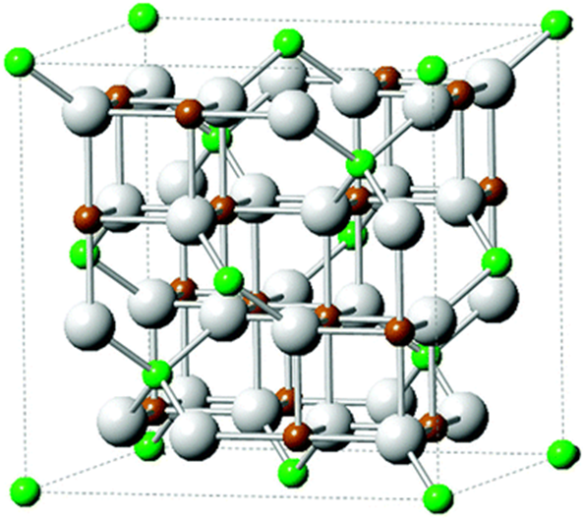
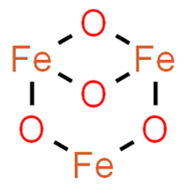
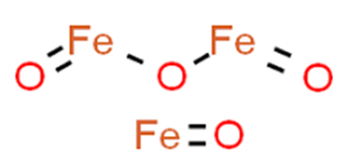
Fe₃O₄ is an unexpected formula, but the compound is found in nature and is called magnetite. How do you account for the formula Fe₃O₄?
Magnetite is unusual not only because of the iron oxidation states (one is +2 and two are +3) but also because it is a compound that is ferromagnetic.
When iron(III) oxide is treated with hydrogen, it is converted to Fe₃O₄ before the reduction to iron occurs.
https://onlinelibrary.wiley.com/doi/full/10.1002/srin.201900108
Bonus question. Three structures for Fe₃O₄ are in the literature. Which if any is consistent with the crystal structure to the right?
In the crystal structure, the green atoms are Fe(II) and brown atoms Fe(III). All Fe(III) atoms are linked with six O atoms, sharing 'half an electron' with each oxygen; all Fe(II) atoms are linked with four O atoms, and all O atoms are linked with four Fe atoms.
None of the formulas give the appropriate bonding indicated by the crystal structure.

Slide 10
Page 194. The periodic table of 1921 is similar to today’s periodic table but there has been at least one very important improvement. Can you name it?
S p, d and f orbitals had not yet been recognized and the d orbital elements were inserted into the table and Group VIII added.

Slide 11
Pages 206-207. Decades before 1921, the role of carbon dioxide in affecting global temperatures had already been noted. However, CO₂ was not considered a threat to global temperatures. The paragraphs to the right indicate that nature maintains a “beautiful balance.” Is this an accurate assessment of the potential effects of CO₂?
As you can observe on the next two slides, the word “balance” applied very roughly right up to the time (1920’s) the paragraphs were written. Since then, the exponential increase in fossil fuel use has overwhelmed the balance and CO₂ is increasing at an alarming rate. Consequently, global temperatures and sea levels are increasing with melting of glaciers. The result is lethal heat waves, flooding, drought, wildfires, weather extremes with environmental destruction and death to humans and animals. About 98% of climatologists agree that human caused climate change is in progress and a huge problem. Solutions exist such as conversion to solar, wind and possibly nuclear power but a substantial portion of society is still in denial and progress is much too slow. The world needs to act now to attempt to minimize the damage that we are already experiencing.

Slide 12
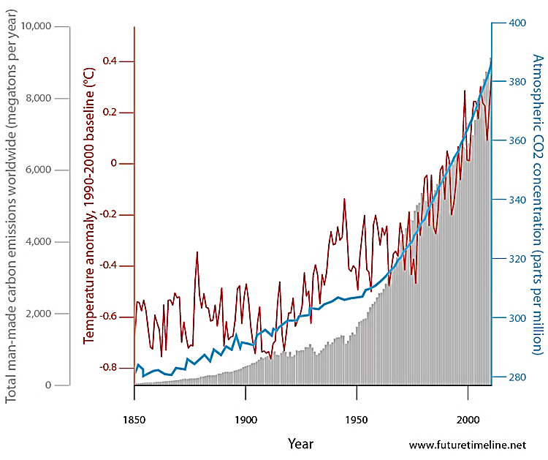
This slide shows that increases in the temperature of the earth correlate with the increasing CO₂ levels.
In addition, there is a correlation with the amount of CO₂ produced providing strong evidence that human activities are warming the earth.
Atmospheric CO₂ blue line
Temperature, dark line
CO2 production, “solid” grey

Slide 13
Average global temperatures from Nov., 2014 - 2017,
compared to a baseline average for the years, 1890 - 1920.
North and South Poles
ºC
https://data.giss.nasa.gov/gistemp/maps/

Slide 14
Brinkley, Stuart B., Introductory General Chemistry, Macmillan, N.YI., 1933.
Critically comment on the periodic table that was on page 171.
The title indicates that the order of the elements was based on atomic weights. Mendeleev (1869) used atomic weights and just like Brinkley, adjusted the position of several elements based on reactivity alignments. Brinkley recognized that atomic numbers are the appropriate ordering quantity and included another periodic table arranged by atomic number.
The long periods were still not yet understood in terms of electron structure.

Slide 15
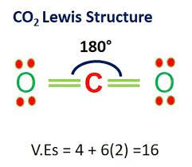
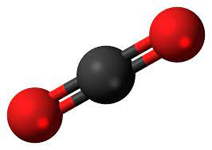
A previous slide introduced the global problem of climate change. Several gases are increasing in our atmosphere as a result of human action. The most important culprit is CO₂. Is the Lewis structure presented for CO₂ in Brinkley’s text , the best possible Lewis structure for CO₂?
A structure for carbon dioxide can be drawn that satisfies the absolute requirement that it has the correct number of electrons. In this case, the structure does show the correct number of 16 electrons. However, other priorities like satisfying the octet rule and minimizing formal charges are not followed with this structure. The carbon is 4 electrons short of an octet and has a +2 formal charge. Each of the oxygens has a -1 formal charge. These problems can be eliminated by making both carbon oxygen bonds into double bonds.
Incidentally, it appears that magnesium oxide is represented by a covalent structure. The large electronegativity difference between magnesium and oxygen (about 2) by accepted convention indicates that MgO has a predominantly ionic bond.

Slide 16
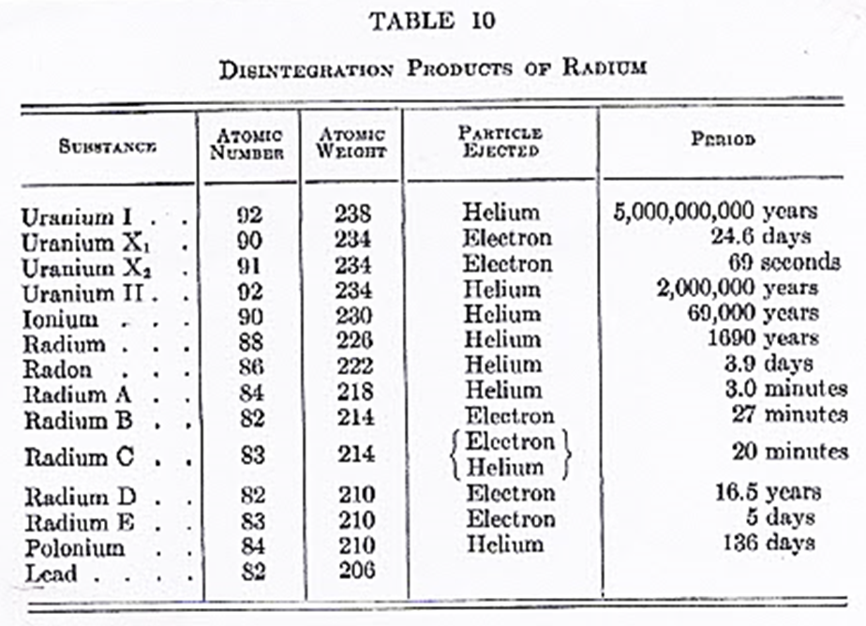
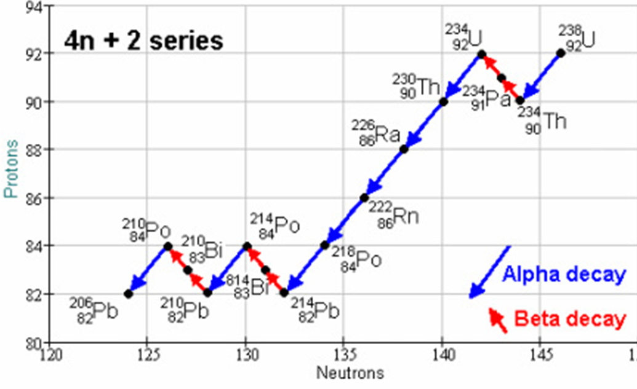
1. Does the figure above correctly depict the radioactive decay thread of Uranium-238?
Accepted decay in 2023.
The figure has the correct emission types, atomic numbers and atomic mass values. However, the names assigned, and symbols used are from an obsolete system for naming isotopes. For example, ionium is an isotope of thorium and radium A is polonium.
Pages 158, 177.

Slide 17
Pages 160-161. The description of atomic structure differs significantly from the model commonly accepted today. What is the most important difference?
The existence of the neutron had been suspected but was not confirmed until about the time this textbook was written. To account for the discrepancy in atomic mass, it was assumed that the nucleus contained an additional number of protons (with an equal number of electrons to neutralize their charge) to account for the extra mass. In a sense, this was not absurd as isolated neutrons do decay to a proton and an electron. The discovery of the neutron solved the discrepancy issue.

Slide 18
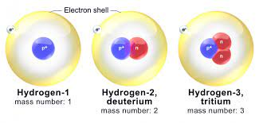
Page 177. In addition to the problem caused by not knowing of the existence of neutrons and the use of obsolete names for isotopes, other statements in this paragraph need clarification. What are some of the inaccuracies?
Isotopes have similar chemical behavior but not identical. The most noticeable difference is that rates of reactions are mass dependent. Hydrogen and deuterium with a doubling of the mass can exhibit rate differences of up to a factor of seven.

Slide 19
Deming, H. G., General Chemistry, Wiley, N.Y., 4th ed., 1935.
The periodic table included in this textbook is to the right. How does it compare to the one on the first slide of this site?
It is much closer to the tables of today as it does account much better for the filling of the d orbitals but overly complicates the table with the diagonal lines.

Slide 20
The 4th edition of this text appeared shortly after Chadwick discovered and verified the existence of the neutron in 1932. Do you find any fault with the discussion to the right (pages 319-320)?
Basically, the content is correct although as the author recognized, more detail was needed to describe the neutron. An isolated neutron does decay to a proton and an electron, but it is probably best not to describe it as a proton plus an electron.

Slide 21
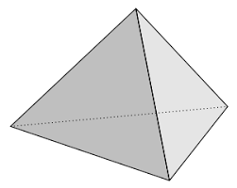
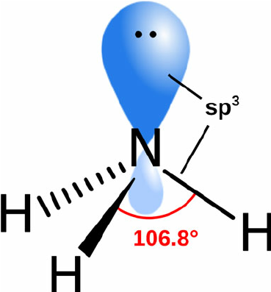
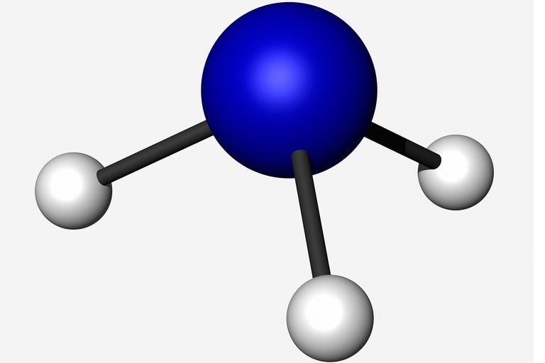
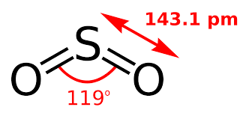
For what appears to be the first mention of structure in the texts thus far discussed, CO₂, SO₂, water and ammonia are described (page 583.). Do you agree with the structures described?
The descriptions are basically correct and consistent with vsepr theory. The “flattened triangular pyramid” for ammonia is consistent with the tetrahedral structure of ammonia with nitrogen at the apex.
https://byjus.com/maths/triangular-pyramid/
https://www.cuemath.com/geometry/triangular-pyramid/
https://en.wikipedia.org/wiki/Tetrahedron

Slide 22
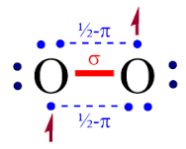
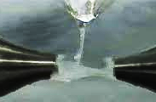
Briscoe, H.T., General Chemistry for Coileges, Houghton Mifflin, Cambridge, MA, 3rd ed., 1943.
Is the Lewis structure given for diatomic oxygen (to the right) correct (pages 103, 280)?
The structure does follow the Lewis structure rules and guidelines but is not consistent with the properties of O₂. Even today, a search for the Lewis dot structure of oxygen will often yield the incorrect structure with all electrons paired. Oxygen is a paramagnetic substance and is attracted (stream bends in a magnetic field) to a magnet. This means that it has at least one unpaired electron. The image to the right gives one attempt to draw a Lewis structure for O₂.
Lewis structures that follow the rules and guidelines are almost always good models. This is one of the exceptions.

Slide 23
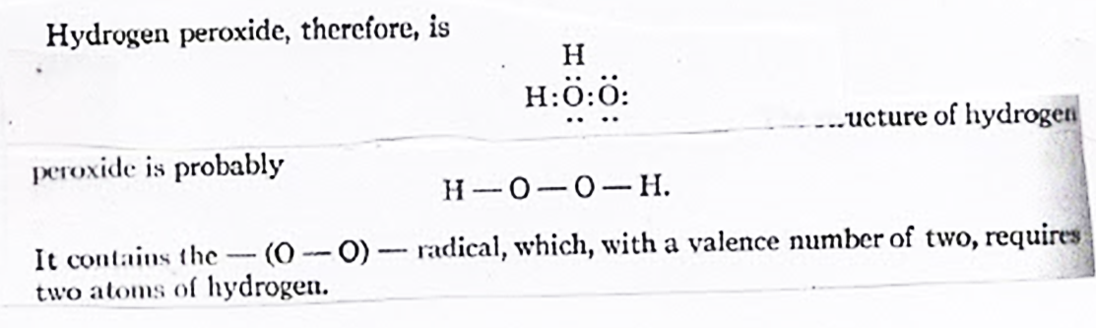
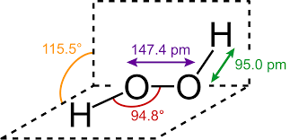
The text ( page 103) gives what appears to be a triangular structure for ozone. This structure does satisfy Lewis dot structure guidelines but is it the structure you would have drawn?
Three membered rings exist but are highly strained resulting in weaker than normal bond strengths. The structure below is a more likely model and is consistent with the observation that ozone is polar and has a dipole moment. The ring structure would not have a permanent dipole.
The text appears to give two different structures for hydrogen peroxide (pages 184, 318). Explain this statement. Which, if either structure do you prefer and why?
The second structure should be preferred and is consistent with experimental evidence. The first structure has non-zero formal charges. Commonly, symmetrically bonded structures are preferred.

Slide 24
Sisler, H. H., Vander Werf, C. A., Davidson, A. W., General Chemistry: A Systematic Approach, Macmillan, N.Y. 1949, page 174.
Does this periodic table of 1949 differ in significant ways from periodic tables used today?
The primary difference is that it stops at element 98. Since then, elements 99 – 118 have been discovered. It also uses the American system of numbering the groups, but the International system uses 1 - 18. The placement of the two bottom series is sometimes this way but more commonly like the chart on the first slide. Importantly, d and f orbitals have been accepted and incorporated into this design. Notice hydrogen ambiguity.

Slide 25
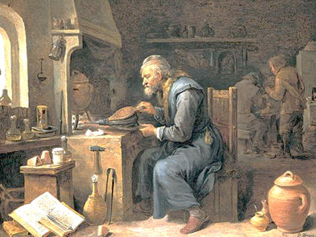
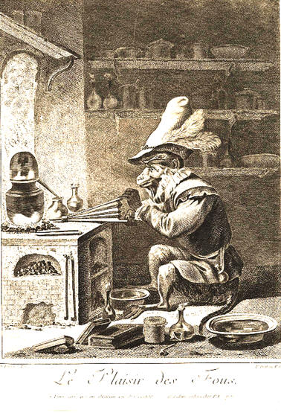
For links to many historical textbooks, please visit:
http://murov.info/chemhistexe.htm
Pictures of Alchemists by the David Teniers (circa late1600’s)
Visit: http://murov.info/alchemists.htm

