Slide 1
This presentation will use 2 or 3 examples from each of the 28 exercises at: http://murov.info/chemexe.htm or http://exercises.murov.info/chemexercises.htmto demonstrate approaches and methods for solving chemistry problems commonly encountered in high school and college chemistry courses. The use of PowerPoint enables the inclusion of simple animation to enhance the lessons. The pptx files created have been converted to html files to avoid time consuming downloads.
Available without download at:
http://murov.info/chemprob/chemprob.html

Slide 2
Contents
CHAPTER 1 Measurements in Chemistry
CHAPTER 2 Matter, Changes and Energy
CHAPTER 3 Elements, Compounds, and Their Composition
CHAPTER 4 The Periodic Table and Chemical Nomenclature
CHAPTER 5 Modern Atomic Theory
CHAPTER 6 The Chemical Bond
CHAPTER 7 Chemical Reactions
CHAPTER 8 Quantitative Relationships in Chemistry
CHAPTER 9 The Gaseous State
CHAPTER 10 The Solid and Liquid States, Energy Changes
CHAPTER 11 Aqueous Solutions
CHAPTER 12 Acids, Bases, and Salts
CHAPTER 13 Oxidation-Reduction Reactions
CHAPTER 14 Reaction Rates and Equilibrium
CHAPTER 15 Nuclear Chemistry
CHAPTER 16 Organic Chemistry
http://murov.info/chemexe.htm
http://exercises.murov.info/chemexercises.htm includes links to lessons and tutorials.

Slide 3
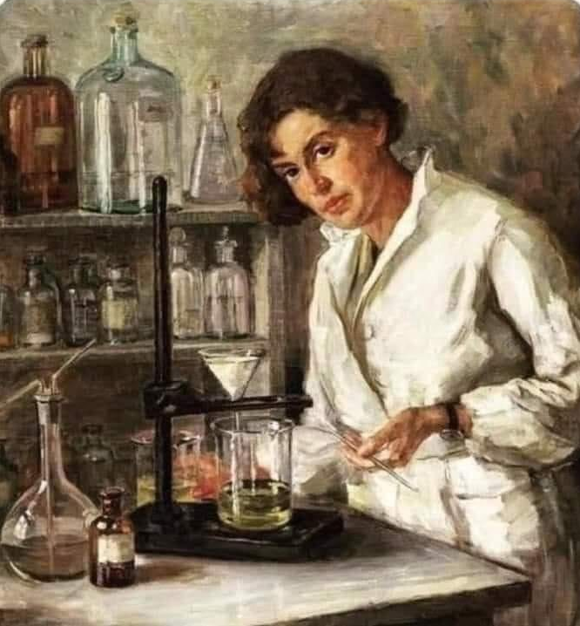
CHEMISTRY RESOURCES
Many resources to assist learning are available in hardcopy and on the Internet. A very limited selection of Internet resources is given below. Some chemistry resources are available at: http://murov.info/webercises.htm
For links to many tutorials directly correlated with the problems used in this site, please visit:
http://exercises.murov.info/chemexercises.htm
Texts Online
https://en.wikibooks.org/wiki/General_Chemistry
https://openstax.org/details/books/chemistry-2e
https://opentextbc.ca/chemistry/
https://www.khanacademy.org/science/chemistry
Lessons
http://www.chemteam.info/ChemTeamIndex.html
https://chemfiesta.org/

Slide 4
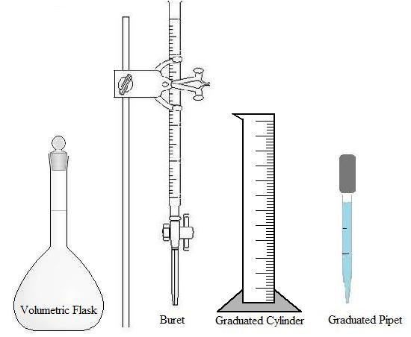
CHAPTER 1 - Measurements in Chemistry Exercise 1-1 Significant Figures and Scientific Notation - Exercise 1-1 1-2 Unit Conversions - Exercise 1-2

Slide 5
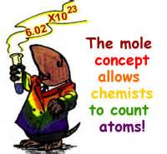
Chemistry has very important qualitative and quantitative components. The quantitative portion encompasses very large to extremely small numbers. For example, chemists commonly work with mole quantities. A mole of any chemical includes 602,214,090,000,000,000,000,000 atoms, molecules or formula units or 602 sextillion units (to give you an idea of how large this is, there is very roughly a mole of sand grains on the earth (imagine all the beaches and deserts). To illustrate how small molecules are, a mole of water occupies a volume of a little more than a tablespoon and has as many molecules as the number of grains of sand on earth.
A hydrogen atom has a diameter of 0.00000000011 meters. It is time consuming to write tiny and large numbers and the multitude of zeros could easily lead to mistakes. To avoid these problems and to simplify the recording of large and small numbers, scientists commonly use scientific notation (a special version of exponential notation). A number can be written as the product of two numbers (e.g., 6 = 2 x 3). In scientific notation, a number is expressed as the product of a number and 10 raised to the appropriate power. In the strictest form the number is written as one digit followed by a decimal and then the remainder of the measured value. For the second factor, 10^{x}, the x is selected to place the decimal in the correct position. Examples:
212 = 2.12x10² 76543 = 7.6543x10⁴ 0.0324 = 3.24x10⁻²
602,214,090,000,000,000,000,000 = 6.0221409x10²³ 0.00000000011 = 1.1x10⁻¹⁰
In addition to simplifying the writing of the number, it is much easier to express the number of significant figures correctly (sig. figs. are addressed in the next section).
Diameter of hydrogen
atom = 1.1x10⁻¹⁰ meters, Bohr solar system model works only for hydrogen.

Slide 6
SIGNIFICANT FIGURES. It is necessary, in science, to convey the accuracy of figures reported in data and the accuracy of conclusions derived from that data. Suppose as you drive your car, the speedometer reads 65 mph and you drive for 2 hours. Could you say with confidence that you had driven between 129.9 and 130.1 miles or 129 and 131 miles or 120 and 140 miles? Because of several reasons (there are substantial errors in speedometer readings, possible errors in timing and probable deviations from the 65 mph), you would probably respond between 120 and 140 miles. However, if someone asked you how far you had driven, you would probably respond 130 miles no matter which range was most appropriate. For scientists, this is not adequate as scientists must know the error range of a measurement. When constructing a table, would it be all right for the legs to differ in length by 1 mm, 1 cm or 1 m? Probably a 1 mm tolerance would not lead to significant wobbling, but legs that differ by 1 cm would make a very wobbly table.
The question then is how do you communicate the precision of the number to other people? Perhaps the best way is to include the range of possible values (130 ± 10 miles), but determining standard deviations takes some time and often is more information than is really needed. To provide a very simple method that admittedly does have some shortcomings, scientists have developed a convention based on significant figures. Use of this method enables the users to instantly ascertain an idea of the range of possible values of a measurement or a value calculated from a series of measurements. For the distance problem in the paragraph above, a range between 129.9 and 130.1 would be expressed 130.0 miles or 1.300x10² miles, between 129 and 131 would be expressed 1.30x10² miles (130 miles leads to ambiguity and it is necessary to use scientific notation to avoid confusion over significant figures when there is no decimal showing and the last digit is a zero), and between 120 to 140 miles would be expressed 1.3x10² miles (although 130 miles should be interpreted the same way).
All recorded digits read directly, plus the final estimated digit, are significant. The primary difficulty with significant figures is with zeros. Zeros have two roles: numerical value and decimal placement. When used as numerical values, they are significant. Zeros are not significant when used as decimal place holders. Consider a measurement of 1.2 cm. This can also be expressed as 0.012 m. Clearly, changing units cannot change the number of significant figures. As 1.2 cm has two significant figures, 0.012 m must also have two. The first zero is present for aesthetic reasons and the second simply to place the decimal. In a number such as 10.010, there are five significant figures as all have numerical value with the zero on the far right an estimated digit.

Slide 7
DIMENSIONAL ANALYSIS (also known as unit conversions, factor label method). Problems in chemistry often involve many steps. Application of a technique called dimensional analysis can often provide a systematic simplified approach toward the solution of these problems. In dimensional analysis, a measured or given value is multiplied by a unit conversion or series of unit conversions until a new numerical value is obtained with the desired units. Consider the equality, 100 cm = 1 m. This equation can be divided on both sides by 100 cm and the equation 1 = 1 m/100 cm results. The ratio 1 m/100 cm is equal to 1 and is therefore called a unit conversion. As any measurement can be multiplied by the number 1 without changing the true value of the measurement, multiplication by unit conversions simply changes the measurement from one set of units to another with a new numerical value. Notice also that the reciprocal of 1 is still 1 so any unit conversion can be inverted and used as a unit conversion (100 cm/1 m is a unit conversion). For example, if you are 1.70x10² cm tall and want to know the value in meters, multiply by the unit conversion 1 m/100 cm.
1.70x10² cm x 1 m = 1.70 m
100 cm
Notice that the goal is to use the unit conversion that will cancel the given units (cm) and introduce the desired units (m). When the unit conversion or ratio of desired units to given units is not immediately available, it is sometimes possible to string a series of unit conversions together to obtain the desired units. Now let’s check the saying that "a pint is a pound the world around" by utilizing the density of water at 20ºC (0.998 g/mL) in the metric system. Notice in the following calculation that sequential diagonal cancellation of units using familiar unit conversions is utilized until the desired result is obtained.
1.00 pt x 1 qt x 1 L x 10³ mL x 0.998 g x 1 lb = 1.04 lb
2 pt 1.057 qt 1 L 1 mL 453.7 g
The saying apparently has a 4% error. The sequence that you use to perform the above calculation is not relevant as long as values in the numerator are multiplied and values in the denominator are used to divide. Be sure to write the complete unit. If your problem is concerned with grams of copper, the unit is written "grams Cu", not simply "grams". “grams Cu" does not cancel with "grams Zn."

Slide 8
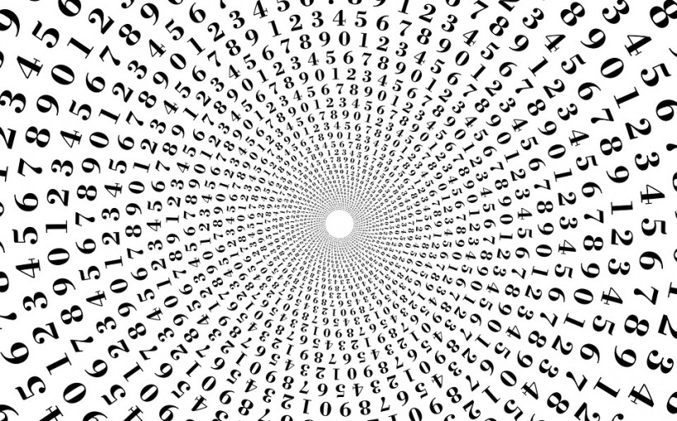
http://exercises.murov.info/ex1-1.htm problems 1, 2
1. 2001 in scientific notations is:
Place a decimal after the 2 and count the places the decimal has been moved. This yields 2.001 and the decimal has been moved 3 places to the left of the original position.
Multiply the 2.001 by 10^{x}. 2.001x10^{x}
Since the decimal was moved 3 places to the left, the exponent, 3 must be positive as the number 2.001 was made smaller so 10^{x} must be greater than 1 or 10³ in this case.
2.001
x10³
2. 0.00345 in scientific notation is:
Place a decimal after the 3 and count the places the decimal
has been moved. 3.45 and the decimal has been moved 3 places to the right of the original position.
2. Multiply the 3.45 by 10^{x}. 3.45x10^{x}
3. Since the decimal was moved 3 places to the right, the exponent, 3 must be negative as the number 3.45 was made larger so 10^{x} must be less than 1 or 10⁻³ in this case.
3.45
x10⁻³

Slide 9
http://exercises.murov.info/ex1-2.htm problems 7, 9
To determine the number of significant figures, if a decimal is showing, count from left to right starting with the first non-zero digit. If a decimal is not showing, count from right to left starting with the first non-zero digit. 2100.00 has 6 sig. figs. 2100 has 2 sig. figs.
7. Express 2100.0 in 3 significant figures:
To do this requires a change to scientific notation. Write the number with 3 sig. figs., 2.10, and count the number of place the decimal has moved to the left.
2.10x10³
9. Express 0.06406 in 3 significant figures: The first zero is for aesthetic purposes and the second zero is a place holder and not a sig. fig. To 3 sig. figs, the answer could be written 0.0641 but it is preferable to change to scientific notation. Write the number with 3 sig. figs., 6.41, and count the number of places the decimal has moved to the right.
6.41x10⁻²

Slide 10
http://exercises.murov.info/ex1-2.htm problems 18, 20
In multiplication and division, the result should have the same number of sig. figs as the factor with the least number of sig. figs.
18. How many significant figures should be expressed in the answer to the following: (2.30x10⁴)(1.11x10⁵) =
2.55x10⁹
Both numbers have 3 sig. figs. so the product should have 3 sig. figs.
For addition and subtraction, the number of sig. figs. in the numbers is not the consideration.
It is the last position of confidence on the right with respect to the position of the decimal.
20, How many significant figures should be expressed in the answer to the following:
2.333x10³ + 1.1x10² =
2333
+ 110 the zero is not a sig.fig.
2443 the final 3 is not significant as the zero above it is not significant. Although the first number has 4 sig. figs. and the second only 2, the sum in this case has 3 sig. figs., because of the confidence with respect to the decimal position.
2.44x10³

Slide 11
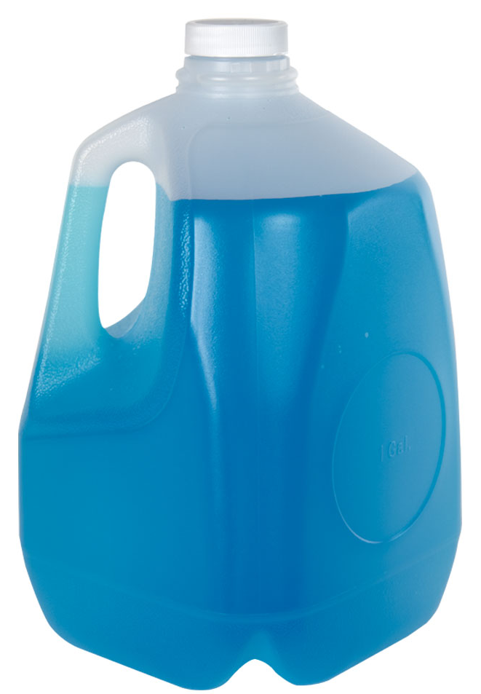
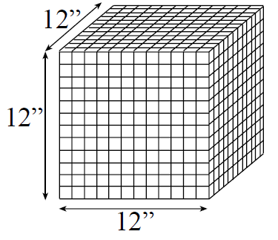
http://exercises.murov.info/ex1-2.htm problems 6, 15
6. Convert 7.90x10⁻¹ km to cm.
Unless you know the direct unit conversion or have confidence that you can figure it out in your head, two unit conversions will be needed.
7.90x10⁻¹ km
(10³ m)
(1 km )
(10² cm) =
(1 m)
7.90x10⁴ cm
15. Convert 1.00 ft³ to gallons.
When people are asked how many gallons would it take to fill a cubic foot, most underestimate and give an average answer of about 3 gallons. Let’s calculate the number.
In this case the # of sig.figs. Is determined by the 1.00 ft³ or 3. The other factors except the 1.057 (4 sig. figs.) are exact.
1.00 ft³
(12 inches)³
( 1 ft.)³
( 2.54 cm)³
(1 inch)³
( 1 mL)
(1 cm³)
( 1 L )
(10³ mL)
(1.057 qts.)
( 1 L)
( 1 ga.) =
(4 qts.)
7.48 ga.
Please notice that this calculation demonstrates one of the big advantages of the metric system over the American system. Conversions in the American system involves factors of 3, 4, 12, 16, 36, 5280 and other clumsy numbers. In the metric system, distance cubed defines volume measurements and most factors are powers of 10. To determine this relationship in # 15 without using a reference, the value was converted to metric and back.

Slide 12
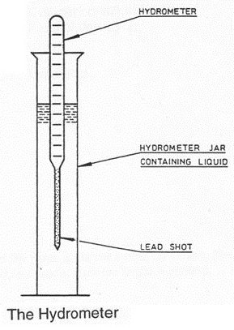
http://exercises.murov.info/ex2-1.htm problems 4, 13
CHAPTER 2 - Matter, Changes and Energy Exercise 2-1 Density - Exercise 2-1 2-2 Terminology - Exercise 2-2
The density of a substance is a very useful property that assists with identification and provides useful information for application purposes. Determination of density requires two measurements. The mass of a sample is divided by the volume although there are tools such as a (hydrometer) that read out density out directly. In addition, density should be considered to be a unit conversion. Given the density and the mass or the volume, it is straightforward to calculate the remaining parameter.
4. An irregular 77.7 g piece of silver is placed into a graduated cylinder that has 15.0 mL of water in it. The new water level is 22.4 mL. What is the density of the silver?
(note after subtraction, only 2 sig. figs. remain)
Density = m/v = 77.7 g/[(22.4 – 15.0) mL] = 1.0x10¹ g/mL
13. The density of copper is 8.92 g/mL. The volume of a piece of copper that has a mass of 10.0 g is:
Note the inversion of the density.
(10.0 g) (1 mL/8.92 g) = 1.12 mL = 1.12 cm³

Slide 13
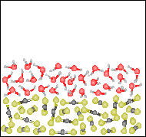
http://exercises.murov.info/ex2-2.htm problems 35, 36
35. For the figure to the right, which one of the descriptions best describes the contents of the figure.
a. A heterogeneous mixture of two elements in their liquid states.
b. A homogeneous mixture of two compounds in their liquid states.
c. A heterogeneous mixture of two compounds in their liquid states.
d. A heterogeneous mixture of two compounds in their solid states.
e. None of the previous answers.
←
The figure shows the presence of two compounds with each having two atoms of one element and an atom of a second element. The top one has a bent structure, and the bottom is linear. Because the two substances are not mixed, the mixture is heterogeneous. Because the molecules of each substance are randomly oriented but close together, both substances are in the liquid state.
36 . Referring to the figure for the previous question (#35), which is the denser liquid, water or carbon disulfide?
a. water
b carbon disulfide
c. Not enough information to decide.
The top or less dense liquid has a bent structure and the bottom one is linear. Water is bent with single bonds and CS₂ is linear with two double bonds. Unless you want to argue that this does not prove that these represent water and carbon disulfide, the bent water molecules are above the denser CS₂.

Slide 14
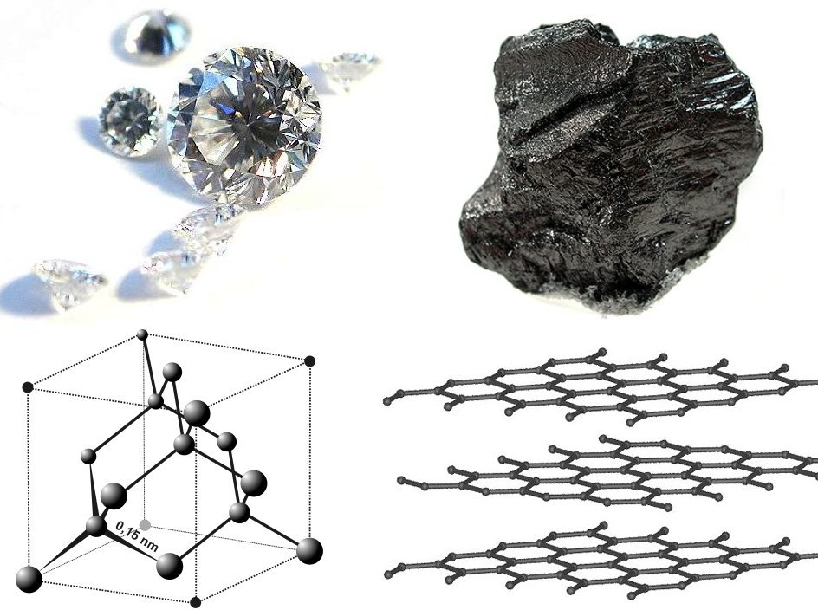
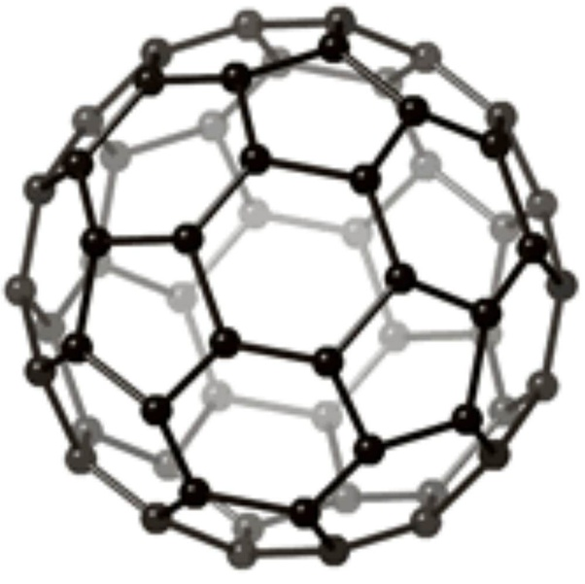
2. A heavy alkaline earth element. Despite the toxicity of its salts, one of the salts (sulfate is used in the "milk shakes' taken by a patient for a gastrointestinal series of X-rays (also what happens to patients when the doctor fails).
CHAPTER 3 - Elements, Compounds, and Their Composition Exercise 3-1 Symbols and Properties of the Elements - Exercise 3-1 3-2 Protons, Neutrons, Electrons and Isotopes - Exercise 3-2
20. Organic chemistry is the chemistry of compounds of this element. It occurs as diamond and graphite and a third form has been made that is in the class of compounds called fullerenes and is commonly called buckyballs.
The group 2 elements (2A in the American system) are called the alkaline earth elements. Barium ion is very toxic to humans, but barium sulfate has very low solubility in water. Consumption of barium sulfate does not introduce a dangerous amount of barium ion into the body.
Over 20 million (and counting) compounds have been reported. Of these it is estimated that 90% contain the element carbon. Until 1828, it was thought that chemicals derived from anything living had a special property called vitalism. This was disproven by Wöhler in 1828 and organic chemistry was eventually redefined as the chemistry of compounds that contain carbon. There are several reasons why there are so many carbon compounds – C forms four bonds, bonds strongly to itself (makes polymers) in different spatial ways and to many other elements.
diamond graphite buckyball

Slide 15
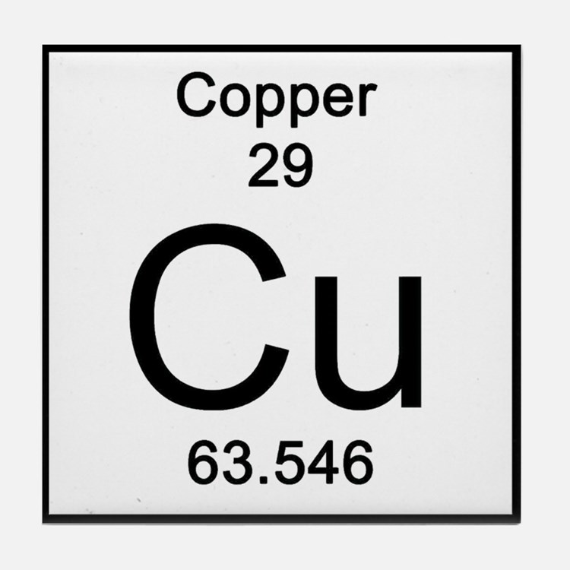
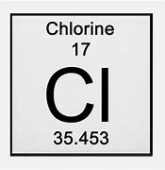
http://exercises.murov.info/ex3-1.htm problems 3, 17, 20
3. How many protons and electrons are in an atom of copper?
The atomic number defines the element and is the number of protons in the nucleus. Since protons (1.6726×10⁻²⁴ grams, 1.007277 amu) and neutrons 1.6749 x10⁻²⁴ grams, 1.008665 amu) have amu mass values very close to 1 and electrons only 1.098x10 ⁻²⁷ grams or 0.0055 amu, the atomic mass up to at least the first decimal place is the sum of the protons and neutrons. This means the atomic mass minus the atomic number will give the average number of neutrons. The word average needs to be emphasized as the atomic mass is determined experimentally on samples found on earth. Many elements have stable atoms with different numbers of neutrons. These atoms are called isotopes. Traditional periodic tables do not give direct isotope information, but the atomic mass values provide some information. If the atomic mass is within 0.1 of a whole number, there is likely a predominance of one isotope. If the value differs by more than 0.1 from a whole number, there must be at least 2 isotopes, but the actual number of isotopes cannot be definitively discerned without information such as a mass spectrum.
17. How many neutrons are in an atom of chlorine?
20. From the periodic table, what can you conclude about the number of isotopes of chlorine that are found on earth?
3. From the atomic number, Cu must have 29 protons and for
neutral Cu, an equal number of electrons (29).
17, 20. The atomic mass minus the atomic number for Cl tells us that Cl has an average of 18.5 neutrons and at least 2 isotopes. The tendency might be to think that about half have 18 neutrons and the remaining atoms have 19 neutrons. This is incorrect as a mass spectrum reveals that 75% of chlorine has 18 neutrons and 25% have 20 neutrons yielding an average of 18.5 neutrons aand an atomic mass of 35.5 amu.

Slide 16
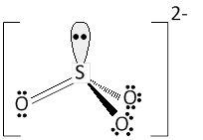
http://exercises.murov.info/ex4-1.htm problems 43, 46
46. Assuming the space filling model represents an ion with a negative 2 charge, it could represent:
carbonate, sulfur trioxide, sulfate, nitrate or none of the previous answers.
CHAPTER 4 - The Periodic Table and Chemical Nomenclature Exercise 4-1 Polyatomic Ions - Exercise 4-1 4-2 Formulas of Compounds - Exercise 4-2 4-3 Nomenclature and Properties of Compounds - Exercise 4-3
Carbonate is CO₃²⁻ and fits.
Sulfur trioxide is neutral, sulfate is SO₄²⁻, nitrate is NO₃⁻ so only carbonate fits.
43. Polyatomic ions that have the formula XO_{n}^{m-} where X is the central atom (such as C, N, S, P, Cl, Cr) and n and m are whole numbers that depend on the nature of X and its oxidation number are also called oxoanions or oxyanions. For commonly occurring oxoanions, the X in XO₃²⁻ could be: S or N or P or Cl.
SO₃²⁻ NO₃⁻ PO₃⁻³ ClO₃⁻ These ions are sulfite, nitrate, phosphite and chlorite. Only the sulfite has the n and m values given in the problem.

Slide 17
http://exercises.murov.info/ex4-2.htm problems 8, 19
Provide the correct formula for the compounds in # 8 and 19.
8. tin(IV) oxide
Tin(IV) means Sn⁴⁺ . Oxygen in compounds except for peroxides is almost always -2. Using the criss cross method yields Sn₂O₄ but this needs to be reduced to
SnO₂.
19. magnesium phosphate
Magnesium is in group 2 (or 2A). Group 2 elements are always +2 in compounds. Phosphate is PO₄³⁻. There are some guidelines for the names of the oxoanions but it is best to just learn them (make flash cards with the name of one side and the formula on the other side. Using the criss cross method or the lowest common multiple to end up with a neutral molecule yields
Mg₃(PO₄)₂

Slide 18
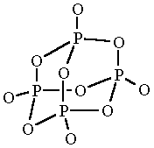
http://exercises.murov.info/ex4-3.htm problems 3, 15
3. Select the correct name for Fe(NO₃)₃:
Since nitrate should be recognized as NO₃⁻, the iron must be 3+ or ferric.
x + 3(-1) = 0 and x = 3. The reverse criss cross method yields the same result. The correct result was not included among the multiple choice answers so the correct response was none of the above.
iron(III) nitrate or ferric nitrate
15. Select the correct name for P₄O₁₀:
For non-metal to non-metal compounds, the oxidation states are not included in the name. Instead the number of the atoms of each element are given by a prefix. The numbers are not reduced if this is a molecular formula rather than an empirical formula.
tetraphosphorous decaoxide

Slide 19
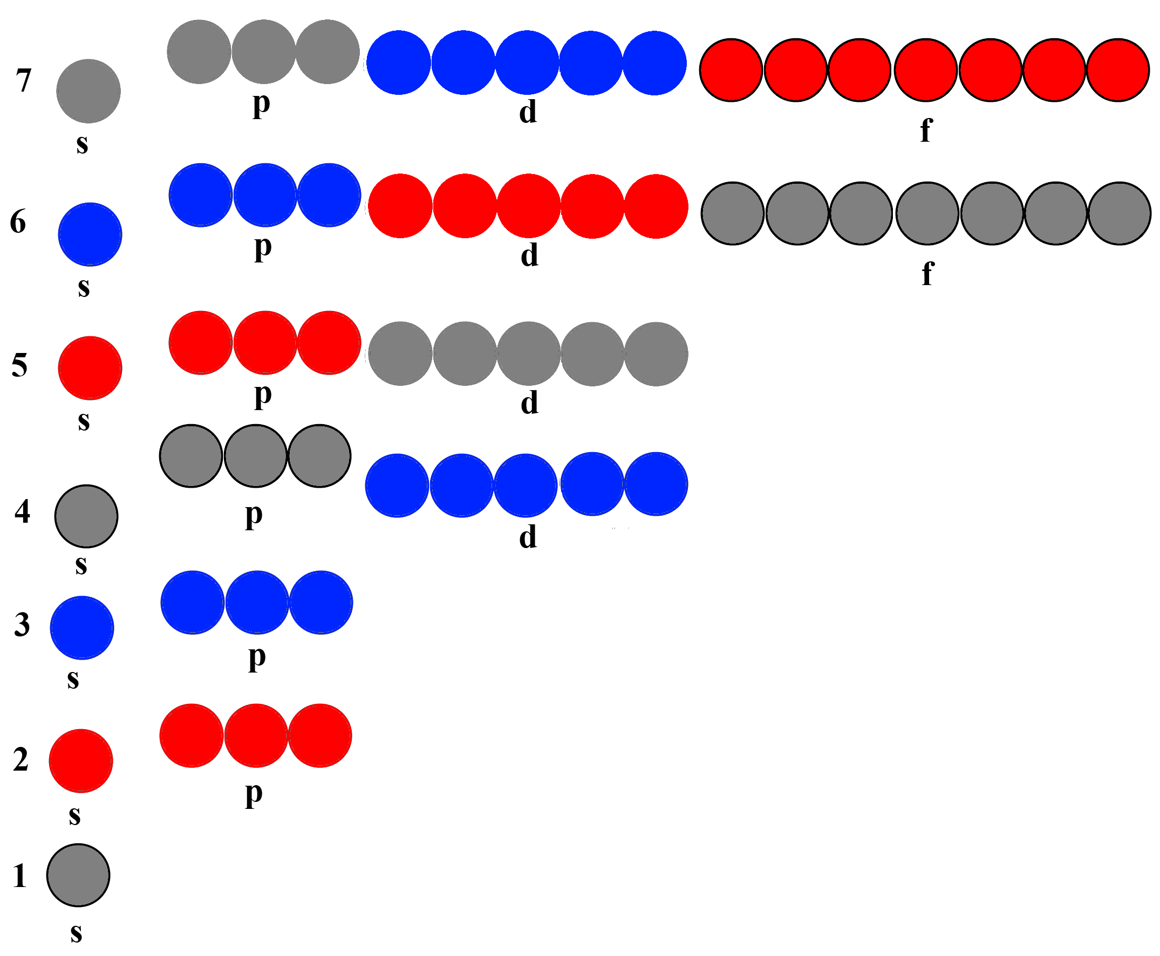
http://exercises.murov.info/ex5-1.htm problems 12, 20, 26.
CHAPTER 5 - Modern Atomic Theory Exercise 5-1 Electronic Structure of Atoms- Exercise 5-1 5-2 Periodic Properties of the Elements - Exercise 5-2
12. Nickel has how many unpaired electrons?
Nickel with atomic number 28 has 28 electrons. The electron structure is: 1s²2s²2p⁶3s²3p⁶4s²3d⁸. This leaves 2 electrons unpaired.
20. When the quantum numbers n,l,m,s are represented by 4,2,1,1/2, the symbolism for the electron is:
The 4 is the principal quantum number and the 2 is the angular momentum number l and tells us that it represents a d orbital. m and s are not represented in the symbolism, so this is a 4d electron.
26. For a 5d electron the values of n,l,m,s respectively could be:
5,1,0,1/2 5,2,3,1/2 5,2,2,1/2 5,3,0,1/2
None of the previous answers.
For a 5 d electron, n = 5, l = 2 or a p orbital, m = -2, -1, 0, 1 or 2 and s = ½ or – ½ .
Of the given answers, only the third one is one of the correct options.

Slide 20
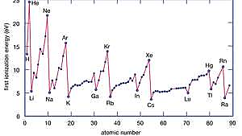
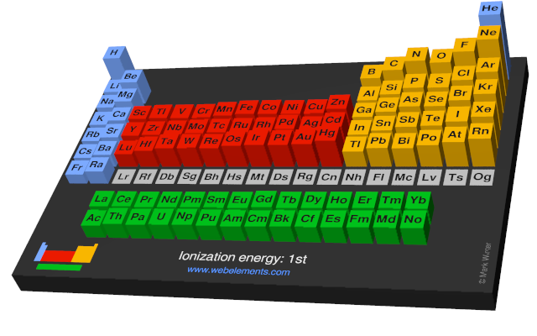
http://exercises.murov.info/ex5-2.htm problems 12, 20, 26.
3. How does the first ionization energy (called ionization enthalpy at WebElements) vary as the atomic number increases going across a period?
The ionization energy generally increases due to the increased attraction by the increasing number of protons. The electrons are filling the same quantum level.
6. How does the first ionization energy (called ionization enthalpy at WebElements) vary as the atomic number increases going down a group or family?
The ionization energy decreases as the outer electrons are going into a higher quantum level (and farther away from the nucleus) orbitals. The inner electrons shield the outer electrons from the positively charged nucleus.

Slide 21
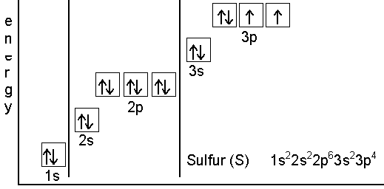
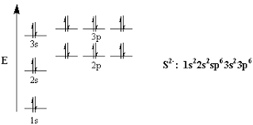
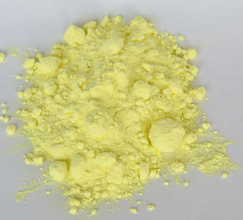
http://exercises.murov.info/ex6-1.htm problems 3, 9.
CHAPTER 6 - The Chemical Bond Exercise 6-1 Valence and Ion Electron Structures- Exercise 6-1 6-2 Lewis Structures of Molecules - Exercise 6-2 6-3 Bond Type and Polarity - Exercise 6-3
3. The electron configuration for sulfide is:
1s²2s²2p⁶3s²3p⁴ is the electron structure of sulfur. To check, add up the electrons and notice that the sum is the atomic number of sulfur (16). Sulfide is a negative ion of sulfur. As expected for a group 16 (6A) element, sulfide has a negative 2 charge giving it a stable inert gas structure of electrons. Adding two electrons to the sulfur electron configuration results in the same configuration as the inert gas, argon:
1s²2s²2p⁶3s²3p⁶
9. The valence electron structure of the halogens is (n represents the number of the highest incomplete quantum level):
ns²np⁵ Halogens are group 17 (7A) elements with 7 valence electrons. The word valence should only be applied to elements with zero or filled d and f orbitals.

Slide 22
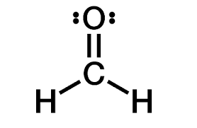
VSEPR Guidelines
http://exercises.murov.info/ex6-2.htm problems 7, 28, 39.
groups¹ of electrons electronic
around central atom shape² bond angles hybridization
2 linear 180º sp
3 planar 120º sp²
4 tetrahedral 109.47º sp³
5 trigonal bipyramid 90º, 120º, 180º dsp³
6 octahedral 90º, 180º d²sp³
¹The number of groups of electrons is equal to the sum of the number of neighbor atoms and nonbonded electron pairs.
²Be sure to distinguish electronic shape from molecular shape. If one or more of the groups of electrons are nonbonded pairs, the molecule needs to be described by the relative positions of the atoms; not by the shapes of the electronic orbitals.
7. What are the bond angles and shape of CH₂O?
Using VSEPR guidelines, the number of groups of electrons around the carbon is three. To orient 3 groups as far apart as possible, the groups are 120º apart in a plane - trigonal planar structure.
28. What is the bond angle in NO₂⁺?
2 groups around a central aotm orient 180º apart on a line.
39. The model to the right could represent:
There are atoms of 3 different elements present. Two atoms are of similar size but the third is much smaller and probably hydrogen. Hydrogen cyanide is consistent with these conclusions unlike the rest of the answers.

Slide 23
1. A simple way of assigning descriptive labels to bonds is to assume that metal-nonmetal and metal-polyatomic bonds are ionic and that nonmetal-nonmetal bonds, with two qualifications are polar covalent. Bonds between two atoms of the same element and the carbon-hydrogen bond should be considered nonpolar covalent. Electonegativity differences can also be used but for the purposes of this exercise, use the above guidelines to classify the bonds in each formula unit. Use of electronegativity values often lead to incorrect conclusions. Classify the bonding in Br₂.
http://exercises.murov.info/ex6-3.htm problems 1, 2, 18.
Bonds between two atoms of the same element are non-polar covalent.
2. Classify the bonding in NO
Fluorine is the most electronegative element. Electronegativity decreases going left and down from fluorine but decreases faster going down. Although nitrogen and chlorine have similar electronegativities, nitrogen hydrogen bonds and chlorine does not. Oxygen is more electronegative than nitrogen resulting in polar covalent bonding in NO. Note that NO is a free radical and very reactive and a dangerous pollutant.
The carbon dioxide molecule has polar C – O bonds but because the molecule is linear and symmetrical, the polarity of the two C – O bonds cancel leaving the molecule non-polar. As a result, CO₂ has low solubility in very polar water.
18. CO₂ is a _______ molecule.

Slide 24
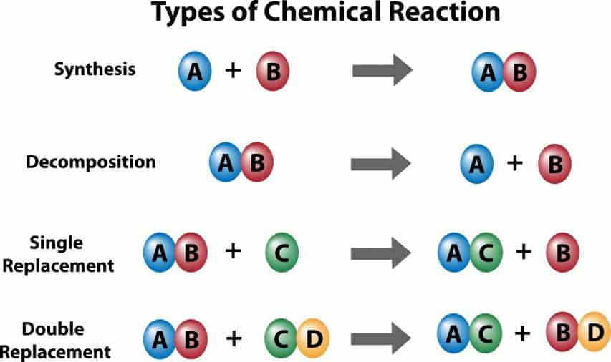
CHAPTER 7 - Chemical Reactions Exercise 7-1 Balancing and Classifying Chemical Reactions - Exercise 7-1 7-2 Net Ionic Equations and Double Replacements Exercise 7-2
Balancing chemical reactions
In chemical reactions, mass is conserved within measurable limits. In addition, nuclei (elements) do not change. By adjusting the coefficients of each reactant and product to make the number of atoms of each element on both sides of the reaction the same, mass and the elements will be conserved. This procedure elevates the reaction to an equation.

Slide 25
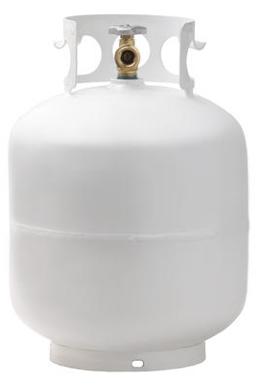
http://exercises.murov.info/ex7-1.htm problems 1, 2.
Questions will be presented in pairs. For each reaction, first balance it with the lowest possible whole number coefficients and sum the coefficients to check your answer. The second question of each pair will ask you to classify the reaction according to the scheme: combination, decomposition, combustion, single replacement and double replacement. Example:
The sum of the coefficients for
CH₄(g) + 2 O₂(g) = 2 H₂O(g) + CO₂(g) is
1 +2 + 2 + 1 = 6.
What is the sum of the coefficients for
__ C₃H₈(g) + __O₂(g) = __H₂O(g) + __CO₂(g) ?
2. The reaction in problem 1 should be classified as a _______ reaction
__ C₃H₈(g) + __O₂(g) = __H₂O(g) + __CO₂(g)
1. Start with the most complex compound [C₃H₈] and save the simplest [O₂] for last. Changing the simplest (often an element), changes the fewest elements. Enter a (or imagine that it is there) as the coefficient for C₃H_{8 .}
1
2. Since there are now 3 carbons on the left, balance the carbons by adding a In front of CO₂.
3
3. To balance the 8 hydrogens on the left, divide the 8 needed on the right by 2 since there are 2 hydrogens in each water and insert the 8/2 = in front of H₂O.
4
4. Add up the oxygens on the right (4 + 6). With 10 oxygen atoms needed and two provided by each molecule of O_{2,} add 10/2 = in front of O₂.
5
Check your results to make sure all elements are balanced.
To answer the question, the sum of the coefficients is:
1 + 3 + 4 + 5 = 13
Because molecular oxygen is a reactant, the reaction is a combustion reaction and a redox reaction.
Problem 2.

Slide 26
http://exercises.murov.info/ex7-1.htm problems 15, 16
15. What is the sum of the coefficients for
___Al(s) + __ HCl(aq) = __AlCl₃(aq) + __H₂(g)
___Al(s) + __ HCl(aq) = __AlCl₃(aq) + ____H₂(g)
1
1. Start with the most complex compound [AlCl₃], insert a and save the simplest [H₂] for last. Changing any coefficient other than the one for hydrogen changes two elements. Enter a as the coefficient for HCl. This also results in a coefficient of as the coefficient of Al.
Please note that the number 1 is usually not actually written in but it must be remembered when balancing.
3
1
2. There are now 3 hydrogens on the left. Balance the hydrogens
by adding a In front of H₂. While it is perfectly ok to have fractional coefficients (we can consider the reaction to represent mole-like amounts rather than atoms or molecules), it is more common to multiply all coefficients by the denominator (2) to remove the fraction.
For the purposes of this exercise, the fractions need to be removed before the coefficients are added. Alternatively, as soon as it was realized that hydrogen would end up with a non-whole number, a new start could have been initiated with doubled coefficients.
3/2
2 Al(s) + 6 HCl(aq) = 2 AlCl₃(aq) + 3 H₂(g)
The aluminum replaces the hydrogen
in HCl resulting in a single replacement.
It is also a redox reaction.
3. Check your results to make sure all elements are balanced.
To answer the question the sum of the coefficients is:
2 + 6 + 2 + 3 = 13

Slide 27
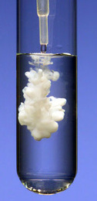
Double replacement reactions are observed when one of the products is insoluble in water (such as barium phosphate in this case), an insoluble gas is formed and bubbles out of the solution or a weakly ionized or unionized compound such as water is formed resulting in the evolution of heat.
http://exercises.murov.info/ex7-1.htm problem 21
21. What is the sum of the coefficients for
__BaCl₂(aq) + __Na₃PO₄(aq) = __Ba₃(PO₄)₂(s) + __NaCl(aq) ?
1. Since the cations exchange partners, this reaction is a double replacement. Start with the most complex compound - Ba₃(PO₄)₂ and insert a in double replacements, oxyanions (or polyatomic ions) stay in tack and should be balanced as a whole (it is easier than balancing the individual elements). Work back and forth across the = sign. Since there are 2 phosphates on the right, insert a in front of sodium phosphate.
1
2
6
Now you have locked in 6 sodium atoms so insert a in front of NaCl.
On the left insert a 6/2 = in front of the BaCl₂ to balance the chlorines.
3
All coefficients have been set but check the barium atoms
to make sure you have correctly balanced the reaction.
__BaCl₂(aq) + __Na₃PO₄(aq) = __Ba₃(PO₄)₂(s) + __NaCl(aq)
21. For the purposes of answering the exercise, the sum of the coefficients is:
3 + 2 + 1 + 6 = 12

Slide 28
Sometimes it is enlightening to focus on the actual changes in bonding that occur during a reaction. For double replacements and reactions that occur in aqueous solution, a method for looking specifically at the changes involves the writing of a net ionic equation. It is sometimes possible to directly write down and balance the net ionic equation, but a systematic approach includes several steps.
1. Write down a formula equation and balance it.
http://exercises.murov.info/ex7-2.htm problem 1
1. Balance each of the reactions and then write the net ionic equation for the reaction.
__ CaCl₂(aq) + __AgNO₃(aq) = __ Ca(NO₃)₂(aq) + __AgCl(s)
1 CaCl₂(aq) + 2 AgNO₃(aq) = 1 Ca(NO₃)₂(aq) + 2 AgCl(s)
Break down all soluble ionic compounds into their ions. Do
not change insoluble compounds, unionized compounds, weakly ionized compounds (such as weak acids and bases) or water. For this reaction, the total ionic equation results.
Ca²⁺ + 2 Cl⁻ + 2 Ag⁺ + 2 NO₃⁻ = Ca²⁺ + 2 NO₃⁻ + 2 AgCl(s) total ionic equation
Like for algebraic equations a + b = a + c, the a’s are
subtracted out resulting in b = c. For this reaction
2 Cl⁻ + 2 Ag⁺ = 2 AgCl(s) results. The 2’s cancel and it is common convention to place the cations before the anions.
Ag⁺ + Cl⁻ = AgCl(s) . The net ionic equation.

Slide 29
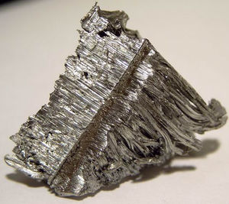
http://exercises.murov.info/ex8-1.htm problems 5, 12, 30.
CHAPTER 8 - Quantitative Relationships in Chemistry Exercise 8-1 Formula Mass, Moles and Molecules - Exercise 8-1 8-2 Percent Composition, Empirical and Molecular Formulas Exercise 8-2 8-3 Stoichiometry Exercise 8-3
Many if not most calculations in chemistry include a calculation of the number of moles often in the first step. Examples include the division of mass by molecular mass, molarity times the volume and PV/RT.
5. How many atoms are in 8.38 g of krypton?
(8.38 g Kr) (1 mole Kr ) (6.022x10²³ atoms Kr) =
(83.798 g Kr) ( 1 mole Kr)
6.02x10²² atoms Kr
12. What is the mass of 1 molecule of carbon dioxide?
(1 molecule CO₂) (1 mole CO₂ ) (44.01 g CO₂) =
(6.022x10²³ molecules CO₂) (1 mole CO₂)
7.12x10⁻²³ g CO₂
molybdenum
30. It is determined that 6.90x10⁻³ moles of an element have a mass of 0.662 g. The element is probably:
The given data enables the calculation of the atomic
mass of the element. Next use the periodic table.
0.662 g X =
6.90x10⁻³ mole X
95.9 g X/mol X This value is
consistent with the element Mo.

Slide 30
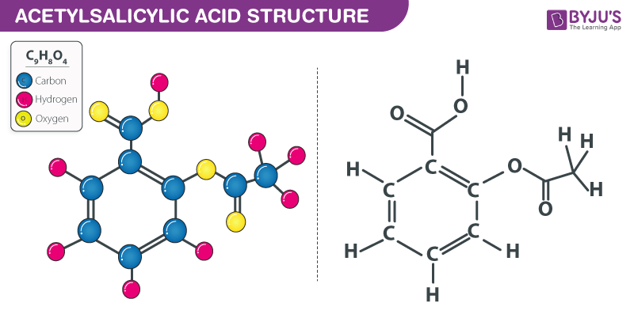
http://exercises.murov.info/ex8-2.htm problems 4, 14.
4. Calculate the mass percent of carbon in aspirin (C₉H₈O₄).
(9 moles C) (12.011 g C) (1 mole asp.) (100%) =
(1 mole asp.) (1 mol C) (180.16 g asp.)
60.00%
14. Determine the molecular formula of a compound that consists of 92.26% carbon and 7.74% hydrogen by mass and has a molecular mass of about 78 g/mol.
(92.26 g C) (1 mole C) = 0.0768 moles C
(100 g X) (12.011 g C) 100 g X
C₆H₆ is probably benzene.
(7.74 g H) (1 mole H) = 0.0768 moles H
(100 g X) (1.008 g H) 100 g X
0.0768 moles C = (1 mole C)/(1 mole H) means that the empirical formula is CH. CH has a formula mass
0.0768 moles H of 13.02 g/mol. Dividing the molecular mass of 78 g/mol by the formula mass gives 5.99 and the subscripts need to be multiplied by 6 to yield the correct formula mass while retaining the correct subscript ratio. The molecular formula is C₆H₆.

Slide 31
http://exercises.murov.info/ex8-3.htm problem 9, 10, 24.
Ο
Ο
9. Questions 9 - 13 refer to the chemical equation
4 FeS₂(s) + 11 O₂(g) = 2 Fe₂O₃(s) + 8 SO₂(g)
How many moles of O₂ are required for complete reaction of 4.0x10⁻³ moles of FeS₂?
Calculations of this type that go all the way from grams of one substance in a reaction to grams of another substance proceed from grams to moles to moles to grams. This is sometimes called the mole train.
4.0x10⁻³ moles of FeS₂ (11 moles O₂) =
(4 moles FeS₂)
1.1x10⁻² moles O₂
10. For the reaction above, how many moles of Fe₂O₃ should be produced from the reaction of 4.0x10⁻³ moles of FeS₂ with an excess of oxygen?
4.0x10⁻³ moles of FeS₂ (2 moles Fe₂O₃) =
(4 moles FeS₂)
2x10⁻³ moles Fe₂O₃
24. 2 Al(s) + 6 HCl(aq) = 2 AlC_{l3}(aq) + 3 H₂(g)
How many grams of hydrogen gas are produced from the reaction of 5.4 grams of aluminum with an excess of HCl?
5.4 g Al (1 mole Al) (3 moles H₂) (2.016 g H₂) =
(26.982 g Al) (2 moles Al) (1 mol H₂)
0.61 g H₂ (apparently, the answer 0.60 g given
was rounded off incorrectly.)

Slide 32
http://exercises.murov.info/ex8-3.htm problem 35.
35. The chemical equation for the reaction
is best represented by:
a. H₂O₂(g) = H₂(g) + O₂(g)
b. 4 H₂O₂(g) + 2 H₂O(g) = 6 H₂O(g) + 2 O₂(g)
c. 2 H₂O₂(g) = 2 H₂O(g) + O₂(g)
d. 2 H₂O(g) = 2 H₂(g) + O₂(g)
e. None of the previous answers
→
There are at least two different approaches toward solving this problem. Since it is a multiple-choice question, it is possible to evaluate each answer or to analyze the problem and figure out the correct answer.
Approach 1:
a. Wrong as water is formed and hydrogen should have been one of the products
This reaction is correct but can be simplified.
c. This is the simplified form of b and is correct.
Hydrogen is not a product and the disappearance of hydrogen peroxide is not accounted for.
e. Since c is correct, e is incorrect.
Elephant toothpaste –
O₂ evolved causes foaming of detergent.
Approach 2. The starting materials include 4 molecules that have 4 atoms and 2 that have 3 atoms. The product box contains 4 molecules with 3 atoms so 2 have been produced by the reaction. The 4 atom molecules have disappeared and two molecules of a diatomic molecule that could be oxygen are produced. This is consistent with a decomposition of hydrogen peroxide into water and oxygen.

Slide 33
http://exercises.murov.info/ex9-1.htm problems 6, 14, 16.
CHAPTER 9 - The Gaseous State Exercise 9-1 Gas Laws - Exercise 9-1 Exercise 9-2 Gases and Gas Stoichiometry Exercise 9-2
Most gas law problems can be solved using the ideal gas law equation PV = nRT. If the number of moles of gas stays constant, this equation can be used to derive the combined gas law, P₁V₁/T₁ = P₂V₂/T₂. From this equation, the derivation of Boyle’s Law, Charles’ Law and Amonton’s (also called Gay-Lussac’s) law are straightforward. The ideal gas law also includes Avogadro’s Law as the volume of a gas depends on the number of moles of a gas but not on the nature of the gas.
6. The volume of a gas maintained at constant pressure halves when cooled. What is the relationship of the new temperature to the original temperature?
V₁/T₁ = V₂/T₂ at const. P
Given V₂ = ½ V₁
T₂/T₁ = 1/2 The Kelvin temperature halved.
16. One mole of an ideal gas at STP occupies 22.4 L. Calculate the volume of one mole of gas at 20ºC and 1.00 atm pressure.
14. A gas occupies 4.00 liters at 751 torr and 37ºC. What is the volume of the gas at 641 torr and 0ºC?
PV = nRT
V = nRT/P = (1 mol)(0.08206 L-atm/mol K)(293 K)
1.00 atm
V = 24.0 L be careful with the conversion 22.4L/mol as it only works at STP.
P₁V₁/T₁ = P₂V₂/T₂
V₂ = P₁V₁T₂/T₁P₂ = (751 torr)(4.00 L)(273 K)/310 K)(641 torr)
= 4.13 L

Slide 34
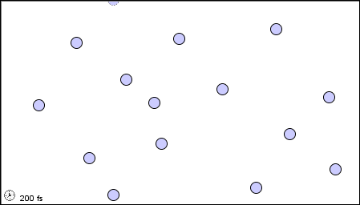
http://exercises.murov.info/ex9-1.htm problem 23.
23. Assume the box to the right contains helium (boiling point 4 K) at about 300 K. Which of the boxes below would most closely represent the box if the absolute temperature of the box were approximately halved?
e. None of the above.
a. b. c. d.
Under these conditions, helium is a gas. It should be recognized that the gas molecules are in constant motion but fill the space available. This rules out a, b, and d. The atoms at any point in time will be in different positions than at any other time. Halving the temperature as long as it stays above the boiling point will change a static image only by the positions of the atoms. If the motion of the atoms could be observed, they would be moving much slower in c than they were before the temperature was halved.

Slide 35
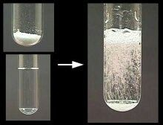
http://exercises.murov.info/ex9-2.htm problem 10.
10. When a 0.350 gram sample of aluminum reacts with excess HCl, a volume of 488 mL of hydrogen at a corrected pressure of 753 mm at 25ºC is obtained. What is the experimental value for the atomic mass of aluminum from this experiment?
2 Al(s) + 6 HCl(aq) = 2 AlCl₃(aq) + 3 H₂(g)
First use the ideal gas law to calculate the number of moles of H₂ that were formed.
PV = nRT n = PV/RT n = [(753/760) atm] [ 0.488 L]/ (0.08206 L atm/mol deg)( 298 deg) = 0.0198 mol H₂
Next, use the balanced equation to calculate the number of moles of aluminum that reacted.
0.0198 mol H₂ (2 moles Al) = 0.0132 mol Al
(3 moles H₂)
Finally, calculate the experimental atomic mass of Al: 0.350 g Al/0.0132 mol Al = 26.5 g Al/mol Al

Slide 36
http://exercises.murov.info/ex10-1.htm problem 3, 7.
CHAPTER 10 - The Solid and Liquid States Exercise 10-1 Energy Changes - Exercise 10-1
3. (From # 2 above). The specific heat of iron is 0.449 J/g-ºC. What is the ratio of the temperature change for iron to water if the same amount of heat is transferred to the same mass of each substance?
∆E = m C_{p} ∆T ∆T = ∆E/m C_{p}
∆T_{fe}/∆T_{water} = C_{pwater}/C_{pFe} = 4.184/0.449 = 9.32
7. The heat of fusion of ice (the energy required to melt 1.00 gram of ice) is 6.01 kJ/mol. How much heat (in Joules) is required to melt 3.00 grams of ice at 0.0ºC and raise the temperature of the water to 15.0ºC?
(3.00 g) (6.01x103 J/mole) (1 mole/18.02 g) + (3.00 g)(15.0 deg)(4.184 J/mol-deg) =
1.19x10³ J

Slide 37
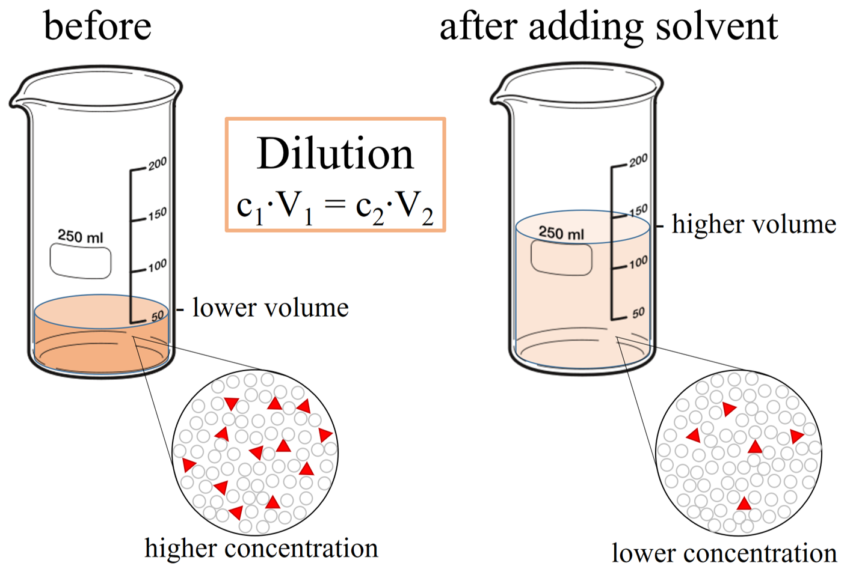
http://exercises.murov.info/ex11-1.htm problems 4, 6, 9.
CHAPTER 11 - Aqueous Solutions Exercise 11-1 Concentrations and Solution Stoichiometry Exercise 11-1
4. 7.5 g of acetic acid are diluted to 150 mL with water. What is the molarity of the acetic acid?
(7.5 g HAc) (1 mol HAc) =
(0.150 L) (60.05 g HAc)
0.83 M HAc
6. What is the approximate concentration of pure at room temperature?
(1.0 g) (1 mol) (1000 mL) =
(1.0 mL) (18 g) (1 L)
56 M
Note: the density of water at room temp.is 0.998 g/mL but only 2 sig. figs are needed for this “approximate” calculation. The molarity of pure water is very high due to the low molecular mass of water.
9. How many mL of a 6.0 M HCl solution should be diluted to 1.5 L with water to prepare a 0.20 M HCl solution?
M₁V₁ = M₂V₂ 6.0 V₁ = (0.20) (1.5)
V₁ = 0.050 L = 5.0x10¹ mL
Be sure when using this equation for dilutions
that the volumes are in the same units.

Slide 38
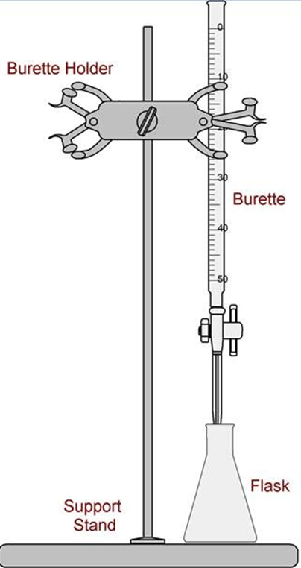
http://exercises.murov.info/ex11-1.htm problems 16, 19.
16. What are the concentrations of iron and sulfate ions respectively in a 0.25 M iron(III) sulfate solution?
Iron(III) sulfate has the formula Fe₂(SO₄)₃. As a result, one mole of dissolved Fe₂(SO₄)₃
yields 2 moles of iron(III) or ferric ions and 3 moles of sulfate ions.
The iron(III) concentration will be 0.50 M and the sulfate 0.75 M.
19. 14.5 mL of 0.111 M sodium hydroxide are needed to titrate 10.0 mL of a sulfuric acid solution to the end point. What is the molarity of the sulfuric acid solution?
H₂SO₄(aq) + 2 NaOH(aq) = Na₂SO₄(aq) + 2 H₂O(l)
(0.0145 L NaOH) (0.111 moles NaOH) (1 mole H₂SO₄) =
(0.0100 L H₂SO₄) (1 L NaOH) (2 moles NaOH)
0.0805 M H₂SO₄

Slide 39
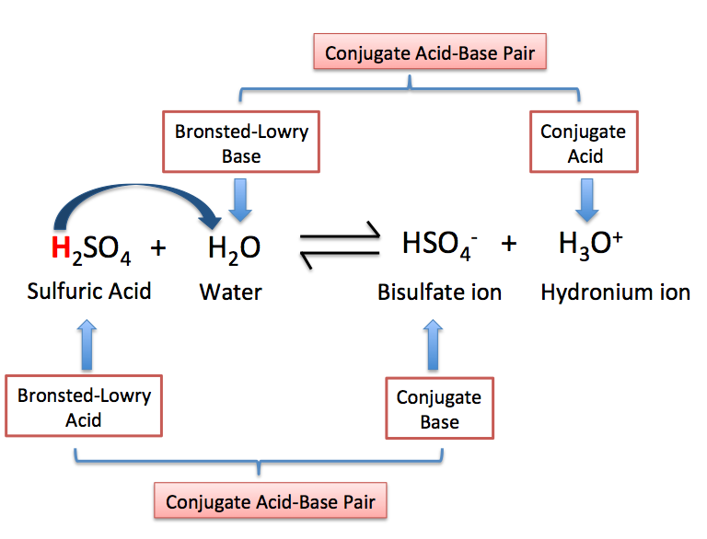
http://exercises.murov.info/ex12-1.htm problems 5, 9, 11.
CHAPTER 12 - Acids, Bases, and Salts Exercise 12-1 Acids and Bases, pH - Exercise 12-1
5. In the reaction, CO₃²⁻ + H₂O(l) = HCO₃⁻ + OH⁻ , water is a:
A Brönsted acid (BA) is a proton donor and a Brönsted base (BB) is a proton acceptor. A BA reacts to form its conjugate (product thereof) base (CB). In the reverse reaction, the CB accepts a proton and is a BB. A BB reacts to form its conjugate acid (CA). In the reverse reaction, the CA donates a proton and is a BA. In this reaction, water donates a proton and is a BA.
9. For the next several questions, remember that p = -log₁₀ thus pH = -log₁₀[H⁺] where [H⁺] is the hydrogen ion concentration. Also in aqueous solution [H⁺][OH⁻] = 1x10⁻¹⁴ and derivable from the last equation, pH + pOH = 14.
What is the approximate pH of a 1x10⁻⁴ M HCl solution?
11. What is the approximate pH of a 1x10⁻³ M NaOH solution?
pOH = -log₁₀(1x10⁻³) = 3
pH + pOH = 14 pH = 14 - pOH = 14 - 3 = 11
pH = -log₁₀(1x10⁻⁴) = 4

Slide 40
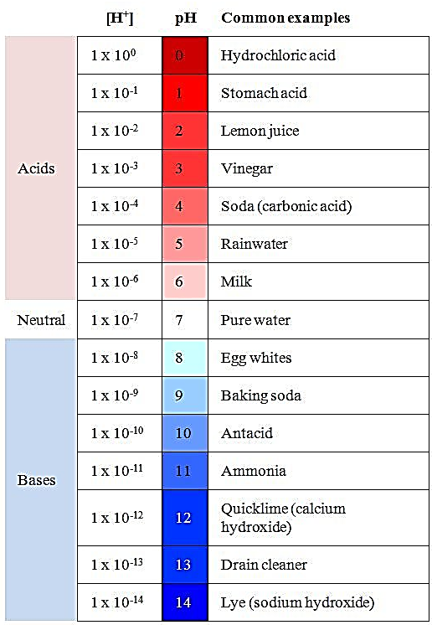
http://exercises.murov.info/ex12-1.htm problems 14, 19, 20.
14. A solution with pH = 2 has how many times more hydrogen ion concentration than one with pH = 4?
pH = 2 = -log₁₀[H⁺] 4 = -log₁₀[H⁺]
[H+] = 1x10⁻² M [H+] = 1x10⁻⁴ M
(1x10⁻² M)/(1x10⁻⁴ M) = 1x10²
19. If 24.7 mL of a 0.120 M sodium hydroxide solution are required to neutralize 0.462 grams of an unknown monoprotic acid, what is the molecular mass of the acid?
HX(aq) + NaOH(aq) = H₂O(l) + NaX(aq)
(0.462 g HX) (1 L NaOH) (1 mol NaOH) =
(0.0247 L NaOH) (0.120 M NaOH) (1 mol HX)
156 g/mol HX. After arriving at an answer, always ask If the answer makes sense. 156 g/mol is a reasonable value for a molecular mass.
20. Write the net ionic equation for the reaction of sodium hydroxide with hydrochloric acid.
Total ionic equation H⁺ + Cl⁻ + Na⁺ + OH⁻ = H₂O(l) + Cl⁻ + Na⁺
net ionic equation H⁺ + OH⁻ = H₂O(l)

Slide 41
http://exercises.murov.info/ex13-1.htm problems 14, 19, 28.
Prioritized guidelines for determining oxidation states. When two or more of the above rules are in conflict, the one higher in the list has priority.
1. Any pure element has an oxidation state of zero.
2. The sum of the oxidation states of all atoms forming a molecule or ion is the net charge of that species.
3. In their compounds, group 1 metals have an oxidation state of +1 In their compounds, group 2 metals have an oxidation state of +2.
4. In its compounds, fluorine always has an oxidation state of -1.
5. In their compounds, hydrogen atoms have an oxidation state of +1 , except when combined with group 1 or group 2 metals (often -1 in these cases).
6. In its compounds, oxygen atoms normally have an oxidation state of -2 , except in compounds in which O is bonded to O (peroxides).
CHAPTER 13 - Oxidation-Reduction Reactions Exercise 13-1 Oxidation and Reduction - Exercise 13-1
14. The oxidation number of nitrogen in nitrate is:
NO₃⁻ x + 3(-2) = -1 x = 4 Nitrogen can have many different oxidation states including -3, 0 1, 2, 3, 4 5
19. In the reaction, Zn(s) + CuSO₄(aq) = ZnSO₄(aq) + Cu(s), what is oxidized?
The oxidized species loses electron(s). The oxidation number of zinc changes from 0 to +2 or a loss of 2 electrons so zinc is oxidized in this reaction. The copper gains electrons and is reduced. Cu²⁺ is the oxidizing agent and zinc is the reducing agent.
28. How many electrons are needed to balance the half reaction involving reduction of permanganate to manganese(II) (using the lowest whole number coefficients and assuming acidic media) and on which side of the equation will they appear?
MnO₄⁻ + 8H⁺ + 5e⁻ = Mn²⁺ + 4H₂O
5 electrons on the left balance the charge on the half reaction.

Slide 42
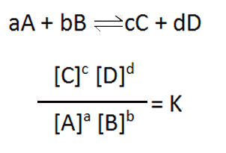
http://exercises.murov.info/ex14-1.htm problems 2, 8.
CHAPTER 14 - Reaction Rates and Equilibrium Exercise 14-1 Equilibrium Expressions, Le Chatelier's Principle - Exercise 14-1
2. Choose the correct equilibrium expression for:
N₂(g) + O₂(g) = 2 NO(g)
Le Chatelier’s Principle. Essentially, the principle states that a system at equilibrium that is subjected to a change (such as concentration, temperature, or pressure changes) that disrupts the equilibrium, responds to the change to reestablish a new equilibrium.
[NO]²/[N₂][ O₂] The equilibrium expression is the product of the concentrations of the products divided by the product of the concentrations of the reactants with the concentration of each reactant or product is raised to the power of its coefficient. Reactants (such as water) that effectively do not change concentration as a result of the reaction are usually dropped out of the equilibrium expression.
The NaOH will react with the hydrogen ion. With low hydrogen ion, the reaction will shift to the right to reestablish equilibrium. Another way of looking at this is to think in terms of the equilibrium expression:
K_{a} = [H^{+]}[F⁻]/[HF] If the [H⁺] is decreased the equality will be destroyed. The reaction shifts to the right raising the [H⁺] and lowering the [HF] reestablishing equality.
8. HF(aq) = H⁺ + F⁻
Assume the above system is at equilibrium. In which direction will the system shift to reachieve equiibrium if NaOH is added to the system?

Slide 43
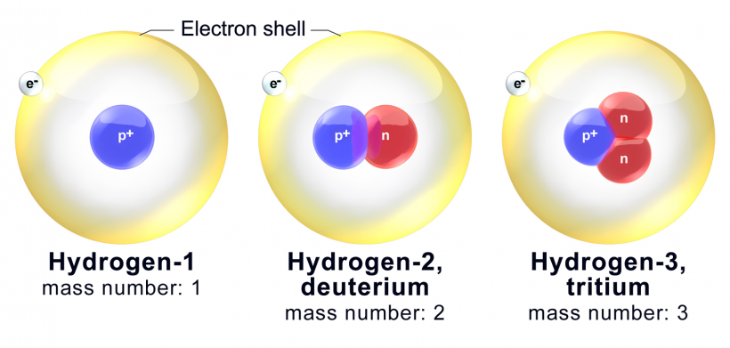
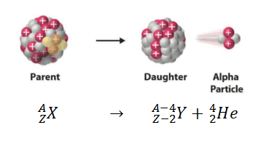
http://exercises.murov.info/ex15-1.htm problems 4, 6, 12.
CHAPTER 15 - Nuclear Chemistry Exercise 15-1 Nuclear Chemistry - Exercise 15-1
4. Which one of the following isotopes is probably unstable?. ¹⁶O ¹³O ⁸⁹Y ²⁰⁹Bi
Except for ¹³O, the isotopes listed are within 0.1 of the atomic mass of each element and likely the predominant isotope of the element. For ¹³O, this isotope differs by 3 from the atomic mass of oxygen and is likely unstable. Actually, ¹³O has a half life of 8.6x10⁻³ sec.
Isotopes of hydrogen
6. ²³⁸U decays by emitting an alpha particle. What is the other product?
²³⁸U → ²³⁴Th + ⁴He
²³⁴Th. An alpha particle is a helium nucleus
12. Which one of the following is an example of nuclear fission?
¹n + ²³⁵U → ¹³⁹Ba + ⁹⁴Kr + 3 ¹n Fission results when certain nuclei are impacted by a neutron. While ²³⁵U and ²³⁹Pu undergo fission, 99.3% of naturally occurring uranium is ²³⁸U and it does not undergo fission.

Slide 44
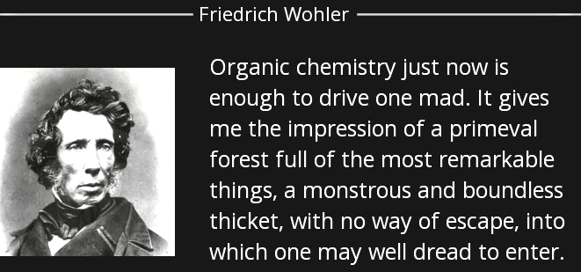
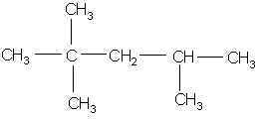
http://exercises.murov.info/ex16-1.htm problems 1, 5, 14.
CHAPTER 16 - Organic Chemistry Exercise 16-1 Organic Chemistry - Exercise 16-1
1. What is the name of:
2,2,4-trimethylpentane is the IUPAC name. Unfortunately, the name isooctane is commonly used for this compound which has been assigned an octane rating of 100 and is a standard for determining octane ratings. Using nomenclature guidelines, isooctane is 2-methylheptane.
5. The compounds that follow are:
Geometric isomers (also stereoisomers). Isomers are compounds with the same molecular formula that differ in structure in one of several ways. This results in some kinds of different and distinguishable properties.
14. The compound that follows belongs to which class of organic compounds:
With R commonly representing a carbon – hydrogen group such as C_{n}H_{2n+1}, alcohols have the formula ROH.

Slide 45
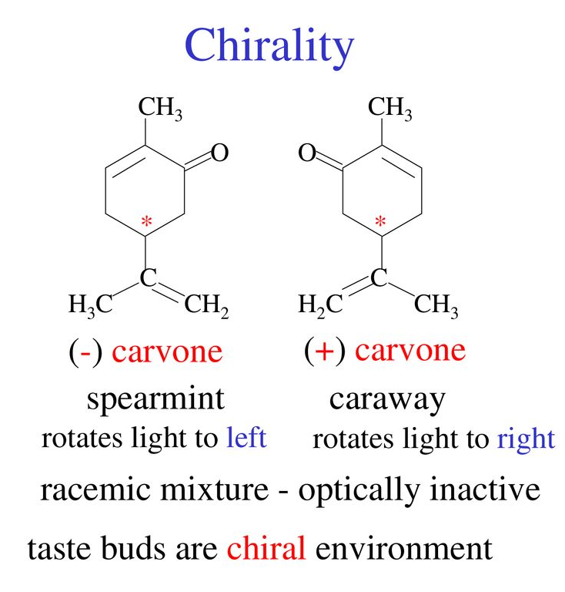
One of the marvels of chemistry is that non-superimposable mirror images like the two stereoisomers of carvone have the same properties (e.g., mp, bp, density, refractive index) except they rotate the plane of polarized light in equal but opposite directions, and they interact with other mirror images differently (sometimes resulting in different perceived odors).
The solved examples in this web site have been selected from the chemistry exercises below. To learn chemistry, you need to experience chemistry in the laboratory and solve chemistry problems. The more problems attempted and solved, the greater your competence will be in the extremely important and exciting field of chemistry. Carvone is one of the plethora of chemistry examples that should inspire interest and curiosity. Explore and enjoy.
Steven Murov http://murov.info http://murov.info/resume.htm
http://murov.info/chemexe.htm or http://exercises.murov.info/chemexercises.htm

