Slide 1
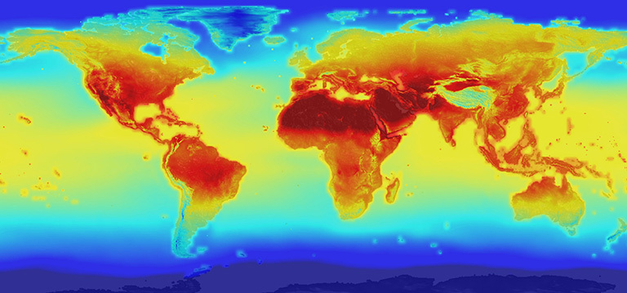
The Causes of Climate Change:
A Brief Introduction to the Science
Climate change is an extremely important and relevant topic. Climate change science needs to be better understood by society to enable the best decisions for responsible action. The PowerPoint slides in this file contain information about the science of climate change. Three other collections provide information about the effects of climate change and the effects of climate change on health. For the slides on effects, please visit: http://murov.info/climintro.pptx , http://murov.info/climeffects.pptx and http://murov.info/climeffectshealth.pptx.
Steve Murov, Prof. Emeritus of Chemistry, Modesto Junior College, http://murov.info
2100 projection of global warming
https://climate.nasa.gov/news/2293/nasa-releases-detailed-global-climate-change-projections/

Slide 2
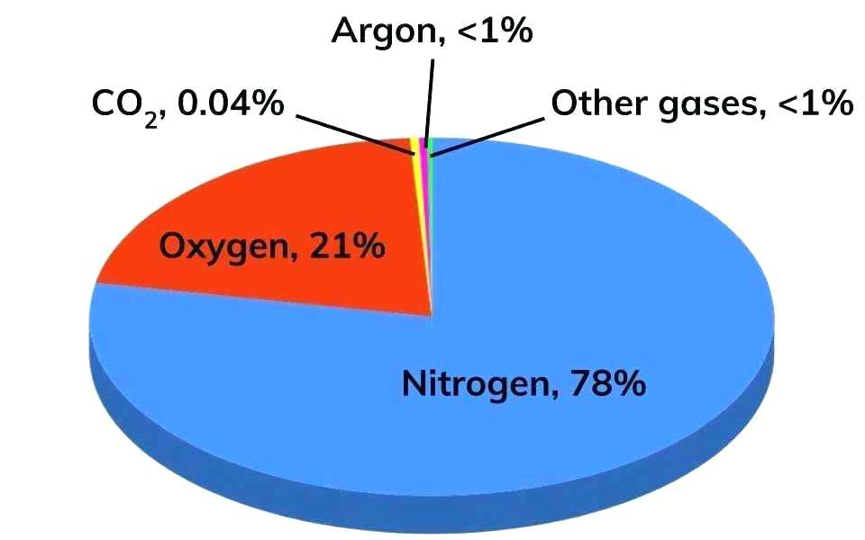
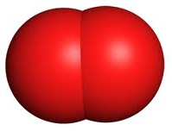
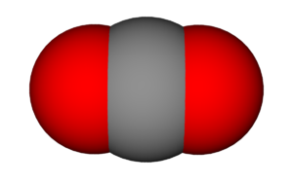
Name the four most abundant gases in air excluding water (the humidity varies widely by location, weather, time of the year from a trace to 4%) in decreasing order of abundance.
Name formula % abundance Lewis Structure model
1. Nitrogen N₂ 78.1%
2. Oxygen O₂ 20.9%
(Note: the Lewis structure for oxygen is one of the few failures of the Lewis structure method as it predicts incorrect magnetic properties of O₂)
3. Argon Ar 0.93%
4. Carbon CO₂ 0.04%
dioxide
Many people do not name nitrogen as the most abundant gas, extremely few name argon as the third most abundant gas and CO₂ is commonly named as one of the three most abundant gases. Presumably the latter is a conclusion reached because plants need CO₂ and animals exhale CO₂. However, only 3% of human exhaled gas is CO₂ and most is N₂. Why? The importance of these misconceptions is the topic of the next slide.

Slide 3
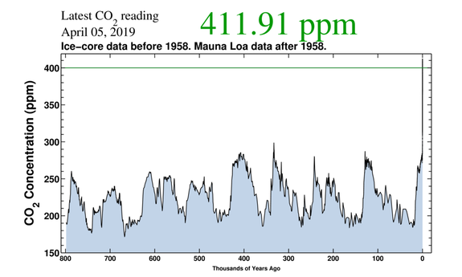
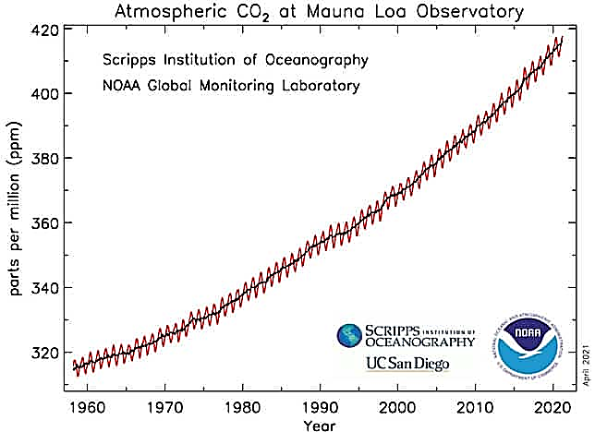
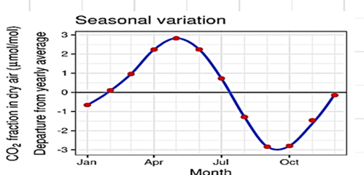
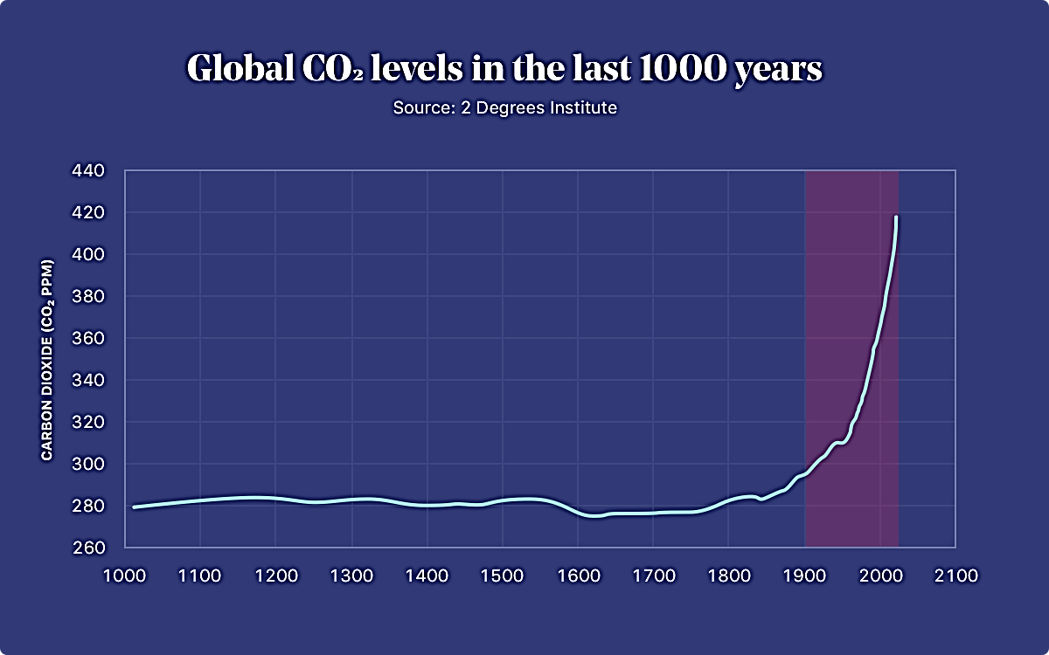
Is the carbon dioxide content of the atmosphere increasing?
800,000 years ago to 2019AD
Current value= 419 ppm = 0.0419% by vol.and is approaching
a 50% increase over pre-industrial value of 280 ppm.
1960 - 2020
1000 AD to 2020 AD
Multiple choice
a. The CO₂ concentration has increased by about 50% since 1700.
The CO₂ concentration averaged about 230 ppm for 800,000 years
and about 280 ppm for 1000 to 1800.
c. The CO₂ concentration leveled off in 2000.
The CO₂ value of 410.52 ppm is a localized Hawaii value due to
volcanic action.
e. a and b are true, c and d are false.
e. a and b are true, c and d are false.
CO₂ concentrations are obviously increasing (280 ppm to 411 ppm.)

Slide 4
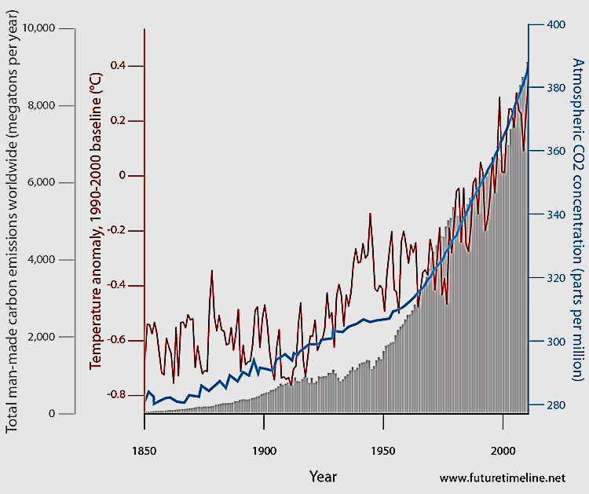
True or False – There is a correlation among global temperature and total CO₂ concentration.
TRUE
Conclusion:
Either the temperature increase causes CO₂ to increase or CO₂ increases causes temperature to increase.
Temperature,
Dark line
atmospheric CO₂,
Blue line
However, the additional correlation with the CO₂ production strongly supports CO₂ as the cause and temperature as the effect.
CO2 production, solid grey

Slide 5
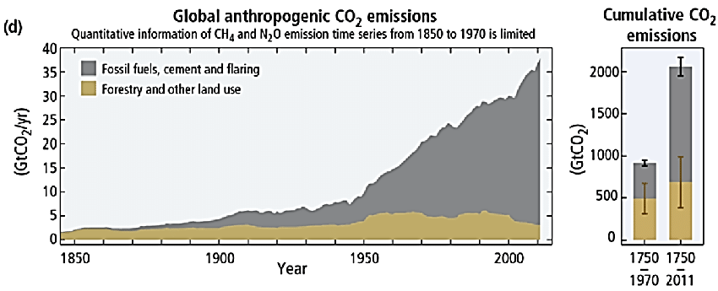
True or False? Fossil fuel combustion is the cause of the 50% increase in CO₂ concentration in the atmosphere?
Description kg kg
Atmosphere (total mass of gases) 5.2x10¹⁸
Atmospheric CO₂ 3.0x10¹⁵
CO₂ annual production from combustion (current) 3.5x10¹³
Average annual CO₂ production for 1945 – 2010 2.2x10¹³
True –Because of the relatively small amount of CO₂ in air (0.042% of the gases in the air), human production of CO₂ has caused a 0.7% average increase per year for 1945 – 2010. This demonstrates that the calculated human production of CO₂ results in a very approximate 46% increase over 65 years that is consistent with experimental observations.
Admittedly, this is a vastly oversimplified model as there are natural CO₂ sources as well as significant CO₂ sinks including the very important oceans. The data and calculation are consistent with the explanation that fossil fuel combustion by humans is changing the CO₂ content of our atmosphere.

Slide 6
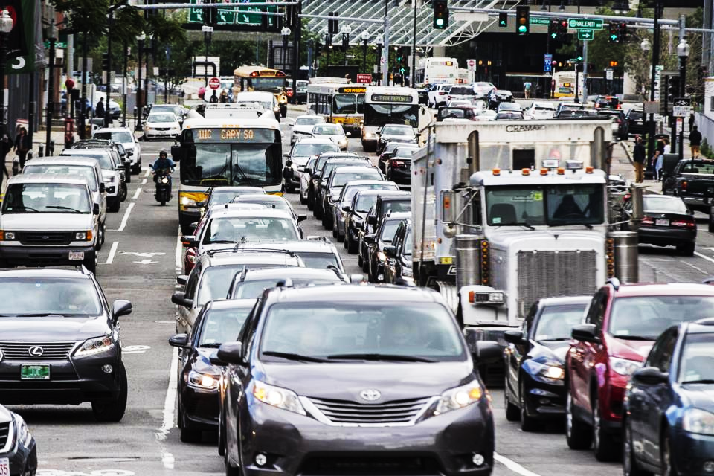
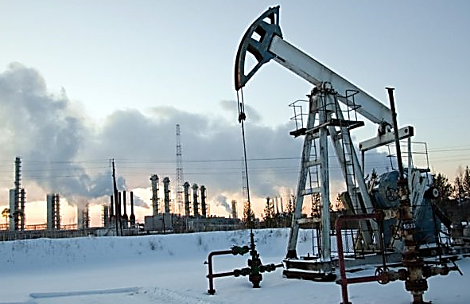
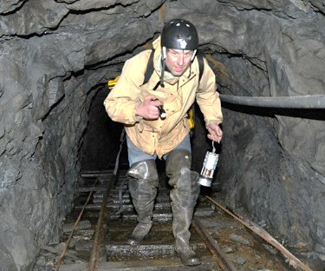
The conclusion on the previous slide was that either temperature increases have caused CO₂ to increase or CO₂ increases causes temperature to increase.
True or false: Previous slides demonstrated that fossil fuel combustion is the cause of the 50% increase of the CO₂ content of the atmosphere and the global temperature of the earth is rising as a result of human burning of fossil fuels.
Human action in the form of fossil fuel combustion is increasing the CO₂ content of the atmosphere (along with other Greenhouse gases such as methane and N₂O) which in turn is trapping more outward bound radiation and raising global temperatures.

Slide 7
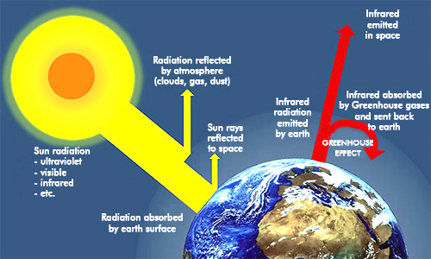
True or False – Because CO₂ is a minor constituent of the air, the CO₂ increase (50% and rising) should not significantly affect the earth’s climate.
FALSE! As observed, humans have caused a 50% (and rising) increase in the amount of CO₂ along with increases in other Greenhouse gases. These increases trap outgoing energy and result in an increase in global temperatures.
https://www.nationalgeographic.org/encyclopedia/greenhouse-effect/

Slide 8
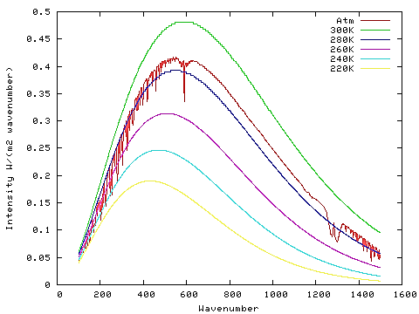
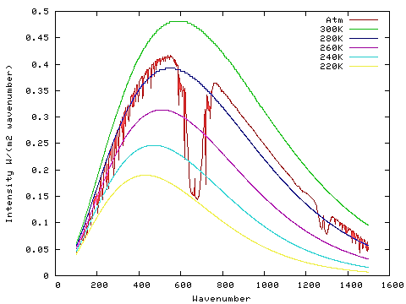
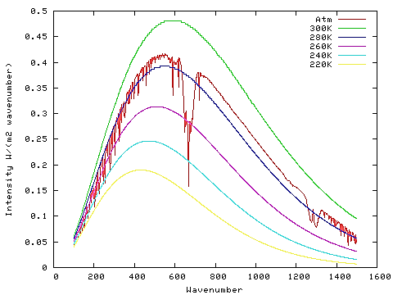
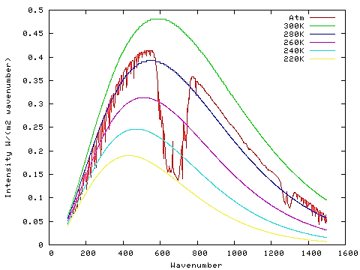
The graphs to the left give spectra of the radiation emitted from the earth (at different earth temperatures). The graph also shows that CO₂ absorbs some of the escaping radiation. CO₂ has increased since the industrial revolution from 280 to 410 ppm. The graph shows:
Increasing CO₂ causes more energy trapping that should result in an increase in global temperatures.
Increasing CO₂ causes more energy to escape that should result in a decrease in global temperatures.
Neither of the above.
0 ppm CO₂
50 ppm CO₂
2 ppm CO₂
390 ppm CO₂
https://chriscolose.wordpress.com/2010/02/18/greenhouse-effect-revisited/

Slide 9
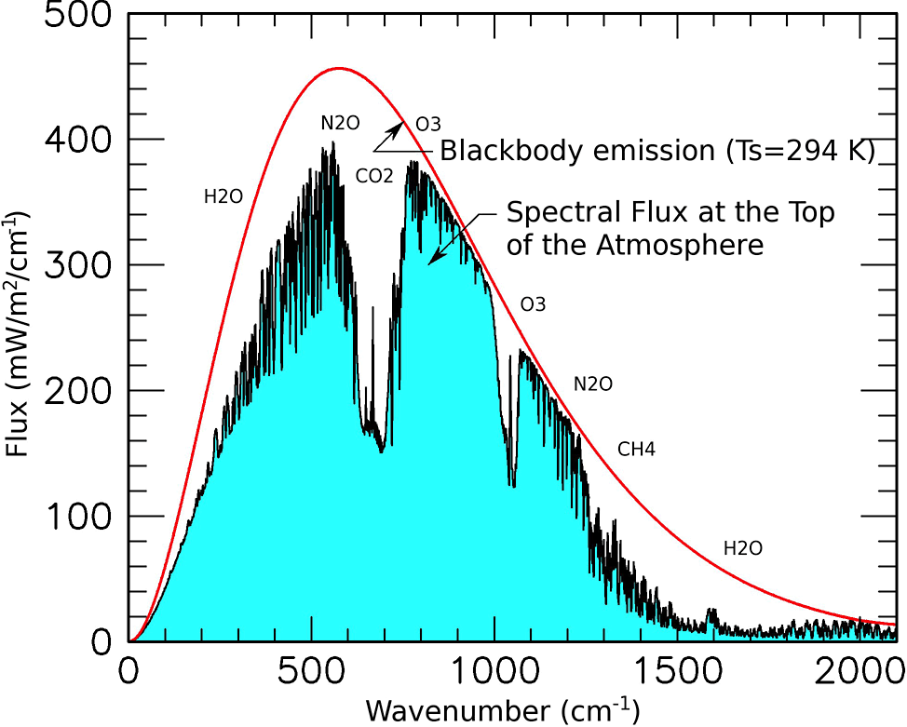
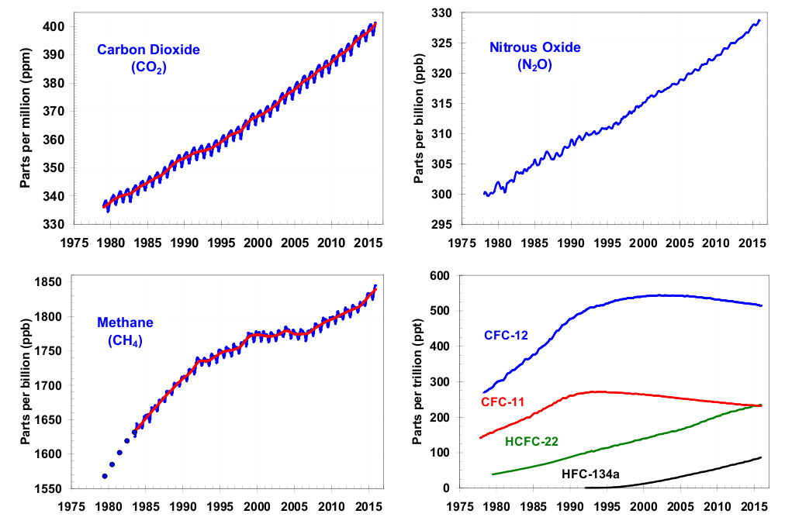
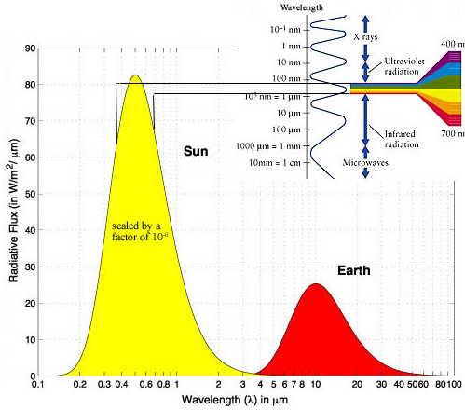
In addition to CO₂, concentrations of other Greenhouse gases such as nitrous oxide and methane are also increasing. Freons are also Greenhouse gases but have leveled out or started to decrease as a result of regulations such as the Montreal Protocol.
Light impacting
earth.
Light
emitted
by earth.

Slide 10
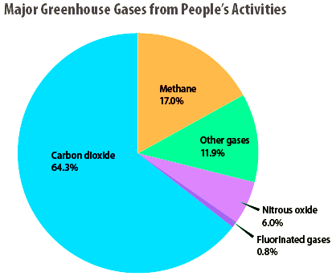
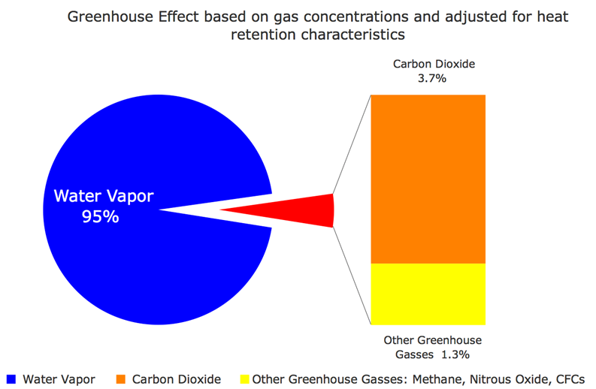
gas | Atmospheric content | Greenhouse Potency (GWP) | % of current Extra Greenhouse effect
H₂O | 0 – 5% | 0.1
CO₂ | 411 ppm | 1 | 50 - 70
CH₄ | 1.8 ppm | 28 | 14 - 18
N₂O | 0.3 ppm | 265 | 6
O₃ | 0.04 ppm | 160 | 3 - 12
freons | 0.0002 ppm | 1300 - 15000 | 0 - 2
After water, CO₂ has the largest greenhouse effect primarily because it has by far the highest concentration, but other gases have much higher potency and become much more important as their concentrations increase.
True or False:
CO₂ currently contributes about 3 to 4x as much as any other Greenhouse gas (except for H₂O) to global warming.
http://cdiac.ess-dive.lbl.gov/pns/current_ghg.html
https://www.epa.gov/ghgemissions/inventory-us-greenhouse-gas-emissions-and-sinks-1990-2016

Slide 11
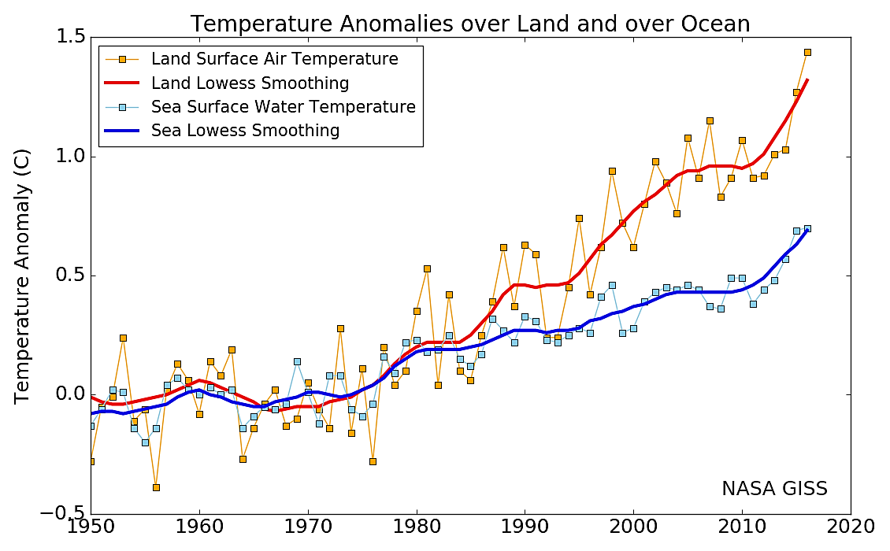
Multiple choice: For the last 60 years
Ocean surface temperatures have been decreasing.
Ocean temperatures have been decreasing while land surface temperatures have been increasing.
Reverse of b.
None of the above.
d. Both have been increasing – land surface by about 1.3ºC and oceans by about 0.7ºC

Slide 12
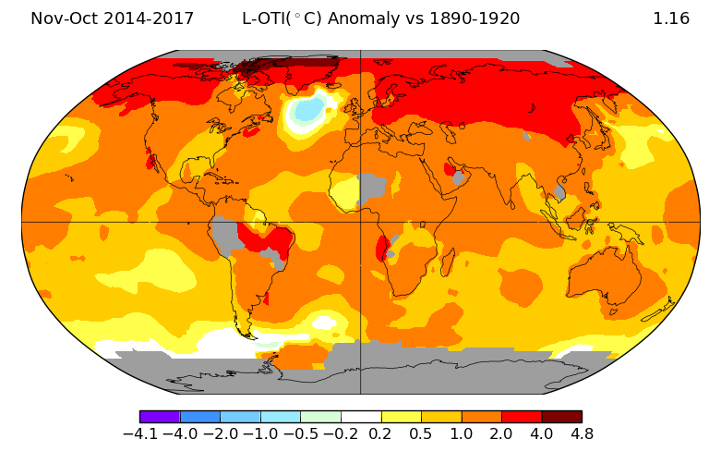
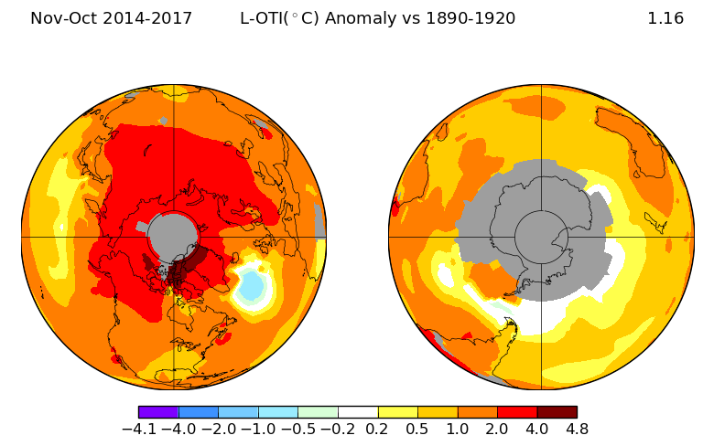
Which statements are true and which are false?
The Southern Hemisphere is warming more than the Northern.
Warming of the earth is not uniform.
Much of the Northern hemisphere has warmed by at least 1ºC (1.8ºF) over the years illustrated.
False
True
True
Average global temperatures from Nov., 2014 - 2017,
compared to a baseline average for the years, 1890 - 1920.
North and South Poles
ºC
https://data.giss.nasa.gov/gistemp/maps/

Slide 13
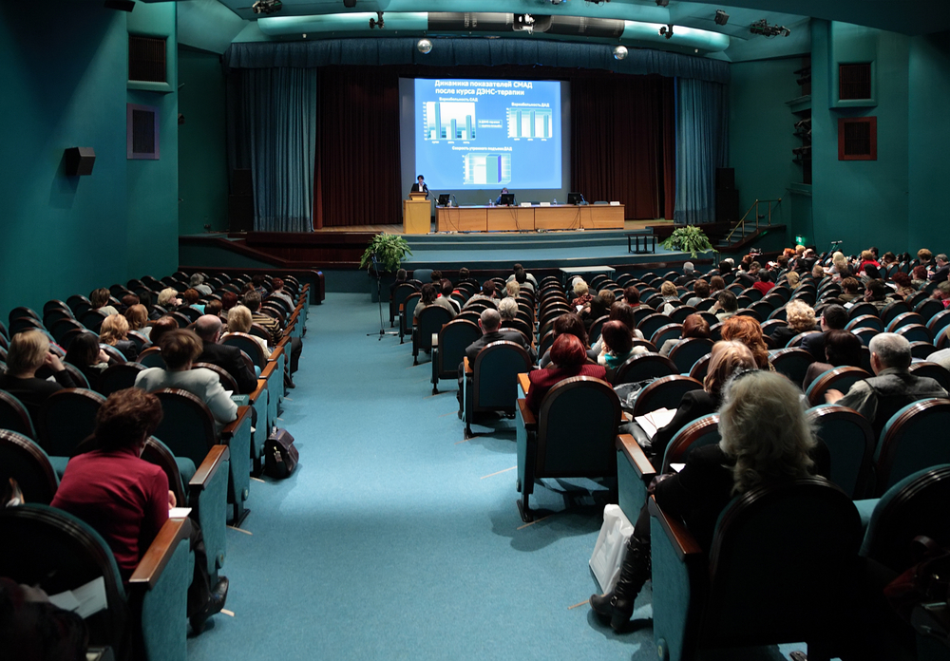
For slides on the effects of climate change, please visit: http://murov.info/climeffects.pptx , http://murov.info/climeffectshealth.pptx .
For introductory slides on climate change, please visit:
http://murov.info/climintro.pptx .
For many PowerPoint
presentations on
other topics, please visit:
http://murov.info

