Slide 1
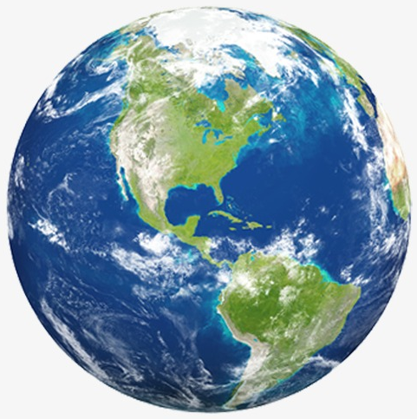
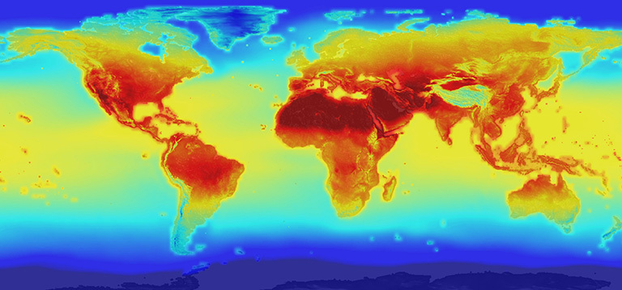
The Effects of Climate Change:
A Summary of Some of the Consequences
Climate change is an extremely important and relevant topic. Climate change science needs to be better understood by society to enable the best decisions for responsible action. The PowerPoint slides in this file contain information about the environmental effects of climate change . Two other collections provide information about the causes of climate change and the effects of climate change on health. For the slides on effects, please visit: http://murov.info/climcauses.pptx and http://murov.info/climeffectshealth.pptx.
Steve Murov, Prof. Emeritus of Chemistry, Modesto Junior College, http://murov.info
2100 projection of global warming
https://climate.nasa.gov/news/2293/nasa-releases-detailed-global-climate-change-projections/

Slide 2
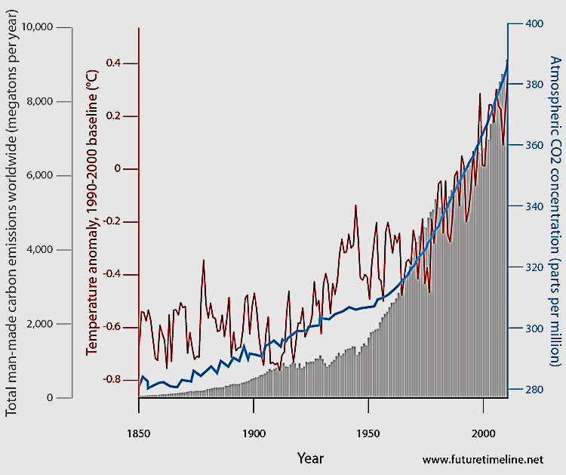
This slide shows that increases in the temperature of the earth correlate with the increasing CO2 levels.
In addition, there is a correlation with the amount of CO2 produced providing strong evidence that human activities are warming the earth.
Temperature,
Dark line
atmospheric CO₂,
Blue line
CO2 production, “solid” grey

Slide 3
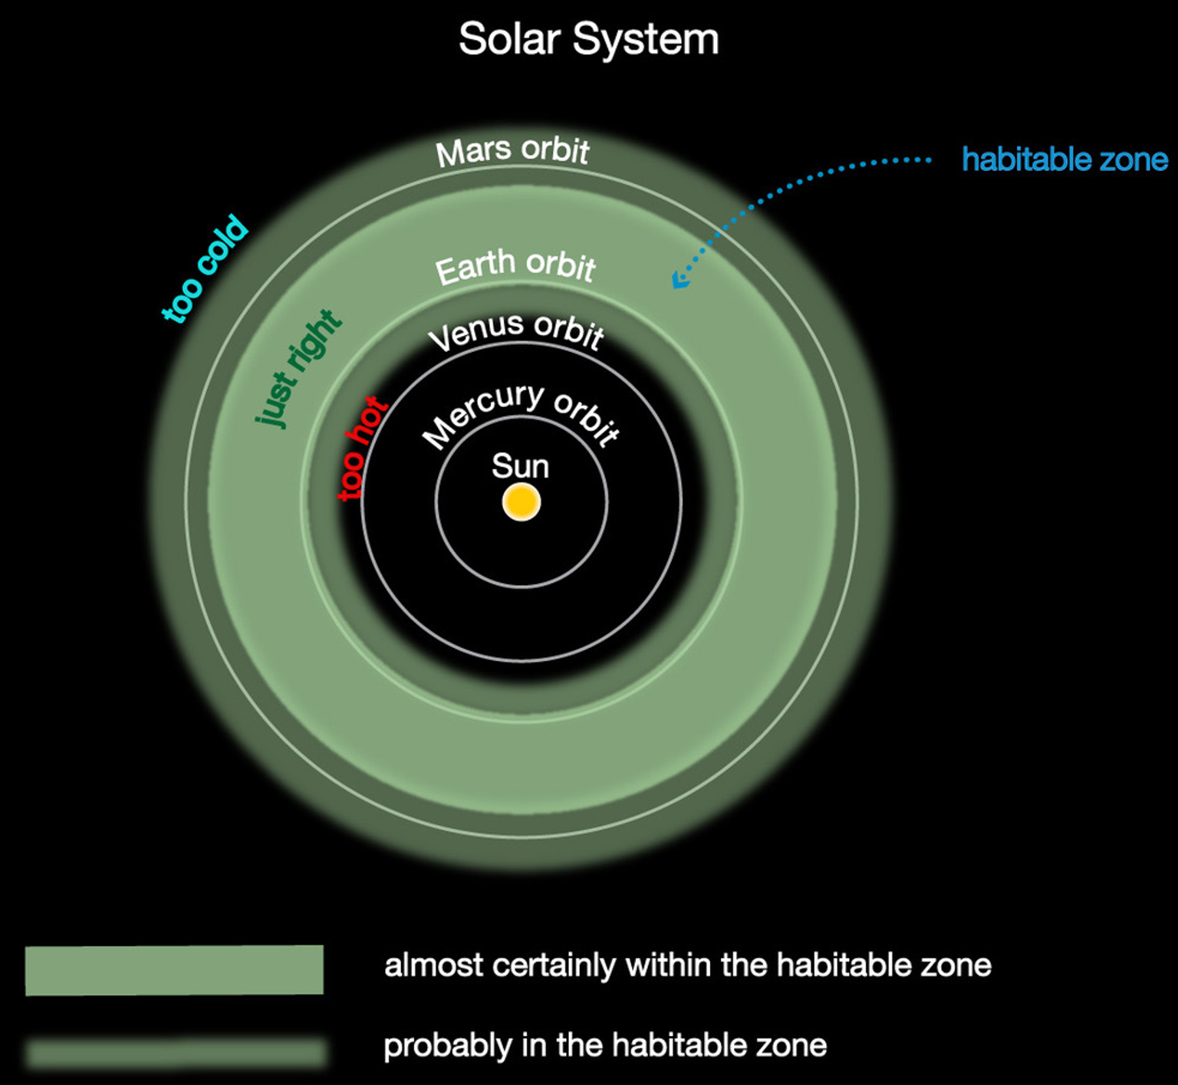
Please notice that while the earth is in the habitable zone of our solar system, the earth is precariously close to the boundary of the just right area. With little margin for error, we must be proactive to make sure that human action does not increase temperatures sufficiently to lower the quality of life on earth.
https://grade8science.com/4-3-1-how-does-earth-compare-to-other-worlds-of-our-solar-system/

Slide 4
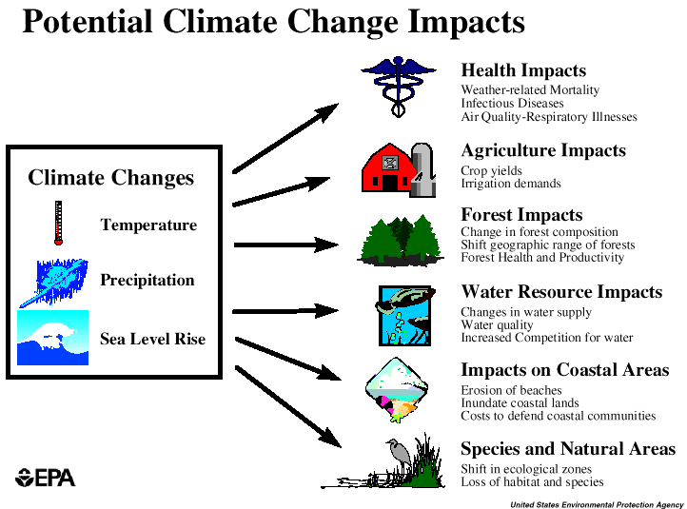
The effects of increasing temperatures on earth will be examined next along with other effects of increasing concentrations of CO₂.

Slide 5
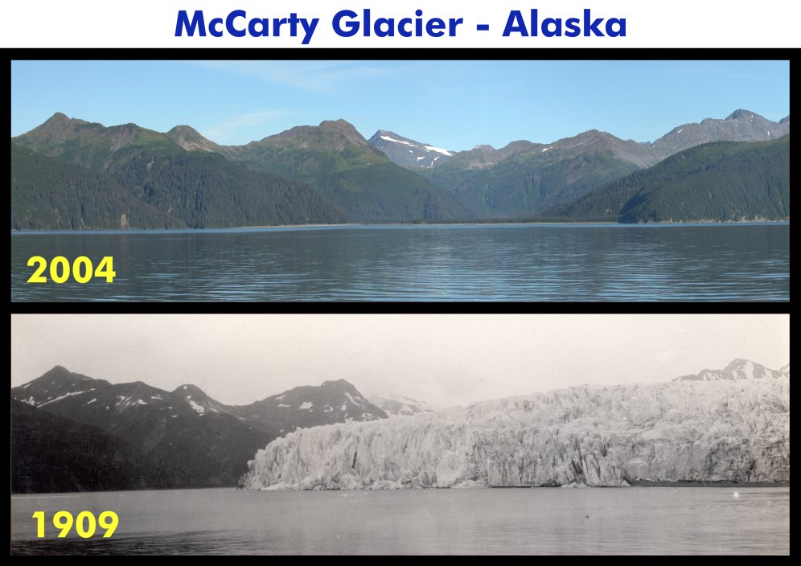
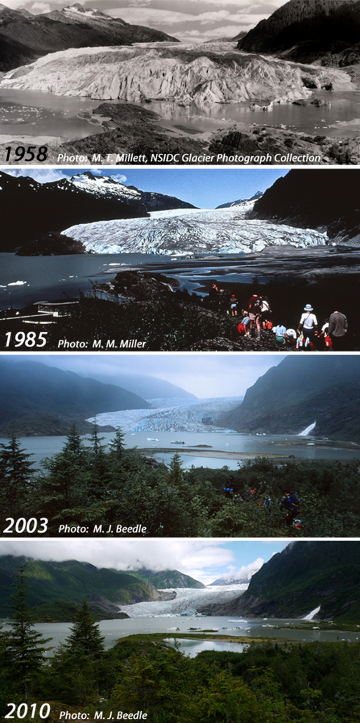
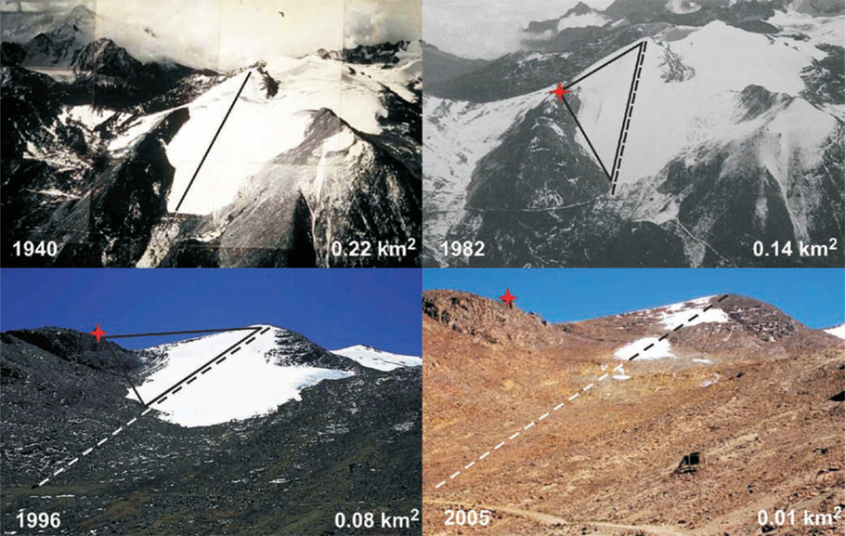
Mendenhall Glacier, Juneau, Alaska
The next several slides focus on the effects of global warming on sea levels and ice mass. These two climate change indicators are strongly connected as melting of land based ice raises sea levels.
Chacaltaya Glacier,
Bolivia

Slide 6
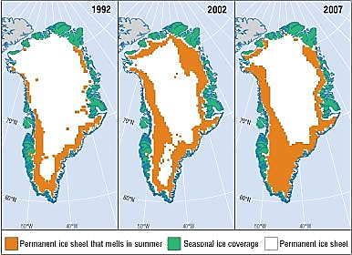
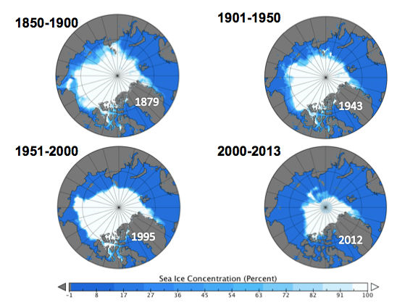
Arctic ice mass
Greenland
Severe ice mass loss in the Northern Hemisphere threatens to cause a dangerous sea level rise. Antarctic ice mass shows a slight increase over the last 34 years but does not come close to negating mass loss in Greenland and the arctic.

Slide 7
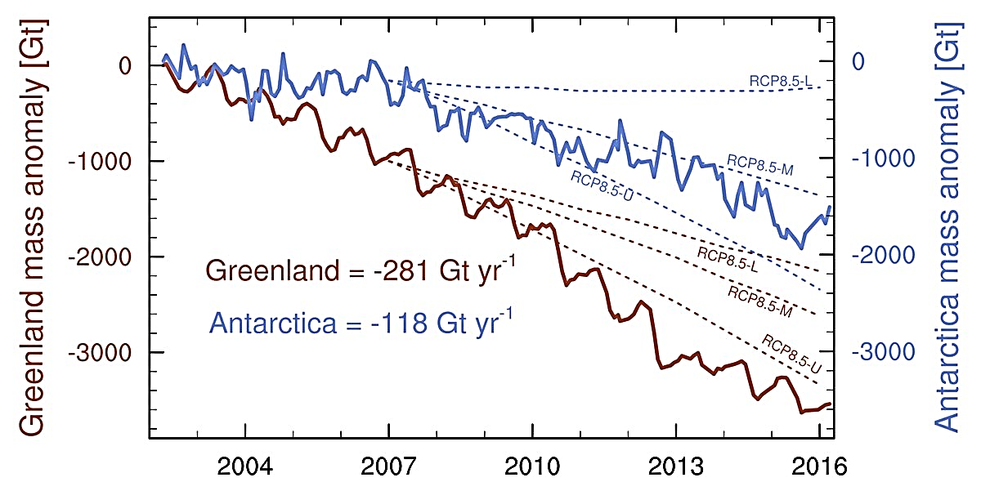
Greenland and Antarctica mass anomalies.

Slide 8
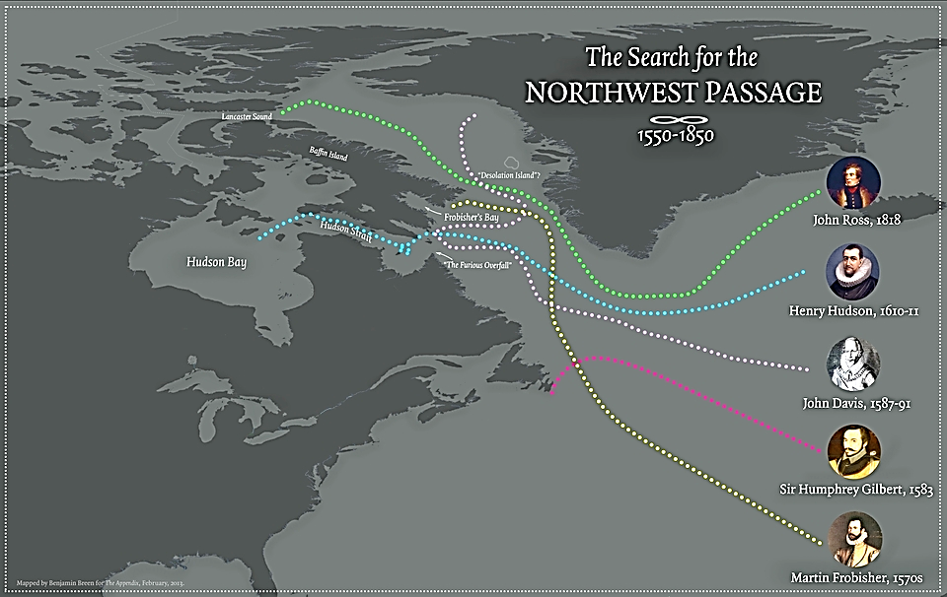
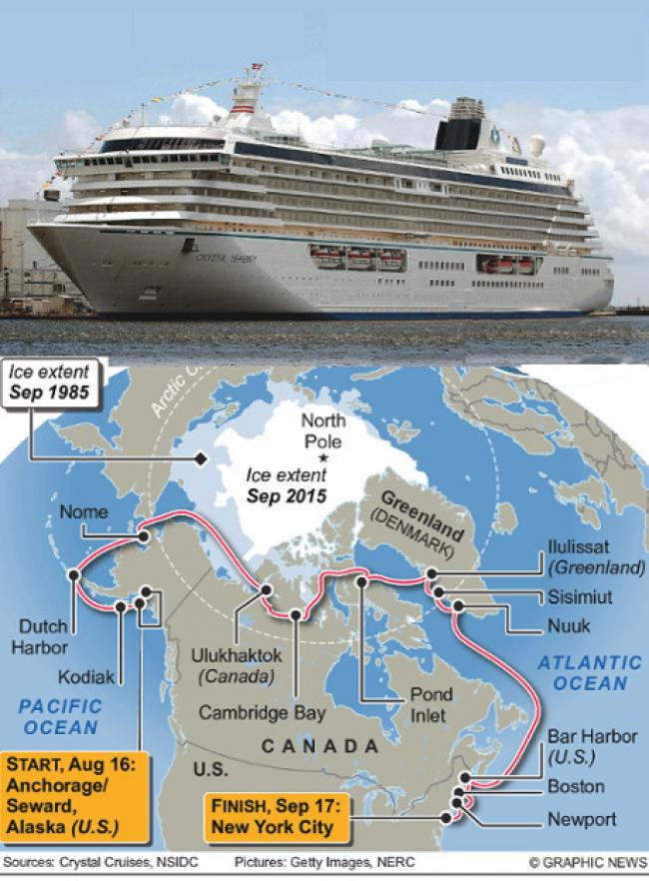
A passage (Northwest) for ships from the Atlantic to Pacific (or vice versa) was sought for hundreds of years until melting of the ice mass enabled the trip just a few years ago. The map to the right shows:
The amount of arctic ice mass is not changing.
The amount of arctic ice mass substantially decreased from 1985 to 2015.
The amount of ice mass is increasing.

Slide 9
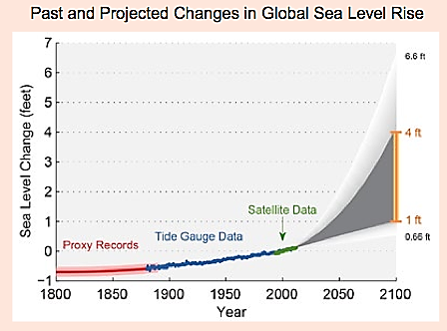
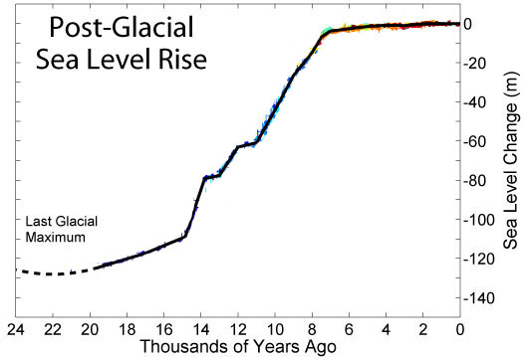
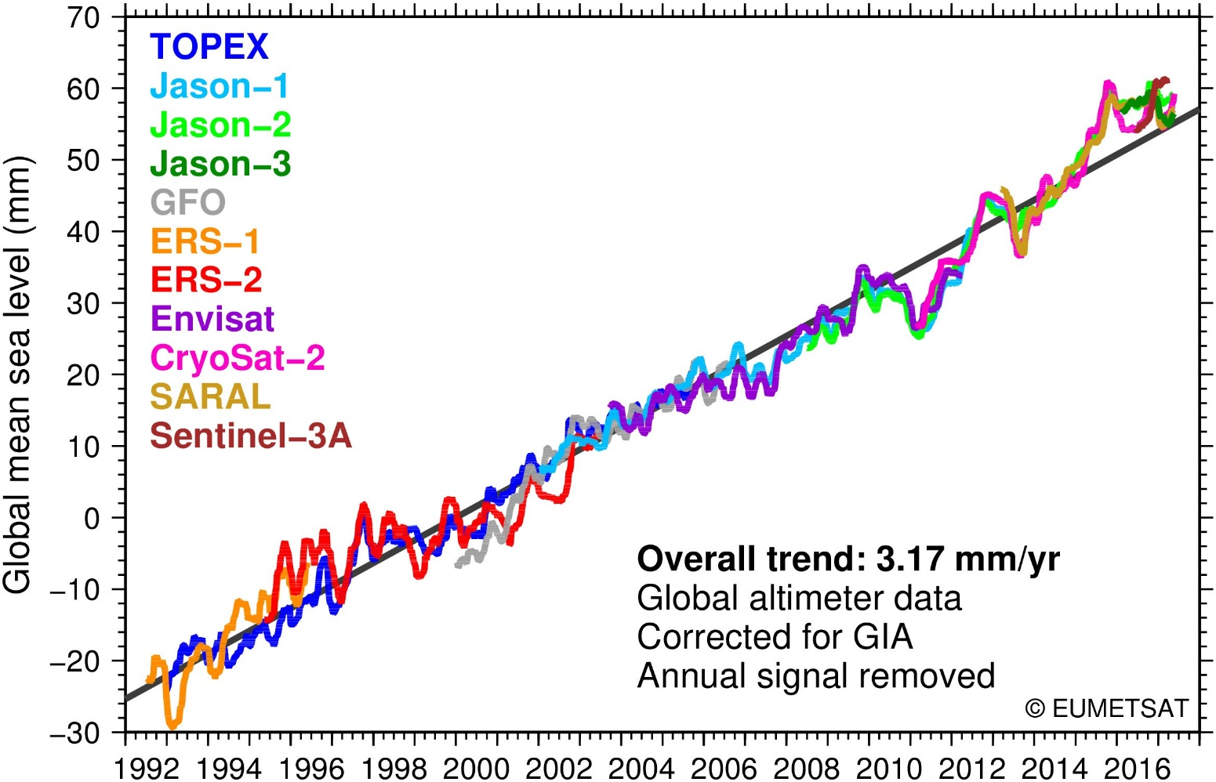
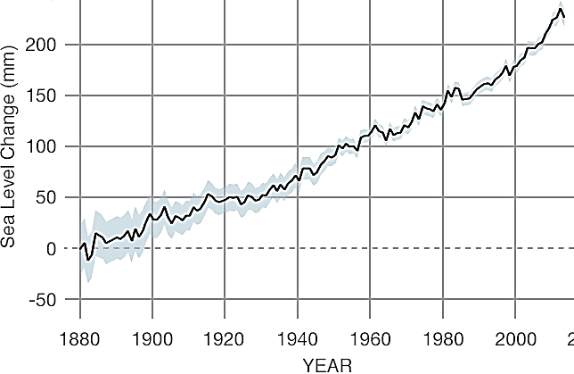
24,000 years ago to present
1992 - 2018
1880 - 2016
The graphs on this slide and the next one show the increase in sea level that is resulting from global warming. The images on the three previous slides show the melting of glaciers and the arctic and Greenland ice masses.
True or False: The rising sea levels will have no impact on coastal communities.

Slide 10
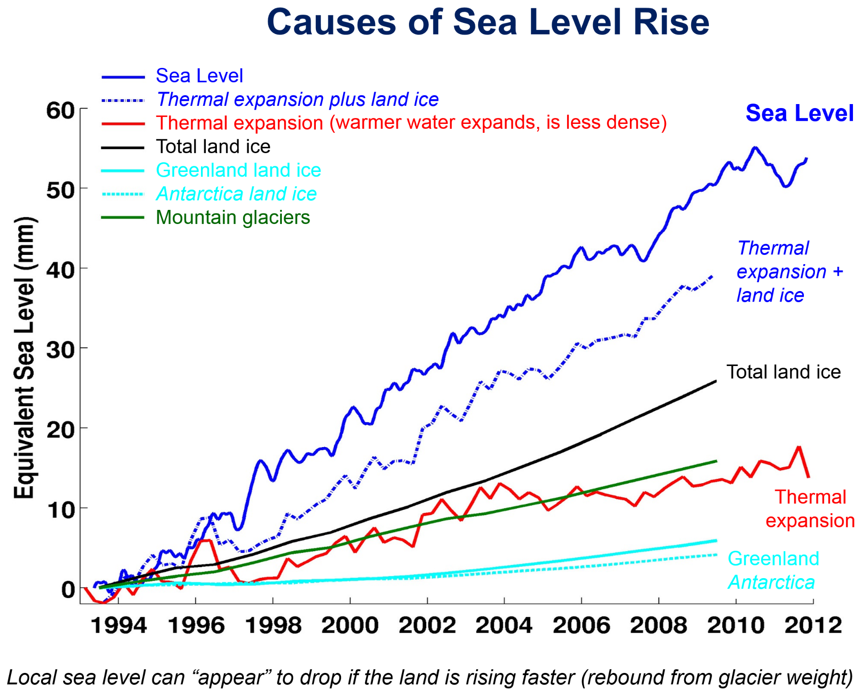
The increase in global temperature has resulted in an increase of about 0.7ºC in the temperature of the surfaces of the seas and 1.3ºC in air temperature. Warmer temperatures lower water density and expand volume and also melt land based ice. Low coastal areas are very susceptible to small changes in sea level especially when storm surges are considered.

Slide 11
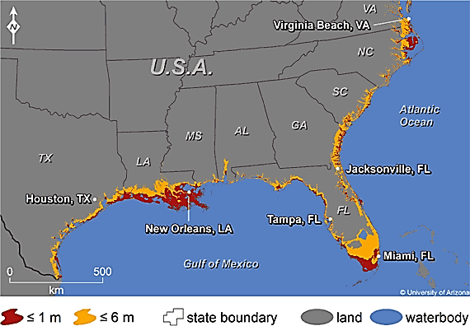
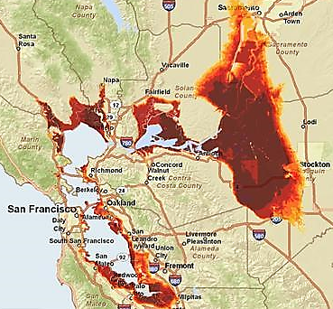
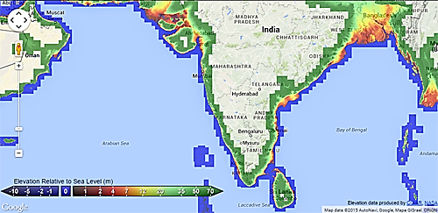
Images show a few of the earth’s land masses threatened by sea level rise.
True or false: Population centers are not threatened by sea level rise.
False: Miami is already building sea walls and using pumps to keep out the water. Rising sea levels make the threat on New Orleans more severe and the poor people of Bangladesh have no place to go as storm surges push higher.
Projected sea level rise from one meter (dark red) to six meters (light orange) in California’s Bay Area. (Weiss and Overpeck 2011)
For interactive maps of sea level rise, please visit:
https://geology.com/below-sea-level/index.shtml

Slide 12
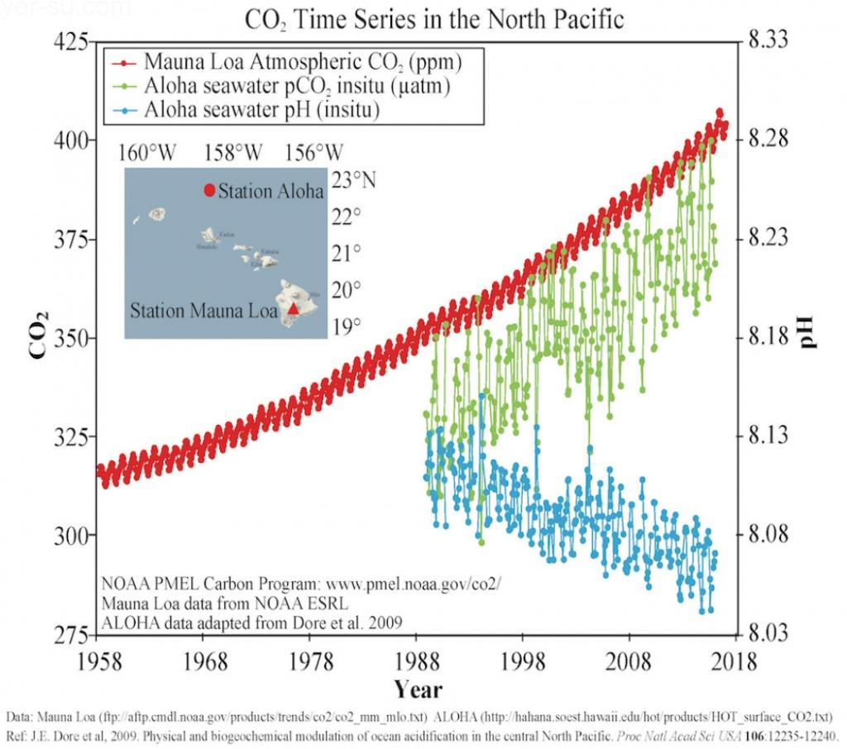
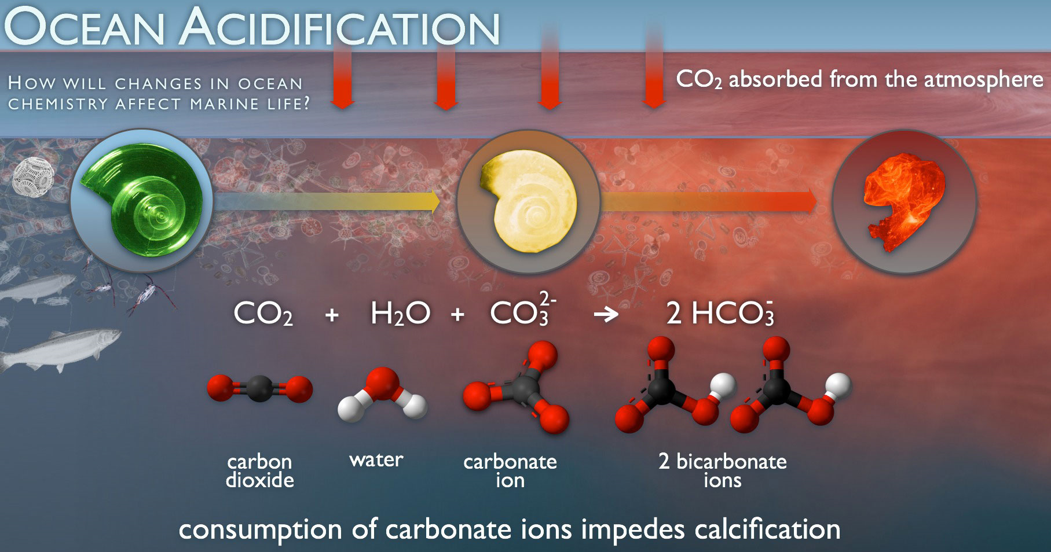
In addition to the global warming caused by increasing CO₂, increased CO₂ causes other problems. Some of the CO₂ is absorbed by the oceans. CO₂ forms carbonic acid in water causing an increase in acidity or a drop in pH.
True or False: A pH change of about 0.1 units has already been measured. This pH change is a severe threat to shell fish and coral.
30 year drop in pH

Slide 13
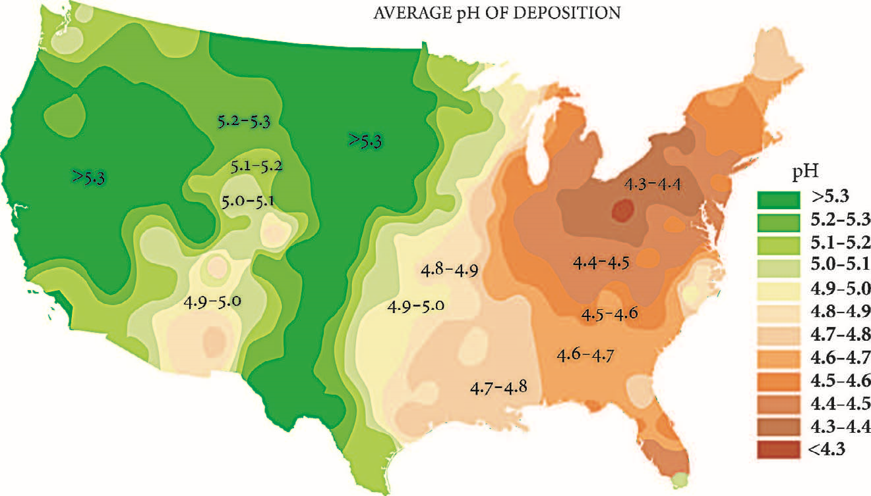
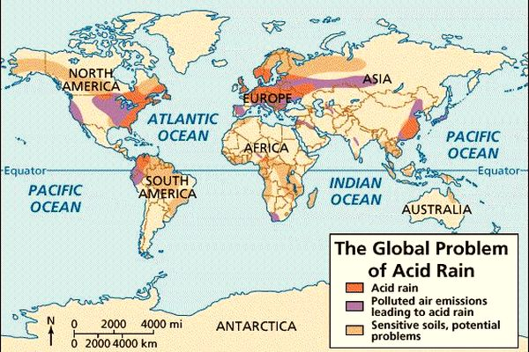
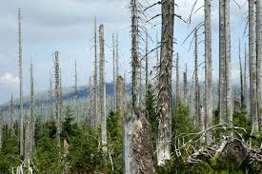
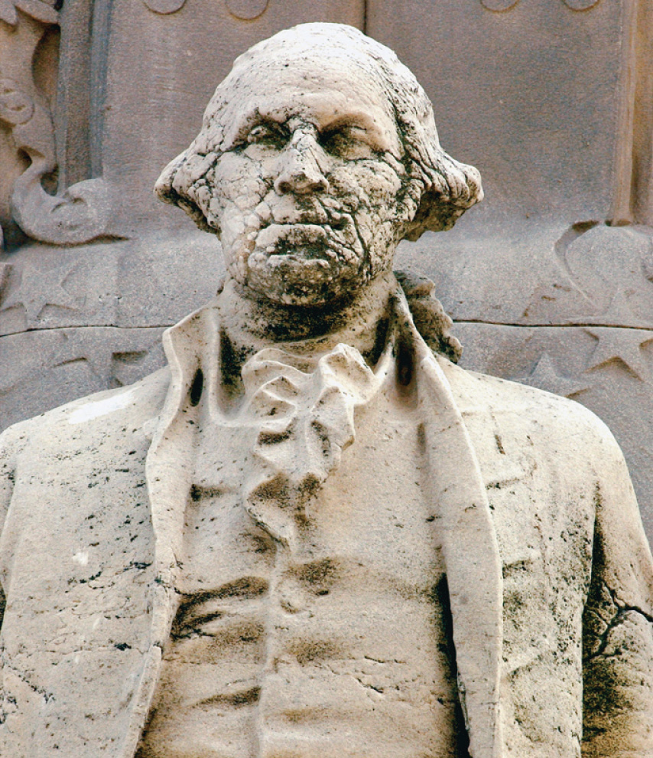
Burning of fossil fuels releases not only CO₂ but also gases such as SO₂ and NO₂ that react with water to form acids. These acids rain down upon the land and cause substantial damage to plants and property.

Slide 14
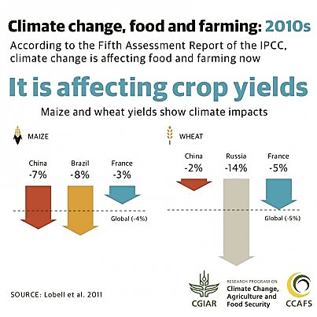
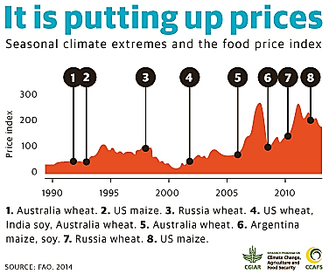
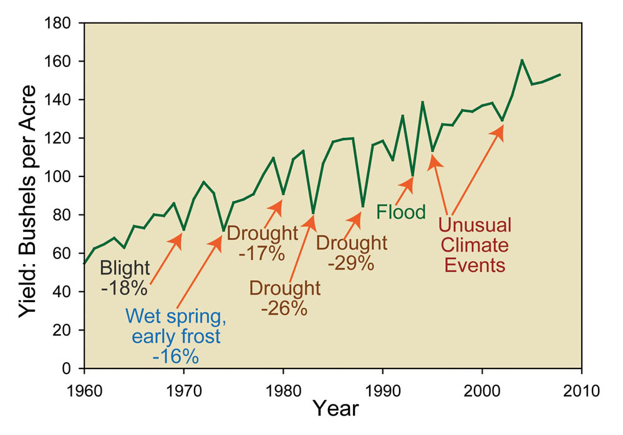

Slide 16
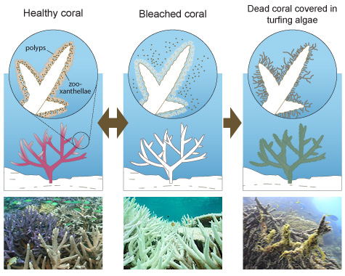
Increasing temperatures and decreasing pH values threaten coral world- wide. It is predicted that the Great Barrier Reef will be extinct by 2050. This will have world-wide repercussions.
Why do corals bleach?

Slide 17
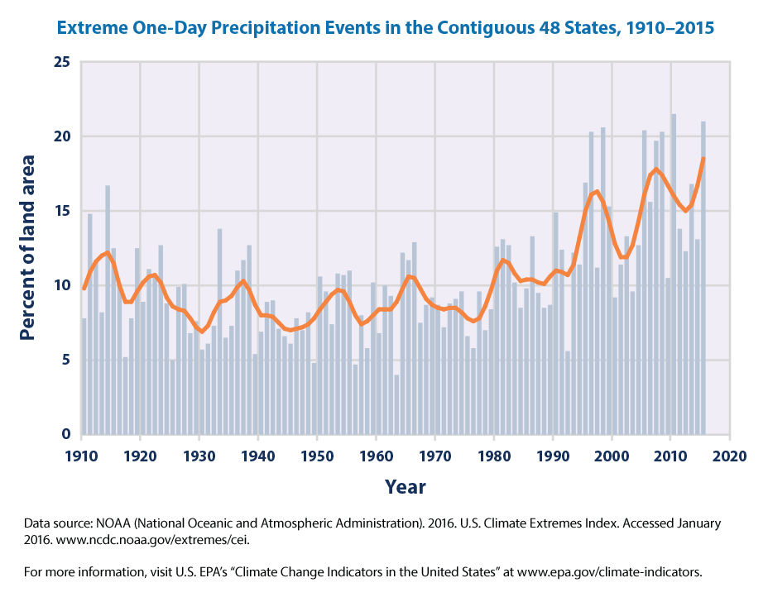
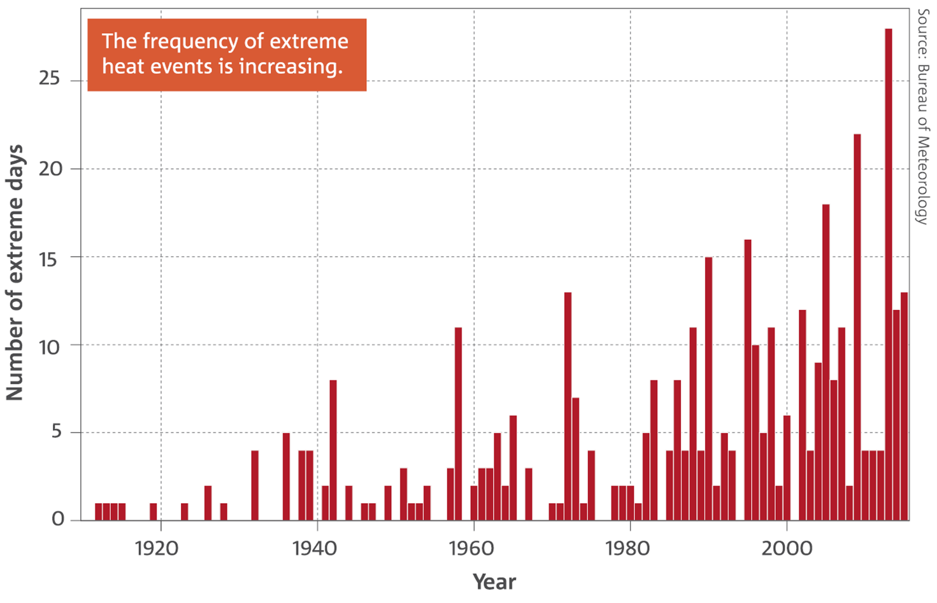
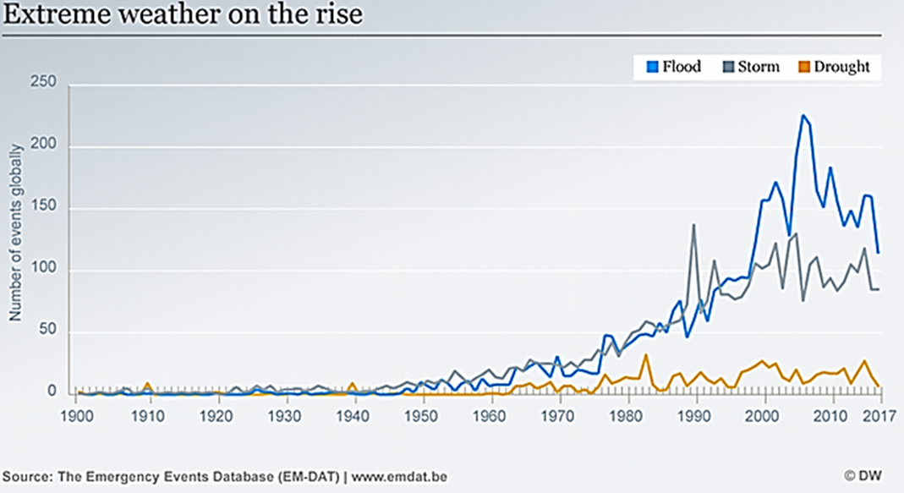
Extreme one day precipitation events.
Frequency of extreme heat events.
True or False.
The graphs show that the frequency of one day precipitation events, extreme heat and weather events are rising consistent with expectations from the observed increase in global temperatures.
Frequency of extreme weather.

Slide 18
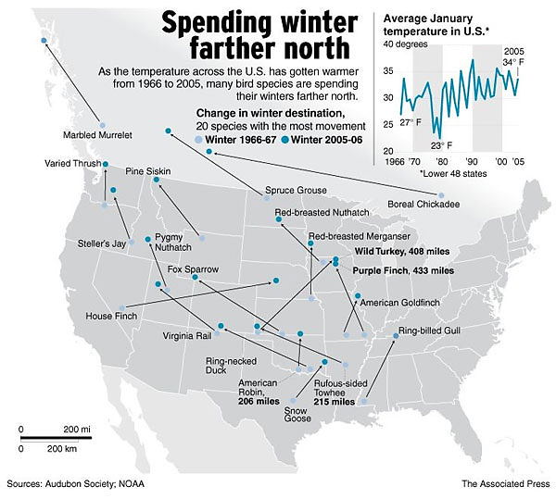
Are the behavior and survival of animals affected by climate change?
Multiple choice about the map to the right:
Many species of birds are migrating farther south due to climate change.
Many species of birds are migrating farther north due to climate change.
There are apparently no changes in migratory patterns as a result of climate change.
Many species of birds are migrating farther north due to climate change.
https://www.seattletimes.com/nation-world/birds-shift-north-as-globe-warms/

Slide 19
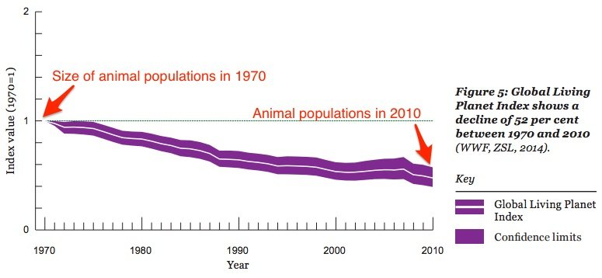
True or False:
Animal populations have declined from the year 1970 to 2010 by 52% while global temperatures have increased by about 0.6ºC (1.1ºF).

Slide 20
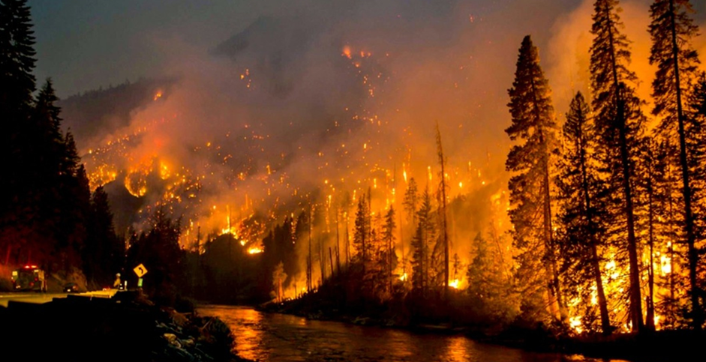
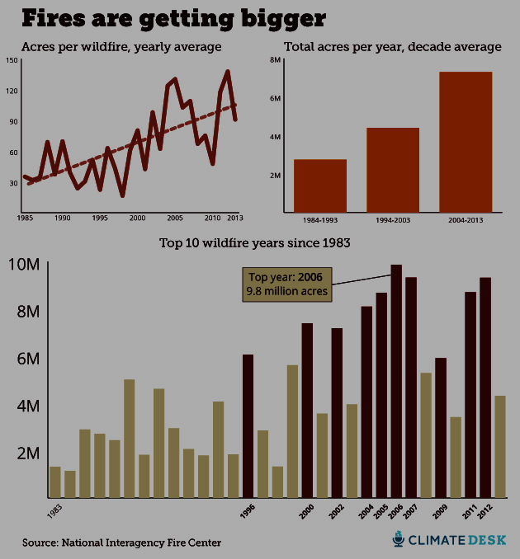
Multiple choice:
Since 1985, the general trend is that more acres are burning and there are more wildfires each year.
Since 1985, the general trend is that while more acres are burning, the number of fires is declining.
Since 1985, the general trend is that while fewer acres are burning, the number of fires is increasing.

Slide 21
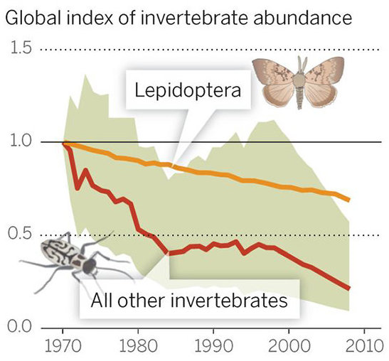
ENVIRONMENT
Insects Are Rapidly Disappearing Around The World, Leaving Scientists Horrified
BEN GUARINO, THE WASHINGTON POST
19 OCT 2018
True or False: The decline of insect populations shown in the chart is a benefit.
False: While there are many nuisance and disease carrying insects, insects do have essential roles in the food chain and in pollination. Significant loss of many types of insects will result in disastrous results to the ecology with extinction of many animals and plants resulting.

Slide 22
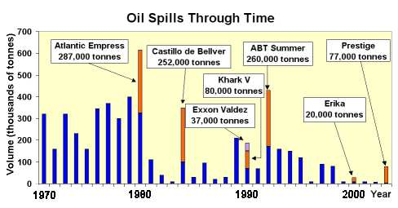
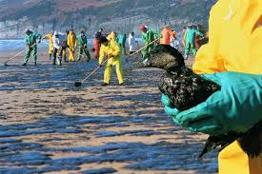
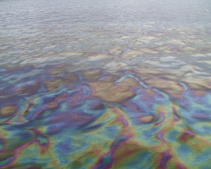
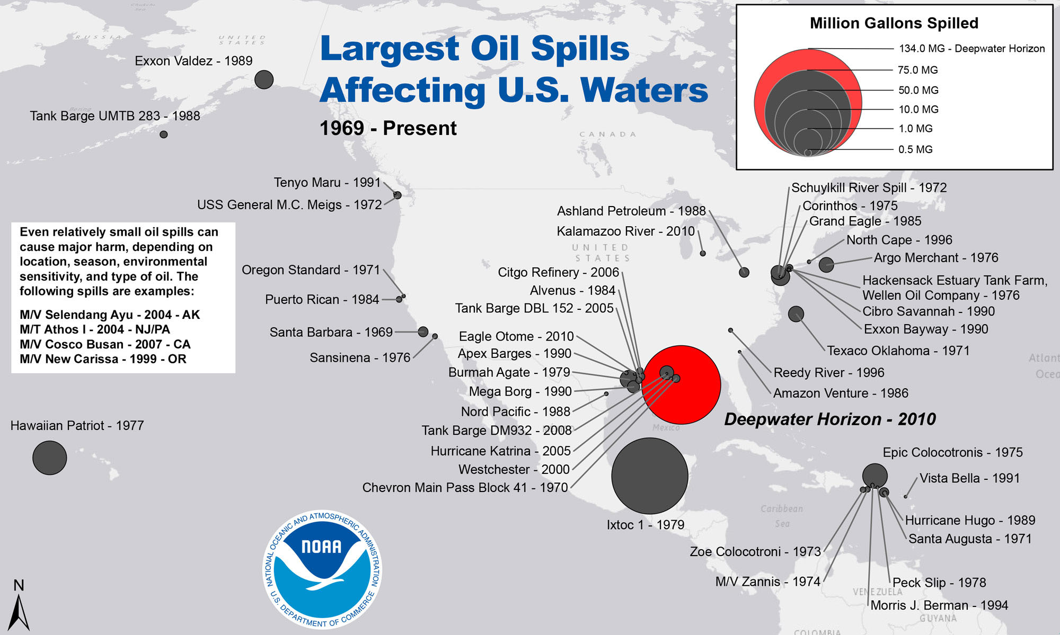
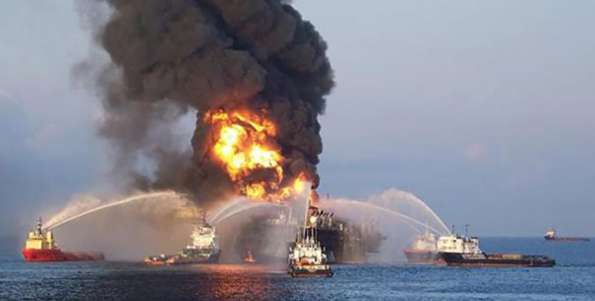
Oil Spills: More fossil fuel problems!
and accidents

Slide 23
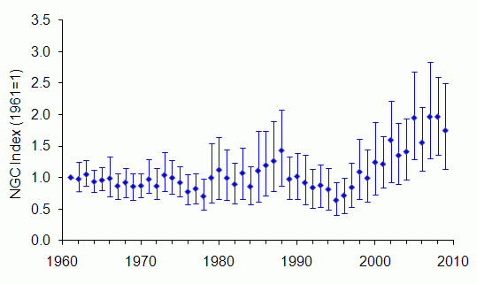
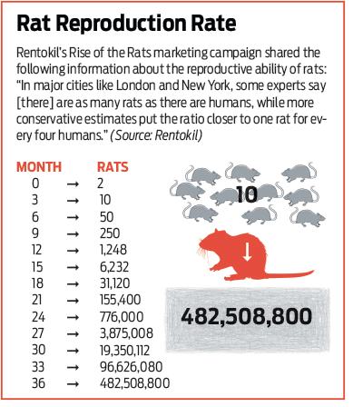
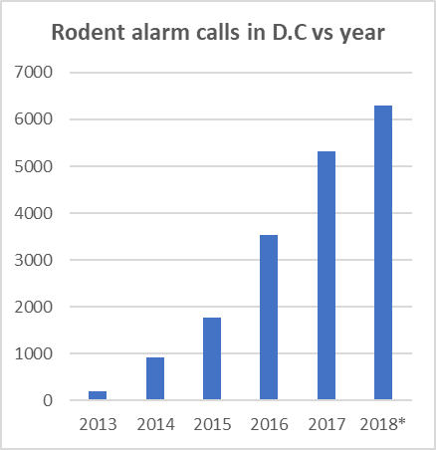
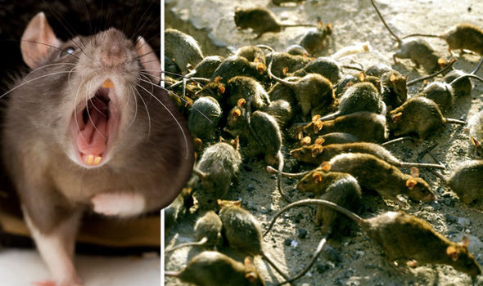
Rat populations In the U.K.
Rat increases in the U.K. match the widespread perception that rats have been much more numerous recently, and it is possible that a series of mild winters boosted survival.
https://www.washingtonpost.com/graphics/2018/local/rat-calls/?utm_term=.42511ee5b91c
*value through June has been doubled.
True or False: Rat populations do not seem to be affected by global warming.
While climate change threatens the populations of many species, some undesirable animals are thriving.

Slide 24
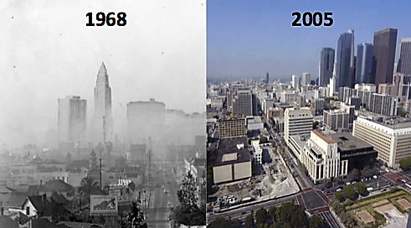
The 2017 -2020 U.S. administration actively cutt or relaxed air quality standards and automobile mpg requirements. Some people think that regulations serve only to restrict business and do not contribute to the quality of life (in this case air quality). The images below show photos of Los Angeles.
True or False: From a scientific point of view, these photos demonstrate definitively that smog is increasing due to the cutting of regulations in L.A.
There are several reasons why these photos have little or no scientific merit.
The photos are not the same locations.
Smog increases with sunlight during the day and the times could very well be different.
There is no indication that these are averages. 1968 could be the worst day of the year and 2005 could be the best day of the year.
Los Angeles
http://www.greenbuildinglawblog.com/tags/clean-air-act/

Slide 25
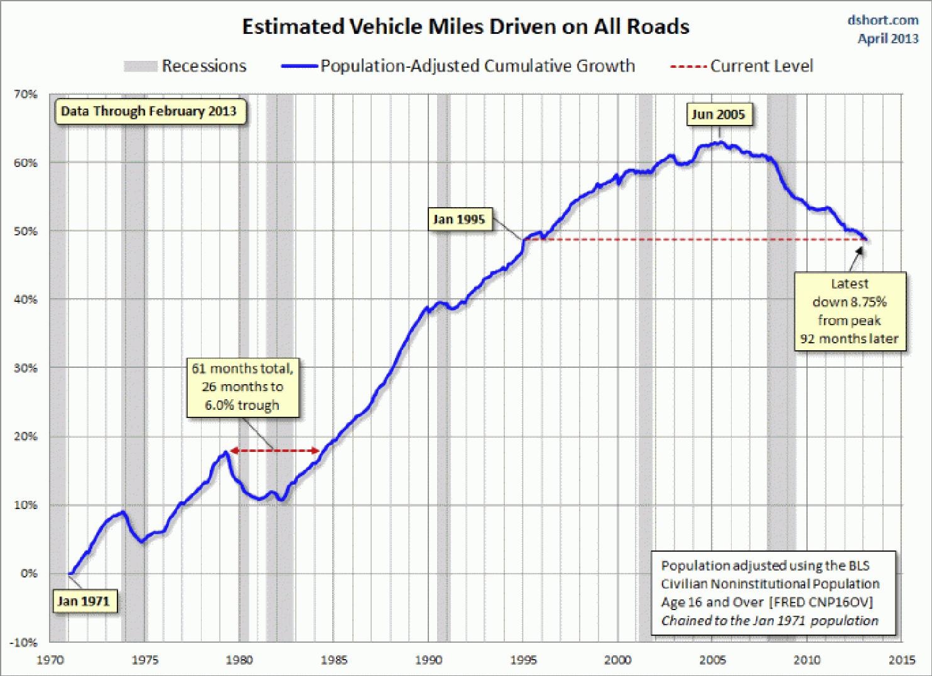
The photos above do not provide meaningful evidence concerning the impact of regulations on air quality. Which of the following if any would be useful methods for determining impacts of regulations on air quality.
Ask people that live in the area.
Graph the amount of ozone concentration as a function of year.
Both of the above.
1970 Clean Air Act amended in 1970
1975 Catalytic Converters required on all cars

Slide 26
California Palmer Draught Severity Index
https://twitter.com/weather_west/status/1061461525099991040

Slide 29
https://www.mercurynews.com/2015/08/07/climate-change-future-bay-area-weather-will-be-more-like-san-diegos/

Slide 32
Very accurate measurements have demonstrated that carbon dioxide concentrations have increased by 50% so far since the start of the industrial revolution. The value is consistent with calculations based on the amount of fossil fuel burning. A global temperature increase of over 1ºC that strongly correlates with the CO₂ increase has also been measured. The higher the temperature, the more the earth will experience damaging effects. The slides show that the increase in sea levels are damaging coastal areas, drought is resulting in the deaths of millions of trees and wildfires are worse every year. Floods are increasingly common and more destructive. Diseases related to increasing temperatures including heat stroke and Lyme disease are on the rise. Ocean acidity increases are threatening and destroying corals and all shellfish. Even rat populations are increasing.
The severe threat of climate change needs to be recognized and confronted. The world must unite to reduce and phase out the use of fossil fuels. Renewables such as wind and solar need to be exploited and investment into new and reasonable energy alternatives must be sought. This is a crisis that will take decades to reverse and the longer before the world starts proactive efforts to minimize the damage from climate change, the more severe the damage will be. Join together today and begin the effort.

Slide 33
In addition to developing and employing renewable energy sources and investing in research into sources of new and efficient energy sources, economic and political techniques can play an important role in encouraging conservation and in the search for energy alternatives. Perhaps the most promising of these approaches involves the carbon fee and dividend program. This approach has achieved support from both sides of the aisle in Congress. One of the strongest advocates of the carbon fee and dividend method is the Citizens Climate Lobby. Consider joining this movement or making a contribution to help the CCL achieve its goals.
Citizens' Climate Lobby is an international grassroots environmental group that trains and supports volunteers to build relationships with their elected representatives in order to influence climate policy. (Wikipedia) https://citizensclimatelobby.org/

Slide 34
Chief Seattle

Slide 35
For more Powerpoint Preshows, exercises and challenges, please visit:
http://murov.info/PPTPreshows.htm

Slide 36
For slides on the effects of climate change, please visit: http://murov.info/climeffects.pptx , http://murov.info/climeffectshealth.pptx .
For a few introductory climate change slides, please visit:
http://murov.info/climintro.pptx
For many PowerPoint
presentations on
other topics, please visit:
http://murov.info

