Slide 1
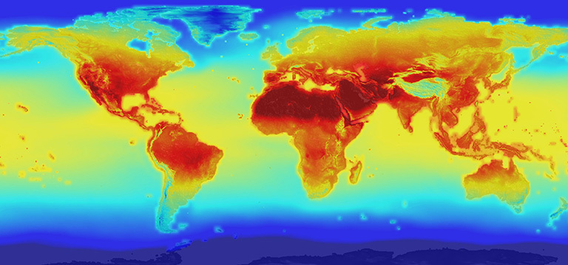
Climate Change: Impacts on Health
Climate change is an extremely important and relevant topic. Considered by some to be one of the highest priority threats to life and the environment on earth and considered by others to be a hoax, climate change science needs to be better understood by society to enable the best decisions for responsible action. This interactive PowerPoint presentation strives to present the evidence and empower users to decide if the climate is changing and if so, the cause of the change. For the slides on causes and effects, please visit: http://murov.info/climintro.pptx , http://murov.info/climcauses.pptx and http://murov.info/climeffects.pptx.
Steve Murov, Prof. Emeritus of Chemistry, Modesto Junior College, http://murov.info
2100 projection of global warming
https://climate.nasa.gov/news/2293/nasa-releases-detailed-global-climate-change-projections/

Slide 2
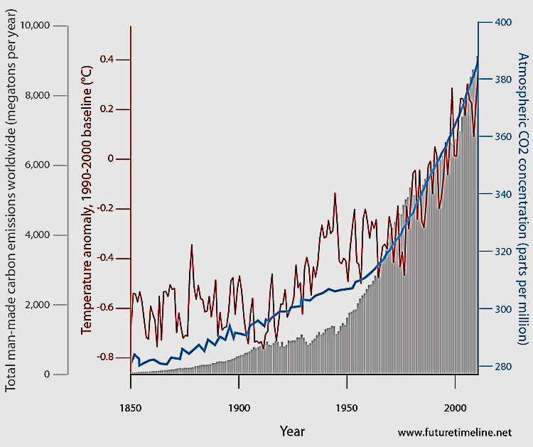
This slide shows that increases in the temperature of the earth correlate with the increasing CO2 levels.
In addition, there is a correlation with the amount of CO2 produced providing strong evidence that human activities are warming the earth.
Temperature,
Dark line
atmospheric CO₂,
Blue line
CO2 production, “solid” grey

Slide 3
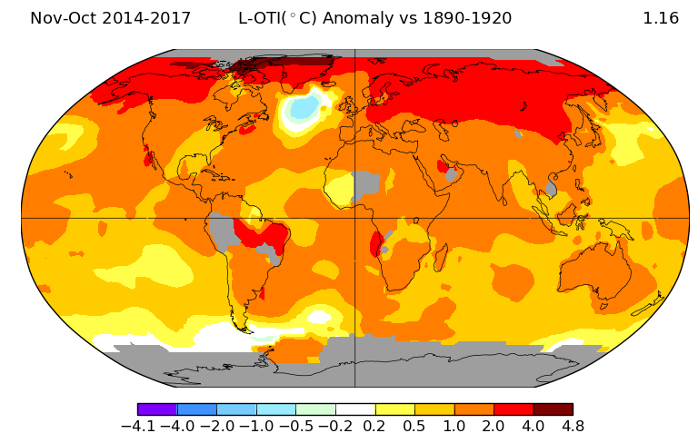
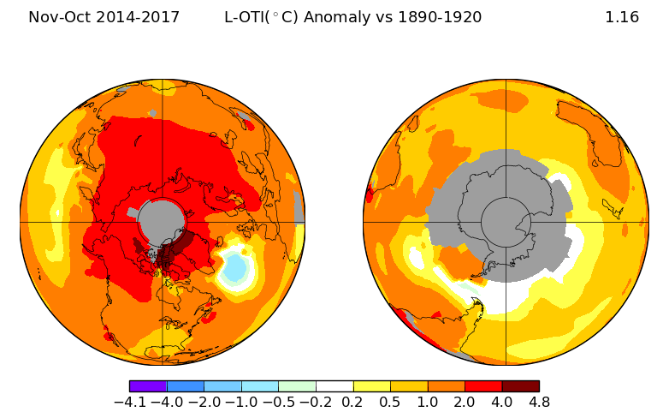
Which statements are true and which are false?
The Southern Hemisphere is warming more than the Northern.
Warming of the earth is not uniform.
Much of the Northern hemisphere has warmed by at least 1ºC (1.8ºF) over the years illustrated.
False
True
True
Average global temperatures from Nov., 2014 - 2017,
compared to a baseline average for the years, 1890 - 1920.
North and South Poles
ºC
https://data.giss.nasa.gov/gistemp/maps/

Slide 4
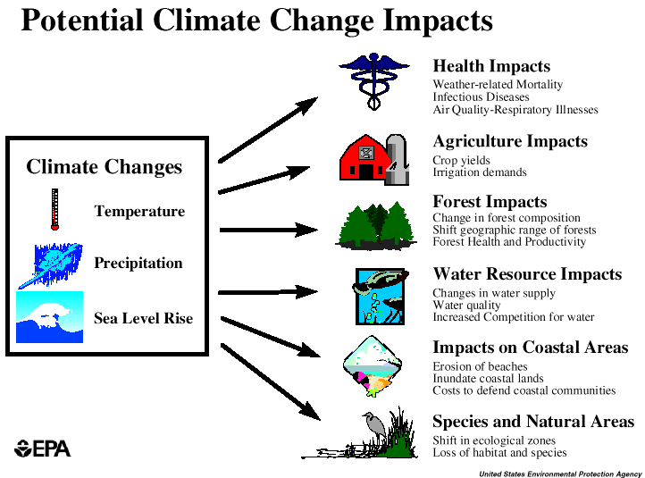
The effects of increasing temperatures on earth will be examined next along with other effects of increasing concentrations of CO₂.

Slide 5
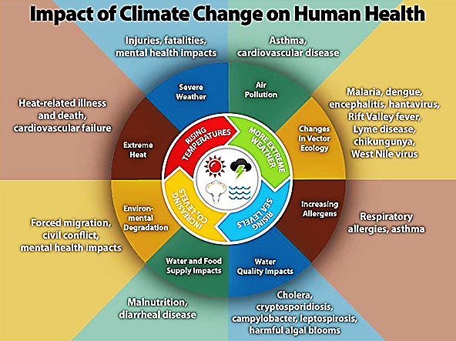
https://www.cdc.gov/climateandhealth/images/climate_change_health_impacts600w.jpg
https://www.cdc.gov/climateandhealth/default.htm

Slide 6
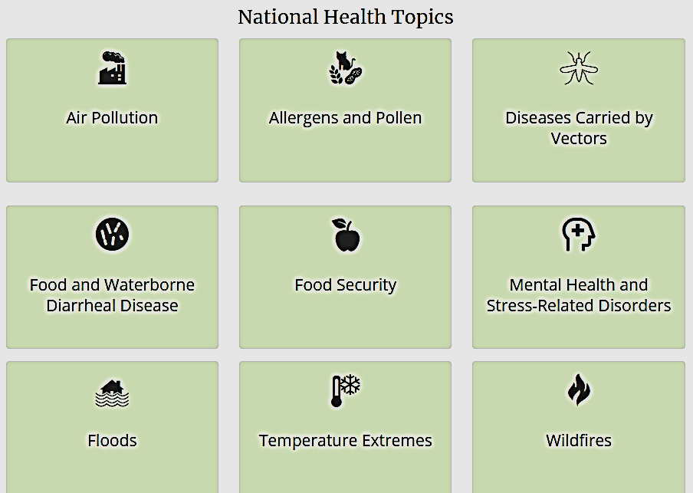
https://www.cdc.gov/climateandhealth/effects/default.htm

Slide 7
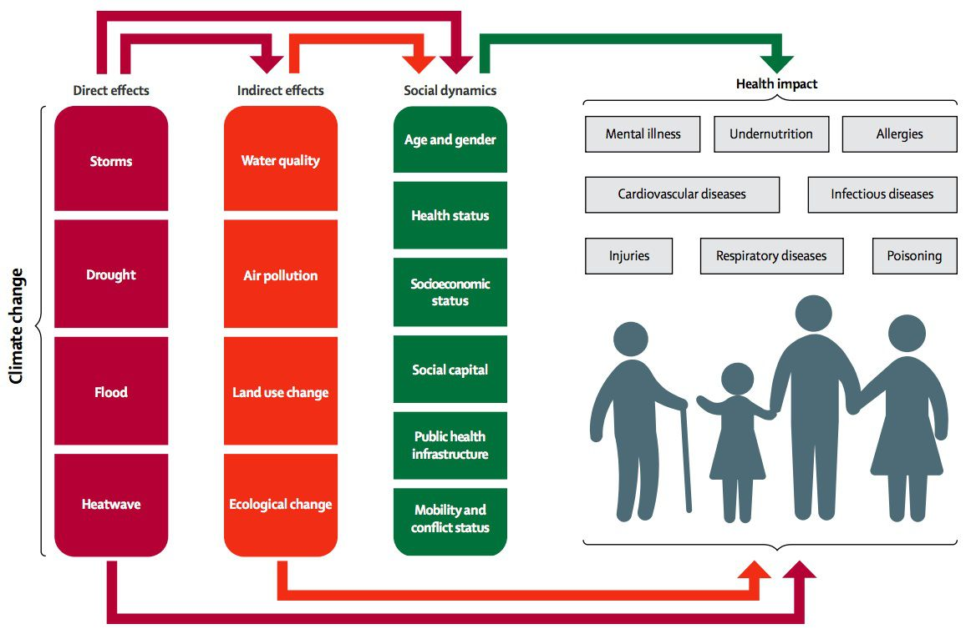
https://cdn.vox-cdn.com/thumbor/oP0ZyOVu-0QQQa7tJgt7Vj2DHhM=/0x0:1162x760/920x0/filters:focal(0x0:1162x760):format(webp):no_upscale()/cdn.vox-cdn.com/uploads/chorus_asset/file/3812500/climate%20health.jpg

Slide 8
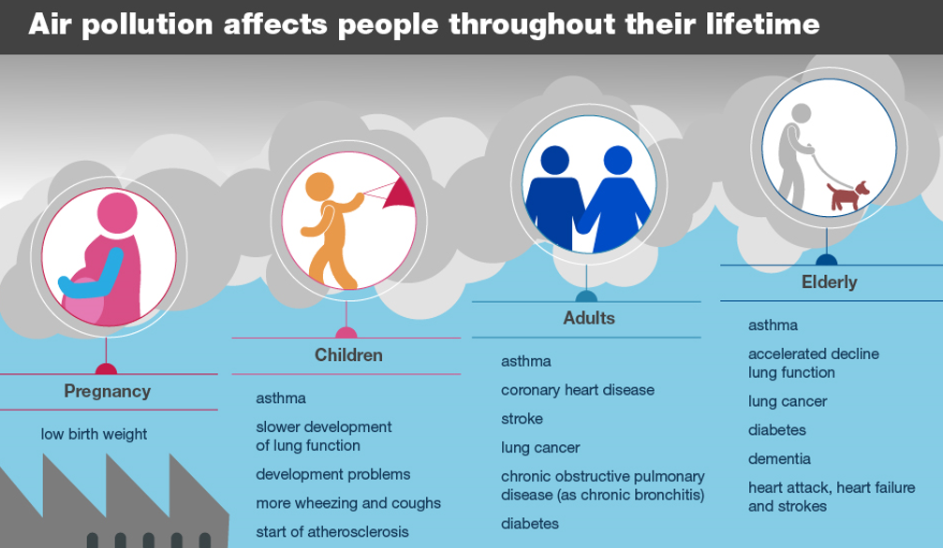
Health Effects of Air Pollution. Reproduced from Public Health England

Slide 9
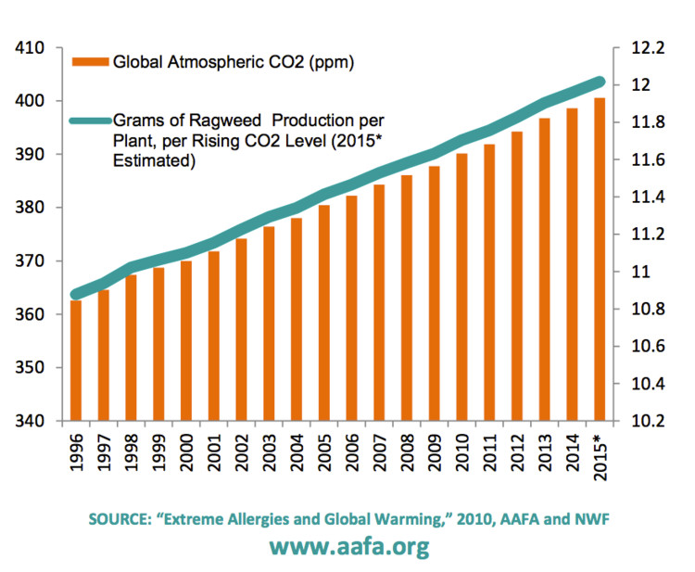
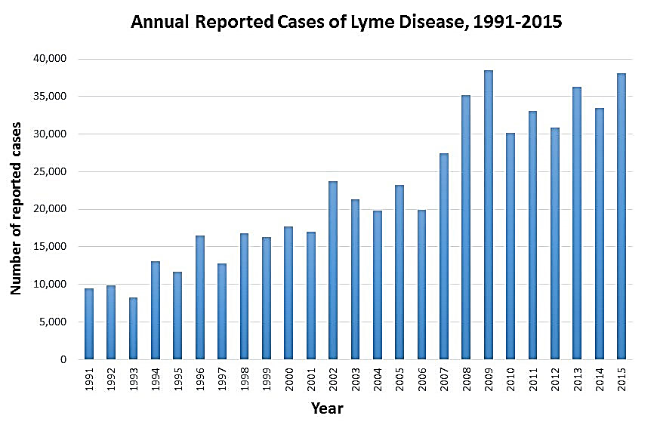
TRUE OR FALSE: Allergenic ragweed production and the number of lyme disease cases do not correlate with atmospheric CO₂ concentrations.
Ragweed production increases and the number of lyme disease
cases are rising along with the rising temperatures.

Slide 10
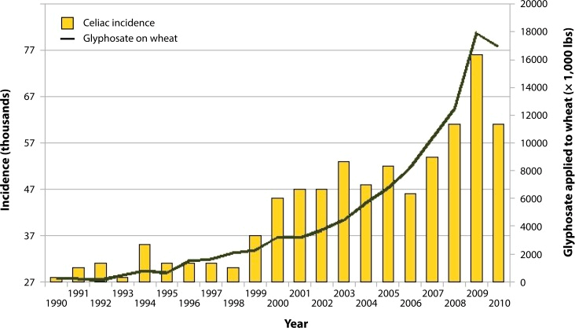
https://www.ncbi.nlm.nih.gov/pmc/articles/PMC3945755/
CO₂ vs year
Weed Killer Roundup: To Blame for Celiac and Gluten Sensitivity? There's no research suggesting a causal link to glyphosate By Jane Anderson | Medically reviewed by a board-certified physician Updated June 11, 2018
https://www.verywellhealth.com/weed-killer-roundup-to-blame-3973244

Slide 11
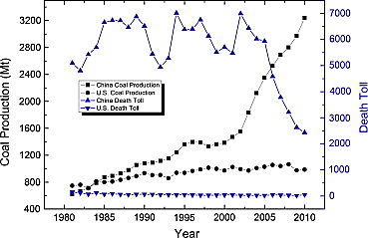
Coal miner deaths have sharply declined in the U.S. since 1970 and have also declined in China since 2004. Coal production in China has sharply increased since 2002 but is only slightly increasing in the U.S.

Slide 12
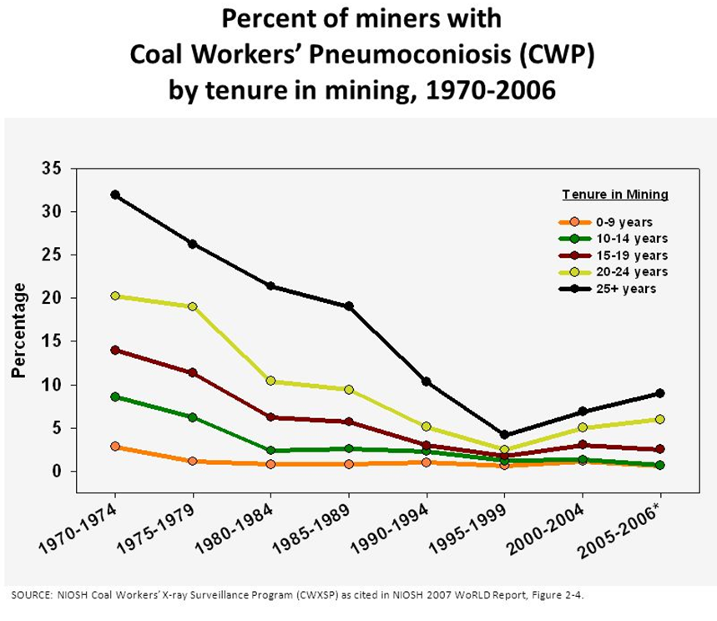
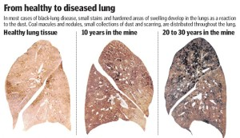
black lung disease
Coal miner deaths have declined along with the percentage of black lung disease in miners. However, in 2006 the decline reversed and about 6% of miners who have worked 20 years are still at high risk.
Is this an acceptable risk?
Assessing risk vs benefit is a very difficult challenge. If coal mining could be stopped, would people suffer from a lack of available electricity and heating? Because any deaths should be considered unacceptable, we should certainly be striving to find better and lower risk alternatives to coal.

Slide 13
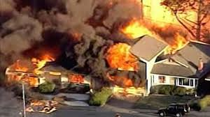
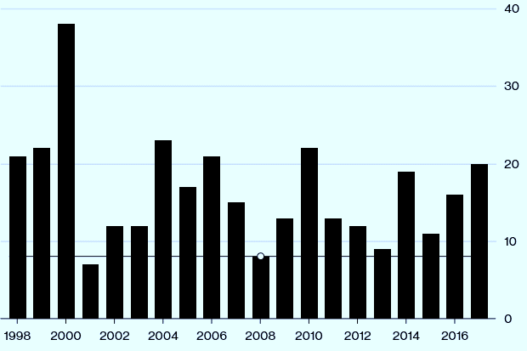
Graphs on this page compare deaths that result from oil and gas pipeline explosions to deaths from terrorism and gun violence in the U.S. Which statements are true?
The annual number of terrorism related deaths and those from pipeline explosions (except for 2001) are similar.
The number of gun violence deaths is a about 1000 times greater (not counting 2001 – 9/11/01) than deaths from terrorism or pipeline explosions.
Between explosions, gun violence and terrorism, despite the numbers, most people worry most about terrorism.
All are true although c is a matter of opinion.
Pipeline-Related Deaths
last year were the worst
for U.S. fatalities since 2010.

Slide 14
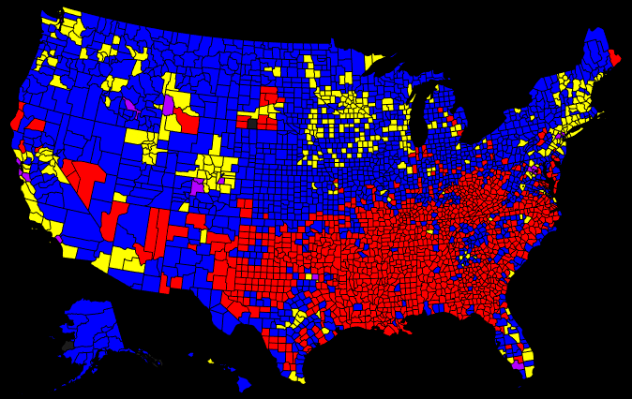
Life expectancy male female
U.S. 76.3 81.3
CA 78.3 83.1
Stanislaus Cty. 76.2 80.2
Santa Barbara 79.6 83.7
L.A. 79.0 83.6

Slide 15
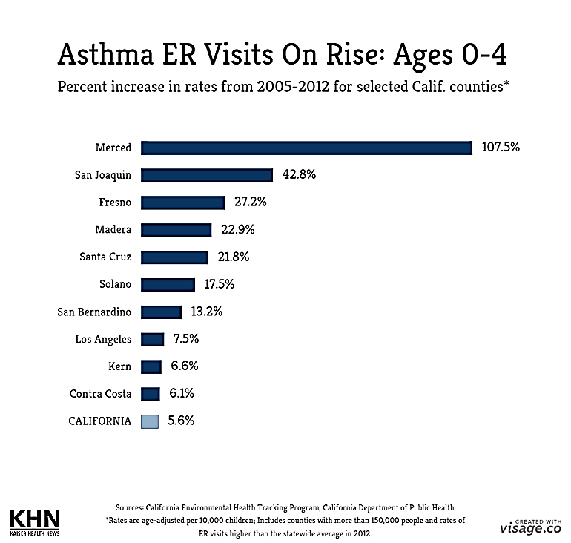
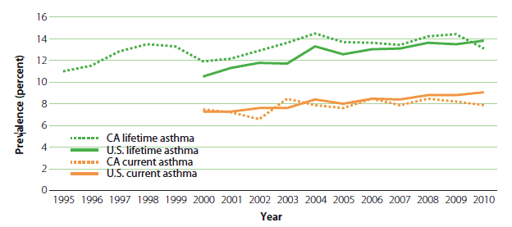
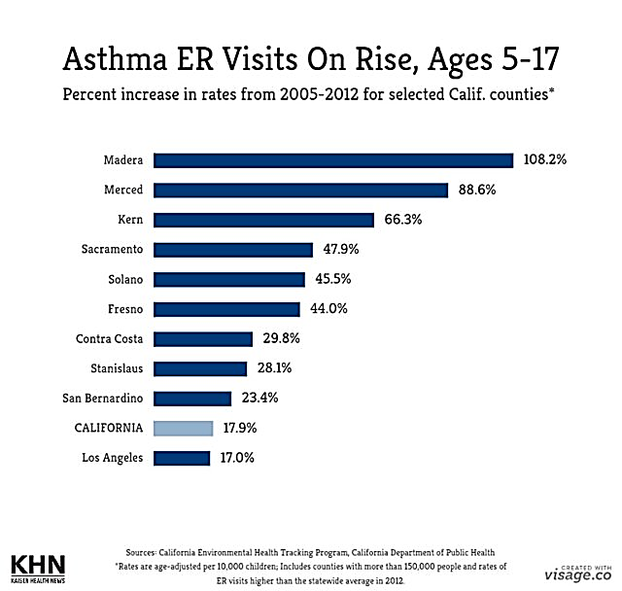

Slide 16
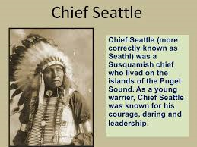
Chief Seattle

Slide 17
For more Powerpoint Preshows, exercises and challenges, please visit:
http://murov.info/PPTPreshows.htm

Slide 18
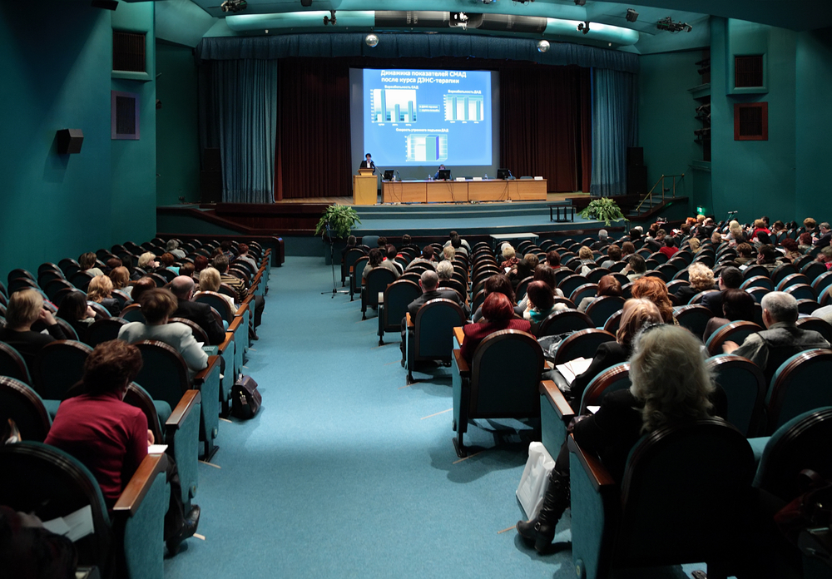
For slides on the causes and effects of climate change, please visit: http://murov.info/climcauses.pptx , http://murov.info/climeffects.pptx .
For introductory slides to climate change, please visit:
http://murov.info/climintro.pptx .
For many PowerPoint
presentations on
other topics, please visit:
http://murov.info

