Slide 1
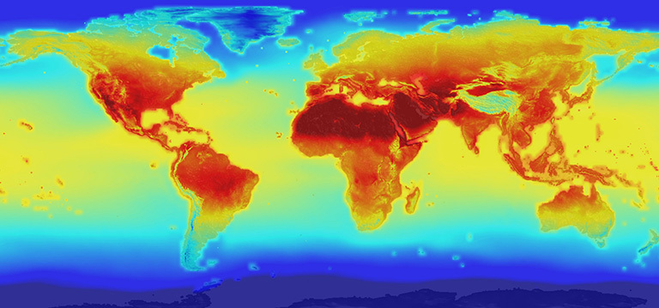
Intro to Climate Change
Climate change is an extremely important and relevant topic. Climate change science needs to be better understood by society to enable the best decisions for responsible action. The PowerPoint slides in this file contain information about the science of climate change. Three other collections provide information about the effects of climate change and the effects of climate change on health. For the slides on causes and effects, please visit: http://murov.info/climcauses.pptx , http://murov.info/climeffects.pptx and http://murov.info/climeffectshealth.pptx.
Steve Murov, Prof. Emeritus of Chemistry, Modesto Junior College, http://murov.info
2100 projection of global warming
https://climate.nasa.gov/news/2293/nasa-releases-detailed-global-climate-change-projections/

Slide 2
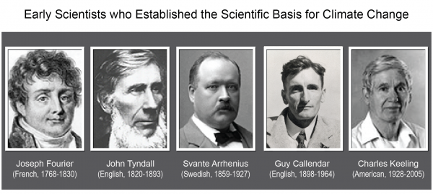
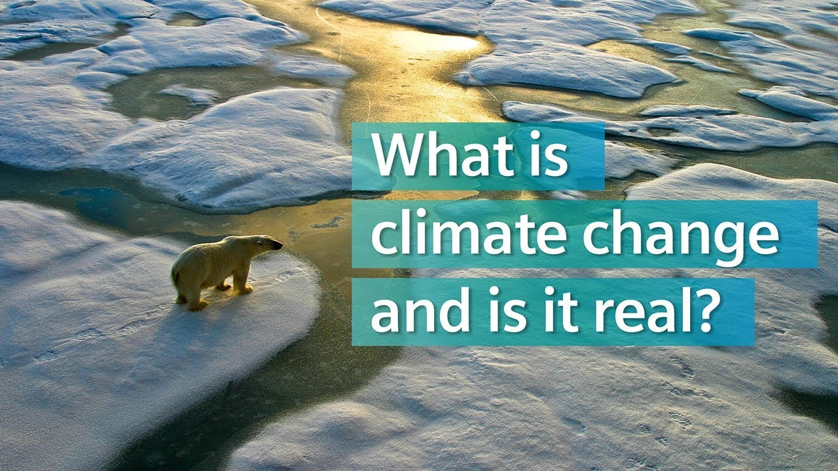
Is the climate of the earth undergoing enhanced climate change and if so, are humans significantly contributing to the change?
In developing a theory to explain the ice ages, Svante Arrhenius, in 1896, was the first to use basic principles of physical chemistry to calculate estimates of the extent to which increases in atmospheric carbon dioxide (CO₂) will increase the Earth's surface temperature through the greenhouse effect.

Slide 3
CLIMATE CHANGE SURVEY RESULTS FROM YALE
The percent of climate change scientists who consider climate change to be a real human caused threat is: a. 25% b. 50% c. 70% d. 97% e. None of the answers given.
D or 97% is the correct answer but non-scientists give a wide range of answers to this question with an average (70%) significantly below the correct answer with only 15% responding 90% or higher.
Multiple choice
What percent of Americans think global warming is caused by humans?
a. 10% b. 40% c. 58% d. 75% e. 97%
c. 58%. While climate change scientists have a 97% confidence percentage, non-scientist are much more skeptical.
According to a Yale web site, what percentage of people achieve grades of A or B on a basic test on climate change science?
a. 8% b. 40% c. 52%
Unfortunately % of C + D grades % of F grades
8% is correct!
http://climatecommunication.yale.edu/wp-content/uploads/2018/04/Climate-Change-American-Mind-March-2018-1.pdf

Slide 4
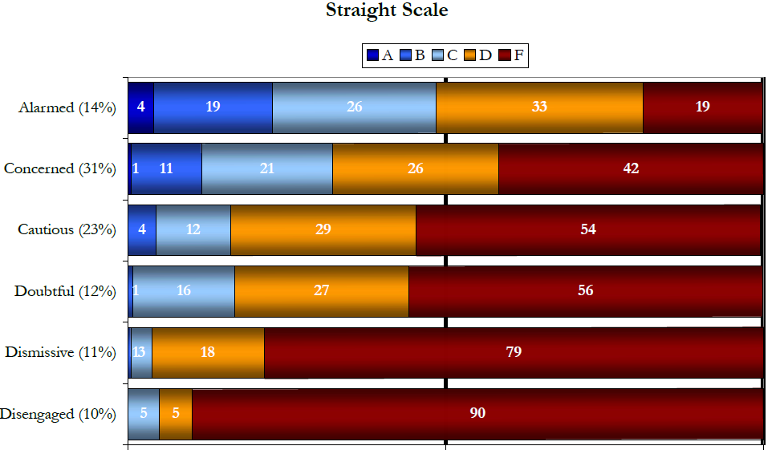
http://environment.yale.edu/climate-communication/article/knowledge-of-climate-change-across-global-warmings-six-americas1
The Yale study presents grades for understanding of climate change grouped according to opinions towards climate change.
True or False: The chart indicates that the better the understanding, the higher the concern level. People who flunk the climate change test are likely deniers.

Slide 5
The Yale survey reveals some American conceptions of the causes of global warming. 61% think the ozone hole contributes and 54% blame aerosol spray cans.
The answer is C as freons contribute to the depletion of ozone and formation of the ozone hole but are also effective Greenhouse gases. The major Greenhouse gases, H₂O, CO₂ and methane are not responsible for ozone depletion.
Multiple choice
a. The ozone hole is intimately connected to global warming.
As ozone depletion increases, global warming increases.
Ozone depletion and climate change are relatively independent problems. The primary
connection is that ozone depletion gases such as chlorofluorocarbons (freons) cause ozone
depletion and are also greenhouse gases.
d. None of the above.
http://climatecommunication.yale.edu/wp-content/uploads/2016/02/2010_10_Americans’-Knowledge-of-Climate-Change.pdf

Slide 6
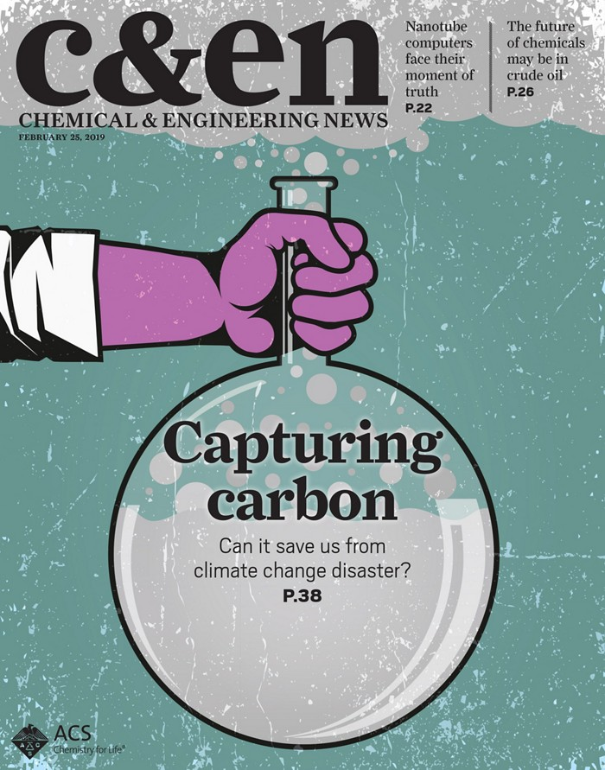
Time is not on our side.
Catastrophic consequences of climate change are just steps away, according to a slew of reports released at the end of 2018. The Intergovernmental Panel on Climate Change (IPCC) says that without swift action, global temperatures will rise by 1.5 °C by 2030 and 2 °C by 2050—and will continue to climb beyond then. Those increases will cause disastrous effects, including record-breaking sea-level rise, flooding, wildfires, extreme weather events, famine, and wildlife habitat destruction, the IPCC says. The impacts will hit the world’s poor particularly hard.
Feb. 25, 2019

Slide 7
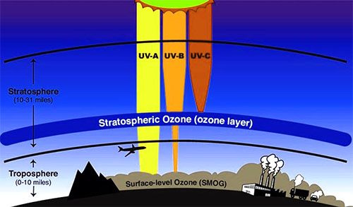
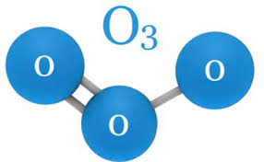
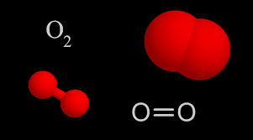
More on the
ozone issue.
The oxygen that animals need for respiration is O₂ or diatomic oxygen. Ozone is O₃ and is much more reactive than O₂. As a result, O₃ is toxic and one of the most damaging gases when present in the lower atmosphere. However, ozone plays the very important role in the stratosphere of filtering harmful ultraviolet rays that cause cancer. Stratospheric ozone was being reduced by the emission of freons into the atmosphere. Fortunately, most of the bad freons are no longer used but it will take several decades for recovery of the ozone layer.

Slide 8
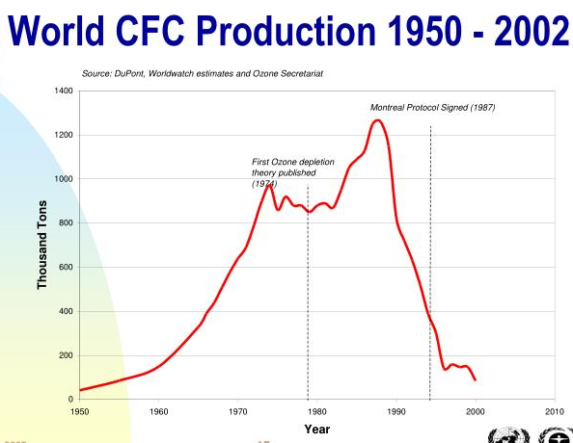
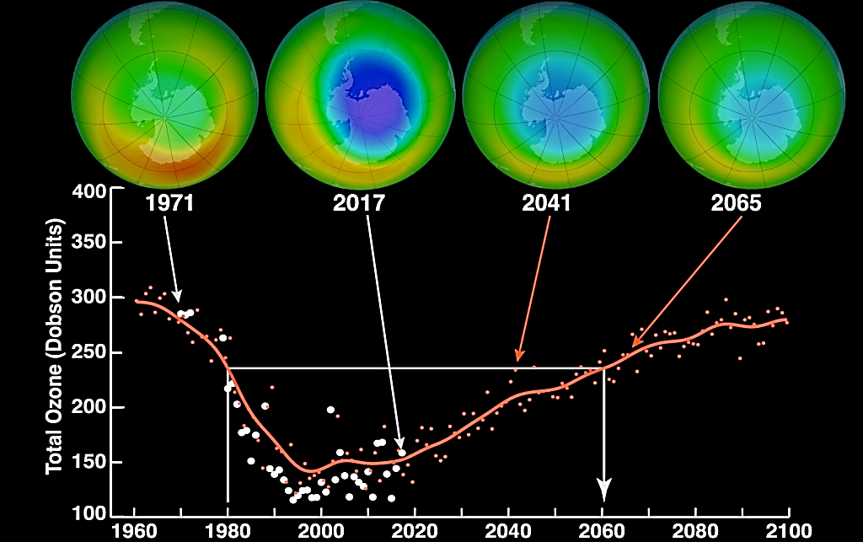
Images of ozone hole over Antarctic
projected
October average minimum ozone over Antarctica
https://svs.gsfc.nasa.gov/30602
Ozone depletion by freons was first predicted publicly in the early 70’s. Taken seriously, in 1977, the U.S. acted to phase out the most damaging freons and the world followed in 1987 with the Montreal Protocol. The graph on the upper left shows a slow recovery began about 1995 as a result of the significantly dropped production of freons as shown in the upper right.

Slide 9
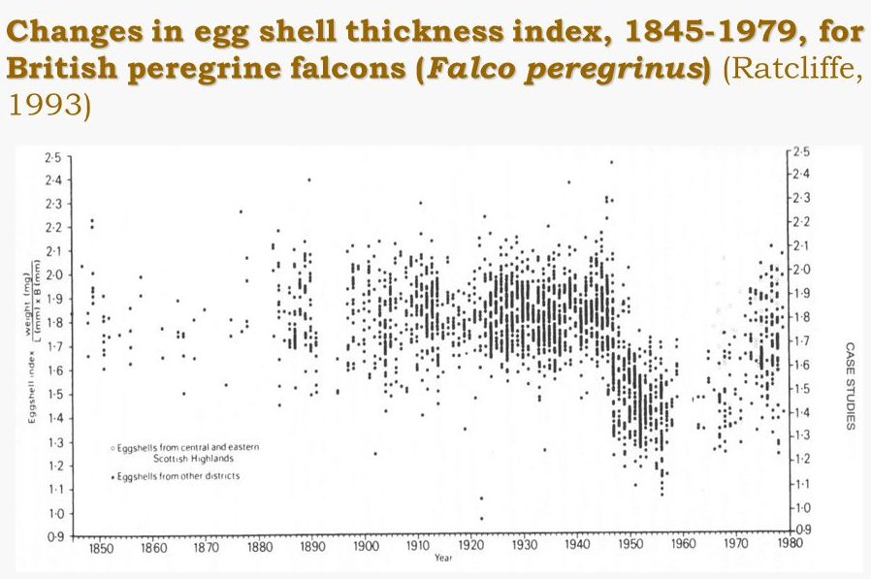
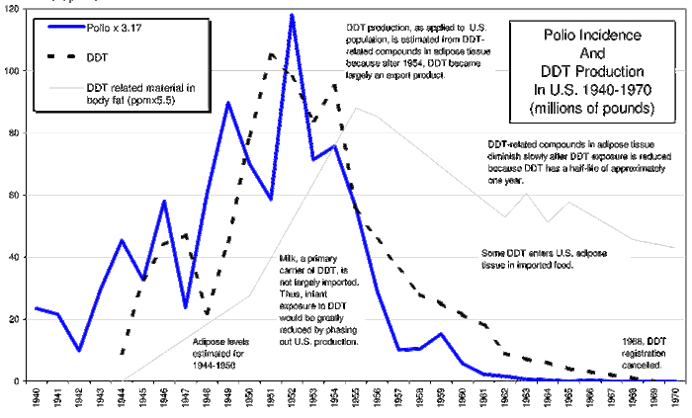
Historical analogies and lessons for climate change include the ozone issue and the DDT problems experienced from the mid 1940’s until the 1990’s. Societal action helped to decrease the impacts of ozone and DDT.
Shell-thickness index of Eurasian Sparrowhawks (Accipiter nisus) in Britain, 1870–1997; the research program came to an end in 1998. Shell-thinning became apparent very quickly from 1947, following the widespread introduction of DDT in agriculture. The problem improved from the 1970s, following progressive restrictions in the use of the chemical, which was banned altogether from 1986. Each dot represents the mean shell index of a clutch (or part-clutch), and more than 2000 clutches are represented from all regions of Britain. Shell index was measured as shell weight (mg)/ shell length 3 breadth (mm). Adapted from Newton 1986.

Slide 10
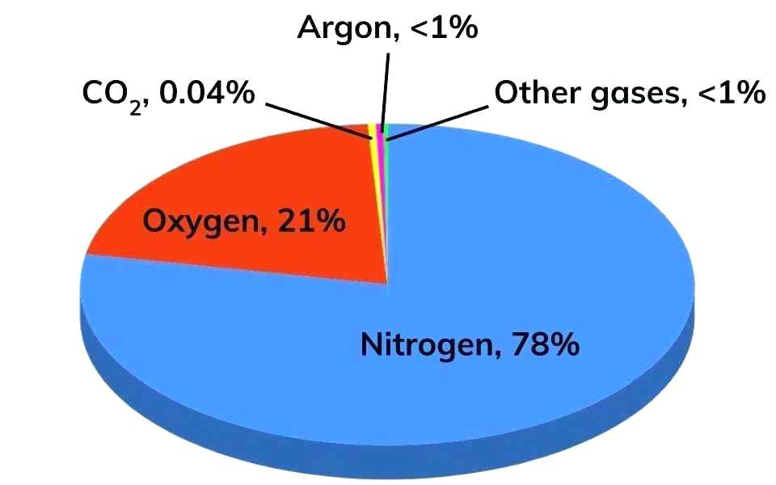
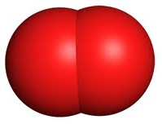
Name the four most abundant gases in air excluding water (the humidity varies widely by location, weather, time of the year from a trace to 4%) in decreasing order of abundance.
Name formula % abundance Lewis Structure model
1. Nitrogen N₂ 78.1%
2. Oxygen O₂ 20.9%
(Note: the Lewis structure for oxygen is one of the few failures of the Lewis structure method as it predicts incorrect magnetic properties of O₂)
3. Argon Ar 0.93%
4. Carbon CO₂ 0.04%
dioxide
Many people do not name nitrogen as the most abundant gas, extremely few name argon as the third most abundant gas and CO₂ is commonly named as one of the three most abundant gases. Presumably the latter is a conclusion reached because plants need CO₂ and animals exhale CO₂. However, only 3% of human exhaled gas is CO₂ and most is N₂. Why? The importance of these misconceptions is the topic of the next slide.

Slide 11
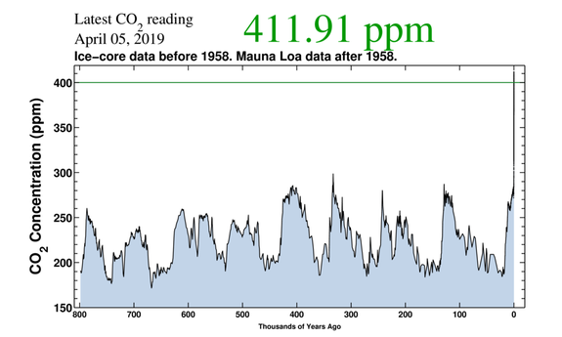
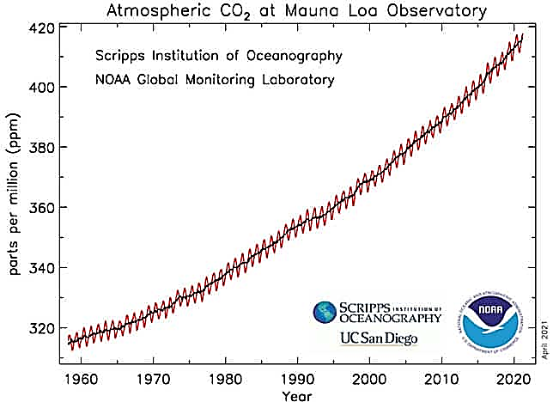
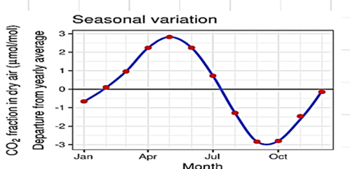
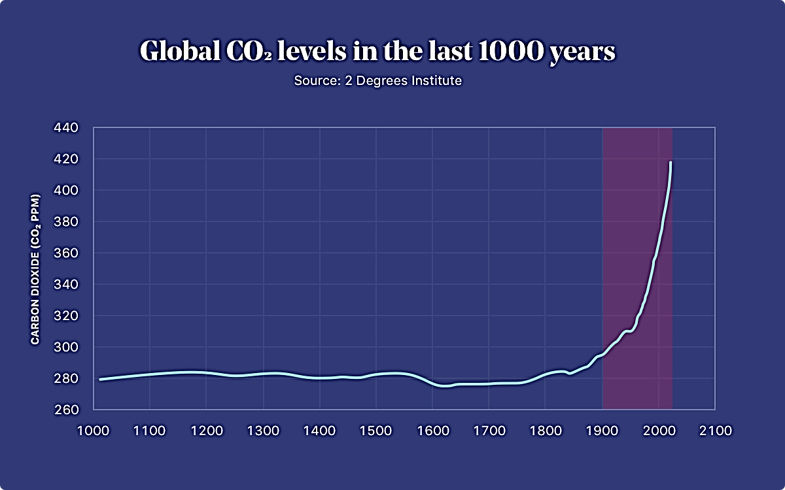
Is the carbon dioxide content of the atmosphere increasing?
800,000 years ago to 2019AD
Current value= 419 ppm = 0.0419% by vol.and is approaching
a 50% increase over pre-industrial value of 280 ppm.
1960 - 2020
1000 AD to 2020 AD
Multiple choice
a. The CO₂ concentration has increased by about 50% since 1700.
The CO₂ concentration averaged about 230 ppm for 800,000 years
and about 280 ppm for 1000 to 1800.
c. The CO₂ concentration leveled off in 2000.
The CO₂ value of 410.52 ppm is a localized Hawaii value due to
volcanic action.
e. a and b are true, c and d are false.
e. a and b are true, c and d are false.
CO₂ concentrations are obviously increasing (280 ppm to 411 ppm.)

Slide 12
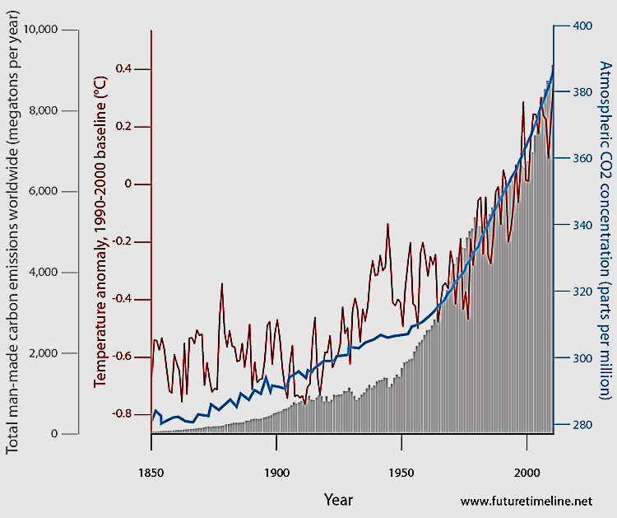
True or False – There is a correlation among global temperature and total CO₂ concentration.
TRUE
Conclusion:
Either the temperature increase causes CO₂ to increase or CO₂ increases causes temperature to increase.
Temperature,
Dark line
atmospheric CO₂,
Blue line
However, the additional correlation with the CO₂ production strongly supports CO₂ as the cause and temperature as the effect.
CO2 production, solid grey

Slide 13
For slides on the causes and effects of climate change, please visit: http://murov.info/climcauses.pptx , http://murov.info/climeffects.pptx , http://murov.info/climeffectshealth.pptx .
For many PowerPoint
presentations on
other topics, please visit:
http://murov.info

