Slide 1
ANIMAL EXTINCTIONS TO BE CAUSED BY CLIMATE CHANGE

Slide 2
This exercise is one of many PowerPoint programs from http://murov.info. This site presents images of animals and asks the user to name the animal. The images presented are animals that are experiencing worrisome declines in populations. Most of the declines are the result of human action and most often at least partially due to climate change (e.g., see: http://murov.info/climatechange.htm ). The narratives included have been taken directly from sites that result from googling the name of the animal and the name of the animal followed by “endangered.” The animals presented represent a small selection of animals that are threatened by human action and climate change. A late slide contains a list of many more of the animals that we are in danger of losing if we do not correct our misguided actions.

Slide 3
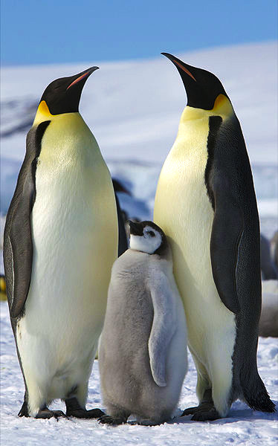
Emperor Penguin
The emperor penguin is the tallest and heaviest of all living penguin species and is endemic to Antarctica. The male and female are similar in plumage and size, reaching 100 cm in length and weighing from 22 to 45 kg.
The journal Global Change Biology reports that the emperor penguin population could all but disappear by 2100. That's if greenhouse gas emissions continue to increase at their current rates, melting Antarctic sea ice.

Slide 4
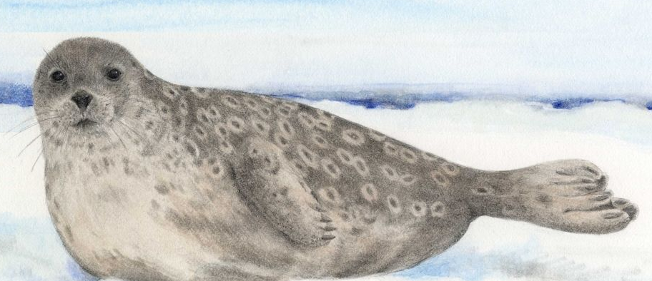
Ringed Seal
The ringed seal is an earless seal inhabiting the Arctic and sub-Arctic regions. The ringed seal is a relatively small seal, rarely greater than 1.5 m in length, with a distinctive patterning of dark spots surrounded by light gray rings, hence its common name.
In December 2012, the National Oceanic and Atmospheric Administration announced that the ringed seal, as well as the bearded seal, would be listed as a threatened species under the Endangered Species Act because of the risks posed by melting sea ice and reduced snowfall.

Slide 5
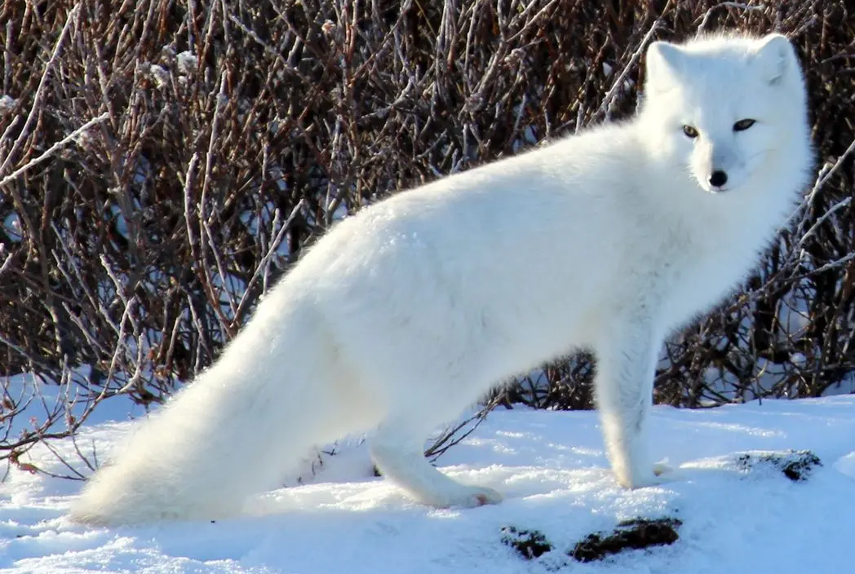
Arctic Fox
The Arctic fox, also known as the white fox, polar fox, or snow fox, is a small fox native to the Arctic regions of the Northern Hemisphere and common throughout the Arctic tundra biome. It is well adapted to living in cold environments, and is best known for its thick, warm fur that is also used as camouflage.
The Arctic fox is a critically endangered species in Finland. At the beginning of the 2000s, the entire Nordic Arctic fox population hit an all-time low, with approximately 100 adult individuals. Currently, Norway, Sweden and Finland are estimated to have about 450 adult Arctic foxes.
The Arctic fox faces several threats including climate change to energy development in once protected areas, to hunting due to the fur industry and even the pet trade. Climate change also decreases the prey species available for the Arctic foxes minimizing valuable food sources.

Slide 6
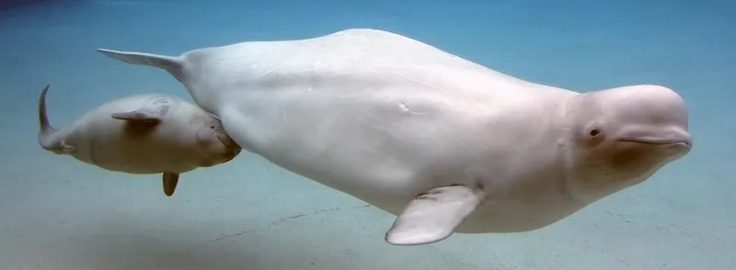
Beluga Whale
The beluga, or white whale, is one of the smallest species of whale. Unlike most other whales, the beluga has a very flexible neck that enables it to nod and turn its head in all directions.
Beluga whales are known for their white color and range of vocal sounds, earning them the title of "canary of the sea." They are very social animals.
Thousands of years of evolution have prepared Arctic species like the polar bear, walrus and beluga for life on and around the sea ice. Because of climate change, that ice cover has been changing rapidly, in both extent and thickness, and shrinking far too quickly for these species to adapt

Slide 7
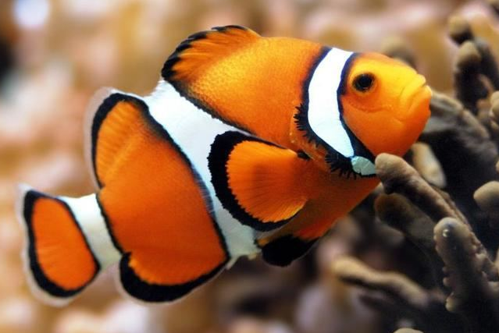
Orange Clownfish
Orange clownfishes, Amphiprion percula (Lacepède, 1802), also known as the Clown anemonefish and Percula clownfish are one of many members of the ‘Anemonefishes’ group. Orange clownfish generally live in groups of unrelated individuals that consist of one breeding pair and up to four non-breeders. Like other polyp fishes, it frequently resides in association with sea anemones.
Tropical Reef Fish ARE Threatened by Ocean Acidification, Global Warming, Aquarium Trade.

Slide 8
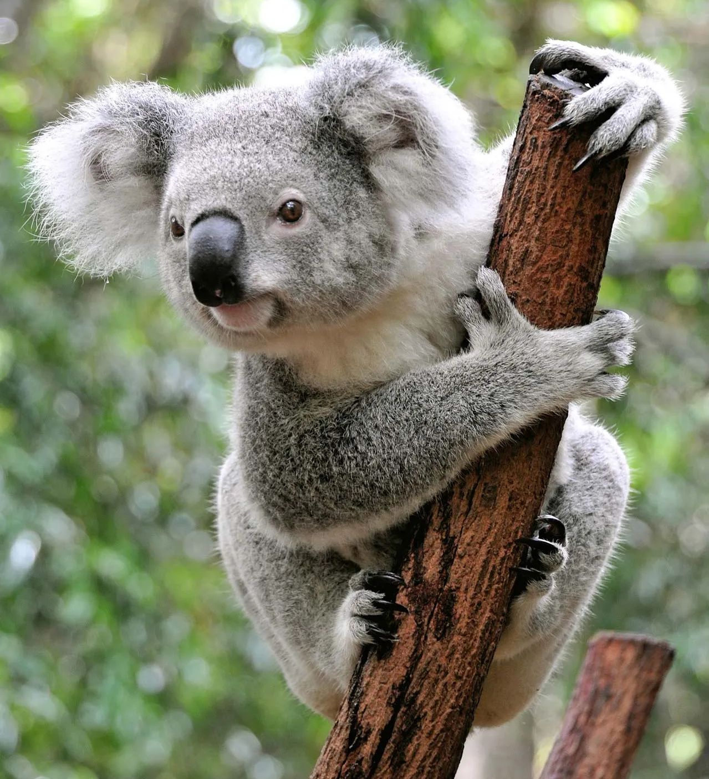
Koala
Though sometimes called a koala bear, the koala is not a bear. The koala is actually a type of tree-dwelling marsupial, with a backwards-facing pouch, like wombats. The Koala is a small to medium-sized mammal that is found inhabiting a variety of different types of forest in south-eastern Australia. Koalas are so distinctive amongst this specially adapted family of mammals that they are classified in a scientific group of their own.
Today, koala numbers are at an all-time low. They have been labelled functionally extinct. Koalas Rely on Eucalyptus Trees for Food, Shelter and Safety against Predators. Impacts of drought, bush fires and habitat are causing the population to dwindle.

Slide 9
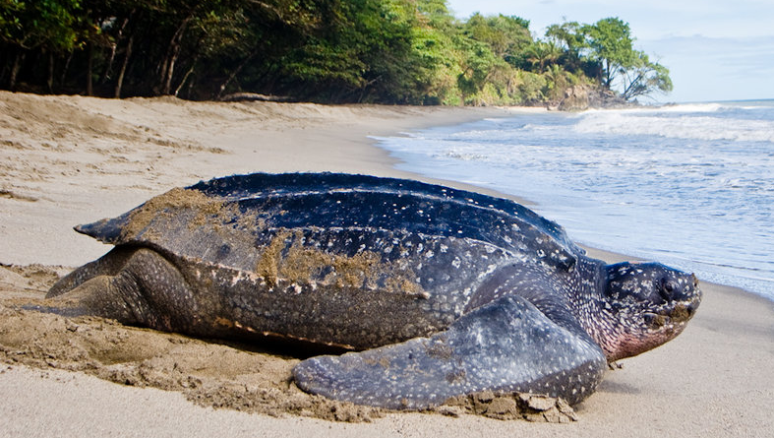
Leatherback Turtle
Leatherback turtles are named for their shell, which is leather-like rather than hard, like other turtles. They are the largest sea turtle species and also one of the most migratory, crossing both the Atlantic and Pacific Oceans. Pacific leatherbacks migrate from nesting beaches in the Coral Triangle all the way to the California coast to feed on the abundant jellyfish every summer and fall.
Although their distribution is wide, numbers of leatherback turtles have seriously declined during the last century as a result of intense egg collection and fisheries.

Slide 10
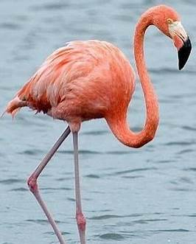
Flamingo
Flamingo, (order Phoenicopteriformes), any of six species of tall, pink wading birds with thick downturned bills. Flamingos have slender legs, long, graceful necks, large wings, and short tails. They range from about 90 to 150 cm (3 to 5 feet) tall. Flamingos are highly social birds.
While flamingos are an abundant bird species, they are threatened by habitat loss due to mineral mining and human disturbance.

Slide 11
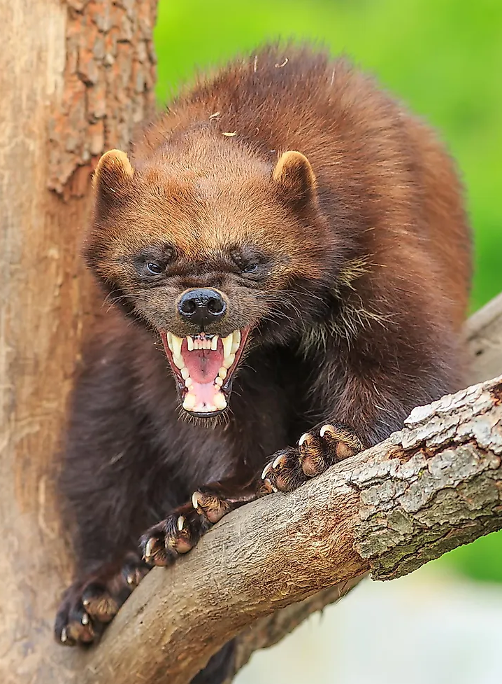
Wolverine
The wolverine is a powerful animal that resembles a small bear but is actually the largest member of the weasel family. These tough animals are solitary, and they need a lot of room to roam. Individual wolverines may travel 15 miles in a day in search of food. Because of these habitat requirements, wolverines frequent remote boreal forests, taiga, and tundra in the northern latitudes of Europe, Asia, and North America.
The main threat to the Wolverine is habitat loss due to forest clearing, and habitat fragmentation often associated with mineral extraction, forestry, and road creation.

Slide 12
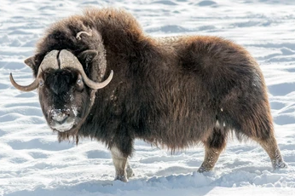
Musk Ox
Musk ox are a shaggy-haired Arctic ruminant of the family Bovidae. Musk oxen are stocky mammals with large heads, short necks, and short, stout legs. Their name derives from their musky odour and from their superficial resemblance to the ox, though they are not closely related to cattle. Musk oxen are closely related to the mountain goat.
Musk oxen are losing ground due to climate gentrification in two of their island homes, where herd sizes have dropped by 80 percent in the last decade, tracking alongside changes to their environment.

Slide 13
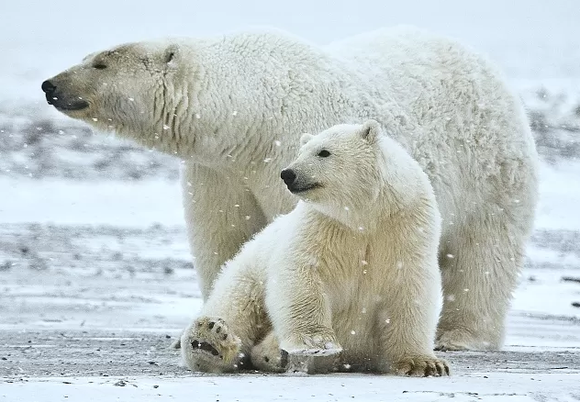
Polar Bear
The polar bear is a hypercarnivorous species of bear. Its native range lies largely within the Arctic Circle, encompassing the Arctic Ocean and its surrounding seas and landmasses, which includes the northernmost regions of North America and Eurasia.
Terrestrial and marine denning habitats for polar bears are increasingly disappearing and under threat from climate change and human and industrial influence.

Slide 14
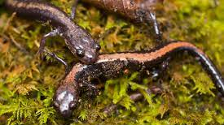
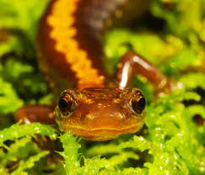
Shenandoah Salamander
The Shenandoah salamander is a small, terrestrial salamander found exclusively in Shenandoah National Park in Virginia. The Shenandoah salamander inhabits a very small range of land on just three mountain peaks.
The Shenandoah salamander is an endangered salamander that is at risk of extinction due to its small, high-elevation range, competition with the co-occurring red-backed salamander, and the predicted future climate in the Appalachian mountain range.

Slide 15
Adelie Penguin
The Adélie penguin is a species of penguin common along the entire coast of the Antarctic continent, which is the only place where it is found. It is the most widespread penguin species, and, along with the emperor penguin, is the most southerly distributed of all penguins.
Adélie penguins are increasing in Antarctica. However, in areas where climate change is established, Adélie populations have fallen by more than 65% in the past 25 years. The biggest threat to them right now is climate change (other penguins, like gentoos, are better adapted to warmer climates).

Slide 16
Hawksbill Turtle
Hawksbill sea turtles inhabit the tropical and sub-tropical waters of all of the world’s major oceans. Hawksbills get their name from their unique beak-like mouth, which resembles that of a hawk and is perfect for finding food sources in hard-to-reach cracks and crevices. They are the only species of sea turtle that can survive on a diet consisting mainly of sponges.
A major threat to hawksbill turtles is the loss of nesting habitat and coral reefs due to coastal development, rising seas from climate change, and pollution. Coastal development, including shoreline hardening or armoring (e.g., seawalls), can result in the complete loss of dry sand suitable for successful nesting.

Slide 17
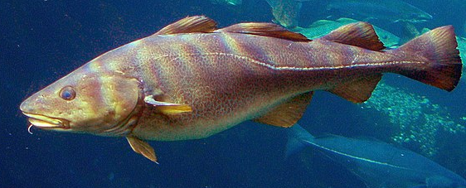
Atlantic Cod
Atlantic cod are one of the most popular food fishes in the western world. Distinguished by a distinctive elongated hairlike structure called a “barbel” that hangs from their chin, they also have three dorsal fins, two anal fins, and broom-shaped tails. Atlantic cod are brown to green or gray on their dorsal (upper) sides and flanks, with a paler ventral (under) side and they have smooth, small scales.
Once one of the larger oceanic fish, reaching up to six and a half feet and 211 pounds, cod fish have steadily decreased in size over the last several decades, likely due to the effects of overfishing. Many smaller cod are able to escape from fishing nets, giving them an advantage over their larger counterparts. Scientists have theorized that because of this man-made threat, cod have evolved to grow slowly to survive a fishing industry that has significantly reduced their population for decades.

Slide 18
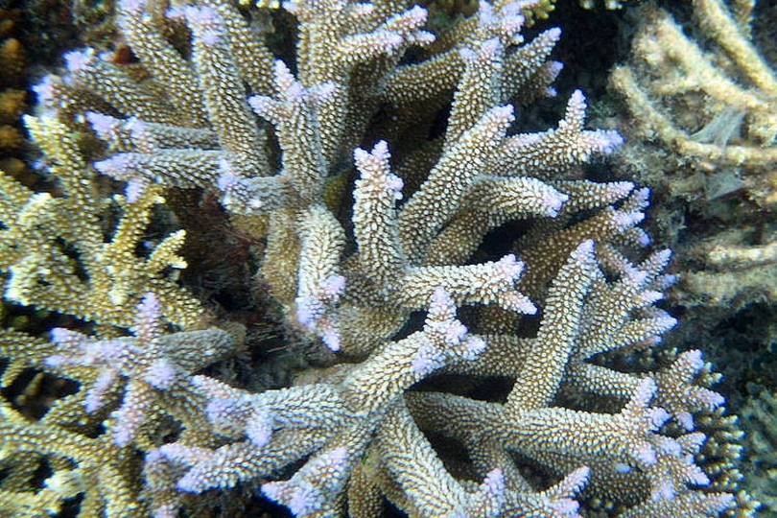
Staghorn Coral
Staghorn coral is a species of coral that looks a bit like the antlers of a male deer. Capable of growing into thickets up to five feet high and more than 30 feet across, staghorn corals produce long, cylindrical branches out of bases anchored to the ocean floor.
Particularly susceptible to bleaching, staghorn coral populations have declined more than 80 percent over the past 30 years due to higher incidence of disease and the impacts of global warming, especially higher ocean temperatures and ocean acidification.

Slide 19
Atlantic Puffin
The Atlantic puffin also known as the common puffin, is a species of seabird in the auk family. It is the only puffin native to the Atlantic Ocean; two related species, the tufted puffin and the horned puffin, are found in the northeastern Pacific. At sea, it swims on the surface and feeds on small fish and crabs, which it catches by diving under water, using its wings for propulsion.
Puffins are not technically endangered on a global level, although the Atlantic Puffin is classified as vulnerable. Their numbers have improved in some areas due to the efforts of conservationists, but newer threats like climate change and plastic pollution continue to threaten the species.

Slide 20
Extinction web sites https://earthly.org/en-US/how-many-species-are-extinct-due-to-climate-change https://www.pnas.org/doi/10.1073/pnas.1913007117 https://www.iucnredlist.org/ https://royalsocietypublishing.org/doi/pdf/10.1098/rspb.2012.1890 https://e360.yale.edu/features/escalator-to-extinction-can-mountain-species-adapt-to-climate-change https://www.carbonbrief.org/climate-change-threatens-one-in-six-species-with-extinction-study-finds/ https://theconversation.com/dna-evidence-proves-climate-change-killed-off-prehistoric-megafauna-45080 https://www.theglobaleducationproject.org/climate-change/ https://stacker.com/plants-animals/polar-bears-and-50-other-species-threatened-climate-change
https://www.treehugger.com/animals-most-endangered-by-global-warming-4119338
https://www.antarcticajournal.com/climate-change-extinction-on-the-rise/
https://www.science.org/doi/10.1126/science.aaa4984
htps://www.worldwildlife.org/magazine/issues/fall-2015/articles/animals-affected-by-climate-change
https://www.co2nsensus.com/blog/animals-that-have-gone-extinct-due-to-global-warming

Slide 21
African elephant
African wild dog
American Pika
Amur leopard
Arctic Fox
Asian elephant
Atlantic cod
Atlantic puffin
Bicknells Thrush
Bigeye tuna
Bluefin tuna
Black-footed Albatros
Black-footed ferret
Blue whale
Bramble Cay Melomys
Bright-eyed frog
Cheetah
Dugong
Emperor Penguin
Fin whale
Galapagos penguin
Giant panda
Giant tortoise
Golden Toad
Greater one-horned rhino
Greater one-horned rhino
Great white shark
Green sea turtle
Hawaiian honeycreeper
Hawksbill turtle
Honduran brook frog
Hippopotamus
Humphead wrasse
Ice seal
Ivory gull
Javan rhino
Koala
Leatherback sea turtle
Loggerhead turtle
Marine iguana
Monarch Butterfly
Mountain gorilla
New Zealand Maui dolphin
North Atlantic right whale
Olive Ridley turtle
Orangutan
Poison dart frog
Red panda
Rusty patched bumblebee
Sea lion
Sei whale
Sockeye Salmon
Southern rockhopper penguin
Shenandoah salamander
Snow leopard
Sri Lankan elephant
Staghorn Coral
Taita Hills warty frog
Tiger
Tufted Puffin
Western Glacier Stonefly
Whooping Crane
Williams bright-eyed frog
Whale shark
Yangtze finless porpoise
Animals with declining populations

Slide 22
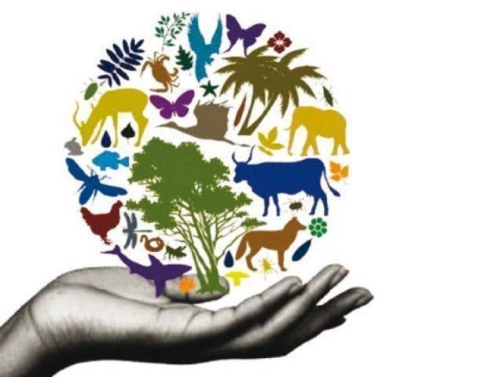
PROTECT
OUR
DIVERSITY
For more Powerpoint Preshows,
please visit: http://murov.info/PPTPreshows.htm

