Slide 1
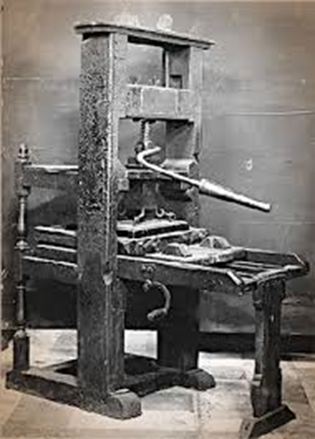
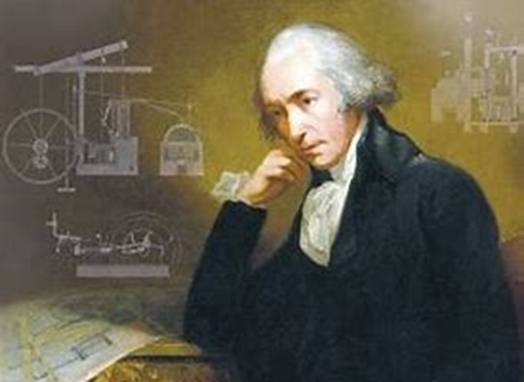
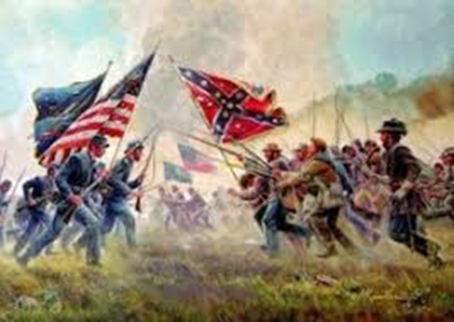
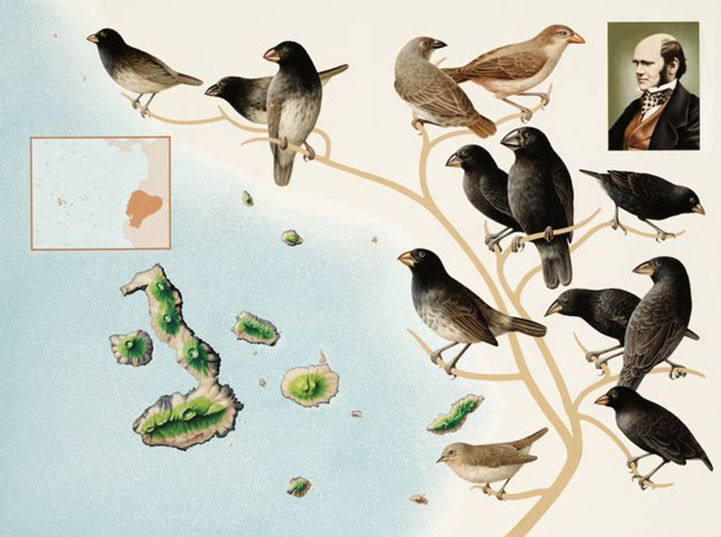
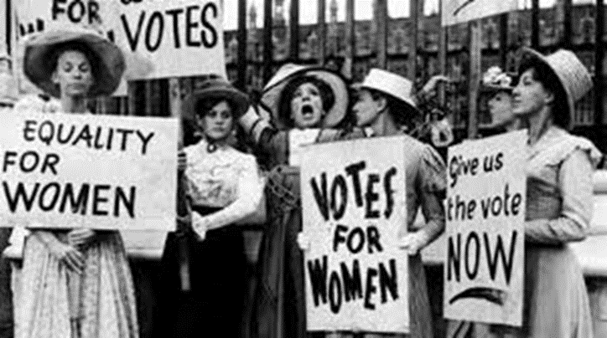
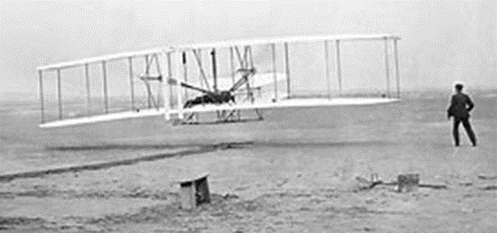
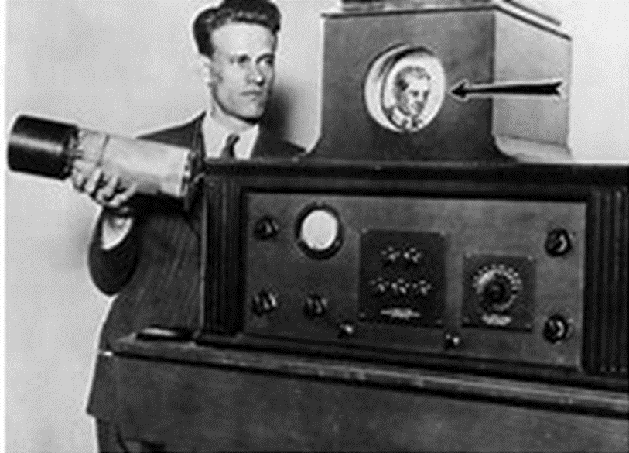
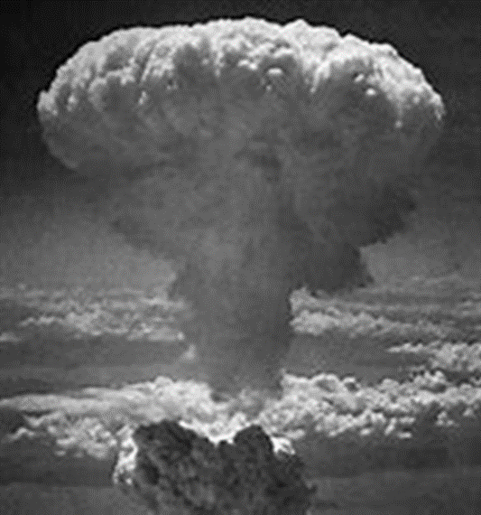
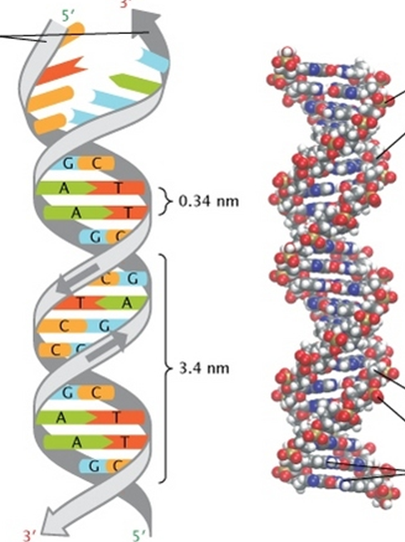
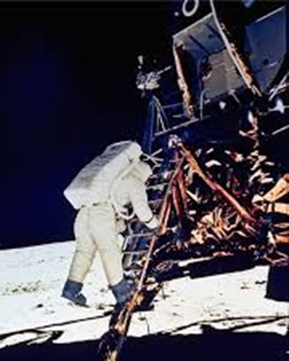
Selected
Historical Events Quiz

Slide 2
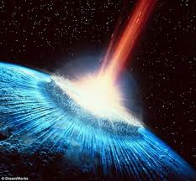
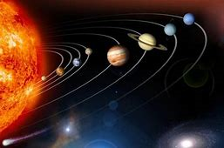
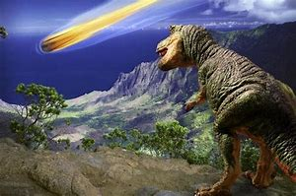
This first question deals with the beginning of time to 65 million years ago. The remaining slides in approximate chronological order deal with human related activities during the last 600 years. What 3 events 13.8 billion years ago, 4.6 billion years ago and 65 million years significantly impacted life on earth today?
Big Bang – 13.8 billion years ago - The rapid expansion of matter from a state of extremely high density and temperature marked the origin of the universe.
The nebular hypothesis, maintains that 4.6 billion years ago, the Solar System formed from the gravitational collapse of a giant molecular cloud which was light years across.
A giant asteroid slamming into Earth 65 million years ago near what is now Mexico's Yucatan Peninsula caused the end of the Age of Dinosaurs.

Slide 3
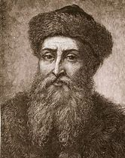
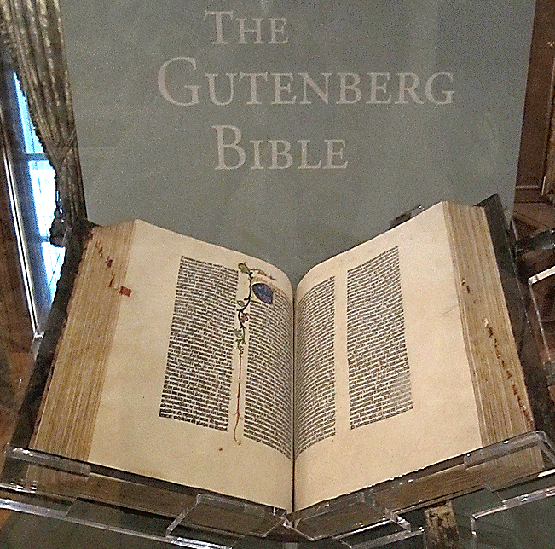
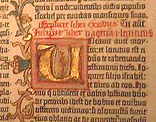
What significant discovery in 1450 forever changed the storage and availability of information?
The PRINTING
PRESS
Johannes Gutenberg (ca. 1398-1468)
What really set Gutenberg apart from his predecessors in Asia was his development of a press that mechanized the transfer of ink from movable type to paper. Adapting the screw mechanisms found in wine presses, papermakers' presses and linen presses, Gutenberg developed a press perfectly suited for printing. The first printing press allowed for an assembly line-style production process that was much more efficient than pressing paper to ink by hand. For the first time in history, books could be mass-produced — and at a fraction of the cost of conventional printing methods. https://www.livescience.com/43639-who-invented-the-printing-press.html

Slide 4
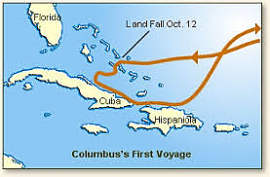
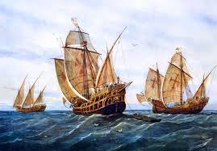
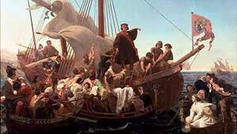
What significant event happened in 1492?
During four separate trips that started with the one in 1492, Columbus landed on various Caribbean islands that are now the Bahamas as well as the island later called Hispaniola. He also explored the Central and South American coasts but never landed in North America.

Slide 5
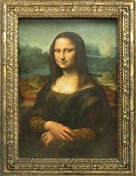
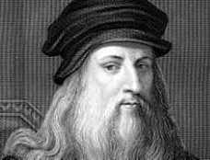
Originally thought to have been created in 1503 -1506,
it is now considered to have been finished in 1519.
Mona
Lisa
Leonardo da Vinci
Dimensions: 2′ 6″ x 1′ 9″
Location: Louvre Museum (since 1797)

Slide 6
Who is widely regarded as the greatest writer in the English language and the world's greatest dramatist?
William Shakespeare was an English poet, playwright, and actor, he is often called England's national poet and the "Bard of Avon".
Born: April 1564, Stratford-upon-Avon, United Kingdom
Died: April 23, 1616, Stratford-upon-Avon, United Kingdom
The best-selling fiction author of all time (estimated 4 billion copies sold)

Slide 7
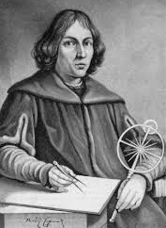
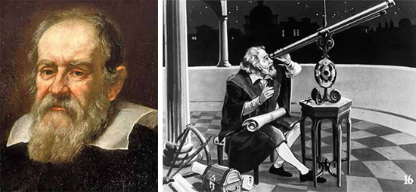
Prior to the lives of Copernicus and Galileo,
what was considered to be the center of the Universe?
Galileo Galilei’s discoveries with the telescope revolutionized astronomy and paved the way for the acceptance of the Copernican heliocentric system, but his advocacy of that system eventually resulted in an Inquisition process against him. Over 300 years later, in 1992, Pope Paul II admitted that Galileo had been correct.
Born: February 15, 1564, Pisa, Italy
Died: January 8, 1642, Arcetri, Italy
Nicolaus Copernicus was a Renaissance-era mathematician and astronomer, who formulated a model of the universe that placed the Sun rather than Earth at the center of the universe, in all likelihood independently of Aristarchus of Samos, who had formulated such a model some eighteen centuries earlier.
Born: February 19, 1473, Torun, Poland
Died: May 24, 1543, Frombork, Poland

Slide 8
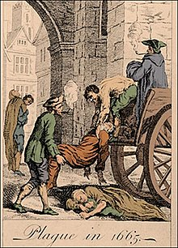
What reoccurring event ravaged the world in the middle of the second millennium?
Black Death: The Medieval black plague that ravaged Europe and killed a third of its population. It was due to the plague which is caused by a bacterium (Yersinia pestis) transmitted to humans from infected rats by the oriental rat flea. In 14th-century Europe, the victims of the Black Death had bleeding below the skin (subcutaneous hemorrhage) which darkened ("blackened") their bodies. The Black Death was characterized by gangrene of the fingers, toes, and nose. Although some scientists have speculated that the Black Death was caused by other agents (including anthrax, typhus, and Ebola virus), DNA tests on 600-year-old teeth from victims of the Black Death have confirmed that Yersinia pestis was indeed the cause of the Black Death.
Diary of Samuel Pepys - April 30th, 1665
“Great fears of the Sicknesses here in the City, it being said that two or three houses are already shut up. God preserve us all.”

Slide 9
What contributions did Isaac Newton make to the advancement of knowledge?
Besides his work on universal gravitation (gravity), Newton developed the three laws of motion which form the basic principles of modern physics. His discovery of calculus (also independently by Gottfried Leibniz) led the way to more powerful methods of solving mathematical problems.

Slide 10
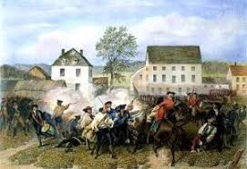
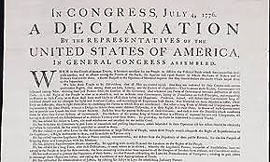
"The shot heard round the world" is a phrase that refers to the opening shot of the Battle of Concord on 4/19/1775, which began the American Revolutionary War and led to the creation of the United States of America. This event led to what significant event on July 4, 1776?
We hold these truths to be self-evident, that all men are created equal, that they are endowed by their Creator with certain unalienable Rights, that among these are Life, Liberty and the pursuit of Happiness. From the Declaration of Independence
The United States Declaration of Independence is the pronouncement written by Thomas Jefferson and others and adopted by the Second Continental Congress meeting at the Pennsylvania State House in Philadelphia, Pennsylvania, on July 4, 1776.

Slide 11
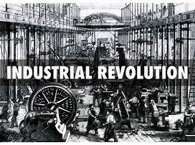
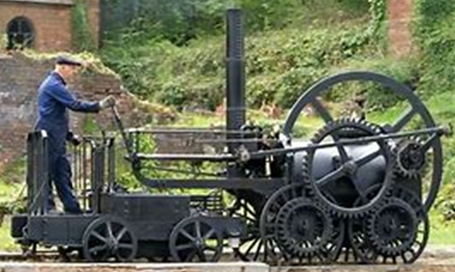
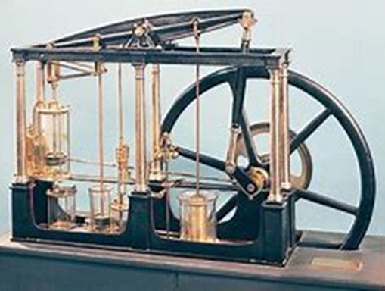
Who made the steam engine practical, what year did this happen and what era did it initiate?
James Watt (January 19, 1736–August 25, 1819) was a Scottish inventor, engineer, and chemist. He made the Thomas Newcomen steam engine (1712) into a workable steam engine that utilized a separate condenser (1776); this innovation made the steam engine a useful tool for a vast range of uses. In many ways, Watt's improvement steam engine—was the technological impetus behind the Industrial Revolution and the birth of rail transport.

Slide 12
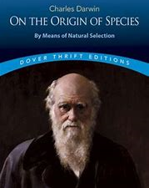
What development in the 19th Century forever affected thinking about life’s origins?
Darwin
The Galapagos and its finches.
In the early 19th century Jean-Baptiste Lamarck (1744–1829) proposed his theory of the transmutation of species, the first fully formed theory of evolution. In 1858 Charles Darwin and Alfred Russel Wallace published a new evolutionary theory, explained in detail in Darwin's On the Origin of Species (1859).

Slide 13
What conflict in the middle of the 19th century posed a threat to the United States?
The American Civil War: 1860-1865
— 1860: Election of Republican Abraham Lincoln as U.S. President leads southern states to secede
— February 1861: Seven southern states form the Confederate States of America followed in 1861 by four more states
— 1/1/1863: The Emancipation Proclamation frees slaves in rebel areas
— 7/1-3/1863: The Union victory at the Battle of Gettysburg is the turning point of the war in favor of the Union (Pennsylvania)
— 4/9/1865: Confederate General Robert E. Lee surrenders the Army of Virginia to Union General Ulysses S. Grant at Appomattox Court House (Virginia)
— 4/15/1865: Assassination of Abraham Lincoln by John Wilkes Booth (Washington, D.C.)
— 4/26/1865: Confederate General Joseph E. Johnston surrenders the Army of Tennessee to Union General William T. Sherman (North Carolina)
Four score and seven years ago our fathers brought forth on this continent, a new nation, conceived in Liberty, and dedicated to the proposition that all men are created equal.
Now we are engaged in a great civil war, testing whether that nation, or any nation so conceived and so dedicated, can long endure. Extracted from Lincoln’s Gettysburg address.

Slide 14
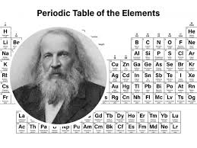
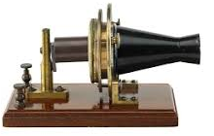
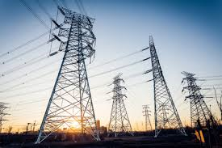
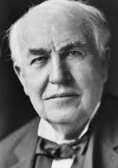
What inventions and developments were made by Edison, Tesla, Markovnikov, and Bell in the latter half of the 19th Century?
Alexander Graham Bell was awarded the first U.S. patent for the invention of the telephone in 1876.
1869
Dimitri
Mendeleev
✦
1876  2019
Nikola Tesla is known for designing the alternating-current (AC) electric system (1982), which is the predominant electrical system used across the world today. He also created the "Tesla coil," which is still used in radio technology.
Thomas A. Edison

Slide 15
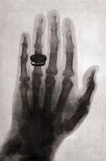
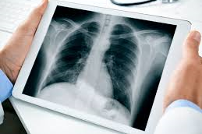
What discovery in 1895 changed the future of the medical field?
The Discovery of X-Rays: 1895
1875: Researchers first noticed x-rays emanating from experimental discharge tubes called Crookes tubes
1886: Ivan Pulyui (Ukraine/Germany) discovered that sealed photographic plates darkened when exposed to Crookes tubes
1887: Nikola Tesla (Serbia/US) begins experimenting with x-rays
1891: Fernando Sanford (US) generates and detects x-rays
1895: Wilhelm Röntgen who was a Professor at Wuerzburg University in Germany working with a cathode-ray tube in his laboratory observed a fluorescent glow of crystals on a table near his tube. The use of x-rays for medical use quickly followed.
The hand received a radiation dose 1,500 times greater than today’s dosage—which explains why many people who were X-rayed or who worked with the original machines suffered from radiation burns and loss of hair.

Slide 16
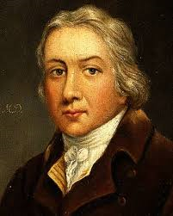
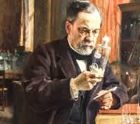
Who discovered the invaluable life saving technique of vaccination?
Edward Jenner is considered the founder of vaccinology in the West in 1796, after he inoculated a 13 year-old-boy with vaccinia virus (cowpox) and demonstrated immunity to smallpox. In 1798, the first smallpox vaccine was developed. Over the 18th and 19th centuries, systematic implementation of mass smallpox immunization culminated in its global eradication in 1979. Born: May 17, 1749, Berkeley, United Kingdom
Died: January 26, 1823, Berkeley, United Kingdom
Louis Pasteur’s experiments spearheaded the development of live attenuated cholera vaccine and inactivated anthrax vaccine in humans (1897 and 1904, respectively) and the rabies vaccine (with Émile Roux). Louis Pasteur was renowned for his discoveries of the principles of vaccination, microbial fermentation and pasteurization. He is remembered for his remarkable breakthroughs in the causes and prevention of diseases, and his discoveries have saved millions lives ever since.
Born: Dec. 27, 1822, Dole, France
Died: Sept. 28, 1895, Marnes-la-Coquette, France

Slide 17
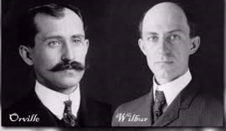
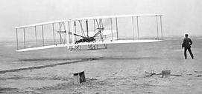
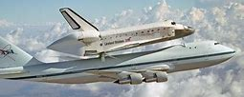
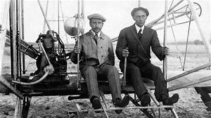
What significant event that changed transportation forever occurred on 12/17/1903?
On December 17, 1903, Wilbur and Orville Wright made four brief flights at Kitty Hawk with their first powered aircraft.

Slide 18
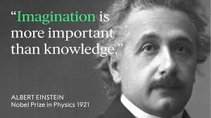
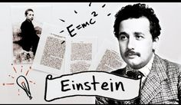
For what reason was 1905 termed Annus Mirabills (miraculous year) for this person and also for humankind?
In 1905, Albert Einstein living in Switzerland published 4
astonishing and groundbreaking papers.
— 6/9/1905: Paper explaining the photoelectric effect by means of quanta
— 7/18/1905: Paper explaining Brownian motion provides evidence of atoms
— 9/26/1905: Einstein publishes the special theory of relativity
— 11/21/1905: Einstein shows the equivalence of energy and matter (E = mc2)

Slide 19
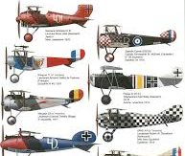
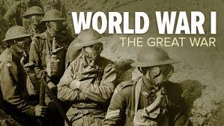
What conflict was sometimes called the GREAT WAR?
World War I began in 1914 after the assassination of Archduke Franz Ferdinand and lasted until 1918. During the conflict, Germany, Austria-Hungary, Bulgaria and the Ottoman Empire (the Central Powers) fought against Great Britain, France, Russia, Italy, Romania, Japan and the United States (the Allied Powers). Thanks to new military technologies and the horrors of trench warfare, World War I saw unprecedented levels of carnage and destruction. By the time the war was over and the Allied Powers claimed victory, more than 16 million people—soldiers and civilians alike—were dead.
— June 1917: The US enters the war
— 11/11/1918: An armistice ends the fighting
— 1919: The Treaty of Versailles redraws the map of Europe and imposes harsh terms on Germany
Some World War I airplanes, the first war that used planes.

Slide 20
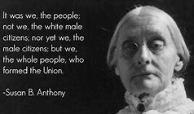
What event in 1920 culminated the work of Susan B. Anthony?
The Suffrage Movement: Women Fight For the Right to Vote: 1893-1928
1848: The Declaration of Sentiments, written by Elizabeth Cady Stanton and signed at the Women’s Rights Convention in Seneca Falls, NY, calls for giving women the right to vote (US)
1872: Susan B. Anthony is arrested when she votes in the presidential election (US)
1893: The self-governing colony of New Zealand grants suffrage to women; Colorado becomes first US state to grant full voting rights to women
1903: Australia is the first sovereign nation to grant women the right to vote
1906: The Grand Duchy of Finland, part of the Russian Empire, becomes the first country to give women both the right to vote and to run for office
1920: 19th Amendment to the US Constitution grants women the right to vote

Slide 21
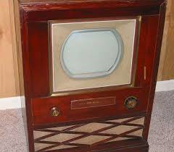
What invention made in 1927 do we spend much too much time facing?
The First Electronic Television was Invented in 1927. The world's first electronic television was created by a 21 years old inventor named Philo Taylor Farnsworth. That inventor lived in a house without electricity until he was age 14.
Although a practical demonstration of mechanically-scanned color television was given by John Logie Baird in 1928, it was 20 years later before an electronic version was developed. Sometime between 1946 and 1950, the research staff of RCA Laboratories invented the world's first electronic, color television system. A successful color television system based on a system designed by RCA began commercial broadcasting on December 17, 1953.

Slide 22
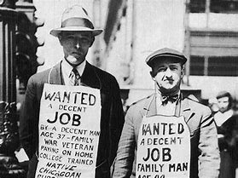
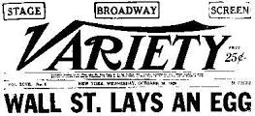
What was Black Tuesday?
The Wall Street Crash of 1929, also known as the Stock Market Crash of 1929 or the Great Crash, was a major stock market crash that occurred in late October, 1929. It started on October 24 and continued until October 29, 1929, when share prices on the New York Stock Exchange collapsed. There were widespread bank failures in US and Europe and the Great Depression lasted from 1929 – 1940.

Slide 23
What serendipitous discovery in 1928 was finally made useable during WWII and has saved millions of lives?
Fleming did not have the resources to find methods for using the antibacterial properties of the penicillin that he had accidentally discovered. It remained for the pressure of infected injuries in WWII that Florey and Chain developed methods for delivering the drug. Penicillin is unstable in stomach acid and had to be injected. Modifications to the structures produced ampicillin and amoxicillin which can be take orally. Many bacteria have developed resistance to penicillins and there is a need for the development of new antibiotics.

Slide 24
What conflict involved virtually every part of the world with the principal belligerents being the Axis powers—Germany, Italy, and Japan—and the Allies—France, Great Britain, the United States, the Soviet Union, and, to a lesser extent, China.

Slide 25
On August 6 and 9, 1945, what events changed the future course of international relations forever?
The United States detonated two nuclear weapons over the Japanese cities of Hiroshima and Nagasaki.
A discovery by nuclear physicists in a laboratory in Berlin, Germany, in 1938 made the first atomic bomb possible, after Otto Hahn, Lise Meitner and Fritz Strassman discovered nuclear fission. The Nobel prize probably for inappropriate reasons was awarded only to Hahn. The Manhattan Project turned the theory into reality. When an atom of radioactive material splits into lighter atoms, there's a sudden, powerful release of energy. The development of special relativity by Albert Einstein in 1905 that demonstrated the relationship between energy and mass set the stage for the discovery of nuclear fission. Nuclear fission, besides use in destructive bombs, is also a carbon free method of generating electricity.

Slide 26
What great discovery that affected the future of medicine was made by Crick, Watson, Wilkins and Franklin in 1953?
James Watson Francis Crick Hugh Wilkins Rosalind Franklin
While Watson and Crick are commonly given the credit for discovering the structure of DNA, Hugh Wilkins shared the 1962 Nobel prize with them. Unfortunately, equally deserving of the credit but not acknowledged by the Nobel committee, Rosalind Franklin took the x-ray image that enabled the determination of the double helix structure. DNA (deoxyribonucleic acid), a self-replicating material is present in nearly all living organisms as the main constituent of chromosomes and is the carrier of genetic information.

Slide 27
U.S. Civil Rights Movement: 1954-1968 (US)
— 5/17/1954: The U.S. Supreme Court rules in Brown v. Board of Education that segregated education is unconstitutional
— 12/1/1955: Rosa Parks refuses to sit in the back of the bus, sparking Montgomery bus boycott
— 1957: President Eisenhower sends US troops to protect black students attending Central High School in Little Rock, Arkansas
— 1960: First lunch counter protest in Greensboro, North Carolina
— 8/28/1963: Martin Luther King, Jr. leads march on Washington, makes “I Have a Dream” speech
— 9/15/1963: Four black girls killed in bombing of church in Birmingham, Alabama
— 7/2/1964: President Johnson signs the Civil Rights Act
— 2/21/1965: Assassination of Malcolm X
— 3/7/1965: Protest march from Selma to Montgomery, AL
— 8/6/1965: President Johnson signs the Voting Rights Act
— 4/4/1968: Assassination of Martin Luther King, Jr.
What were the significant steps related to civil rights that took place in the in the U.S. between 1954 and 1968?

Slide 28
Jeopardy: What is the question?
We choose to go to the Moon in this decade and do the other things, not because they are easy, but because they are hard; because that goal will serve to organize and measure the best of our energies and skills, because that challenge is one that we are willing to accept, one we are unwilling to postpone, and one we intend to win, and the others, too.
The Cuban Missile Crisis was a 13-day confrontation between the United States and the Soviet Union initiated by the American discovery of Soviet ballistic missile deployment in Cuba. Dates: Oct 16, 1962 – Oct 28, 1962
The Bay of Pigs Invasion was a failed military invasion of Cuba undertaken by the Central Intelligence Agency (CIA)-sponsored rebel group Brigade on 17 April 1961.
"Ich bin ein Berliner" is a speech by United States President John F. Kennedy given on June 26, 1963, in West Berlin. It is widely regarded as the best-known speech of the Cold War and the most famous anti-communist speech.
John F. Kennedy, the 35th president of the United States, as he rode in a motorcade in Dallas, Texas, on November 22, 1963, was assassinated by Lee Harvey Oswald.
Name the most famous memories of the John F. Kennedy years.

Slide 29
Soviet Union Launches Sputnik, First Man-Made Satellite: 10/4/1957 (Russia)
What two related events occurred
on 10/4/1957 and 7/20/1969?
10/4/1957 - Soviet Union launches
Sputnik and initiates space race.
On 7/20/1969, U.S. lands
first humans on the moon.
July 16, 1969
←
Left to right:
Armstrong,
Collins,
Aldrin

Slide 30
The following people played a role in the development of what technology that has changed society?
Charles Babbage (1833), John Atanasoff and Clifford Berry (1939), George Stibitz (1940), Konrad Zuse (1941, 1945), Max Newman and Tommy Flowers (1943), John Mauchlyand J. P. Eckert (1945), John Bardeen, Walter Brattain and William Shockley (1945) Jack Kilby and independently Robert Noyce (1959).
The Digital Revolution: The Invention of the Digital Electric Computer
Isn’t is a little strange that few if any of these people have significant name recognition?
Charles Babbage
and his calculating
machine(1833)
1953: IBM unveils the 701, the world’s first scientific computer.
1955: MIT launches Whirlwind, the first computer with integrated RAM.
1956: MIT demos the first transistorized computer.
1964: Italian Pier Giorgio Perotto unveils the Programma 101, the first desktop machine. 44,000 were sold at $3,200 each.
1968: Hewlett Packard started selling the HP 9100A. It was the first mass-marketed desktop computer.
1970: American John Blankenbaker created what many experts consider to be the first personal computer—the Kenbak-1. The computer went on sale in 1971; just 50 machines were built. They sold for $750, that’s about $5,000 today.

Slide 31
The following represent a few of the steps in the
development of what valuable resource (1965-1995)?
— 1965: Lawrence G. Roberts and Thomas Merrill create the first wide-area computer network
— 1967: Roberts publishes a plan for the ARPANET (Advanced Research Projects Agency Network)
— December 1969: Four computers are linked in the ARPANET
— 1970: S. Crocker and his Network Working Group finish the ARPANET’s initial host-to-host protocol, the Network Control Protocol (NCP)
— 1973: The first trans-Atlantic transmission occurs, to University College of London
— 1977: Dennis Hayes and Dale Heatherington invent the PC modem
— 1979: Usenet and CompuServe are launched
— 1981: The National Science Foundation (NSF) creates
CSNET and links it to ARPANET
— 1983: ARPANET computers switch from the NCP protocol
to the TCP/IP protocol
— 1985: The first dot-com domain name is registered
— 1986: NSF creates NSFNET, which is linked with ARPANET
— 1990: ARPANET is decommissioned in favor of NSFNET
— 1995: NSFNET is decommissioned and replaced by
networks operated by several commercial service providers
The Birth of the Internet (US)

Slide 32
What happened on 11/09/1989?
Erected in the dead of night on August 13, 1961, the Berlin Wall was a physical division between West Berlin and East Germany. Its purpose was to keep disaffected East Germans from fleeing to the West. The total length of the Berlin Wall was 91 miles (155 kilometers). It cut not only through the center of Berlin, but also wrapped around West Berlin, entirely cutting it off from the rest of East Germany.
The wall itself went through four major transformations during its 28-year history. 1. barbed-wire for a few days. 2. concrete blocks topped with barbed wire. 3. 1965 –concrete wall with steel girders. 4. 1975-1980 – concrete slabs up to 12 feet high and 4 feet wide with a smooth pipe across the top.
When the Berlin Wall fell on November 9, 1989, its destruction was nearly as instantaneous as its creation. For 28 years, the Berlin Wall had been a symbol of the Cold War and the Iron Curtain between Soviet-led Communism and the democracies of the West. When it fell, the event was celebrated around the world.

Slide 33
What happened in South Africa
between 1990 and 1994?
Apartheid, the Afrikaans name given by the white-ruled South Africa's Nationalist Party in 1948 to the country's harsh, institutionalized system of racial segregation, came to an end in the early 1990s in a series of steps that led to the formation of a democratic government in 1994.
The apartheid system in South Africa was ended through a series of negotiations between 1990 and 1993 and through unilateral steps by the de Klerk government. These negotiations took place between the governing National Party, the African National Congress, and a wide variety of other political organizations.
Nelson Mandela, leader of the movement to end South African apartheid, is released from prison by de Klerk after 27 years on February 11, 1990.

Slide 34
What does the image to the right depict?
The September 11, 2001, attacks (also referred to as 9/11) were a series of four coordinated terrorist attacks by the Islamic terrorist group al-Qaeda against the United States on the morning of Tuesday, September 11, 2001. The attacks killed 2,977 people, injured over 25,000 others, and caused at least $10 billion in infrastructure and property damage. Additional people have died of 9/11-related cancer and respiratory diseases in the months and years following the attacks.
Four passenger airliners operated by two major U.S. passenger air carriers (United Airlines and American Airlines)—all of which departed from airports in the northeastern United States bound for San Francisco and Los Angeles—were hijacked by 19 al-Qaeda terrorists. Two of the planes, American Airlines Flight 11 and United Airlines Flight 175, were crashed into the North and South towers, respectively, of the World Trade Center complex in Lower Manhattan. Within an hour and 42 minutes, both 110-story towers collapsed.

Slide 35
Hopefully, a listing sometime in the future of historical events will be void of conflicts and tragedies but filled with promise and positives.
Selection of the events covered in this exercise were made in part from the following web sites:
https://beckchris.wordpress.com/history/the-55-most-important-events-in-human-history/
https://www.ranker.com/list/most-important-historical-events-of-the-20th-century/mwahahahaha https://www.therichest.com/most-influential/15-most-important-historical-events-that-changed-the-world-forever/
https://list25.com/25-most-important-events-in-history/
For more Powerpoint Pre-shows, please visit: http://murov.info/PPTPreshows.htm

