Slide 1
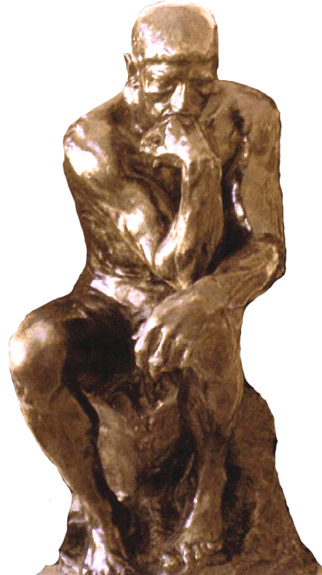
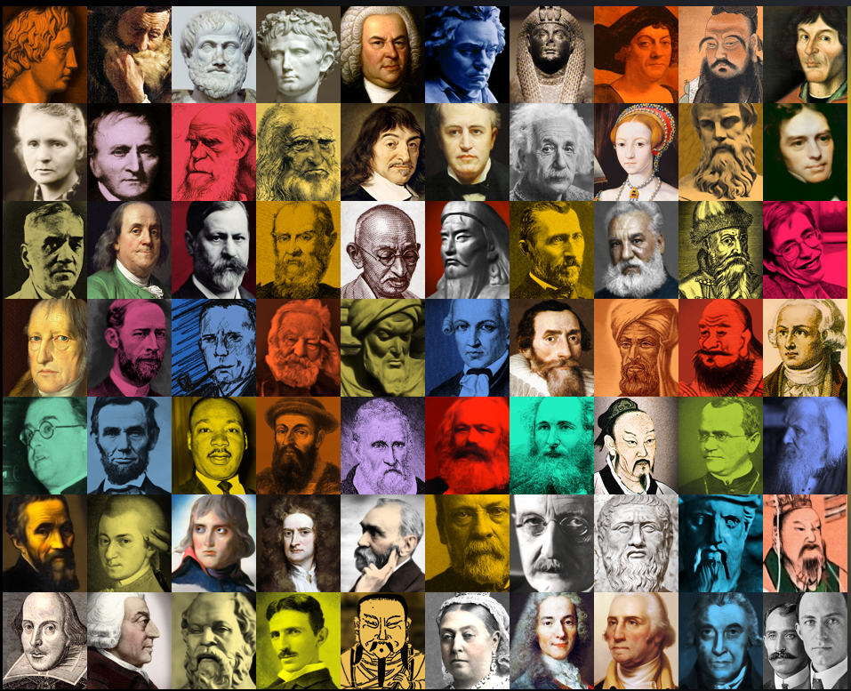
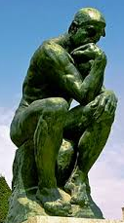
40 of the most influential thinkers of all time.
Not included are two distinctly different groups: religious leaders and sadistic dictators.
Examples could include but are not restricted to people pictured below.
ARRANGED
CHRONOLOGICALLY
by birthdate
People selected from:
The Thinker - Rodin
https://www.biographyonline.net/people/100-most-influential.html
http://listographic.com/121-influential-people
https://www.ranker.com/crowdranked-list/the-most-influential-people-of-all-time
http://ideas.time.com/2013/12/10/whos-biggest-
the-100-most-significant-figures-in-history/

Slide 2
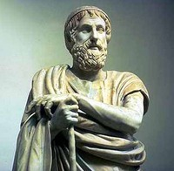
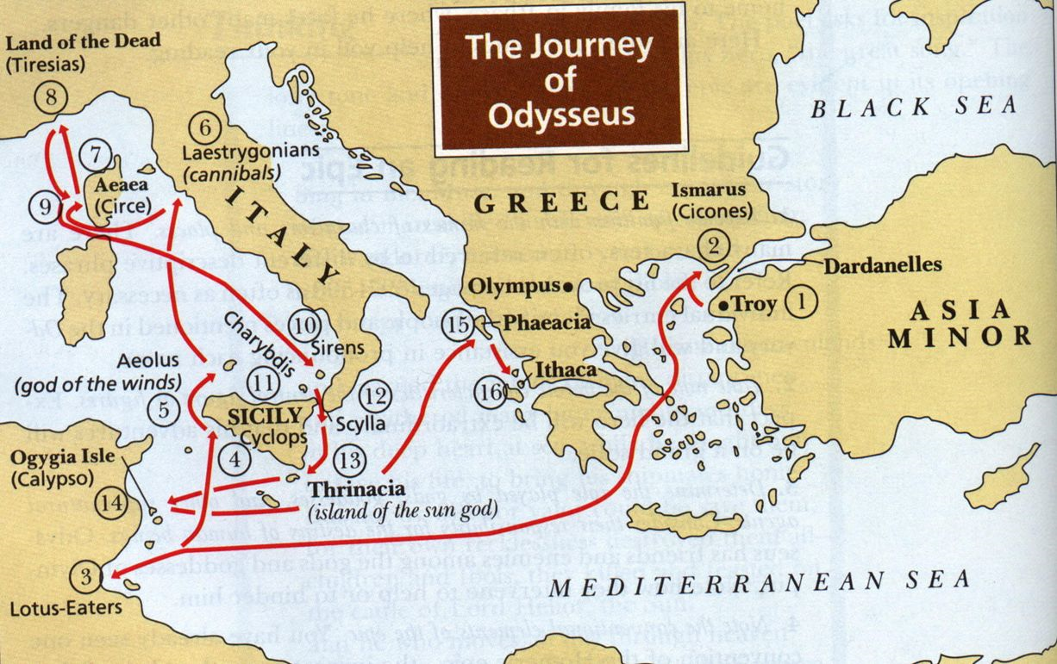
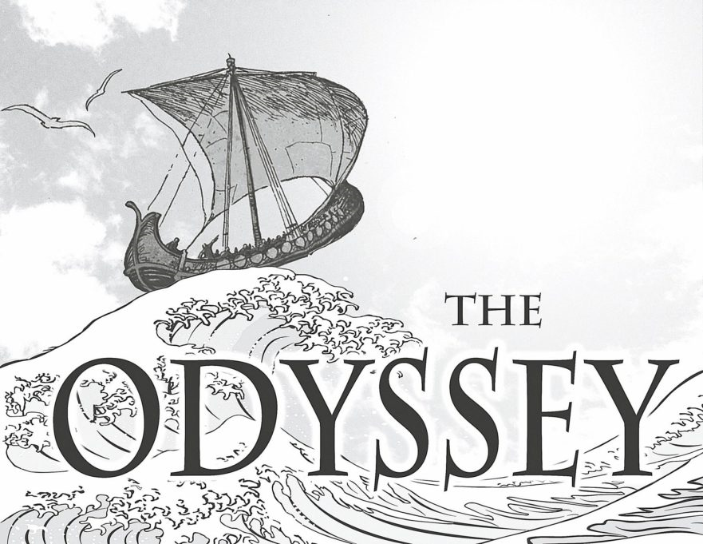
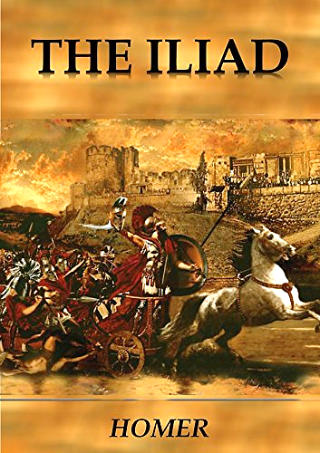
1. He as been considered the greatest poet of classical antiquity.
2. He is the presumed author of the classics Iliad and the Odyssey.
3. Some maintain that his poems are dependent on an oral tradition, a generations-old technique that was the collective inheritance of many singer-poets.
Homer was born at Smyrna in the Ionian region of Asia Minor (or possibly on the island of Chios), and that he died on the Cycladic island of Ios. Indirect reports from Herodotus and others generally date him approximately between 750 and 700 BCE.
How prone to doubt, how cautious are the wise!
There is nothing more admirable than when two people who see eye to eye keep house as man and wife, confounding their enemies and delighting their friends.

Slide 3
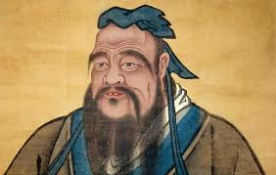
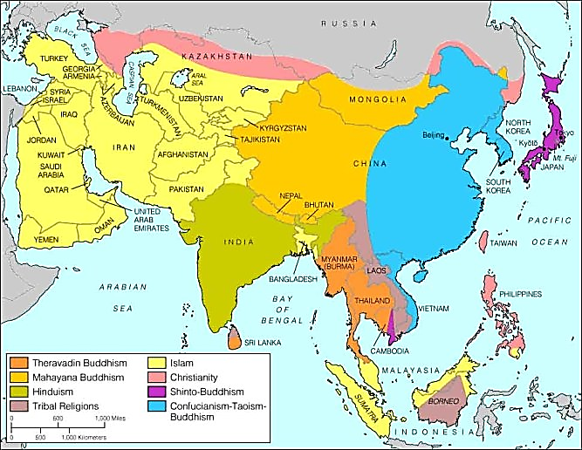
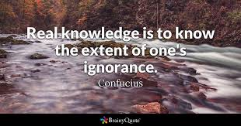
1. a Chinese teacher, editor, politician, and philosopher of the Spring and Autumn period of Chinese history.
2. His philosophy emphasized personal and governmental morality, correctness of social relationships, justice and sincerity. China’s most renowned thinker.
Confucius (551 B.C. to 479 B.C.),
also known as Kong Qui or K’ung Fu-tzu
3. Our greatest glory is not in never falling, but in rising every time we fall.
4. It does not matter how slowly you go as long as you do not stop.
5. The will to win, the desire to succeed, the urge to reach your full potential... these are the keys that will unlock the door to personal excellence.
The Five Virtues
Ren is the virtue of benevolence, charity, and humanity;
Yi, of honesty and uprightness;
Zhi, knowledge;
Xin, the virtue of faithfulness and integrity;
Li, correct behavior, or propriety, good manners,
politeness, ceremony, worship.

Slide 4
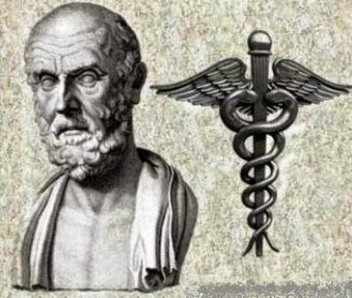
1. Greek physician of the Age of Pericles, who is considered one of the most outstanding figures in the history of medicine.
2. He based his medical practice on observations and on the study of the human body.
3. He held the belief that illness had a physical and a rational explanation. He rejected the views of his time that considered illness to be caused by superstitions and by possession of evil spirits and disfavor of the gods.
Hippocrates of Cos (450 BCE to 380 BCE.
4. Developed an Oath of Medical Ethics for physicians to follow. This Oath is taken by physicians today.
The classical Hippocratic Oath summary:
"A solemn promise:
Of solidarity with teachers and other physicians.
Of beneficence (to do good or avoid evil) and non-maleficence (from the Latin 'primum non nocere', or 'do no harm') towards patients. (In fact the well-known "first do no harm" phrase does not feature in the classical Hippocratic Oath.)
Not to assist suicide or abortion.
To leave surgery to surgeons.
Not to harm, especially not to seduce patients.
To maintain confidentiality and never to gossip."
Make a habit of two things: to help; or at least to do no harm.
Let food be thy medicine and medicine be thy food.

Slide 5
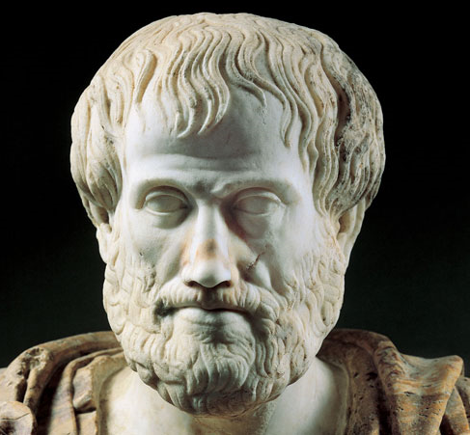
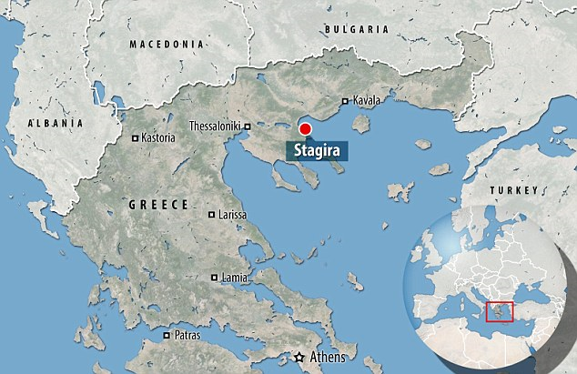
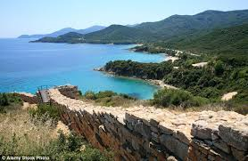
1. A translation of his name is “the best purpose”. He was “The Philosopher.”
2. A pupil of Plato and was first reverent to him then very critical, about Plato’s theory of ideas for example.
3. He is said to have written 150 philosophical treatises that have made significant and lasting contributions. The 30 that survive touch on an enormous range of philosophical problems from biology and physics to morals to aesthetics to politics.
Excellence is never an accident. It is always the result of high intention, sincere effort, and intelligent execution; it represents the wise choice of many alternatives – choice, not chance, determines your destiny.
Aristotle (384 B.C. to 322 B.C.)
Born in the North of classical Greece
The high-minded man must care more for the truth than for what people think.
Stagira
He who cannot be a good follower cannot be a good leader.
Please note that Socrates and Plato also merited inclusion in this presentation.

Slide 6
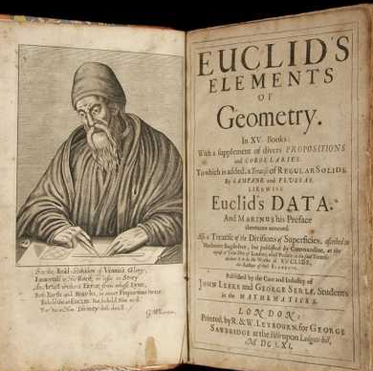
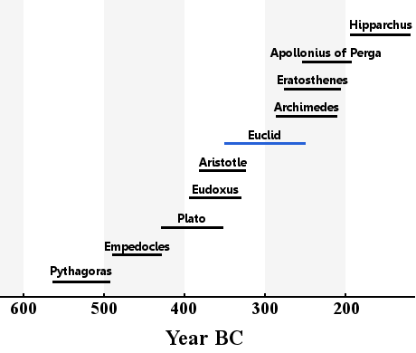
1. He was a Greek mathematician, often referred to as the "father of geometry”.
2. His books, Elements served as the main textbook for teaching mathematics (especially geometry) from the time of its publication until the late 19th or early 20th century.
3. He was also famous for another enormously influential book, Optics, in which he explained light’s behavior using geometrical principles he had developed the Elements.
QED - Quod erat demonstrandum.
Socrates
Euclid or Euclid of Alexandria (c. 325 – c. 270 BC)
There is no Royal Road to Geometry.

Slide 7
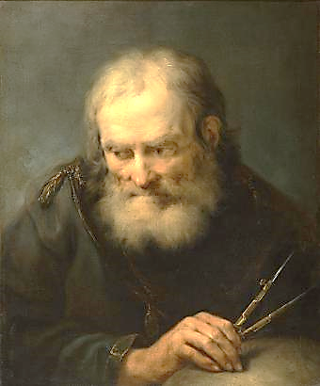
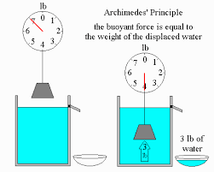
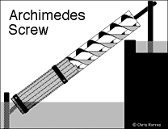
1. He is considered by most historians of mathematics as one of the greatest mathematicians of all time. His mathematical approaches evolved a couple of thousand years later into calculus.
2. He discovered the relation between the surface and volume of a sphere and its circumscribing cylinder.
3. He discovered the laws of levers and pulleys including his famous screw still used today to move water upwards.
Give me a place to stand, and a lever long enough, and I will move the world.
4. Eureka! Eureka! Supposed to have been his cry, jumping naked from his bath and running in the streets, excited by a discovery about water displacement to solve a problem about the purity of a gold crown.
Archimedes
born in Sicily (287 bce - 212 bce)
5. The Babylonians estimated pi to be 25/8 (3.125), while the Egyptians estimated it to be 256/81 (roughly 3.16). This Ancient Greek mathematician is considered to be the first to calculate an accurate estimation of the value of π (3 10/71 < π < 3 1/7) .

Slide 8
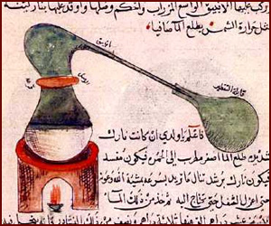
1. He was a prominent Islamic alchemist, pharmacist, philosopher, astronomer, and physicist. He has also been referred to as "the father of Arab chemistry.
2. He has been credited with the discovery or isolation of nitric acid, hydrochloric acid, sulfuric acid and the field of perfumery.
3. Perhaps the first to distinguish between metals and non-metals.
4. He has also been credited with the development of extremely important techniques including distillation, filtration and crystallization.
Jābir ibn Hayyān
often referred to as Geber, (c.721–c.815)
He who performs not practical work nor makes experiments will never attain to the least degree of mastery.

Slide 9
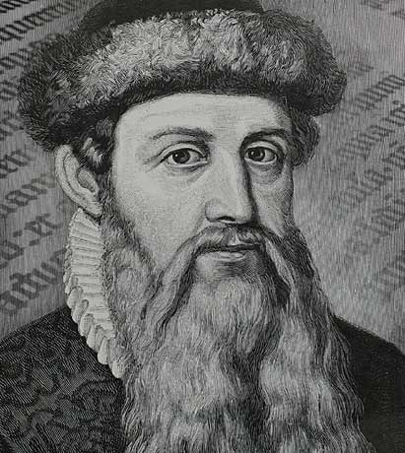
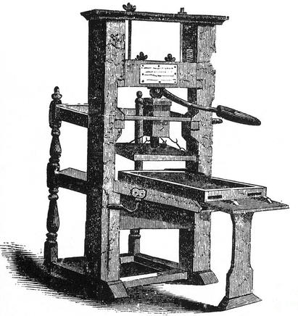
1. German blacksmith, goldsmith, inventor, printer, and publisher.
2. He is best known for developing the first mechanical moveable type printing press.
The most influential book published by Gutenberg was the Gutenberg Bible in 1455.
Yes, it is a press, certainly, but a press from which shall flow in inexhaustible streams, the most abundant and most marvelous liquor that has ever flowed to relieve the thirst of men! Through it, God will spread His Word. A spring of truth shall flow from it: like a new star it shall scatter the darkness of ignorance, and cause a light heretofore unknown to shine amongst men.
Johannes Gutenberg
(c. 1398 – 1468 in Germany)

Slide 10
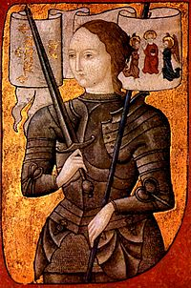
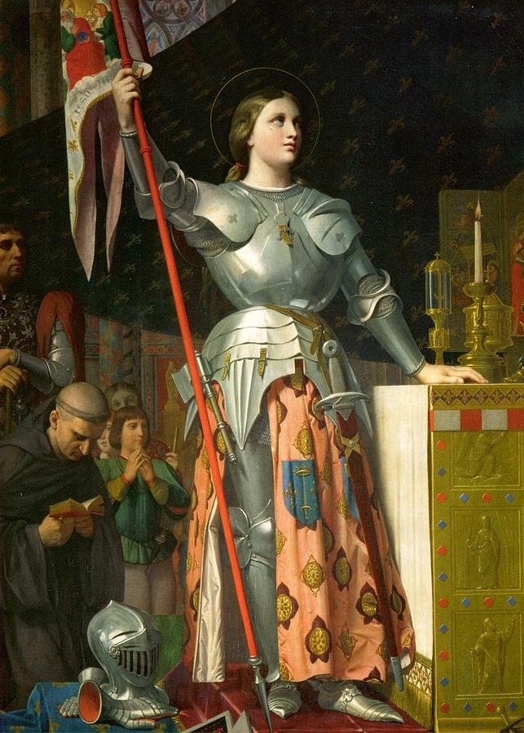
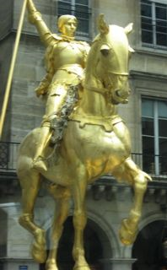
1.She was considered a heroine of France for her role during the Lancastrian phase of the Hundred Years' War. She led the French army to victory over the English at Orléans.
2.Her nickname was "The Maid of Orléans”.
3. She was excommunicated and burned at the stake for heresy by local officials in 1431, central Church officials would later nullify her excommunication
4.She was canonized as a Roman Catholic saint.
Joan of Arc (Jeanne d’Arc) 1412 – 1431
I am not afraid... I was born to do this.
One life is all we have and we live it as we believe in living it. But to sacrifice what you are and to live without belief, that is a fate more terrible than dying.

Slide 11
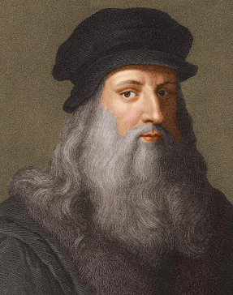
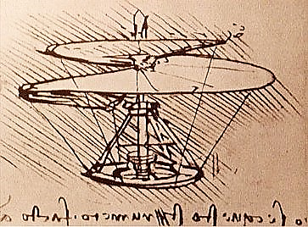
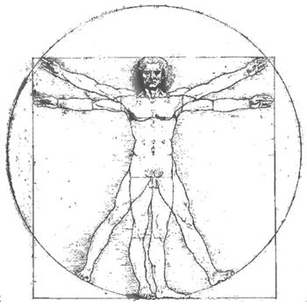
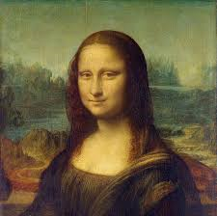
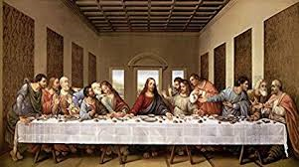
Nothing strengthens authority so much as silence.
Simplicity is the ultimate sophistication.
The noblest pleasure is the joy of understanding.
Art is never finished, only abandoned.
Nothing can be loved or hated unless it is first known.
Wisdom is the daughter of experience.
2. He was an architect, musician, engineer, scientist and inventor and painter who was way ahead of his time.
1..
3. He sketched the first parachute, first helicopter, first aeroplane, first tank, first repeating rifle, swinging bridge, paddle boat and first motor car.
4. He had a profound interest in anatomy, proportions of the human body and performed many dissections.
5. He painted the Mona Lisa and the Last Supper.
Leonardo di ser Piero da Vinci
1452 – 1519. Born in a Tuscan hamlet near Vinci.

Slide 12
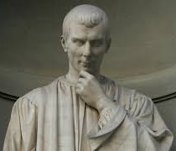
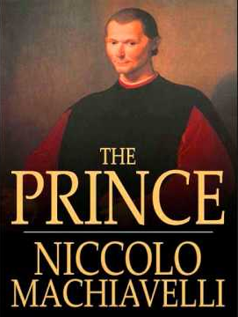
1. He was an Italian diplomat, politician, historian, philosopher, humanist, writer, playwright and poet of the Renaissance period. He has often been called the father of modern political science.
2. He wrote The Prince, a handbook for unscrupulous politicians. The Prince contained the view that any means can be used if it is necessary to maintain power.
Niccolò di Bernardo dei Machiavelli
(1469 – 1527) Italy
The first method for estimating the intelligence of a ruler is to look at the men he has around him.
All courses of action are risky, so prudence is not in avoiding danger (it's impossible), but calculating risk and acting decisively.

Slide 13
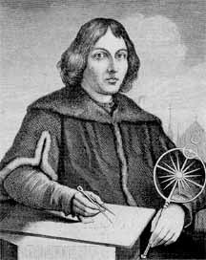
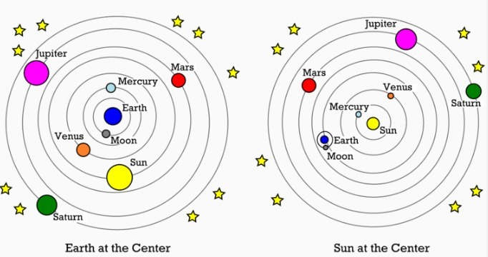
1. Renaissance-era mathematician and astronomer who formulated a model of the universe that placed the Sun rather than the Earth at the center of the universe.
2. Finally we shall place the Sun himself at the center of the Universe.
To know that we know what we know, and to know that we do not know what we do not know, that is true knowledge.
Ptolemaic model
Copernican model
Nicolaus Copernicus
(1473 – 1543) Poland
Aristarchus of Samos (c. 310 – c. 230 BC) was an ancient Greek astronomer and mathematician who presented the first known heliocentric model that placed the Sun at the center of the known universe with the Earth revolving around it.

Slide 14
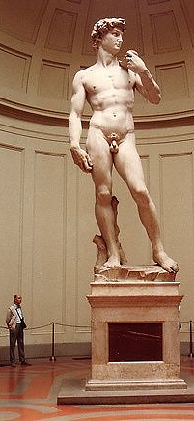
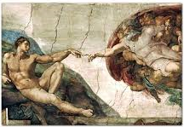
1. He was a sculptor, painter and architect widely considered to be one of the greatest artists of the Italian Renaissance period.
Michelangelo di Lodovico Buonarroti Simoni
2. He painted the ceiling of the Sistine Chapel.
3. Two of his most famous creations, David and the Creation of Adam, are pictured here.
I saw the angel in the marble and carved until I set him free.
The greater danger for most of us lies not in setting our aim too high and falling short; but in setting our aim too low, and achieving our mark.

Slide 15
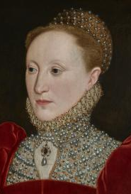
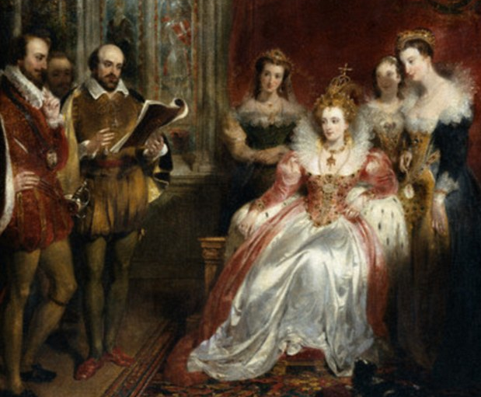
1. She was born a princess The daughter of King Henry VIII and his second wife Anne Boleyn, but declared illegitimate through political machinations. She actually spent tw o months in jail at the Tower of London. Eventually, upon her half-sister Mary Tudor’s death, she took the crown.
2. Sometimes called The Virgin Queen, Gloriana or Good Queen Bess.
3.
Elizabeth Tudor
Elizabeth I (1533 – 1603)
Queen of England and Ireland from 1558 - 1603.
I would rather be a beggar and single than a queen and married.
Life is for living and working at. If you find anything or anybody a bore, the fault is in yourself.

Slide 16
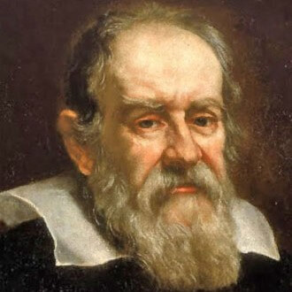
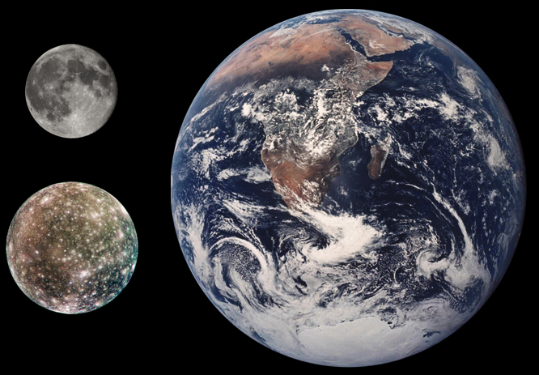
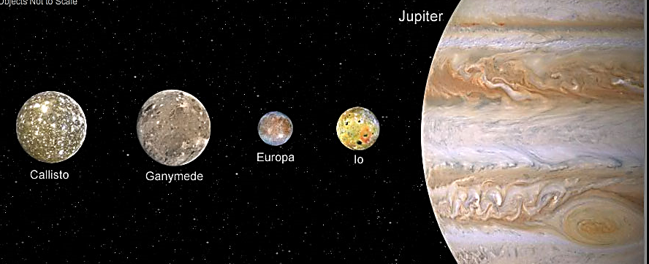
2. Considered the father of modern science.
1.
3.
a. Invented a forerunner to the modern thermometer.
Credited with the invention of an improved military compass.
c. Found that swings of the pendulum always take the same amount of time, independent of the amplitude.
d. Considered the developer of the scientific method.
4. Vastly improved the telescope, aimed it at the sky and discovered 4 of Jupiter’s satellites.
Who would set a limit to the mind of man? Who would dare assert that we know all there is to be known?
Earth
Galileo Galilei, 1564 – 1642,
born in Pisa, Italy. The Roman Inquisition tried Galileo in 1633 and found him "vehemently suspect of heresy", sentencing him to indefinite imprisonment. Galileo was kept under house arrest until his death. He was pardoned in 1992.
Earth’s
moon

Slide 17
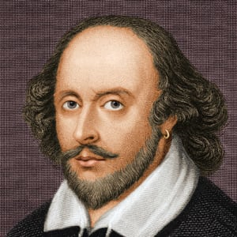
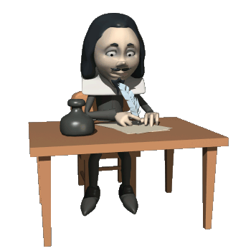
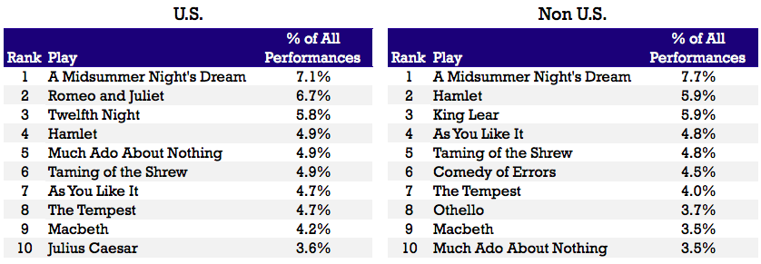
2.
1. England's national poet and the "Bard of Avon.
2. Actor and the creator of the historical Globe Theatre.
He wrote 37 plays and 154 sonnets
that contained 884,647 words and 118,406 lines.
4. World's greatest dramatist.
5. Widely regarded as the greatest writer in the English language.
This above all: to thine own self be true,
And it must follow, as the night the day,
Thou canst not then be false to any man.
William Shakespeare
April 26, 1564 -1616, Stratford-upon-Avon
United Kingdom
To be, or not to be: that is the question:
Whether ’tis nobler in the mind to suffer
The slings and arrows of outrageous fortune,
Or to take arms against a sea of troubles,
And by opposing end them. To die: to sleep.

Slide 18
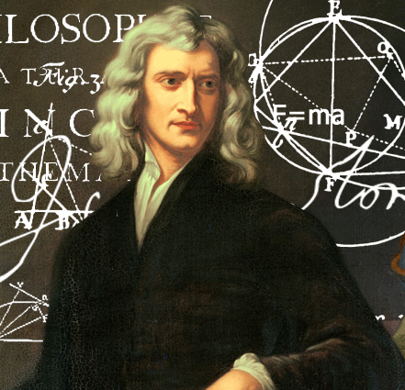
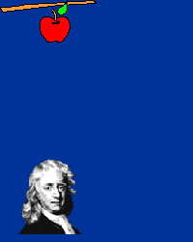
1. Published his masterpiece Philosophiae Naturalis Principia Mathematica. One of the most influential scientists of all time.
2. Invented a reflecting telescope.
3. Developed a particle theory of light and separated white light into component colors.
4. Credited for developing essential theories of calculus.
5. Developed laws of motion including the influence of gravity.
Isaac Newton, Lincolnshire, England, 1643 - 1727)
We build too many walls and not enough bridges.
If I have ever made any valuable discoveries, it has been due more to patient attention, than to any other talent.
What we know is a drop, what we don’t know is an ocean.

Slide 19
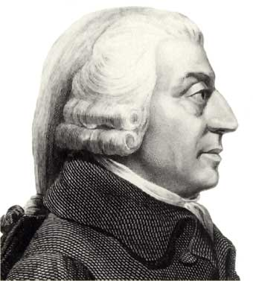
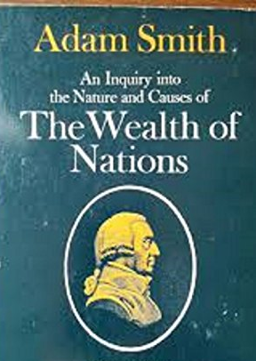
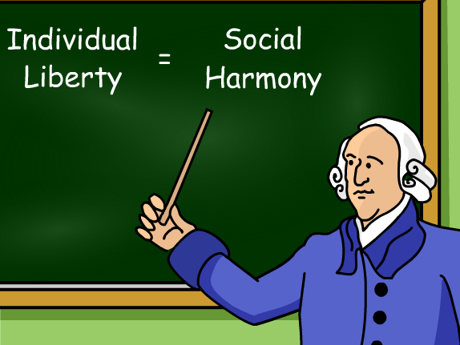
1. Scottish economist, philosopher and author as well as a moral philosopher, a pioneer of political economy and a key figure during the Scottish Enlightenment.
2. Emphasized the importance of sympathy for other people as a key element of human morality.
3. He wrote two classic works, The Theory of Moral Sentiments and An Inquiry into the Nature and Causes of The Wealth of Nations.
Adam Smith
(1723-1790) Scotland
The subjects of every state ought to contribute towards the support of the government, as nearly as possible, in proportion to their respective abilities.
No society can surely be flourishing and happy, of which the far greater part of the members are poor and miserable.

Slide 20
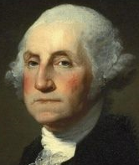
1. He was born on Feb. 22, 1732, and passed away in 1799.
2. He married Martha Dandridge Custis in 1759.
3. In the 1760s, he was a leader of the movement in Virginia to boycott British goods.
4. He was one of the founding fathers of America.
5. Served as a general and commander-in-chief of the colonial armies during the American Revolution.
6. Reluctantly served two terms as the first U.S. president, from 1789 to 1797 and is historically regarded as one of America’s greatest presidents.
Knowledge is in every country the surest basis of public happiness.
George
Washington
Please note that other American leaders such as B. Franklin, Jefferson, Lincoln and the Roosevelts merited inclusion in this presentation.

Slide 21
1. Central to the 18th-century chemical revolution, he had a large influence on both the history of chemistry.
2. Debunked phlogiston concept.
3. Developed and experimentally verified Law of Conservation of Mass.
4. Produced one of the first lists of elements (1789).
5. Although he was a great chemist, he made his living as a tax collector and was guillotined.
In nature nothing is created, nothing is lost, everything changes.
Antoine Lavoisier
1743 – 1794, France
We ought, in every instance, to submit our reasoning to the test of experiment, and never to search for truth but by the natural road of experiment and observation.
Please note that many scientists including Boyle, Dalton, Faraday, Mendeleev, Planck and others merited inclusion in this presentation.

Slide 22
1. German poet, playwright, novelist, scientist, statesman, theatre director, critic, and amateur artist, considered the greatest German literary figure of the modern era.
2. His most celebrated drama was Faust.
Johann Wolfgang von Goethe
(1749 – 1832), Germany
Knowing is not enough; we must apply. Willing is not enough; we must do.
Generosity wins favour for every one, especially when it is accompanied by modesty.

Slide 23
1. A German composer and pianist. A crucial figure in the transition between the Classical and Romantic eras in Classical music.
2. One of the first composers to make a living without being employed by the church or a member of the nobility.
3. After he reached 30 years old, he started going deaf. Even though he could no longer hear well enough to play the piano, he composed some of his best music after he was deaf!
4. His best known compositions include 9 symphonies, 5 concertos for piano, 32 piano sonatas and 16 string quartets.
Don’t only practice your art, but force your way into its secrets, for it and knowledge can raise men to the divine.
Ludwig van Beethoven
(1770, Bonn, Germany –
1827, Vienna, Austria)
Anyone who tells a lie has not a pure heart, and cannot make a good soup.
Music is the wine which inspires one to new generative processes, and I am Bacchus who presses out this glorious wine for mankind and makes them spiritually drunken.
Please note that Bach, Mozart and other composers also merited inclusion in this presentation.

Slide 24
1. She was an English novelist known primarily for her six major novels, which interpret, critique and comment upon the British landed gentry at the end of the 18th century.
2. Her plots often explore the dependence of women on marriage in the pursuit of favorable social standing and economic security.
There is no charm equal to tenderness of heart.
Jane Austen (1775 – 1817), England
I declare after all there is no enjoyment like reading! How much sooner one tires of any thing than of a book! -- When I have a house of my own, I shall be miserable if I have not an excellent library.
It isn't what we say or think that defines us, but what we do.

Slide 25
1. He was an American writer, editor, and literary critic best known for his poetry and short stories, particularly his tales of mystery and the macabre. His writings included 97 poems and 69 tales.
2. The nature of his marriage to his 13-year-old cousin, Virginia Eliza Clemm, is shrouded in mystery.
3. His most famous poem was The Raven. One of his more popular dark and creepy tales was The Fall of the House of Usher.
4. He has been called the father of the detective story.
Edgar Allan Poe
(1809, Boston, Massachusetts, -1849.)
I became insane, with long intervals of horrible sanity.
Those who dream by day are cognizant of many things which escape those who dream only by night.

Slide 26
1. He was (is) considered a literary genius because he created some of the world's best-known fictional characters and is regarded as the greatest novelist of the Victorian era.
2. His success began with the 1836 serial publication of The Pickwick Papers.
3. Among his best known works are A Christmas Carol, Oliver Twist, Great Expectations, David Copperfield and A Tale of Two Cities.
Charles John Huffam Dickens
1812 – 1870, United Kingdom
It was the best of times, it was the worst of times.
From a Tale of Two Cities.
There are dark shadows on the earth, but its lights are stronger in the contrast.
Have a heart that never hardens, and a temper that never tires, and a touch that never hurts.

Slide 27
3.
1. In 1831, he embarked on a five-year survey voyage around the world on the HMS Beagle.
2. Based predominantly on Beagle voyage, he developed scientific theory of evolution by natural selection.
4. His basic idea was that in the struggle to survive, some organisms adapt better than others to their surroundings, and when these survivors give birth they pass their traits on to their offspring, causing species to evolve.
5.
A man who dares to waste one hour of time has not discovered the value of life.
An American monkey, after getting drunk on brandy, would never touch it again, and thus is much wiser than most men.
Charles Robert Darwin, 1812, Shrewsbury, United Kingdom - 1882

Slide 28
1. A German philosopher, economist, historian, sociologist, political theorist, journalist and socialist revolutionary.
2. His socialist writings would get him expelled from Germany and France.
3. He published The Communist Manifesto with Friedrich Engels and was exiled to London, where he wrote the first volume of Das Kapital and lived the remainder of his life.
There is no royal road to science, and only those who do not dread the fatiguing climb of its steep paths have a chance of gaining its luminous summits.
Karl Marx
(1818 – 1883, born in Prussia)
Workers of the world unite; you have nothing to lose but your chains.
To be radical is to grasp things by the root.
The philosophers have only interpreted the world, in various ways. The point, however, is to change it.

Slide 29
1. He was a French biologist, microbiologist and chemist renowned for his discoveries of the principles of vaccination, microbial fermentation.
2. He demonstrated that microorganisms cause disease and discovered how to make vaccines from weakened, or attenuated, microbes.
3. He came up with the process of pasteurization, where bacteria is destroyed by heating beverages and then allowing them to cool.
Louis Pasteur (1822 – 1895), France
Let me tell you the secret that has led me to my goal. My strength lies solely in my tenacity.
In the fields of observation chance favors only the prepared mind.
Science knows no country, because knowledge belongs to humanity, and is the torch which illuminates the world.

Slide 30
1. His writings on truth, morality, language, aesthetics, cultural theory, history, nihilism, power, consciousness, and the meaning of existence have exerted an enormous influence on Western philosophy and intellectual history.
2. For his concept of nihilism, there is no objective order or structure in the world except what we give it. The nihilist discovers that all values are baseless and that reason is impotent.
3. Two of his books were Twilight of the Idols and Thus Spoke Zarathustra.
Friedrich Wilhelm Nietzsche
(1844–1900)
I’m not upset that you lied to me, I’m upset that from now on I can’t believe you.
The surest way to corrupt a youth is to instruct him to hold in higher esteem those who think alike than those who think differently.
One must still have chaos in oneself to be able to give birth to a dancing star.

Slide 31
1. He was a Dutch Post-Impressionist painter who is among the most famous and influential figures in the history of Western art.
2. In just over a decade he created about 2,100 artworks, including around 860 oil paintings, most of them in the last two years of his life.
3. Three of his most famous paintings that will appear shortly include Starry Night, Irises and his self portrait.
4. He allegedly cut off his left ear when tempers flared with Paul Gauguin, the artist with whom he had been working for a while in Arles.
For my part I know nothing with any certainty, but the sight of the stars makes me dream.
I feel that there is nothing more truly artistic than to love people.
I dream of painting and then I paint my dream.
Vincent Willem van Gogh (1853–1890), Netherlands. Self portrait.
Please note that many artists including Picasso, Rembrandt and others merited inclusion in this presentation.

Slide 32
1. He was an Austrian neurologist and the founder of psychoanalysis, a clinical method for treating psychopathology through dialogue between a patient and a psychoanalyst.
2. In the psychoanalysis method, an analyst unpacks unconscious conflicts based on the free associations, dreams and fantasies of the patient.
Time spent with cats is never wasted.
Sigmund Freud (1856 to 1939)
Civilization began the first time an angry person cast a word instead of a rock.
The mind is like an iceberg, it floats with one-seventh of its bulk above water.
The interpretation of dreams is the royal road to a knowledge of the unconscious activities of the mind.

Slide 33
1. He was a Serbian-American inventor, electrical engineer, mechanical engineer, and futurist. He has been called the man who invented the 20th century.
2. He invented the first alternating current (AC) motor.
3. He is best known for his contributions to the design of the modern alternating current electricity supply system.
The history of science shows that theories are perishable. With every new truth that is revealed we get a better understanding of Nature and our conceptions and views are modified.
Nikola Tesla
(1856-1943)
Tesla coil
Tesla AC motor
Today's scientists have substituted mathematics for experiments, and they wander off through equation after equation, and eventually build a structure which has no relation to reality.
Life is and will ever remain an equation incapable of solution, but it contains certain known factors.

Slide 34
1. She was a British political activist (sometimes militant) and leader of the British suffragette movement who helped women win the right to vote.
2. On 10, October 1903, she and several colleagues founded the Women's Social and Political Union (WSPU), an organization open only to women and focused on direct action to win the vote.
Emmeline Pankhurst
(1858 – 1926), United Kingdom
Justice and judgment lie often a world apart.
Please note that many others including Susan B. Anthony and Rosa Parks merited inclusion in this presentation.
Trust in God. She will provide.

Slide 35
1. A Polish born and naturalized-French physicist and chemist who conducted pioneering research on radioactivity.
2. Discovered and isolated radioactive elements (polonium and radium) that filled in gaps in the periodic table.
3. First woman awarded a Nobel prize.
4. First person to win two Nobel prizes.
All my life through, the new sights of Nature made me rejoice like a child.
Marie (1867 – 1934) and Pierre Curie
I shall devote only a few lines to the expression of my belief in the importance of science ... it is by this daily striving after knowledge that man has raised himself to the unique position he occupies on earth, and that his power and well-being have continually increased.

Slide 36
1. Activist who was the leader of the Indian independence movement against British rule.
2. Employing nonviolent civil disobedience, he inspired movements for civil rights and freedom across the world.
Be the change that you want to see in the world.
The best way to find yourself is to lose yourself in the service of others.
Happiness is when what you think, what you say, and what you do are in harmony.
Mahatma Gandhi, by name of Mohandas Karamchand Gandhi, 1869 - 1948)
I object to violence because when it appears to do good, the good is only temporary; the evil it does is permanent.

Slide 37
1. Physicist, 1879 – 1955, born in Ulm, Germany
2. The scientific method usually includes the steps, observation, explanation, testing, elevation of the explanation to theory, further observation and testing. One of the many distinguishing attributes of this physicist is that he developed theories that preceded and enabled experimental observations.
3. He revolutionized scientific thought with new theories of space, time, mass, motion, and gravitation.
4. Among the many important concepts attributable to this physicist are the theories of general and special relativity.
Imagination is more important than knowledge. Knowledge is limited. Imagination encircles the world.
5.
ALBERT EINSTEIN
The important thing is to not stop questioning. Curiosity has its own reason for existing.

Slide 38
1. She was an American marine biologist, author, and conservationist whose writings are credited with advancing the global environmental movement.
2. She challenged the notion that humans could obtain mastery over nature by chemicals, bombs and space travel.
3. Her sensational book Silent Spring (1962) warned of the dangers to all natural systems from the misuse of chemical pesticides such as DDT.
The road we have long been traveling is deceptively easy, a smooth superhighway on which we progress with great speed, but at its end lies disaster.
But man is a part of nature, and his war against nature is inevitably a war against himself.
Rachel Carson
(1907-1964)
Those who contemplate the beauty of the earth find reserves of strength that will endure as long as life lasts.
Those who dwell among the beauties and mysteries of the earth are never alone or weary of life.

Slide 39
1. At the age of 18, she was given permission to join a group of nuns in Ireland.
2. Founder of the Order of the Missionaries of Charity in Calcutta, a Roman Catholic congregation of women dedicated to helping the poor.
3. Her order established a hospice; centers for the blind, aged and disabled; and a leper colony.
4. In 1979 she received the Nobel Peace Prize for her humanitarian work.
I alone cannot change the world, but I can cast a stone across the waters to create many ripples.
Mother Teresa
1910 - 1997, Macedonia.
Baptized Agnes Gonxha Bojaxhiu
We shall never know all the good that a simple smile can do.
Spread love everywhere you go. Let no one ever come to you without leaving happier.

Slide 40
1. She was an English chemist and X-ray crystallographer who made contributions to the understanding of the molecular structures of RNA, viruses, coal, and graphite.
2. Using her X-ray photograph and their own data, Watson and Crick created their famous DNA model. Franklin's contribution was not acknowledged, but after her death Crick and Watson admitted that her contribution had been critical.
Rosalind Elsie Franklin
(1920 – 1958)
The results suggest a helical structure (which must be very closely packed) containing probably 2, 3 or 4 coaxial nucleic acid chains per helical unit and having the phosphate groups near the outside.

Slide 41
1. In the 1950’s and 1960’s he became the predominant leader in the Civil Rights Movement to end racial segregation and discrimination in America.
2. He was a leading spokesperson for nonviolent methods of achieving social change and racial justice.
3. He was awarded the Nobel Peace Prize in 1964.
I have a dream that my four little children will one day live in a nation where they will not be judged by the color of their skin, but by the content of their character.
Martin Luther King Jr.
1929 - 1968 Atlanta, GA, USA
Intelligence plus character—that is the goal of true education.
The time is always right to do what is right.
True peace is not merely the absence of tension; it is the presence of justice.

