Slide 1
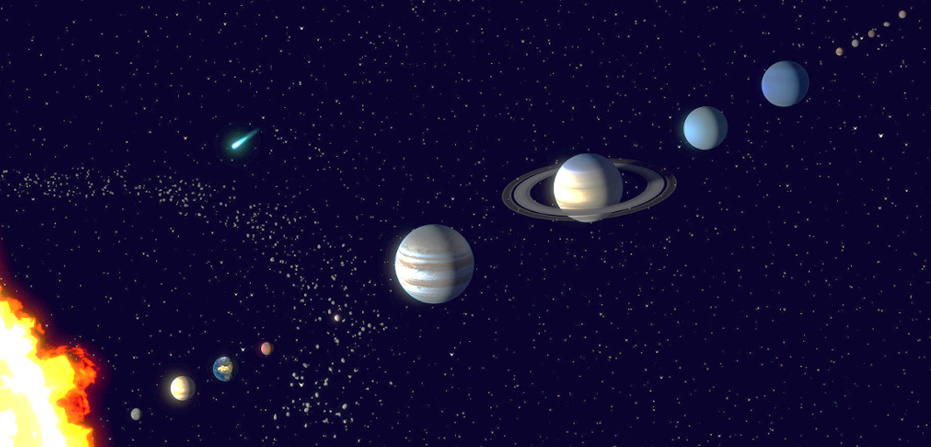
MOONS in our Solar System:
How many? Is there life out there?
https://en.wikipedia.org/wiki/List_of_natural_satellites
https://skyandtelescope.org/astronomy-news/solar-system/a-guide-to-planetary-satellites/
https://www.britannica.com/topic/list-of-moons-2033266
https://solarsystem.nasa.gov/moons/overview/

Slide 2
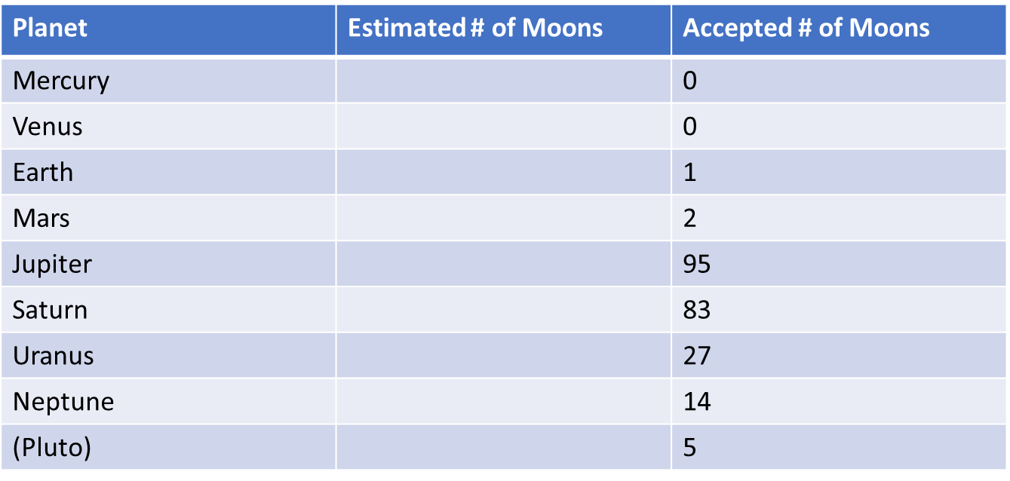
There are about 200 natural moons in our solar system (227 according to NASA). The number depends on how you define the word moon and whether you count the satellites around dwarf planets such as Pluto as moons. Estimate the number of moons for each planet by mentally filling in the table below.
Planet | Estimated # of Moons | Accepted # of Moons
Mercury
Venus
Earth
Mars
Jupiter
Saturn
Uranus
Neptune
(Pluto)

Slide 3
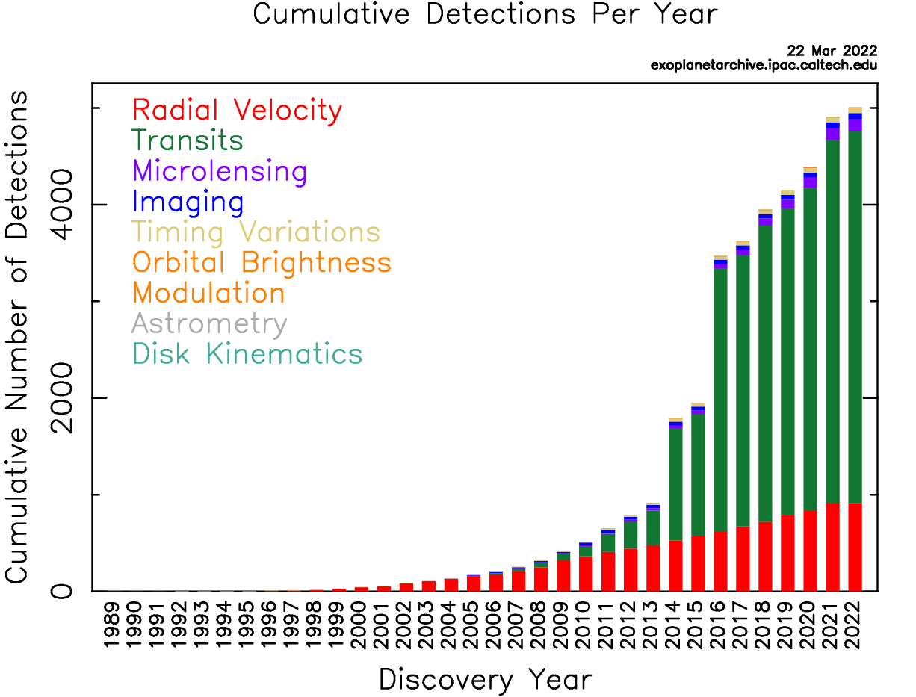
Is there life anywhere out there and is any of it “intelligent” life.
As of 1 May 2023, there are 5,366 confirmed exoplanets in 3,962 planetary systems, with 856 systems having more than one planet. Most of these were discovered by the Kepler space telescope.
https://en.wikipedia.org/wiki/Lists_of_exoplanets
https://exoplanetarchive.ipac.caltech.edu/docs/counts_detail.html
The number of discovered exoplanets has been limited by our available techniques and is undoubtedly a very small fraction of the number of planets out there. One estimate puts the number of stars in the universe at 200 sextillion (2x10²³ or to a chemist about a third of a mole).
https://astronomy.com/news/astro-for-kids/2021/09/astro-for-kids-how-many-stars-are-there-in-space
If our solar system is a good model, most planets have moons and often several moons. Thus the number of planets and moons that could have life is indeed huge and at least 200 or more sextillion.
# of discovered planets

Slide 4
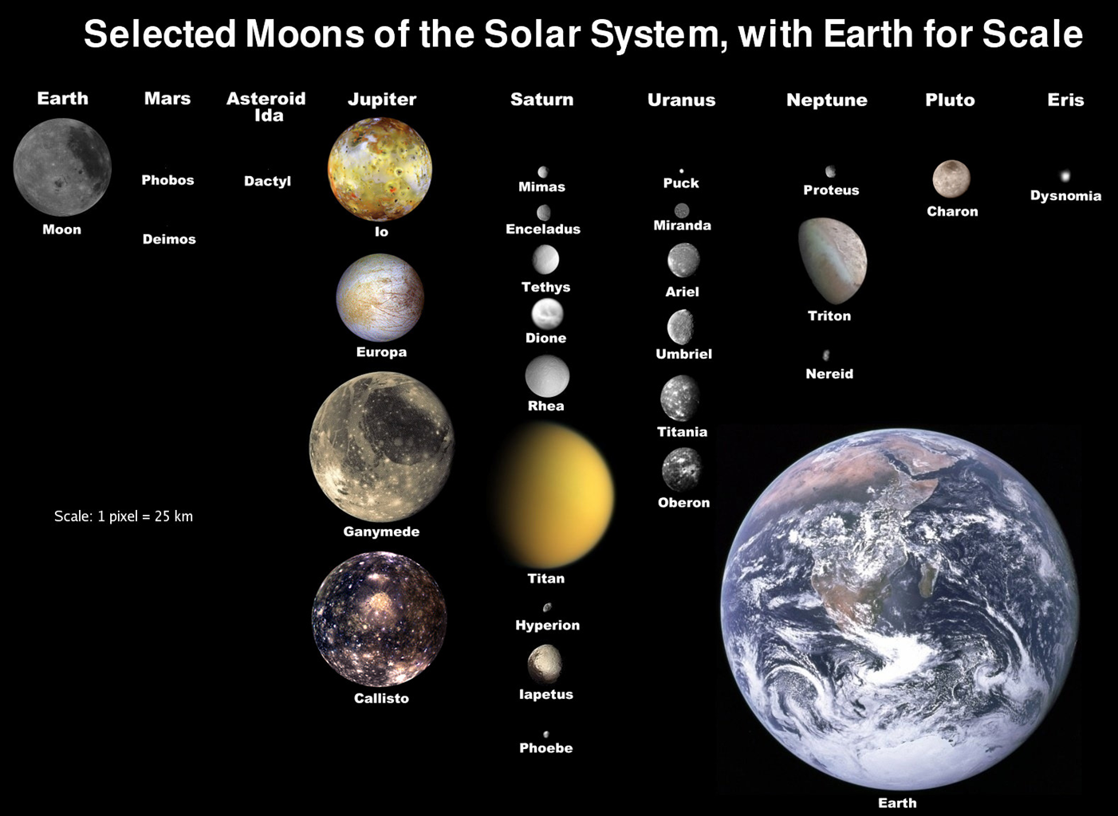
Since life developed on the earth, it is likely there are many other planets and moons that sometime during the 13.8 billion years of the existence of the universe as we know it have also developed life. While substantial discussion takes place of the possibility of life on exoplanets, it is possible that even in our solar system, life has at some time (including the possibility of the present) has existed on Mars or one of the moons of Jupiter, Saturn, Uranus of Neptune.

Slide 5
What are the requirements for the formation and sustenance of life?
Lists of essentials vary from 3 to 8 with many qualifications. One of the key qualifications is how much if at all life must share some of the same characteristics as life on earth. The following is one list of human perceived qualifications:
1. Water · 2. Carbon · 3. Nitrogen · 4. Phosphorus · 5. Sulphur · 6. Luck · 7. Time · 8. Location.
https://evolution.berkeley.edu/a-place-for-life/ingredients-for-life/requirements-for-life
https://spaceandbeyondbox.com/the-5-requirements-for-life-beyond-earth/
https://www.ncbi.nlm.nih.gov/pmc/articles/PMC4156692/
https://www.astronomy.ohio-state.edu/pogge.1/Ast161/Unit7/life.html
http://murov.info/wat.htm
As seen on the next slide, even on earth life thrives under extreme conditions such as near deep ocean thermal vents. Under these conditions, light does not penetrate. Life as we experience it is very dependent on plant photosynthesis but this is apparently not a necessary condition for life.
https://www.scisnack.com/2020/04/15/the-deep-sea-is-completely-dark-how-does-life-thrive-there-without-photosynthesis/

Slide 6
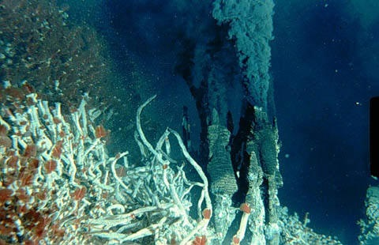
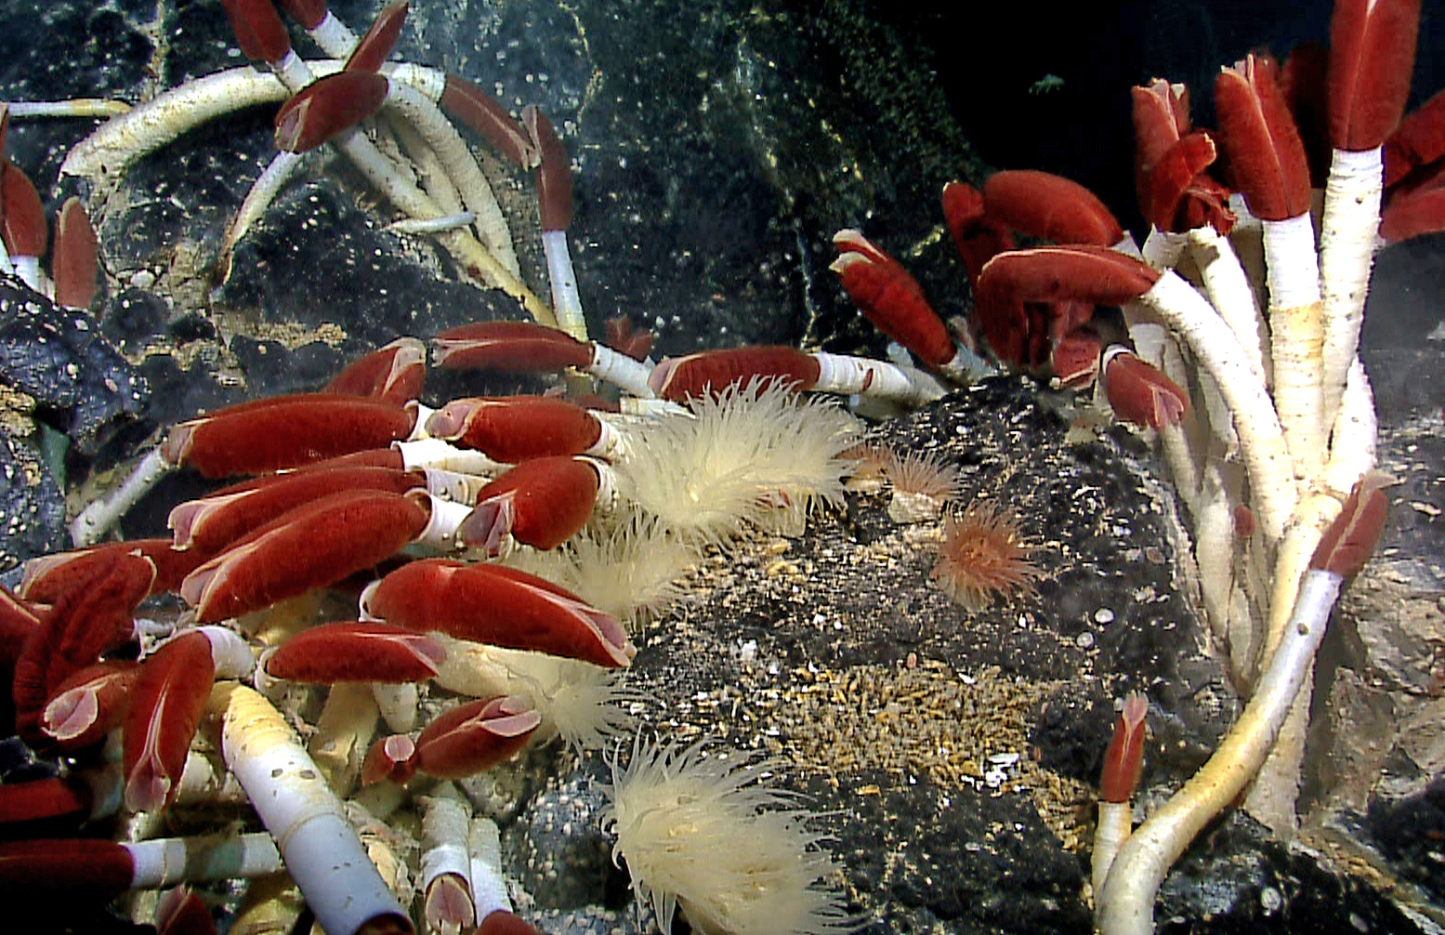
Life on earth near deep ocean thermal vents.
Ocean vents eject hot, often toxic, fluids and gases into the surrounding seawater. They often mark sites of tectonic activity, and create some of the most hostile habitats on Earth. Ocean vents are a type of hydrothermal vent. Other types of hydrothermal vents include hot springs, geysers, and fumaroles.

Slide 7
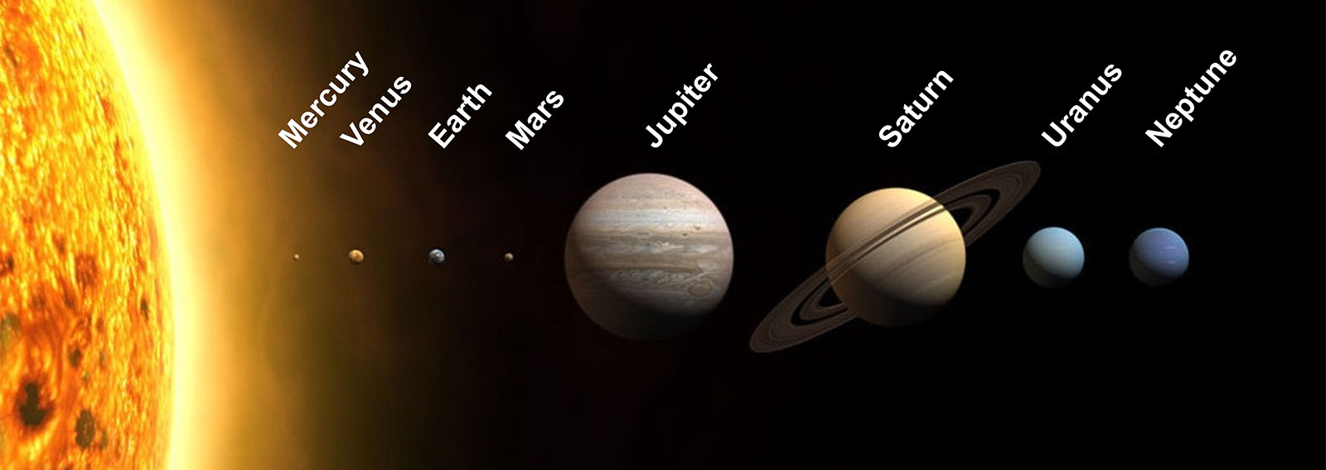
While it is possible that life forms could exist without water, the chances that living systems could have developed using ammonia or some other substance as basic components are small. For this reason, this web site will restrict the search for life in our solar system to planets and moons with existing evidence for the presence of water in some form (solid, liquid or gas). This means that the two moons on the next two slides will not be considered to presently host life. As you come to the next two slides, try to name the moon.

Slide 8
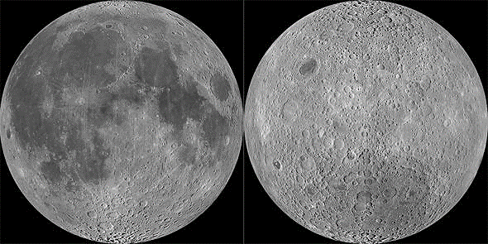
https://slate.com/technology/2014/07/the-moon-s-two-faces-why-are-they-so-different.html
https://www.futurity.org/moon-sides-2723862/
https://www.brown.edu/news/2022-04-08/moonfaces
The earth’s moon. To the left, the side always facing the earth. To the right, the side always facing away from the earth.
https://moon.nasa.gov/inside-and-out/water-on-the-moon/ There is now evidence of water both historically and presently on the moon but moon landings have not revealed any evidence that the moon has or had any kind of life.

Slide 9
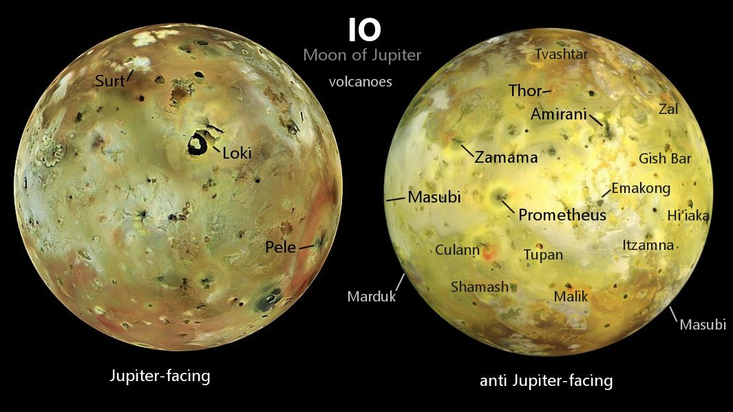
Volcano eruption on very volcanically active Io.
Its average orbital distance is about 262,000 miles (422,000 km). Io takes 1.77 Earth-days to orbit Jupiter. Io is tidally locked, so the same side always faces Jupiter. Size: Io has a mean radius of 1,131.7 miles (1,821.3 km) making it slightly larger than Earth's moon. Unlike most moons in the outer Solar System, which are mostly composed of water ice, Io is primarily composed of silicate rock surrounding a molten iron or iron sulfide core. Io is the most volcanically active world in the Solar System, with hundreds of volcanoes, some erupting lava fountains dozens of miles (or kilometers) high. Io is caught in a tug-of-war between Jupiter's massive gravity and the smaller but precisely timed pulls from two neighboring moons that orbit farther from Jupiter—Europa and Ganymede.
https://earthsky.org/space/life-on-io-an-astrobiologist-says-its-possible/
https://solarsystem.nasa.gov/moons/jupiter-moons/io/in-depth/

Slide 10
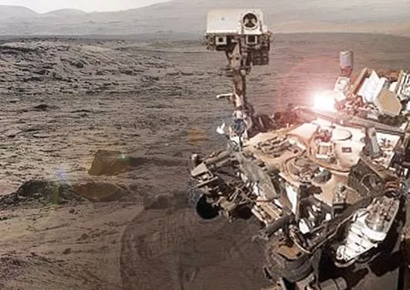
Before returning to a tour of moons in our solar system that according to evidence have water, we will take a quick look at the planets in our solar system.
Ice giants are currently not considered suitable for life due to temperature, pressure and composition. Mercury's environment is not conducive to life as we know it. The temperatures and solar radiation that characterize Mercury are most likely too extreme for organisms to adapt to. Pluto and Ceres are very far from the sun and will not be considered here. That leaves Mars and the searches for evidence from telescope, satellite and landings has not provided definitive evidence that life exists or ever existed on Mars.
Water on planets in the Solar System
Mercury: Frozen water. More info
Venus: Basically no water at all.
Earth: Lots of water in all forms (liquid, ice, vapour).
Mars: Ice, trace amounts of vapor,
possibly some liquid water underground.
Jupiter: Water in frozen and vapor form.
Saturn: Water in frozen and vapor form.
Uranus: Frozen water.
Neptune: Frozen water.
dwarf planets
Pluto: Frozen water.
Ceres: Some frozen water,
possibly underground liquid water.
MARS

Slide 11
https://solarsystem.nasa.gov/news/12795/the-solar-system-and-beyond-is-awash-in-water/
https://www.nasa.gov/specials/ocean-worlds/#:~:text=Earth%20isn't%20the%20only,life%20beyond%20our%20home%20planet
https://www.scientificamerican.com/article/the-six-moons-most-likely-to-host-life-in-our-solar-system/
https://www.windows2universe.org/our_solar_system/moons_table.html

Slide 12
Although the ice giants themselves are not likely to have life, there is much hope to find it on some of the many moons of those planets. Europa, from the Jovian system, has a subsurface ocean below a thick layer of ice. Ganymede and Callisto also have subsurface oceans, but life is less likely in them because water is sandwiched between layers of solid ice. Europa would have contact between the ocean and the rocky surface, which helps the chemical reactions. It may be difficult to dig so deep in order to study those oceans, though. Enceladus, a tiny moon of Saturn with another subsurface ocean, may not need to be dug, as it releases water to space in eruption columns. The space probe Cassini flew inside one of those, but could not make a full study because NASA did not expect this phenomenon and did not equip the probe to study ocean water. Still, it could detect complex organic molecules, salts, evidence of hydrothermal activity, hydrogen, and methane.[35]
Titan is the only celestial body in the Solar System besides Earth that has liquid bodies on the surface. It has rivers, lakes, and rain of hydrocarbons, methane, and ethane, and even a cycle similar to Earth's water cycle. This special context encourages speculations about lifeforms with different biochemistry, but the cold temperatures would make such chemistry take place at a very slow pace. Water is rock-solid on the surface, but Titan has a subsurface ocean like other moons. However, it is too deep and it would be very difficult to access it for study.
https://www.technologyreview.com/2021/06/16/1026473/best-worlds-extraterrestrial-life-solar-system-ranked/
https://solarsystem.nasa.gov/news/12795/the-solar-system-and-beyond-is-awash-in-water/
https://www.nasa.gov/specials/ocean-worlds/#:~:text=Earth%20isn't%20the%20only,life%20beyond%20our%20home%20planet
https://www.scientificamerican.com/article/the-six-moons-most-likely-to-host-life-in-our-solar-system/
https://en.wikipedia.org/wiki/Extraterrestrial_life#:~:text=So%20far%2C%20the%20only%20lifeforms,already%20been%20detected%20by%
https://www.ncbi.nlm.nih.gov/pmc/articles/PMC2744519/
https://www.windows2universe.org/our_solar_system/moons_table.html

Slide 13
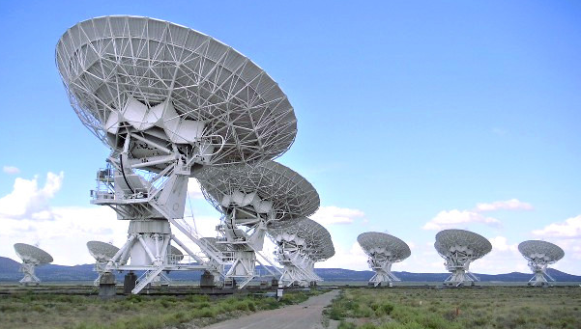
For the next several slides, identify the moon as the information appears. The moons are arranged very roughly in increasing order of the probability of finding life on the moon.

Slide 14
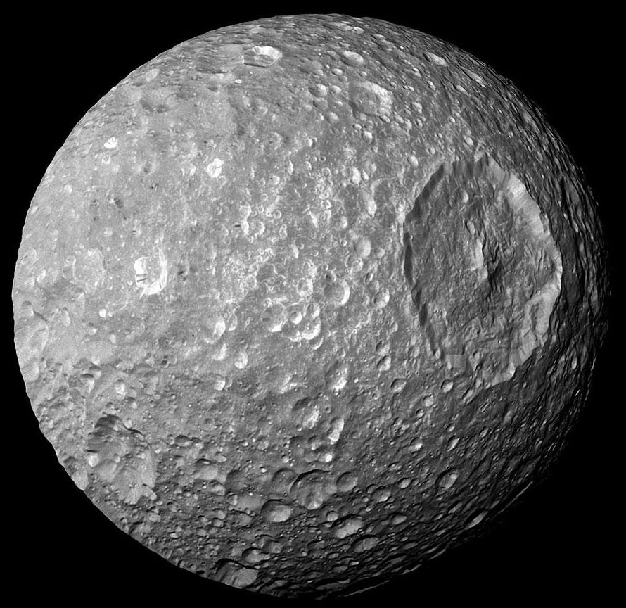
Mimas
7th moon from Saturn’s and 7th largest
The smallest and innermost of Saturn's major moons. It is not quite big enough to hold a round shape, so it is somewhat ovoid with dimensions of 129 x 122 x 119 miles (207 x 197 x 191 kilometers, respectively)
Year Discoverer Dist. from Diameter Orbital Period
Dis. Planet (km) (km) (days)
1789 W. Herschel 185,520 398 0.942
It is the 20th largest moon in the Solar System and is the thought to be the smallest to have its shape rounded by its own gravity. Mimas was discovered by the British astronomer, Sir William Herschel in 1789. Most of what we now know about Mimas was discovered during the two Voyager missions.
The huge crater, named Herschel after the 1789 discoverer of Mimas, Sir William Herschel, spans about 130 kilometers and is featured here. Mimas' low mass produces a surface gravity just strong enough to create a spherical body but weak enough to allow such relatively large surface features. Mimas is made of mostly water ice with a smattering of rock - so it is accurately described as a big dirty snowball.

Slide 15
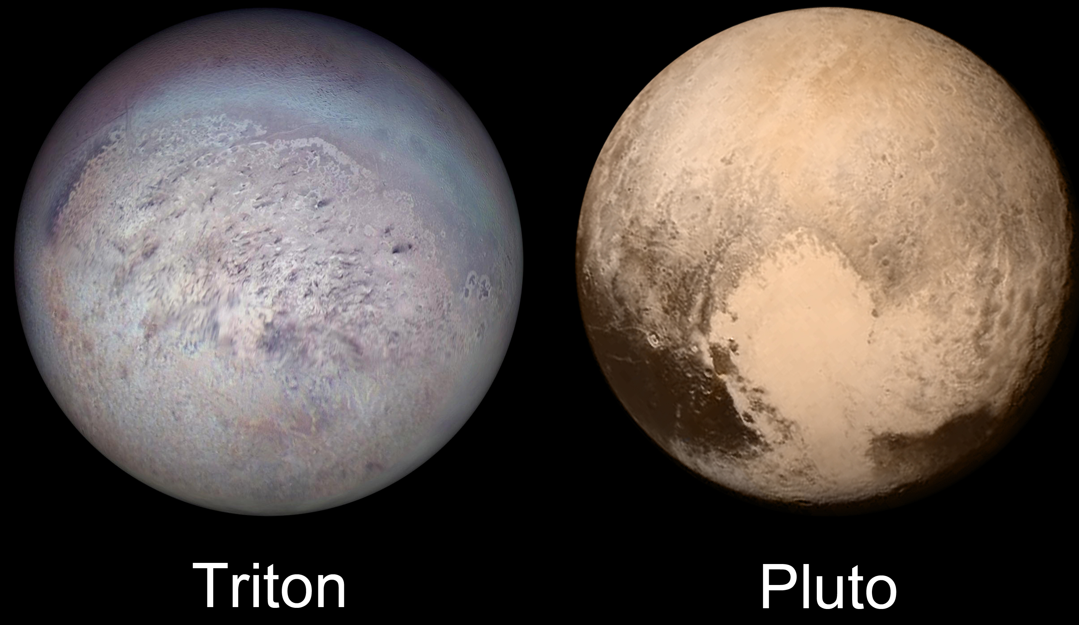
Triton
The biggest of Neptune’s thirteen known moons. This moon is suspected to have been captured by Neptune, which would explain its highly unusual orbit and rotation. One of the only bodies in the solar system to have a retrograde orbit, it also rotates at an angle of 157° to the axis of Neptune’s rotation.
Its atmosphere is 70,000 times less dense than Earth’s and is composed of nitrogen, methane, and carbon monoxide. It is about 2.8 billion miles away from the Sun, and although the surface temperature there is a frigid -230 ºC, the Sun’s heat can cause seasonal changes. Seasons last 40 earth years.
Neptune’s largest moon
Year Discoverer Dist. from Diameter Orbital Period Dis. Planet (km) (km) (days)
1846 W. Lassel 354,800 2705 5.877
?

Slide 16
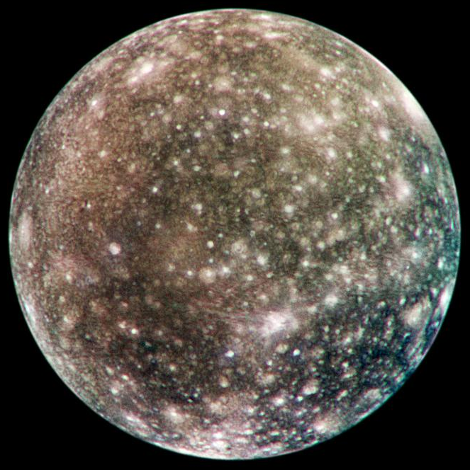
Callisto
Jupiter’s second largest moon and the third largest moon in our solar system and is about the same size as Mercury.
It orbits just beyond Jupiter's main radiation belt. Its surface is the most heavily cratered of any object in our solar system indicating that geological processes could be dead. However, it may also hold an underground ocean. It's unclear if the ocean could sustain because the surface is so old.
Year Discoverer Dist. from Diameter Orbital Period Dis. Planet (km) (km) (days)
1610 Galileo 1,883,000 4,800 16.689
Io Europa Ganymede Callisto

Slide 17
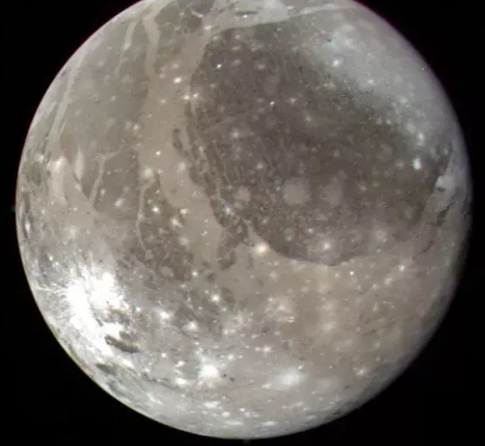
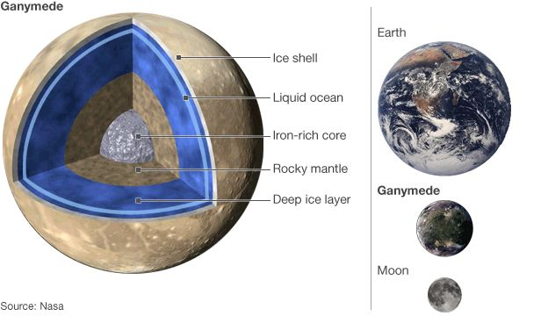
Ganymede
AKA, Jupiter III, is the largest and most massive natural satellite of Jupiter as well as in the Solar System, being a planetary-mass moon.
It is bigger than both Mercury and dwarf planet Pluto and only slightly smaller than Mars. The moon likely has a salty ocean underneath its icy surface, making it a potential location for life. It is the largest Solar System object without an atmosphere, despite being the only moon of the Solar System with a magnetic field.
Year Discoverer Dist. from Diameter Orbital Period Dis. Planet (km) (km) (days)
1610 Galileo 1,070,000 5276 7.155

Slide 18
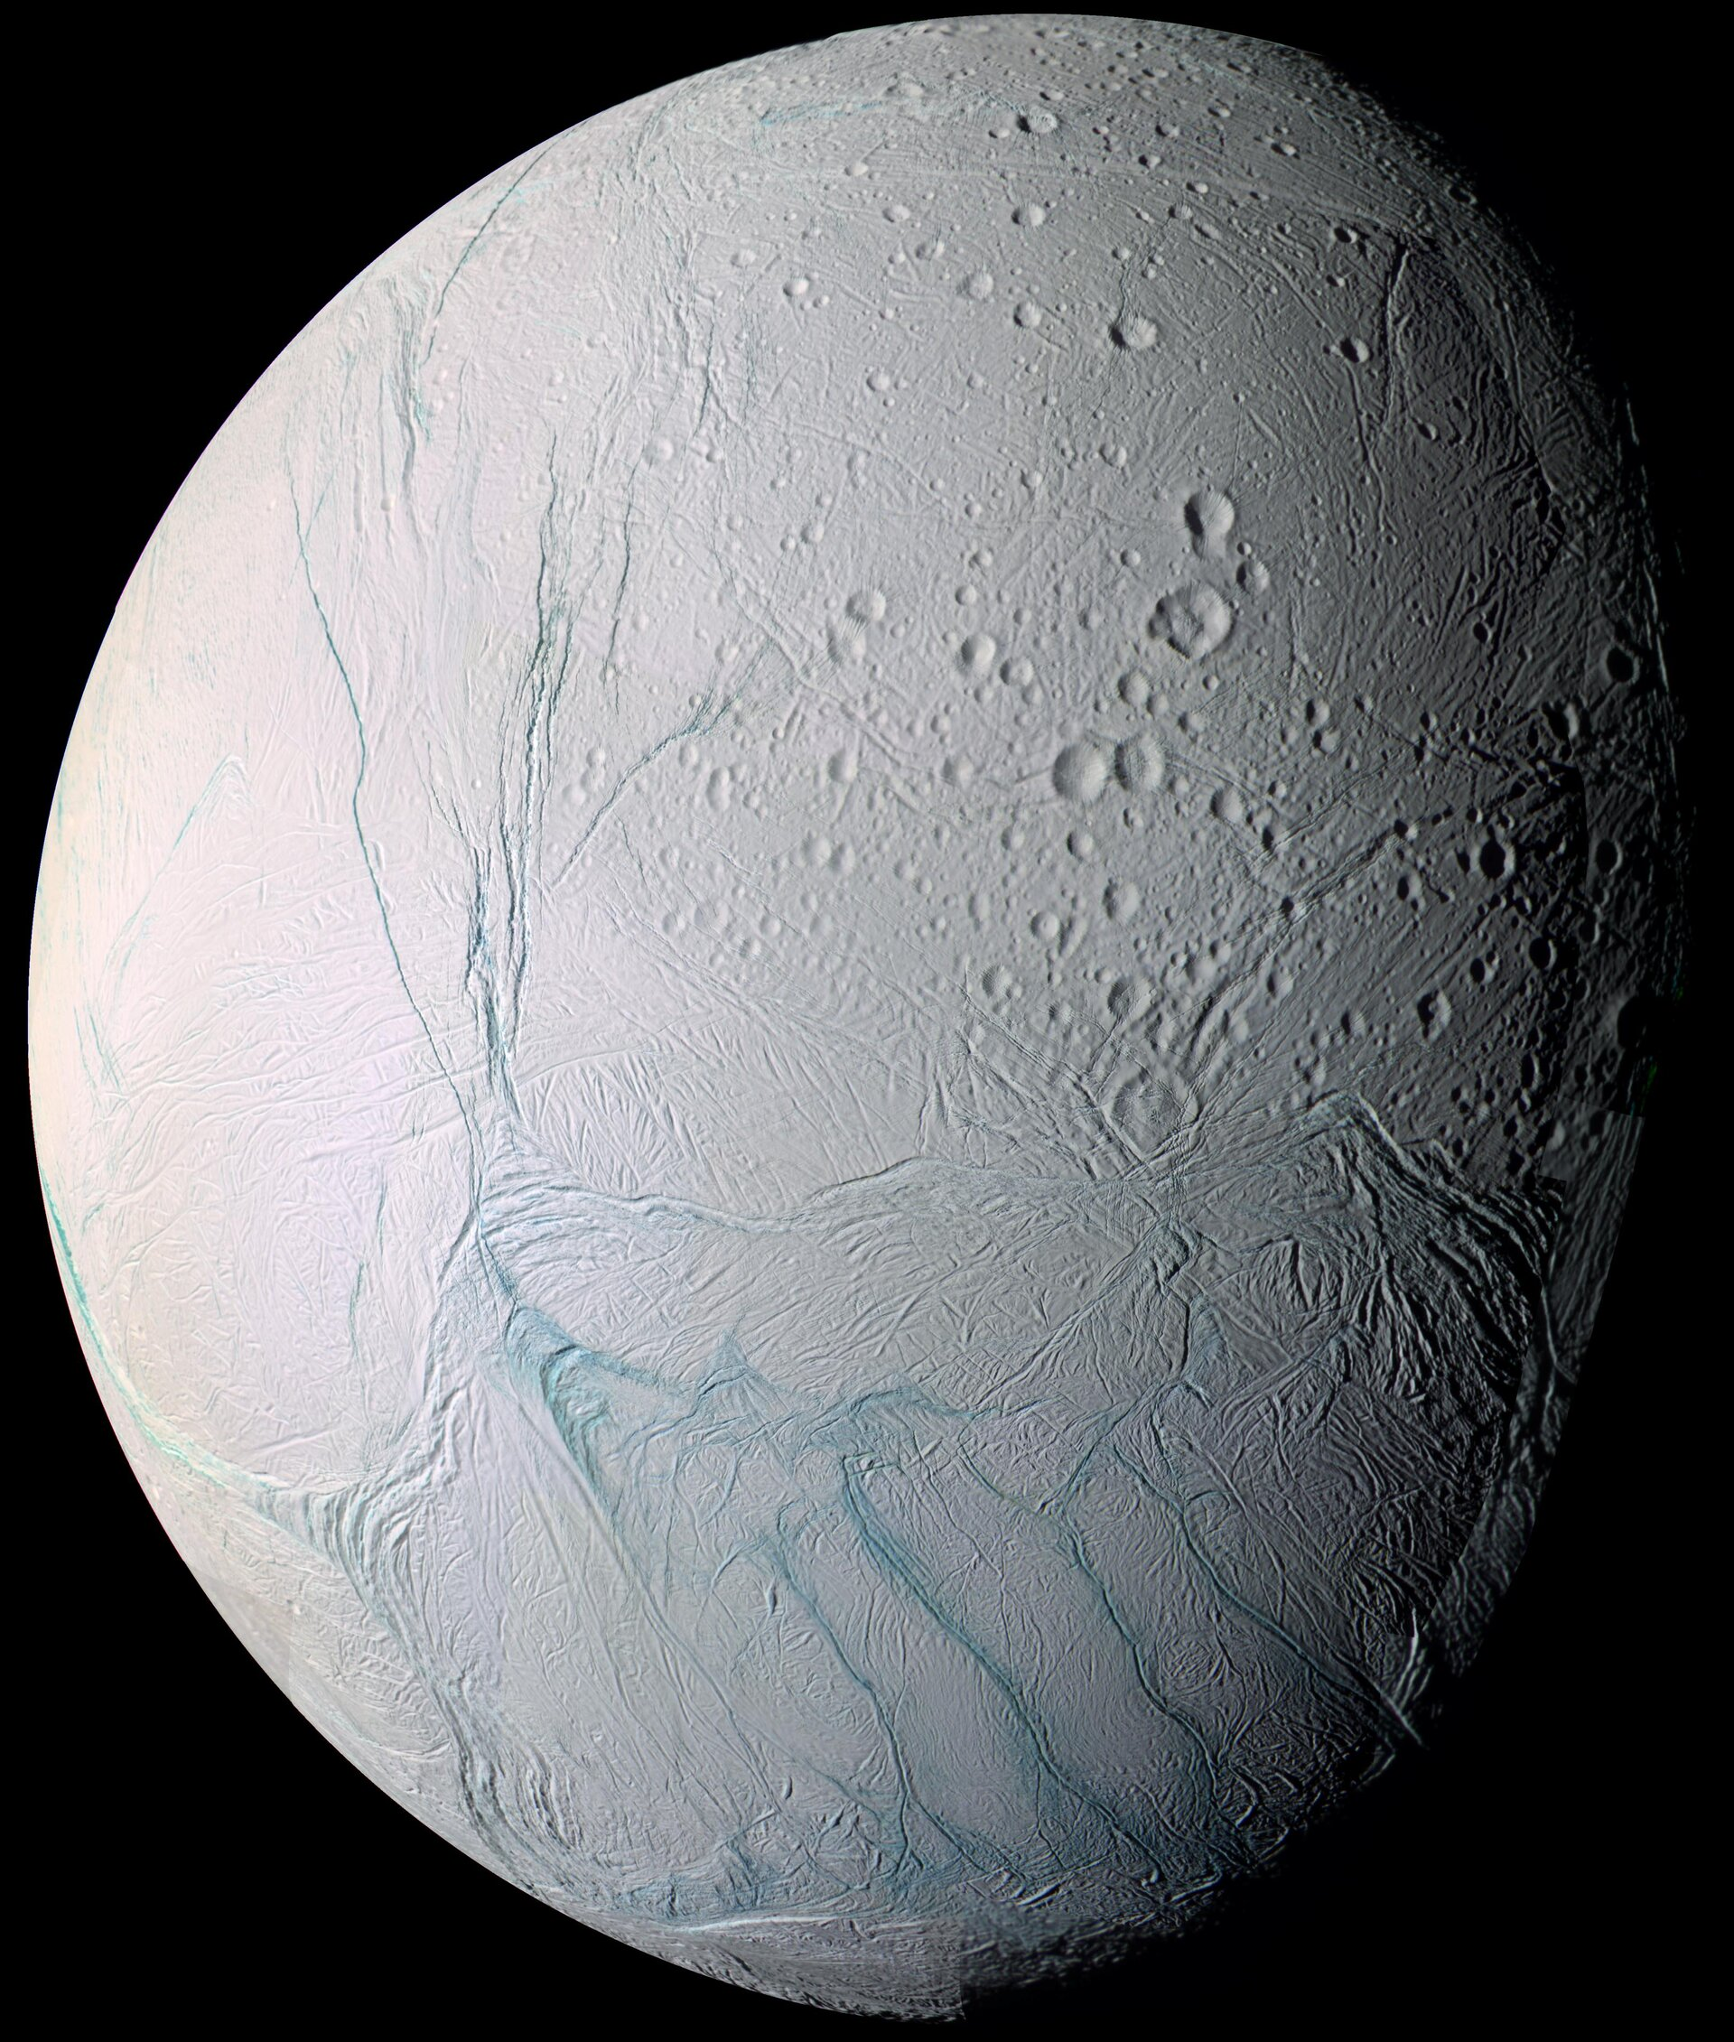
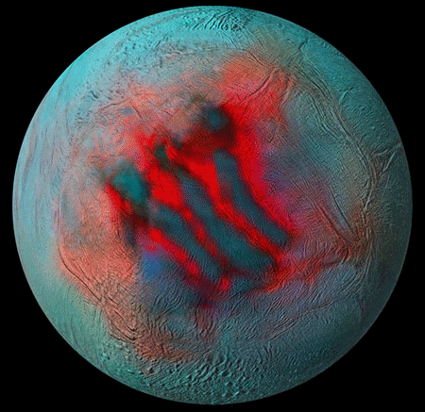
Enceladus
Saturn's sixth-largest moon and one of the most promising potential sites in the solar system for hosting life.
It is about 500 kilometers in diameter, about a tenth of that of Saturn's largest moon, Titan. It orbits Saturn within the planet’s E-ring, and continually spews out a concoction of water and simple organic chemicals into space, at around 800 miles per hour (400 meters per second) forming huge plumes that extend hundreds of miles into space according to NASA. While some of the material falls back to the icy world, some escapes and feeds Saturn's large E ring.
Because Enceladus is coated in clean, highly reflective ice, it has the brightest surface of any object in our solar system. However, its surface is not uniform, with some of it being highly cratered and other areas being almost entirely crater-free, according to NASA. Scientists think this points to relatively recent geological processes that enabled Enceladus to renew its surface.
Year Discoverer Dist. from Diameter Orbital Period Dis. Planet (km) (km) (days)
1789 W. Herschel 238,020 498 1.370

Slide 19
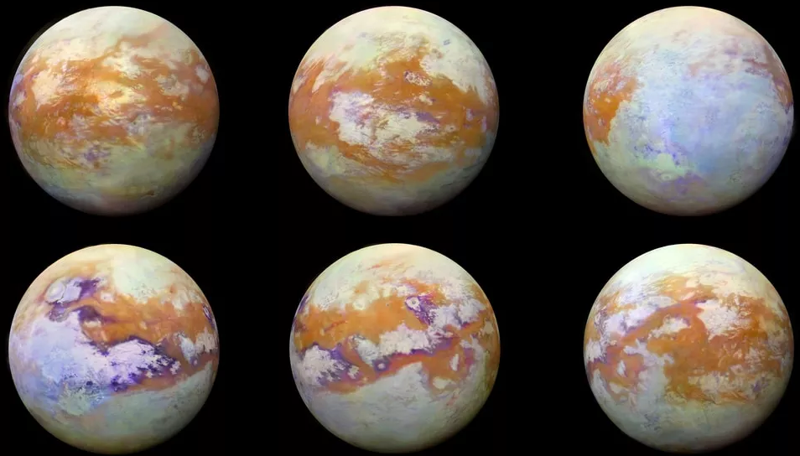
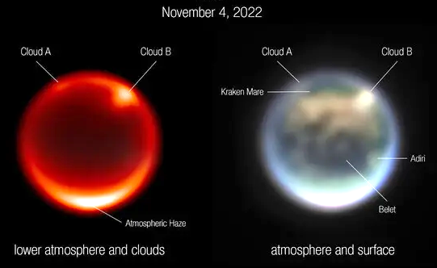
Titan
Saturn's largest moon
This moon of Saturn features some very Earth-like landscapes: lakes and rivers, labyrinthine canyons, and soft sand dunes. However, these geological formations on Titan are made of entirely different materials. Instead of water, it's liquid methane that flows through rivers, and instead of sand, it's hydrocarbons that blow into dunes.
Year Discoverer Dist. from Diameter Orbital Period Dis. Planet (km) (km) (days)
1655 C. Huygens 1,221,850 5150 15.945

Slide 20
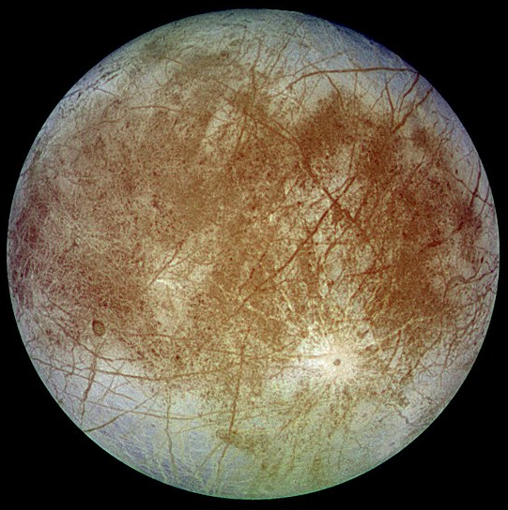
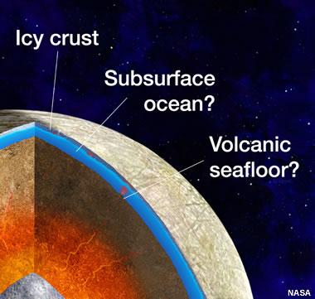
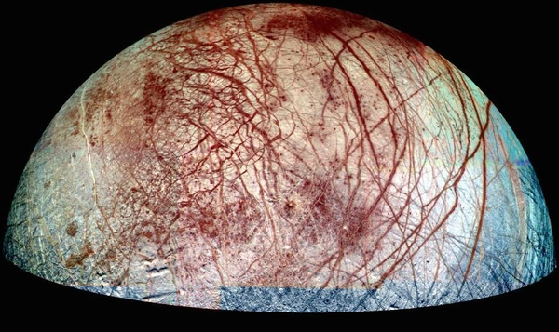
Europa
Jupiter II, is the smallest of the four Galilean moons orbiting Jupiter, and the sixth-closest to the planet of all the 95 known moons of Jupiter. It is also the sixth-largest moon in the Solar System.
Scientists are almost certain that hidden beneath the icy surface of Jupiter II is a salty-water ocean thought to contain twice as much water as Earth’s oceans combined. And like Earth, Jupiter II is thought to also contain a rocky mantle and iron core.
Year Discoverer Dist. from Diameter Orbital Period Dis. Planet (km) (km) (days)
1610 Galileo 670,900 3126 3.551
Io Europa Ganymede Callisto

Slide 21
For more PowerPoint preshows and trivia challenges,
please visit any one of the following:
http://murov.info
http://murov.info/PPTPreshows.htm
http://murov.info/triviachallenges.htm

