Slide 1
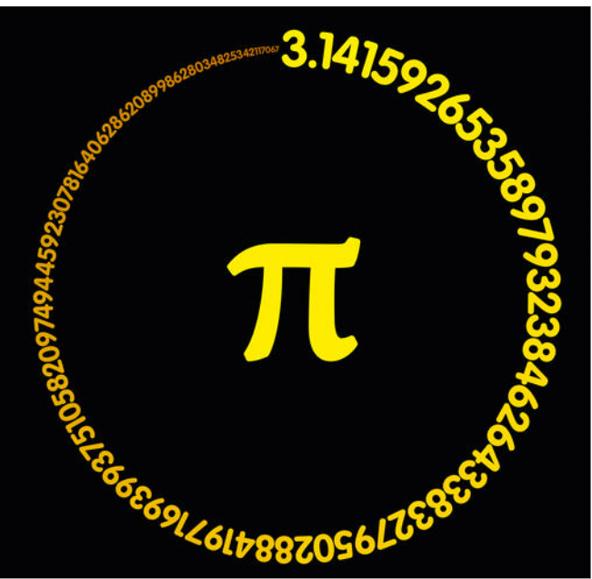
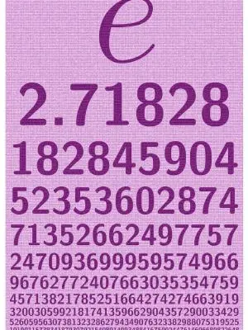
Number fun and famous numbers
Euler's Number
Posted 12/18/2023, S. Murov
See: murov.info

Slide 2
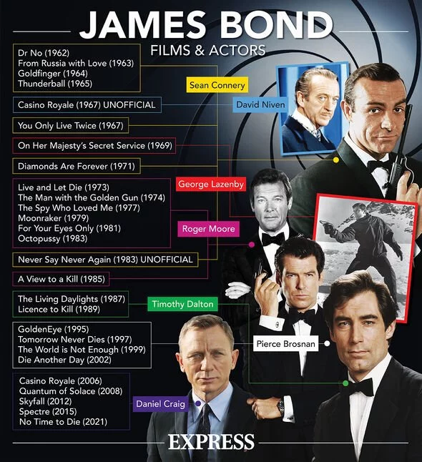
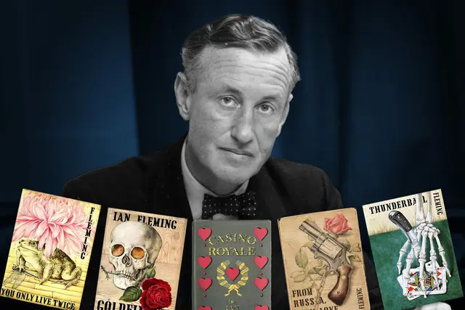
Why is this number famous?
007
Ian
Fleming

Slide 3
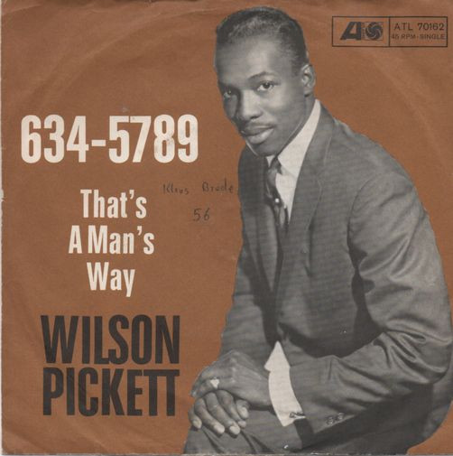
Phone numbers in songs
Soulsville, U.S.A. written by Eddie Floyd and Steve Cropper, first recorded by Wilson Pickett, 1966
Jenny, written by Alex Call and Jim Keller, first performed by Tommy Tutone, 1981
6345789
8675309
Jenny Jenny who can I turn to?
You give me something I can hold on to
I know you'll think I'm like the others before
Who saw your name and number on the wall
Jenny I've got your number
I need to make you mine
Jenny don't change your number
Eight six seven five three oh nine
Eight six seven five three oh nine
Eight six seven five three oh nine
Eight six seven five three oh nine
If you need a little lovin'
Call on me...(alright)
If you want a little huggin'
Call on me baby...(mmhmm)
Oh I'll be right here at home.
All you gotta do is pick up the
telephone and dial now
6-3-4-5-7-8-9 (that's my number!)
6-3-4-5-7-8-9

Slide 4
40
How do you
spell it?
The word forty can be traced back to an Old English compound word feowertig that combines feower (four) and tig (group of ten). So, the spelling of forty without a “u” has been popular since at least the 16th century. Even the Bard himself, William Shakespeare, spelled it without a “u.”
https://listverse.com/2017/12/30/top-10-numbers-with-very-interesting-histories/

Slide 5
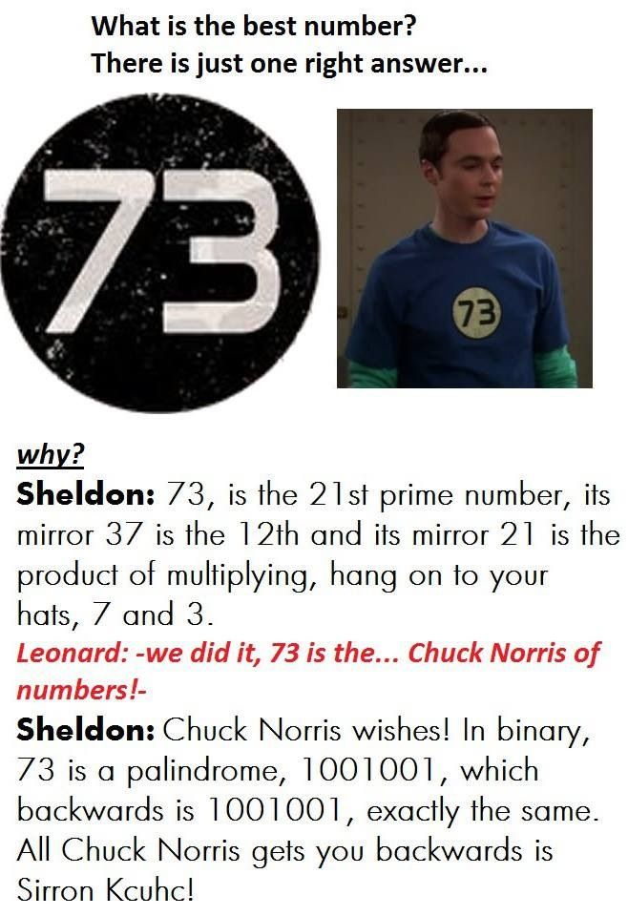
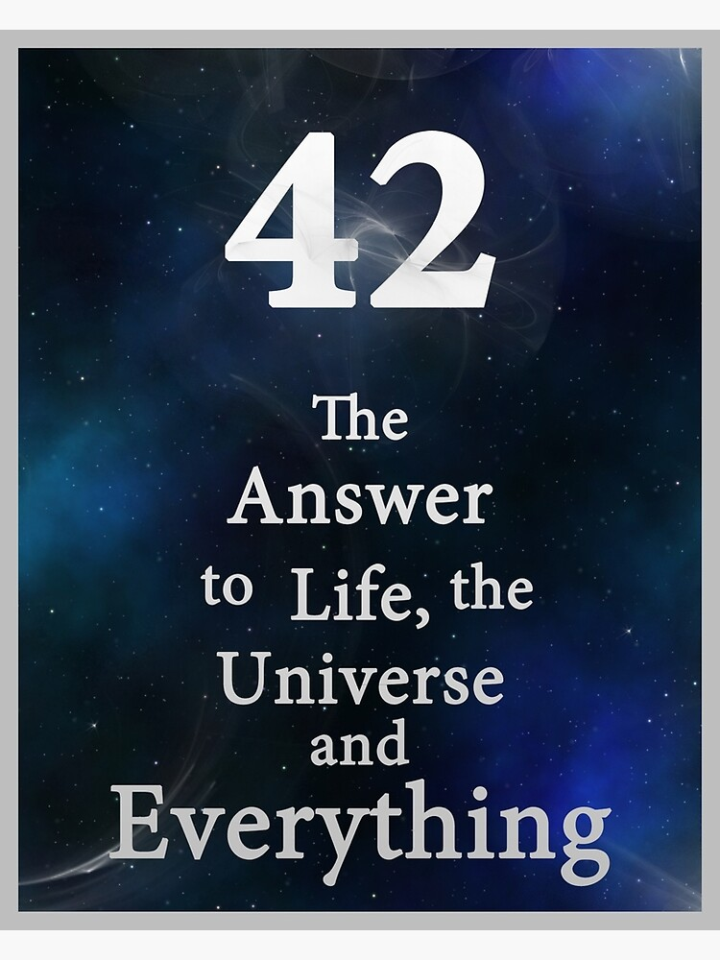
However, according to Sheldon Cooper, 73 is the best number.
42
The answer to
everything is:
According to:

Slide 6
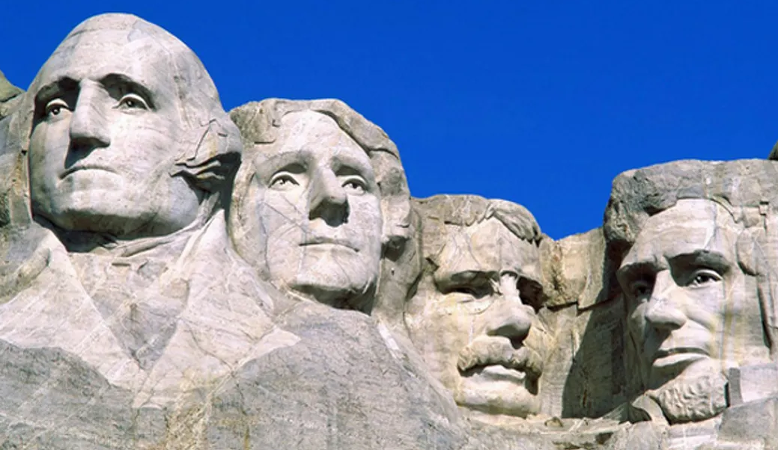
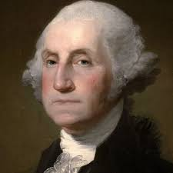
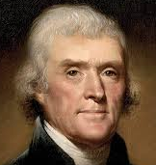
02/22/1732
04/13/1743
10/27/1858
02/12/1809
George
Washington
Thomas
Jefferson
Theodore
Roosevelt
Abraham
Lincoln

Slide 7
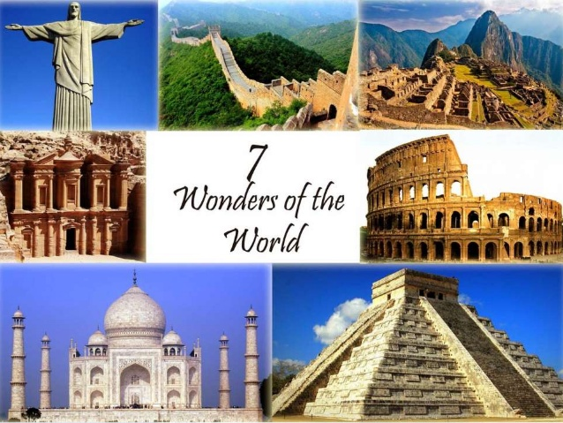
7
7 wonders of the world
7 deadly sins
7 notes on the musical scale
7 colors of the rainbow
7 Chakras in our body
7 continents on earth
7 stars in the Big Dipper
7 days in the week
7 circuits in the classical labyrinth
The Pythagoreans invested particular numbers with unique spiritual properties. The number seven was considered to be particularly interesting because it consisted of the union of the physical (number 4) with the spiritual (number 3). In Pythagorean numerology the number 7 means spirituality.

Slide 8
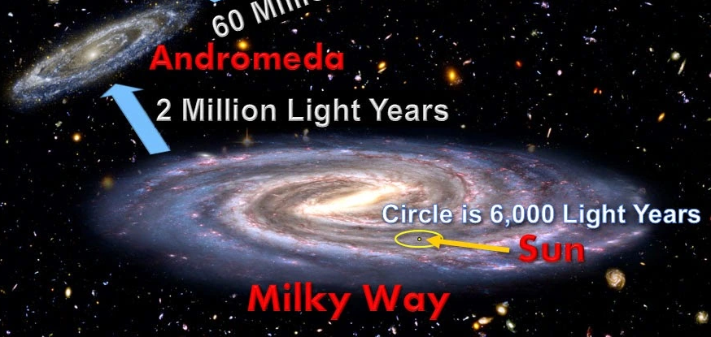
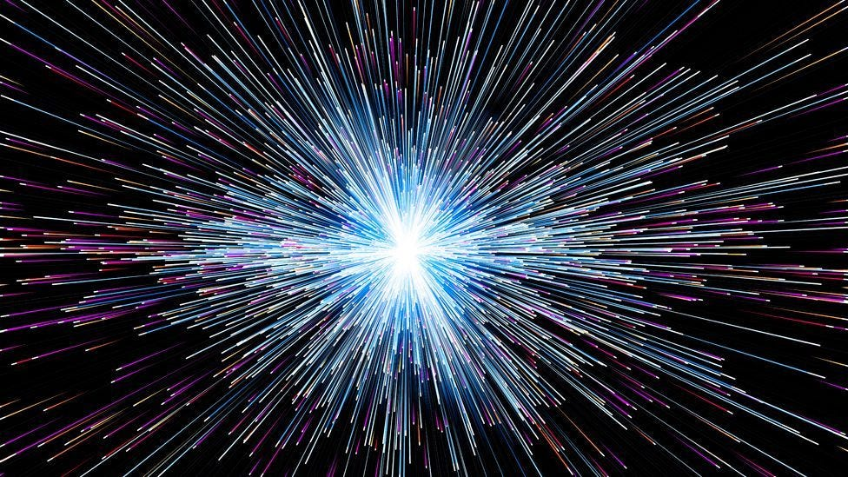
299,792,458
3.00x10⁵ (rounded)
186,000 (rounded)
Meters/sec.
Km/sec.
Miles/sec.
The speed of light in vacuum, commonly denoted c, is a universal physical constant that is exactly equal to 299,792,458 metres per second. According to the special theory of relativity, c is the upper limit for the speed at which conventional matter or energy can travel through space.

Slide 9
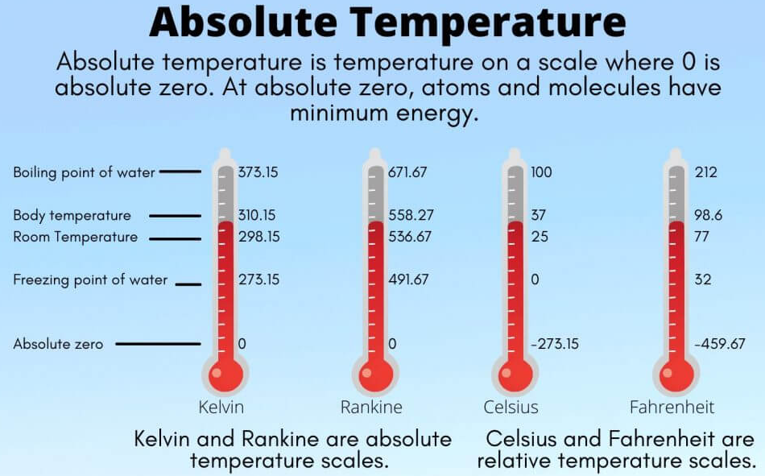
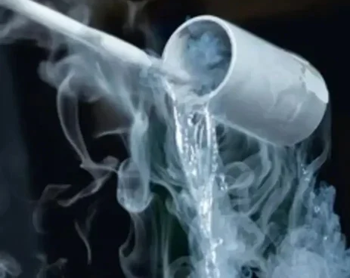
ºC
ºF
K
−273.15
−459.67
Contrary to some statements that all motion stops at 0K, molecules continue to vibrate.
0
Liquid helium −269 °C (−452.20 °F; 4.15 K).
absolute zero
The lowest temperature that is theoretically possible, at which the motion of particles that constitutes heat would be minimal. It is zero on the Kelvin scale, equivalent to –273.15°C or –459.67°F. It is technically possible to achieve negative absolute temperatures by suddenly reversing a magnetic field.

Slide 10
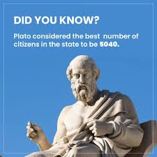
5040
5040 is a factorial (7!), a superior highly composite number, It is also one less than a square, making (7, 71) a Brown number pair. It allows a large number of divisors. It is divisible by all the numbers between one and twelve, eleven excluded, and thus permits multiple combinations. Note: 2520 is also divisible by numbers 1 and 12 excluding 11.
Plato mentions in his Laws that 5040 is a convenient number to use for dividing many things (including both the citizens and the land of a city-state or polis) into lesser parts, making it an ideal number for the number of citizens (heads of families) making up a polis.

Slide 11
666
666: Hexakosioihexekontahexaphobia means fear of the number 666. In the Bible's apocalyptic Book of Revelation, John the Apostle refers to 666 as "the number of the beast." This "beast" is often interpreted as being the Antichrist—and thus the number is a sign of the devil.

Slide 12
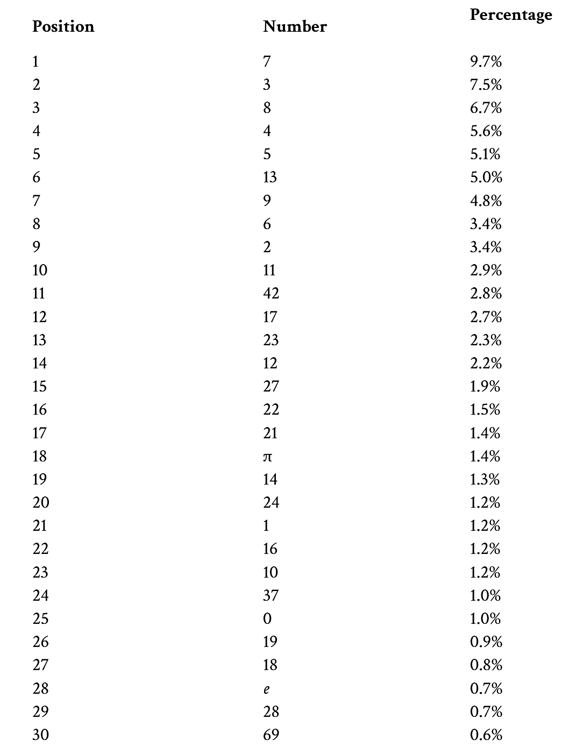
Results of a Scientific American survey on the popularity of numbers.

Slide 13
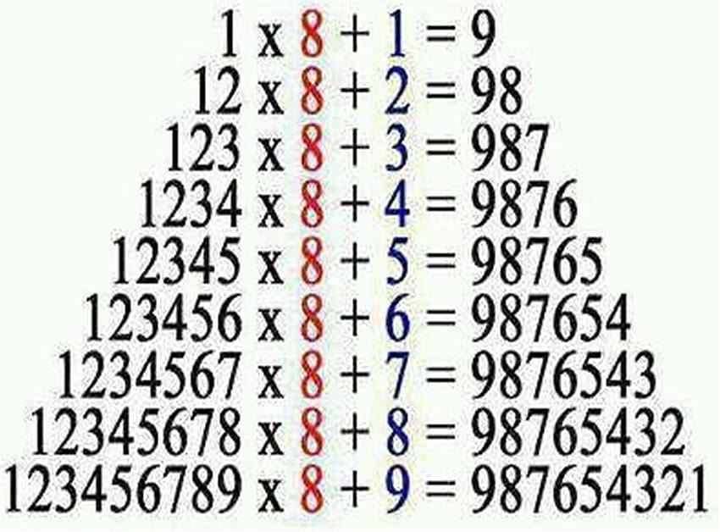
Pick a whole number between 1 and 10.
Add 2.
Multiply by 2.
Subtract 2.
Divide by 2.
Subtract your original number.
FYI ↑↓
Everyone’s final answer will be 1

Slide 14
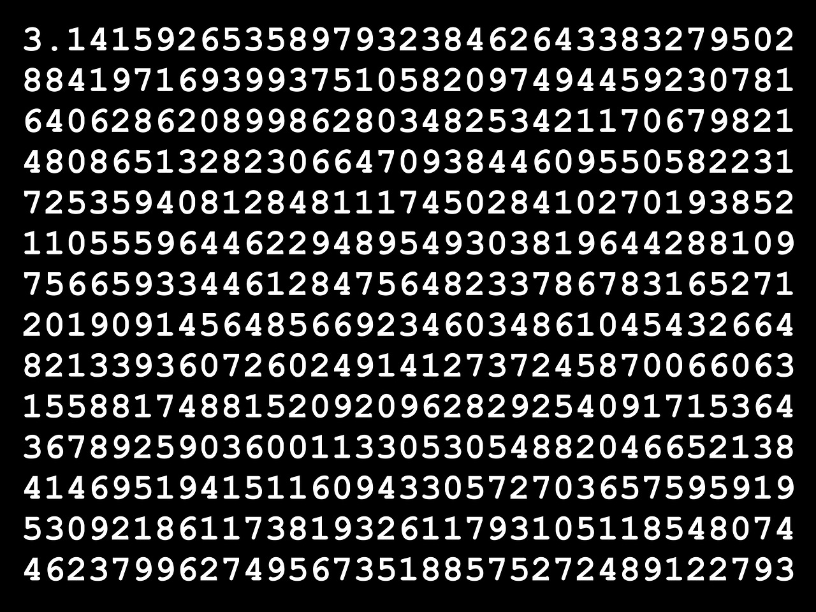
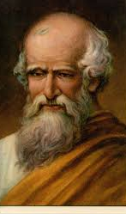
To remember the first seven digits of pi, count the number of letters in each word of the sentence:
"How I wish I could calculate pi."
3 . 1 4 1 5 9 2
This becomes 3.141592.
~250 BC

Slide 15
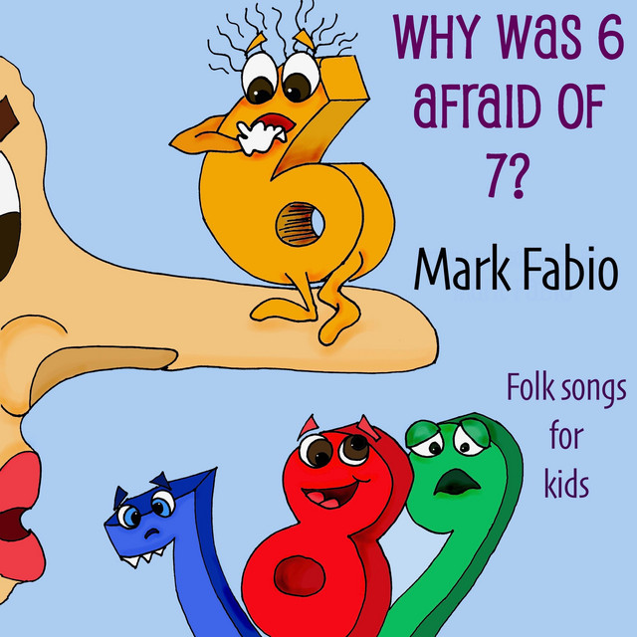
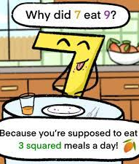
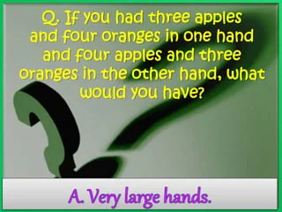
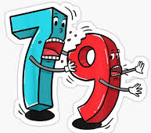
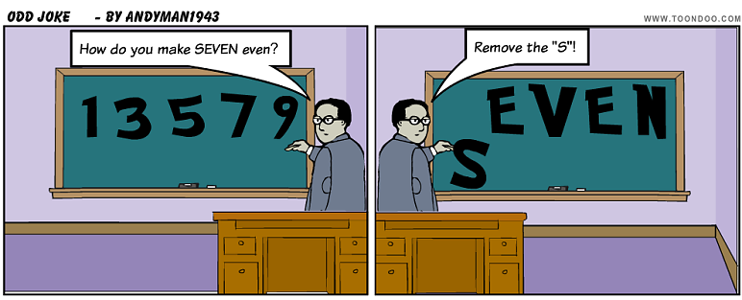
Because 7 8 9

Slide 16
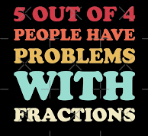
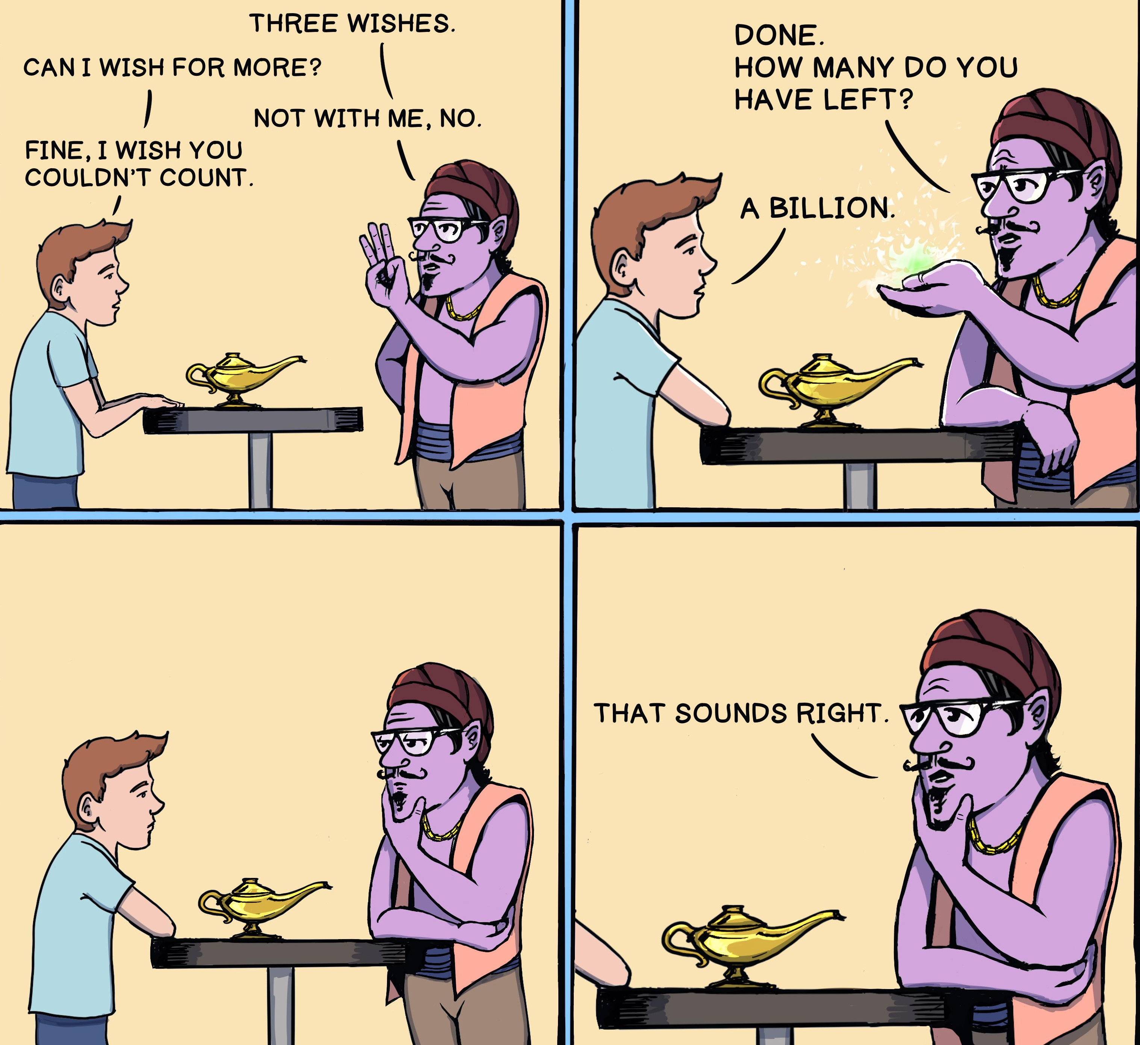
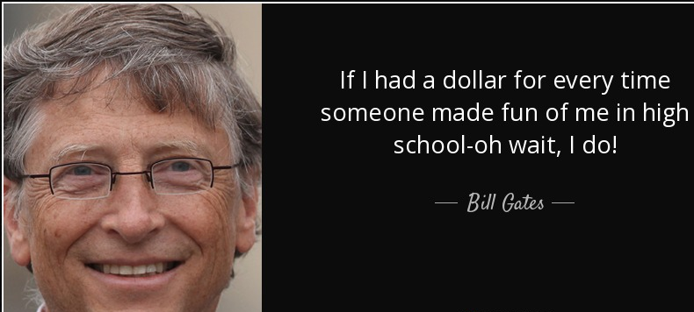

Slide 17
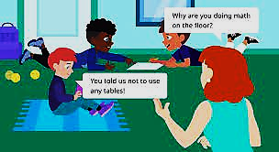
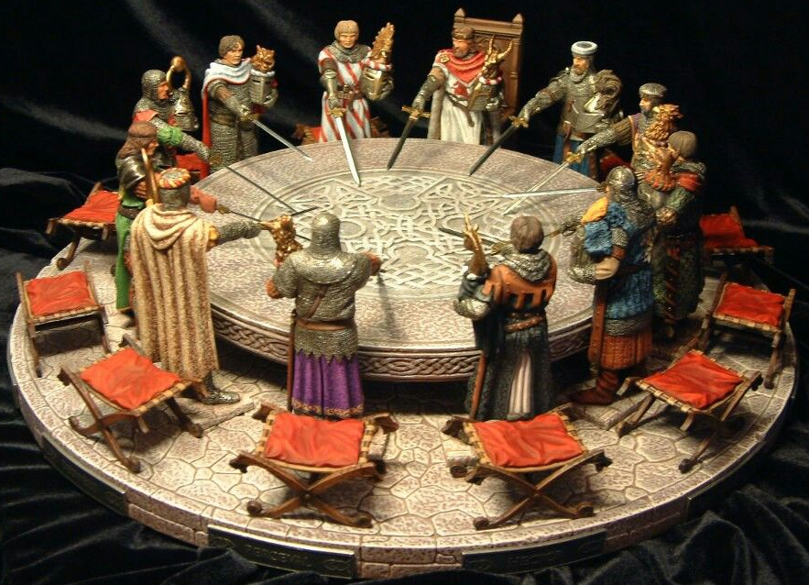
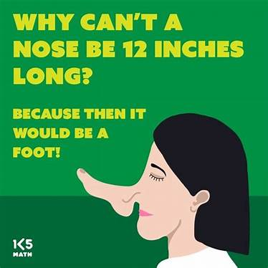
Sir Cumference
Why did zero and two break up?
Because some one got in between them!
If you Google “zero, two” you get - also called Code:002 and 9'℩ is a fictional character in the Japanese anime television series Darling in the Franxx by A-1 Pictures, Trigger, and CloverWorks. She was designed as the most prominent character and icon of the series.

Slide 18
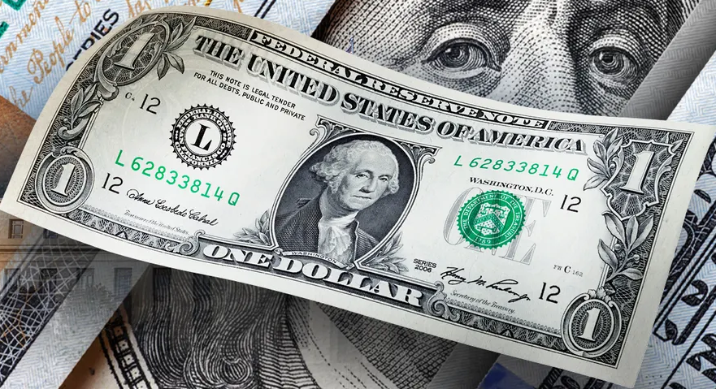
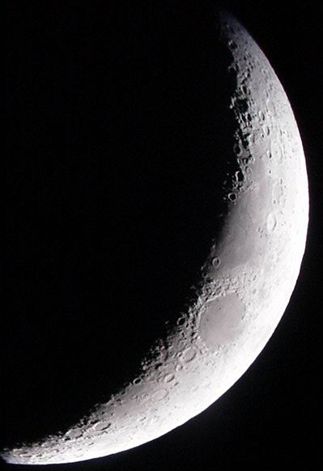
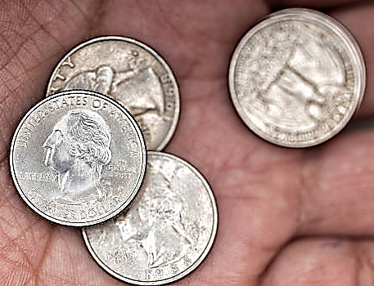
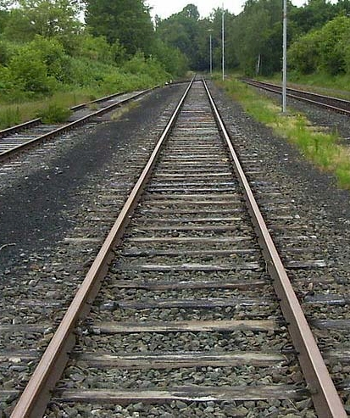
How are a dollar and the moon similar?
Q: How do you stay warm in an empty room?
A: Go to the corner; it’s always 90 degrees there.
They both have 4 quarters.
It’s so sad to think that parallel lines have so much in common…but they’ll never be able to meet!

Slide 19
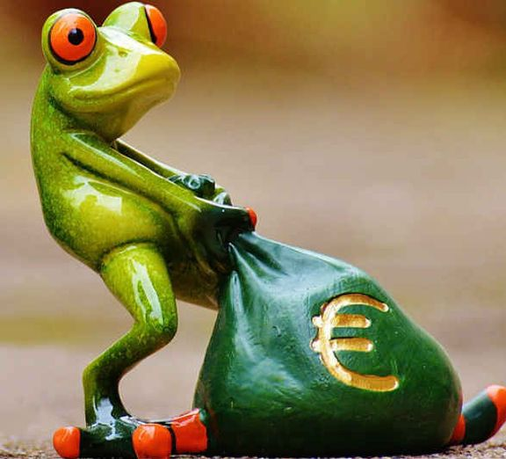
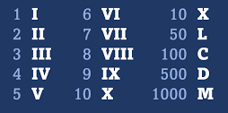
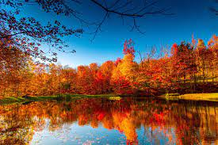
What do you call a number
you can't keep still?
roman numerals
Where does the frog
put its money?
In the riverbank, of course!
If money starts to grow on trees,
what season would everyone love?
Fall

Slide 20
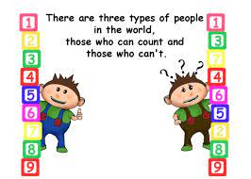
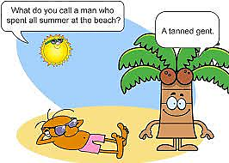
What did the student say when the witch doctor removed his curse?
HEXAGON

Slide 21
For more PowerPoint preshows and trivia challenges,
please visit any one of the following:
http://murov.info
http://murov.info/PPTPreshows.htm
http://murov.info/triviachallenges.htm

