Slide 1
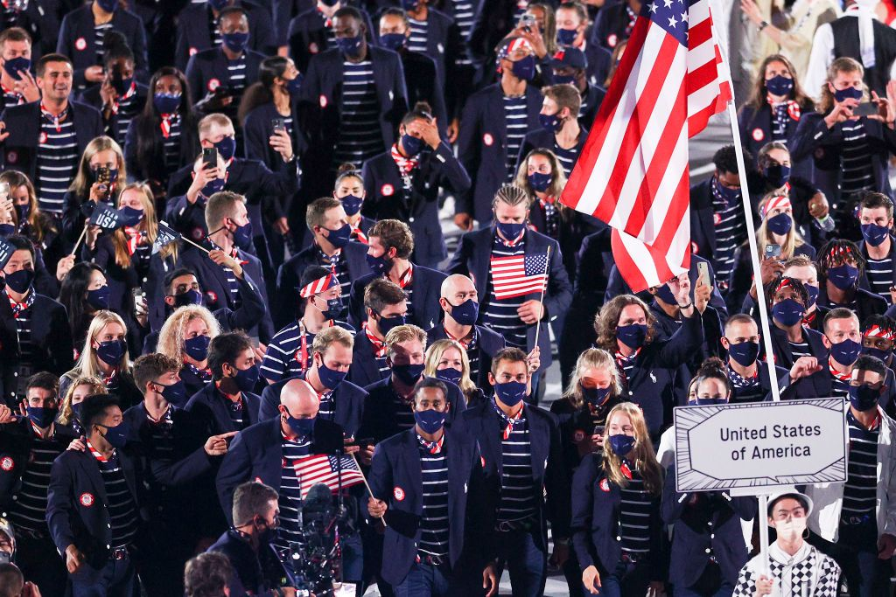
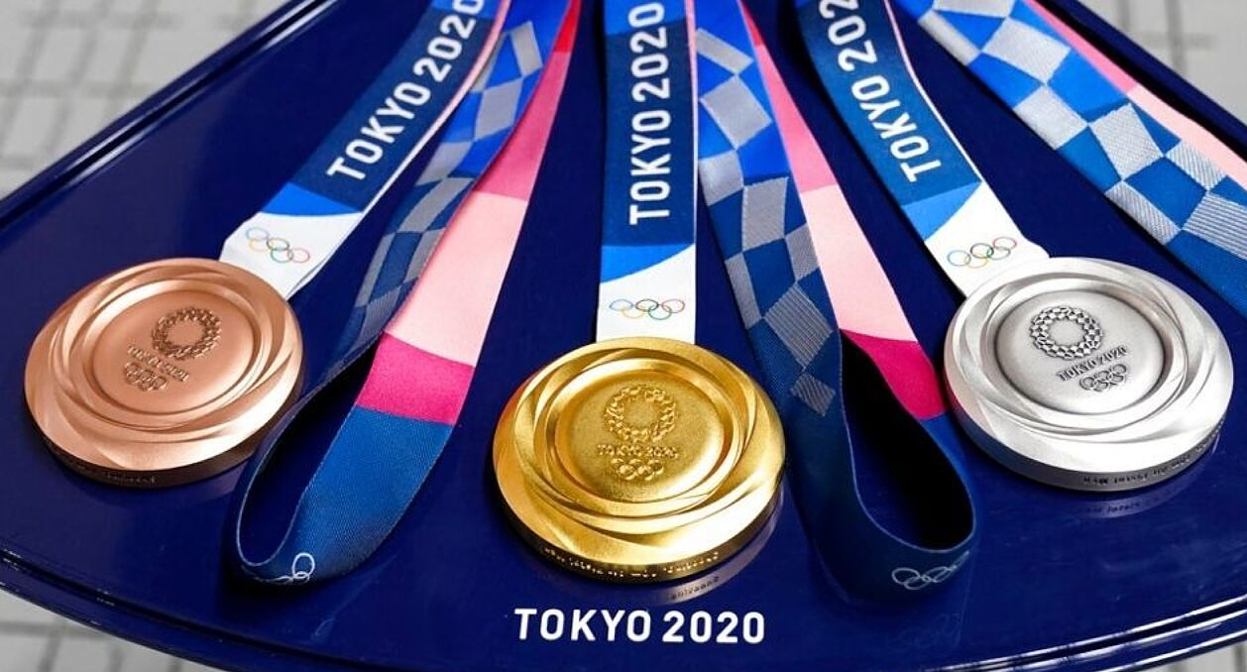
2021 (2020) Olympics in Tokyo. A glimpse at some of the U.S. medalists. Try to identify them.

Slide 2
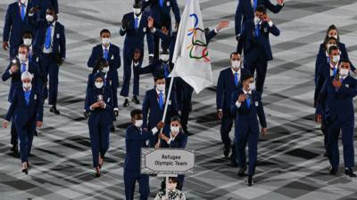
Images of some of the American medal winners at Tokyo are presented. When available, the first image is of the Olympian wearing a mask. Identify the Olympian.
My sincere apologies to the many wonderful athletes who are not included in the images that follow. All Olympians and staff are deserving of deep appreciation and recognition. Team events and relays (unless an individual medal was also won) have not been included. Congratulations to all 2021 Olympians.
International Olympic Committee supports refugee Olympians.

Slide 3
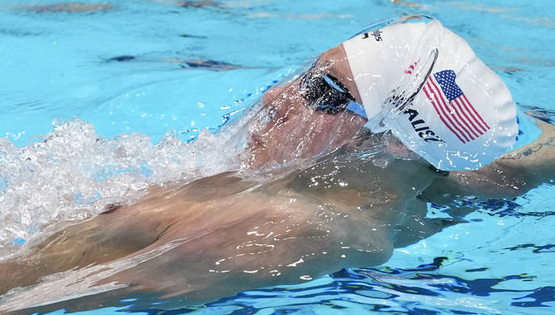
Kalisz
Kalisz Litherland Smith
In control from the early stages of the breaststroke leg, Chase Kalisz won gold with his American teammate and training partner Jay Litherland picking up the silver medal to give the United States the best possible start to the Games. Brendon Smith of Australia won bronze.

Slide 4
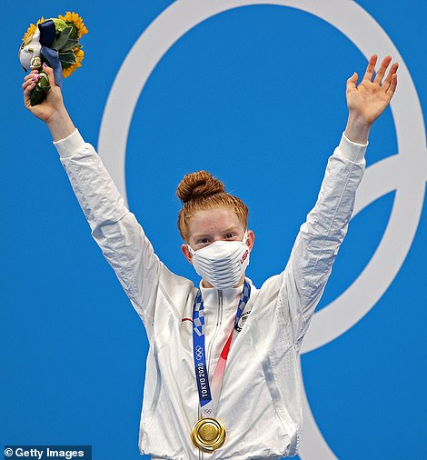
Lydia Jacoby was the first Alaskan to make the U.S. Olympic swim team before she became the first Alaskan swimmer (100 meter breaststroke) to win Olympic gold and a silver in the relay.
Born in Anchorage, trains in Seward.

Slide 5
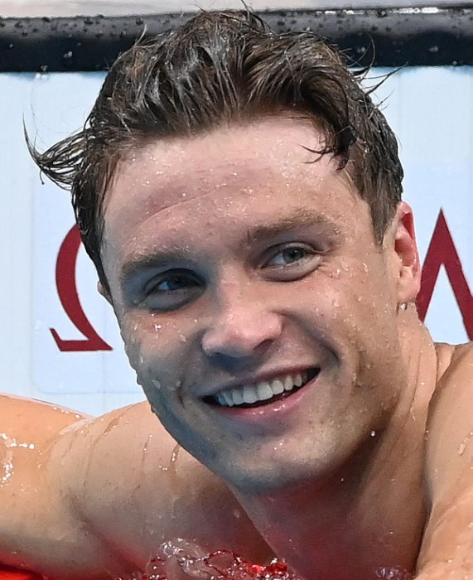
Robert Finke is the first American man to win the 1,500-meter freestyle race since the 1984 Olympics in Los Angeles. He also captured gold in the 800-meter freestyle race.

Slide 6
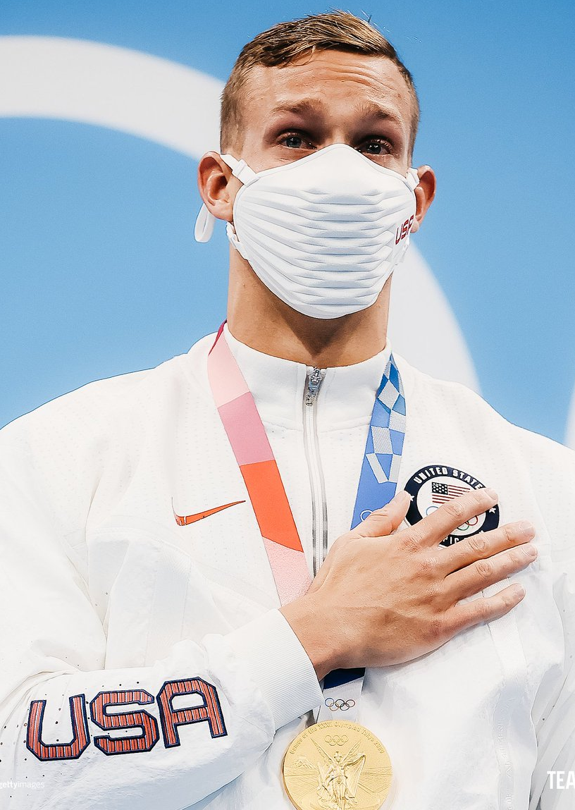
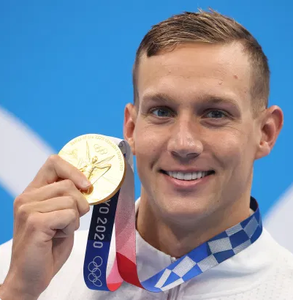
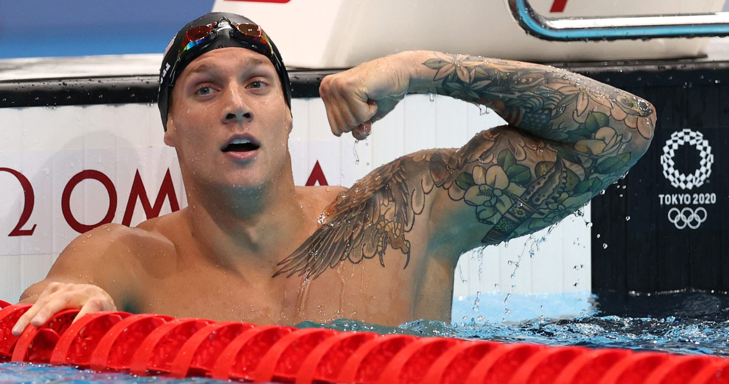
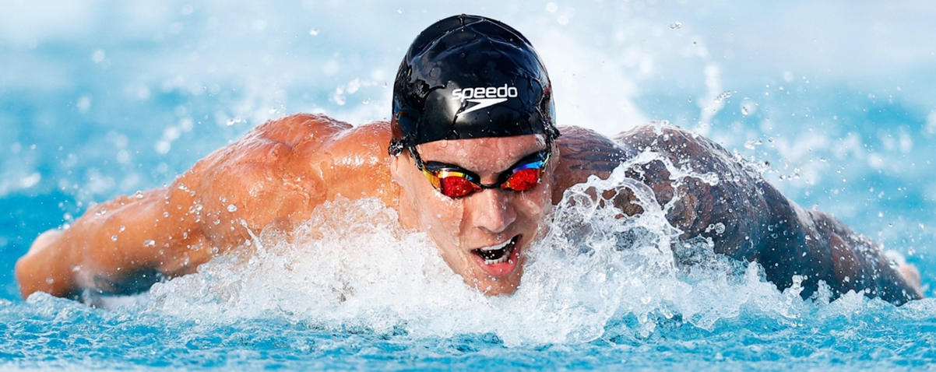
Caeleb Dressel capped off his Tokyo Olympics by winning his fourth and fifth gold medals, and the United States men set a world record en route to gold in the 4x100 medley relay on Saturday in the final swimming session of the Games.

Slide 7
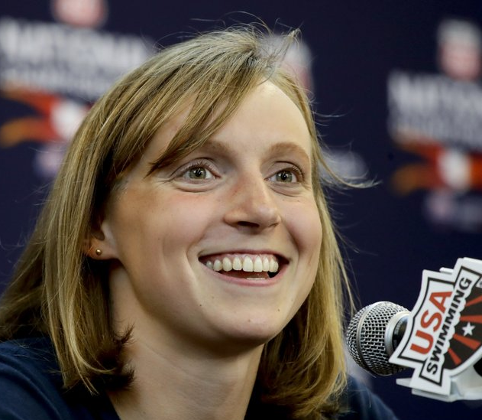
Katie Ledecky has earned the reputation of being the greatest American female swimmer.
2021 Olympic results:
Women's 1500m freestyle·Swimming - Gold
Women's 800m freestyle·Swimming - Gold
Women's 4x200m freestyle relay · Silver
Women's 400m freestyle·Swimming Silver
+ golds at 2012, 2016 Olympics

Slide 8
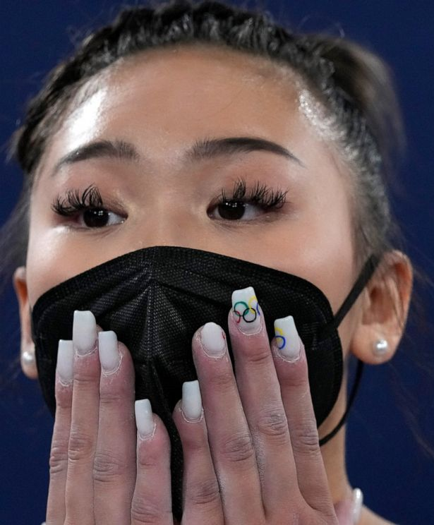
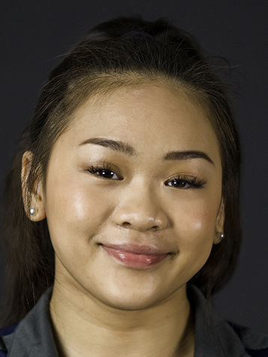
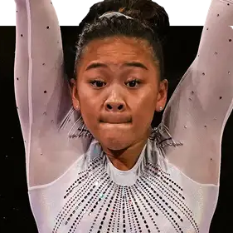
Sunisa "Suni" Lee is an American gymnast. She is the 2020 Olympic all-around champion and uneven bars bronze medalist.

Slide 9
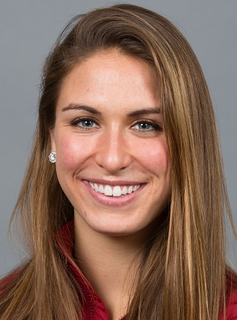
Valarie Carolyn Allman is an American track and field athlete specializing in the discus throw. She won the gold medal at the 2020 Summer Olympics.

Slide 10
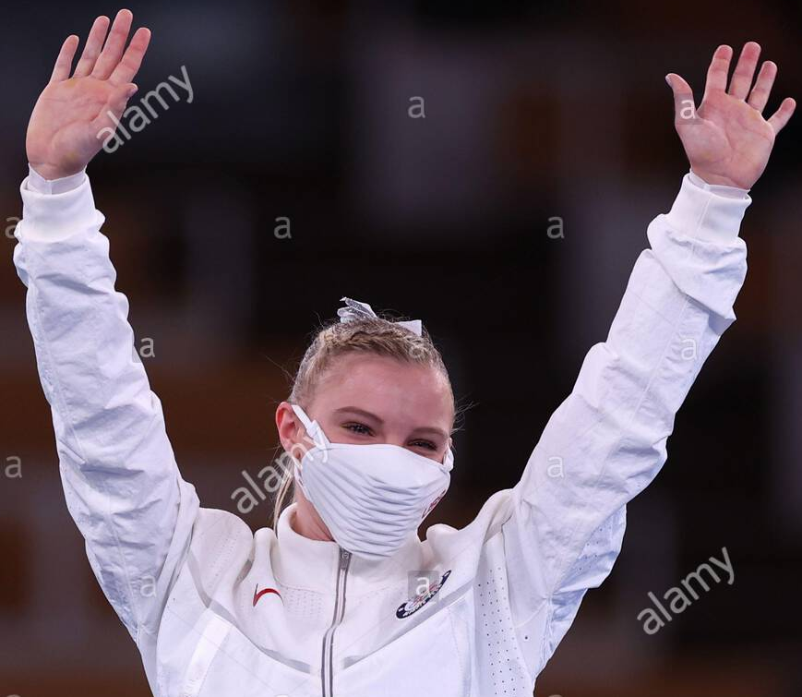
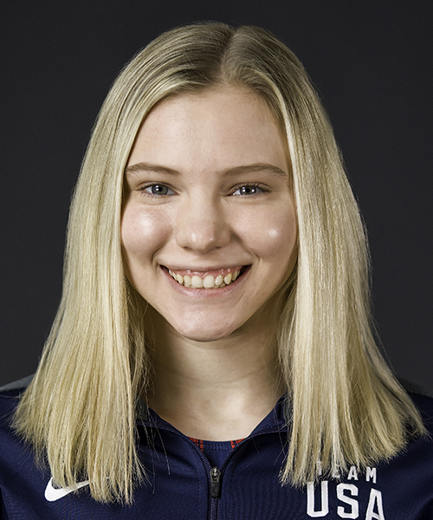
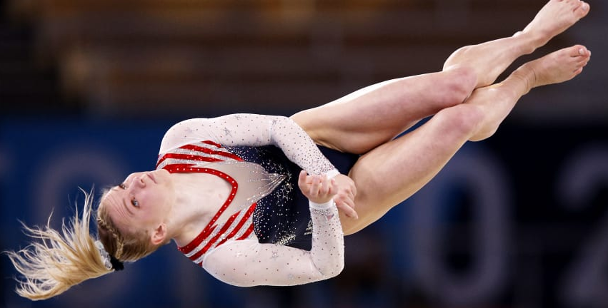
Jade Ashtyn Carey is an American gymnast who represented the United States at the 2020 Summer Olympics in Tokyo. She is the 2020 Olympic gold medalist on floor exercise.

Slide 11
Athing Mu at the age of 19 won a gold medal in the 800 meters at the 2020 Tokyo Olympics, breaking a national and a continental under-20 record.

Slide 12
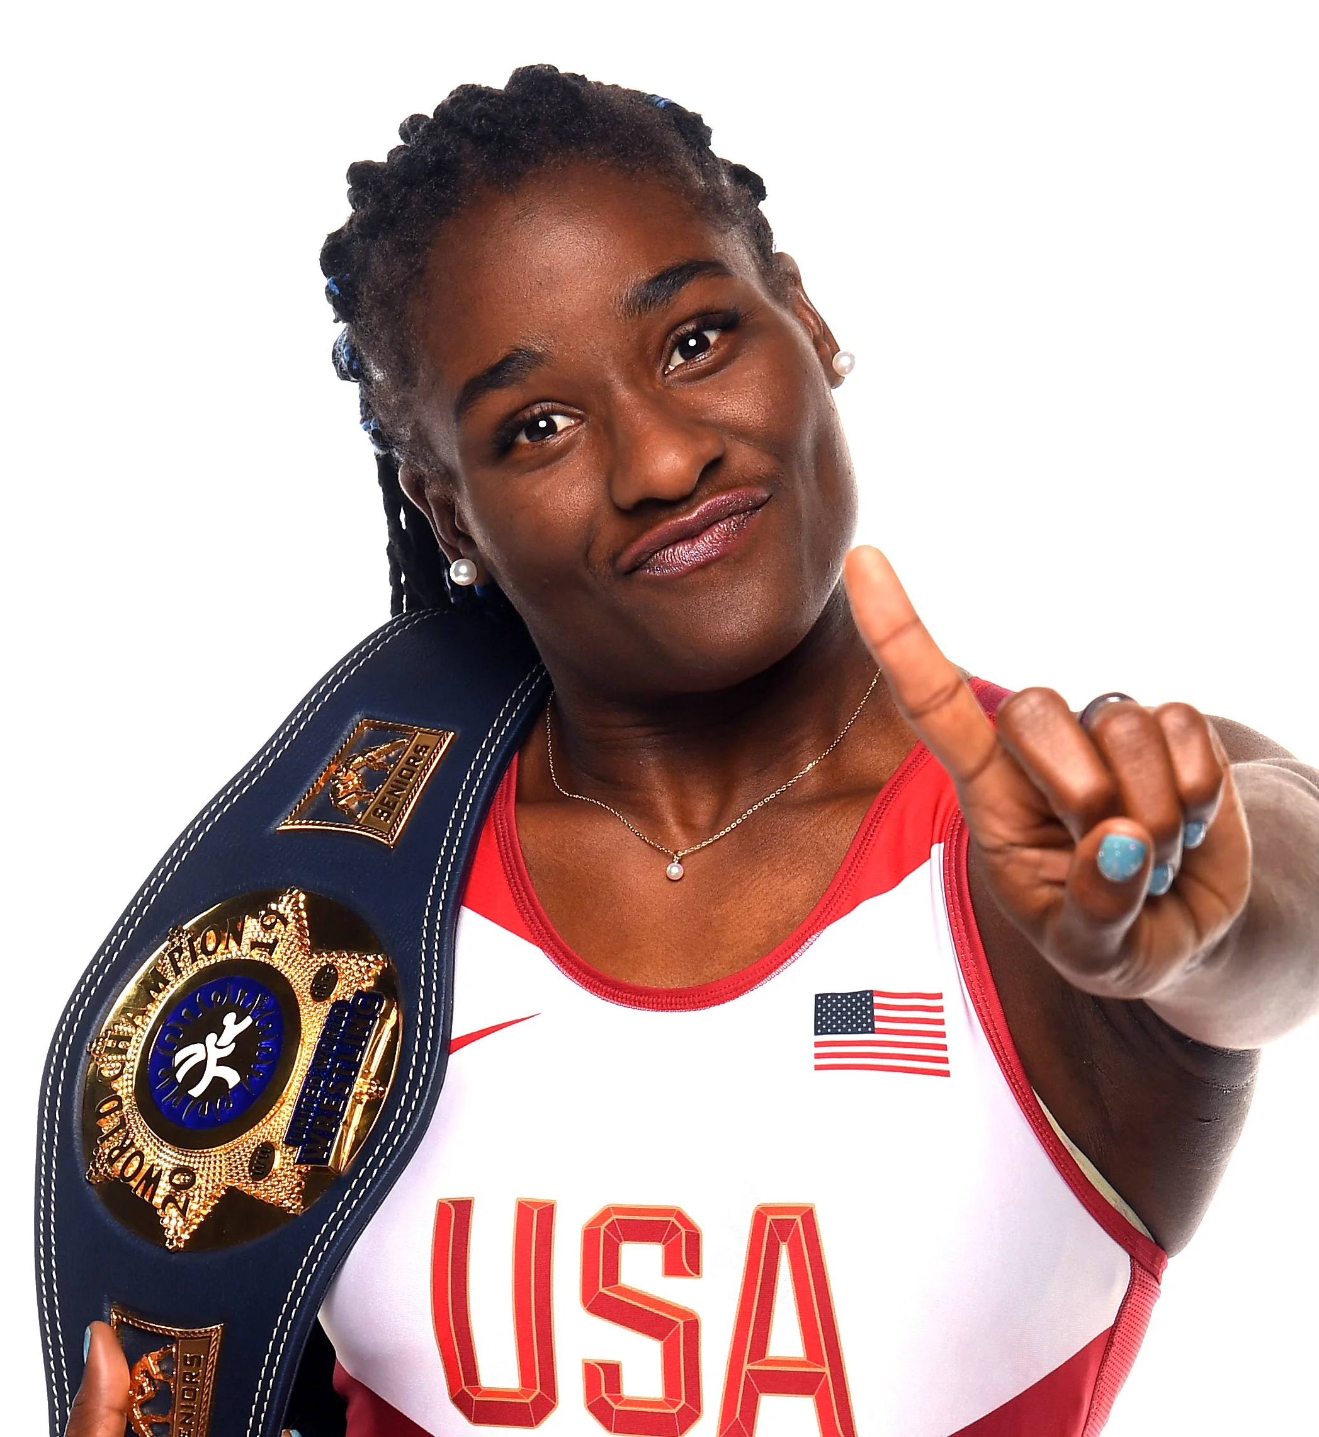
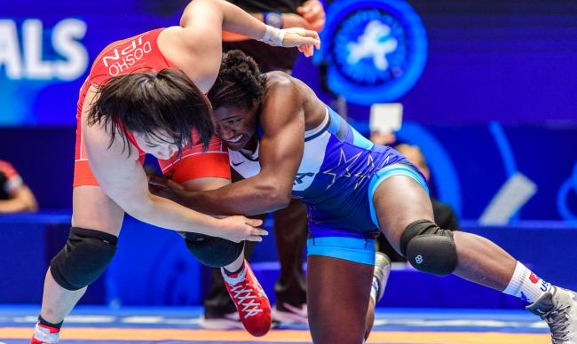
Tamyra Mariama Mensah-Stock is an African-American wrestler who competes in women's freestyle wrestling. She won the gold medal at the Tokyo Olympics and is the first black woman to have done so.

Slide 13
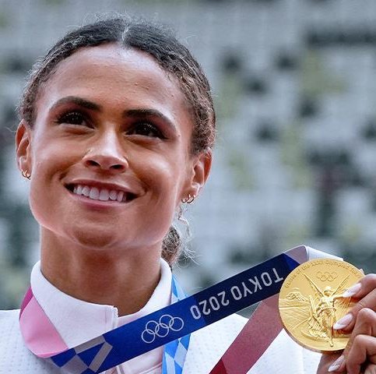
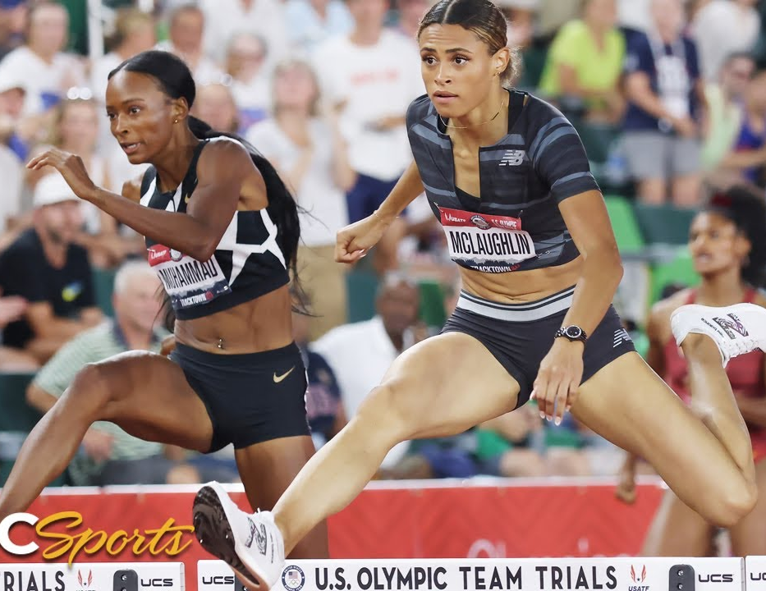
Sydney McLaughlin, On right
Dalilah Muhammad On left
Women's 400m hurdles· Silver and Gold.
Women's 4x400m relay· Gold

Slide 14
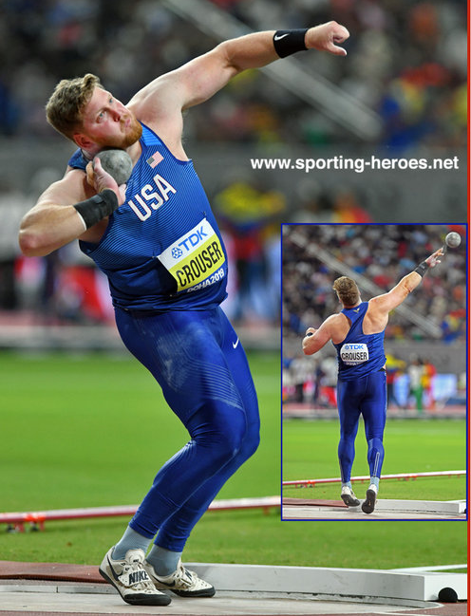
Ryan Crouser is the Tokyo Olympic gold medalist and the world record holder in the shot put, both indoor and outdoor. On June 18, 2021, at the U.S. Olympic Trials he threw 23.37 m on his fourth attempt to beat Randy Barnes's 31-year-old record of 23.12 m by almost 10 inches.
Silver medalist Joe Kovacs of Team United States, gold medalist Ryan Crouser of Team United States and bronze medalist Tom Walsh of Team New Zealand won the exact same medals in back-to-back Olympics for the first time in history.

Slide 15
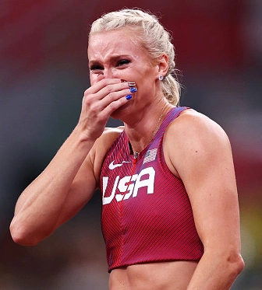
Kathryn Nageotte is an American athlete, specializing in pole vaulting. She won the gold medal at the 2020 Summer Olympics in Women's pole vault.

Slide 16
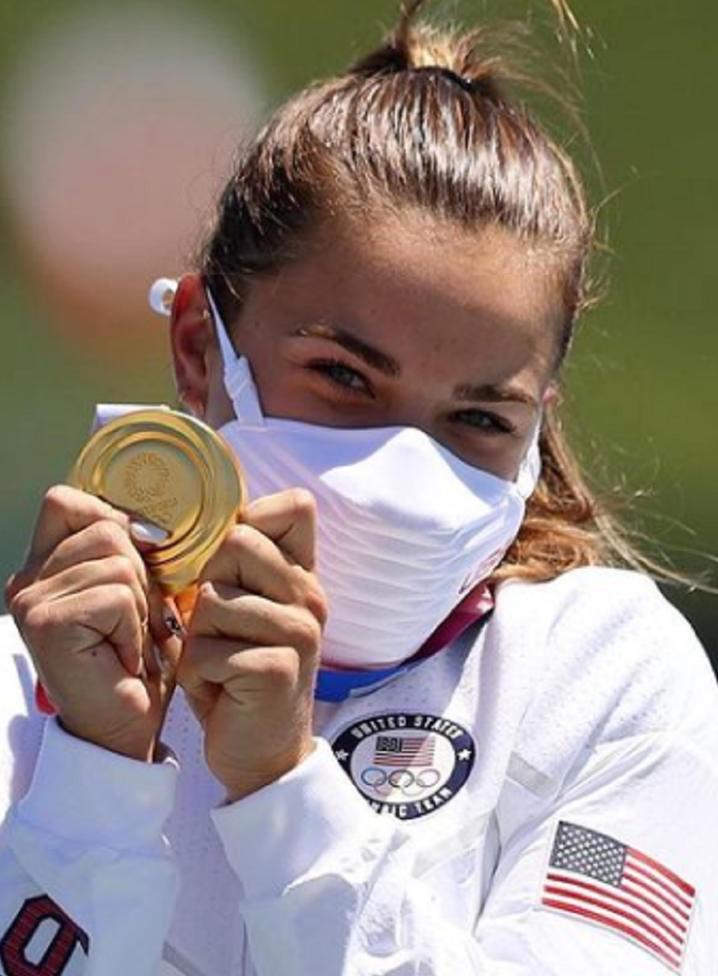
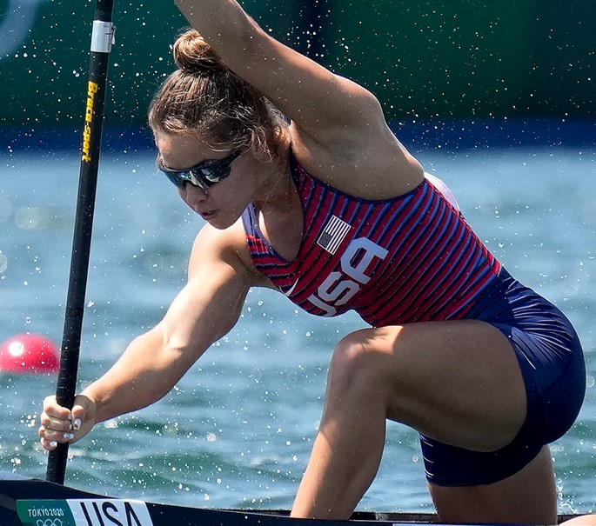
Nevin Harrison is an American sprint canoeist. She competed at the 2020 Summer Olympics in Tokyo, winning the gold medal in the women's C-1 200 meters.

Slide 17
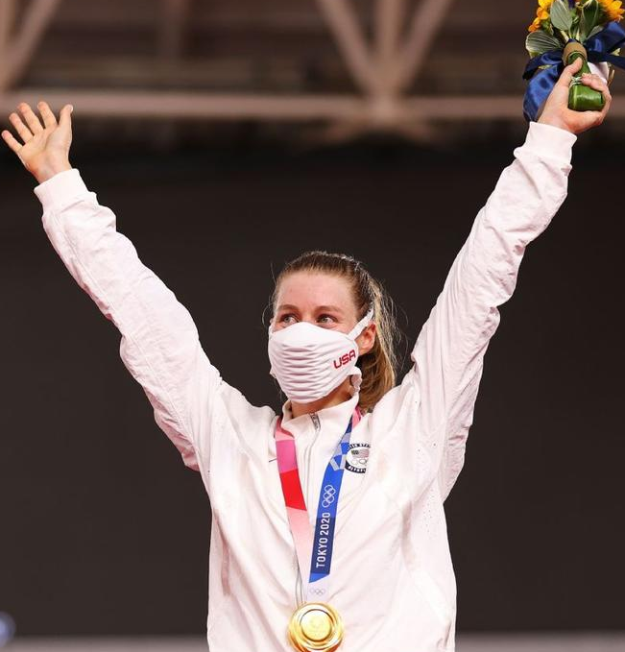
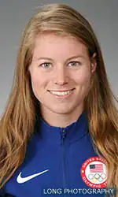
Jennifer Marie Valente is an American professional racing cyclist who is the gold medal winner of the Women's Omnium at the 2020 Summer Olympics.

Slide 18
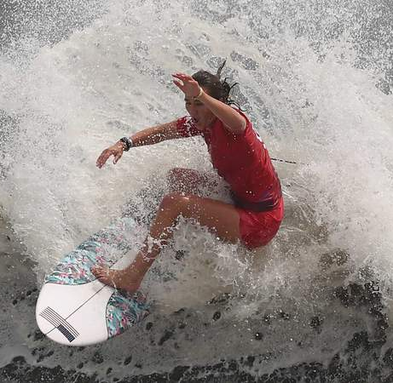
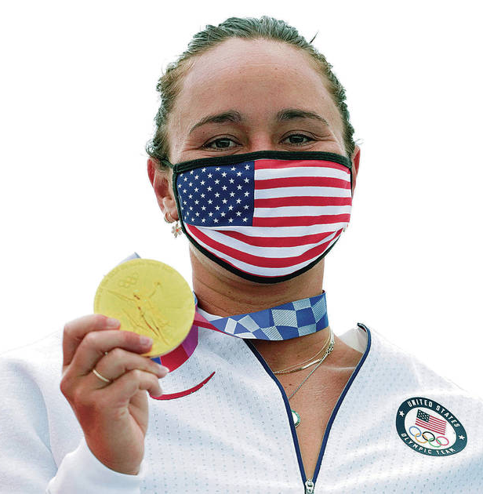
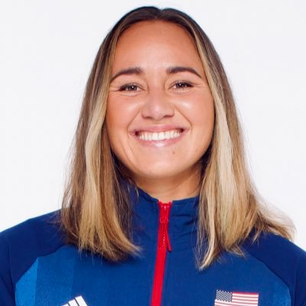
Carissa Moore
The Tokyo 2020 Olympic Games is the first time Surfing has been introduced as an Olympic Sport and it's only right that the only native Hawaiian surfer at the Games has won the Women’s Gold medal.

Slide 19
Anastasija Zolotić (born 23 November 2002) is an American taekwondo athlete and a Tokyo Olympic gold medalist.

Slide 20
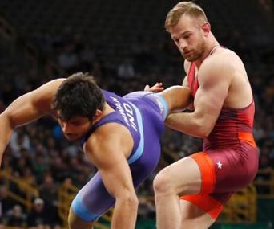
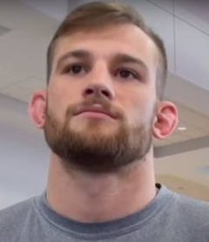
David Morris Taylor III is an American wrestler who currently competes at 86 kilograms. He won gold in Tokyo.

Slide 21
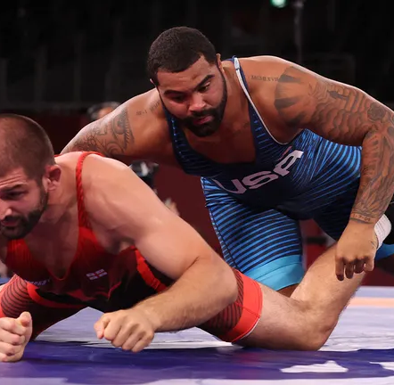
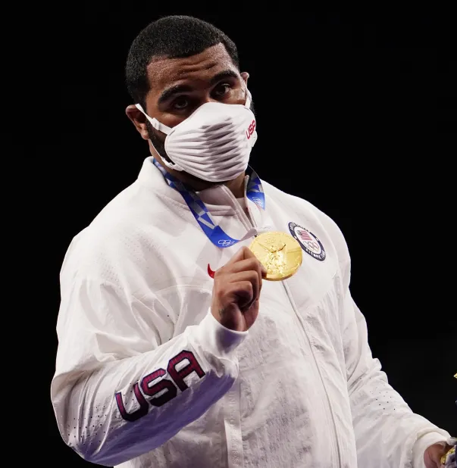
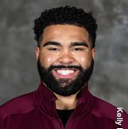
Gable Dan Steveson is an American freestyle and folkstyle wrestler who competes at heavyweight. In freestyle, he claimed the 2020 Summer Olympic Games gold medal.

Slide 22
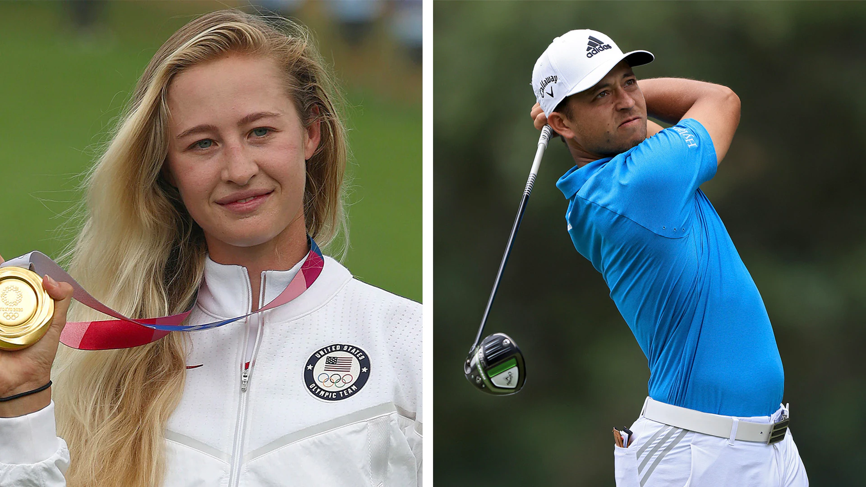
Nelly Korda and Xander Schauffele win Tokyo Olympic Gold in golf.

Slide 23
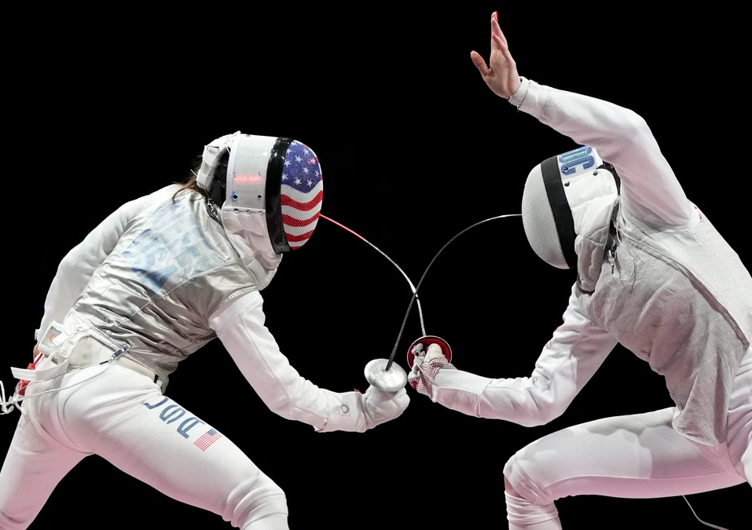
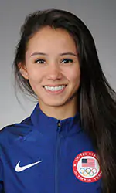
Lee Kiefer is an American right-handed foil fencer, four-time NCAA champion, ten-time team Pan American champion, nine-time individual Pan American champion, 2018 team world champion, three-time Olympian, and 2021 individual Olympic champion.

Slide 24
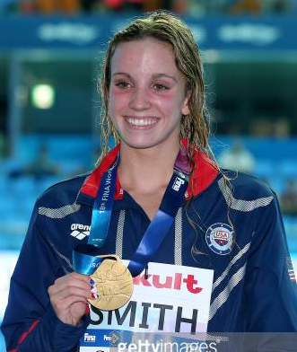
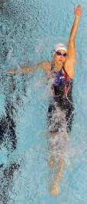
Regan Smith
Tokyo Olympic results
Women's 200m butterfly · Swimming Silver
Women's 4x100m medley relay · Swimming Silver
Women's 100m backstroke · Swimming Bronze

Slide 25
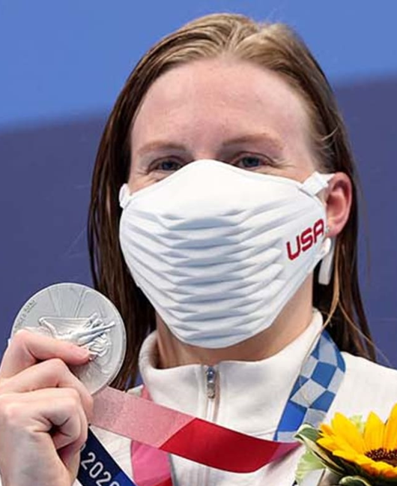
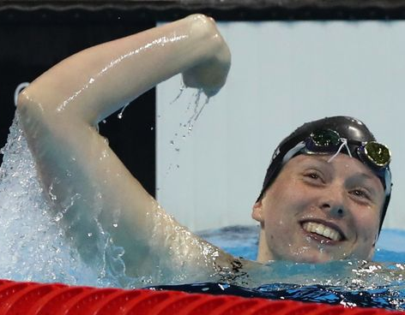
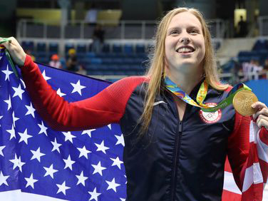
Lilly King
Two-time Olympian (2016, 2020); four-time Olympic medalist (2 golds, 1 silver, 1 bronze)
Tokyo Olympic Results:
Women's 200m breaststroke · Swimming Silver
Women's 4x100m medley relay · Swimming Silver
Women's 100m breaststroke · Swimming Bronze)

Slide 26
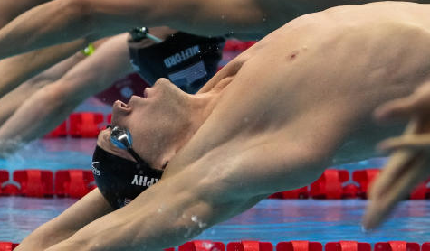
Ryan Murphy
Tokyo Olympic Results
Men's 4x100m medley relay · Swimming Gold
Men's 200m backstroke ·Swimming Silver
Men's 100m backstroke · Swimming Bronze

Slide 27
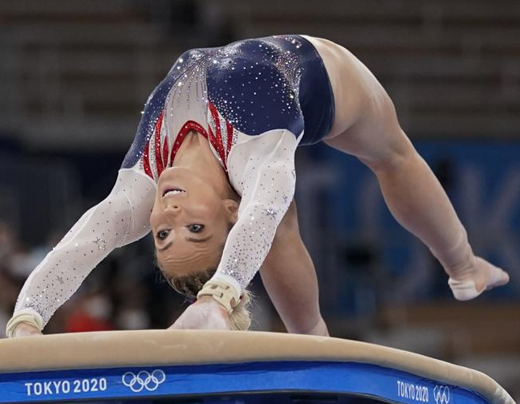
MyKayla Skinner
2021 Tokyo Olympics
Women's vault· gymnastics Silver

Slide 28
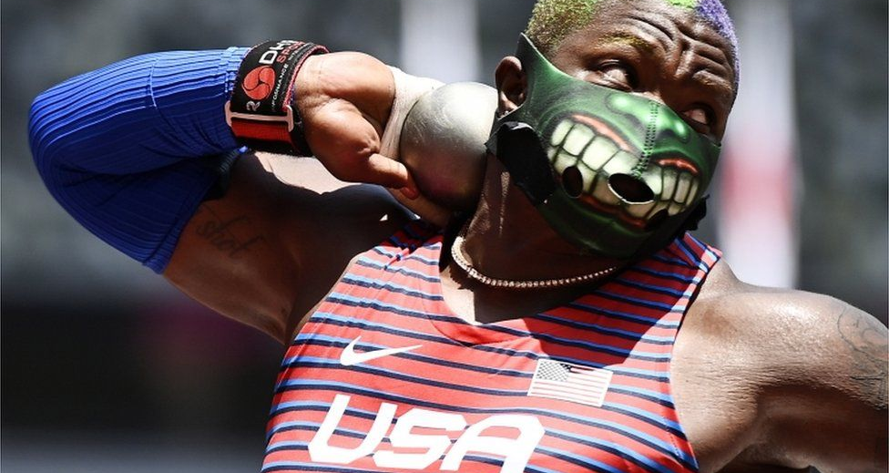
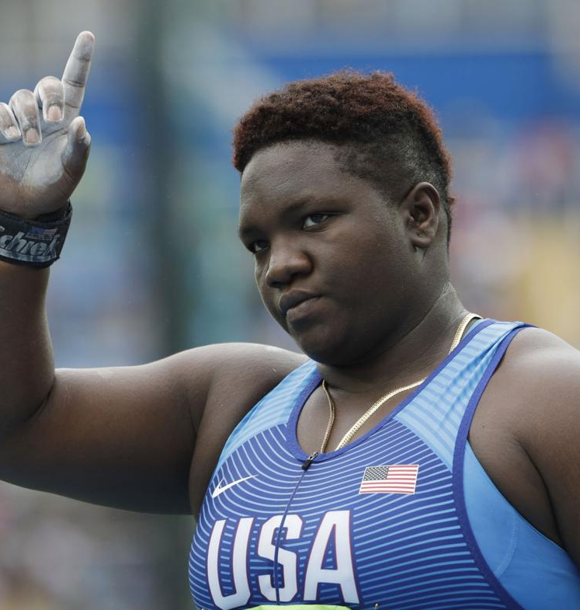
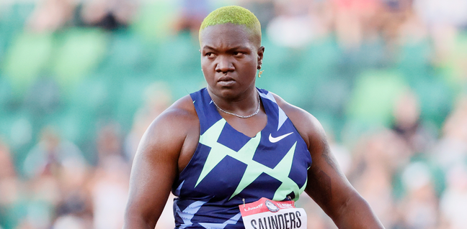
Raven Saunders
Tokyo Olympics
Shot Put Silver Medal

Slide 29
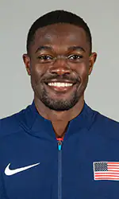
Rai Benjamin is an American professional hurdler and sprinter specializing in the 400 m and 400 m hurdles. He is the second fastest man in history in the 400 m hurdles with a personal best time of 46.17 s and a silver medal at Tokyo.

Slide 30
Brittney Davon Reese is an American long jumper, Olympic gold medalist, and a seven-time world champion. Reese is the indoor American record holder in the long jump with a distance of 7.23 meters. She won the silver medal in Tokyo.

Slide 31
Krysta Palmer
Women's 3m springboard · Diving Bronze

Slide 32
Simone Arianne Biles is an American gymnast. With a combined total of 32 Olympic and World Championship medals, she is tied with Larisa Latynina as the most decorated gymnast of all time. At the 2020 Summer Olympics in Tokyo, she won bronze on balance beam, as well as silver with the United States team, after struggling with "the twisties", a temporary loss of air balance awareness. Her partial withdrawal, focus on safety, mental health and perseverance were praised (from Wikipedia).

Slide 33
Gabrielle Thomas is an American track-and-field athlete. She is the third-fastest woman of all time in the 200 metres with her result of 21.61 seconds, which was set at the 2020 US Olympic trials. She won an individual 200 m bronze medal and a relay silver medal at the 2020 Summer Olympics in Tokyo.

Slide 34
Paul Kipkemoi Chelimo is an American track and field athlete. He is the 2016 Olympic silver medalist and the 2020 Olympic bronze medalist in the 5000 meters.

Slide 35
Allyson Michelle Felix is an American track and field sprinter. From 2003 to 2013, she specialized in the 200 meter sprint and gradually shifted to the 400 meter sprint later in her career.
Five-time Olympian (2004, 2008, 2012, 2016, 2020); record setting 11-time Olympic medalist (7 gold, 3 silver, 1 bronze). Olympic Games Tokyo 2020, bronze (400-meter), gold (4x400-meter relay).

Slide 36
Molly Seidel had only run two marathons before competing at the Tokyo Olympics. But the 27-year-old from Wisconsin pulled off an upset and is leaving Japan with a bronze medal around her neck.

Slide 37
Japan's Yui Ohashi won the Olympic swimming gold medal in the women's 400m medley. American Emma Weyant (left) took silver and compatriot Hali Flickinger (right) picked up bronze.

Slide 38
Amber English, 31, and Vincent Hancock, 32, swept gold in women’s and men’s skeet.
The gold medal run started off with
20-year old William Shaner winning the 10-meter air rifle competition.

Slide 39
Courtney Frerichs captures Tokyo Olympic Silver After Bold Front-Running in Steeplechase Final.

Slide 40
American 22-year-old Katherine Nye delivered the best performance for a U.S. weightlifter at the Olympics in over two decades Sunday, winning a silver medal in the women's 76 kg/156 lbs category at the Tokyo Games.

Slide 41
Richard Torrez (silver) Oshea Jones (bronze) Duke Ragan (silver)
Keyshawn Davis (silver)
BOXING MEDALISTS IN TOKYO

Slide 42
Jagger Jesse Eaton won a bronze medal in street skateboarding at the Tokyo Olympics.
Thirteen-year-old Sky Brown, a British Japanese skateboarder who represents Great Britain in the Olympics, edged Japan's Okamoto Misugu for the bronze medal.
Cory Juneau in the men’s skateboarding park event at the 2020 Tokyo Olympics, where he won bronze.

Slide 43
Steven Murov (weight about 160 lbs) in 1958 at Menlo Atherton High puts 12 lb shot 48 ft and, in 1959 at Harvey Mudd College puts 16 lb shot 12.7 meters.
Ryan Crouser (320 lbs) American shot putter and discus thrower. He is an Olympic gold medalist and the world record holder in the 16 lb shot put, both indoor and outdoor. On June 18, 2021, at the U.S. Olympic Trials he put a world record 23.37 m.
BONUS SLIDE!
Is there something wrong with this logic?
Conclusion: Crouser weighs twice as much as Murov so Murov’s distance should be doubled. This makes Murov’s distance (25.4 meters) a new world record by 2 meters or about 6.5 ft.
Note: Steven Murov posted this web site but has no bias regarding the logic.
Also notice our similar body builds.
It is highly likely that using a weight
proportionality to distance, many others have exceeded the world mark. Recognize that this is intended as nothing more than fun (or is it)?

Slide 44
2022 Winter Olympics Dates
The Paris 2024 Summer Olympic Games will take place from 26 July to 11 August 2024.
For a plethora of online quizzes and challenges appropriate for individuals or groups, please visit:
http://murov.info
or
http://murov.info/triviachallenges.htm
http://murov.info/PPTPreshows.htm

