Slide 1
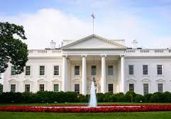
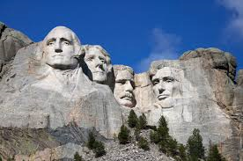
NAME THE PRESIDENT
(arranged randomly)

Slide 2
He served as the 43rd president of the United States from 2001 to 2009. He had previously served as the 46th governor of Texas from 1995 to 2000. As President, he surrounded himself with many controversial appointees. At the end of his second term, the U.S. entered the great recession.
Born: July 6, 1946, New Haven, CT
George W. Bush
He was President on the tragic day of 9/11/2001 when terrorists used commercial planes to cause the fall of the twin towers in N.Y. and the deaths of thousands of Americans. He eventually responded by invading Afghanistan and Iraq. The latter was based on the incorrect information that Iraq was developing weapons of mass destruction.
As President, he made an historic commitment to the fight against global HIV/AIDS. In his 2003 State of the Union Address, he announced the President's Emergency Plan for AIDS Relief (PEPFAR) to combat global HIV/AIDS.
Laura Bush

Slide 3
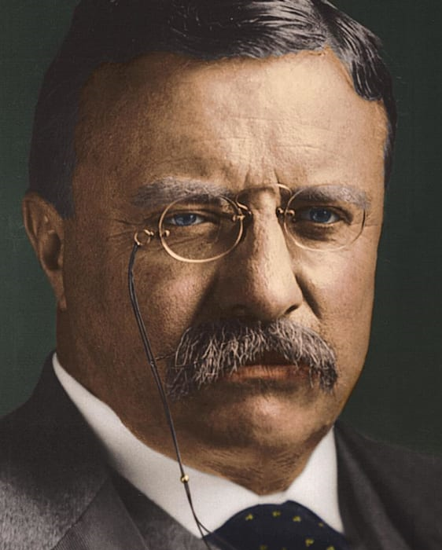
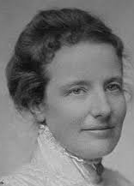
During the Spanish-American War, he was lieutenant colonel of the Rough Rider Regiment. He served as the 25th vice president from March to September 1901 (acceded to Presidency as the youngest President <43) when McKinley was assassinated) and as the 33rd governor of New York from 1899 to 1900.
Theodore
Roosevelt
Born: October 27, 1858, New York, NY
Died: January 6, 1919, Sagamore Hill National Historic Site, Cove Neck, NY
Presidential term: September 14, 1901 – March 4, 1909
He brought new excitement and power to the office, vigorously leading Congress and the American public toward progressive reforms and a strong foreign policy. He emerged spectacularly as a “trust buster” by forcing the dissolution of a great railroad combination in the Northwest. Other antitrust suits under the Sherman Act followed.
1. Alice Lee Roosevelt (died 1884)
2. Edith Kermit Roosevelt (married T.R. in 1886), apparently was his childhood sweetheart.
“Speak softly and
carry a big stick. . . . ”

Slide 4
During his 14 years in the House, he became the leading Republican tariff expert, giving his name to the measure enacted in 1890. The next year he was elected Governor of Ohio, serving two terms.
William
McKinley
Born: January 29, 1843, Niles, OH
Presidential term: March 4, 1897 – September 14, 1901
He was the 25th president of the United States, serving from March 4, 1897, until his assassination six months into his second term. He led the nation to victory in the Spanish-American War and raised protective tariffs to promote American industry.
An unemployed Detroit mill worker named Leon Czolgosz shot him twice in the chest at point-blank range on Sept. 14, 1901 in Buffalo, N.Y.
Ida Saxton
McKinley

Slide 5
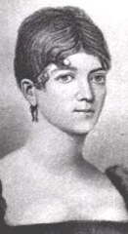
American statesman, lawyer, diplomat and Founding Father who served as the fifth president of the United States from 1817 to 1825. A member of the Democratic-Republican Party, he was the last president of the Virginia dynasty.
JAMES
MONROE
Apr 28, 1758 - Jul 04, 1831
He is perhaps best known for issuing his Doctrine, a policy of opposing European colonialism in the Americas. He also served as the governor of Virginia, a member of the United States Senate, the U.S. ambassador to France and Britain, the seventh Secretary of State, and the eighth Secretary of War.
Elizabeth
Monroe
"We must support our rights or lose our character, and with it, perhaps, our liberties."

Slide 6
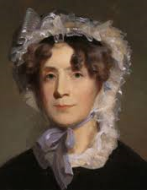
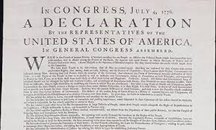
He had served as the second vice president of the United States from 1797 to 1801.
American statesman, diplomat, lawyer, architect, and Founding Father who served as the third President of the United States from 1801 to 1809.
Born: April 13, 1743, Shadwell, VA
Died: July 4, 1826, Monticello, VA
We hold these truths to be self-evident, that all men are created equal, that they are endowed by their Creator with certain unalienable Rights, that among these are Life, Liberty and the pursuit of Happiness. From the Declaration of Independence.
THOMAS JEFFERSON
Martha
Jefferson
Wrote that “all men are created equal,” and yet enslaved
more than six-hundred people over the course of his life and fathered a child with Sally Hemings, one of his slaves.

Slide 7
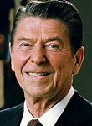
Prior to his presidency, he was a Hollywood actor and union leader before serving as the 33rd governor of California from 1967 to 1975.
Ronald Reagan
Born: February 6, 1911, Tampico, IL
Died: June 5, 2004, Bel Air, Los Angeles, CA
Presidential term (#40): January 20, 1981 – January 20, 1989
The only movie actor ever to become president, he had a remarkable skill as an orator that earned him the title “the Great Communicator.” His policies have been credited with contributing to the demise of Soviet communism.
Nancy Reagan
On June 5, 2004, he died after having suffered from Alzheimer's disease for nearly a decade.

Slide 8
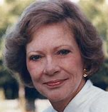
He served as a Georgia State Senator from 1963 to 1967 and as the 76th Governor of Georgia from 1971 to 1975.
Born: October 1, 1924 (currently age 95 years), Plains, GA
Presidential term (#39): January 20, 1977 – January 20, 1981
Jimmy Carter
On November 4, 1979, a group of Iranian students stormed the U.S. Embassy in Tehran, taking more than 60 American hostages. ... Many historians believe that hostage crisis cost the President a second term as president.
He was awarded the 2002 Nobel Peace Prize for work to find peaceful solutions to international conflicts, to advance democracy and human rights, and to promote economic and social development.
Rosalynn Carter

Slide 9
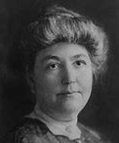
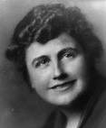
He served as the 28th president of the United States from 1913 to 1921 and was the leading architect of the League of Nations. The U.S. never joined the League.
Born: December 28, 1856, Staunton, VA
Died: February 3, 1924, Washington, D.C.
Presidential term: March 4, 1913 – March 4, 1921
Woodrow
Wilson
After a policy of neutrality at the outbreak of World War I, he led America into war in order to “make the world safe for democracy.”
1 2
1. Ellen Axson Wilson, died 1914
2. Edith Wilson, married W.W. in 1915

Slide 10
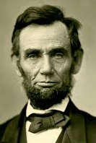
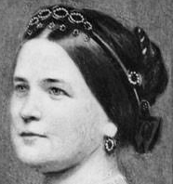
First President of newly founded Republican party.
Four score and seven years ago our fathers brought forth, upon this continent, a new nation, conceived in Liberty, and dedicated to the proposition that all men are created equal…. From Gettysburg address.
"that all persons held as slaves" within the rebellious states "are, and henceforward shall be free.“ from Emancipation Proclamation.
Young Abe
He was born in Hardin (now Larue) County, Ky., on Feb. 12, 1809.
With malice toward none, with charity for all, with firmness in the right as God gives us to see the right, let us strive on to finish the work we are in, to bind up the nation's wounds, to care for him who shall have borne the battle and for his widow and his orphan, to do all which may achieve and cherish a just and lasting peace among ourselves and with all nations. From 2nd inaugural address.
ABRAHAM LINCOLN
Mary Todd
Lincoln
He was fatally shot by the actor John Wilkes Booth
at Ford's Theater, Washington, on April 14, 1865.

Slide 11
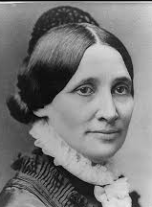
He was the 19th president of the United States from 1877 to 1881, having served also as an American representative and governor of Ohio. He was a lawyer and staunch abolitionist who defended refugee slaves in court proceedings in the antebellum years. He announced he would serve only one term and he did not seek reelection.
Rutherford
Birchard
Hayes
Born: October 4, 1822, Delaware, OH
Died: January 17, 1893, Fremont, OH
He oversaw the end of Reconstruction, began the efforts that led to civil service reform, and attempted to reconcile the divisions left over from the Civil War. He brought to the Executive Mansion dignity, honesty, and moderate reform.
Lucy
Webb
Hayes

Slide 12
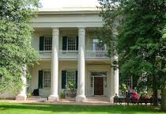
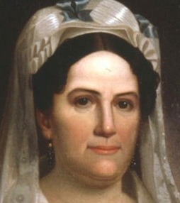
Born: March 15, 1767, Waxhaws, N.C.
Died: June 8, 1845, The Hermitage, Nashville, TN
A national war hero after defeating the British in the Battle of New Orleans during the War of 1812.
Andrew Jackson
Hermitage
Before being elected to the presidency (1829 – 1837), he gained fame as a general in the United States Army and served in both houses of Congress.
In 1830, he signed the Indian Removal Act, which forcibly relocated most members of the Native American tribes in the South to Indian Territory. The relocation process dispossessed the Indians and resulted in widespread death and disease. He opposed the abolitionist movement, which grew stronger in his second term.
Rachel
Jackson
Nicknames: King Mob, The Hero of New Orleans, Old Hickory

Slide 13
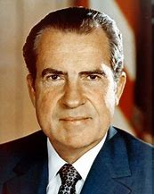
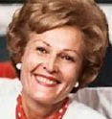
The only president to resign from the office, he previously served as the nation's 36th vice president from 1953 to 1961, and as a representative and senator from California.
Richard
Nixon
Born: January 9, 1913, Yorba Linda, CA
Died: April 22, 1994, New York, NY
He eventually ended American fighting in Vietnam and improved international relations with the U.S.S.R. and China. He also established the EPA.
Pat
Nixon
He resigned in 1974, halfway through his second term, rather than face impeachment over his efforts to cover up illegal activities by members of his administration in the Watergate scandal.

Slide 14
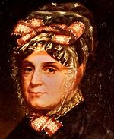
He died of pneumonia 31 days into his term (the shortest tenure, March 4, 1841 – April 4, 1841 ), becoming the first President to die in office. He was the ninth U.S. President.
Born: February 9, 1773, Berkeley Plantation, VA
Died: April 4, 1841, The White House, Washington, D.C.
William Henry Harrison
The Whigs in 1840 presented this candidate as a simple frontier Indian fighter, living in a log cabin and drinking cider, in sharp contrast to an aristocratic champagne-sipping Van Buren. In fact he was a scion of the Virginia planter aristocracy.
Anna
Harrison
Negotiating for settlers, he deprived Indians of substantial land.
His grandson was the 23rd president of the United States.

Slide 15
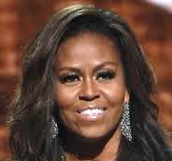
He served as the 44th President of the United States from 2009 to 2017. A member of the Democratic Party, he was the first African-American to be elected to the presidency.
Barack
Obama
Born: August 4, 1961, Honolulu, HI
He mounted a valiant effort to improve health care in the U.S. The effort resulted in a compromised affordable care act that lacked a needed public option.
The 2009 Nobel Peace Prize was awarded to him for his "extraordinary efforts to strengthen international diplomacy and cooperation between people".
Michelle Obama
His efforts brought us out of the great recession and started the U.S. on a path to improve the quality of life.

Slide 16
He served in Congress for 25 years. Well-liked and ideologically flexible, he won the role of House minority leader in 1965 and held this position until Nixon named him vice president in 1973 when Spiro Agnew had to resign the vice presidency.
Gerald
Ford
Born: July 14, 1913, Omaha, NE
Died: December 26, 2006, Rancho Mirage, CA
Vice president: Nelson Rockefeller (1974–1977)
Presidential term: August 9, 1974 – January 20, 1977
He became the first unelected president in the nation’s history when Nixon resigned. He had been a longtime Republican congressman from Michigan. He is credited with helping to restore public confidence in government after the disillusionment of the Watergate era. In a controversial executive action, President Gerald Ford pardoned his disgraced predecessor Richard M. Nixon for any crimes he may have committed or participated in while in office.
Betty
Ford

Slide 17
He was the 17th president of the United States, serving from 1865 to 1869. He assumed the presidency as he was vice president of the United States at the time of the assassination of Abraham Lincoln.
Andrew
Johnson
Born: December 29, 1808, Raleigh, NC
Died: July 31, 1875, Elizabethton, TN
Presidential term: April 15, 1865 – March 4, 1869
Johnson favored a very lenient version of Reconstruction and state control over voting rights, and he openly opposed the 14th Amendment. Although Johnson had supported an end to slavery in the 1860s, he was a white supremacist. “This is a country for white men, and by God, as long as I am President, it shall be a government for white men,” he wrote in 1866.
Eliza McCardle
Johnson
The House voted eleven articles of impeachment against him. He was tried by the Senate in the spring of 1868 and acquitted by one vote.

Slide 18
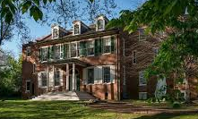
James Buchanan Jr.
A member of the Democratic Party, he served as the United States Secretary of State and in both houses of Congress before becoming president.
Born: April 23, 1791, Cove Gap, PA
Died: June 1, 1868, PA
Presidential term: March 4, 1857 – March 4, 1861
Wheatland, PA
Served as the 15th president of the United States, serving prior to the American Civil War. Presiding over a rapidly dividing Nation, he inadequately grasped the political realities of the time. Relying on constitutional doctrines to close the widening rift over slavery, he failed to understand that the North would not accept constitutional arguments which favored the South. He is regarded by many historians as one of the worst presidents of all time.
He vowed to never marry and he never did. When he eventually won the presidency, his niece Harriet Lane assumed the responsibilities of first lady.

Slide 19
American engineer, businessman, and politician who served as the 31st president of the United States from 1929 to 1933.
Born: August 10, 1874, West Branch, IA
Died: October 20, 1964, New York, NY
Herbert Hoover
He was a popular President until the stock market crash of 1929 which triggered the start of the Great Depression. While he was blamed for the depression, the ground was laid for the crash during the years before his reelection. Initially, he thought the market would recover on its own but later tried to take steps to bring about a recovery but his actions were insufficient to begin a turnaround.
Lou Henry Hoover

Slide 20
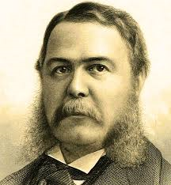
Chester Arthur
Elected vice president on the Republican ticket of 1880, he acceded to the presidency upon the assassination of President James A. Garfield. As President, he confounded his critics and dismayed many of his friends among the stalwart faction of the Republican Party by supporting the Pendleton Civil Service Act (1883), which provided for the open appointment and promotion of federal employees based on merit rather than patronage.
Born: October 5, 1829, Fairfield, VT
Died: November 18, 1886, New York, NY
Presidential term: September 20, 1881 – March 4, 1885
He became one of the few Presidents to fail to win his party's nomination for re-election. Historians suspect he didn't campaign very aggressively for it, as early in his term he had learned — but kept secret — that he had a fatal kidney disease. He died less than two years after leaving office.
Nell
Arthur

Slide 21
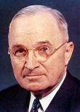
He was the 33rd president of the United States from 1945 to 1953, succeeding upon the death of Franklin D. Roosevelt after serving as vice president. He surprised many when he defeated Dewey in 1948.
He implemented the Marshall Plan to rebuild the economy of Western Europe and established a Doctrine (named after him).
Harry S.
Truman
Born: May 8, 1884, Lamar, MO
Died: December 26, 1972, Kansas City, MO
In his first months in office authorized dropping of two atomic bombs on Japan, ending World War II. He later said, “The atom bomb was no “great decision.” It was merely another powerful weapon in the arsenal of righteousness.”
Bess
Truman
The buck stops here. In his farewell address to the American people given in January 1953, this President referred to this concept very specifically in asserting that, “The President–whoever he is–has to decide. He can't pass the buck to anybody.

Slide 22
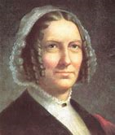
Born into desperate poverty at the dawn of the nineteenth century, he became President (1850 -1853) when Zachary Taylor died after one year in office. He inherited a nation breaking into fragments over the question of slavery. Despite his best efforts, the lines of the future battles of the Civil War were drawn, and he found himself rejected by his own dying party and he was denied re-nomination.
Born: January 7, 1800, New York
Died: March 8, 1874, Buffalo, NY
Millard
Fillmore
His insistence on federal enforcement of the Fugitive Slave Act of 1850 alienated the North and led to the destruction of the Whig Party.
His first wife, Abigail passed away near the end of his Presidency. He married Caroline 5 years after he left office.
Abigail Fillmore
Caroline Fillmore
1. 2.

Slide 23
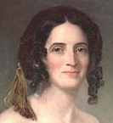
He served as Speaker of the House of Representatives and governor of Tennessee. A protégé of Andrew Jackson, he was a member of the Democratic Party and an advocate of Jacksonian democracy.
JAMES K. POLK
Born: November 2, 1795, Pineville, NC
Died: June 15, 1849, Nashville, TN
The 11th President of the United States, serving from 1845 to 1849 and the first president to be elected under the age of 50.
He promised to actively encourage America’s westward expansion. With political forcefulness and savvy, he tirelessly pursued his ambitious goals. Texas joined the country as the 28th state during his first year in office. Tense negotiations with Great Britain concluded with American annexation of the Oregon Territory south of the 49th Parallel. Following a controversial two-year war, Mexico ceded New Mexico and California to the United States. His administration also achieved its major economic objectives by lowering tariffs and establishing an independent Federal Treasury.
Sarah
Childress
Polk

Slide 24
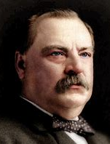
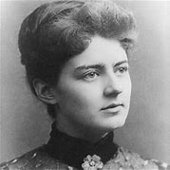
He was an American politician and lawyer who was the 22nd and 24th president of the United States, the only president in American history to serve two non-consecutive terms in office.
Grover Cleveland
Born: March 18, 1837, Caldwell, NJ
Died: June 24, 1908, Princeton, NJ. Presidential terms:
March 4, 1885 – March 4, 1889, March 4, 1893 – March 4, 1897
He distinguished himself as one of the few truly honest and principled politicians of the Gilded Age. His view of the president’s function as primarily to block legislative excesses made him quite popular during his first term, but that view cost him public support during his second term when he steadfastly denied a positive role for government in dealing with the worst economic collapse the nation had yet faced.
Frances Clara Cleveland
First lady at age 21, she
remains the youngest wife
of a sitting president.

Slide 25
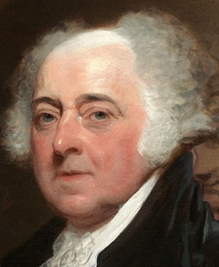
Born: October 30, 1735, Braintree, MA
Died: July 4, 1826, Quincy, MA
He was a direct descendant of Puritan colonists from the Massachusetts Bay Colony. He studied at Harvard University, where he received his undergraduate degree and master's, and in 1758 was admitted to the bar.
John Adams
Before his presidency, he was a leader of the American Revolution that achieved independence from Great Britain and served as the first vice president of the United States.
American statesman, attorney, diplomat, writer, and Founding Father who served as the second president of the United States from 1797 to 1801. Later, his son became President.
Abigail Adams

Slide 26
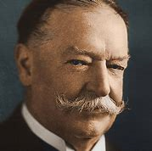
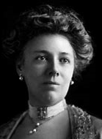
He was the 27th president of the United States and after his Presidency, the tenth chief justice of the United States, the only person to have held both offices. He preferred the chief justice position.
William
Howard
Taft
Born: September 15, 1857, Cincinnati, OH
Died: March 8, 1930, Washington, D.C.
Presidential term: March 4, 1909 – March 4, 1913
He was active in “trust-busting,” initiating some 80 antitrust suits against large industrial combinations –twice as many as Roosevelt. He led passage of the Payne-Aldrich Act which basically raised tariffs contrary to the wishes of Roosevelt and the progressives.
Helen
Herron
Taft
In 1912, when the Republicans re-nominated him, Roosevelt bolted the party to lead the Progressives, thus guaranteeing the election of Woodrow Wilson.

Slide 27
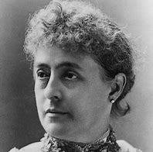
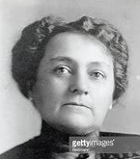
American politician and lawyer who served as the 23rd president of the United States from 1889 to 1893. He was a grandson of the ninth president, creating the only grandfather–grandson duo to have held the office. Defeated Cleveland and four years later lost to him.
BENJAMIN
HARRISON
Born: August 20, 1833, North Bend, OH
Died: March 13, 1901, Indianapolis, IN
One of the lasting legacies of his presidency was the expansion of the country to include the states of Montana, Washington, Idaho, Wyoming and the Dakotas.
1. 2.
1. Caroline Harrison
2. Mary Dimmick Harrison was nearly 25 years younger than Benjamin and was the niece of his first wife.

Slide 28
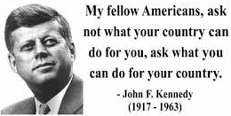
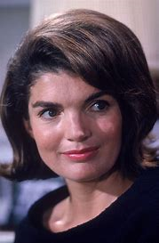
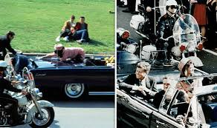
.
We choose to go to the Moon in this decade and do the other things, not because they are easy, but because they are hard.
"Ich bin ein Berliner" is a speech he gave as President on June 26, 1963, in West Berlin.
He was President during the failed Bay of Pigs Invasion on April, 17, 1961 and during the highly anxious 13 day Cuban Missile Crisis. During his Presidency, the Viet Nam war dangerously expanded.
Born: May 29, 1917, Brookline, MA
Presidential term: 1/20/1961 – 11/22/1963
Jacqueline
Kennedy
As the 35th President of the United States, he rode in a motorcade in Dallas, Texas, on November 22, 1963 and was assassinated by Lee Harvey Oswald.

Slide 29
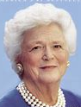
He served as the 41st president of the United States from 1989 to 1993 and the 43rd vice president from 1981 to 1989.
George H. W. Bush
Born: June 12, 1924, Milton, MA
Died: November 30, 2018, Houston, TX
He brought to the White House a dedication to traditional American values and a determination to direct them toward making the United States “a kinder and gentler nation” in the face of a dramatically changing world.
His greatest test came when Iraqi President Saddam Hussein invaded Kuwait, then threatened to move into Saudi Arabia. He rallied the United Nations, the U. S. people, and Congress and sent 425,000 American troops. They were joined by 118,000 troops from allied nations. After weeks of air and missile bombardment, the 100-hour land battle dubbed Desert Storm freed Kuwait and routed Iraq’s million-man army.
Barbara Bush

Slide 30
During World War II, he was a five-star general in the United States Army and served as supreme commander of the Allied Expeditionary Forces in Europe.
Dwight David
Eisenhower
Born: October 14, 1890, Denison, TX
Died: March 28, 1969,, Bethesda,MD
Presidential term: January 20, 1953 – January 20, 1961
During his presidency (34th), he managed Cold War-era tensions with the Soviet Union, ended the war in Korea in 1953. On the home front, he strengthened Social Security, created the massive new Interstate Highway System and maneuvered behind the scenes to discredit the rabid anti-Communist Senator Joseph McCarthy. He faltered in the protection of civil rights for African Americans.
Mamie
Eisenhower

Slide 31
He was the governor of Arkansas from 1979 to 1981, and again from 1983 to 1992, and the attorney general of Arkansas from 1977 to 1979.
Bill Clinton
Born: August 19, 1946, Hope, AR
Presidential term (#42): January 20, 1993 – January 20, 2001
He presided over the longest period of peacetime economic expansion in American history. He signed into law the North American Free Trade Agreement but failed to pass his plan for national health care reform. He was impeached but not convicted for a cover up of an “affair>”
Hillary Clinton
His final four budgets were very rare balanced budgets with surpluses, beginning with the 1997 budget. The ratio of debt held by the public to GDP, a primary measure of U.S. federal debt, fell from 47.8% in 1993 to 33.6% by 2000.

Slide 32
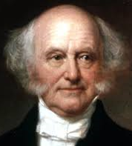
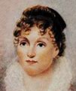
Served as the eighth Vice President and the tenth Secretary of State, both under President Andrew Jackson and was one of the founders of the democratic party.
MARTIN
VAN BUREN
Born: December 5, 1782, Kinderhook, NY
Died: July 24, 1862, Kinderhook, NY
While the country was prosperous when the “Little Magician” (5’6”) was elected President in 1837, less than three months later the financial panic of 1837 punctured the prosperity. He was the first President born after the independence of the United States from the British Empire.
HANNAH
VAN BUREN
Inclined more and more to oppose the expansion of slavery, he blocked the annexation of Texas because it assuredly would add to slave territory–and it might bring war with Mexico.

Slide 33
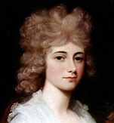
The first President who was the son of a previous President.
American statesman, diplomat, lawyer, and diarist who served as the sixth President of the United States from 1825 to 1829. His Presidency was extremely controversial.
John
Quincy
Adams
Born: July 11, 1767, Braintree, MA
Died: February 23, 1848, Washington, D.C.
Serving under President Monroe, he was one of America’s great Secretaries of State, arranging with England for the joint occupation of the Oregon country, obtaining from Spain the cession of the Florida’s, and helping to formulate the Monroe Doctrine.
Louisa
Adams
In 1830, the Plymouth district elected him to the House of Representatives, and there served as a powerful leader where he fought against circumscription of civil liberties. In 1836 southern Congressmen passed a “gag rule” providing that the House automatically table petitions against slavery. he tirelessly fought the rule for eight years until finally he obtained its repeal.

Slide 34
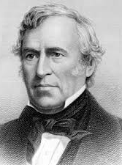
He was a career officer in the United States Army, rose to the rank of major general and became a national hero as a result of his victories in the Mexican–American War. He earned the nickname “Old Rough and Ready”.
Zachary
Taylor
Born: November 24, 1784, Barboursville, Virginia
Died: July 9, 1850, The White House, Washington, D.C.
He was elected to be the 12th President of the United States, serving from March 1849 for only a year until his death in July 1850.
Although he was a slave owner, he took on an anti-slavery slant. He urged California and New Mexico residents to write constitutions and apply for statehood, knowing that both would likely bar slavery. He was correct in his assumptions, and in doing so angered Southerners who viewed his actions as a betrayal.
Margaret
Taylor

Slide 35
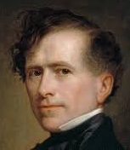
He served as speaker of the state legislature before winning election to the U.S. House of Representatives in 1833. He served two terms in the House and one in the Senate.
FRANKLIN PIERCE
Born: Nov. 23, 1804, in Hillsborough (now Hillsboro), N. H.
Died: Oct. 8, 1869, in Concord, New Hampshire
The 14th President of the United States, a northern Democrat who saw the abolitionist movement as a fundamental threat to the unity of the nation.
He was nominated by the Democratic party to run for President in 1852. Despite being from the North, he was pro-slavery, which appealed to southerners.
Jane
Pierce
They had three children, but none lived past age 12. One was killed by a train soon after his election.

Slide 36
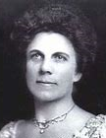
He served as the 29th President of the United States from 1921 until his death in 1923.
Born: November 2, 1865, Blooming Grove, OH
Died: August 2, 1923, San Francisco, CA
Warren
Harding
Though his term in office was fraught with scandal, including the Teapot Dome, he was a popular President. He embraced technology and was sensitive to the plights of minorities and women.
Florence
Harding
After his sudden passing in the middle of his Presidential term, rumors of scandal or even worse including poisoning emerged.
Today, most historians accept that he, at age 57, died from a heart attack brought on by evidence of cardiac problems.

Slide 37
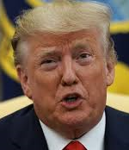
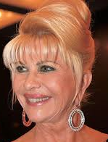
Elected to be the 45th President by the Electoral College (lost the popular vote by 3 million votes), he has been President of a very divided country. He successfully passed a tax cut that benefited corporations and the wealthy more than the middle class. The tax cut increased the national debt.
Born: June 14, 1946, NY
Spouses: Melania (m. 2005), Marla Maples
(m. 1993–1999), Ivana (m. 1977–1992)
Donald J. Trump
During his tenure, the economy has continued a very favorable trend and unemployment has dropped.
Ivana Marla Melania
His predominantly Democratic opposition accused him of racism, abuse of power, obstruction of justice and initiated impeachment proceedings. He reversed gains made against climate change. Historical scholars rate him as one of the 3 worst U.S. Presidents.

Slide 38
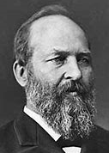
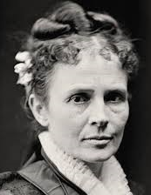
He was the first sitting member of Congress to be elected to the Presidency and remains the only sitting House member to gain the White House.
Born: November 19, 1831, Moreland Hills, OH
Assassinated: September 19, 1881, Elberon, Long Branch, NJ
He was the 20th President of the United States, serving from March 4, 1881 until seriously wounded in an assassination attempt 4 months later followed by death almost 3 months later. The motive for assassination was revenge against the President for an imagined political debt.
He recommended a universal education system funded by the federal government, in part to empower African Americans. He also appointed several former slaves, including Frederick Douglass, to prominent government positions.
James
Abram
Garfield
Lucretia Garfield
Established what was effectively the first presidential library.

Slide 39
He served as the 36th president of the United States from 1963 to 1969. Formerly the 37th vice president from 1961 to 1963, he assumed the presidency following the assassination of President John F. Kennedy.
Born: August 27, 1908, Stonewall, TX
Died: January 22, 1973, Stonewall, TX
Lyndon B. Johnson
After taking office, he won passage of a major tax cut, the Clean Air Act, and the Civil Rights Act of 1964, a landmark civil rights and labor law in the United States that outlaws discrimination based on race, color, religion, sex, or national origin. After the 1964 election, Johnson passed even more sweeping reforms. The Social Security Amendments of 1965 created two government-run healthcare programs, Medicare and Medicaid. He was unable to bring an end to the Viet Nam war.
Lady Bird
Johnson

Slide 40
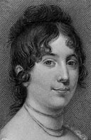
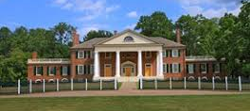
American statesman, lawyer, diplomat, philosopher and Founding Father who served as the fourth President of the United States from 1809 to 1817.
James Madison
In preparation for the 1787 Constitutional Convention, he drafted a document known as the Virginia Plan, which provided the framework for the Constitution of the United States.
He compiled a list of 19 proposals and a Congressional committee reworked those suggestions into 12 amendments, 10 of which would go on to be ratified by the states. The amendments were added at the end of the Constitution as a separate Bill of Rights.
Born: March 16, 1751, Belle Grove
Died: June 28, 1836, Montpelier Station, VA
Dolly
Madison
Montpelier
The advancement and diffusion of knowledge is the only guardian of true liberty.

Slide 41
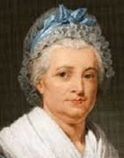
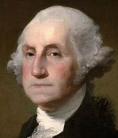
young.
American political leader,
military general and statesman.
Led Patriot forces to victory
in the nation's War for Independence.
February 22, 1732 - December 14, 1799
Martha
Founding Father who served as the first President of the United States from 1789 to 1797. Many historians rank him as the best U.S. President.
George Washington
There are many myths about him including one where he throws a silver dollar across the Potomac. However, silver dollars did not exist then. The most famous myth about him: When he was six years old, he received a hatchet as a gift, after which he promptly cut down his father’s favorite cherry tree. When asked, he replied that he had done it. With those brave words, his father embraced his son, exclaiming that his honesty was worth more than a thousand trees.
Delaware River

Slide 42
He (March 29, 1790 – January 18, 1862) was the tenth President of the United States from 1841 to 1845 after briefly serving as the tenth Vice-President (1841); he was elected to the latter office on the 1840 Whig ticket with President William Henry Harrison. Harrison died of pneumonia 31 days after his election.
John
Tyler
After ascending to the Presidency he was rejected by the Democrats and Whigs and became a President without a party. Nevertheless, his administration managed to accomplish a great deal. It reorganized the navy, established the United States Weather Bureau, brought an end to the Second Seminole War (1835–42) in Florida, and put down the rebellion (1842) led by Thomas Dorr against the state government of Rhode Island. He was a stalwart supporter and advocate of states' rights.
His wife, Letitia Christian, died in 1842 (8 children), the first President’s wife to die in the White House. He married Julia Gardiner (7 children) in 1844, thus becoming the first President to marry while in office.
Julia Tyler Letitia Tyler
He holds the record for the most children sired (legitimately, at least) by a president.

Slide 43
During the American Civil War, as a general, he led the Union Army to victory over the Confederacy.
Ulysses S
Grant
He was later elected the 18th President of the United States (1869–1877) for two terms, working to implement Congressional Reconstruction and to remove the vestiges of slavery.
Born: April 27, 1822, Point Pleasant, OH
Died: July 23, 1885, Wilton, NY
During two terms in office, Grant worked hard to bring the North and the South together again, contending with an emerging white supremacist group called the Ku Klux Klan, and violent uprisings against blacks and Republicans. He met with Native American leaders, including Red Cloud, trying to develop a peace policy in the West. He also took steps to repair the damaged economy. But his two terms as president are best remembered for financial scandals among members of his party and his administration.
Julia
Grant

Slide 44
Assuming the Presidency as the 32nd President at the depth of the Great Depression, he helped the American people regain faith in themselves. He brought hope as he promised prompt, vigorous action. He was the fifth cousin of the 26th President and the only person elected for 4 terms as President despite suffering the consequences of polio.
Franklin D.
Roosevelt
He asserted in his Inaugural Address, “the only thing we have to fear is fear itself.”
He initiated new programs of reform: Social Security, heavier taxes on the wealthy, new controls over banks and public utilities, and an enormous work relief program for the unemployed.
Born: January 30, 1882, Hyde Park, NY
Died: April 12, 1945, GA
Presidential term: March 4, 1933 – April 12, 1945
Lucy Page Mercer Rutherfurd,
evidence indicates she was
a mistress of FDR.
Elanor Roosevelt

Slide 45
A Republican lawyer from New England, he worked his way up the ladder of Massachusetts state politics, eventually becoming governor and later the 30th President.
Born: July 4, 1872, Plymouth Notch, Plymouth, VT
Died: January 5, 1933, Northampton, MA
Presidential term: August 2, 1923 – March 4, 1929
Calvin Coolidge
During his presidency, the U. S. experienced a period of rapid economic growth that characterized the "Roaring Twenties." Although he favored tariffs, he disdained regulation. Some contemporaries and historians have blamed his laissez-faire ideology for the Great Depression. He did speak out in favor of civil rights.
Grace
Coolidge

Slide 46
https://www.presidentsusa.net/presvplist.html

Slide 47
Final exam on the Presidents? (or were you paying attention?)
Which President never married?
Which President had the most children?
How many Presidents were assassinated and who were they?
Who were (see photos)?
Who became chief Justice after his Presidency?
Who is the only President to serve 2 non-consecutive terms?
Who was called Old Rough and Ready?
James Buchanan
John Tyler
4 - Abraham Lincoln, James Garfield, William McKinley, and John F. Kennedy.
Grant, Jefferson, F. Roosevelt, T. Roosevelt
William Taft
Grover Cleveland
Zachary Taylor

Slide 48
8. Who said, “Speak softly and carry a big stick, you will go far.”
9. Current law allows the President to be elected to the Presidency a maximum of 2 times.
Before this law was passed, who was elected 4 times.
10. How many of the President’s wives had the same first name?
What was the most common first name of a President?
How many groups of relatives have served in the Presidency?
14. Who was President during WWI?
Theodore Roosevelt
Franklin Roosevelt
5 – two of each of the following: Martha, Edith, Mary, Caroline, Abigail
James over John and William, 5 – 4, 4. (Note: Jimmy Carter was named James).
4: Adams, Harrison, Roosevelt, Bush
Woodrow Wilson

Slide 49
“A person without
education is like a
building without
foundation.”

