Slide 1
Famous Sayings, Quotations and Lines from Speeches
Give origin (speaker or author), approx. date and country

Slide 2
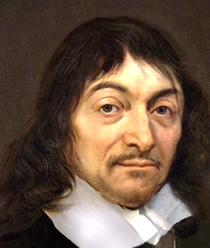
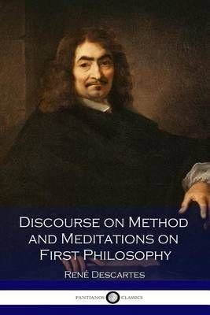
I think,
therefore I am.
I am, therefore I think.
Ayn Rand (writer 1905 – 1982)
I think; therefore I am” (1637) was the end of the search Rene Descartes (1596 – 1650) conducted for a statement that could not be doubted. He found that he could not doubt that he himself existed, as he was the one doing the doubting in the first place. In Latin (the language in which Descartes wrote), the phrase is “Cogito, ergo sum.”

Slide 3
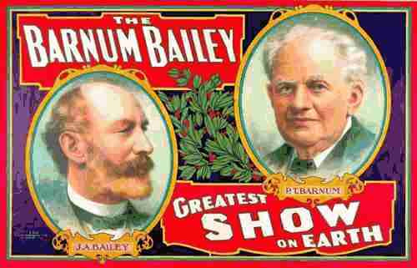
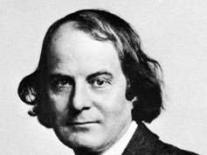
When life gives you
lemons, make lemonade.
There’s a sucker born every minute.
Elbert Green Hubbard (1856 – 1915) was an American writer, publisher, artist, and philosopher. Raised in Hudson, Illinois, he had early success as a traveling salesman for the Larkin Soap Company.
Phineas Taylor (P. T.) Barnum was an American showman, businessman, and politician, remembered for promoting celebrated hoaxes and founding the Barnum & Bailey Circus with James Anthony Bailey.

Slide 4
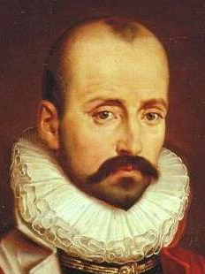
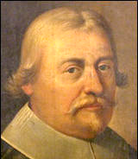
Actions speak louder than words.
Let me assert my firm belief that the only thing we have to fear is fear itself—nameless, unreasoning, unjustified terror which paralyzes needed efforts to convert retreat into advance.
It has been reported that this phrase dates back as far as the 1550s, when the French writer Michel de Montaigne (1533-1592) said, “Saying is one thing and doing is another.”
This proverb was voiced, at the time of the English Civil War, by John Pym, the English parliamentarian. It was recorded in 1628 in Hansard, the record of the proceedings of the UK parliament: ‘A word spoken in season is like an Apple of Gold set in Pictures of Silver,’ and actions are more precious than words.
Franklin Delano Roosevelt
(1882 - 1945)
First inauguration address, 1933
Actions speak louder than words, and are more to be regarded. President Abraham Lincoln confirms the phrase is in the vernacular by 1856 writing, “Actions speak louder than words is the maxim; and, if true, the South now distinctly says to the North, “Give us the measures, and you take the men.”

Slide 5
“I came, I saw, I conquered.”
Mr. Gorbachev, tear down this wall!
Veni, vidi, vici is a Latin phrase popularly attributed to Julius Caesar who, according to Appian, used the phrase in a letter to the Roman Senate around 47 BC after he had achieved a quick victory in his short war against Pharnaces II of Pontus at the Battle of Zela.
"Mr. Gorbachev, tear down this wall", also known as the Berlin Wall Speech, was a speech delivered by United States President Ronald Reagan in West Berlin on June 12, 1987.

Slide 6
Two wrongs don't make one right:
Two wrongs won't right a wrong.
Look twice before you leap.
This ancient adage, like so many others, has its roots in one of Aesop’s fables and in print in the Douce MS of about 1350. The fox, unable to climb out of a well into which he fell, persuades the goat to jump in, too. He then climbs out by standing on the goat’s shoulders, leaving the goat in the well. Charlotte Brontë used it ironically in Shirley (1849): “When you feel tempted to marry . . . look twice before you leap.”
The first known citation in the USA is in a 1783 letter by Benjamin Rush. Benjamin Rush (1746 - 1813) was a signer of the United States Declaration of Independence and a civic leader in Philadelphia, where he was a physician, politician, social reformer, humanitarian, and educator and the founder of Dickinson College.
.
Charlotte Brontë was an English novelist and poet, the eldest of the three Brontë sisters who survived into adulthood and whose novels became classics of English literature.

Slide 7
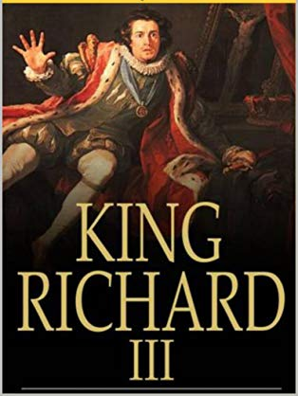
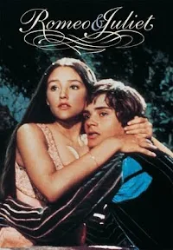
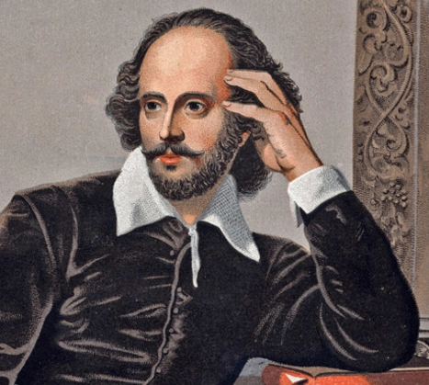
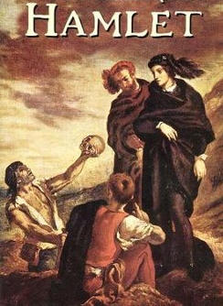
A horse! A horse! My
Kingdom for a horse!
A rose by any other name
would smell as sweet.
Juliet, Act II, Scene II,
"Romeo and Juliet"
King Richard, Act V,
Scene IV, "Richard III”
To be, or not to be, that is the question:
Whether 'tis nobler in the mind to suffer
The slings and arrows of outrageous fortune,
Or to take Arms against a Sea of troubles,
And by opposing end them: to die, to sleep;
William Shakespeare was an English playwright, poet, and actor, widely regarded as the greatest writer in the English language and the world's greatest dramatist. (1564 – 1616)
Prince Hamlet in the so-called "nunnery scene" of William Shakespeare's play Hamlet, Act 3, Scene 1.

Slide 8
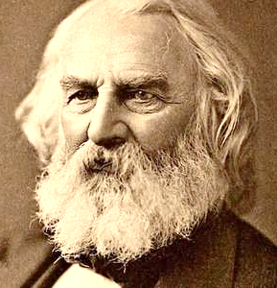
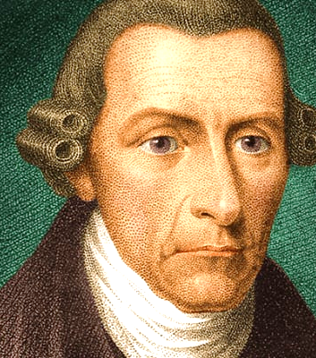
One if by land, two if by sea.
Give me liberty or give me death.
The phrase was coined by the American poet, Henry Wadsworth Longfellow (1807 – 1882) in his poem, Paul Revere’s Ride. It was a reference to the secret signal orchestrated by Revere during his historic ride from Boston to Concord on the verge of American Revolutionary War. The signal was meant to alert patriots about the route the British troops chose to advance to Concord.
It is a quotation attributed to Patrick Henry from a speech he made to the Second Virginia Convention on March 23, 1775, at St. John's Church in Richmond, Virginia.

Slide 9
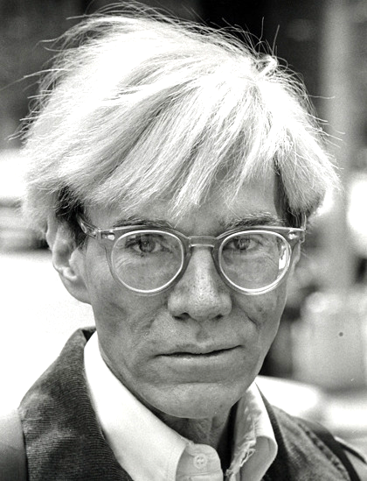
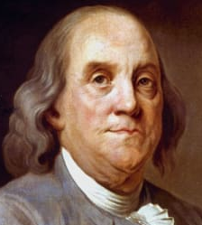
Everyone will be famous for 15 minutes.
A penny saved is a penny earned.
The original form of this proverb used 'got' or 'gained' instead of 'earned'. That is recorded as early as the 17th century, in George Herbert's Outlandish Proverbs, circa 1633: A penny spar'd is twice got.
3
1
2
The original quote seems to trace back to a 1968 brochure Andy Warhol distributed at one of his exhibitions in Sweden. But, according to art critic Blake Gopnik, it could have been Pontus Hultén (1), a famous curator in Europe, who coined the phrase. There are other claimants, too, including painter Larry Rivers and photographer Nat Finkelstein (2). Finkelstien insisted that he made the remark in reply to a comment that Warhol (3) made about everyone wanting to be famous, quipping, "Yeah, for about 15 minutes, Andy."
Benjamin Franklin never actually said this, one of the adages most often attributed to him. He did, however, write in the 1737 Poor Richard’s Almanack: “A penny saved is two pence clear.”

Slide 10
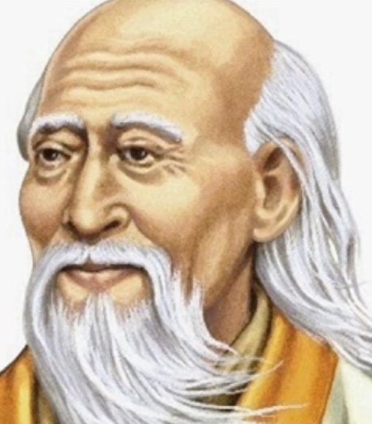
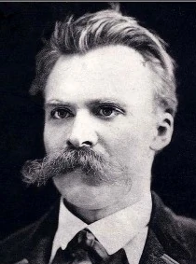
The journey of a thousand miles begins with one step.
That which does not kill us makes us stronger.
Lao-Tzu (l. c. 500 BCE, also known as Laozi or Lao-Tze) was a Chinese philosopher credited with founding the philosophical system of Taoism.
Friedrich Nietzsche (1844–1900) was a German philosopher and cultural critic who published intensively in the 1870s and 1880s.

Slide 11
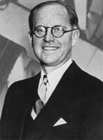
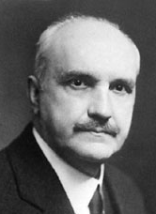
When the going gets tough, the tough get going.
Those who cannot remember the past are condemned to repeat it.
This has been attributed to both Joseph Kennedy, father of President John F. Kennedy, and to American football player Knute Rockne.
Variations on the repeating-history theme appear alongside debates about attribution. Irish statesman Edmund Burke is often misquoted as having said, “Those who don’t know history are destined to repeat it.” Spanish philosopher George Santayana is credited with the aphorism, “Those who cannot remember the past are condemned to repeat it,” while British statesman Winston Churchill wrote, “Those that fail to learn from history are doomed to repeat it.”
Knute Kenneth Rockne was a Norwegian-American player and coach of American football at the University of Notre Dame. Rockne is regarded as one of the greatest coaches in college football history.
George Santayana, was a philosopher, essayist, poet, and novelist. Originally from Spain, Santayana was raised and educated in the US.
Joseph Patrick Kennedy Sr. (1888 –1969) was a prominent American businessman, investor and politician. He is known for his own political prominence as well as that of his children and was the patriarch of the Irish-American Kennedy family.

Slide 12
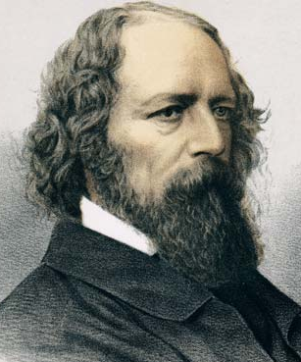
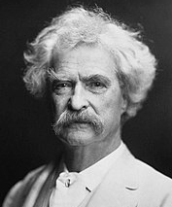
Tis better to have loved and lost than to have never loved at all.
Twenty years from now you will be more disappointed by the things that you didn’t do than by the ones you did do.
Alfred Tennyson, 1st Baron Tennyson FRS (1809 – 1892) was an English poet. He was the Poet Laureate during much of Queen Victoria's reign and remains one of the most popular British poets.
Samuel Langhorne Clemens, known by his pen name Mark Twain, was an American writer, humorist, entrepreneur, publisher, and lecturer. He was lauded as the "greatest humorist the United States has produced," and William Faulkner called him "the father of American literature".

Slide 13
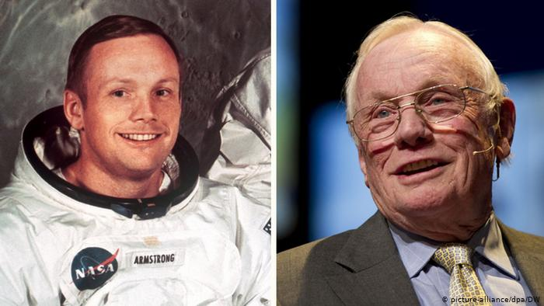
Do not go where the path may lead; go instead where there is no path and leave a trail.
That’s one small step for a man, one giant leap for mankind.
Ralph Waldo Emerson, who went by his middle name Waldo, was an American essayist, lecturer, philosopher, abolitionist and poet who led the transcendentalist movement of the mid-19th century
Neil Alden Armstrong was an American astronaut and aeronautical engineer, and the first person to walk on the Moon. He was also a naval aviator, test pilot, and university professor.

Slide 14
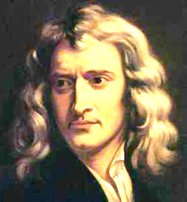
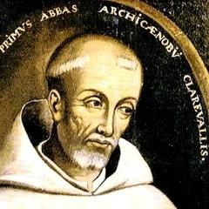
If I have seen further than others, it is by standing upon the shoulders of giants.
Although commonly attributed to Isaac Newton, the ideas as indicated below and to the right preceded Newton.
Bernard of Chartres
In 1159, John wrote in his Metalogicon: "Bernard of Chartres used to compare us to dwarfs perched on the shoulders of giants. He pointed out that we see more and farther than our predecessors, not because we have keener vision or greater height, but because we are lifted up and borne aloft on their gigantic stature."
This picture is derived from Greek mythology: the blind giant Orion carried his servant Cedalion on his shoulders to act as the giant’s eyes.

Slide 15
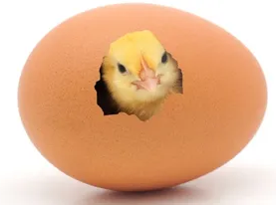
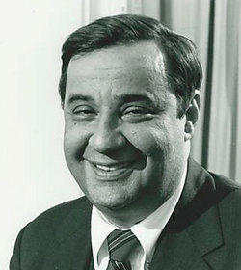
If it ain’t broke, don’t fix it.
Don’t count your chickens before they hatch.
Many of the proverbial words of advice that have lasted the test of time begin with 'don't'. 'look a gift horse in the mouth', 'change horses in mid-stream' etc. 'Don't count your chickens' is one of the oldest, and possibly the wisest, of these. The thought was recorded in print by Thomas Howell in New Sonnets and pretty Pamphlets, 1570
Thomas Bertram "Bert" Lance was an American businessman who served as director of the Office of Management and Budget under President Jimmy Carter in 1977. He is known mainly for resigning from the Carter administration because of a scandal during his first year in office. However, he was later cleared of all charges
English poet, Thomas Howell published a book in 1570 containing New Sonnets and Pretty Pamphlets with a poem that had this couplet:
Counte not thy Chickens that vnhatched be,
Waye wordes as winde, till thou finde certaintee.

Slide 16
Beauty is in the eye of the beholder.
The person who is widely credited with coining the saying in its current form is Margaret Wolfe Hungerford (née Hamilton), who wrote many books, often under the pseudonym of 'The Duchess'. In Molly Bawn, 1878. Hungerford was an Irish novelist whose light romantic fiction was popular throughout the English-speaking world in the late 19th century.
This saying first appeared in the 3rd century BC in Greek. It didn't appear in English and in its current form in print until the 19th century, but in the mean-time there were various written forms that expressed much the same thought.
John Lyly (1588)
Shakespeare (1588)
David Hume (1742)
Benjamin Franklin (1741)

Slide 17
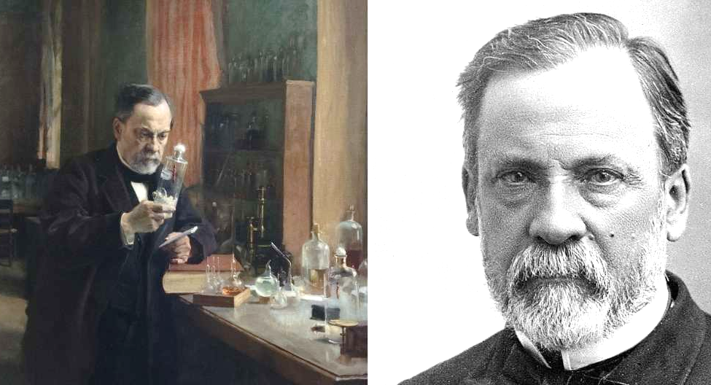
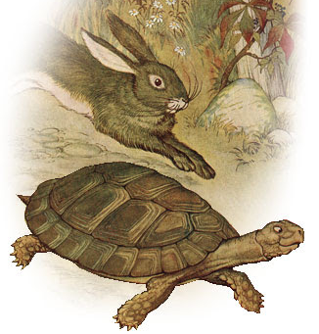
In the fields of observation, chance favours only the prepared mind.
The early bird catches the worm.
This proverb has been attributed to William Camden (1605) and John Ray (1670).
Louis Pasteur (1822 – 1895) was a French chemist and microbiologist renowned for his discoveries of the principles of vaccination, microbial fermentation, and pasteurization.
Slow and Steady Wins the Race.
Derived from the classic Aesop fable of "The Tortoise and the Hare," in which the titular tortoise is able to beat the hare in a race because the hare, overconfident in his superior speed, decides to take a nap along the way.
–

Slide 18
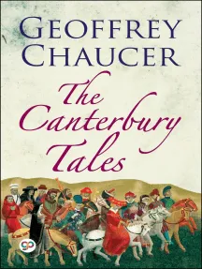
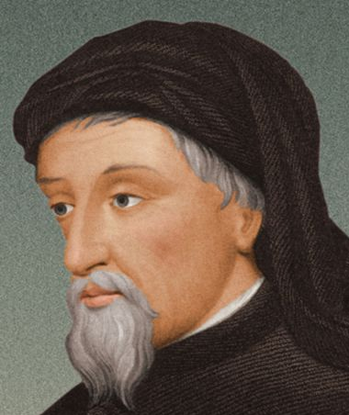
All good things must come to an end.
Familiarity breeds contempt.
The origination of the phrase comes from the 1386 in the work titled “Tale of Melibee” by Chaucer. Although it is believed that the idea expressed in the phrase is older.
Geoffrey Chaucer, who wrote in his poem, Troilus and Criseyde: “But at the laste, as every thing hath ende, She took hir leve, and nedes wolde wende.”
Geoffrey Chaucer (1342 – 1400) was an English poet and author. Widely considered the greatest English poet of the Middle Ages, he is best known for The Canterbury Tales. He has been called the "father of English literature", or, alternatively, the "father of English poetry".

Slide 19
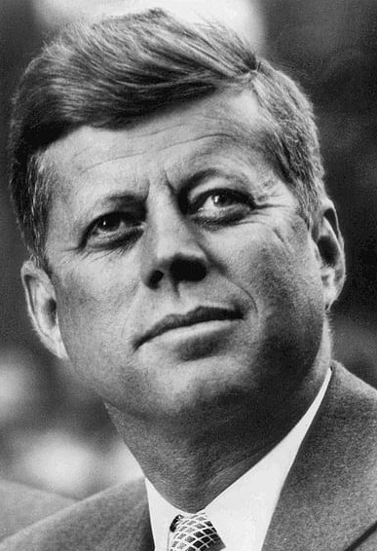
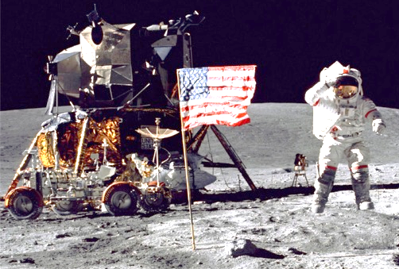
Ask not what your country can do for you – ask what you can do for your country.
(Sept., 1962) We choose to go to the moon in this decade and do the other things, not because they are easy, but because they are hard, because that goal will serve to organize and measure the best of our energies and skills, because that challenge is one that we are willing to accept, one we are unwilling to postpone, and one which we intend to win, and the others, too.
John F. Kennedy’s inaugural address (1961) inspired children and adults to see the importance of civic action and public service. His historic words, challenged every American to contribute in some way to the public good.
July 20, 1969

Slide 20
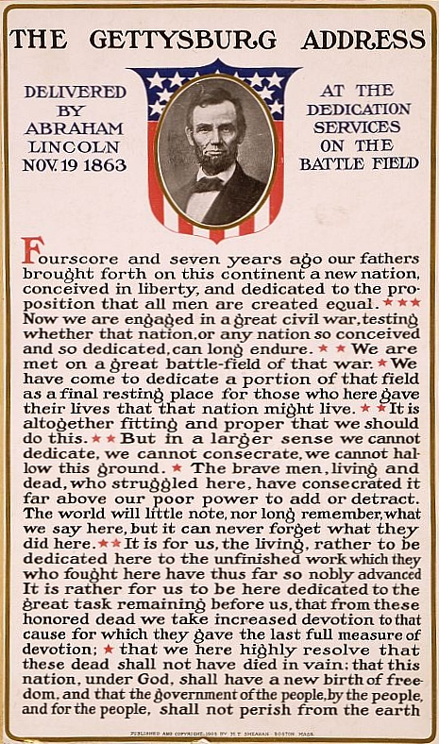
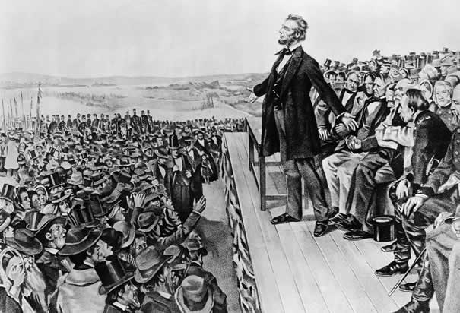
"Four score and seven years ago our fathers brought forth on this continent a new nation, conceived in Liberty, and dedicated to the proposition that all men are created equal.
The Gettysburg Address is a speech that U.S. President Abraham Lincoln delivered during the American Civil War at the dedication of the Soldiers' National Cemetery in Gettysburg, Pennsylvania. Originally published: November 19, 1863.

Slide 21
“With malice toward none, with charity for all, with firmness in the right as God gives us to see the right, let us strive on to finish the work we are in, to bind up the nation’s wounds, to care for him who shall have borne the battle and for his widow and orphan, to do all which may achieve and cherish a just and lasting peace among ourselves and with all nations.”
President Abraham Lincoln’s second inaugural address, presented on March 4, 1865.

Slide 22
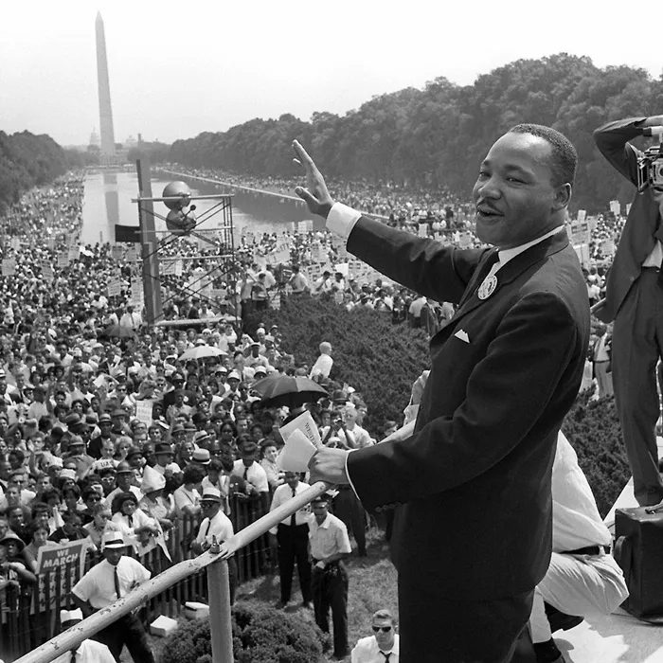
So even though we face the difficulties of today and tomorrow, I still have a dream. It is a dream deeply rooted in the American dream. I have a dream that one day this nation will rise up and live out the true meaning of its creed: We hold these truths to be self-evident, that all men are created equal. I have a dream that one day on the red hills of Georgia, the sons of former slaves and the sons of former slave owners will be able to sit down together at the table of brotherhood. I have a dream that one day even the state of Mississippi, a state sweltering with the heat of injustice, sweltering with the heat of oppression will be transformed into an oasis of freedom and justice. I have a dream that my four little children will one day live in a nation where they will not be judged by the color of their skin but by the content of their character. I have a dream today. I have a dream that one day down in Alabama with its vicious racists, with its governor having his lips dripping with the words of interposition and nullification, one day right down in Alabama little black boys and black girls will be able to join hands with little white boys and white girls as sisters and brothers. I have a dream today. I have a dream that one day every valley shall be exalted, every hill and mountain shall be made low, the rough places will be made plain, and the crooked places will be made straight, and the glory of the Lord shall be revealed, and all flesh shall see it together.
Dr. Martin Luther King, Jr., delivered this iconic 'I Have a Dream' speech at the March on Washington on August 28, 1963.

Slide 23
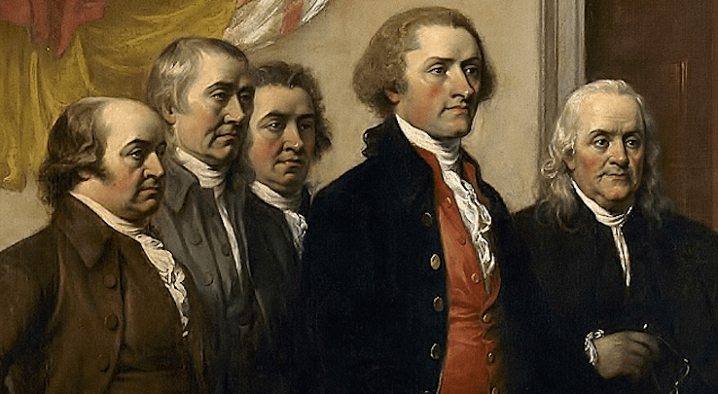
We hold these Truths to be self-evident, that all Men are created equal, that they are endowed by their Creator with certain unalienable Rights, that among these are Life, Liberty and the Pursuit of Happiness.
At the Second Continental Congress during the summer of 1776, Thomas Jefferson of Virginia was charged with drafting a formal statement justifying the 13 North American colonies’ break with Great Britain. A member of a committee of five that also included John Adams of Massachusetts, Benjamin Franklin of Pennsylvania, Robert Livingston of New York and Roger Sherman of Connecticut, Jefferson drew up a draft and included Franklin’s and Adams’ corrections. At the time, the Declaration of Independence was regarded as a collective effort of the Continental Congress; Jefferson was not recognized as its principal author until the 1790s.

Slide 24
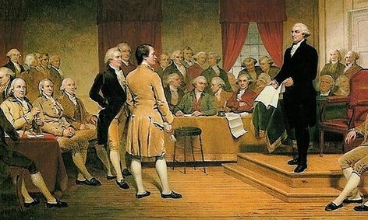
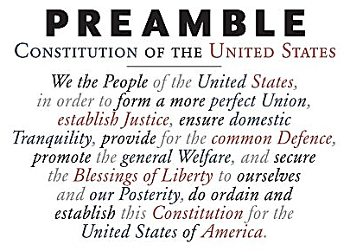
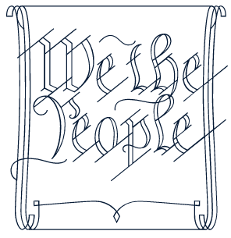
1787

Slide 25
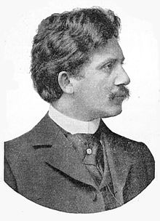
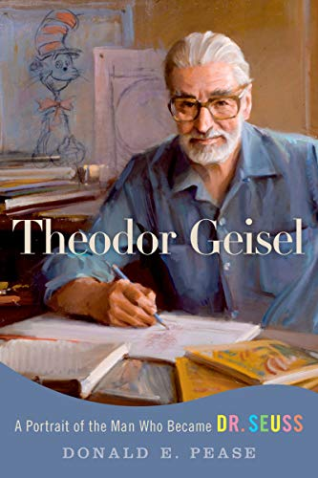
Don’t cry because it’s over, smile because it happened.”
Don't cry because it's over—smile because it happened” has been cited in print since at least 1998 and is of unknown authorship. These words have been attributed to Theodor Geisel who was better known as Dr. Seuss, the famous author of children’s literature. However, researchers have been unable to locate any substantive evidence that Dr. Seuss employed this saying. He died in 1991, and it was assigned to him by 2002. The saying appears to be a German proverb that was used by German poet Ludwig Jacobowski (1868-1900) in his poem “Leuchtende Tage” ("Bright Days").
Ludwig Jacobowski or Dr. Seuss (Theodor Geisel)

Slide 26
HOPE TO SEE YOU AGAIN SOON
For a plethora of online quizzes and challenges appropriate for individuals or groups, please visit:
http://murov.info
or
http://murov.info/triviachallenges.htm
or
http://murov.info/PPTPreshows.htm

