Slide 1
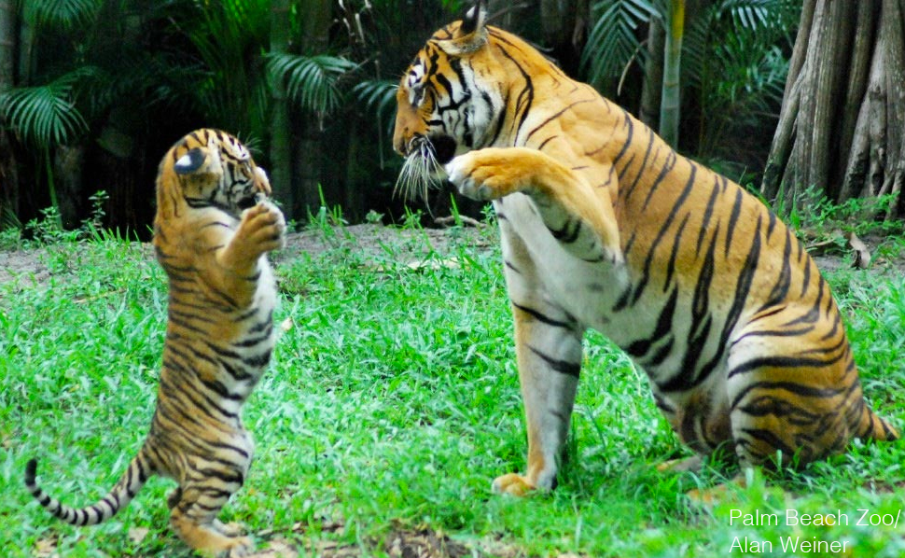
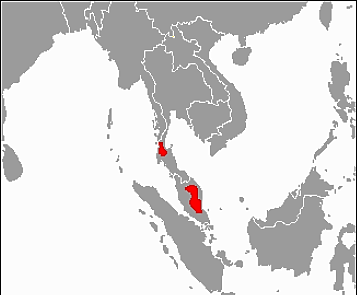
This population inhabits the southern and central parts of the Malay Peninsula. About 300 remain.
Malayan Tiger
Name the critically endangered animal.

Slide 2
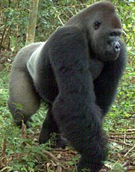
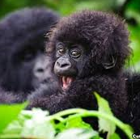
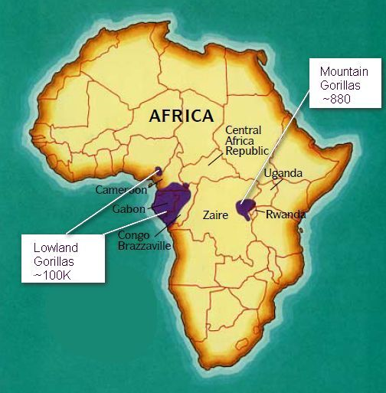
There are currently only 200-300 Cross River Gorillas left in the wild, making them the most endangered great ape in Africa. They live in mountainous border area between Cameroon and Nigeria at the top of the Cross River, after which they are named.
Cross River Gorilla

Slide 3
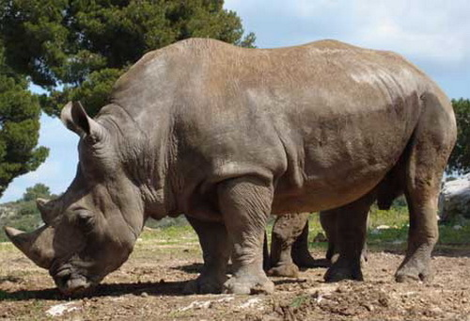
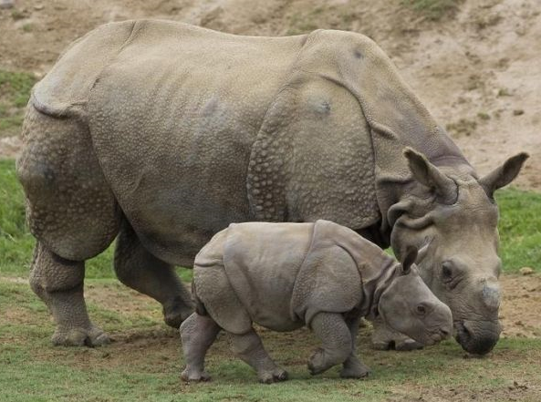
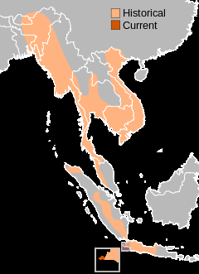
Javan Rhino
Found in Western Indonesia and Eastern Indochina. The Javan rhino habitats are tropical and subtropical moist broadleaf forests such as dense rainforests with mud wallows and plenty of water. Estimated that only 100 remain.

Slide 4
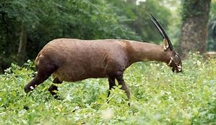
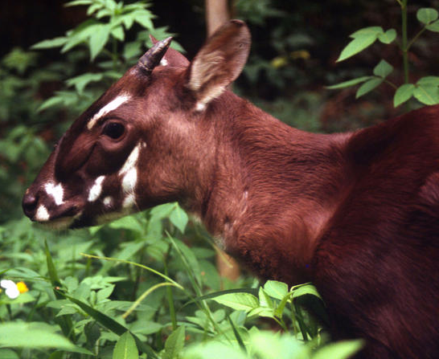
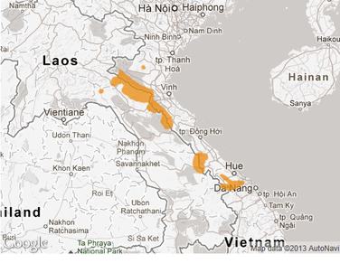
Saola
The saola, also called siola, Vu Quang ox, spindlehorn, Asian unicorn, or, infrequently, the Vu Quang bovid, is one of the world's rarest large mammals, a forest-dwelling bovine found only in the Annamite Range of Vietnam and Laos.
Between 100 and 700 survive.

Slide 5
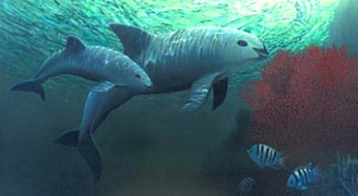
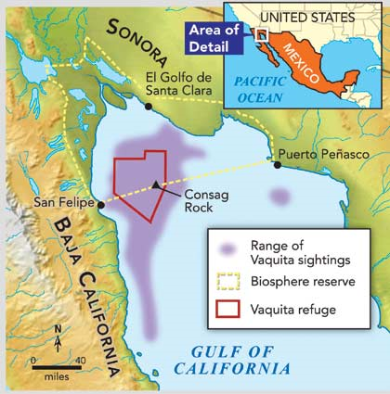
Vaquita
The population was estimated at 600 in 1997, below 100 in 2014, approximately 60 in 2015, around 30 in November 2016, and only 12-15 in March 2018, leading to the conclusion that the species will soon be extinct. A study in July 2019 concluded that the population size in autumn 2018 was about 9.
The vaquita is a species of porpoise endemic to the northern part of the Gulf of California that is on the brink of extinction.

Slide 6
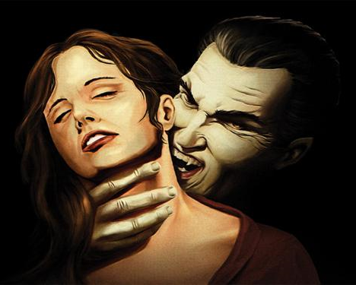
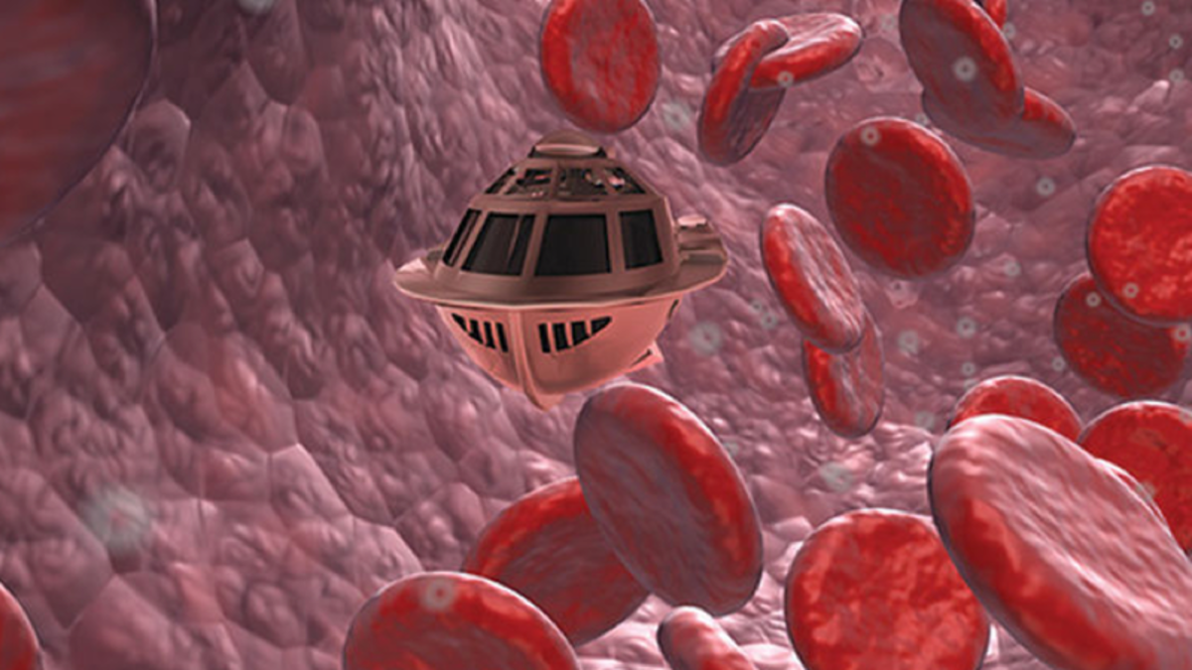
What kind of boats
do vampires like?
Blood vessels.
Puns.

Slide 7
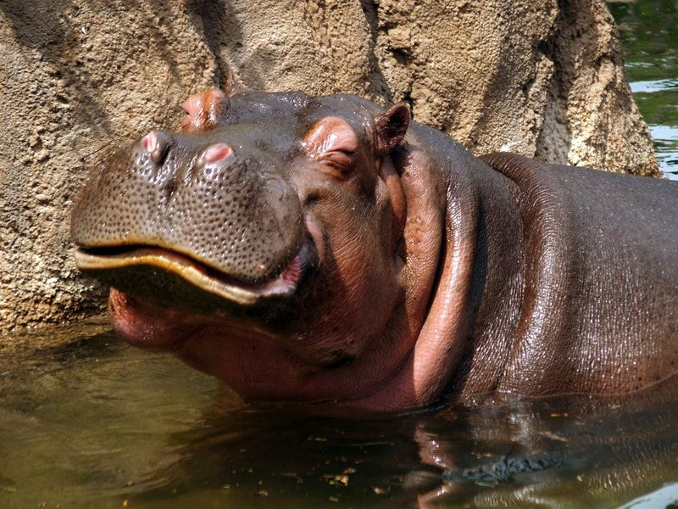
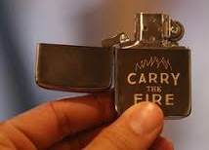
What’s the difference between a hippo and a Zippo?
A hippo is really heavy, and a Zippo is a little lighter.

Slide 8
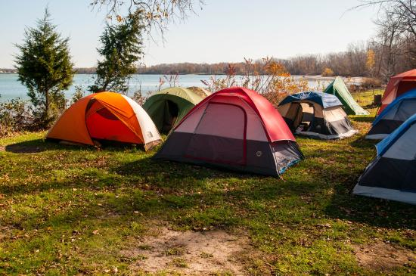
Why can’t you run
through a campground?
You can only ran, because it’s past tents.

Slide 9
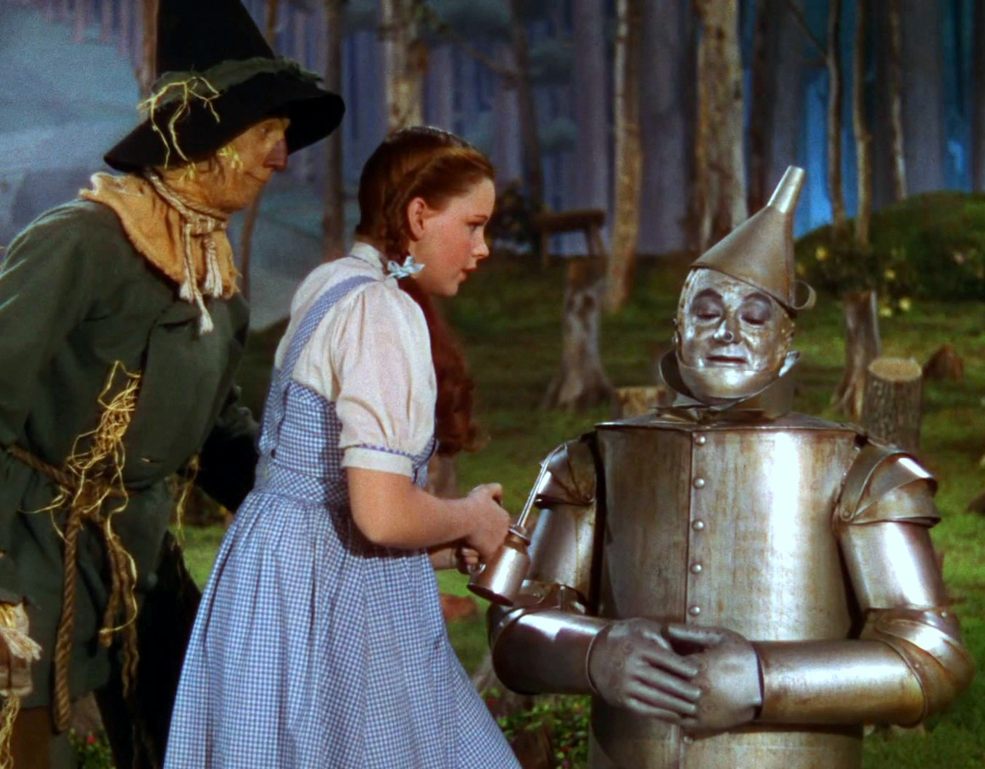
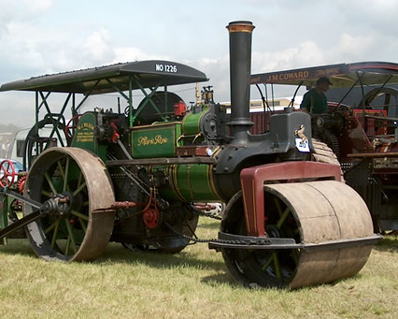
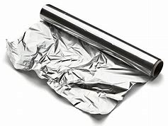
+
=
What did the Tin Man say when he got run over by a steamroller?
“Curses! Foiled again!”

Slide 10
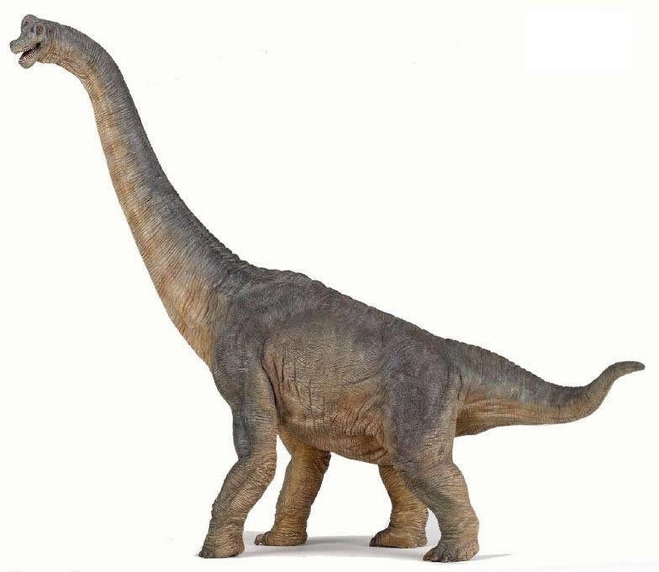
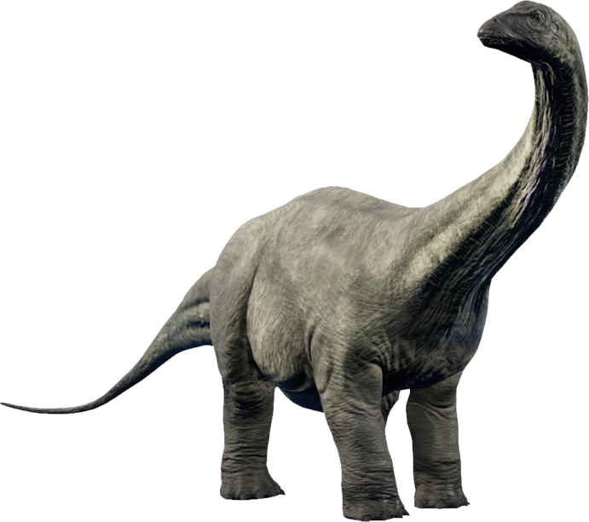
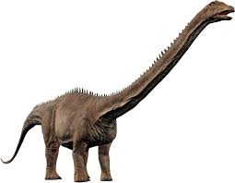
Name the dinosaur.
85 feet (26 m) long
weighed 66,000-176000 lbs
Length: 69 – 75 ft.
Mass: 36,000 – 49,000 lbs
24 meters (79 ft).
11 and 17.6 tons
Sauropods: Brachiosaurus, Apatosaurus, and Diplodocus
Since 1903, the scientific consensus has been that the brontosaurus wasn’t different enough from the apatosaurus to deserve its own genus. However the differences found recently between Brontosaurus and Apatosaurus were at least as numerous as the ones between other closely related genera.

Slide 11
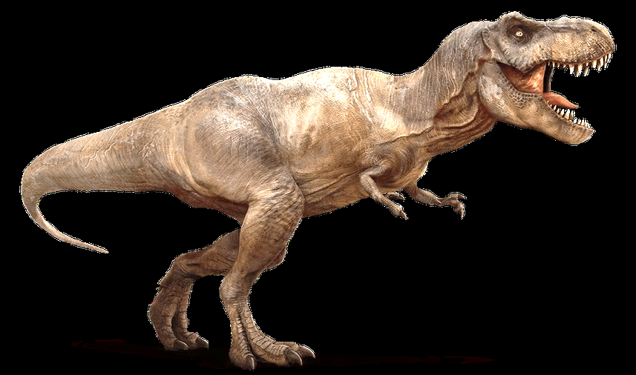
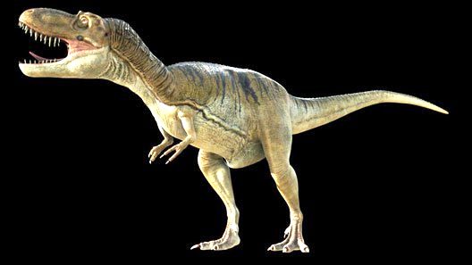
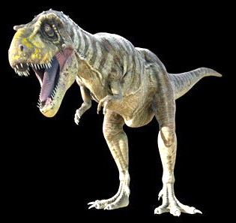
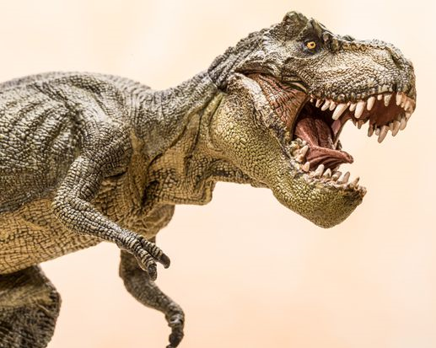
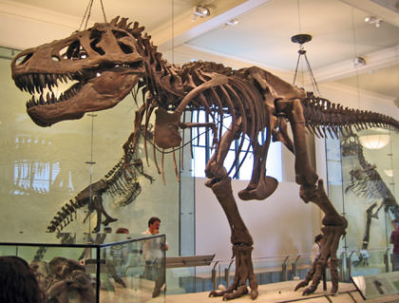
Height: 12 – 20 ft.
Mass: 9,900 – 31,000 lbs
Length: 30 ft.
Mass: 2,900 – 4,200 lbs
Length: 26 – 30 ft.
Mass: 4,000 – 8,400 lb
Tyrannosaurs: Tyrannosaurus rex, Albertosaurus, Daspletosaurus

Slide 12
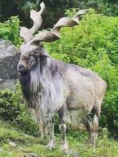
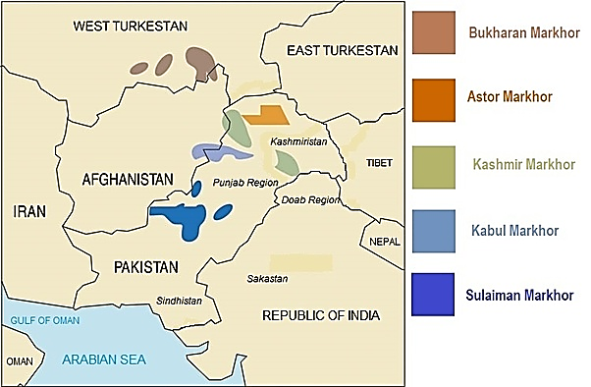
Animals with unusual appearance.
The Markhor (Capra falconeri) is the largest of the goat family and is found in the rugged mountains of central Asia, from Southern Russia to the sparse woodland of the West Himalayas. The markhor is largely found in the Northern Areas of Pakistan especially in Chitral, Ghizar and Hunza regions.
Markhor Goat

Slide 13
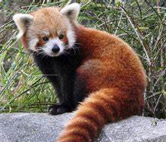
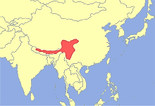
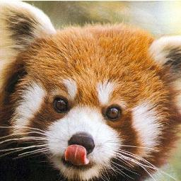
The red panda has given scientists taxonomic fits. It has been classified as a relative of the giant panda, and also of the raccoon, with which it shares a ringed tail. Currently, red pandas are considered members of their own unique family—the Ailuridae. Red pandas are an at-risk species, victims of deforestation.
Red Panda

Slide 14
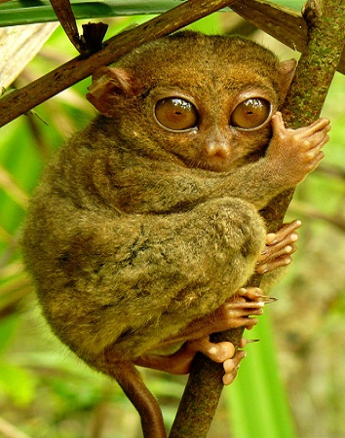
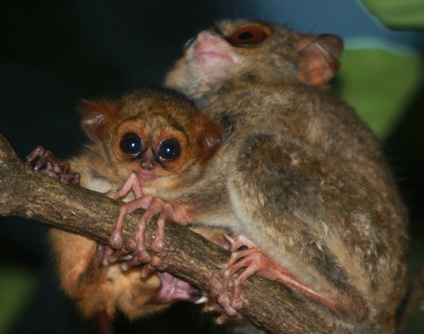
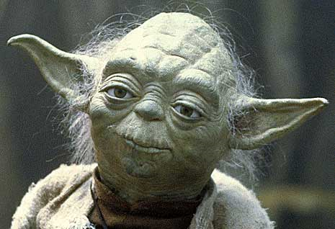
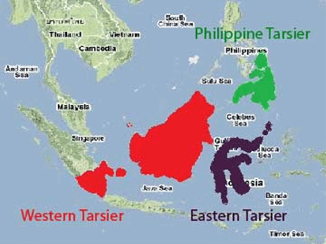
Tarsier
It has been suggested that Yoda was based on a tarsier.
Tarsier, (family Tarsiidae), any of six or more species of small leaping primates found only on various islands of Southeast Asia, including the Philippines. Tarsiers are intermediate in form between lemurs and monkeys, measuring only about 9–16 cm (3.5–6 inches) long, excluding a tail of about twice that length.

Slide 15
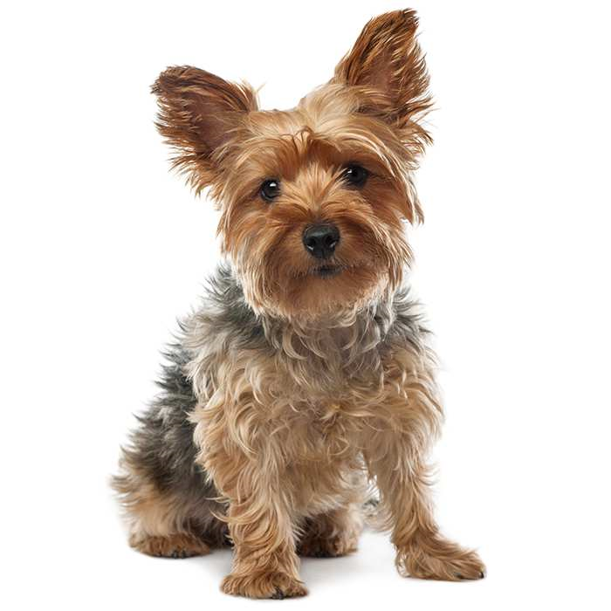
Name the breed of dog.
Yorkshire Terrier

Slide 16
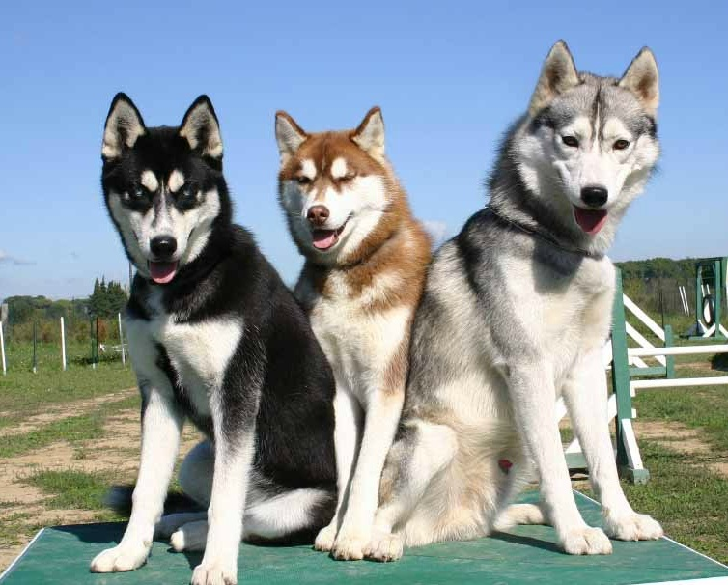
SIBERIAN HUSKIES

Slide 17
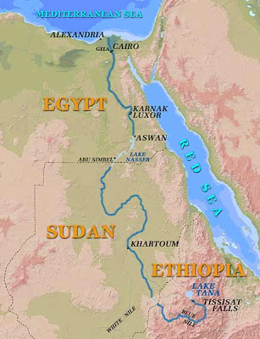
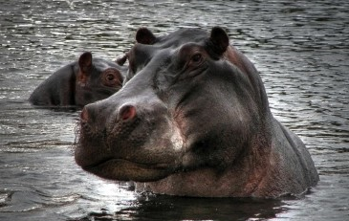
What is longest river
on earth?
Congo
Nile
Mississippi/Missouri
Amazon
Yangtze
Nile, Africa 6,825 km
Amazon, South America 6,437 km
Chang Jiang (Yangtze), Asia 6,380 km
Mississippi/Missouri, North America 5,971 km
Yenisey-Angara, Asia 5,536 km
Huang (Yellow), Asia 5,464 km
Ob-Irtysh, Asia 5,410 km
Amur, Asia 4,416 km
Lena, Asia 4,400 km
Congo, Africa 4,370 km
Mackenzie-Peace, North America 4,241 km
Mekong, Asia 4,184 km
Niger, Africa 4,171 km
Geography questions.

Slide 18
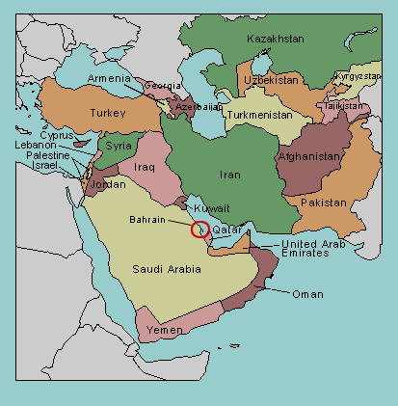
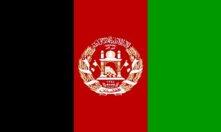
2. Name the countries with yellow rectangles.
=
=
=
=
Iran
Iraq
c. Syria
d. Afghanistan
b.
d.
a.
c.

Slide 19
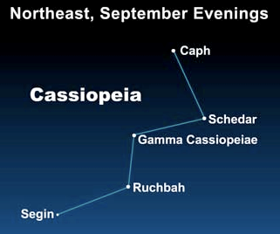
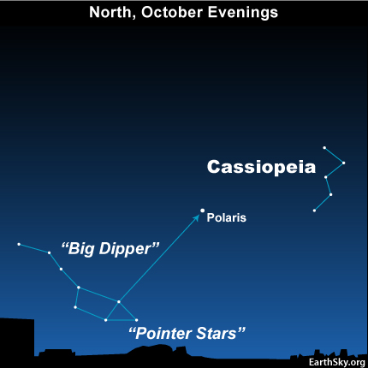
Name the constellation.
Cassiopeia is a constellation in the northern sky, named after the vain queen Cassiopeia in Greek mythology, who boasted about her unrivaled beauty.

Slide 20
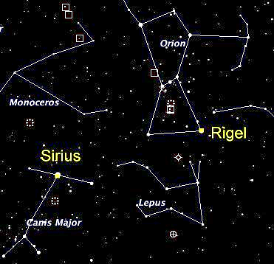
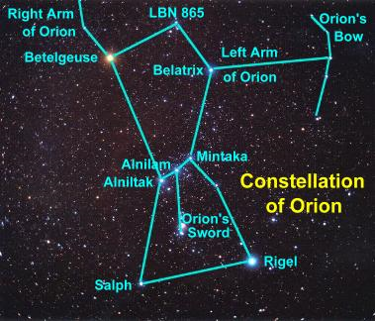
Orion is a prominent constellation located on the celestial equator and visible throughout the world. It is one of the most conspicuous and recognizable constellations in the night sky. It is named after Orion, a hunter in Greek mythology. Its brightest stars are blue-white Rigel and red Betelgeuse.

Slide 21
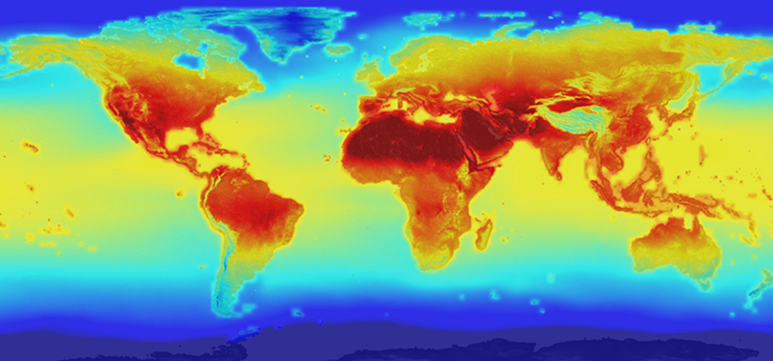
Two Climate Change Questions.
2100 projection of global warming.

Slide 22
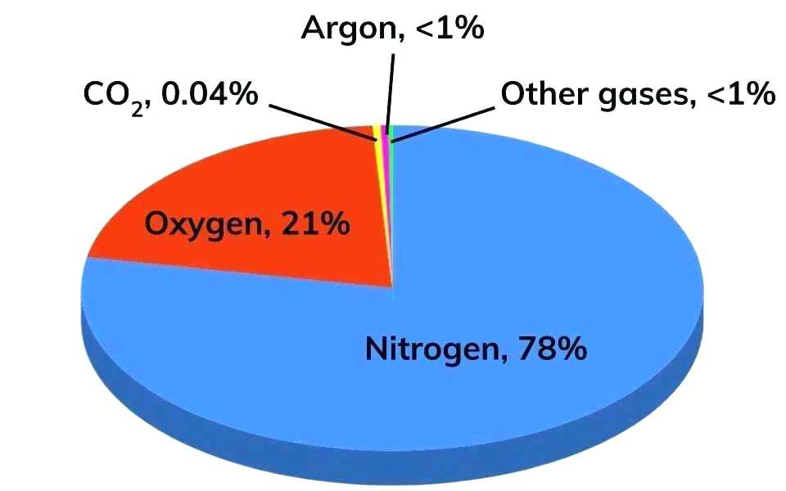
Name the four most abundant gases in air excluding water (the humidity varies widely by location, weather, time of the year from a trace to 4%) in decreasing order of abundance.
Name formula % abundance Lewis Structure model
1. Nitrogen N₂ 78.1%
2. Oxygen O₂ 20.9%
(Note: the Lewis structure for oxygen is one of the few failures of the Lewis structure method as it predicts incorrect magnetic properties of O₂)
3. Argon Ar 0.93%
4. Carbon CO₂ 0.04%
dioxide
Many people do not name nitrogen as the most abundant gas, extremely few name argon as the third most abundant gas and CO₂ is commonly named as one of the three most abundant gases. Presumably the latter is a conclusion reached because plants need CO₂ and animals exhale CO₂. However, only 3% of human exhaled gas is CO₂ and most is N₂. Why?

Slide 23
True or False – There is a correlation between global temperatures and total CO₂ concentrations.
TRUE
Conclusion:
Either the temperature increase causes CO₂ to increase or CO₂ increases causes temperature to increase.
Temperature,
Dark line
atmospheric CO₂,
Blue line
However, the additional correlation with the CO₂ production strongly supports CO₂ as the cause and temperature as the effect.
CO2 production, solid grey

Slide 24
Name the artist and the name of the painting.
Georges Seurat - A Sunday Afternoon on the Island of La Grande Jatte. (1884-1886)

Slide 25
Vincent van Gogh - Starry Night (1889)

Slide 26
Pablo Picasso completed this most famous piece, Guernica, in 1937

Slide 27
Name the celebrity.
Taylor Swift

Slide 28
Vladimir Putin
Or is this
more accurate?

Slide 29
Leonard DiCaprio
Be sure to see
Before the Flood

Slide 30
Donald Trump

Slide 31
Beyonce

Slide 32
For more Powerpoint Preshows and trivia on a variety of topics, please visit: http://murov.info/PPTPreshows.htm

