Slide 1
Observing/Noticing
Definitions (verb) from Oxford Languages
Observe - notice or perceive (something) and register it as being significant.
Notice - become aware of.
Sense - perceive by a sense or senses
Many science texts take several early pages to discuss the so-called mundane Steps in the Scientific Process. In hindsight, it is often possible to demonstrate that many scientific discoveries used the scientific process. However, the researchers did not pause and ask which step would be next. The process is essentially a natural sequence of events that occur during scientific research. https://www.simplypsychology.org/steps-of-the-scientific-method.html .
Make an observation.
Ask a question. A scientific question must be defined, testable, and measurable.
Form a hypothesis
Run an experiment to test the hypothesis (gather data)
5. Analyze the data and draw conclusions (develop a theory)
6. Share your results, so other researchers can further test the theory and modify it.

Slide 2
The first 5 slides are intended to be an introduction to the concept of observing. To go directly to the exercsies, go directly (click on this sentence) to slide number 6.
Observation is the first and key step and arguably the most important step in the scientic process.
It should be noted that scientists sometimes follow definitions that are more scrupulously defined than for the way they are used by society. For example, the word theory to a scientist means a hypothesis or explanation that is supported by evidence. Theory in general usage often means an idea or explanation that is not necessarily supported by evidence. Like theory, the word observe also is more scrupulously defined by scientists. Commonly observe means to see, hear, feel, smell or touch but does not necessarily mean that insight or questions will result. To a scientist, observe corresponds to the Oxford definition that the observations will register “significant information”. Most people see a blue sky but how many ask why the sky is blue? Wouldn’t it be expected that the sky would be white or black? According to the scientific interpretation of the word observe, unless a question is asked, the sky is not truly being observed. But most will apply the word observe even though significant information was available but not obtained. For this reason, this author prefers the verb “notice” over observe. Those with scientific leanings and value curiosity will follow up and seek reasons for the apparently unusual color of the sky.
This web site was developed to demonstrate the importance of complete and unbiased observations. Overlooked observations might have been routes to insight and an important discoveries. For an exercise on optical illusions and observations, please visit: http://murov.info/OpticalIllusionsandObservations.ppt
The importance of making complete and unbiased observations is emphasized in the quotations on the next slide.

Slide 3
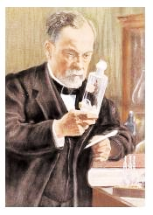
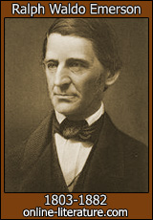
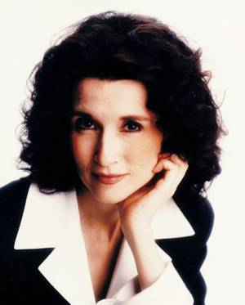
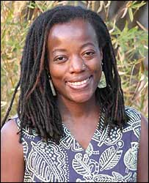
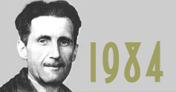
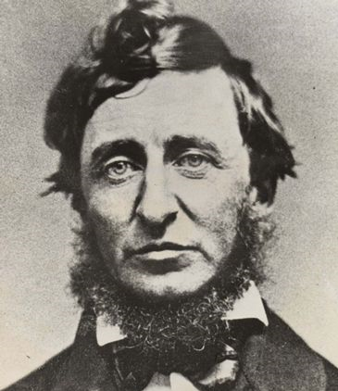
SCIENCE
&
OBSERVATION
In the field of observation, chance
favors only the mind that is prepared.
Louis Pasteur
God hides things by putting them
near us. Ralph Waldo Emerson
To acquire knowledge, one must study; but to acquire wisdom, one must observe.
Marilyn Vos Savant
You are one of the rare people who can separate your observation from your perception...you see what is, where most people see what they expect. Tsitsi Dangarembga
To see what is in front of one’s nose needs a constant struggle.
George Orwell
The question is not what you look at, but what you see. Henry Thoreau

Slide 4
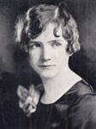
Rachel Carson, author of
Silent Spring, deserves
significant credit for
initiating the
environmental movement.
Only within the moment of time represented by the present century has one
species -- man -- acquired significant power to alter the nature of his world.
One way to open your eyes is to ask yourself:
What if I had never seen this before?
What if I knew I would never see it again?”
Those who dwell, as scientists or laymen,
among the beauties and mysteries of the earth,
are never alone or weary of life.
We should be noticing that human action is changing the climate and dangerously warming the planet. An effort to minimize the damage must begin immediately.

Slide 5
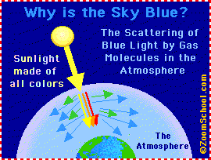
When we notice something puzzling, we are often inspired to ask why and this sometimes leads to explanations that can lead to greater understanding. We all see blue sky, and some notice this and ask why the sky is blue?
https://www.rmg.co.uk/stories/topics/why-sky-blue#:~:text=As%20white%20light%20passes%20through,red%20light%20has%20the%20longest.
https://spaceplace.nasa.gov/blue-sky/en/
https://scijinks.gov/blue-sky/
Noticing a puzzling observation is dependent on prior experience and education. Experience and education coupled with observation are prerequisites to developing the understanding that can lead to new and important discoveries that increase the quality of life.

Slide 6
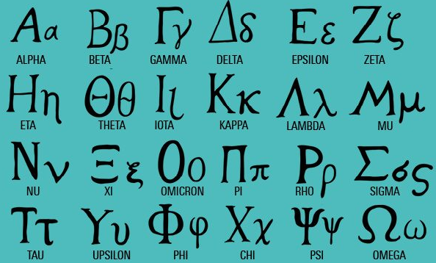
Alphabet ABCDEFGHIJKLMNOPQRSTUVWXYZ
1. Have you ever asked why the letters are arranged in the above order?
2. Why are the 26 letters called an alphabet?
1. Some scholars think it goes back to the Egyptians and how they ordered their hieroglyphics. Another theory is that the letters used to have a number attached to them, and they were put in numerical order. While the numbers were lost over time, the letters and their order remain. Psychology Today posts that it had something to do with how easy it is to memorize with its bouncy cadence. Another theory is that the letters were put in order as part of a memory tool so people could memorize all 26 of them. It's hard to imagine a mnemonic device that's easier than the ABC Song though.
https://www.southernliving.com/news/alphabetical-order-history#:~:text=Some%20scholars%20think%20it%20goes,
letters%20and%20their%20order%20remain .
https://www.mentalfloss.com/article/29011/why-are-letters-abc-order
https://en.wikipedia.org/wiki/Alphabetical_order
2. Alpha and beta are the first two letters of the Greek alphabet.

Slide 7
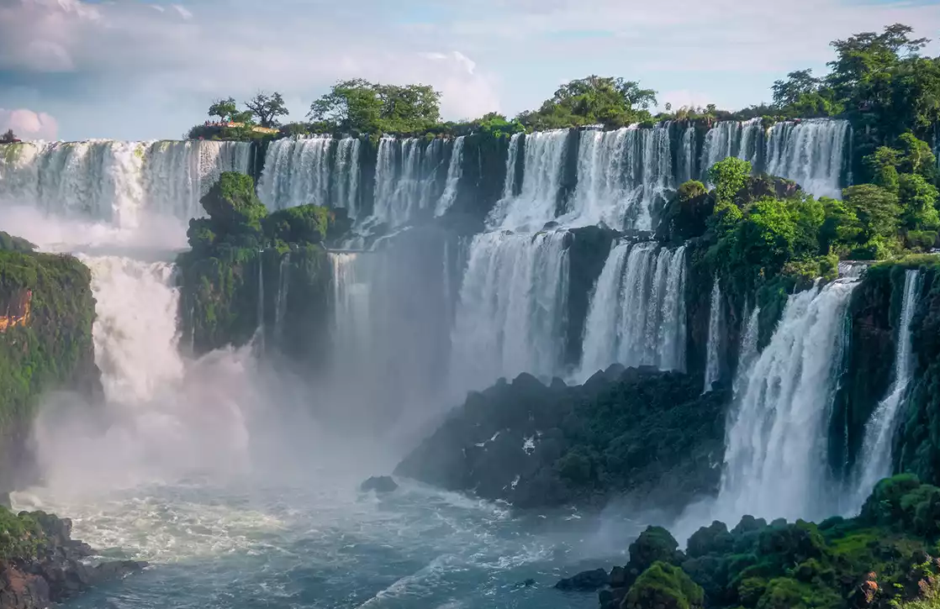
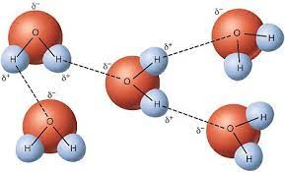
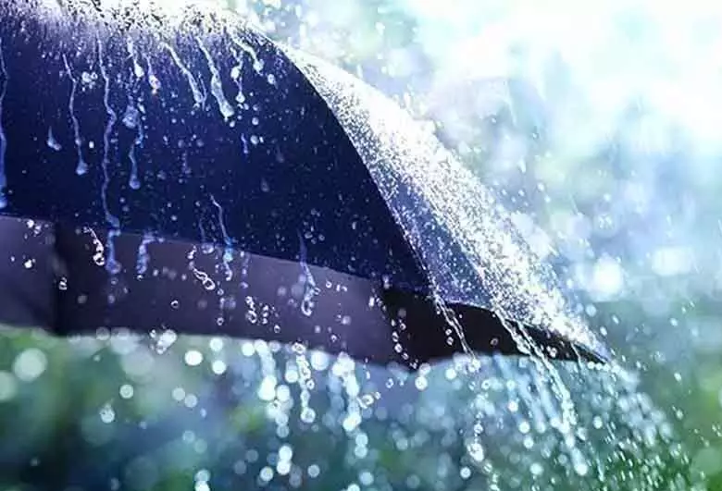
WATER – Should a boiling point of 100ºC (212ºF) be expected for a small molecule with the formula H₂O?
“Water is life's matter and matrix, mother and medium. There is no life without water.” Albert Szent-Gyorgyi liquid temp range ideal for life. Our bodies contain 60 to 70% water, and we see, feel and drink it everyday. Does water have the properties expected for a compound with the formula H₂O? This is not a simple question. To attempt to provide an answer requires some scientific information that might not be commonly known. A comparison of the properties of compounds with similar formulas to water reveals that some properties of water are unexpected (until we understand water) including the melting and boiling points. The mp and bp of water are much higher than that for similar molecules. This leads to a search for the reason for the apparent anomalous values.
Iguazú Falls — Argentina and Brazil
There are many types of attractive forces between molecules, but we find that water and other molecules with a hydrogen bonded to an oxygen, fluorine or nitrogen are capable of having a very strong intermolecular attraction called hydrogen bonding. Hydrogen bonding is extremely important in nature and is intimately connected with the DNA double helix and genetic information. As a result of H-bonding, the boiling point of water is considerably more than one hundred degrees higher than expected.

Slide 8
Should a solid float or sink in its own liquid?
You have seen an ice-water system like the image to the right countless times. As discussed, earlier, observation is a key to good science. Have you ever asked a question about this system? Is there anything about the system that does not correspond to your expectations? One of the unique features of this observation is that water is probably the only substance out of millions of known substances where you have observed the liquid and solid phases in a system where it was possible to determine if the solid would sink or float in its own liquid.
As a given mass of liquid cools, do you expect the volume of the liquid to expand or contract? Most people correctly respond that the volume should decrease as the temperature drops. However, this should lead to the expectation that the ice should sink in the liquid water but clearly this is not the case for the liquid water, ice system. The ice floats in the liquid water and without questioning, many if not most assume that the solid of substances will float in its liquid. It turns out that water is an anomaly and for almost all other substances, the behavior is consistent with expectations as the solid sinks in its liquid.
The question why ice floats in liquid water (why ice is less dense than liquid water) is a complex one but inspection of the figures on the next slide reveals that water molecules are closer together in the liquid state than in the solid state. Which one of the test tubes on the next slide contains water?.

Slide 9
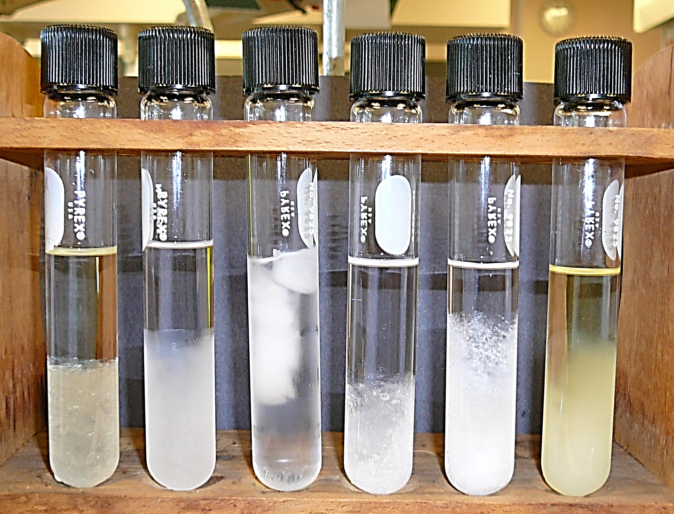
Liquid water
Solid water (ice)

Slide 10
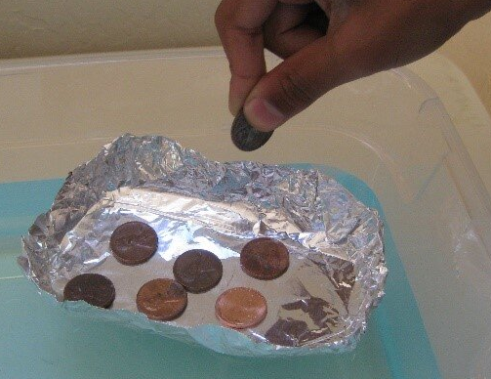
Years ago, on his late, night TV show, host David Letterman would sometimes ask the question, does it sink or float. After a discussion for each object, the objects were tested to determine if they would sink or float in water. Try this experiment with the following:
Diet Cola and regular Coca Cola (or diet and not diet versions of Pepsi.
A lemon and a lime
A six inch square piece of aluminum foil folded into the smallest 3 dimensional volume as possible.
Another six inch square piece of aluminum folded to form a boat.
Contest: Provide several people with a six inch square piece of aluminum and have a contest to see which float holds the most pennies (and how many).

Slide 11
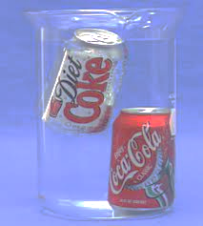
Diet drinks replace the sugar with artificial sweeteners which are hundreds of times sweeter than sugar. As a result, only a hundredth or so of the sweetener compared to sugar is needed. Since density is mass divided by volume and the diet drinks (+ can) contain a lower mass of sweetener, the mass of the diet drinks is slightly less than the mass of the regular drinks. Both have densities very close to the density of water but the diet drinks with slightly less additive have an overall density less than the density of water but the regular drinks have a density slightly greater than the density of water (0.998 grams/mL).
https://stevespangler.com/experiments/floating-lemons-and-sinking-limes/
Please visit the site above but the lime has a density slightly greater than the density of water and the lemon a density slightly less than the density of water.

Slide 12
Bird beaks (or bills)
When you observe a bird, do you think about anything other than it is a bird and can fly? You probably notice its size and color but what about the characteristics of its claws or beak? If you observe the beak, does the beak tell you anything about the lifestyle of the bird such as what kind of food does it eat? If we really observe the bird, we notice the size, color, claw and beak characteristics and more. Let's spend a few minutes thinking about conclusions that might result from a knowledge of a bird’s beak.

Slide 13
RESOURCES ON THE WEB
https://animalcorner.org/bird-beaks-bills/
https://www.birdsandblooms.com/birding/birding-basics/types-of-bird-beaks/
https://www.birdinformer.com/bird-beaks/
https://www.dkfindout.com/us/animals-and-nature/birds/types-beak/
https://www.zooportraits.com/birds-different-beaks-functions/
https://sites.google.com/education.nsw.gov.au/lessons-in-nature/stage-3/bird-beak-adaptations
https://quizizz.com/admin/quiz/5706d399b73851962a78a965/bird-beaks
https://www.birdsandblooms.com/birding/birding-basics/types-of-bird-beaks/
Finches
https://cindygurmann.blog/2017/09/06/darwins-finches-of-the-galapagos-islands/
https://news.harvard.edu/gazette/story/2006/07/how-darwins-finches-got-their-beaks/
https://www.seas.harvard.edu/news/2021/11/darwins-finches-beak-shape-goes-beyond-evolution

Slide 14
The chart to the left categorizes beaks into twelve types. The next slide narrows down the types to six. On that slide, you will be given six different birds. Based on the nature of their beaks, try to classify them into one of the six types.

Slide 15
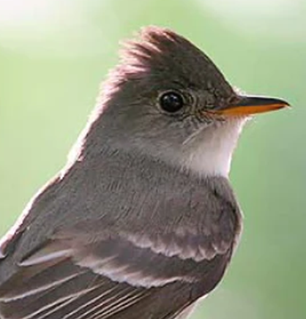
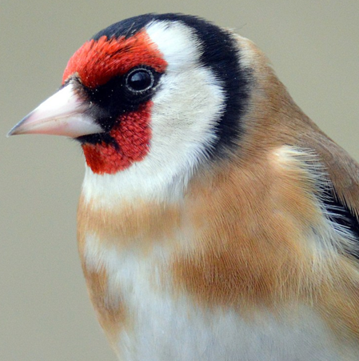
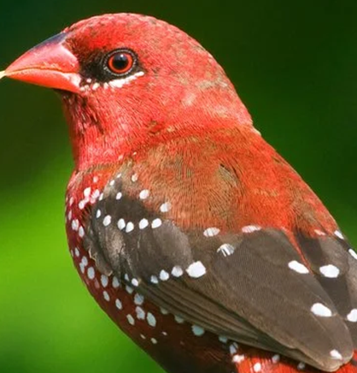
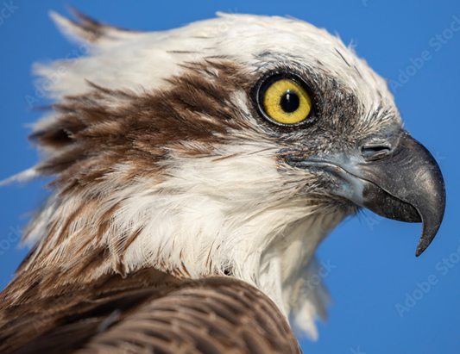
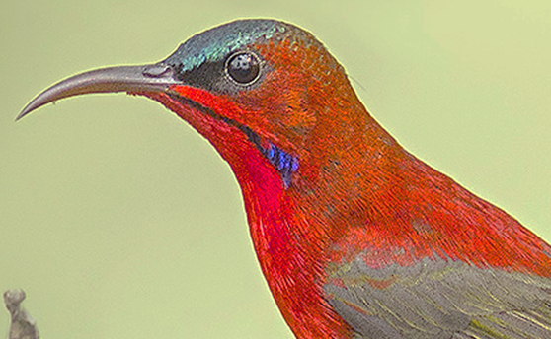
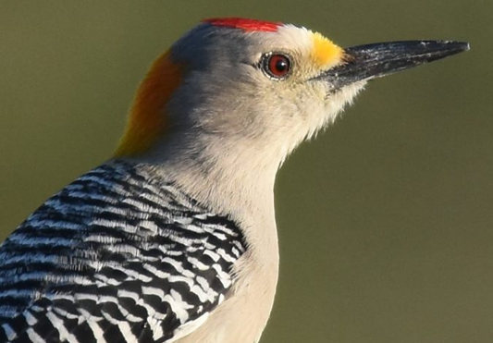
acorn woodpecker with
beak for drilling
ruby-throated hummingbird
with beak for sipping nectar
blue grosbeak with beak
for cracking seeds
What type of bird is this?
This is a crimson sunbird. It
is a nectar
drinker but it also eats insects.
This is a golden-fronted woodpecker
with a beak for drilling.
This is a goldfinch (European)
and is a seed eater. Seed and grain eaters have similar beaks.
This is an avadavat
which is a
grain eater.
This is an osprey
with beak designed
for ripping.
This is a flycatcher and it is an insect eater.
Yellow warbler with beak
for catching insects
Golden eagle with beak for ripping
Black skimmers with
beak for skimming

Slide 16
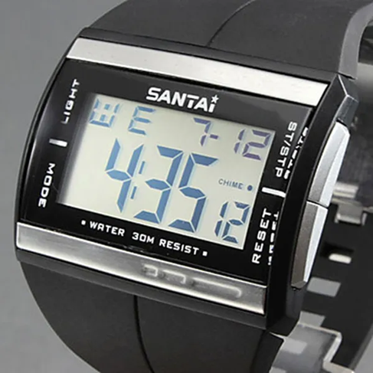
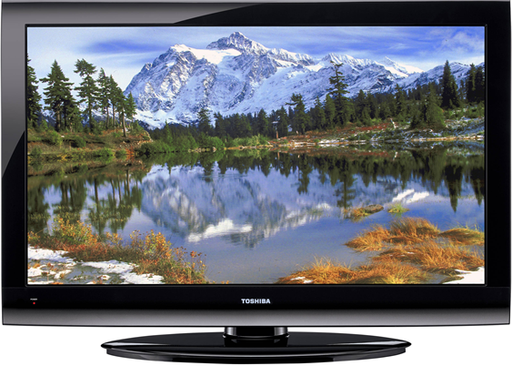
LCD
While you have probably encountered the abbreviation LCD before, have you paused long enough to ask what LCD means and if so, does it make any sense?
LCD stands for liquid crystal display. Do not confuse it with LED which means light emitting diode. There are LCD and LED TV’s and often a TV will include both types of technology. LCD’s are found everywhere in our technological world possibly including your television screen, digital readouts and digital watch.
Does the term “liquid crystal” make sense?
Students are sometimes taught that there are 3 states of matter – solid, liquid and gas. However, most of the visible Universe is not a liquid, solid or gas as stars are a state of matter called plasma. Liquid crystals are a 5th state of matter that occurs for a small number of substances in a temperature range between the solid and liquid states. The liquid crystal state is complex. In a liquid, molecules are adjacent to each other but can slide by one another or wander about their cabin. In the solid, the molecules are about the same distance apart but are held in fixed positions. They have seat belts on. An oversimplified picture of a liquid crystal is that molecules are held in place within layers but the layers can slide by each other. Liquid crystals have properties that make them ideally suited for digital displays.

Slide 17
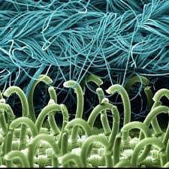
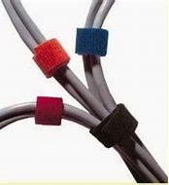
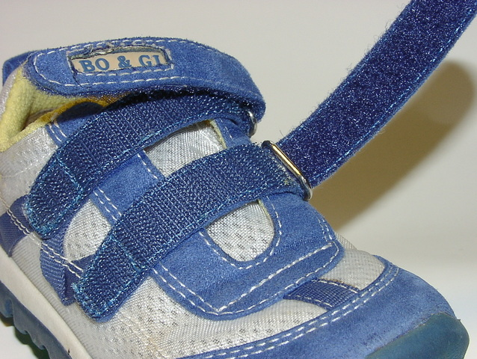
Velcro
How does it work?
Using the digital microscope camera, you should be able to see that Velcro has hooks and catches as illustrated below. The hooks and catches hold the two pieces together but with a little effort, can be separated.

Slide 18
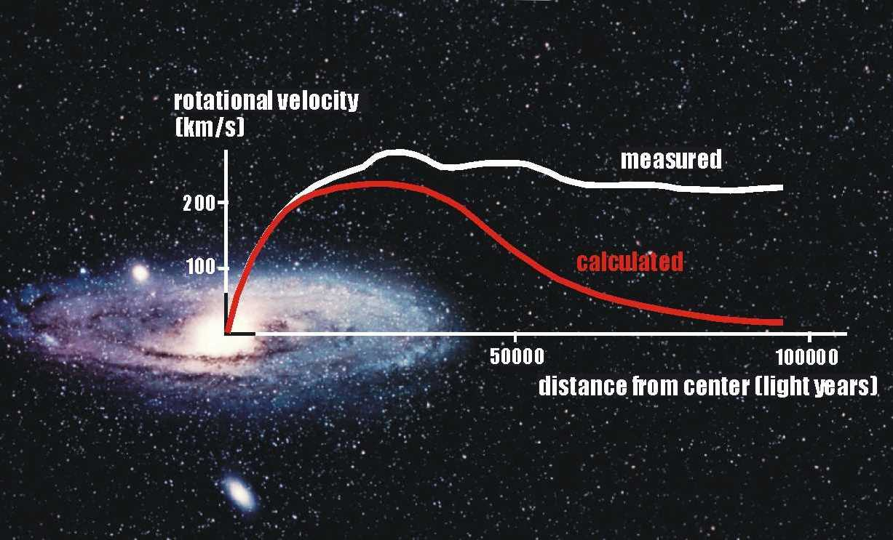
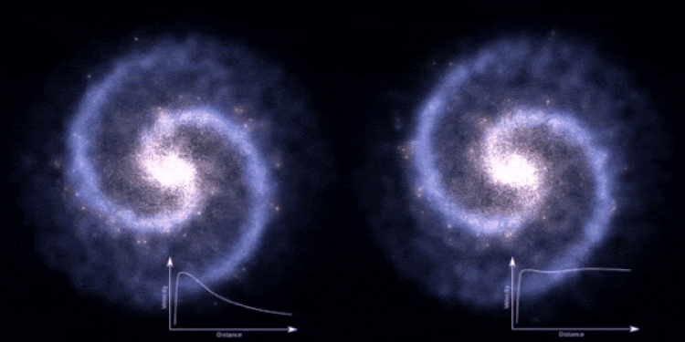
DARK MATTER: What is it?
Dark matter is composed of particles that do not absorb, reflect, or emit light. As a result, they cannot be detected by observing light or more generally, electromagnetic radiation. We know that dark matter exists because of the effect it has on objects that we can observe directly.
https://starchild.gsfc.nasa.gov/docs/StarChild/universe_level2/darkmatter.html
In the diagram to the upper-right, it is observed that the rotational velocity of a galaxy is much faster than calculated from the mass of the “regular” mass of the galaxy. The discrepancy can be accounted for by the presence of substantial additional mass called dark matter. The animation to the right shows the rotations of the galaxy with and without dark matter.
Rotation faster

Slide 19
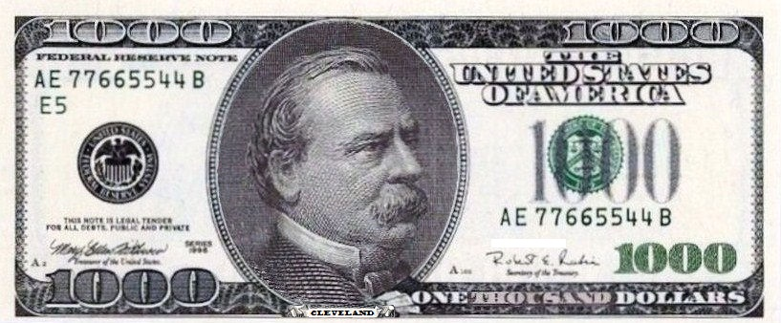
What is the lowest whole positive number with an A in it?
1000 Isn’t it surprising that you have to count to a thousand to find a number with an A in it?
https://www.businessinsider.com/heres-why-we-stopped-using-1000-bills-2017-8

Slide 20
Does dry ice (frozen carbon dioxide – CO₂) melt or is there a liquid phase of CO₂?
Liquid
↓
solid
Dry ice under pressure melting to form liquid CO₂.
You have observed dry ice in blocks being used for cooling (e.g., to keep ice cream cold). But have you asked why the carbon dioxide, as it warms, disappears into the gas phase (it sublimes) rather than melting to form a liquid? Carbon dioxide only melts to form a liquid under high pressure (over 5 atmospheres with a temperature under 31.1 °C (88.0 °F) ). It does not form under atmospheric conditions. The chemical symbol remains the same as gaseous carbon dioxide (CO₂). It is transparent and odorless and the density of it is 1101 kg/m3 when the liquid is at full saturation at −37 °C (−35 °F).

Slide 21
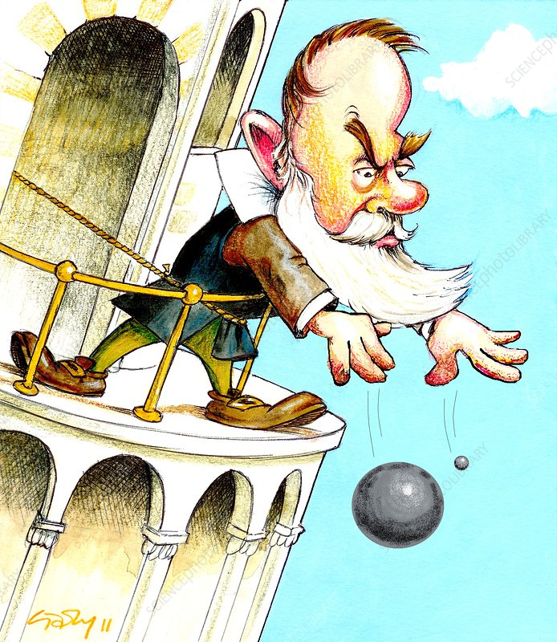
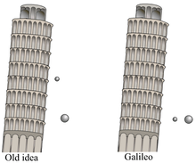
Italian scientist Galileo Galilei (then professor of mathematics at the University of Pisa) is said to have dropped two spheres of different masses from the Leaning Tower of Pisa. If true, did they hit the ground at the same time?
https://en.wikipedia.org/wiki/Galileo%27s_Leaning_Tower_of_Pisa_experiment
Comparison of the antiquated view and the outcome of the experiment
Between 1589 and 1592, the Italian scientist Galileo Galilei (then professor of mathematics at the University of Pisa) is said to have dropped two spheres of different masses from the Leaning Tower of Pisa to demonstrate that their time of descent was independent of their mass, according to a biography by Galileo's pupil Vincenzo Viviani, composed in 1654 and published in 1717: 19–21 . The basic premise had already been demonstrated by Italian experimenters a few decades earlier.
According to the story, Galileo discovered through this experiment that the objects fell with the same acceleration, proving his prediction true, while at the same time disproving Aristotle's theory of gravity (which states that objects fall at speed proportional to their mass). Most historians consider it to have been a thought experiment rather than a physical test.
In terms of angles, the tower now leans at 3.99 degrees. Considering the weight and height of the tower, physicists have said the maximum angle would be 5.44 degrees before the tower falls (at its worst, the tower once leaned briefly at 5.5 degrees.Nov 2, 2013

Slide 22
What does RAP stand for?

Slide 23
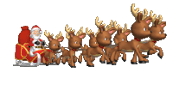
How fast does Santa have to fly?
To deliver his gifts in a single night, Santa and his reindeer must fly 400,000 times faster than the speed of sound.
767 miles/hr =
Speed of sound
MUCH FASTER THAN THAT AND
PROBABLY STRAIGHTER OR SPHERICALLY ALSO.
HAPPY HOLIDAYS TO ALL AND TO ALL A GOOD NIGHT!

Slide 24
For more Powerpoint Preshows, exercises and challenges, please visit:
http://murov.info/PPTPreshows.htm

