Slide 1
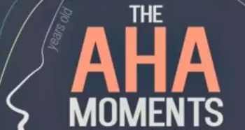

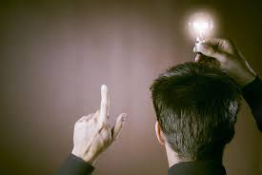

SERENDIPITY AND SERENDIPITOUS DISCOVERIES
Archimedes

Slide 2
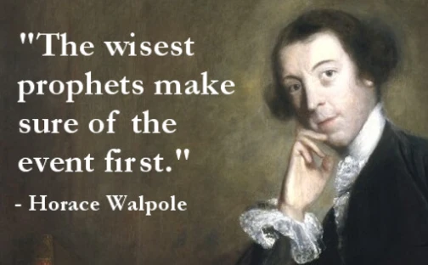
ALL ABOUT SERENDIPITY
Horace Walpole coined the word serendipity in a letter to another Horace—Mann—dated January 28, 1754. It would take nearly two centuries for the adjective form, serendipitous, to come on the scene—its first recorded usage was in 1943.
Say the word serendipity.
Doesn’t it have a great sound.
What does serendipity mean?
Serendipity is an unplanned fortunate discovery, combined with an open mind. The term was coined by Horace Walpole in 1754.
Serendipity refers to the combination of “accident” and “sagacity”; an unexpected and unpredicted event which is noticed by an agent with the right skills to make the most of it.

Slide 3


https://www.youtube.com/watch?v=KtBGG49T50E

Slide 4
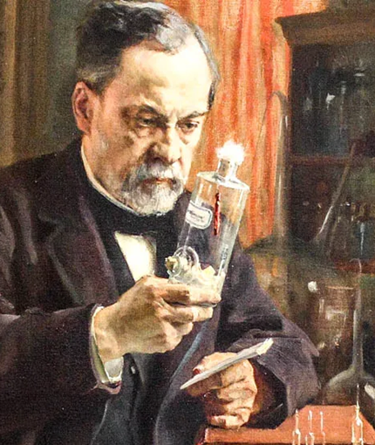
Louis Pasteur famously stated, "In the fields of observation, chance favors only the prepared mind," meaning that preparedness and knowledge are crucial for recognizing and capitalizing on opportunities, even those that seem accidental.
5 inventions by
Louis Pasteur that
changed the world
1. pasteurization of milk
2. his work revolutionized large-scale fermentation
3. bacteria can cause diseases
4. developed vaccines for anthrax in sheep and chicken cholera
5. Developed the Pasteur pipette

Slide 5
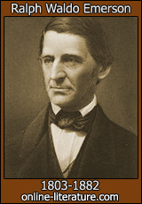
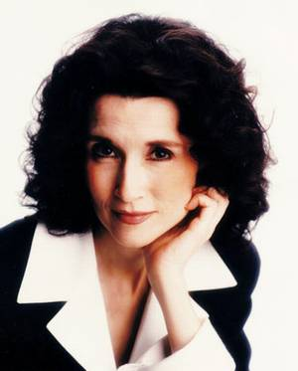
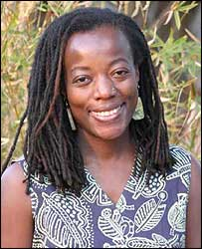
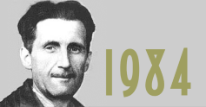
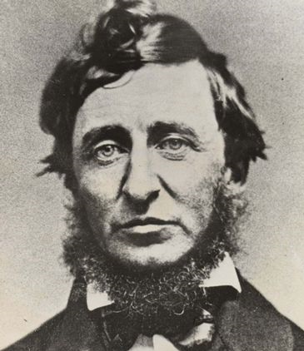
SCIENCE
&
OBSERVATION
More quotations on the importance of complete, careful and unbiased observation that help lead to serendipitous positive results.
God hides things by putting them
near us. Ralph Waldo Emerson
To acquire knowledge, one must study;
but to acquire wisdom, one must observe.
Marilyn Vos Savant
You are one of the rare people who can separate your observation from your perception...you see what is, where most people see what they expect.
Tsitsi Dangarembga
To see what is in front of one’s nose needs a constant struggle.
George Orwell
The question is not what you look at, but what you see. Henry Thoreau

Slide 6
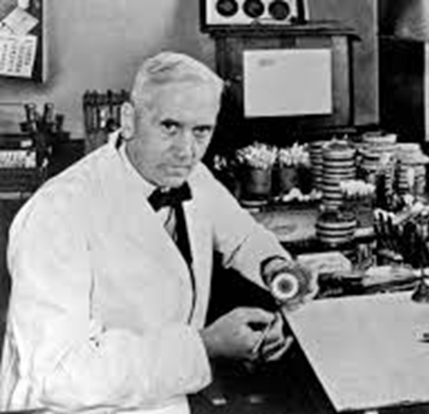
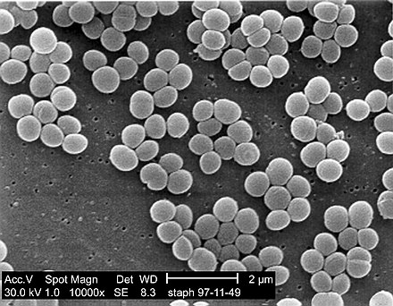
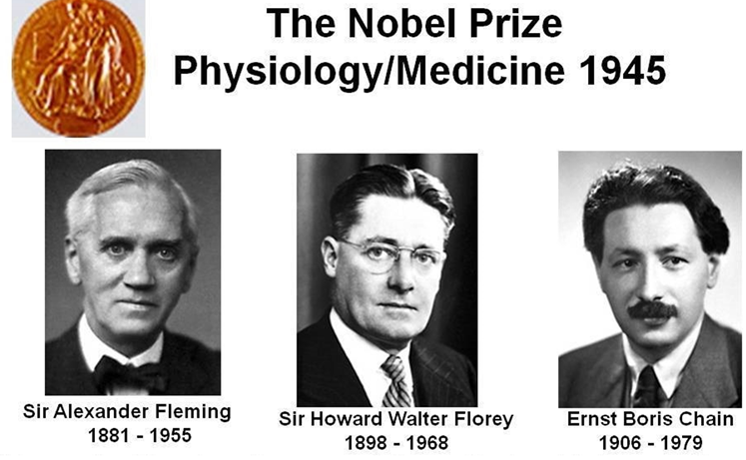
In 1928 Dr. Alexander Fleming returned from a holiday to find mold growing on a Petri dish of Staphylococcus bacteria. He noticed the mold seemed to be preventing the bacteria around it from growing. He soon identified that the mold produced a chemical that could kill bacteria. What was the chemical?
Fleming named this substance "penicillin" after the Penicillium mold that produced it.
It took more than a decade to make penicillin useful as a medicine. Florey and Chain took Fleming’s discovery and made it practical and all 3 were awarded the Nobel Prize in 1945.

Slide 7
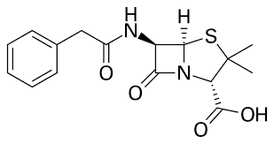
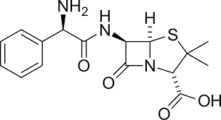
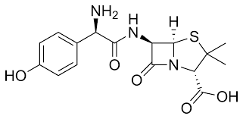
More on penicillin. The discovery of penicillin has saved countless number of lives, many of those wounded in WWII where it was first used and perhaps yours. Unfortunately, the original penicillin G could not be taken orally because it was not stable in stomach acid. Researchers were able to brilliantly develop via research ampicillin and amoxicillin. Are penicillin, ampicillin and amoxicillin closely related and how do they differ?
Penicillin G Ampicillin Amoxicillin
All have the same basic structure but most importantly an ammonia base like NH₂ was added to the penicillin structure to make it stable in acid. What role does serendipity have in this discovery?
Not only are ampicillin and amoxicillin stable in stomach acid and can be administered orally but serendipitously, they are also more effective antibiotics than Penicillin G.
The discovery of penicillin ushered in the age of antibiotics but due primarily to overuse, many bacteria have developed resistance to penicillin. Apparently, because there is not sufficient profit from the development of antibiotics, the pharmaceutical industry has been slow to develop new antibiotics. This could mean that bacteria will kill again.

Slide 8
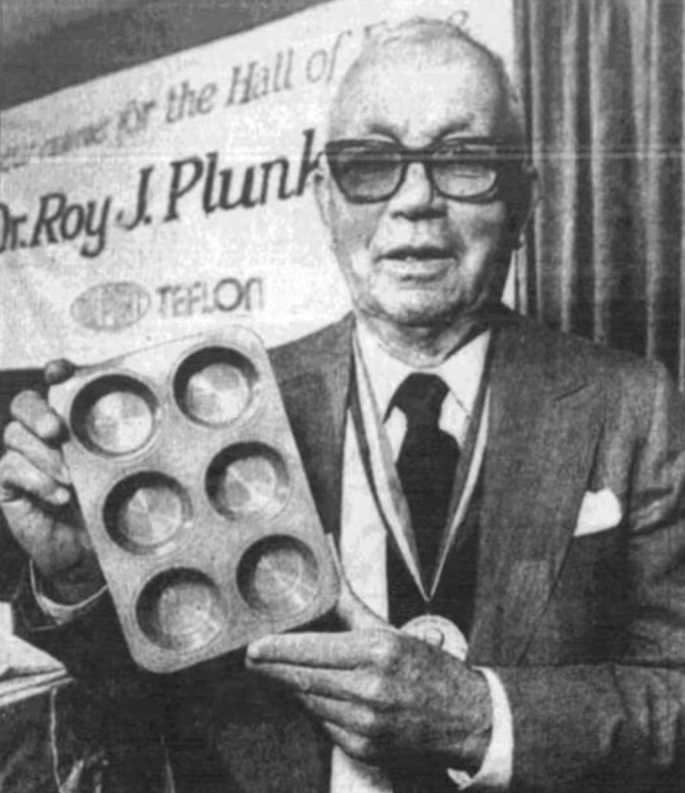
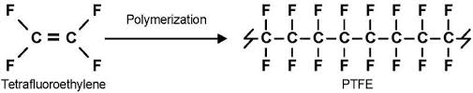

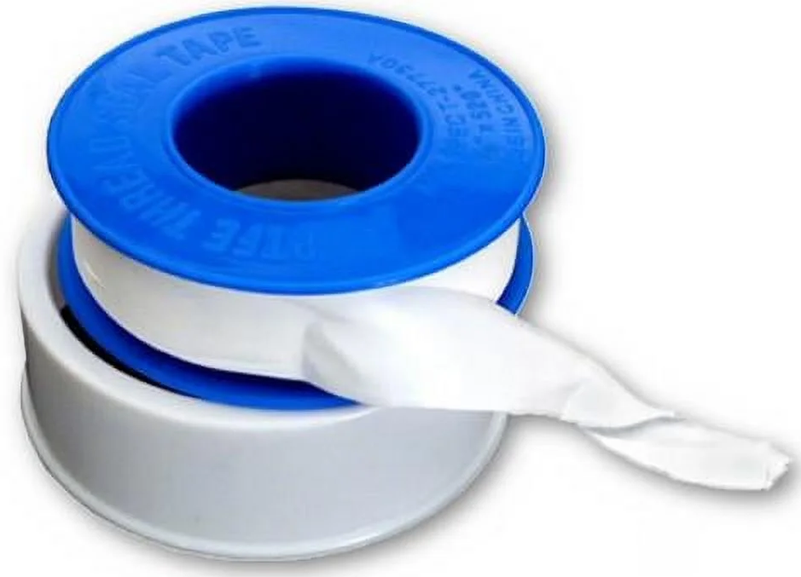
Roy J. Plunkett at DuPont in 1938 was searching for a better coolant (for refrigeration) gas. When trying to test the gas tetrafluoroethylene, he was surprised that the gas would not come out of its cylinder. Upon opening the cylinder, instead of a gas he found a white waxy solid. What was the solid?
The sample had polymerized spontaneously into PTFE or polytetrafluoroethylene commonly called Teflon.

Slide 9
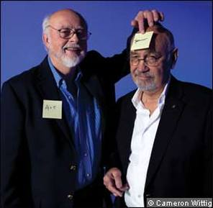
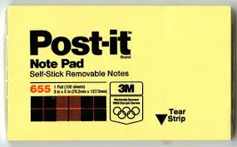
In 1968, Spencer Silver was trying to develop new classes of strong adhesives when he discovered a very weak adhesive. Several years later, Art Fry, was singing in a church choir when he lost his place in the hymnal. He dreamed of a bookmark that was lightly adhesive and could help him keep his place while switching from page to page on his sheet music. Fry remembered that his fellow colleague Spencer Silver had created a light adhesive that he had still found no use for. What use did Fry find for the weak adhesive?

Slide 10
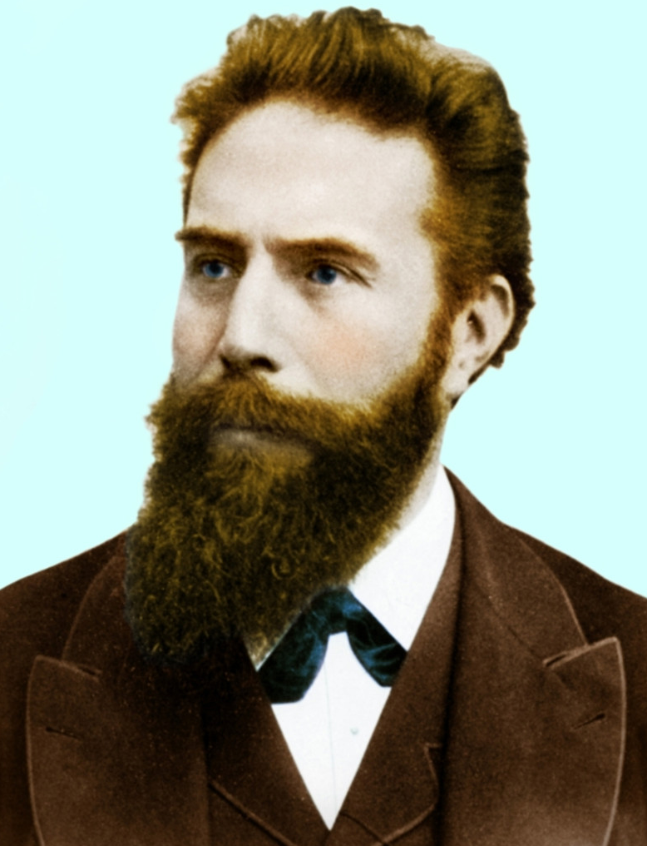
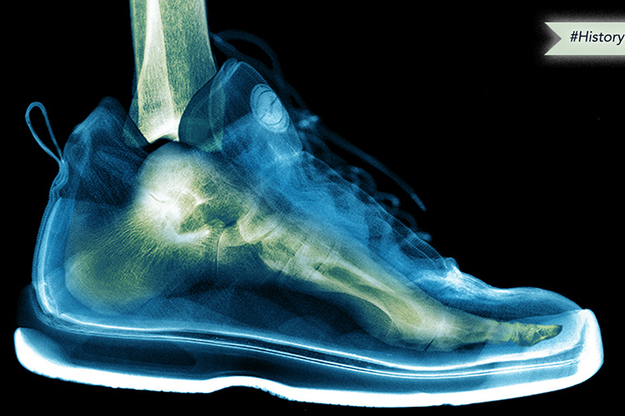
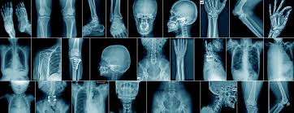
Wilhelm Röntgen, Professor of Physics in Wurzburg, Bavaria, was testing whether cathode rays could pass through glass. His cathode tube was covered in heavy black paper, so he was surprised when an incandescent green light nevertheless escaped and projected onto a nearby fluorescent screen. Through experimentation, he found that the mysterious light would pass through most substances but leave shadows of solid objects. What had Röntgen accidentally discovered?
Because he did not know what the rays were, he called them ‘X,’ meaning ‘unknown,’ rays.
X-rays

Slide 11
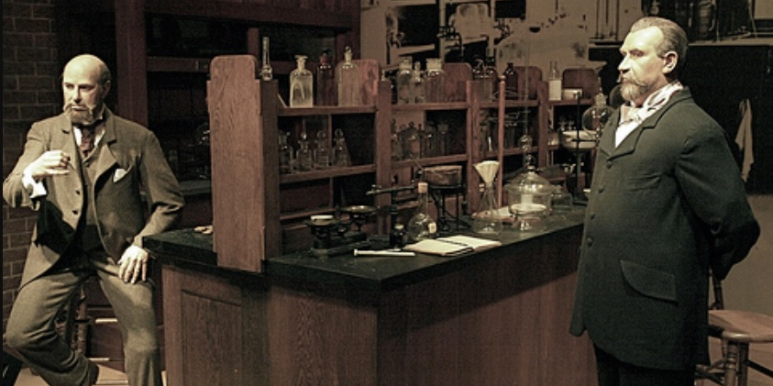
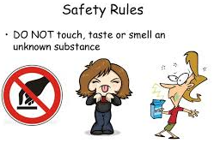
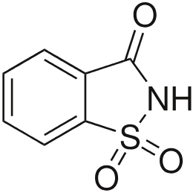
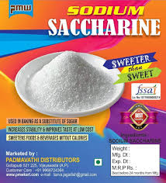
This chemical was discovered accidentally in 1879 by Ira Remsen and Constantin Fahlberg who were looking for new uses for coal tar derivatives. Fahlberg forgot to wash his hands before lunch and tasted something sweet on his fingers. After tasting everything in his lab to determine the source (very bad and dangerous lab technique), he figured out it was benzoic sulfimide, a coal tar derivative that is 300 times sweeter than sugar. What is the common name for benzoic sulfimide?
Saccharin, named for the Latin word for sugar.
Similar versions of this story occur in the accidental discoveries of cyclamate, aka Sweet'N Low, and aspartame.
These artificial sweeteners are dozens if not hundreds of times sweeter than sugar meaning only very small quantities are needed to provide an equivalent sweet taste. However, some have some ambiguous cancer test results making them suspect for use.

Slide 12
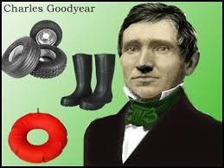

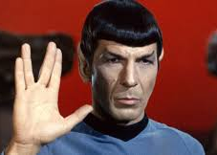
Charles Goodyear accidentally discovered this process in 1839 by heating a mixture of rubber and sulfur on a stove. This resulted in a product that was waterproof and winter-proof minimizing the problem that natural rubber is sticky in hot weather and brittle in cold. What was the name of the process?
Vulcanization, a process that strengthens and makes rubber more elastic by heating it with sulfur (or sulfur compounds) under pressure.
Star Trek’s Spock (Leonard Nimoy, 1931 – 2013) who was (or will be) a Vulcan/Human hybrid, was born on January 6, 2230, in ShiKahr, Vulcan. His father, Sarek, will be Vulcan, while his mother, Amanda Grayson, will be human. Vulcanization and Spock’s planet, Vulcan, are related by a nod to the Roman god of fire and the forge, Vulcan.
Notes:
,

Slide 13
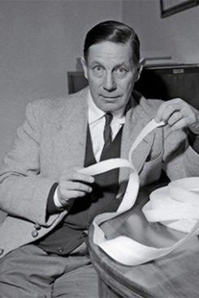
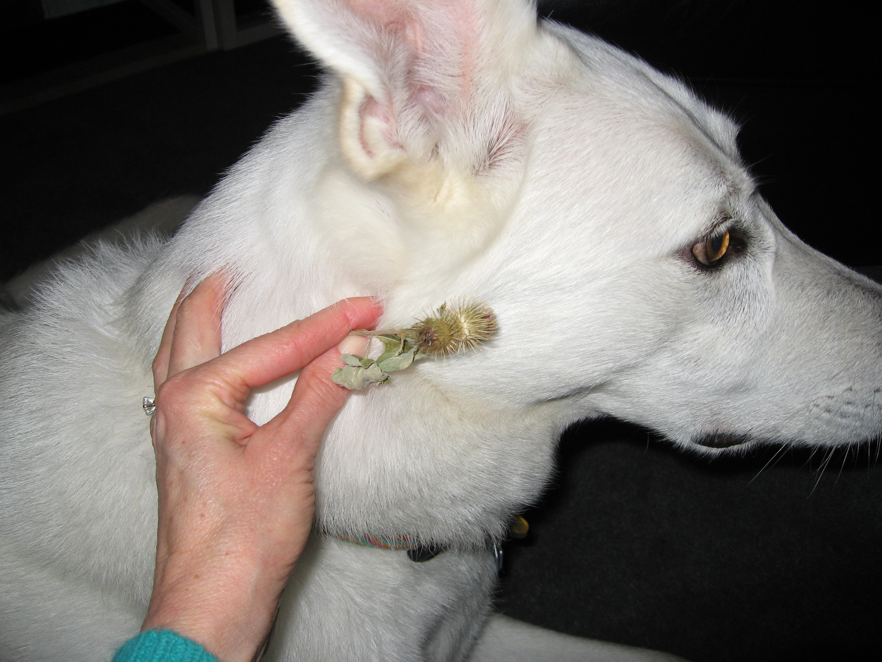
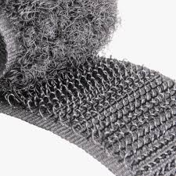
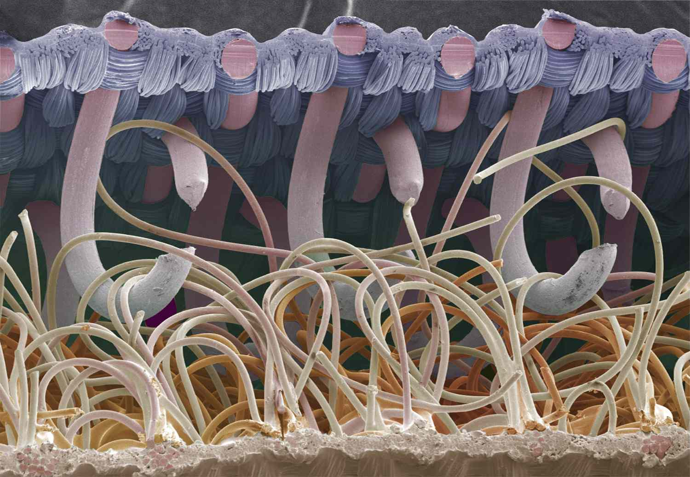

Swiss engineer George de Mestral in the 1940s, inspired by the burrs that clung to his clothes and dog's fur during a walk in the woods, invented what wonderful product?
VELCRO® Brand Hook and Loop
Hooks and loops

Slide 14
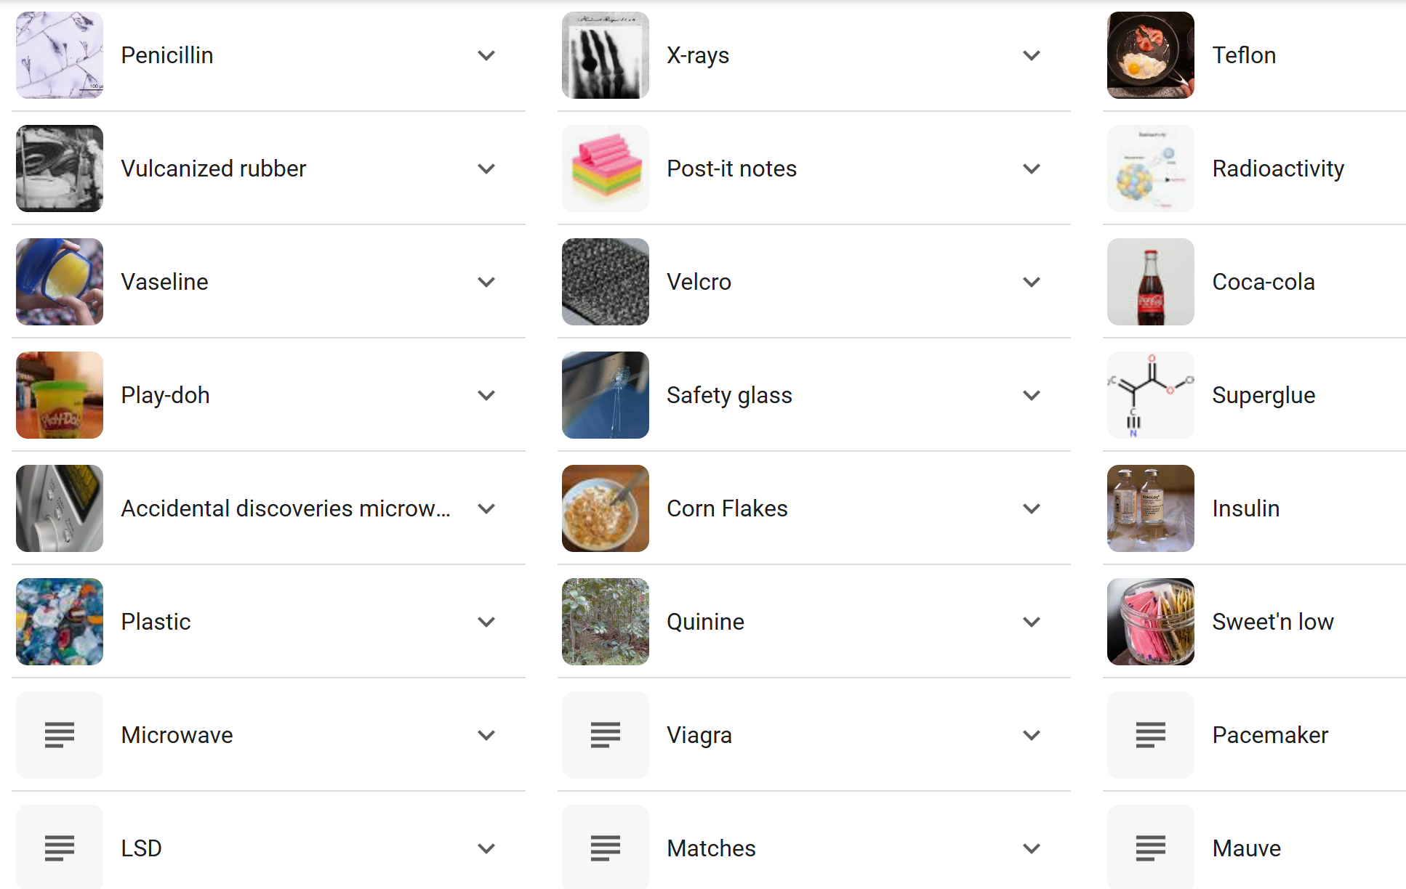
SERENDIPITOUS DISCOVERIES

Slide 15


Slide 16

No, the dire wolf has not been brought back from extinction.
Colossal Biosciences claims three pups born recently are dire wolves, but they are actually grey wolves with genetic edits intended to make them resemble the lost species
Should this kind of genetic engineering be allowed?
Romulus and Remus are genetically modified grey wolves

Slide 17
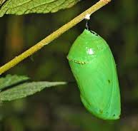
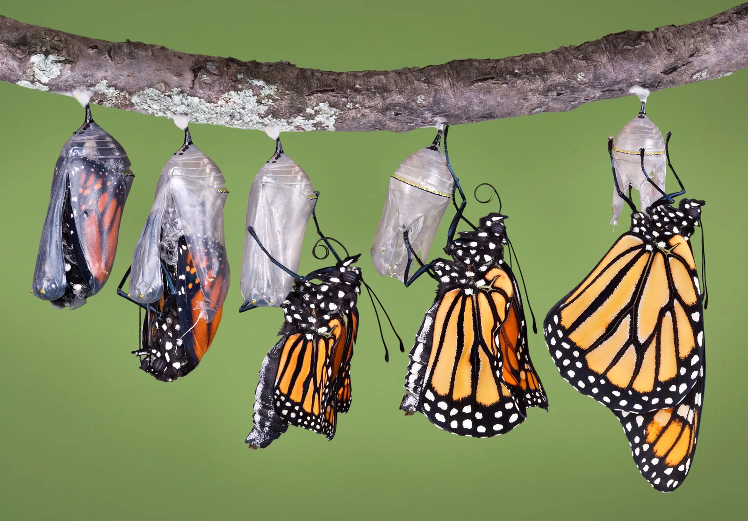
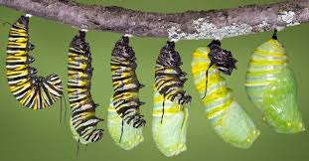
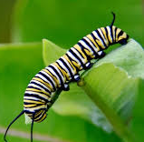
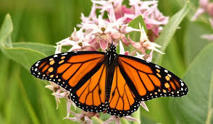
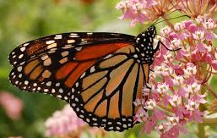
monarch butterfly chrysalis
What is the object to the left?

Slide 18

Should we be taking climate change more seriously?
Please notice climate related damage vs year.

Slide 19

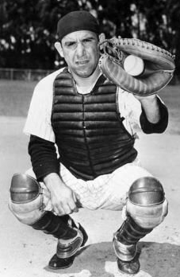
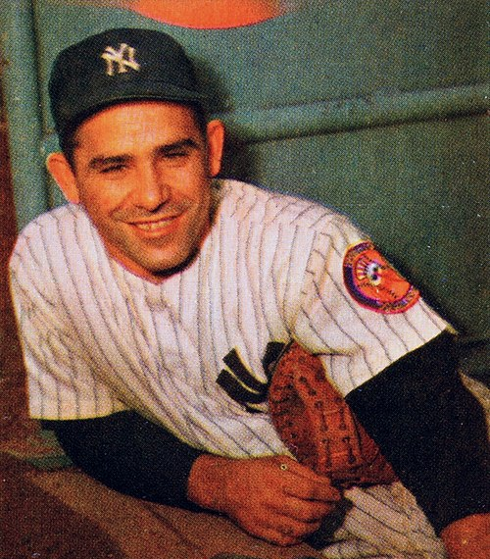
Who was Yogi Berra?
Lawrence Peter "Yogi" Berra (born Lorenzo Pietro Berra; May 12, 1925 – September 22, 2015) was a great American professional baseball catcher who later took on the roles of manager and coach. He played 19 seasons in Major League Baseball (MLB) (1946–1963, 1965), all but the last for the New York Yankees.
No, not Yogi Bear (and Boo Boo)
Why are we being asked who Yogi is?
Yogi is famous not just because he was a great baseball player but also because of his quotations. See next 2 slides.

Slide 20
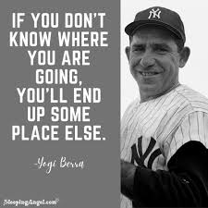
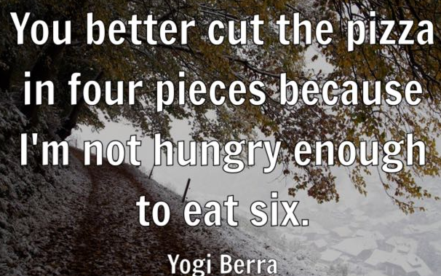
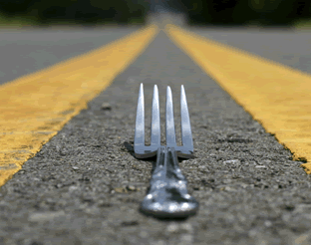
A nickel ain't worth a dime anymore.
Baseball is ninety percent mental. The other half is physical.
I usually take a two-hour nap, from one o'clock to four.
It ain't over 'til it's over.
It gets late early out here.
The future ain't what it used to be.
You should always go to other people's funerals, otherwise,
they won't come to yours.
Never answer an anonymous letter.
A few Yogi quotes:
NO, not that
kind of fork!
Try again.
Finally, according to Yogi, what do you do,
when you come to a fork in the road?
TAKE IT!

Slide 21
UNTIL NEXT TIME
For more preshows and trivia challenges, please visit:
http://murov.info

