Slide 1
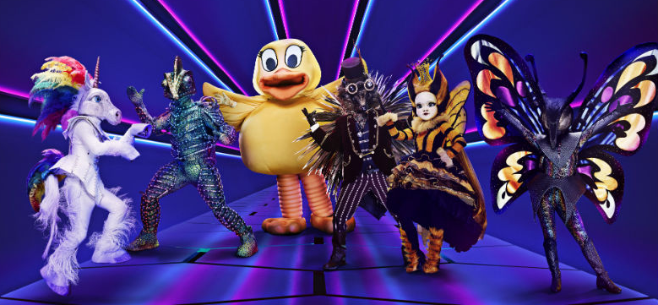
IDENTIFICATION OF
MASKED CELEBRITIES

Slide 2
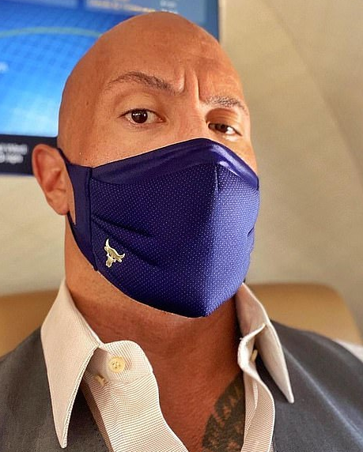
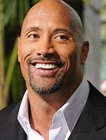
Dwayne Johnson

Slide 3
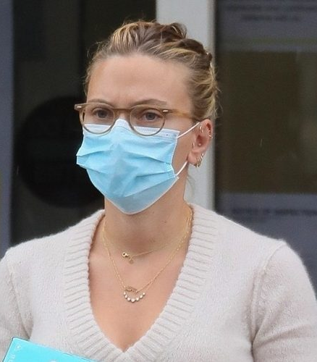
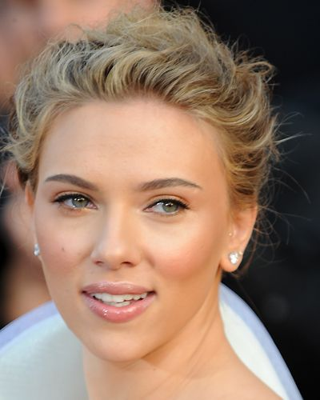
Scarlett Johansson

Slide 4
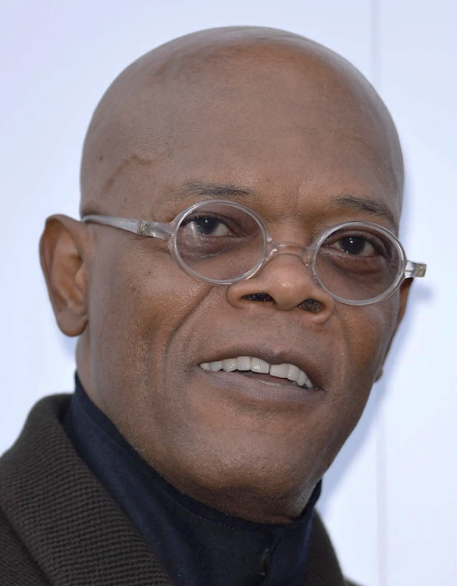
Samuel L. Jackson

Slide 5
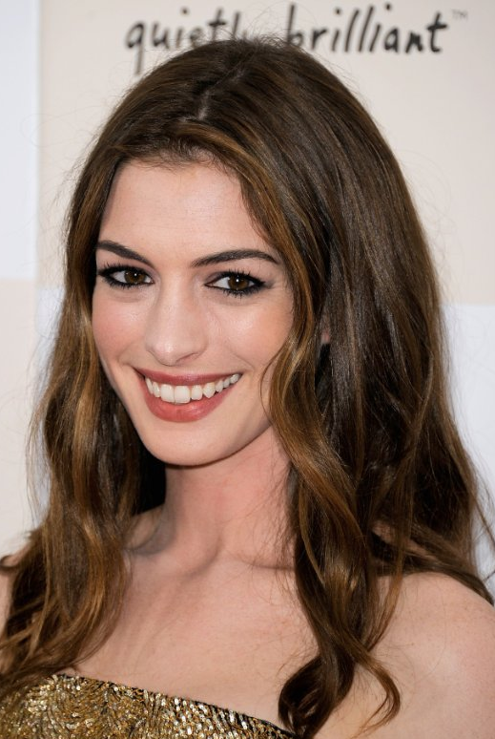
Anne Hathaway

Slide 6
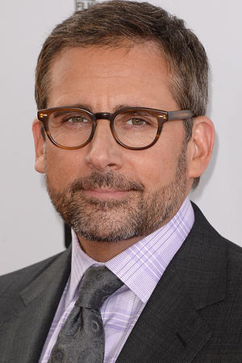
Steve Carell

Slide 7
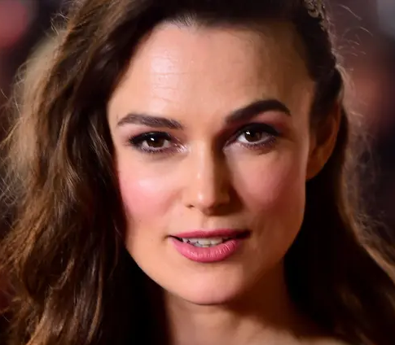
Keira Knightley

Slide 8
Ben Affleck

Slide 9
Drew Barrymore

Slide 10
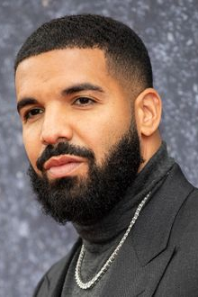
Drake

Slide 11
Ariana
Grande

Slide 12
Tom Hanks

Slide 13
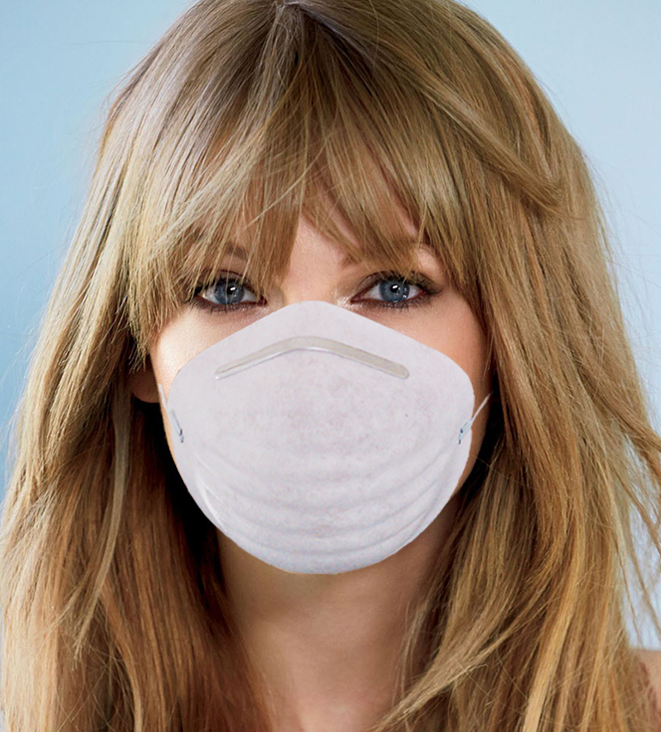
Taylor
Swift

Slide 14
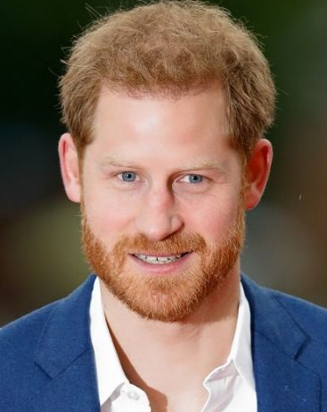
Prince Harry

Slide 15
Jennifer Lopez

Slide 16
Bernie Sanders

Slide 17
Beyonce

Slide 18
Tiger Woods

Slide 19
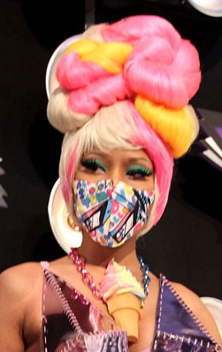
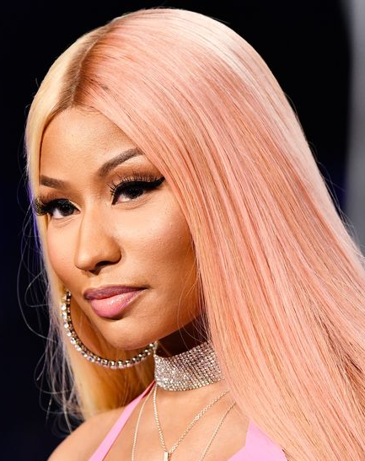
Nicki Minaj

Slide 20
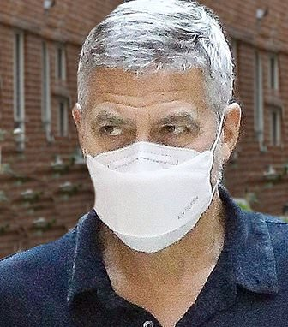
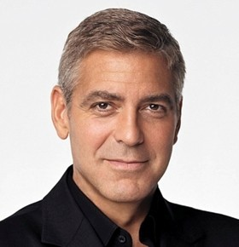
George Clooney

Slide 21
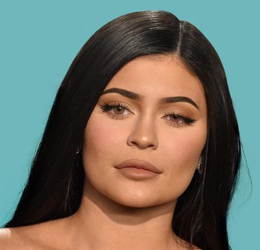
Kylie Jenner

Slide 22
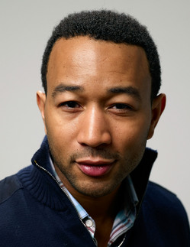
John Legend

Slide 23
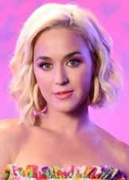
Katy Perry

Slide 24
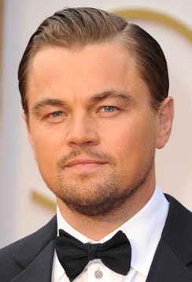
Leonardo DiCaprio

Slide 25
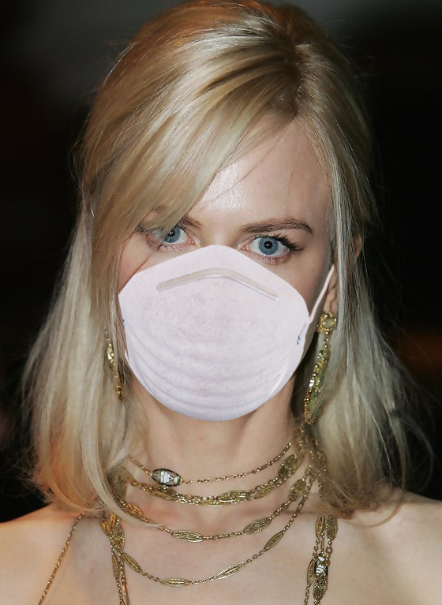
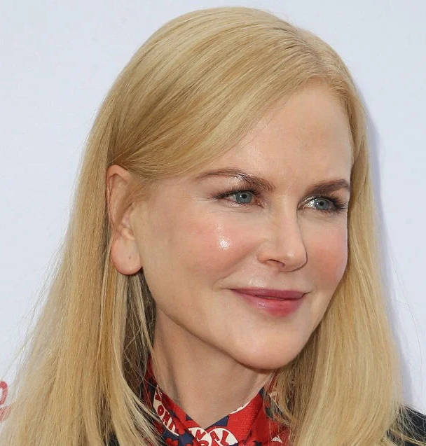
Nicole Kidman

Slide 26
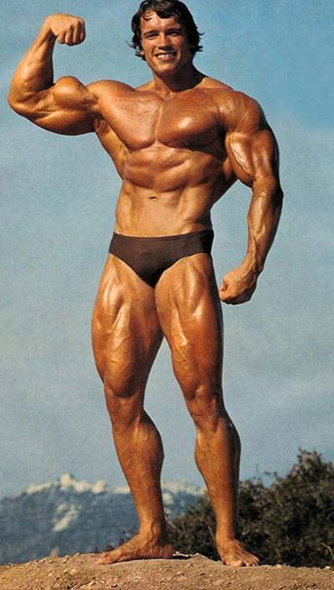
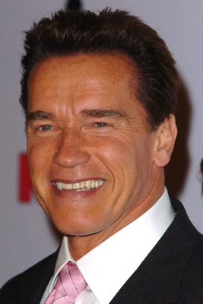
Arnold Schwarzenegger

Slide 27
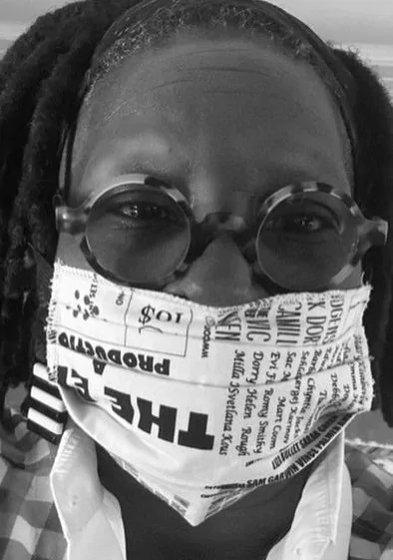
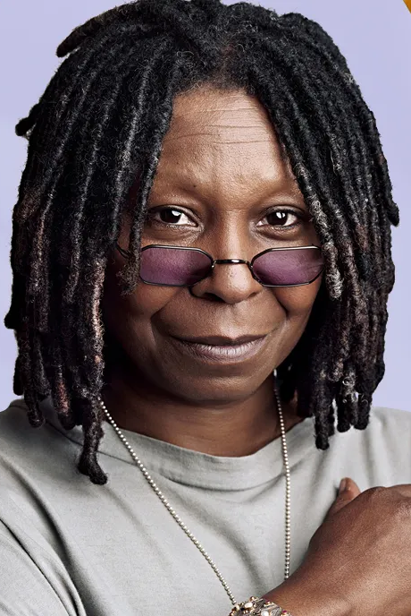
Whoopi
Goldberg

Slide 28
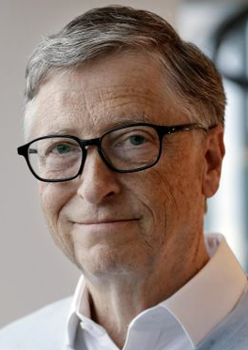
Bill
Gates

Slide 29
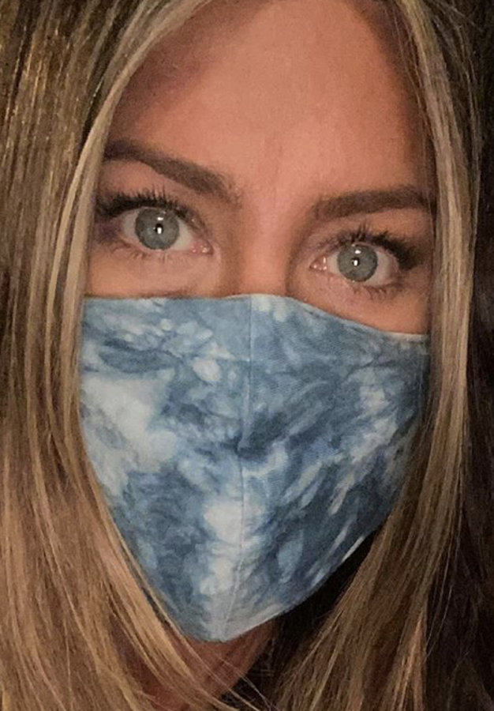
Jennifer
Anniston

Slide 30
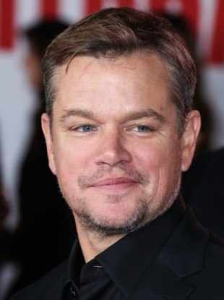
Matt Damon

Slide 31
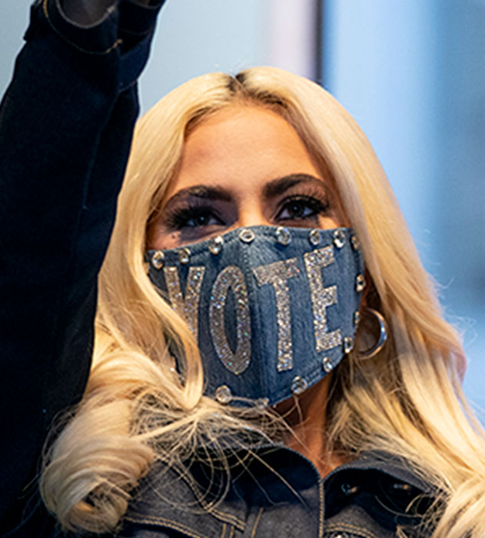
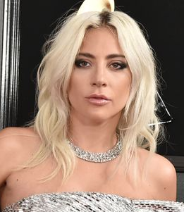
Lady Gaga

Slide 32
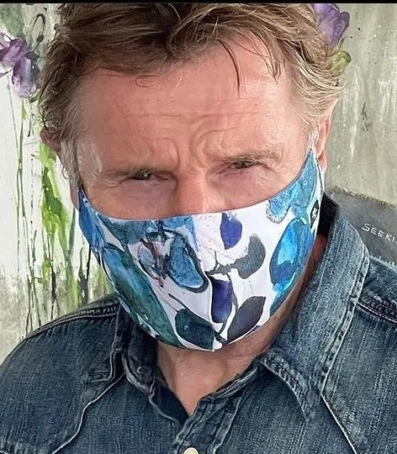
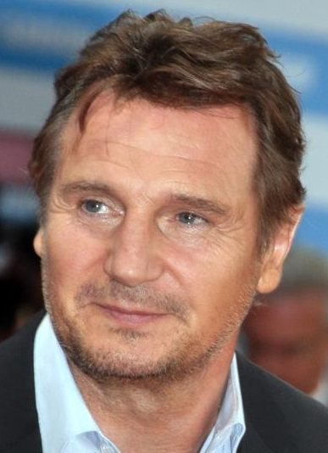
Liam Neeson

Slide 33
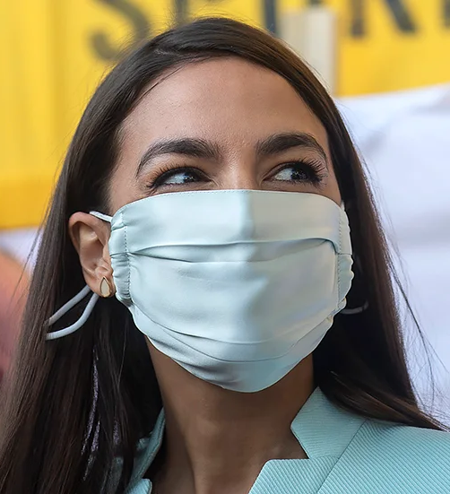
Alexandria Ocasio-Cortez (AOC)

Slide 34
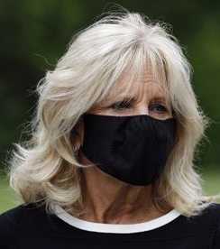
Jill
Biden
“Education is possibility set in motion.”

Slide 35
FOR A PLETHORA OF POWERPOINT
CHALLENGES AND TRIVIA QUIZES,
PLEASE VISIT:
http://murov.info/PPTPreshows.htm
or http://murov.info
Celebrities selected from: https://today.yougov.com/ratings/entertainment/fame/people/all
https://www.imdb.com/list/ls052283250/
https://www.telltalesonline.com/26925/popular-celebs/
Till Next Time -

