Slide 1
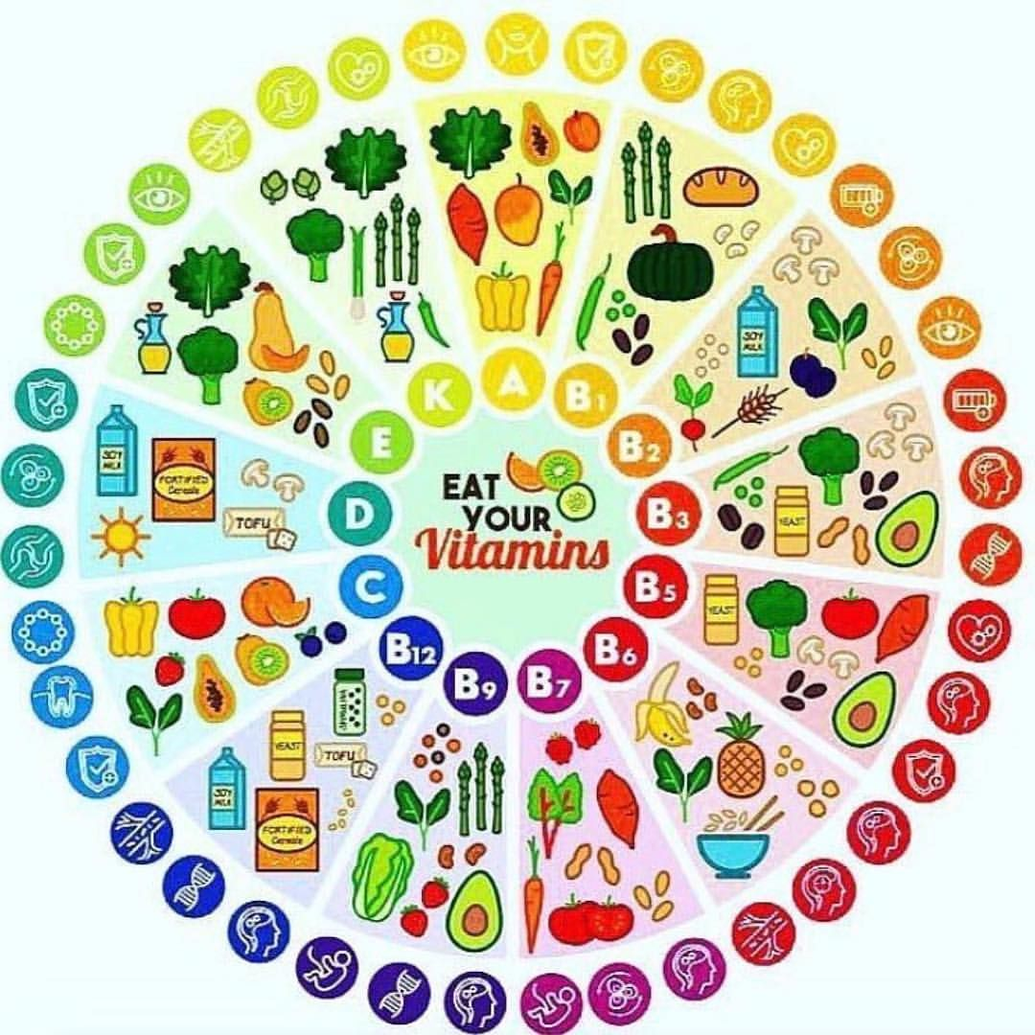
VITAMINS:
FUNCTION, STRUCTURE AND IDENTIFCATION
VITAMINS:
FUNCTION, STRUCTURE AND IDENTIFCATION

Slide 2
Each slide will present the structure of a vitamin followed by information
on its function and food sources. Try to identify the vitamin.
Vitamin: any of a group of organic compounds which are essential for normal growth and nutrition and are required in small quantities in the diet because they cannot be synthesized by the body.
From Medical News Today. B vitamins are a group of eight essential nutrients that play roles in many organs and bodily systems. Although they can work together in the body, they also carry out their own unique functions.
B vitamins are important for making sure the body’s cells are functioning properly. They help the body convert food into energy (metabolism), create new blood cells, and maintain healthy skin cells, brain cells, and other body tissues.
B vitamins often occur together in the same foods. Many people can get enough B vitamins by eating a variety of nutrient-dense foods.
Sources: Whole grains, meat, fish, eggs and dairy products (milk, cheese), Legumes (beans, lentils), ​Seeds and nuts (sunflower seeds, almonds), Dark, leafy vegetables (broccoli, spinach, kai lan), Fruits (citrus fruits, avocados, bananas).

Slide 3
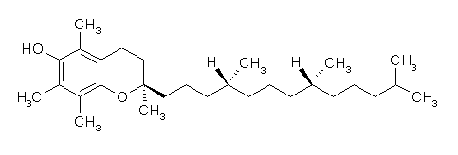
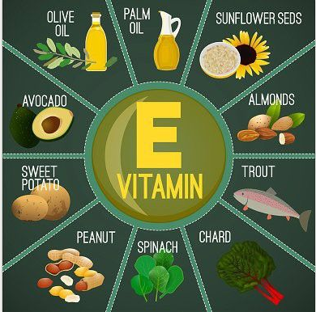
Vitamin E
tocopherol
Function: antioxidant that helps the body form red blood cells and use Vitamin K.
Deficiency – rare, mild hemolytic anemia in newborn infants.
Sources: avocado, dark green vegetables,
papaya, mango, seeds, nuts, wheat germ,
sunflower, corn, safflower oil or margarine.

Slide 4
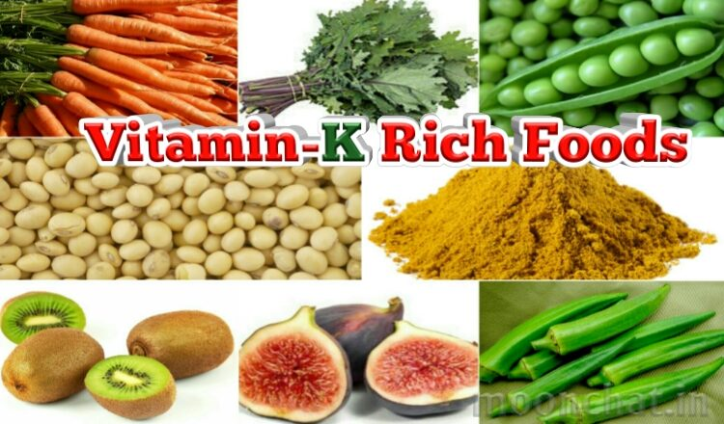
Vitamin K
phylloquinone
Function: required for coagulation of blood
and probably important for blood health.
Deficiency: bruises easily, gets small blood clots underneath their nails, bleeds in mucous membranes that line areas inside the body, produces stool that looks dark black (almost like tar) and contains some blood.
Sources: cabbage, cauliflower,
broccoli, egg yolks, liver

Slide 5
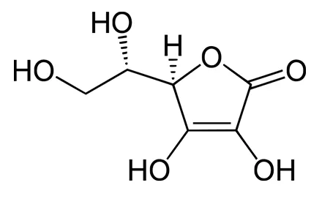
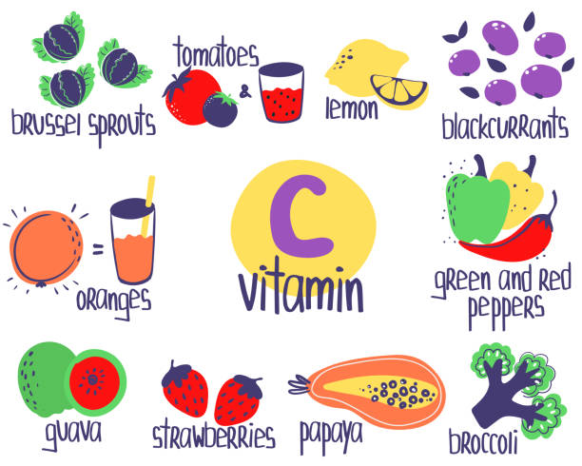
Ascorbic Acid
Vitamin C
Function: antioxidant that promotes healthy teeth and gums, helps with absorption of iron, protein metabolism and immune system health and essential for wound healing.
Deficiency: scurvy
Sources: fruits and vegetables and especially citrus.

Slide 6
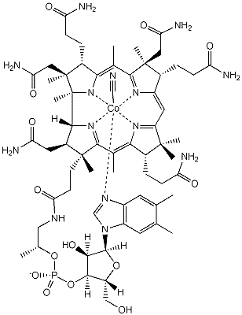
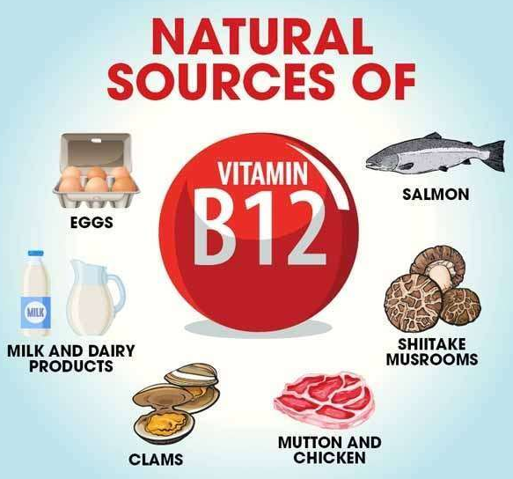
Vitamin B₁₂
Cyanocobalamin
Function: helps with formation of red blood cells and maintain the central nervous system and important for metabolism.
Deficiency: symptoms are rare but can include fatigue, breathlessness, numbness, poor balance, and memory trouble.
Sources: meat, seafood,
eggs, milk.

Slide 7
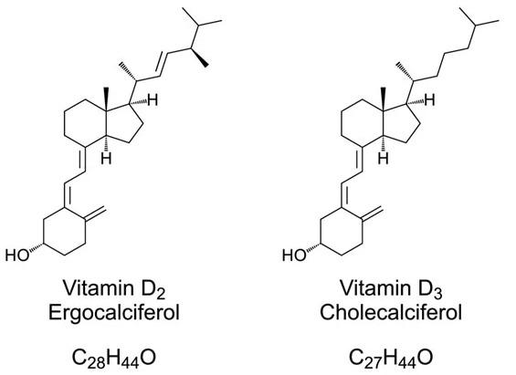
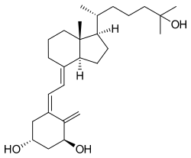
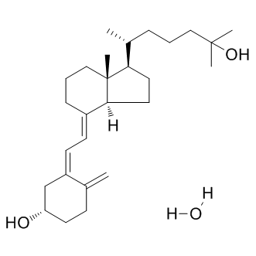
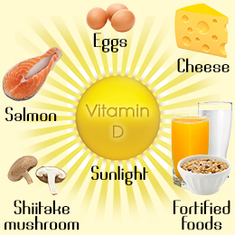
Function: absorption of calcium.
Deficiency: thin, brittle,
or misshapen bones.
Vitamin D
Sources: egg yolks, liver,
fatty fish, fortified milk.
Calcitriol – active form of vitamin D, 1000x more effective at binding to receptor than D₂ or D₃.
Calcifediol
Cholecalciferol, ergocalciferol or calcifediol can be employed in subjects with normal renal function and in CKD stage 3-5 patients to correct this vitamin deficiency and improve, respectively, age- or growth-related bone disease and secondary hyperparathyroidism. Calcifediol can be considered more rapid and effective. In all cases, especially with increasing doses, the risk of hypercalcemia must be taken into account. Calcitriol, which can be regarded as the active hormonal form of vitamin D, has the most potent hypercalcemic effect in both normal and renal failure patients. In renal patients calcitriol is a potent inhibitor of parathyroid activity, but has the risk of hypercalcemia. National Library of Medicine

Slide 8
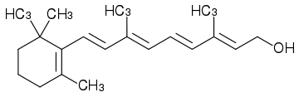
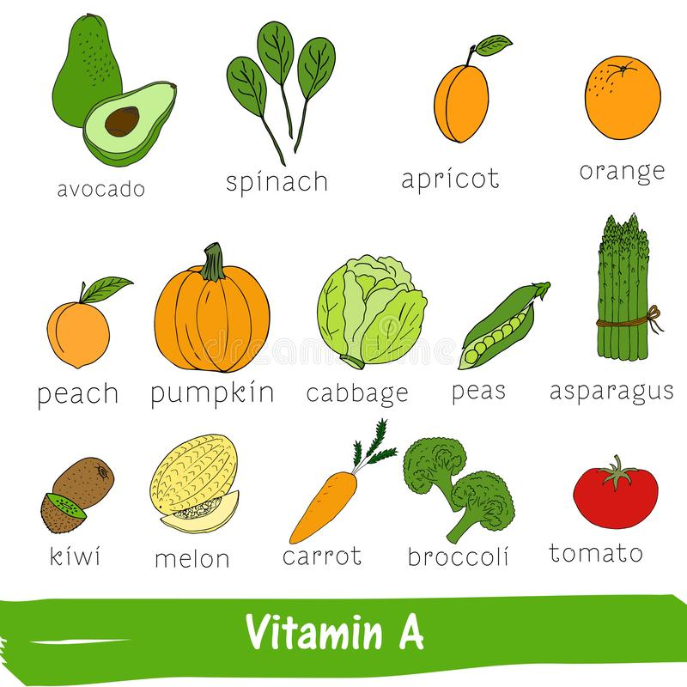
Vitamin A
all trans Retinol
Function: vision, healthy skin, bone and
tooth growth, immune system health.
Deficiency: blindness and it can also
increase the risk of infections.
Sources: oranges, ripe yellow fruits, leafy vegetables,
carrots, pumpkin, squash, spinach.

Slide 9
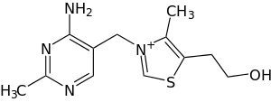
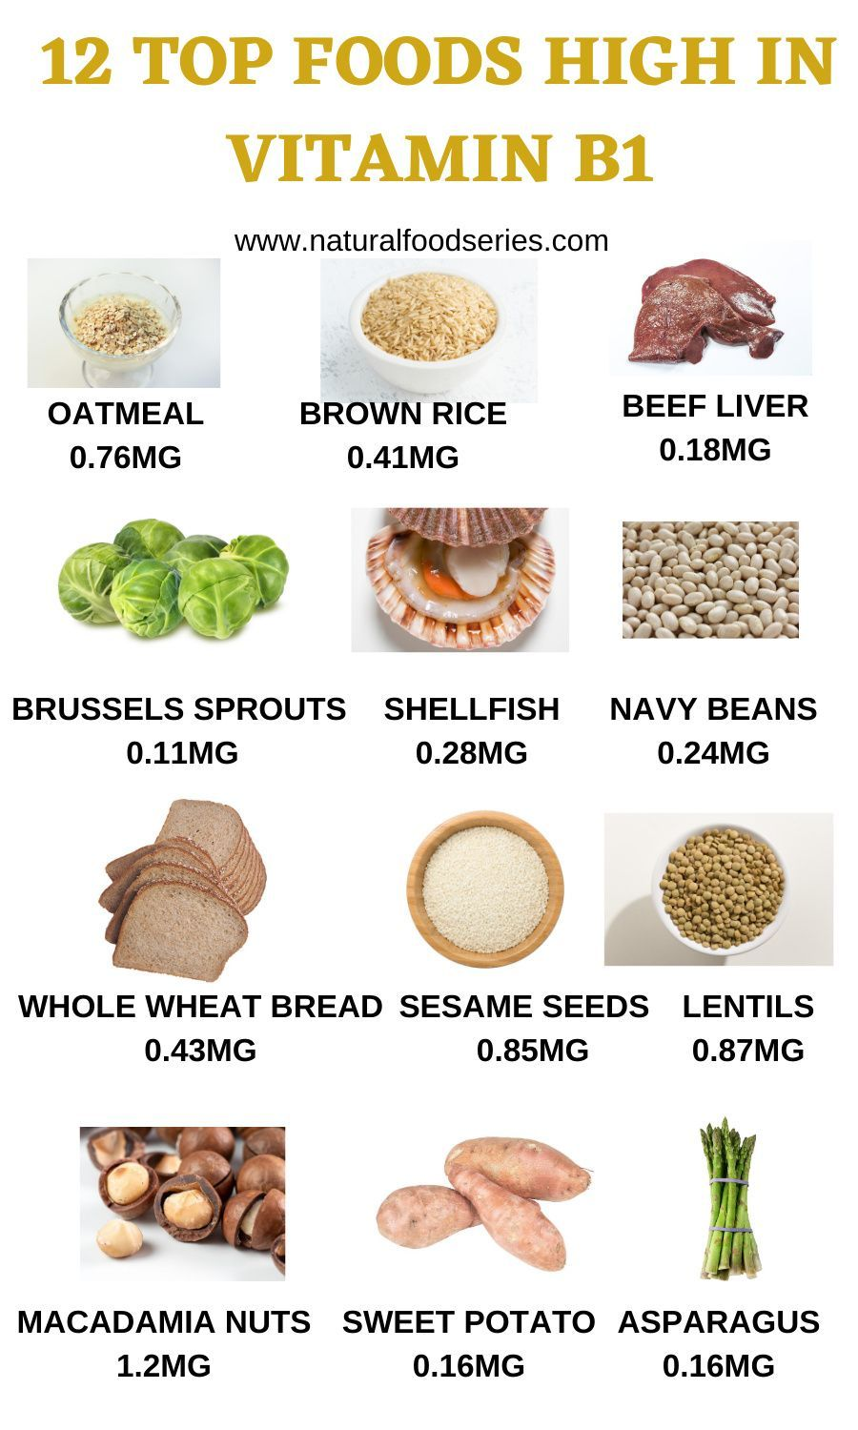
Vitamin B₁
Thiamine
Function: helps the cells in the body convert food into energy.
Deficiency: If you do not have enough of this vitamin, this process cannot work properly. You may have symptoms such as tiredness, loss of appetite and muscle weakness.
Sources: pork, whole-meal grains, nuts and seeds,
brown rice, vegetables, potatoes, liver, eggs.

Slide 10
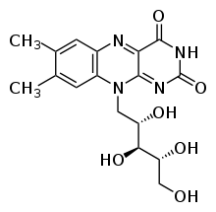
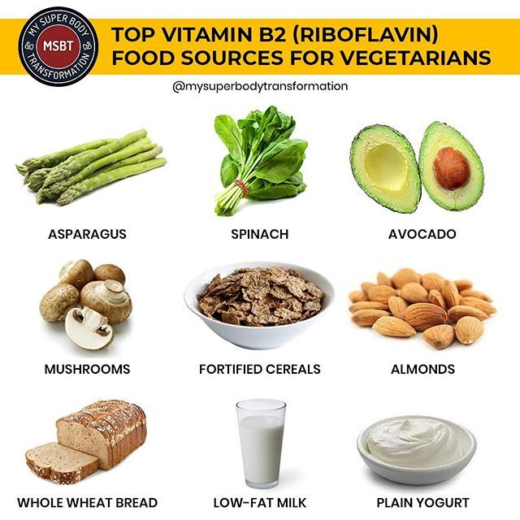
Vitamin B₂
riboflavin
Function: It is required by the body for cellular respiration, energy metabolism, vision, skin health.
Deficiency: skin disorders, hyperemia (excess blood) and edema of the mouth and throat.
Sources: eggs, green vegetables, milk and other dairy products, meat, mushrooms, whole grain and enriched breads and cereals and almonds.

Slide 11
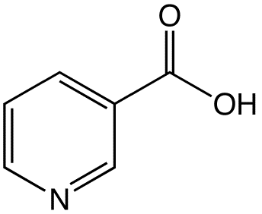
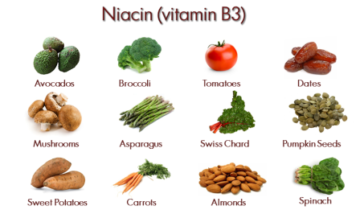
niacin
Vitamin B₃
Functions: plays a role in converting carbohydrates into glucose, metabolizing fats and proteins, and keeping the nervous system working properly.
Deficiency: pellagra
Sources: beef, liver, poultry, eggs, dairy products, fish, nuts, seeds, legumes, avocados, and whole grains. It is also found in fortified cereals and bread.

Slide 12
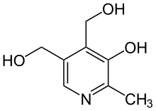
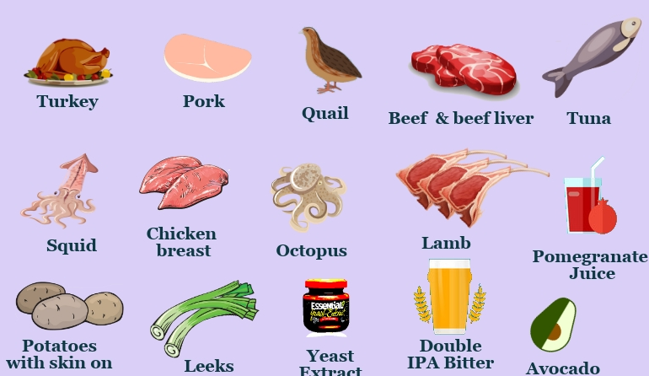
pyridoxine
Vitamin B₆
Functions: protein metabolism, helps make red blood cells.
Deficiency: microcytic anemia, electroencephalographic abnormalities, dermatitis and glossitis (swollen tongue), depression and confusion, and weakened immune function,
Sources: pork, poultry, some fish, pork, poultry, some fish, peanuts, soya beans, wheatgerm, oats, bananas.

Slide 13
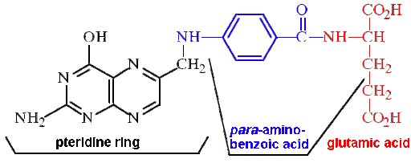
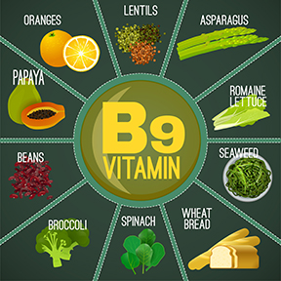
Vitamin B₉
folic acid
Function: make healthy red blood cells.
Deficiency: extreme tiredness (fatigue, lethargy), breathlessness, feeling faint, headaches, pale skin, noticeable heartbeats (palpitations)
Sources: broccoli, brussels sprouts, leafy green vegetables, peas, chickpeas and kidney beans, liver (but avoid this during pregnancy), breakfast cereals fortified with folic acid.

Slide 14
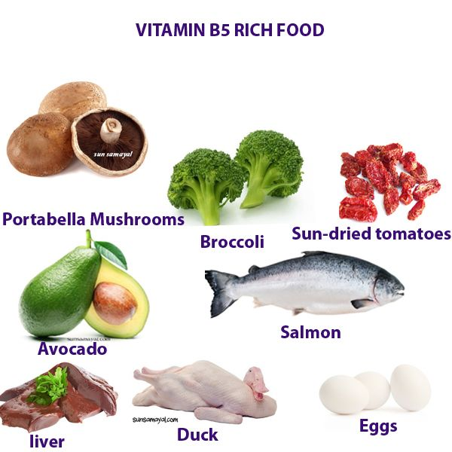
Vitamin B₅
pantothenic acid
Function: helps your body make blood cells and convert food into energy.
Deficiency: rare, but may include symptoms such as fatigue, insomnia, depression,
irritability, vomiting, stomach pains, burning feet, and upper respiratory infections.
Sources: meat, fish, shellfish, grains and cereals, dairy products, eggs, lentils, split peas, and soybeans.

Slide 15
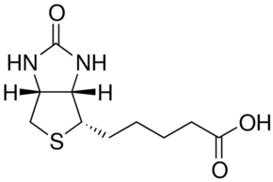
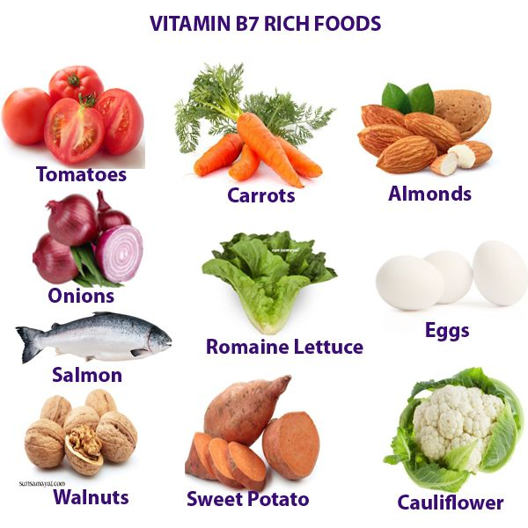
Vitamin B₇
biotin
Function: metabolism of carbohydrates, fats, and amino acids. Biotin is often recommended for strengthening hair and nails.
Deficiency: thinning hair with progression to loss of all hair on the body; scaly, red rash around body openings (eyes, nose, mouth, and perineum), conjunctivitis, ketolactic acidosis.
Sources: egg yolks, organ meats (liver, kidney) , nuts, soybeans and, other legumes, whole grains and cereals, cauliflower, bananas.

Slide 16
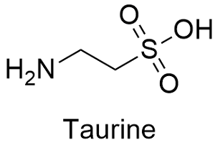
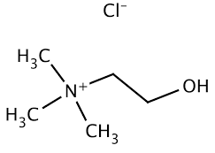
“Conditionally-essential” nutrients or vitamin-like compounds. These nutrients include taurine, lipoic acid, choline, and carnitine. They are normally synthesized by the mammalian organism, but may be required under special conditions, such as during long-term parenteral nutrition, by hemodialysis patients, or by premature infants. Choline, for instance, appears to be essential for adult men. Carnitine is used as a drug in cases of carnitine deficiency syndrome and is available as a dietary supplement; it is advertised as an aid to weight loss and improved exercise performance.
carnitine
choline
lipoic acid

Slide 17
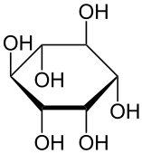
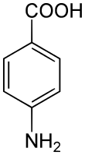
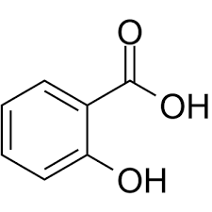
Vitamin B₄ (also known as adenine)
Vitamin B₈ (also known as inositol)
Vitamin B₁₀ (p-aminobenzoic acid – PABA)
Vitamin B₁₁ (salicylic acid)
The above-listed nutrients are no longer labeled vitamins, as they no longer fit the official definition of a vitamin; essential and required for normal human growth and are required to be obtained by diet because they can’t be manufactured by the human body. However, many are still in use and recommended for a variety of health needs as other nutritional supplements. https://lauriegoldmanmd.com/2020/03/11/long-lost-b-vitamins-b4-b8-b10-b11/

Slide 18
HOPE TO SEE YOU AGAIN SOON
For a plethora of online quizzes and challenges appropriate for individuals or groups, please visit:
http://murov.info
or
http://murov.info/triviachallenges.htm
or
http://murov.info/PPTPreshows.htm
Doing these challenges produces vitamin I (intelligence)

